Slide 1
PROJECT MANAGER
Quản lí dự án
phần mềm
Nhóm 9
Nhóm 9

Slide 2
1
Work Content
UNIVERSAL TEMPLATE
2
Completion
content
UNIVERSAL TEMPLATE
3
Achievement Display
UNIVERSAL TEMPLATE
4
Working Arrangements
CONTENT
UNIVERSAL TEMPLATE

Slide 3
Part One
01
Work Content

Slide 4

Work content
Organic
Click on the button under the presentation preview that says "Use as Google Slides”
I hope and I believe that this Template will your Time, Money and Reputation.
I hope and I believe that this Template will your Time, Money and Reputation. I hope and I believe that this Template will your Time, Money and Reputation.

Slide 5

Work content
Social Media
Enter the comprehensive description of the above chart here
Slideshare Campaign
WORK
Enter the comprehensive description of the above chart here
Partnerships
Enter the comprehensive description of the above chart here

Slide 6

Work content
2010
2012
I feel very strongly that change is good because it stirs up the system.
We use well-known development methodologies to create
2015
2019
Woe be to him that reads but one book.
A large income is the best recipe for happiness I ever heard of.

Slide 7
Work content
Partnerships
Conferences
Events
Woe be to him that reads but one book.
Genius hath electric power which earth can never tame.
A large income is the best recipe for happiness I ever heard of.

Slide 8
Part Two
02
Completion

Slide 9

Completion
Conferences and Events
Slideshare Campaign
Genius hath electric power which earth can never tame.
When you feel in your gut what you are and then dynamically pursue it - don't back down and don't give up - then you're going to mystify a lot of folks.
Powerpoint

Slide 10
Completion
Think
Web Design
Skiing consists of wearing $3,000 worth of clothes and equipment and driving 200 miles in the snow in order to stand around at a bar and drink.
When you feel in your gut what you are and then dynamically pursue it - don't back down and don't give up - then you're going to mystify a lot of folks.
Development
Keynote
There is only one difference between a madman and me. I am not mad.
I'm convinced that about half of what separates the successful entrepreneurs from the non-successful ones is pure perseverance.

Slide 11

Completion
Make
I believe that people would be alive today if there were a death penalty.
Check
Genius hath electric power which earth can never tame.
Solutions
The time is now, the place is here. Stay in the present. You can do nothing to change the past, and the future will never come exactly as you plan or hope for.

Slide 12
Completion
Web Design
Users can make a presentation on a projector or computer, or print out the presentation to make a film for use in a wider range of fields Users can make a presentation on a projector or computer, or print out the presentation to make a film for use in a wider range of fields
36.
48.
52.
2015
2009
2001

Slide 13
Completion
Opening Cerenomy
Opening
Break Time
A torn jacket is soon mended; but hard words bruise the heart of a child.
A torn jacket is soon mended; but hard words bruise the heart of a child.
To see what is in front of one's nose needs a constant struggle.
To see what is in front of one's nose needs a constant struggle.
There is only one difference between a madman and me. I am not mad.
There is only one difference between a madman and me. I am not

Slide 14
Part Three
Achievement Display
03

Slide 15
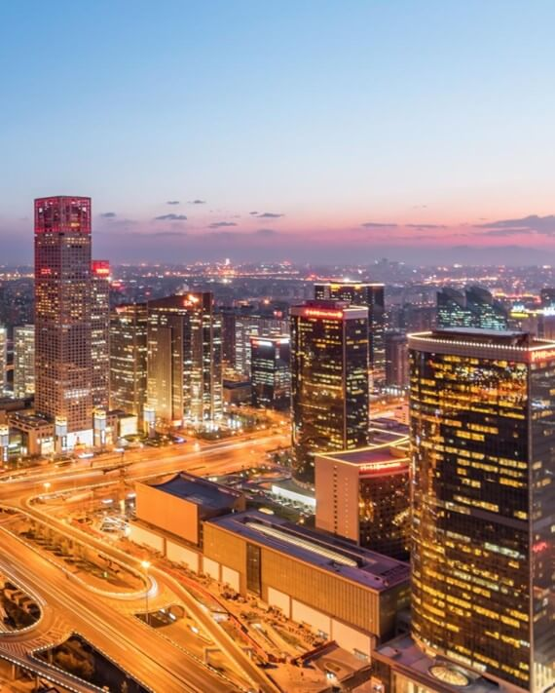
Achievement display
Speakers
Free Time
When you feel in your gut what you are and then dynamically pursue it
I'm convinced that about half of what separates the successful entrepreneurs from the non-successful ones is pure perseverance.

Slide 16

Achievement display
About us
Our Values
When you feel in your gut what you are and then dynamically pursue it - don't back down and don't give up - then you're going to mystify a lot of folks.
Skiing consists of wearing $3,000 worth of clothes and equipment and driving 200 miles in the snow in order to stand around at a bar and drink.
Type your content here, or by copying your text, choose Paste in this box and choose to keep only the text. Type your content here, or by copying your text, choose Paste in this box and choose to keep only the text.

Slide 17
Achievement display
What we do?
Forum
I believe that people would be alive today if there were a death penalty.
Genius hath electric power which earth can never tame.
prıcıng
ServIces
Woe be to him that reads but one book.
I feel very strongly that change is good because it stirs up the system.
Future
TImelIne
A torn jacket is soon mended; but hard words bruise the heart of a child.
A large income is the best recipe for happiness I ever heard of.

Slide 18
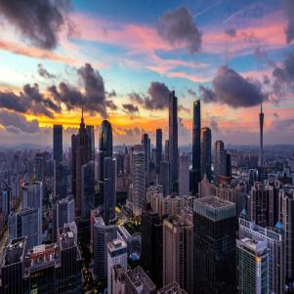
Achievement display
Tech Startup
Conferences
MeetIng
We certainly do not forget you as soon as you forget us. It is, perhaps, our fate rather than our merit. We cannot help ourselves. We live at home, quiet, confined, and our feelings prey upon us. You are
forced on exertion. You have always a profession, pursuits, business of some sort or other, to take you back into the world immediately, and continual occupation and change soon weaken impressions. All the
To see what is in front of one's nose needs a constant struggle.
To see what is in front of one's nose needs a constant struggle.
To see what is in front of one's nose needs a constant struggle.

Slide 19
Achievement display
01
little useless information.
little useless information.
02
A large income is the best recipe for happiness I ever heard of.
03
Genius hath electric power which earth can never tame.
04
I believe that people would be alive today if there were a death penalty.
Public & NGO

Slide 20
Part Four
Working Arrangements
04

Slide 21

Working Arrangements
FashIon
A large income is the best recipe for happiness I ever heard of.
FInance
I feel very strongly that change is good because it stirs up the system.
EducatIon
The time is now, the place is here. Stay in the present. You can do nothing to change the past, and the future will never come exactly as you plan or hope for.

Slide 22

Working Arrangements
Arts & Culture
We certainly do not forget you as soon as you forget us. It is, perhaps, our fate rather than our merit. We cannot help ourselves. We live at home, quiet, confined, and our feelings prey upon us. You are forced on exertion. You have always a profession, pursuits, business of some
The time is now, the place is here. Stay in the present. You can do nothing to change the past, and the.
Future will never come exactly as you plan or hope for.

Slide 23
Working Arrangements
Briefing
E-commerce
Energy
Real Estate
It is a very sad thing that nowadays there is so little useless information.
I believe that people would be alive today if there were a death penalty.
The time is now, the place is here. Stay in the present. You can do nothing to change the past, and the
Genius hath electric power which earth can never tame.
Genius hath electric power which earth can never tame.

Slide 24
Working Arrangements
Design
Workshops
Evaluation
Type your content here, or by copying your text, select Paste in this box and choose to keep only the text
Type your content here, or by copying your text, select Paste in this box and choose to keep only the text
Type your content here, or by copying your text, select Paste in this box and choose to keep only the text

Slide 25
WORK PLAN
Thanks for watching
WORK PLAN
www.freepptbackgrounds.net

