Slide 1
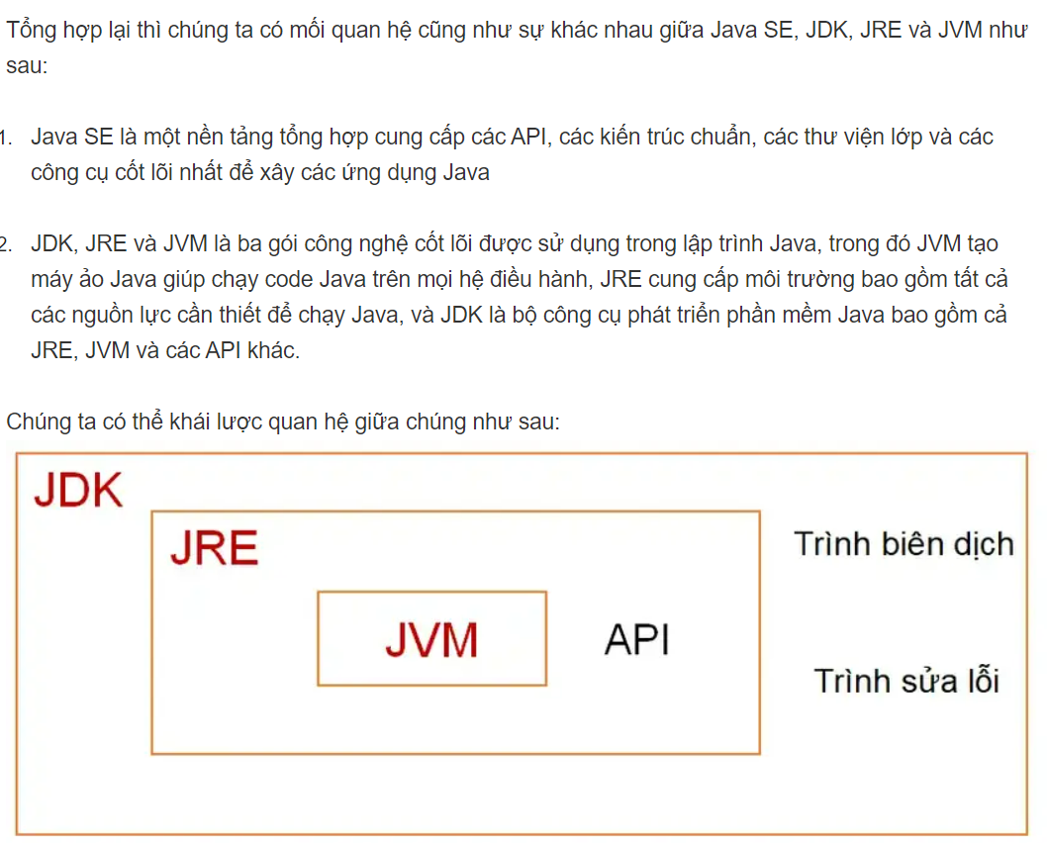
Java basic
Java SE, JDK,JRE,JVM

Slide 2
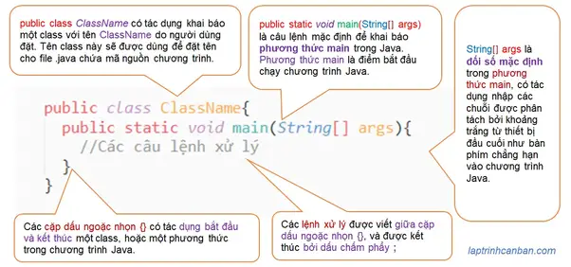
Run PMG
1Cd den thu muc chua ct
2Chay javac tenchuong trinh de tao class trinh bien dich chuong trinh
3 Chay java ten chuong trinh de dua ra ket qua
Cau truc cau lenh java

Slide 3
注意点
1.Ten class phai giong voi ten chuong trinh luu trong thu muc
2. Comment bang // noi it /* noi nhieu
3. Dat ten chu y chu hoa chu thuong,bat dau bang so, ky hieu linh tinh
4. Dat ten bien chu dau tien viet thuong chu cai tu tiep theo viet hoa, ghi ten kieu du lieu vao neu can (vd:studentList)
5.Hang so: FIBONAT_NUM; Phuong thuc(method):coutStudent; Lop’(class):CountStudentExcept;giao dien(interface):Iframe
6. Tu bat dau lop truu tuong phai la Abstract○○; Package(chu thuong):abdc;Project(du an):SinhVienProject

Slide 4
Phuong thuc main trong jv
Bat dau thuc thi chuong trinh tai mot thoi diem vao(entry point) nhu ham/Phuong thuc/thu tuc
Cac dieu kien:
1.1 Ac,cess Modifier phai la public
1.2 phai la static method
1.3 gia tri phai tra ve void
1.4 ten Phuong thuc phai la main voi cac chu cai viet duoi dang chu thuong
1.5 doi so cua Phuong thuc pahi la mang String(hoac la String co doi dai co the thay doi
3.]

Slide 6
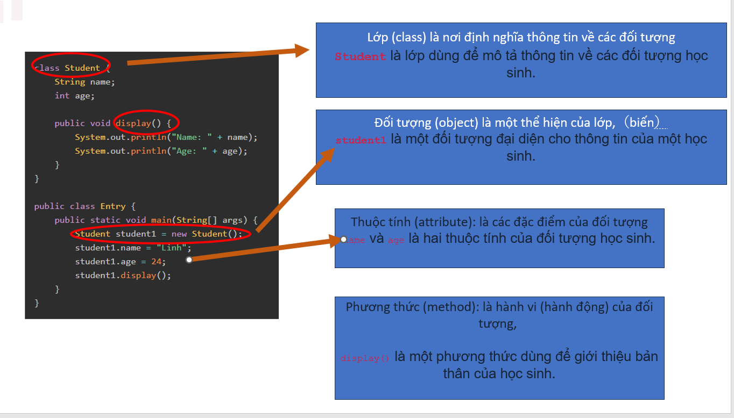

Slide 7
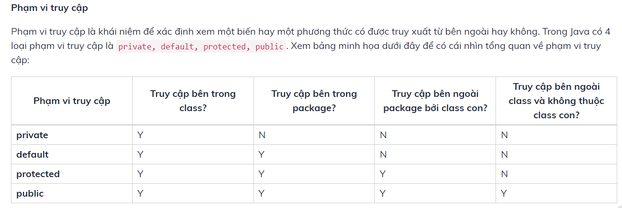

Slide 9
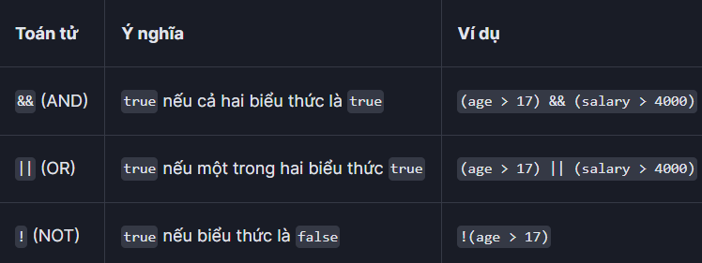
Toán tử logic in ja

