Slide 1
TRANSPORTATION MEETS TECHNOLOGY

Slide 2
Introduction RabbitMq An open source message broker that just works
I. What is RabbitMQ ?
RabbitMQ is an open-source message-broker software (sometimes called message-oriented middleware) that originally implemented the Advanced Message Queuing Protocol (AMQP) and has since been extended with a plug-in architecture to support Streaming Text Oriented Messaging Protocol (STOMP), Message Queuing Telemetry Transport (MQTT), and other protocols.
The RabbitMQ server program is written in the Erlang programming language and is built on the Open Telecom Platform framework for clustering and failover. Client libraries to interface with the broker are available for all major programming languages.

Slide 3
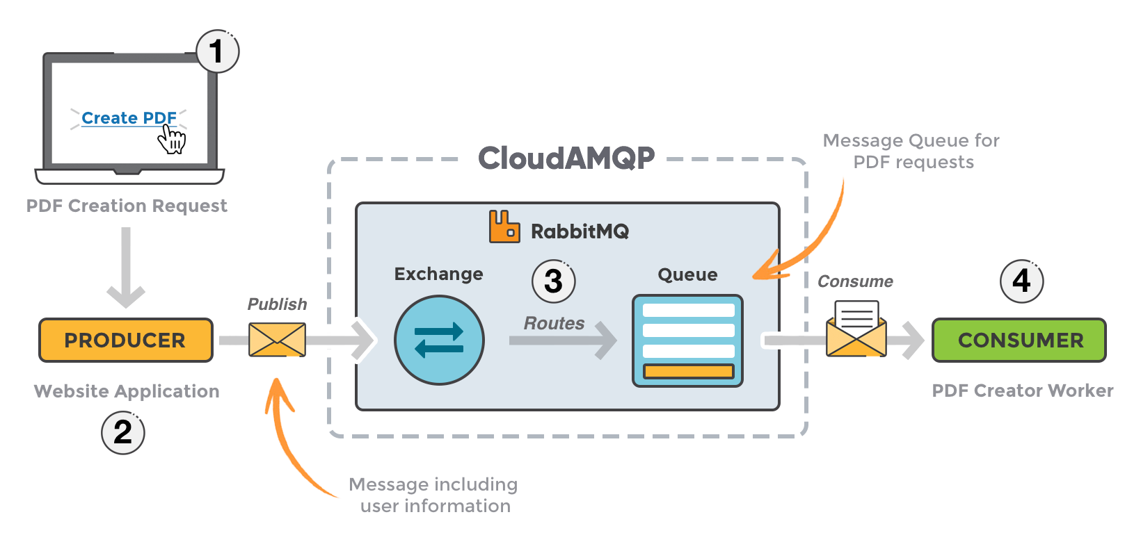
II. When and why should you use RabbitMQ?

Slide 4
1. The user sends a PDF creation request to the web application. 2. The web application (the producer) sends a message to RabbitMQ that includes data from the request such as name and email. 3. An exchange accepts the messages from the producer and routes them to correct message queues for PDF creation. 4. The PDF processing worker (the consumer) receives the task message and starts processing the PDF.
Message queueing allows web servers to respond to requests quickly instead of being forced to perform resource-heavy procedures on the spot that may delay response time. Message queueing is also good when you want to distribute a message to multiple consumers or to balance loads between workers.
The consumer takes a message off the queue and starts processing the PDF. At the same time, the producer is queueing up new messages. The consumer can be on a totally different server than the producer or they can be located on the same server. The request can be created in one programming language and handled in another programming language. The point is, the two applications will only communicate through the messages they are sending to each other, which means the sender and receiver have low coupling.

Slide 5
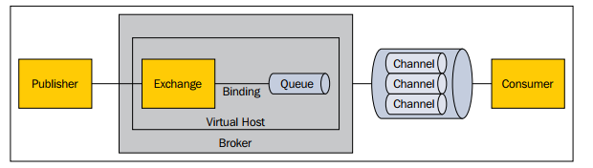
III. What is AMQP ?
The Advanced Message Queuing Protocol (AMQP) is an open standard that defines a protocol for systems to exchange messages. AMQP defines not only the interaction that happens between a consumer/producer and a broker, but also the over-the-wire representation of the messages and commands that are being exchanged. Since it specifies the wire format for messages, AMQP is truly interoperable—nothing is left to the interpretation of a particular vendor or hosting platform. And since it is open, the AMQP community has flourished with broker and client implementations in a wide range of languages.
Overview of the concepts defined by AMQP specification

Slide 6
a
Broker: This is a middleware application that can receive messages produced by publishers and deliver them to consumers or to another broker.
Virtual host: This is a virtual division in a broker that allows the segregation of publishers, consumers, and all the AMQP constructs they depend upon, usually for security reasons (such as multitenancy).
Connection: This is a physical network (TCP) connection between a publisher/consumer and a broker. The connection only closes on client disconnection or in the case of a network or broker failure.
Channel: This is a logical connection between a publisher/consumer and a broker. Multiple channels can be established within a single connection. Channels allow the isolation of the interaction between a particular client and broker so that they don't interfere with each other. This happens without opening costly individual TCP connections. A channel can close when a protocol error occurs.
Exchange: This is the initial destination for all published messages and the entity in charge of applying routing rules for these messages to reach their destinations. Routing rules include the following: direct (point-to-point), topic (publish-subscribe) and fanout (multicast)
Queue: This is the final destination for messages ready to be consumed. A single message can be copied and can reach multiple queues if the exchange's routing rule says so.
Binding: This is a virtual connection between an exchange and a queue that enables messages to flow from the former to the latter. A routing key can be associated with a binding in relation to the exchange routing rule.

Slide 7
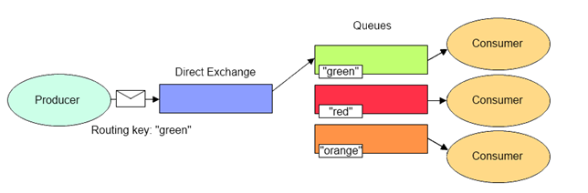
IV. Exchange example 1. Direct Exchange example

Slide 8
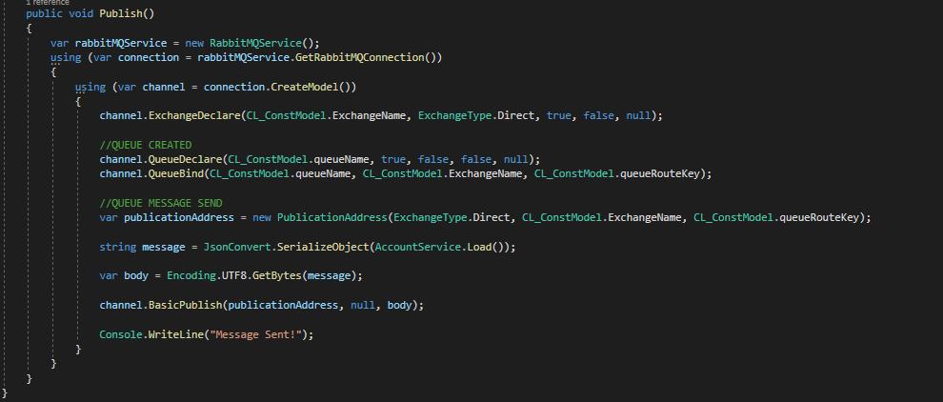
C# Create Application
Direct Exchange will deliver a messages to the queues based on the message routing key. In direct exchange, the message is routed to the queues whose binding key exactly matches with the routing key of the message.
Publish

Slide 9

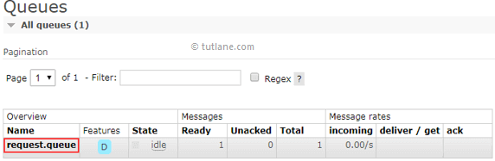
After executing above program, if we check the queue (request.queue) details in rabbitmq web management portal, the Ready column is having 1 like as shown below that means message published successfully to request.queue.
When I execute above c# program, we will get the result like as shown below.
a

Slide 10
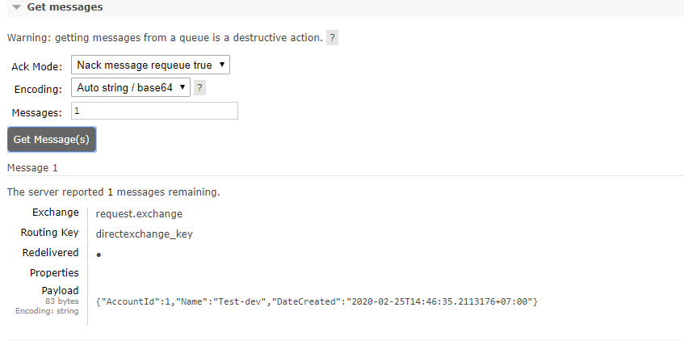
as
Review message in server http://localhost:15672/queues/{virtualhost}/{namequeue}

Slide 11
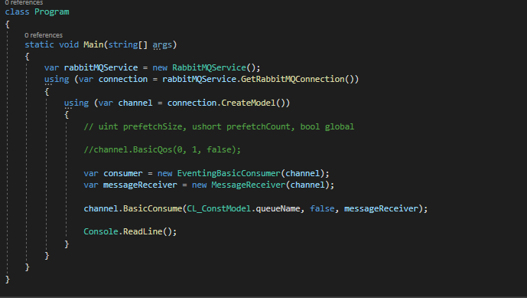
Subscribe

Slide 12
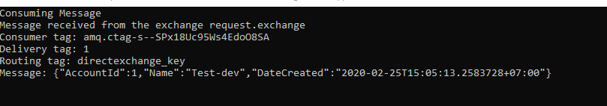
a
When I execute our application, we will get a messages from queue (request.queue) like as shown below.

Slide 13
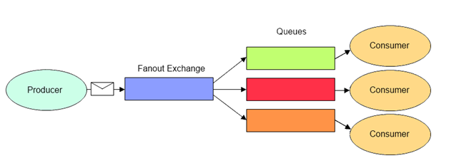
2. Fanout Exchange example
Fanout Exchange will route messages to all of the queues that are bound to it.

Slide 14
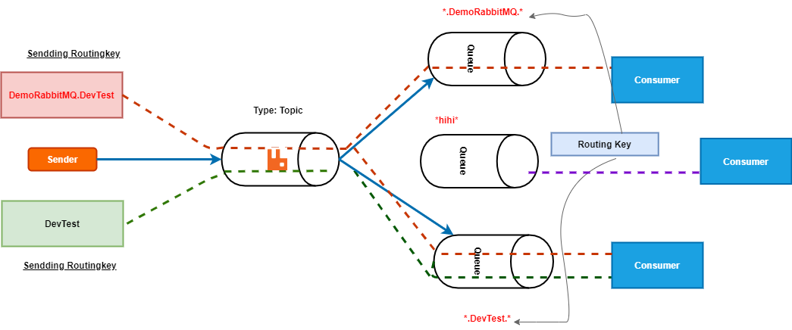
3. Topic Exchange example
The Topic exchange type routes messages to queues whose routing key matches all, or a portion of a routing key. 1 message send multiple queue .

Slide 15
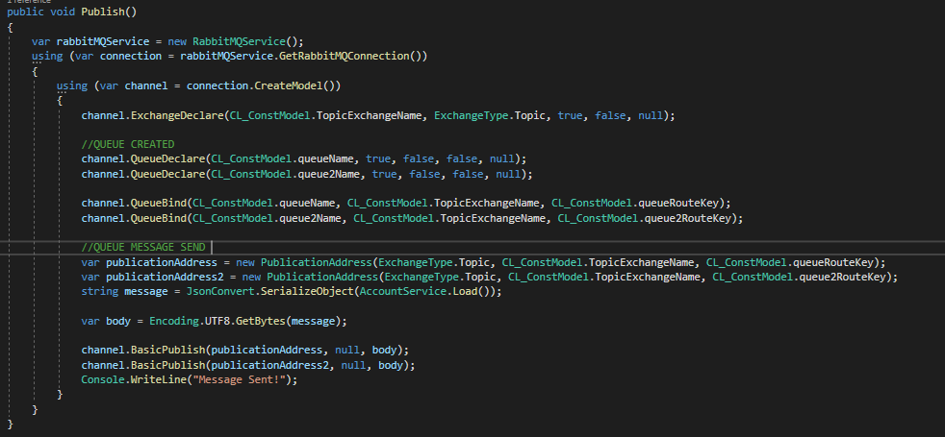
Publish

Slide 16
After executing above program, if I check the queue (request.queue and request.queue2) details in rabbitmq web management portal, the Ready column is having 2 like as shown below that means message published successfully to request.queue and equest.queue2.

Slide 17
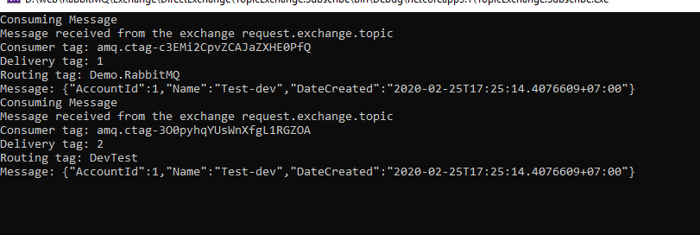
Subscribe
When I execute our application, I will get 2 messages from queue (request.queue and request.queue2) like as shown below.

Slide 18
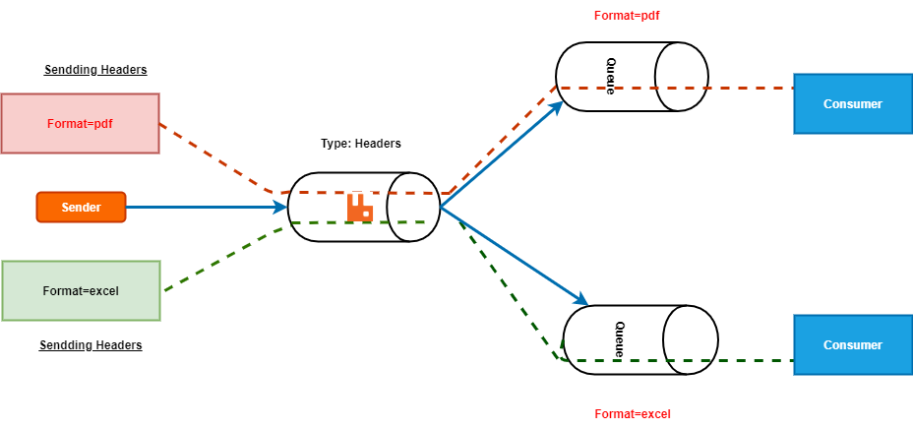
4. Headers Exchange example
Headers Exchange will use the message header attributes to send a messages to queue instead of routing key

Slide 19
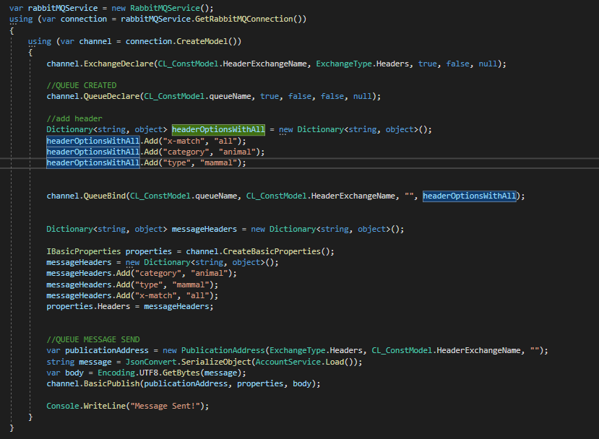
C# Create Application

Slide 20
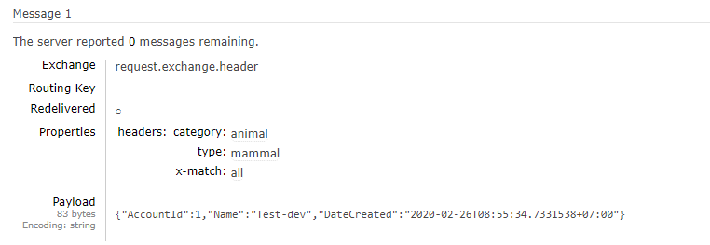
After executing above program, if I check the queue (request.queue) details in rabbitmq web management portal, the Ready column is having a like as shown below that means message published successfully to request.queue.

Slide 21
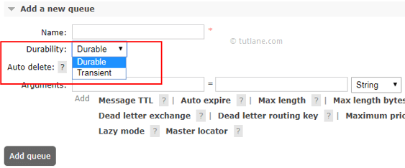
V. RabbitMQ Queues example
1. RabbitMQ Queue Properties
Durability
Durability is a property of queue which tells that a message can survive even after server restarts (broker restart) or not.

Slide 22
There are 2 types of Durability options.
Propety | Descripton
Durable | If we mark queue as Durable, then it will survive even after server restarts.
Transient | If we mark exchange as Transient, then it will not survive after server restarts.
Auto delete
There are 2 options in auto delete, those are :
Yes
No
If queue is exclusive, then the durability attribute has no effect because the queue will be deleted as soon as client disconnects (or its connection is lost). The auto-deleted queues are deleted when the last consumer is canceled (or its channel is closed, or its connection is lost).

Slide 23
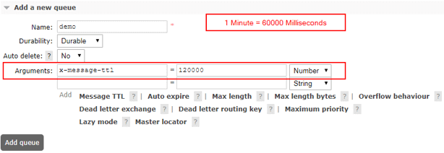
Time-to-live (TTL) Argument
We can set a timespan to queue and it will be discarded if it reaches defined timespan. Here, we can set time in milliseconds.

Slide 24
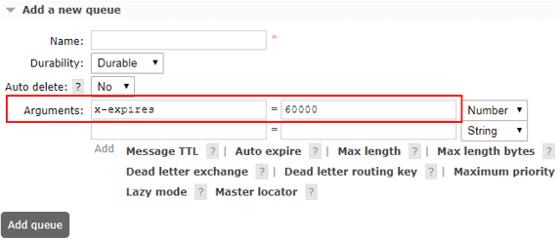
Auto expire Argument
We can set an expiry time to queue and it is used to define how long a queue can be unused before it is automatically deleted.

Slide 25
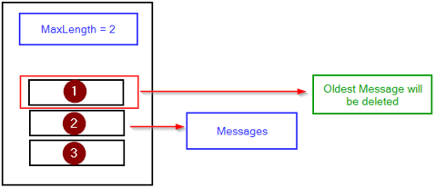
Max Length Argument
We can define how many (ready) messages a queue can contain before it starts to drop them from its head.
A maximum number of messages can be set by supplying the x-max-length queue declaration argument with a non-negative integer value.
E.g. If you set value x-max-length = 2 and if you publish 3 messages in the queue, then only 2 messages will be there and the oldest will be deleted from the queue.

Slide 26
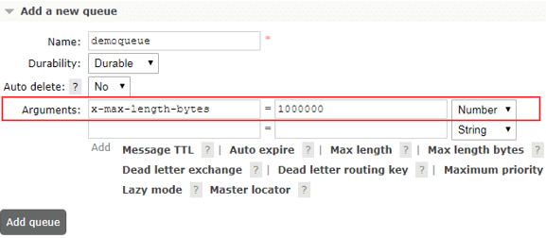
Max Length Bytes Argument
E.g. If you set value x-max-length-bytes = 1000000 (1MB) and if you publish messages in queue and the queue size increase more than 1 MB then the oldest will be deleted from the queue (drop them from its head).

Slide 27
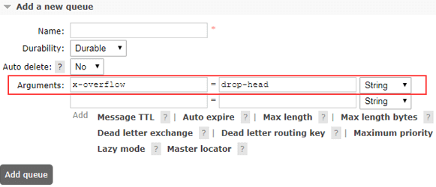
Overflow Behaviour Argument
By using overflow behaviour argument, we can set the queue overflow behavior. This determines what happens to messages when the maximum length of a queue is reached. Valid values are drop-head or reject-publish.

Slide 28
Thank You

