Slide 1
Fast Fourier Transform (FFT)
CS474/674 – Prof. Bebis
Section 4.11

Slide 2
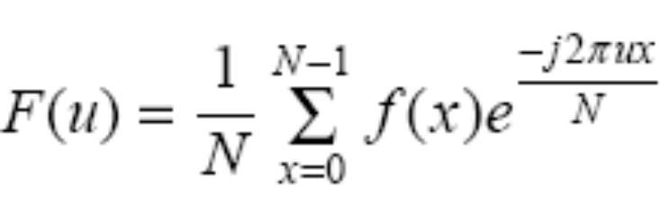
DFT – Time Complexity
How much time does DFT take?
u=0,1,2,...,N-1
O(N²) time

Slide 3
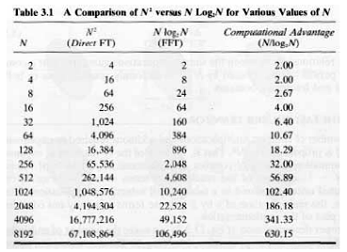
Fast Fourier Transform (FFT)
We will show that FFT takes O(Nlog(N)) time
  Need to assume that N=2^{n} which is easy to enforce!

Slide 4

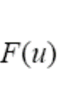

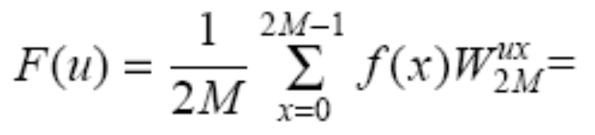
Deriving FFT
To simplify our notation, let’s set
Assuming N=2^{n}, there exist M such that N=2M
u=0,1,2,...,N-1

Slide 5
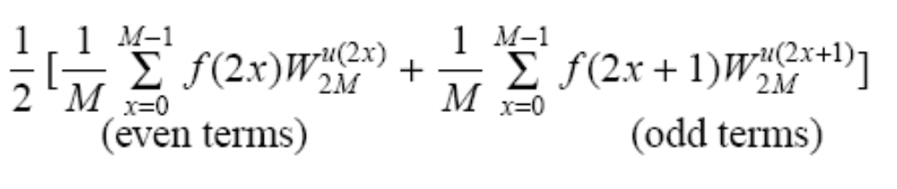
Deriving FFT (cont’d)
Let’s split this summations into two summations, one containing the even terms and the other containing the odd terms.
N terms
N/2 terms
N/2 terms

Slide 6
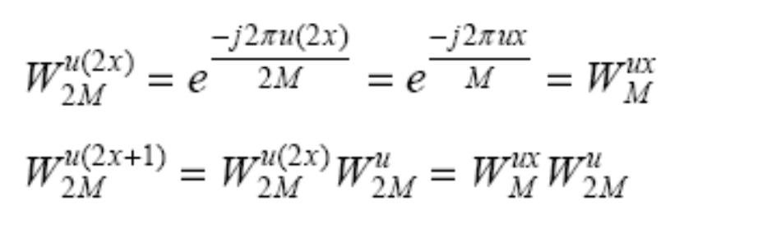
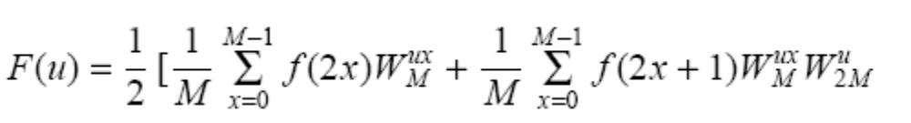
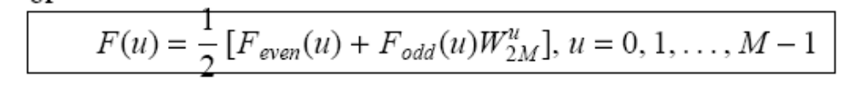
Deriving FFT (cont’d)
N/2 terms

Slide 7
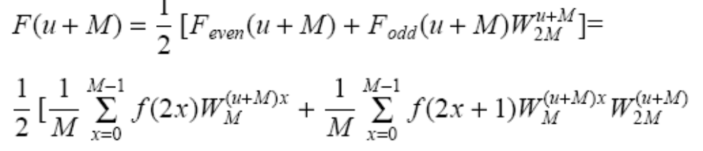
Deriving FFT (cont’d)
How can we compute F(u) for u=M,M+1,…,2M-1?

Slide 8
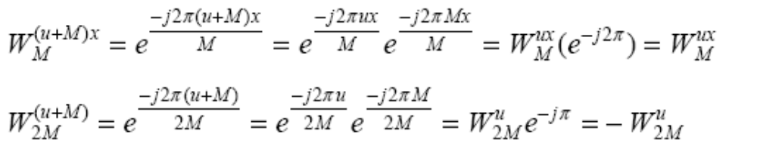
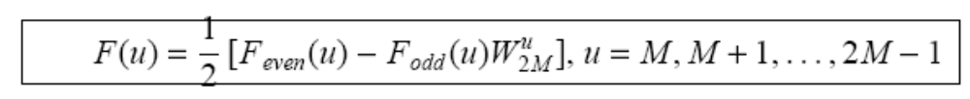
Deriving FFT (cont’d)
x
N/2 terms

Slide 9
Deriving FFT (cont’d)
Therefore, an N-point transform can be computed using two N/2-point transforms!
Similarly, each N/2-point transform can be computed
using two N/4-point transforms etc.

Slide 10
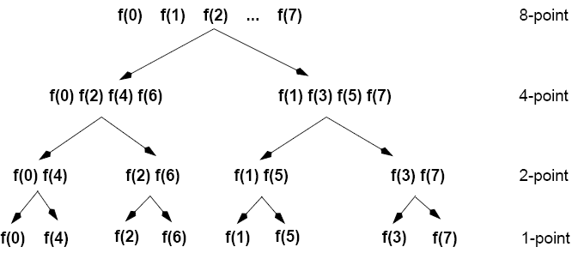
Example
even
odd
even
odd
even
odd
even
odd
odd
even
odd
even
odd

Slide 11
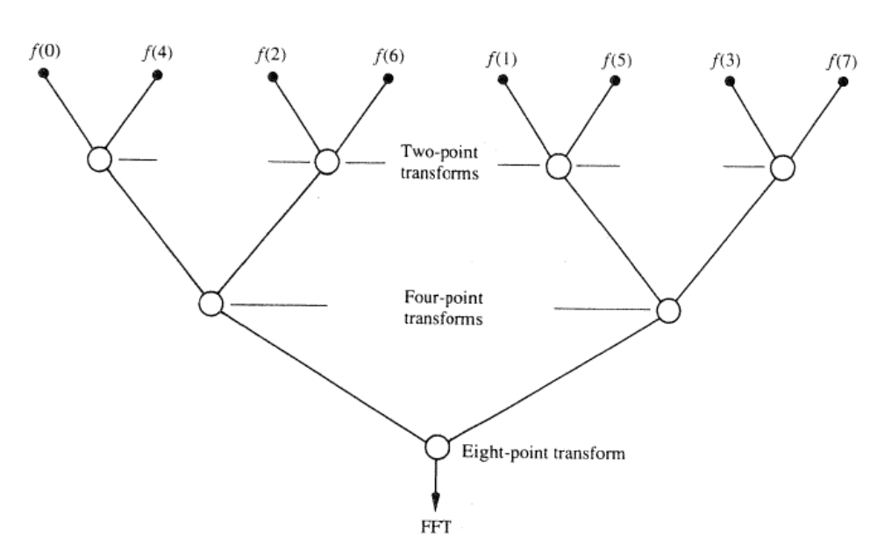
What is the running time of FFT?
Divide and Conquer
Assuming N inputs, what is
the number of levels?
O(logN)
What is the complexity of each
level?
O(N)
Total complexity?
O(Nlog(N))

Slide 12
Implementation Details
Input must be provided in the required order at each level:
f(0) f(1) f(2) f(3) f(4) f(5) f(6) f(7)
original order
required order

Slide 13
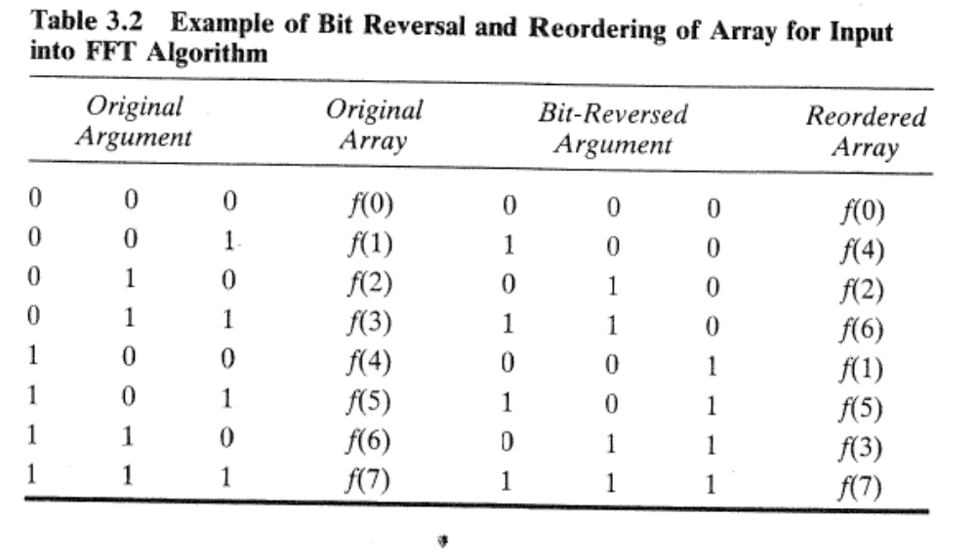
Implementation Details (cont’d)
Bit-wise reversal rule:

Slide 14
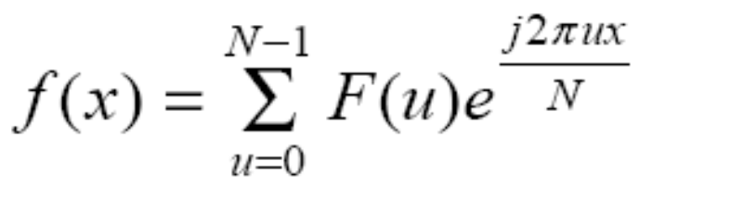
Inverse FFT
Forward DFT
Inverse DFT
The inverse FFT can be computed using the same exactly implementation:
  Use a flag for the sign of the exponential
  Use F(u) instead of f(x)
  Multiply the results by N

