Slide 1
Final presentation
俞项天

Slide 2
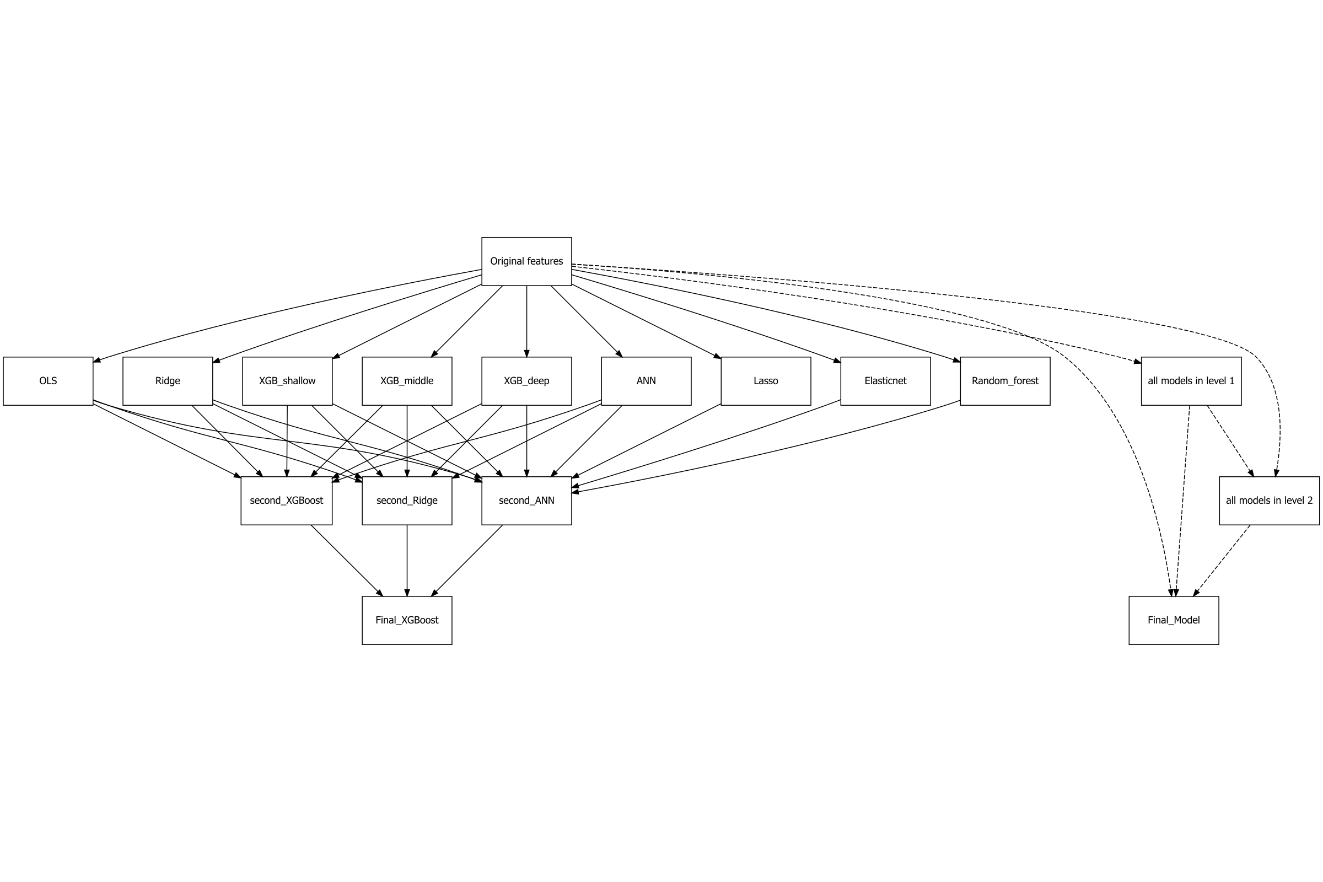
My model looks like...
In Level 1, our model gets 75-82 points, no higher than 83.
In Level 2, our model performance is between 83-83.4+, no higher than 83.5.
For the Final model, it has a performance of 83.5+
So we're really improving step by step!

Slide 3
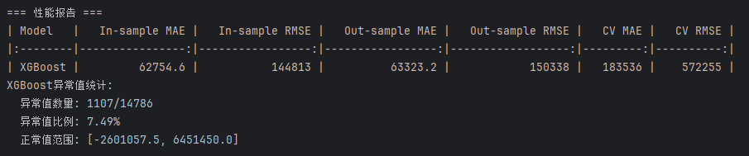
最终模型得分为83.529分，具体表现如上。

Slide 4
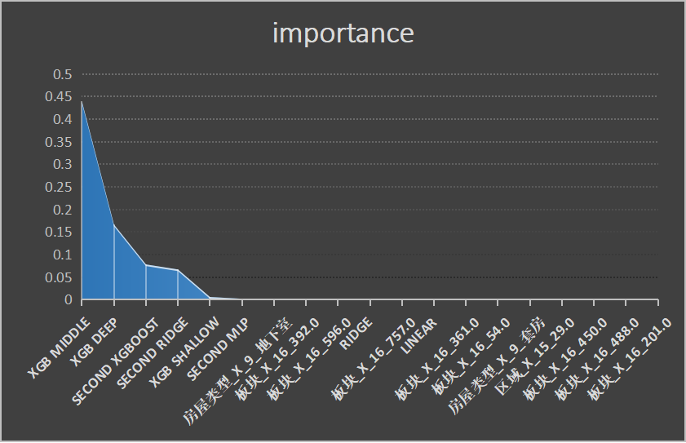
选取了特征重要性的前20个变量，可以发现对决策有主要影响的是先前训练好的一些基模型的oof预测集。

