Slide 1

Machine & Deep Learning
Pr Rahhal ERRATTAHI
rahhal.errattahi@um6p.ma
errattahi.r@ucd.ac.ma
Lecture 06
Neural Networks

Slide 2
Lecture 6 Overview
Neural architectures
Training neural nets
Neural network design
Neural networks in practice
Model selection
Summary

Slide 3
Lecture 6 Overview
Neural architectures
Training neural nets
Neural network design
Neural networks in practice
Model selection
Summary

Slide 4


Overall Picture
Parameters
Input data
Objective Function
Optimization Function
Loss Function

Slide 5


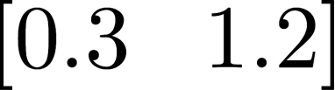
Linear Classifier
Linear Classifier
Score for the car to be accident prone
Score for the car to be
NOT accident prone

Slide 6

Neural Network
Linear Classifier
Linear Classifier
Linear Classifier
Linear Classifier
Linear Classifier
Linear Classifier
Linear Classifier
Score for the car to be accident prone
Score for the car to be
NOT accident prone

Slide 7


Neural Network
Speed
Color
Acceleration
Old cars
Linear Classifier
Linear Classifier
Linear Classifier
Linear Classifier
Linear Classifier
Linear Classifier
Linear Classifier
As a simplification, we can say that, each classifier learns to look at a particular feature of the input (the car in this case)
Score for the car to be accident prone
Score for the car to be NOT
accident prone

Slide 8
Neural Network
Speed
Color
Acceleration
Old cars
Neuron
Neuron
Neuron
Neuron
Neuron
Neuron
Neuron
As a simplification, we can say that, each neuron learns to look at a particular feature of the input (the car in this case)
Score for the car to be accident prone
Score for the car to be NOT
accident prone

Slide 9

Neural Network
The neurons in the layer can be thought of as representing richer features
Think of these richer features as combinations of the input features we provided to the system
Input
Layer 1
x₀ x₁ x₂ x₃ x₄ x₅ x₆
Features

Slide 10
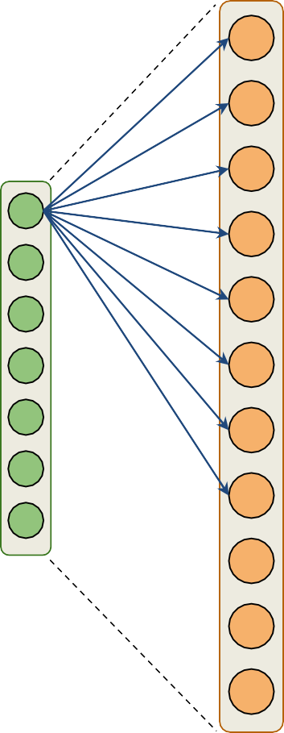
Neural Network
The neurons in the layer can be thought of as representing richer features
Think of these richer features as combinations of the input features we provided to the system
Input
Layer 1
x₀ x₁ x₂ x₃ x₄ x₅ x₆
Features

Slide 11
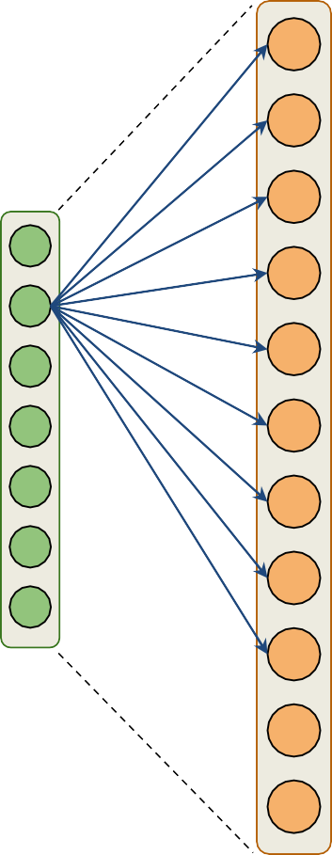
Neural Network
The neurons in the layer can be thought of as representing richer features
Think of these richer features as combinations of the input features we provided to the system
Input
Layer 1
x₀ x₁ x₂ x₃ x₄ x₅ x₆
Features

Slide 12
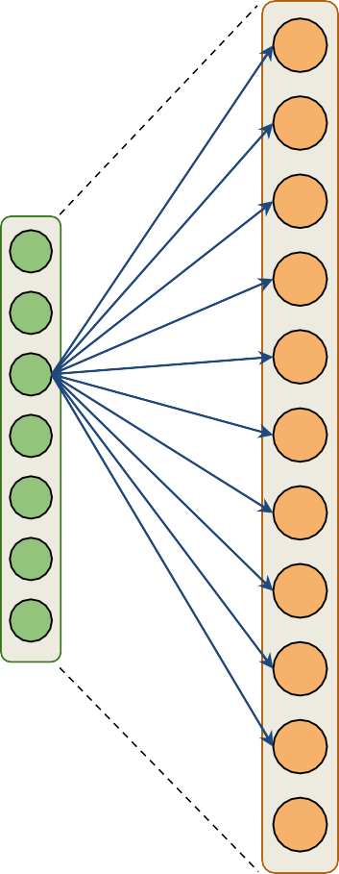
Neural Network
The neurons in the layer can be thought of as representing richer features
Think of these richer features as combinations of the input features we provided to the system
Input
Layer 1
x₀ x₁ x₂ x₃ x₄ x₅ x₆
Features

Slide 13
Neural Network
The neurons in the layer can be thought of as representing richer features
Think of these richer features as combinations of the input features we provided to the system
Input
Layer 1
x₀ x₁ x₂ x₃ x₄ x₅ x₆
Features

Slide 14
Neural Network
x₀ x₁ x₂ x₃ x₄ x₅ x₆
Features
Neurons

Slide 15
Neural Network
Input
Layer 1
Layer 2

Slide 16
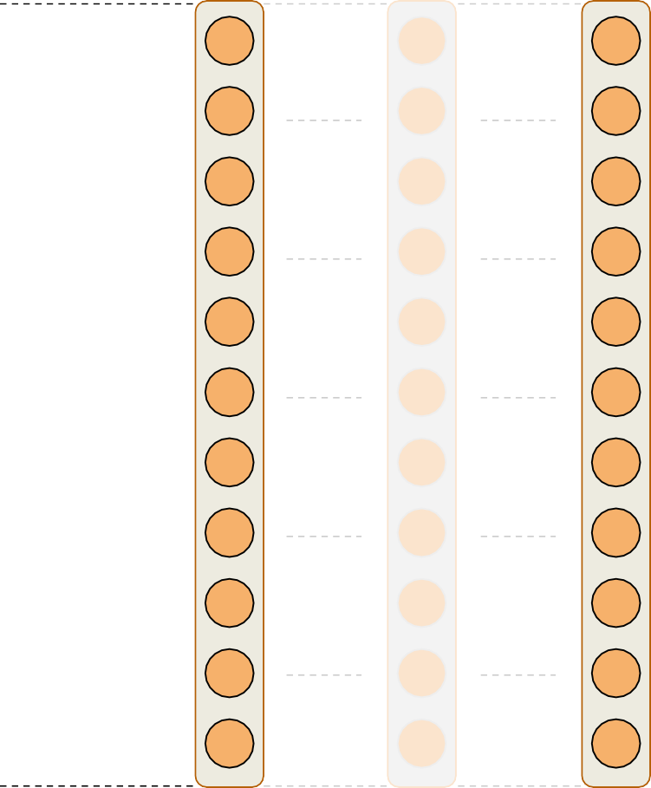
Neural Network
Input
Layer 1
Layer 2
Layer N

Slide 17
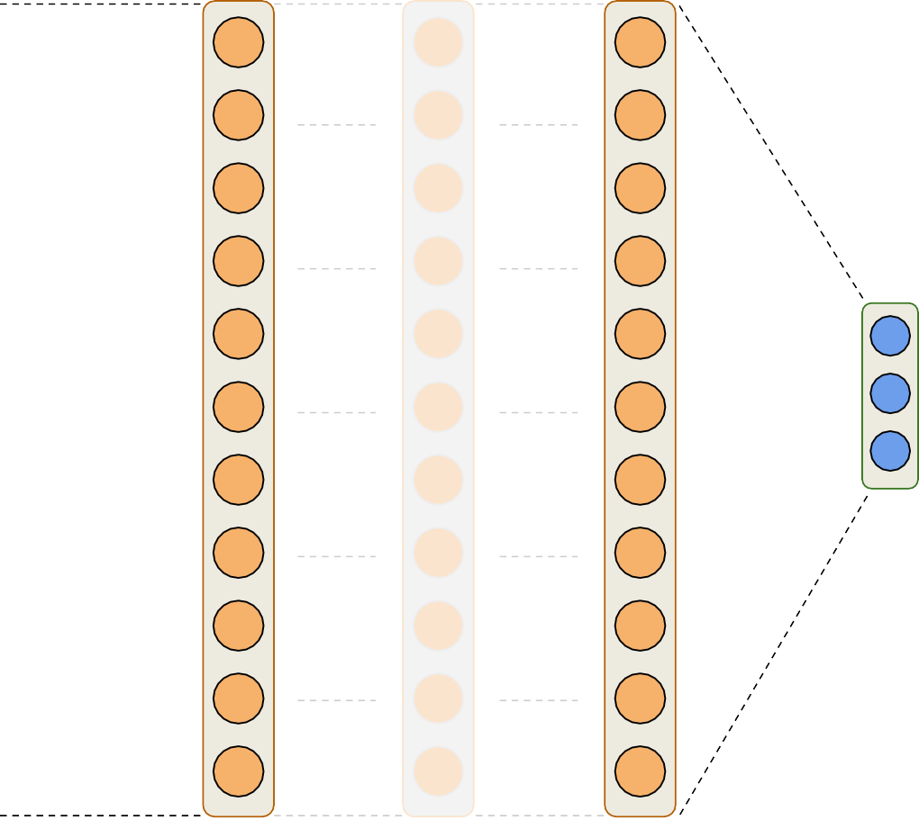
Neural Network
One score
per class
Output
Input
Layer 1
Layer 2
Layer N

Slide 18



Neuron
A Neuron can be thought of as a linear classifier plus an activation function
Output
Activation Function
Linear classifier
Input
x

Slide 19
Activation Functions
Intuitively, a neuron looks at a particular feature of the data
The activation after the linear classifier gives us an idea of how much the neuron “supports” the feature
Activations also helps us map linear spaces into non- linear spaces
Non linearity

Slide 20
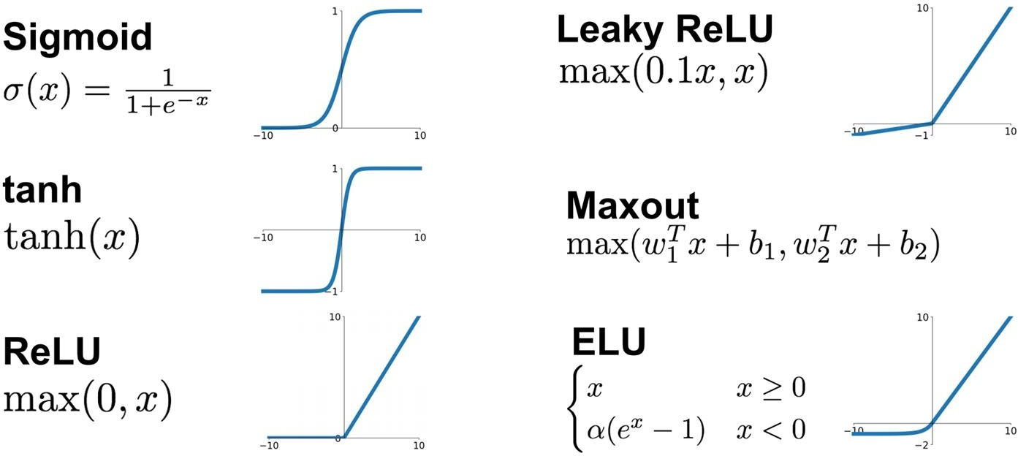
Activation Functions

Slide 21
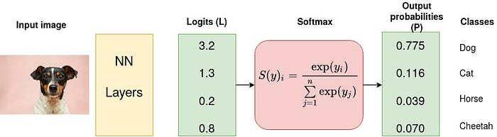
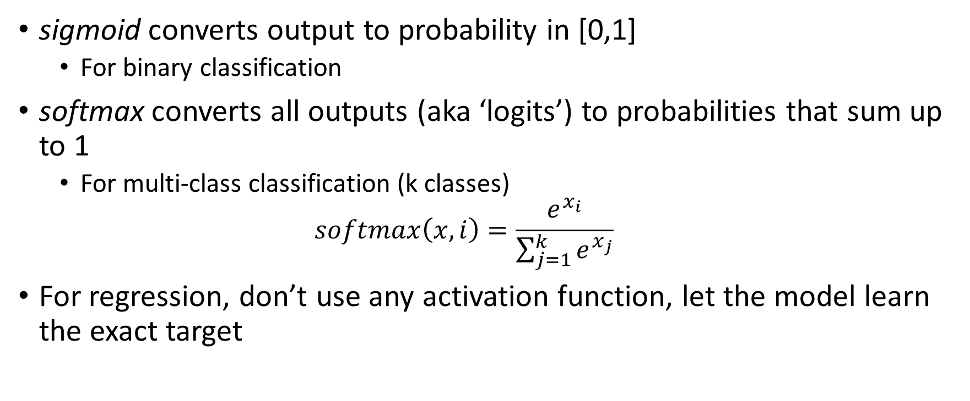
Activation functions for output layer
sigmoid converts output to probability in [0,1]
For binary classification
softmax converts all outputs (aka ‘logits’) to probabilities that sum up to 1
For multi-class classification (k classes)
$$softmax\left(x,i\right)=\frac{e^{x_{i}}}{\sum_{j=1}^{k}{e^{x_{j}}}}$$
For regression, don’t use any activation function, let the model learn the exact target

Slide 22
Lecture 6 Overview
Neural architectures
Training neural nets
Neural network design
Neural networks in practice
Model selection
Summary

Slide 23
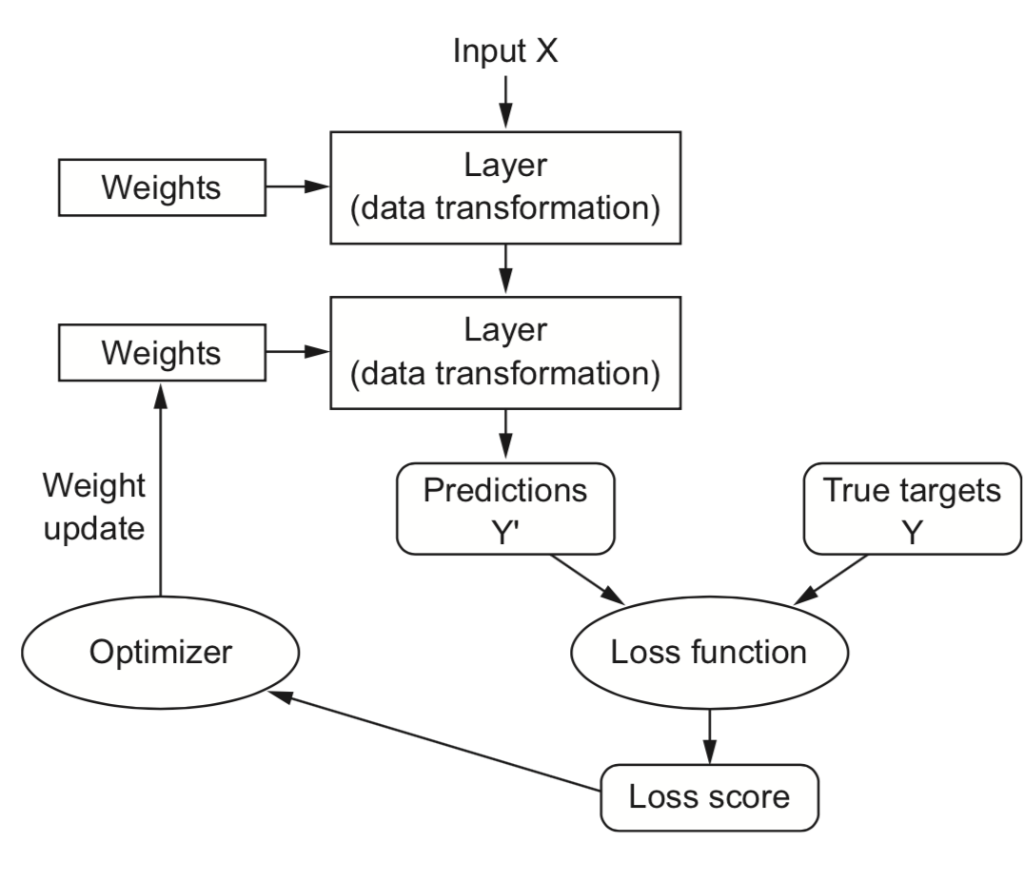
Training Neural Nets
Design the architecture, choose activation functions (e.g. sigmoids)
Choose a way to initialize the weights (e.g. random initialization)
Choose a loss function (e.g. log loss) to measure how well the model fits training data
Choose an optimizer (typically an SGD variant) to update the weights

Slide 24


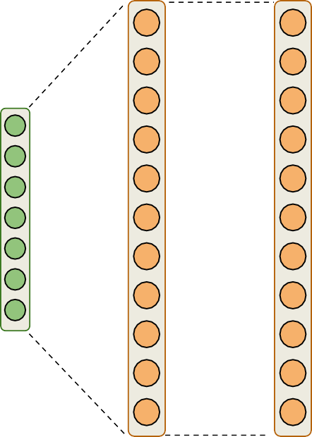






Training Neural Nets
Linear classifier
Entire network is nothing but a function:
Neural network with 3 hidden layers
Activation
function
Output of linear classifier
“richer features”

Slide 25


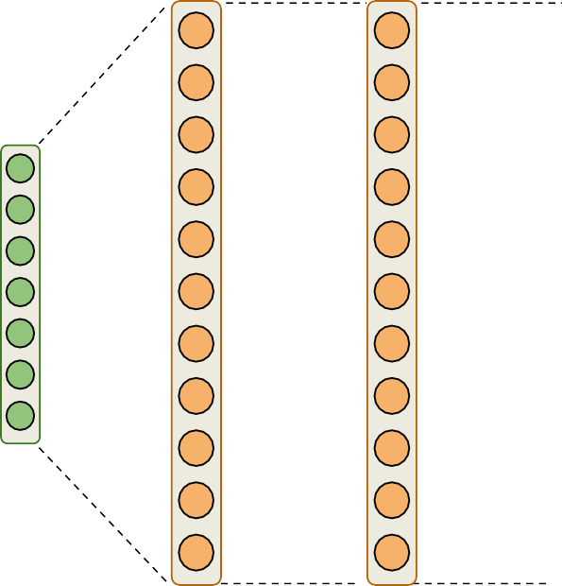
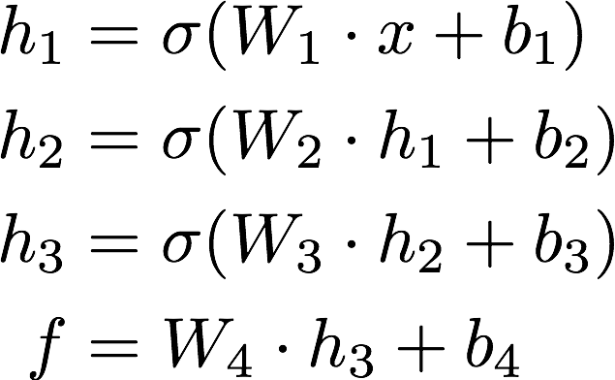




Training Neural Nets
Linear classifier
Entire network is nothing but a function:
Neural network with 3 hidden layers
Final scores

Slide 26
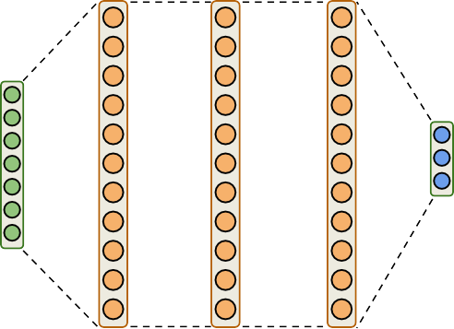
Training Neural Nets
Linear classifier
Everything else remains the same!
Neural network with 3 hidden layers

Slide 27


Training Neural Nets
Input
Layer 1 Layer 2 Output
300 features
100 neurons
50 neurons
3 classes
[4 x 300]
[examples x features]
[4 x 3]
[examples x classes]
[300+1 x 100]
[100+1 x 50]
[50+1 x 3]

Slide 28



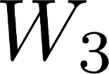
Training Neural Nets
Input
Layer 1 Layer 2 Output
300 features
100 neurons
50 neurons
3 classes
[4 x 300]
[examples x features]
[4 x 3]
[examples x classes]
[300+1 x 100]
[100+1 x 50]
[50+1 x 3]

Slide 29
Training Neural Nets
Input
Layer 1 Layer 2 Output
300 features
100 neurons
50 neurons
3 classes
[4 x 300]
[examples x features]
[4 x 3]
[examples x classes]
[300+1 x 100]
[100+1 x 50]
[50+1 x 3]
hidden layer 1 size
hidden layer 2 size

Slide 30
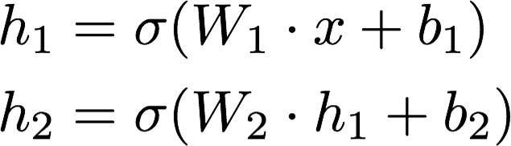

Training Neural Nets
Input Layer 1 Layer 2 Output
Forward Pass

Slide 31

Training Neural Nets
Input Layer 1 Layer 2 Output
Cross Entropy Loss

Slide 32
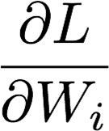

Training Neural Nets
Input Layer 1 Layer 2 Output
Compute
and
using backpropagation
Optimization

Slide 33
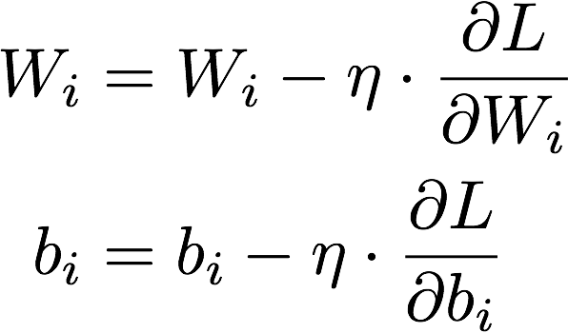
Training Neural Nets
Input Layer 1 Layer 2 Output
Backward Pass

Slide 34
Lecture 6 Overview
Neural architectures
Training neural nets
Neural network design
Neural networks in practice
Model selection
Summary

Slide 35
Weight initialization
Initializing weights to 0 is bad: all gradients in layer will be identical (symmetry)
Too small random weights shrink activations to 0 along the layers (vanishing gradient)
Too large random weights multiply along layers (exploding gradient, zig-zagging)

Slide 36
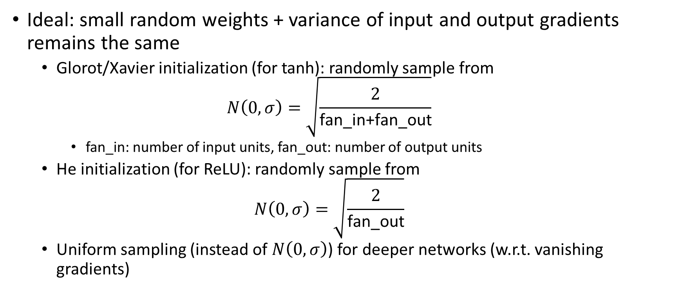
Weight initialization
Ideal: small random weights + variance of input and output gradients remains the same
Glorot/Xavier initialization (for tanh): randomly sample from
$$N\left(0,σ\right)=\sqrt{\frac{2}{\text{fan}\text{_}\text{in}\text{+}\text{fan}\text{_}\text{out}}}$$
fan_in: number of input units, fan_out: number of output units
He initialization (for ReLU): randomly sample from
$$N\left(0,σ\right)=\sqrt{\frac{2}{\text{fan}\text{_}\text{out}}}$$
Uniform sampling (instead of $N\left(0,σ\right)$) for deeper networks (w.r.t. vanishing gradients)

Slide 37

Optimizers
Using a constant learning $η$ rate for weight updates
$w_{i}=w_{i}−η∙\frac{∂L}{∂w_{i}}$ is not ideal
You would need to ‘magically’ know the right value

Slide 38
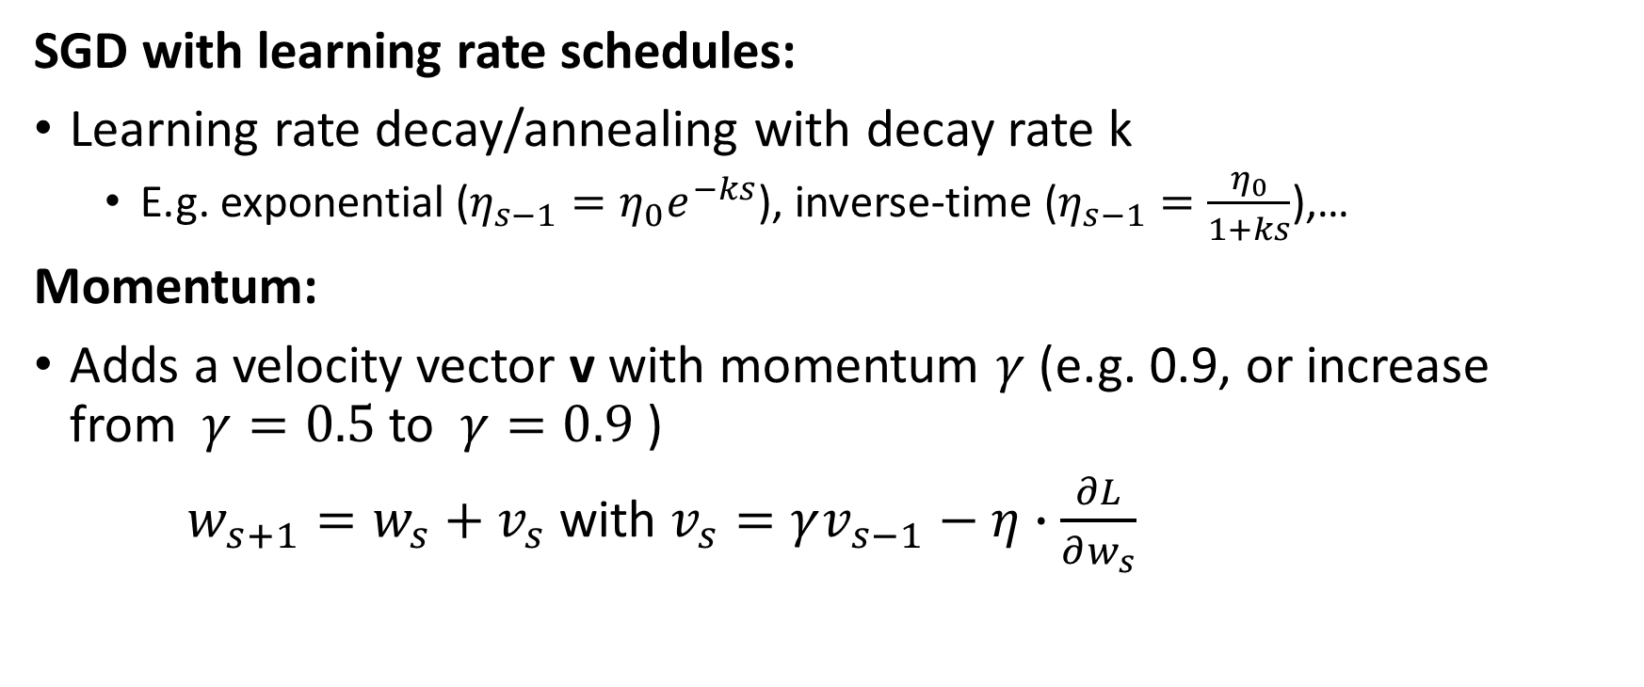
Optimizers
SGD with learning rate schedules:
Learning rate decay/annealing with decay rate k
E.g. exponential ($η_{s−1}=η_{0}e^{−ks}$), inverse-time ($η_{s−1}=\frac{η_{0}}{1+ks}$),…
Momentum:
Adds a velocity vector v with momentum $γ$ (e.g. 0.9, or increase from $γ=0.5$to $γ=0.9$)
$w_{s+1}=w_{s}+v_{s}$ with $v_{s}=γv_{s−1}−η∙\frac{∂L}{∂w_{s}}$

Slide 39
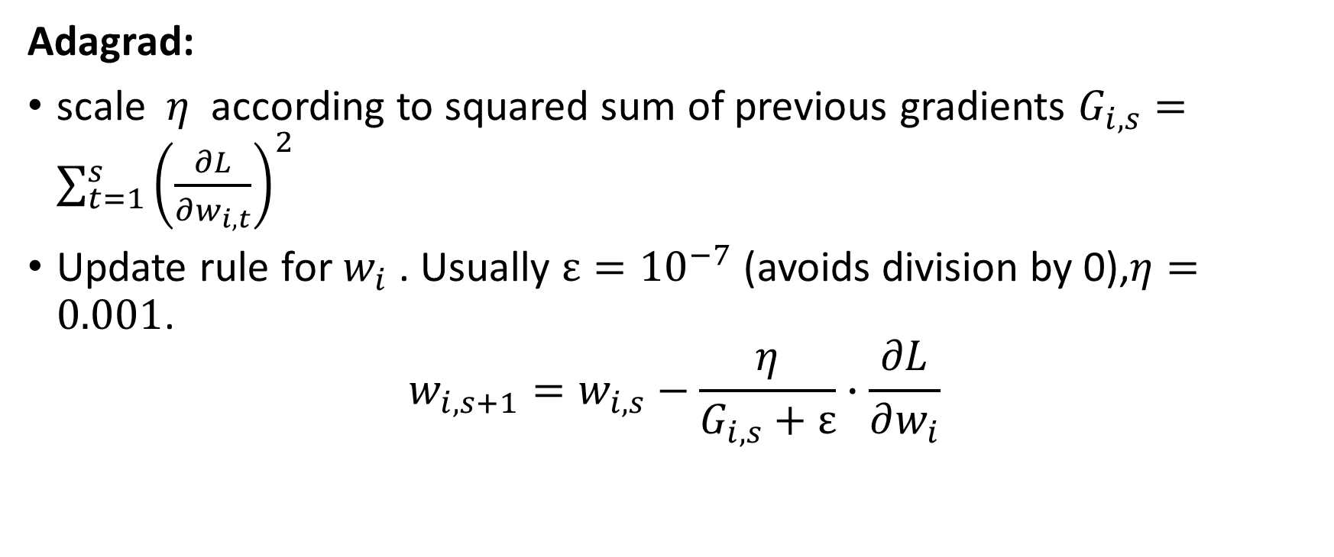
Optimizers
Adagrad:
scale $η$ according to squared sum of previous gradients $G_{i,s}=\sum_{t=1}^{s}{{\left(\frac{∂L}{∂w_{i,t}}\right)}^{2}}$
Update rule for $w_{i}$ . Usually $ε={10}^{−7}$ (avoids division by 0),$η=0.001$.
$$w_{i,s+1}=w_{i,s}−\frac{η}{G_{i,s}+ε}∙\frac{∂L}{∂w_{i}}$$

Slide 40
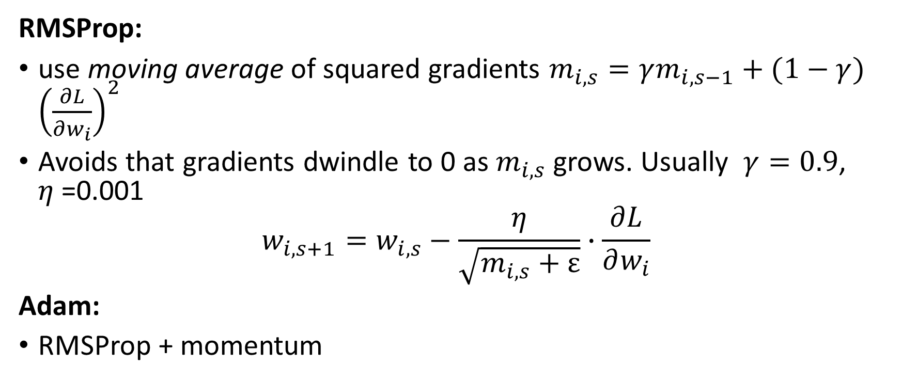
Optimizers
RMSProp:
use moving average of squared gradients $m_{i,s}=γm_{i,s−1}+(1−γ)$ ${\left(\frac{∂L}{∂w_{i}}\right)}^{2}$
Avoids that gradients dwindle to 0 as $m_{i,s}$ grows. Usually $γ=0.9$, $η$=0.001
$$w_{i,s+1}=w_{i,s}−\frac{η}{\sqrt{m_{i,s}+ε}}∙\frac{∂L}{∂w_{i}}$$
Adam:
RMSProp + momentum

Slide 41
Lecture 6 Overview
Neural architectures
Training neural nets
Neural network design
Neural networks in practice
Model selection
Summary

Slide 42
Neural networks in practice
network = models.Sequential()
network.add(layers.Dense(512, activation='relu', kernel_initializer='he_normal', input_shape=(28 * 28,)))
network.add(layers.Dense(512, activation='relu', kernel_initializer='he_normal'))
network.add(layers.Dense(10, activation='softmax'))
Input layer (‘input_shape’): a flat vector of 28*28=784 nodes
We’ll see how to properly deal with images later
Two dense hidden layers: 512 nodes each, ReLU activation
Glorot weight initialization is applied by default
Output layer: 10 nodes (for 10 classes) and softmax activation

Slide 43
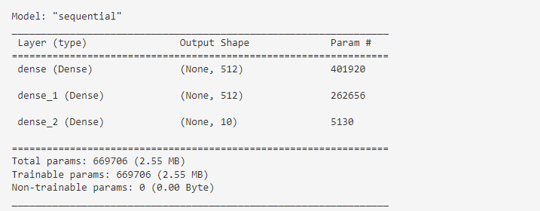
Neural networks in practice
Lots of parameters (weights and biases) to learn!
hidden layer 1 : (28 * 28 + 1) * 512 = 401920
hidden layer 2 : (512 + 1) * 512 = 262656
output layer: (512 + 1) * 10 = 5130
network.summary()

Slide 44
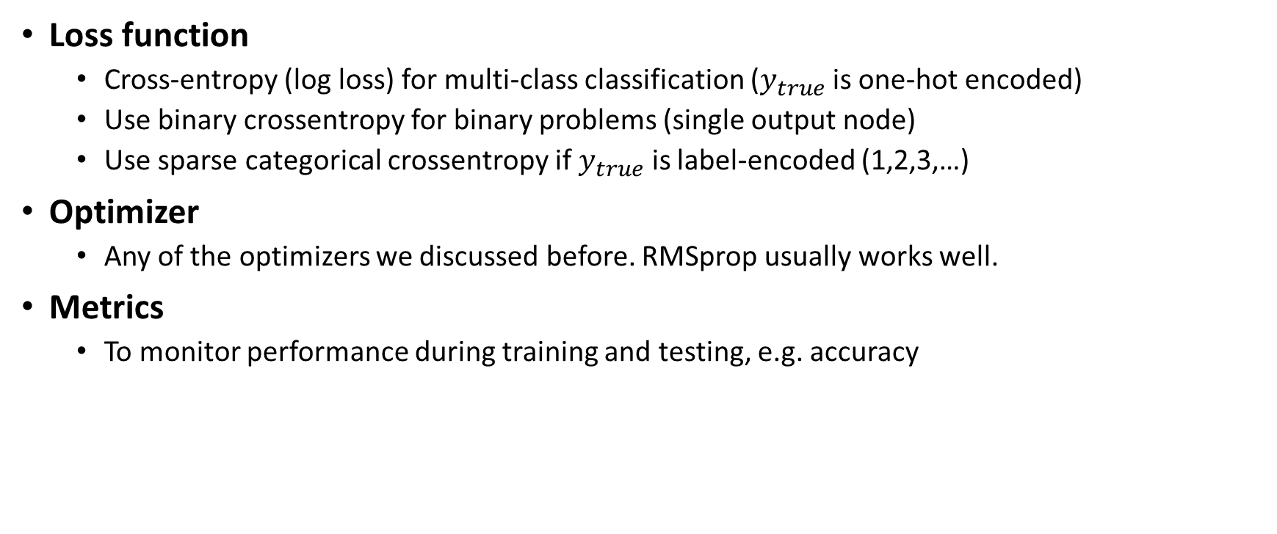
Neural networks in practice
Loss function
Cross-entropy (log loss) for multi-class classification ($y_{true}$ is one-hot encoded)
Use binary crossentropy for binary problems (single output node)
Use sparse categorical crossentropy if $y_{true}$ is label-encoded (1,2,3,…)
Optimizer
Any of the optimizers we discussed before. RMSprop usually works well.
Metrics
To monitor performance during training and testing, e.g. accuracy
# Shorthand
network.compile(loss='categorical_crossentropy', optimizer='rmsprop', metrics=['accuracy'])
# Detailed
network.compile(loss=CategoricalCrossentropy(label_smoothing=0.01), optimizer=RMSprop(learning_rate=0.001, momentum=0.0) metrics=[Accuracy()])

Slide 45
Neural networks in practice
Always normalize (standardize or min-max) the inputs. Mean should be close to 0.
Avoid that some inputs overpower others
Speed up convergence
Reshape the data to fit the shape of the input layer, e.g. (n, 28*28) or (n, 28,28)
Tensor with instances in first dimension, rest must match the input layer
In multi-class classification, every class is an output node, so one-hot-encode the labels
e.g. class ‘4’ becomes [0,0,0,0,1,0,0,0,0,0]
X = X.astype('float32') / 255
X = X.reshape((60000, 28 * 28))
y = to_categorical(y)

Slide 46
Neural networks in practice
Number of epochs: enough to allow convergence
Too much: model starts overfitting (or just wastes time)
Batch size: small batches (e.g. 32, 64,… samples) often preferred
‘Noisy’ training data makes overfitting less likely
Larger batches generalize less well (‘generalization gap’)
Requires less memory (especially in GPUs)
Large batches do speed up training, may converge in fewer epochs
history = network.fit(X_train, y_train, epochs=3, batch_size=32);

Slide 47
Neural networks in practice
We can now call predict to generate predictions, and evaluate the trained model on the entire test set
network.predict(X_test) test_loss,
test_acc = network.evaluate(X_test, y_test)
print ('Test accuracy:', test_acc)
Test accuracy: 0.7547000050544739

Slide 48
Neural networks in practice
Let’s see it in action!
Demo - Neural Network with Spiral Data
Notes:
https://colab.research.google.com/drive/1vxTaaLByJe0viBpJ3viEYIDflNuWVBL-?usp=sharing

Slide 49
Lecture 6 Overview
Neural architectures
Training neural nets
Neural network design:
Neural networks in practice
Model selection
Summary

Slide 50
Model selection
How many epochs do we need for training?
Train the neural net and track the loss after every iteration on a validation set
You can add a callback to the fit version to get info on every epoch
Best model after a few epochs, then starts overfitting

Slide 51
Model selection
Early stopping
Stop training when the validation loss (or validation accuracy) no longer improves
Loss can be bumpy: use a moving average or wait for k steps without improvement
earlystop = callbacks.EarlyStopping(monitor='val_loss', patience=3)
model.fit(x_train, y_train, epochs=25, batch_size=512, callbacks=[earlystop])

Slide 52
Model selection
Regularization and memorization capacity
The number of learnable parameters is called the model capacity
A model with more parameters has a higher memorization capacity
Too high capacity causes overfitting, too low causes underfitting
In the extreme, the training set can be ‘memorized’ in the weights
Smaller models are forced it to learn a compressed representation that generalizes better
Start with few parameters, increase until overfitting stars.

Slide 53
Model selection
Weight regularization (weight decay)
As we did many times before, we can also add weight regularization to our loss function
L1 regularization: leads to sparse networks with many weights that are 0
L2 regularization: leads to many very small weights
network = models.Sequential() network.add(layers.Dense(256, activation='relu', kernel_regularizer=regularizers.l2(0.001), input_shape=(28 * 28,))) network.add(layers.Dense(128, activation='relu', kernel_regularizer=regularizers.l2(0.001)))

Slide 54
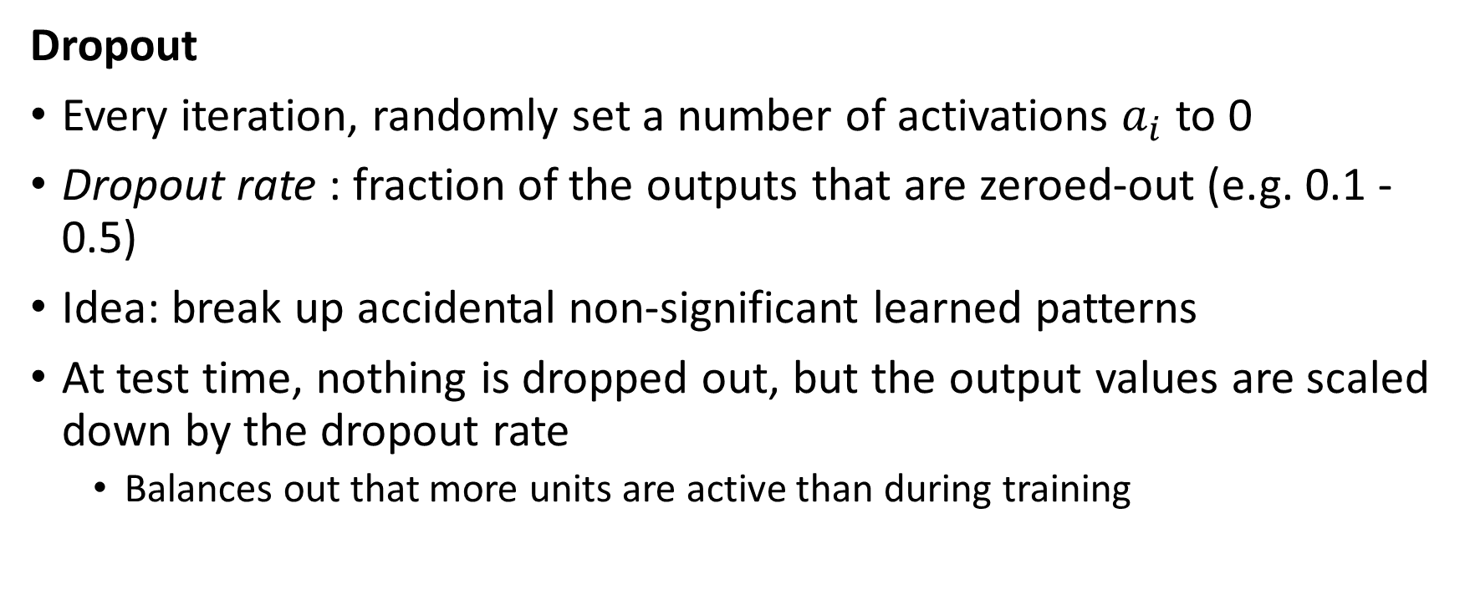
Model selection
Dropout
Every iteration, randomly set a number of activations $a_{i}$ to 0
Dropout rate : fraction of the outputs that are zeroed-out (e.g. 0.1 - 0.5)
Idea: break up accidental non-significant learned patterns
At test time, nothing is dropped out, but the output values are scaled down by the dropout rate
Balances out that more units are active than during training

Slide 55
Model selection
Dropout
Dropout is usually implemented as a special layer
network = models.Sequential()
network.add(layers.Dense(256, activation='relu', input_shape=(28 * 28,)))
network.add(layers.Dropout(0.5))
network.add(layers.Dense(32, activation='relu'))
network.add(layers.Dropout(0.5))
network.add(layers.Dense(10, activation='softmax'))

Slide 56
Model selection
Batch Normalization
Batch normalization: normalize the activations of the previous layer within each batch
Within a batch, set the mean activation close to 0 and the standard deviation close to 1
Allows deeper networks less prone to vanishing or exploding gradients

Slide 57
Model selection
Batch Normalization
network = models.Sequential()
network.add(layers.Dense(512, activation='relu', input_shape=(28 * 28,)))
network.add(layers.BatchNormalization())
network.add(layers.Dropout(0.5))
network.add(layers.Dense(256, activation='relu'))
network.add(layers.BatchNormalization())
network.add(layers.Dropout(0.5))
network.add(layers.Dense(64, activation='relu'))
network.add(layers.BatchNormalization())
network.add(layers.Dropout(0.5))
network.add(layers.Dense(32, activation='relu'))
network.add(layers.BatchNormalization())
network.add(layers.Dropout(0.5))

Slide 58
Lecture 6 Overview
Neural architectures
Training neural nets
Neural network design:
Neural networks in practice
Model selection
Summary

Slide 59
Summary
Neural architectures
Training neural nets
Forward pass: Tensor operations
Backward pass: Backpropagation
Neural network design:
Activation functions
Weight initialization
Optimizers
Neural networks in practice
Model selection
Early stopping
Memorization capacity and information bottleneck
L1/L2 regularization
Dropout
Batch normalization

Slide 60
Lab 8 - Neural networks

