Slide 1
Tracking activity in real time with Google Trends
OECD ECONOMICS DEPARTMENT WORKING PAPERS No. 1634

Slide 2
Overview
This paper introduces the OECD Weekly Tracker of economic activity for 46 OECD and G20 countries using Google Trends search data. The Tracker performs well in pseudo-real time simulations including around the COVID-19 crisis. The underlying model adds to the previous Google Trends literature in two respects: (1) the data are adjusted for common long-term bias and (2) the data include variables based on both Google Search categories and topics (the latter being a collection of related keywords), thus further exploiting the potential of Google Trends. The paper highlights the predictive power of specific topics, including “bankruptcies”, “economic crisis”, “investment”, “luggage” and “mortgage”. Calibration is performed using a neural network that captures non-linear patterns, which are shown to be consistent with economic intuition using machine learning interpretability tools (“Shapley values”). The tracker sheds light on the recent downturn and the dynamics of the rebound, and provides evidence about lasting shifts in consumption patterns.

Slide 3
Motivation
Given that GDP is usually only available on a quarterly basis (with first estimates typically published only 4 weeks or more after the end of the quarter), policymakers and forecasters have long made use of more timely higher frequency data, such as survey-based indicators like Purchasing Managers’ Indices (PMIs). However, both the current crisis and the earlier ones have shown that the underlying relationship with survey-based indicators can become unreliable when changes in economic activity are abrupt and massive.
This paper discusses one alternative indicator based on Google Trends, which are used to construct a Weekly Tracker that provides real-time estimates of GDP growth in 46 G20, OECD and partner countries.
The relationship between Google Trends variables and GDP growth is fitted using a machine learning algorithm (“neural network”). The algorithm captures non-linearities that are likely to be key in extreme situations, but which are difficult to estimate with more conventional econometric approaches.
The model of GDP growth based on Google Trends proves to perform well in out-of-sample nowcast simulations. On average across OECD and G20 countries, the quarterly model based on Google Trends has a Root Mean Squared Error (RMSE) lower by 17% than an auto-regressive model that just uses lags of year-on-year GDP growth. The tracker thus provides a useful tool for real-time narrative analysis on a weekly basis, although it does not on average outperform models based on more standard variables, once these are eventually released.

Slide 4
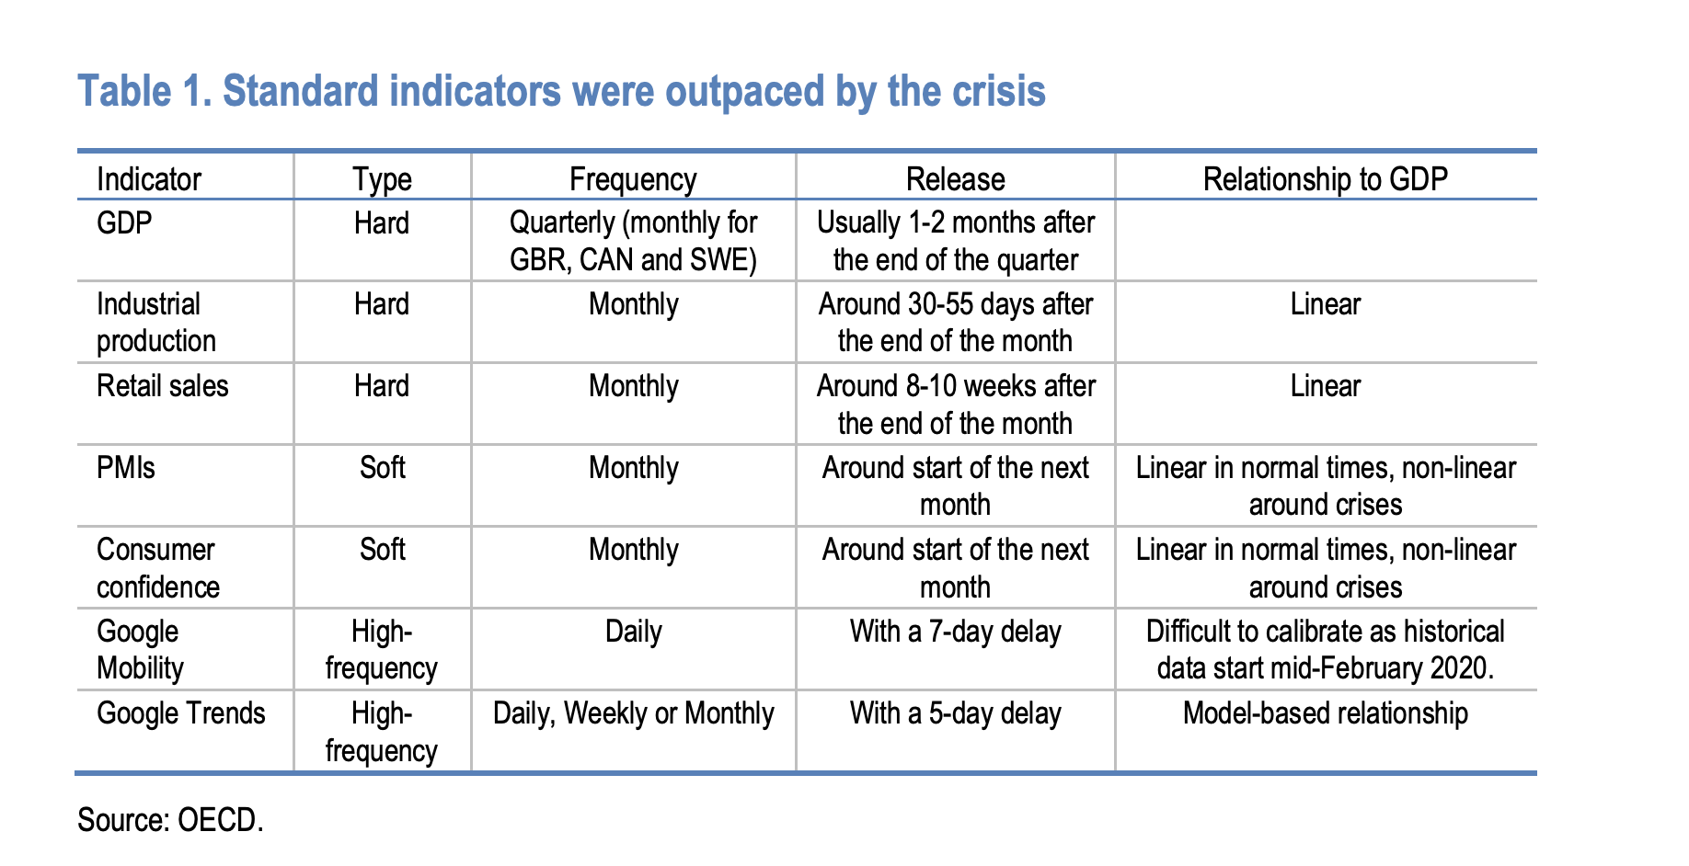
Google Trends
Hard indicators are collected by national administrations or statistical agencies and suffer from publication delays ranging from one to three months, which is a major constraint for policymakers facing rapid fluctuations in activity. Soft indicators are timelier, but can become less informative about GDP during recessions
Google Trends provides Search Volume Indices, which measure search intensity (number of searches for a given keyword divided by total searches) by location and period. Queries can be made by keyword, category of keywords or topic.

Slide 5
Google Trends (categories and topics)
Google has classified searches into categories . These allocate individual searches to (multiple) categories using a probabilistic algorithm. Categories are structured as a 5-level hierarchical classification. For instance, the category “Autos and Vehicles” aggregate together all searches related to cars, whereas an equivalent query based on keywords would have to explicitly combine each possible car name and brand.
Google has created topics that aggregate together multiple requests made on Google Search based on their purpose and meaning, by taking into account where users click. There is no fixed list of topics and topics selection implied exploration from the Google Trends website.
This paper uses 215 categories and 33 topics.
Google Trends categories and topics cover a large number of economic sectors, with a strong though not exclusive focus on consumption. The Tracker built in this paper exploits Google Trends variables related to consumption goods (e.g., food and drinks, vehicle brands, home appliances) or services (e.g., performing arts, travel, sports, restaurants, arts and entertainment), which represent a large share of GDP. It also includes search intensities informative about labour markets (e.g., unemployment benefits, jobs), housing and construction3 (e.g., real estate agencies, credit and lending, forbearance), a large array of business services (e.g., venture capital, commercial vehicles), bankruptcies (e.g., bankruptcy), which can be tightly related to the business cycle. Searches performed as part of some industrial activities are also included (e.g., maritime transport, agricultural equipment), which can provide information on the supply side. Lastly, it includes searches whose intensity suggests economic anxiety (e.g., economic crisis, economic news) in order to better capture crises as well as poverty (e.g., food bank).

Slide 6

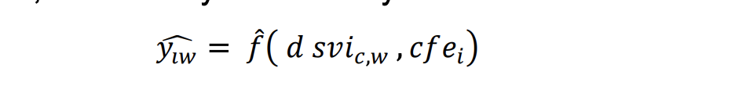
Neural panel model
This paper constructs a model of GDP growth from Google Trends search volume indices. The model aims at nowcasting GDP growth at a weekly frequency. The model is fitted using quarterly Google Trends series and applied to weekly Google Trends series in order to provide a weekly tracker. It can capture multiple non-linearities, as no assumption is made as to the shape of the relationship between Google Trends search intensities and economic activity. Lastly, it exploits a distinctive feature of Google Trends data, i.e. variables comparable across 46 OECD and G20 countries, by pooling countries together.
The Weekly Tracker uses a two-step model to nowcast weekly GDP growth5 based on Google Trends. First, a quarterly model of GDP growth is estimated based on Google Trends search intensities at a quarterly frequency using a panel model of 46 G20, OECD and partner countries:
Second, the function 𝑓𝑓̂ estimated from the quarterly model is applied to the weekly Google Trends series, assuming that this relationship is frequency-neutral, in order to yield a weekly tracker.
The model covers all OECD countries as well as G20 members (excluding the European Union) and partner countries. China and Saudi Arabia are excluded from the sample as well, as the relationship between activity and searches on Google seem more heterogeneous in these two countries7 . The resulting model includes 263 variables and is trained on 2 806 observations, corresponding to 46 countries observed along 61 quarters since 2005.

Slide 7
Neural panel model
The relationship between Google Trends variables and GDP growth is fitted using a machine learning algorithm.
The neural network can be thought of as an alternative to using dynamic factors or principal components as it reduces the dimensionality to a number of intermediate components in the middle layer before making a prediction. The multi-layer structure helps avoid overfitting. As opposed to PCA, it allows for capturing non-linear relationships. Variables are pre-processed using normalisation.
This paper uses a neural panel model, which exploits a large sample of observations from 46 countries while capturing cross-country heterogeneity. Neural networks are able to handle heterogeneity in the data as long as country dummies are included. A neural network whose architecture incudes an intermediate layer with enough neurons (in our case, 100) can flexibly model each possible interaction between Google Trends variables and country dummies. Each neuron takes as input signals from Google Trends variables and country dummies, and returns a non-linear function of the weighted sum of these inputs. As a result, the model can capture country-specific elasticities
Architecture and technical details: The neural network algorithm used in this paper is a standard multi-layer perceptron implemented with most of the default parameters in Python statistical software scikit-learn. It includes two hidden layers of respectively 100 and 20 neurons. Each neuron uses a “relu” activation function. The activation function takes a weighted sum of input signals (the variables values) and yields the linear combination of inputs provided it is higher than a given threshold. The weights and threshold are optimised using stochastic gradient descent.
Ensemble: Neural networks are notoriously sensitive to the initial random parameters. The choice of random parameters proved to have a strong effect on the results. In order to curb the effect of that randomness, the tracker uses an ensemble of five neural networks initialised with random parameters, whose predictions are averaged over

Slide 8
Nowcasting the economy
The predictive performance of the model underlying the Weekly Tracker is assessed using pseudo-real time simulations on the quarterly series. Pseudo-real time simulations emulate the conditions a forecaster would have faced at each time period, by looping on time and using only past or present data (except for the fact that revised series are used, not vintages). The simulations suggest that the Google Trends Tracker provides relevant leading information on GDP growth, economic crises and business cycles in almost all 46 countries in the sample.
The dependent variable to be explained is GDP growth at M-1, which is GDP growth one month before its official release. Simulations are an out-of-sample exercise and emulate a forecast made at the end of the last month of the current quarter. A Q2 GDP growth forecast will thus use Google Trends data up until June and the algorithm will be trained on Google Trends and GDP data up to Q1. At each iteration, the algorithm training parameters are optimised using early stopping and a 10% hold-out sample from the training set.
The quarterly model of annual GDP growth based on Google Trends performs well in out-of-sample nowcast simulations. On average across 46 countries, the quarterly model based on Google Trends has a Root Mean Squared Error (RMSE) that is 17% lower than an autoregressive model that just uses lags of year-on-year GDP growth.
The timing of the downturn and subsequent rebound is well captured by the model, although the full magnitude of the negative shock in 2020 Q2 is typically under-estimated, given its unprecedented scale.
The Tracker provides a useful tool for real-time narrative analysis on a weekly basis, although it does not on average outperform models based on more standard variables, once these are eventually released.

Slide 9
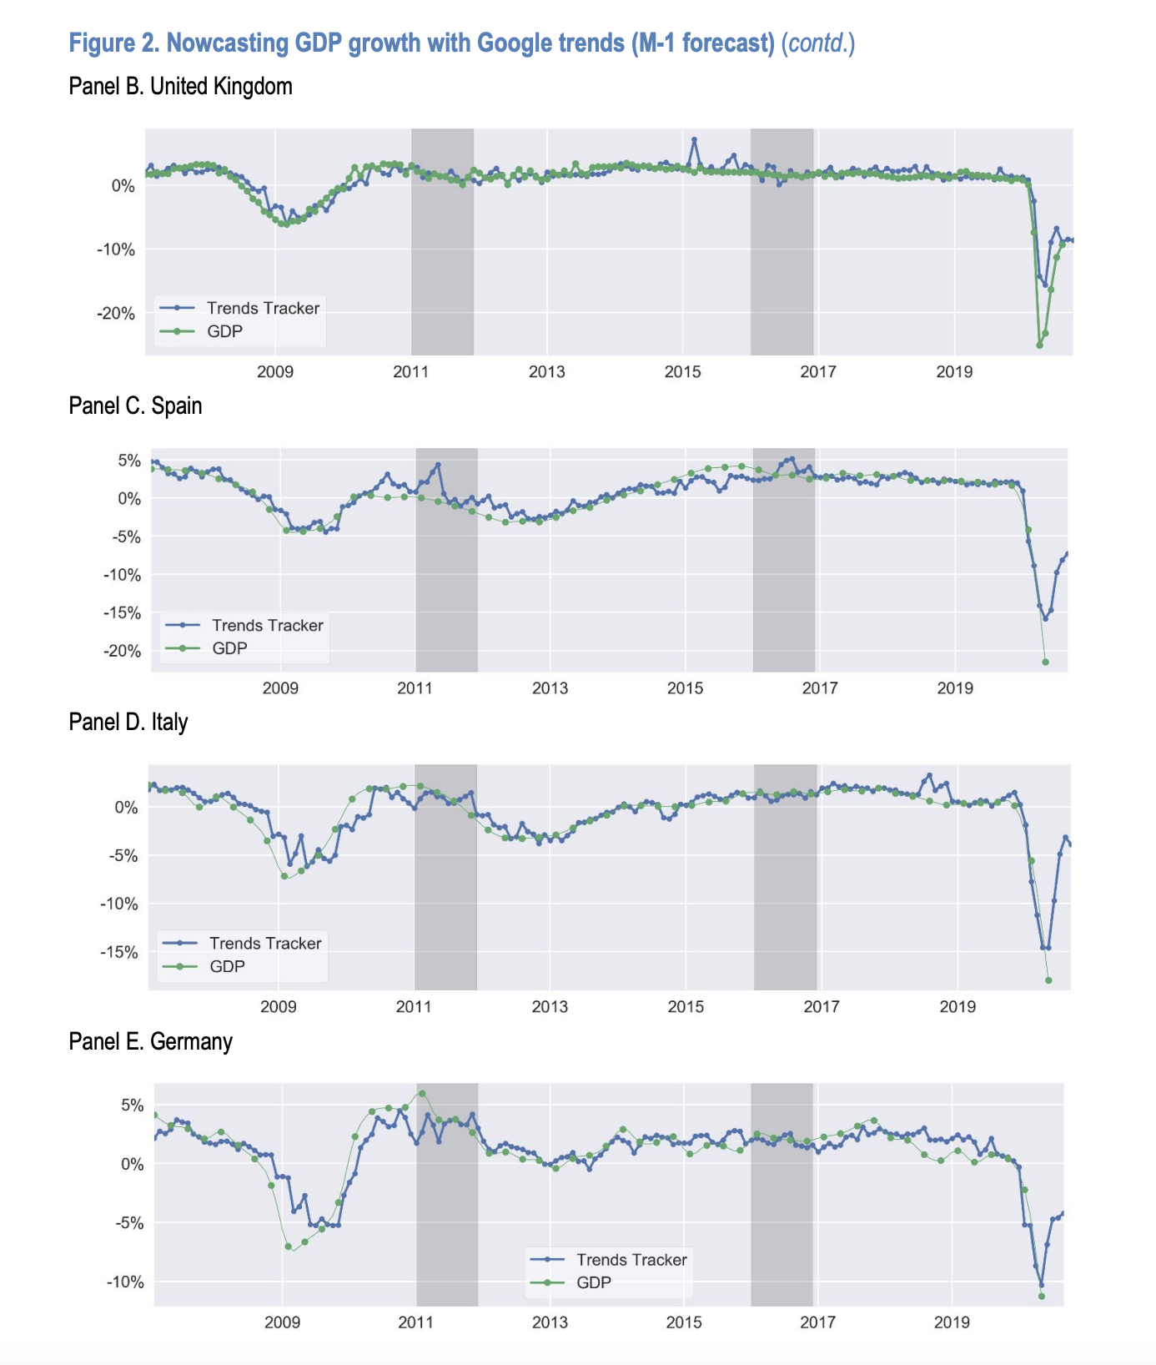
Nowcasting the economy

Slide 10
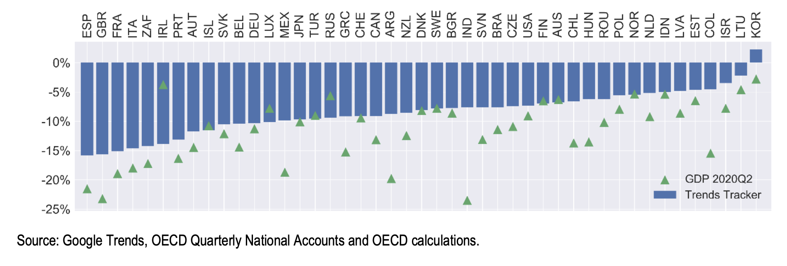
Nowcasting the economy
Tracker’s predictions for Q2 2020

Slide 11
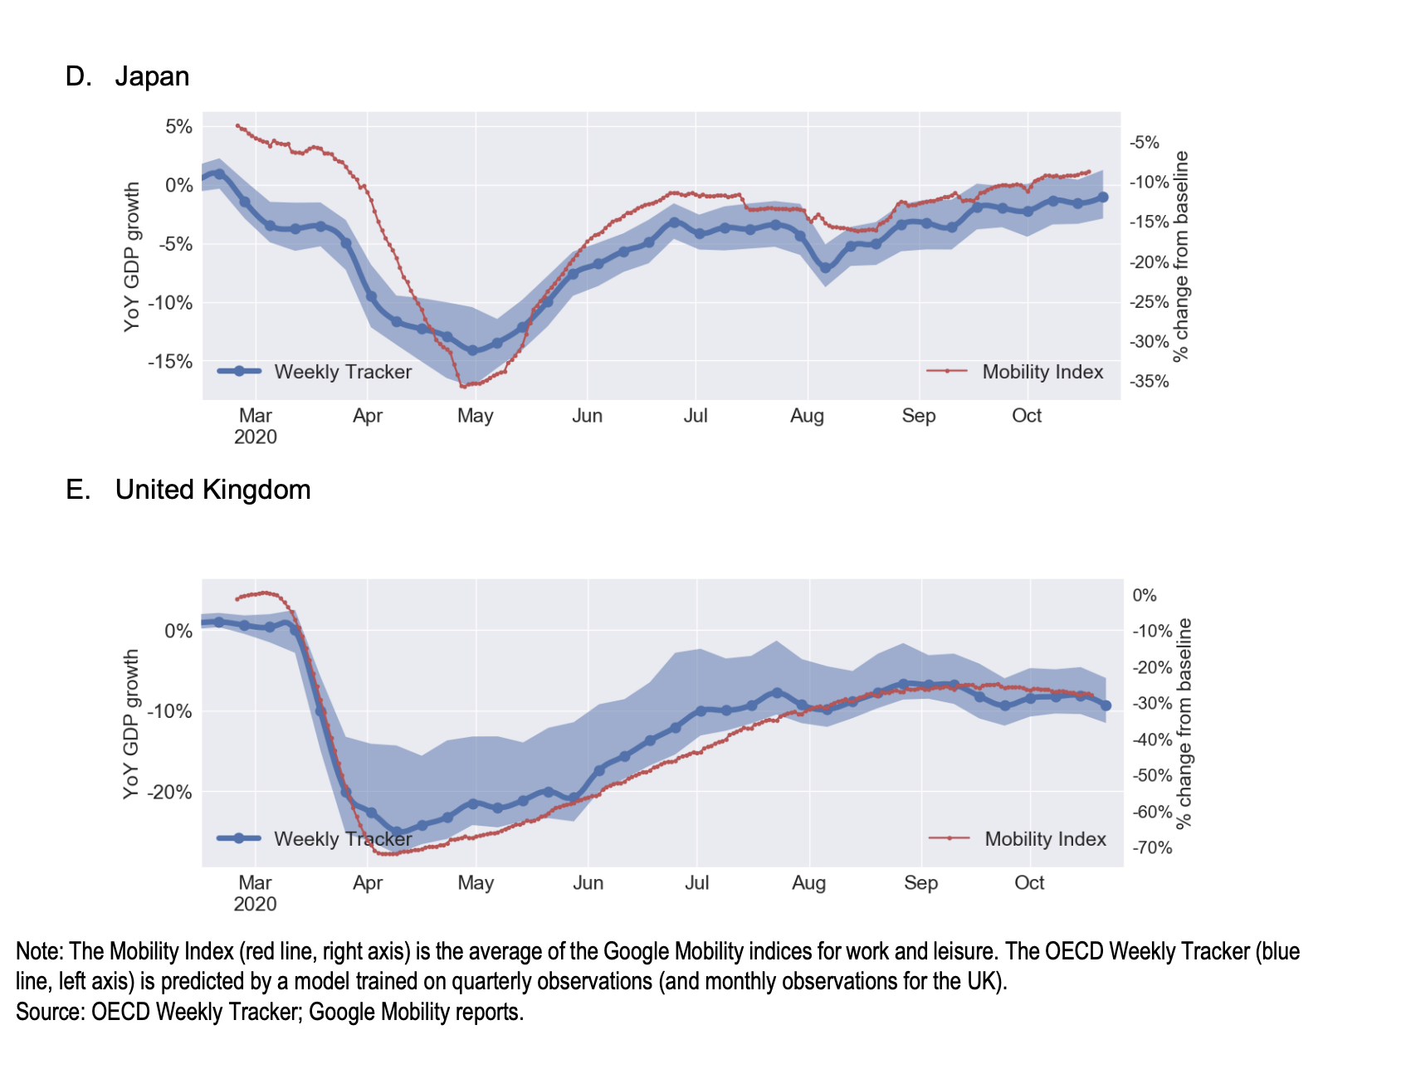
Nowcasting the economy

Slide 12
Model insights
Interpretability techniques can either aim at explaining given predictions (local interpretability) or the general functioning of a model (global interpretability).
Understanding the drivers of the predictions made by the neural network behind the Weekly Tracker is key to ensure that the model is consistent with economic intuition and does not rely on spurious patterns.
A recent tool (‘SHAP’) has already become an industry standard by providing both local and global interpretability. This method decomposes the predictions made by any algorithm into variable contributions (their “Shapley values”). It uses Shapley values, a method from coalitional game theory designed to fairly distribute a ‘pay-out’ from a multi-player game.
Shapley values are a powerful interpretability tool. The Shapley value is the only attribution method that combines the following properties: efficiency (Shapley values sum to the prediction minus its average), symmetry (two variable values have the same Shapley value should they contribute equally to all coalition), dummy (a variable value with no impact on the prediction whatever the coalition has Shapley value equal to zero) and additivity. The Shapley values are based on a mathematical theory and distribute the variable contributions ‘fairly’. Decomposing a given prediction into Shapley values provides local interpretability. Conversely, Shapley values for a given variable can be plotted against that variable (which gives a partial dependence plot) to provide global insights on the model.

Slide 13
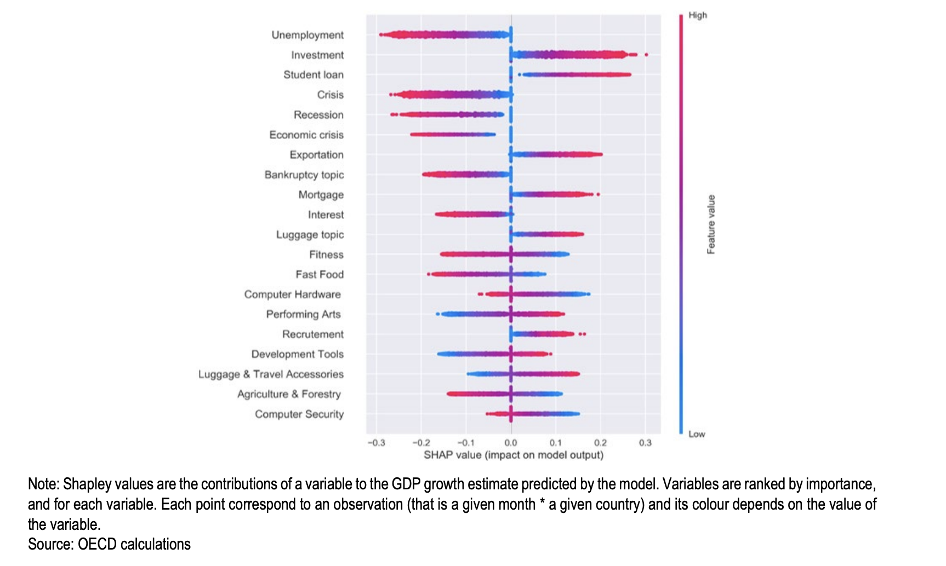
Model insights

Slide 14
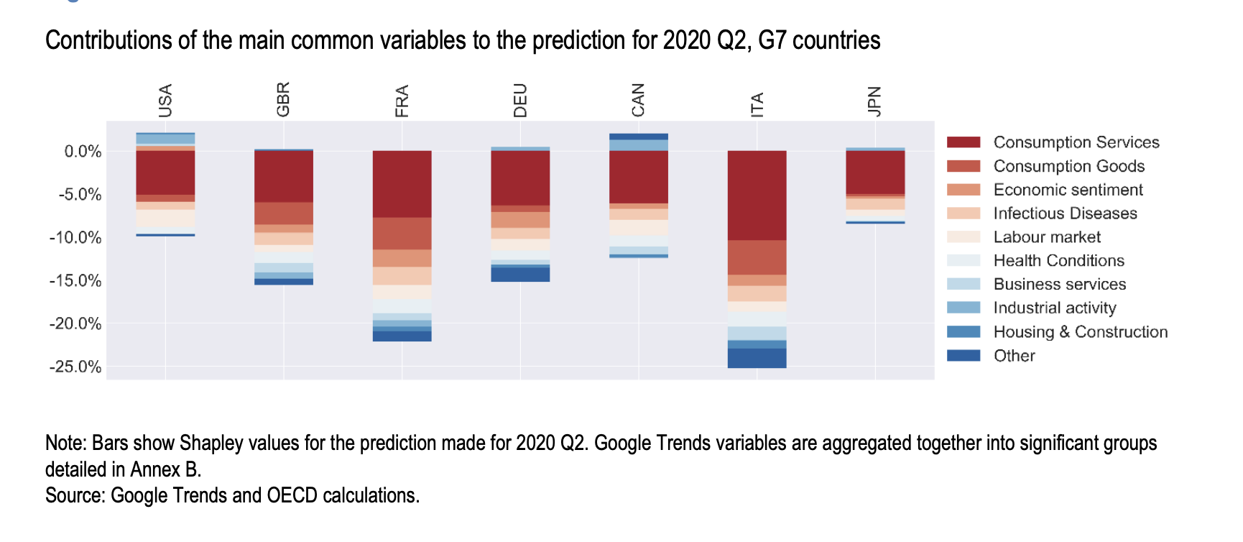
Model insights
This reflects the fact that the supply side may not captured by Google Trends as well as consumption, and should not be taken at face value.

Slide 15
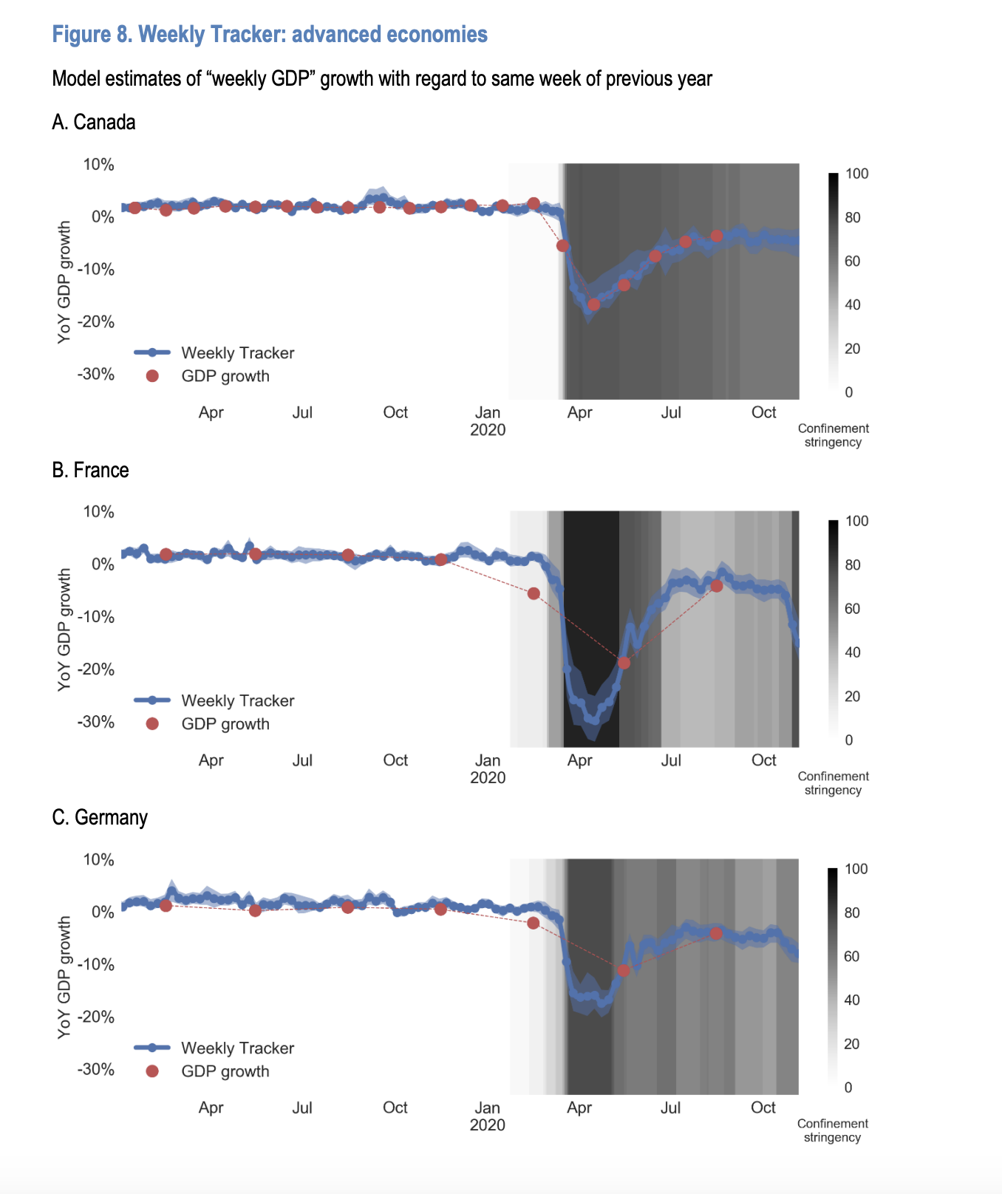
OECD Weekly Tracker

Slide 16
Conclusion
This paper describes the construction of the OECD Weekly Tracker of economic activity for 46 OECD, G20 and partner countries using Google Trends and a neural network algorithm. Simulations in pseudo-real time show that the tracker is a reliable predictor of business cycles in most countries. The Tracker is particularly useful around recessions and captures the COVID-19 downturn and subsequent rebound well. Looking inside the model with recent interpretability tools shows that predictions are based on patterns consistent with economic intuition. The algorithm captures non-linear patterns that related papers have shown to be especially important around crises. Using a panel specification allows for the use of complex algorithms such as neural networks. The paper also introduces a new method to address the downward long-term trend common to many Google Trends variables.
The paper sheds new light on the current crisis. The Tracker captures the COVID-19 recession in most countries, although it underestimates the depth of the downturn in the countries that endured the worst declines. It provides unique information on the timing of the crisis and on the magnitude of the rebound. The fall in activity leads the lockdowns in the United States, United Kingdom, Germany and Canada, while activity falls down at the exact time tighter lockdown measures were implemented in France and Italy. The rebound seems particularly strong in France, Germany and Eastern European countries and much slower in Spain, Japan and Italy

