Slide 1
High Frequency Prediction Using Temporal Fusion Transformer (TFT), Xgboost and MLP
FE5225 Group project
Group 10
Cheng Tuoyuan A0215646A
Wang Duyue A0215648Y
Wang Wenbo A0215659W
Zheng Zhongyi A0215673A

Slide 2
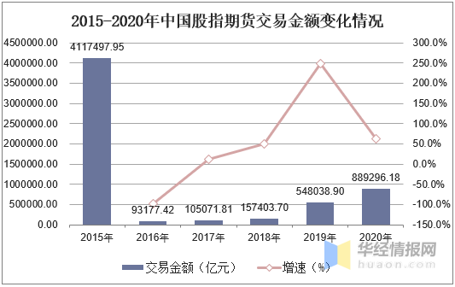
Background
The China stock index futures market started at 2010, it is a very young market, and is growing
Trading Volume(in trillion) of China stock index futures (time scale:2015-2020)
The trading of index futures is T+0, with certain prediction we may profit from intra-day trading.
regulation

Slide 3
Content
Methods
Implementation
Result

Slide 4
Data
Inplementation
The data we used is 500ms "high" frequency order book data of IF1903 future contract, Feburary, 2019 (Source: Wind)
IF1903 represents the major index The CSI 300 Index, which is a constituent stock index based on the weighted value of freely tradable shares selected from the Shanghai and Shenzhen stock markets with large market capitalization and good liquidity.
Transfrom unsupervised into supervised by shifting lastprice 15 lags
Data size: 391725
Training size: 352553
Validation size: 39172
Time series train test split by 9:1

Slide 5
Data Fields
Feature name | Meaning
IFCD | The timestep ID of the order book features.
LASTPRICE | The price at which the most recent order fill occurred.
CP | The total volume
CQ | In the past 500ms, the volume
CM | In the past 500ms, the turnover
OPNINTRST | In the past 500ms, buy+sell orders

Slide 6
Data Fields
Feature name | Meaning
B1 | What is the 1st bid price?
B[2,3,4,5] | What is the [2nd, 3rd, 4th, 5th] best/highest bid price?
S1 | What is the 1st ask price?
S[2,3,4,5] | What is the [2nd, 3rd, 4th, 5th] best/lowest/cheapest ask price?
BV1 | What is the quantity of contracts in the order book at the 1st bid price ?
BV[2,3,4,5] | What is the quantity of contracts in the order book at the [2,3,4,5]th bid price ?
SV1 | What is the quantity of contracts in the order book at the 1st ask price ?
SV[2,3,4,5] | What is the quantity of contracts in the order book at the [2,3,4,5]th ask price?

Slide 7
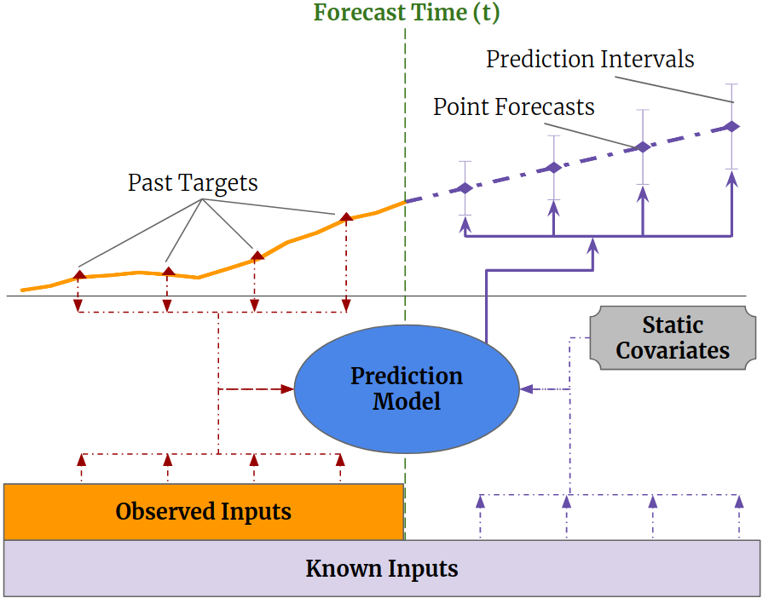
Temporal Fusion Transformers
Method
Multi-horizon forecasting often contains a complex mix of inputs – including, static (i.e. time-invariant) covariates, known future inputs, and other exogenous, time series that are only observed in the past – without any prior information on how they interact with the target.
Several deep learning methods have been proposed, but they are typically ‘black-box’ models which do not shed light on how they use the full range of inputs present in practical scenarios.
Illustration of multi-horizon forecasting with static covariates, past-observed andapriori-known future time-dependent inputs.

Slide 8
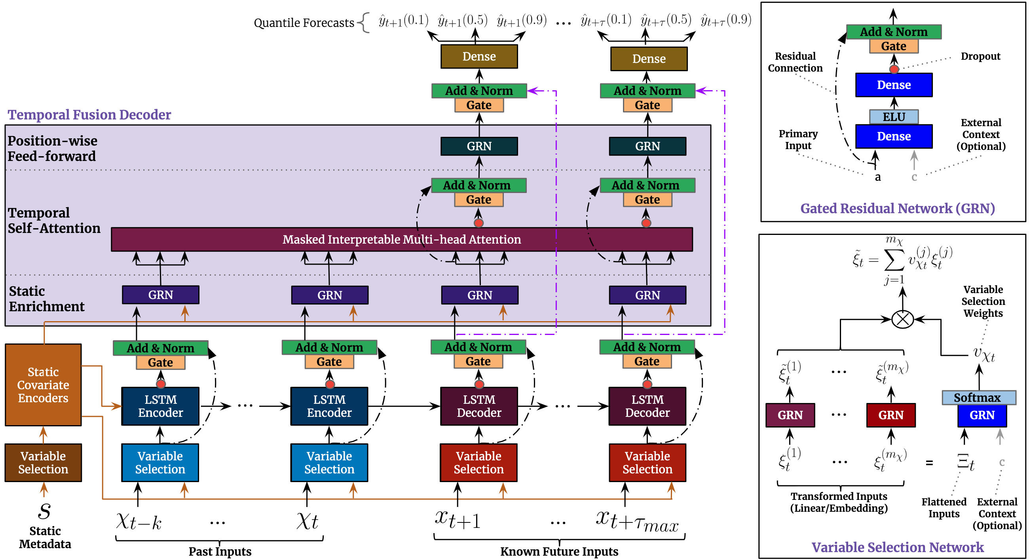
Temporal Fusion Transformers
Method
Temporal Fusion Transformer (TFT) is a novel attention based architecture which combines high-performance multi-horizon forecasting with interpretable insights into temporal dynamics.
To learn temporal relationships at different scales, TFT uses recurrent layers for local rocessing andinterpretable self-attention layers for long-term dependencies. TFT utilizes specialized components to select relevant features and a series of gating layers to suppress unnecessary components, enabling high performance in a wide range of scenarios.
TFT architecture. TFT inputs static metadata, time-varying past inputs and time_x0002_varying a priori known future inputs. Variable Selection is used for judicious selection of the most salient features based on the input. Gated Residual Network blocks enable efficient information flow with skip connections and gating layers. Time-dependent processing is based on LSTMs for local processing, and multi-head attention for integrating information from any time step.

Slide 9
Xgboost
Method
XGBoost is an implementation of gradient boosted decision trees designed for speed and performance.
XGBoost can also be used for time series forecasting, although it requires that the time series dataset be transformed into a supervised learning problem first.
Pros
1. Strong generalization ability
2. Information gain from nodes split is feature importance
3. Can process missing data naturally
4. Robust to outliers

Slide 10
Method
Neural Network-MLP
Multi-layer Perceptron (MLP) is a supervised learning algorithm that learns a function f(·): R^{m}→Rºby training on a dataset, where m is the number of dimensions for input and o is the number of dimensions for output. It can be applied to time series forecasting.
Detail
1. Single hidden layer with 30 units fully connected
2. Set Dropout and Early Stop to prevent overfitting
3. Set the batch Normalization optimization training rate to prevent gradients from disappearing
4. Set ReLU as activation function and Adam as optimizer

Slide 11
Training process detail
Implementation
The code is run on google’s colab and local IDE
Train on test dataset, prediction on the next 15 observation
Training time 1h, TFT
Manually tuning hyperparameters base on validation MSE loss

Slide 12
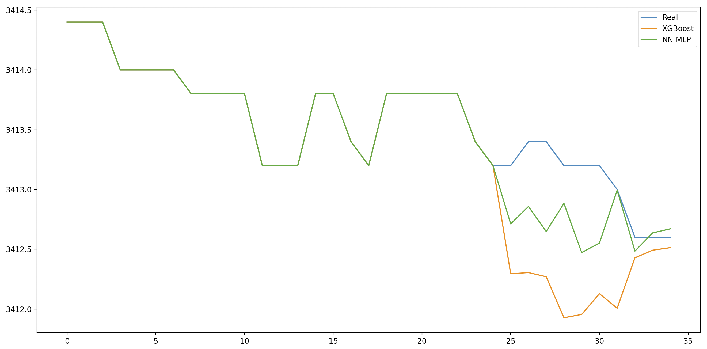
Xgboost and MLP Result
Result
In this down trend
MLP is more stable, as after a drop to a certain extent, it maintains until it meets the true value level.
XGBoost also captures the trend, but after a steeply decline, it finally realizes that a pullback is needed

Slide 13
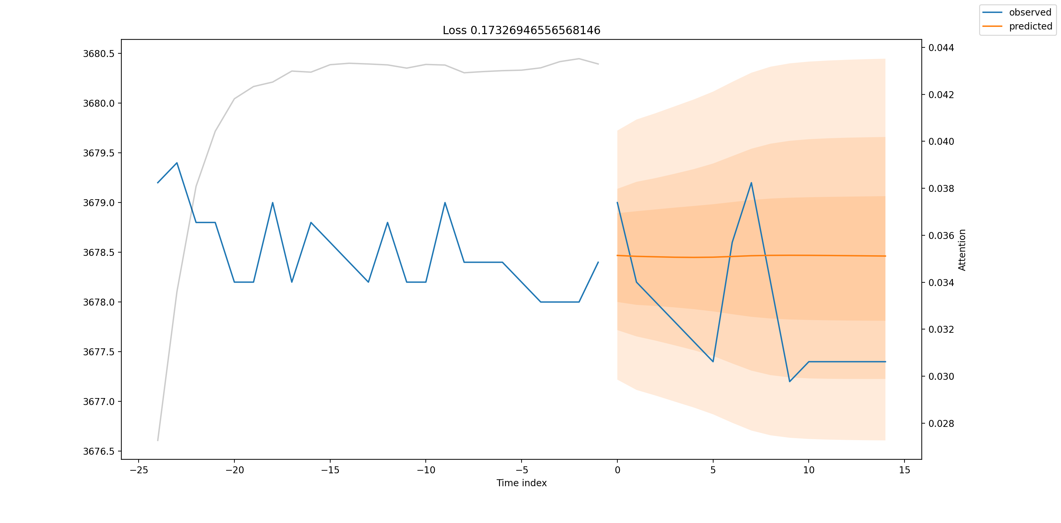
TFT Result
Result

Slide 14
Comparison between methods
Result
For short term prediction based on high frequency data：
MLP is a good fit fot this job as it could follow the trend with stable short term prediction.
XGBoost still shows that gradient boosting descision is still a very powerful model as it's show great generalization but not so stable.
Temporal Fusion Transformer shows stable result and could realize shot term trend, but the problems is that it do not provide us with precised movement directions.

Slide 15
Further Study
1.Try different models: GRU、Bi-LSTM, etc.
2.Combine weighted results from different models

Slide 16
Thanks !

