Slide 1

Language Modeling with Torch
Nicholas Leonard
Element Inc.
https://github.com/nicholas-leonard

Slide 2
Agenda
Meeting Torch
What is Torch?
When should I use Torch?
How does Torch work?
Language Modeling with Torch
Understanding Language Models
Recurrent Neural Networks
Generating sentences

Slide 3
Meeting Torch
Lua, tensors and neural networks

Slide 4
What is Torch? Lua, not Python
Examples of Lua types :
Lua is lightweight, elegant and easy to learn
Easy to interface with C/CUDA
Fast for-loops
Functions as first class citizens, closures
String
Number
Table
a = 'hello'
string.sub(a, 'he[l]+)', 'jell')
print(a)
jello
b = 3
print(b + 4)
7
c = {1,2,3,key='value'}
c.key = 4
c[2]= 7
print(c)
{1,7,3,key=4}

Slide 5
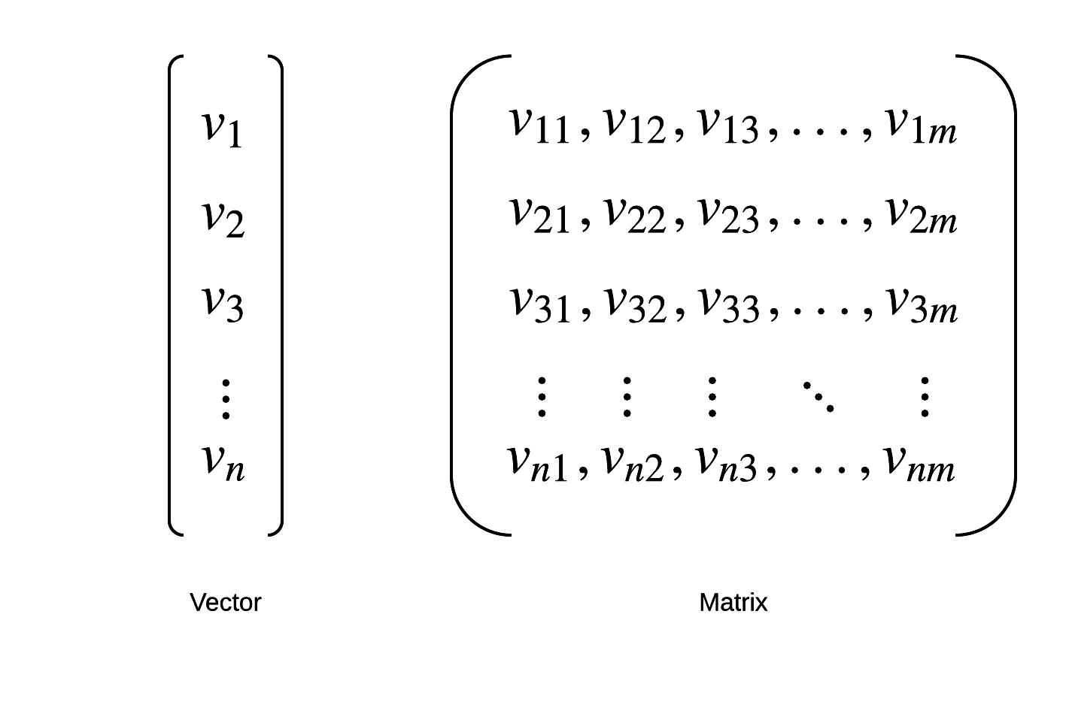
What is Torch? Tensors for linear algebra
Tensors are N-dimension arrays
Initialize and matrix-matrix multiply two tensors:
Basic linear algebra sub-routines (BLAS)
Sub-tensor extraction, etc.
Can be run on GPU/CPU
Different types : DoubleTensor, FloatTensor, LongTensor, CudaTensor, etc.
a = torch.Tensor(2,3)
a:uniform(0,1)
print(a)
0.6187 0.8752 0.1496
0.6979 0.8230 0.1439 [
torch.DoubleTensor of size 2x3]
b = torch.Tensor{{1},{2},{3}}
print(b)
1
2
3
[torch.DoubleTensor of size 3x1]
c = torch.mm(a,b)
c:mm(a,b)
c = a * b

Slide 6
What is Torch? Neural Networks for deep learning
Train neural networks using back-propagation (gradient descent + chain rule)
Automatic gradient differentiation
No compilation (TensorFlow, Theano)
Imperative programming (easier to debug than symbolic graphs)
Extend by implementing nn.Modules or nn.Criterions
-- model
mlp = nn.Sequential()
:add(nn.Linear(3,4))
:add(nn.Tanh())
:add(nn.Linear(4,2))
:add(nn.Sigmoid())
-- loss function
mse = nn.MSECriterion()
-- data sample
input = torch.randn(3)
target = torch.randn(2)
-- forward
output = mlp:forward(input)
loss = mse:forward(output, target)
-- backward
gradOutput = mse:backward(output, target)
mlp:zeroGradParameters()
mlp:backward(input, gradOutput)
-- update
mlp:updateParameters(0.1)

Slide 7
When should Torch be used? Research and production
Deep learning research
Assemble existing Modules and Criterions
Or implement your own
Easy to debug (no compilation or symbolic graph)
Lots of packages to pick from (torch, nn, optim, image, dataload, rnn, etc.)
Production environment
Lua was designed for embedded systems
Servers (GPU/CPU, Ubuntu/Linux, Max OS X)
Smart phones (Android, iOS)
Fast execution
glample/rnn-benchmarks
soumith/convnet-benchmarks

Slide 8
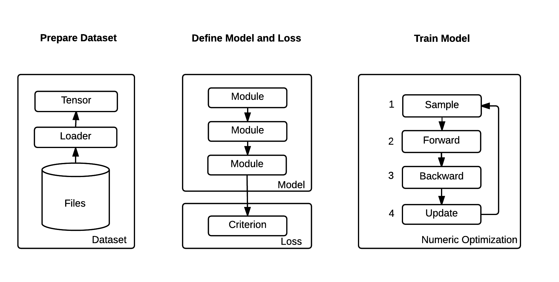
How does Torch work? Mental model

Slide 9
Language Models
Generating sentences using recurrent neural networks

Slide 10

Understanding language models
Language model dataset is a corpus of text samples
“Why does it always rain on Saturdays?”
Maximize the likelihood of a word given previous words:
Applications:
Generate sentences (sample next word given previous words)
Auto-complete
Measure the probability of a sentence (e.g. does this translation make sense?)

Slide 11
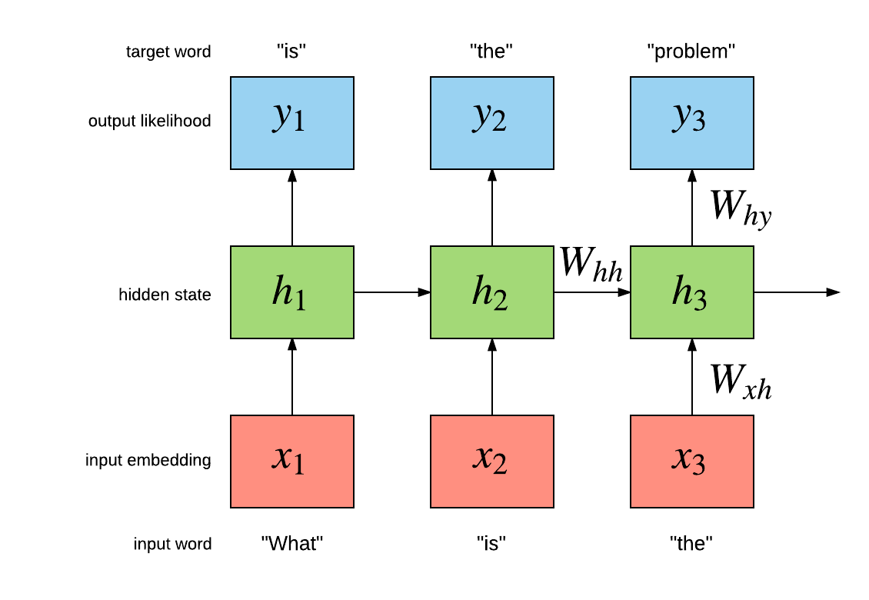
Recurrent Neural Networks

Slide 12
Recurrent Neural Networks
Model architectures
Simple Recurrent Neural Networks (Simple RNN)
Long Short Term Memory (LSTM)
Gated Recurrent Units (GRU)
Used to model sequential data
Video frames, text, time-series
Different applications
Language modeling, sentiment analysis, machine translation
Element-Research/rnn package provides RNNs for Torch
Tutorials, documentation, models, criterions and examples

Slide 13
Generating sentences
Recursively sample sentences (one word at a time)
<S> The company said its net profit rose to $ 289 million , or 96 cents per share , in the three months ended on March 31 compared with $ 173 million , or $ 0.68 a share , a year ago . </S> <S> But I 've been a bit disappointed with our performance , " said Wenger . </S> <S> The first is an even bigger problem . </S> <S> The next big thing for him is he will be able to tell the world he is thinking about his future . </S> <S> The new rules have been added to the legislation so that they don 't have to be approved for public use . </S> <S> The Pentagon 's top counter-terrorism official , who has been in charge of a new system of intelligence collection and inspection , wrote in an e-mail message that while the new system could be easily implemented , it remains an option . </S> <S> " I was trying to get a glass of water . </S> <S> Later he was driven to a nearby house where he was later found to be severely ill . </S>
40GB model learns to generate coherent sentences
Trained on Google 1-billion words dataset

Slide 14
Multi-GPU Multi-Layer LSTM
nn.Serial @ nn.Sequential { [input -> (1) -> (2) -> (3) -> output] (1): nn.ParallelTable { input |`-> (1): nn.Sequential { | [input -> (1) -> (2) -> (3) -> (4) -> (5) -> (6) -> (7) -> (8) -> (9) -> (10) -> (11) -> (12) -> output] | (1): nn.Convert | (2): nn.GPU(2) @ nn.Concat { | input | |`-> (1): nn.GPU(1) @ nn.LookupTableMaskZero | |`-> (2): nn.GPU(2) @ nn.LookupTableMaskZero | ... -> output | } | (3): nn.GPU(2) @ nn.Dropout(0.2, busy) | (4): nn.GPU(1) @ nn.SeqLSTM | (5): nn.GPU(1) @ nn.Dropout(0.2, busy) | (6): nn.GPU(1) @ nn.SeqLSTM | (7): nn.GPU(1) @ nn.Dropout(0.2, busy) | (8): nn.GPU(2) @ nn.SeqLSTM | (9): nn.GPU(2) @ nn.Dropout(0.2, busy) | (10): nn.GPU(2) @ nn.SeqLSTM | (11): nn.GPU(2) @ nn.Dropout(0.2, busy) | (12): nn.GPU(3) @ nn.SplitTable | } |`-> (2): nn.Identity ... -> output } (2): nn.ZipTable (3): nn.GPU(3) @ nn.Sequencer @ nn.Recursor @ nn.MaskZero @ nn.NCEModule(2048 -> 793471) }

Slide 15
For more info: http://torch.ch https://github.com/Element-Research/rnn

