Slide 1
Kairos: Regime-Aware Portfolio Intelligence

Slide 2
Research question
Does regime-aware machine learning allocation improve risk-adjusted returns over classical methods?
Under what market conditions does any advantage hold or break down?

Slide 3
Data and universe
Nine assets: SPY, EFA, TLT, IEF, HYG, GLD, DBC, BTC-USD, ETH-USD
Daily adjusted closes from Yahoo Finance, VIX for regimes, 13-week T-bill as the risk-free rate
No simulated or reconstructed series. Panel validated before use
Universe expands as each asset builds a usable track record

Slide 4
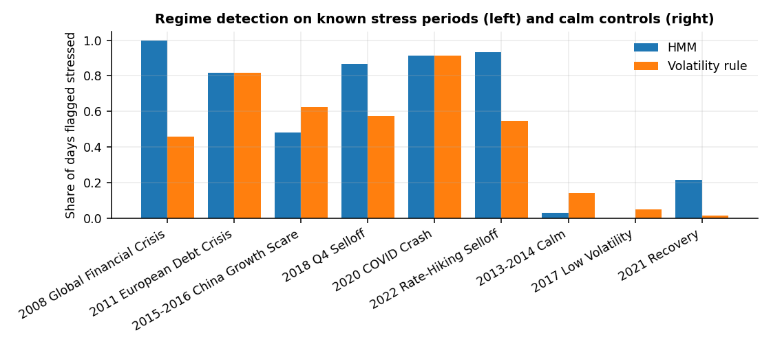
Regime detection
Walk-forward HMM, no look-ahead
Stress windows flagged: 84%
Calm controls flagged: 8%
Volatility rule: 66% and 7%

Slide 5
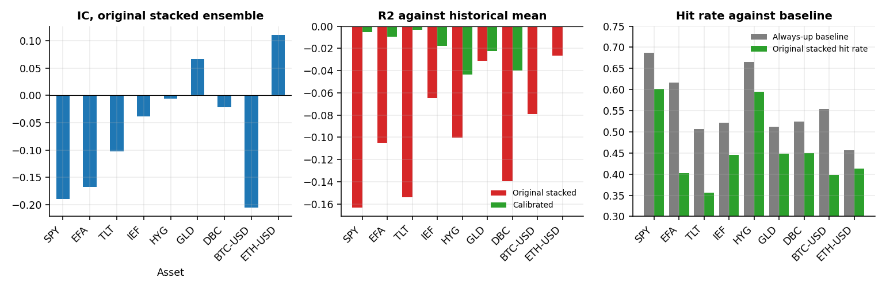
Forecasting skill
Mean stacked IC: -0.061
Significantly negative IC: 2 of 9 assets
Significantly positive IC: 0 of 9 assets
R2 below the historical mean on 9 of 9 assets
Hit rate below always-up baseline: 9 of 9

Slide 6
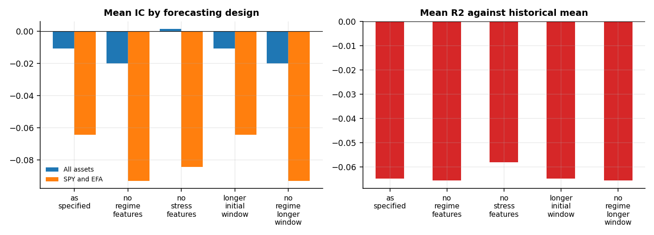
Diagnosing the negative IC
SPY stress-to-return correlation: -0.23 in the initial window, +0.21 afterwards
as specified: mean IC -0.011
no regime features: mean IC -0.020
no stress features: mean IC +0.002
longer initial window: mean IC -0.011
no regime longer window: mean IC -0.020

Slide 7
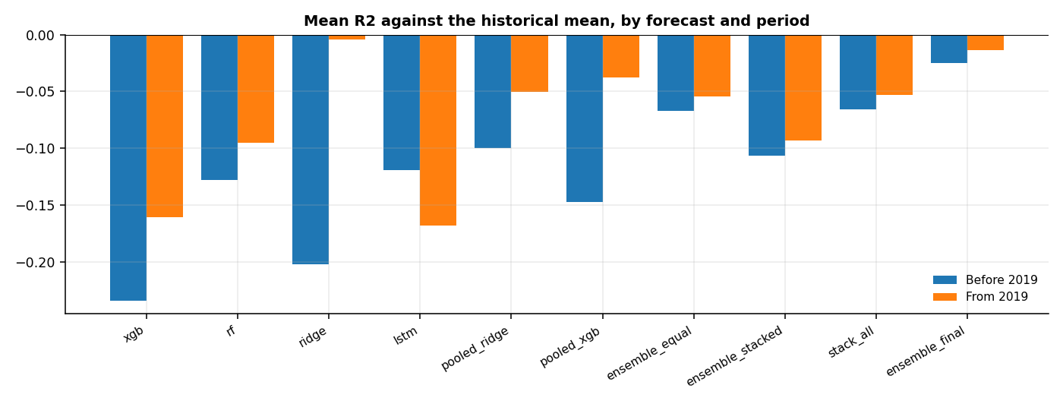
Repairing the forecasts
LSTM dispersion 1.9x to 0.34x realised returns
LSTM mean R2 -3.8 to -0.16
Calibrated forecast R2: -0.025 before, -0.014 after 2019
No forecast beats the historical mean in either period

Slide 8
Portfolio performance
 | AnnReturn | AnnVol | Sharpe | MaxDrawdown
BL_ML_Regime | 0.07 | 0.07 | 0.80 | -0.16
BL_ML_Regime_IC | 0.07 | 0.07 | 0.86 | -0.13
BL_ML_NoRegime | 0.09 | 0.09 | 0.83 | -0.23
BL_ML_Raw_Regime | 0.07 | 0.08 | 0.74 | -0.17
BL_HistMean_Regime | 0.08 | 0.07 | 0.89 | -0.15
Market_Reference | 0.10 | 0.10 | 0.93 | -0.21
Equal_Weight | 0.09 | 0.11 | 0.74 | -0.24
Static_60_40 | 0.10 | 0.09 | 0.98 | -0.21
Inverse_Vol | 0.07 | 0.07 | 0.75 | -0.18
MeanVariance_LW | 0.06 | 0.13 | 0.40 | -0.37
Regime_60_40 | 0.08 | 0.07 | 0.98 | -0.13
Regime_Market | 0.08 | 0.07 | 0.91 | -0.14

Slide 9
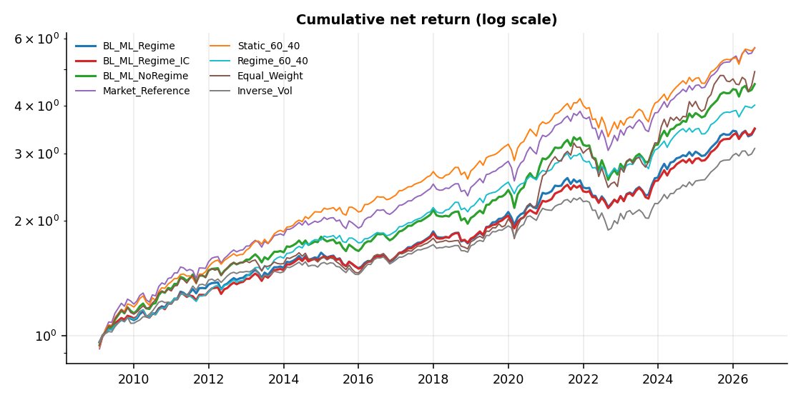
Cumulative returns

Slide 10
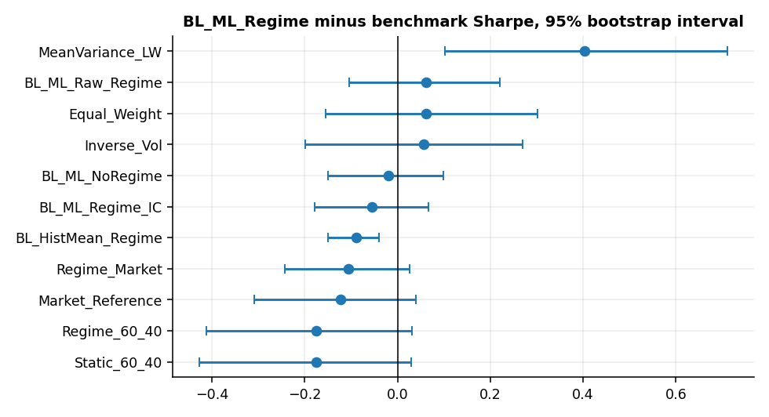
Statistical significance
Regime ablation, Sharpe difference: -0.02 (95% interval -0.15 to 0.10, p = 0.762), not statistically significant
In stressed months the regime-aware portfolio's worst-5% average monthly return was -4.25% against -7.05% without regime scaling.

Slide 11
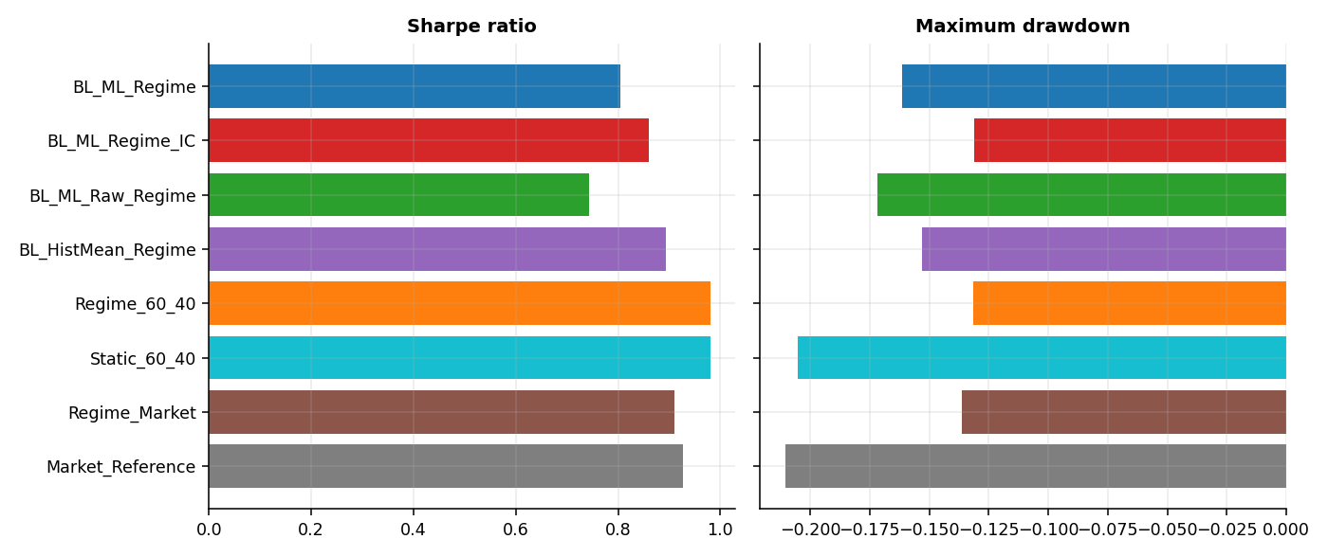
Overlay ablation
Same stress rule on 60/40: Sharpe 0.98 against 0.98
Max drawdown -13.1% against -20.5%
Naive historical-mean views: Sharpe 0.89

Slide 12
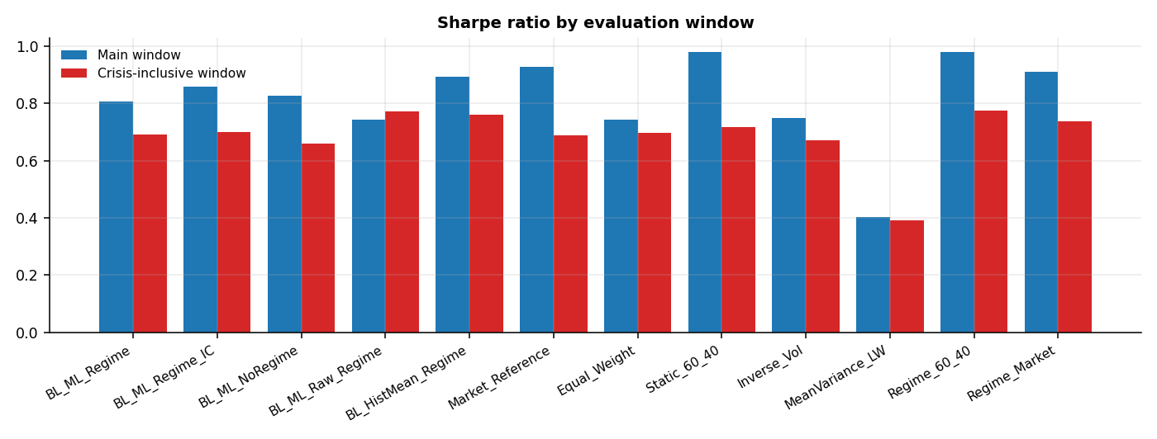
Other evaluation windows
Window starts 2007-01-31, includes 2008
Max drawdown static 60/40: -29.5%
Max drawdown Regime_60_40: -16.6%
BL_ML_Regime Sharpe: 0.69

Slide 13
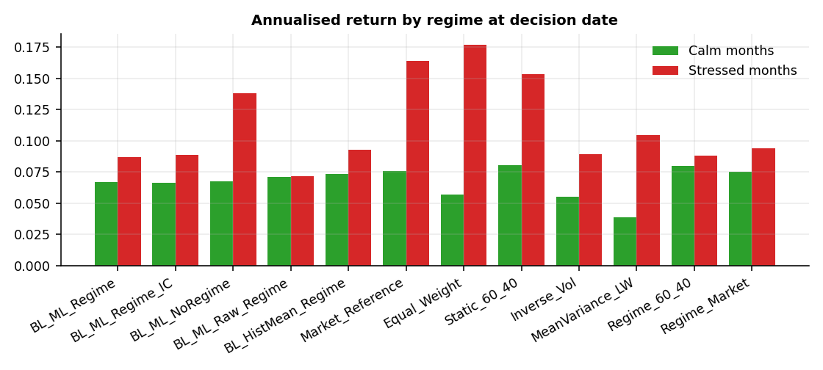
Performance by regime

Slide 14
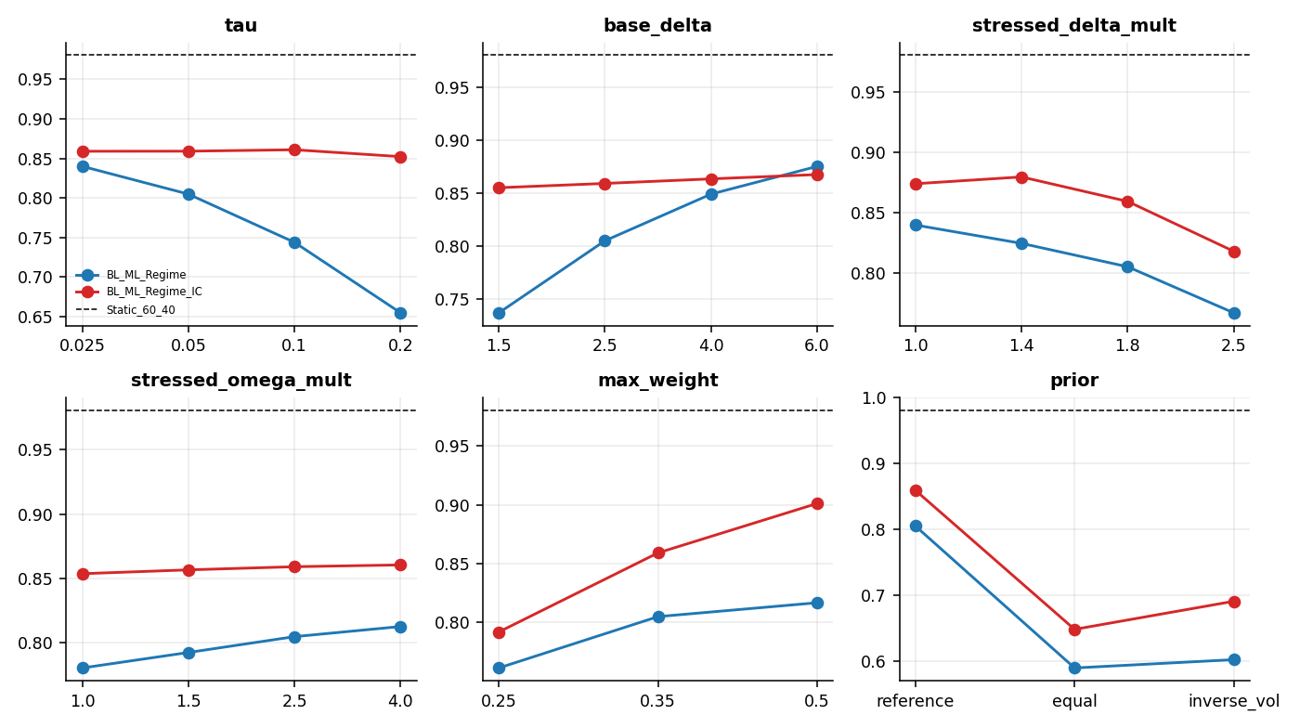
Parameter sensitivity
Runs above 60/40 Sharpe: 0 of 44
Sharpe range: 0.59 to 0.90

Slide 15
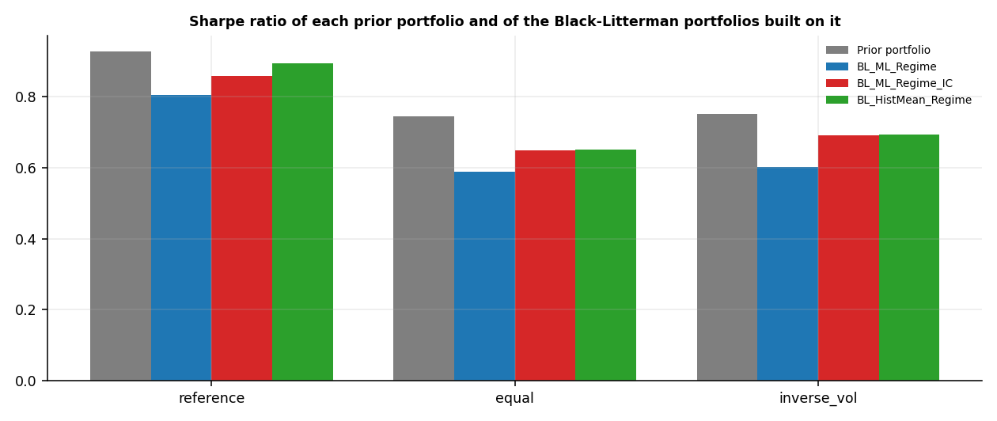
Prior dependence
reference: Sharpe gain over its prior portfolio -0.12 (p = 0.17)
equal: Sharpe gain over its prior portfolio -0.15 (p = 0.05)
inverse_vol: Sharpe gain over its prior portfolio -0.15 (p = 0.14)

Slide 16
Conclusions
The research hypothesis is not supported. The highest Sharpe ratio among the Kairos portfolios and the classical benchmarks belongs to Static_60_40. The Sharpe difference of BL_ML_Regime to the best classical benchmark (Static_60_40) is -0.18 (95% interval -0.43 to 0.03, p = 0.135), not statistically significant; BL_ML_Regime is significantly better than 1 and significantly worse than 0 of the 5 classical benchmarks (5% level). For BL_ML_Regime_IC the difference is -0.12 (95% interval -0.34 to 0.05, p = 0.216), not statistically significant.
Forecasts add no measurable value beyond a mechanical stress overlay; the regime layer mainly lowers drawdowns.
Specification frozen at 2026-07-31; 0 new months evaluated so far.
Limitations: about 15 years of monthly data, no observed market-capitalisation prior, repairs designed after seeing full-sample results.

