Slide 1


SiliconCompiler: “Make for HW”
Andreas Olofsson, William Ransohoff, Noah Moroze
Zero ASIC Corporation
Cambridge, MA
{andreas,will,noah}@zeroasic.com

Slide 2

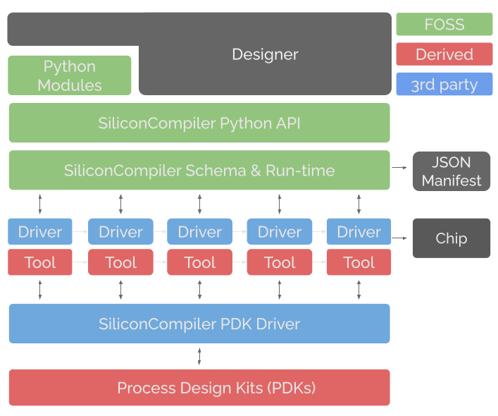
SiliconCompiler: A modular build system for hardware
“Make for hardware”
Standardized build schema (json)
Python OO API
Flowgraph based execution
Developed with cloud first approach
Automated actions/metrics tracking
Built for commercial AND open source ASIC/FPGA tools.
https://github.com/siliconcompiler

Slide 3
Basic Operation: Configure, Run, Observe
SC Driver
SC Driver
SC Driver
Data
Compile
Task
Data
Compile
Task
Data
Compile
Task
Data
Manifest
Manifest
Manifest
Manifest
run()
run()
run()
run()
All compilation tasks (ie EDA tools) are wrapped with SiliconCompiler (SC) interfaces to enable configuration and results tracking in a unified JSON manifest.
The manifest is the golden database that defines the “what, how, when, who, why” of compilation.
A static flowgraph defines the sequence of tasks to be executed by the atomic run() function.
After running, all results and metrics accessible through the manifest.

Slide 4
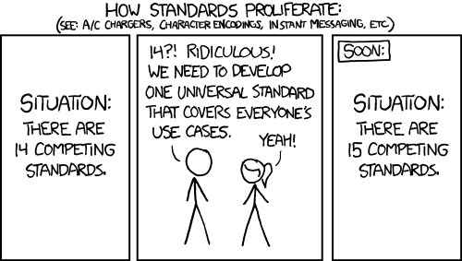
The Manifest: An Open “CAD Standard”
Group | Parameters | Examples
asic | 46 | diearea , maxfanout, cell lists, delay model…
intput/output | 2 | sdc, rtl, def, …
constraint | 8 | PVT, SDC, checks, …
options | 50 | loglevel , skip, optmode, path, …
unit | 10 | Time, voltage, current, ...
pdk | 50 | Runset, stackup, process,...
tool | 29 | Options, exename, license,...
flowgraph | 9 | Inputs, weights, goals
checklist | 9 | Rationale, criteria,
metric | 45 | Setupwns, errors, warnings, …
datasheet | 39 | Abs voltage, setup, hold
package | 32 | Dependency, author, …
A unified HW compilation manifest
Standardize all common settings
Bypass parameters for “one-offs”
Validated with 5 PDKs, 35 EDA tools, ASIC/FPGA/HLS flows
Source: https://xkcd.com/

Slide 5
So many options…which is the right one?
Manifests:
SC, bender, fusesoc, metrics (openroad), mflowgen, hammer, cadre, orflow, openlane, bazelhdl, make/homegrown,...
Collaborations:
Openroad Integration: https://github.com/The-OpenROAD-Project/OpenROAD-flow-scripts/commit/94e9240c7c5297e263cdca862b5c4b1df3fb0111
Caravael/skywater: https://github.com/siliconcompiler/siliconcompiler/commit/fcbf3f7f75b786f0577311fc0714d27db0b1faa5
SC is here to stay, not going anywhere!

Slide 6
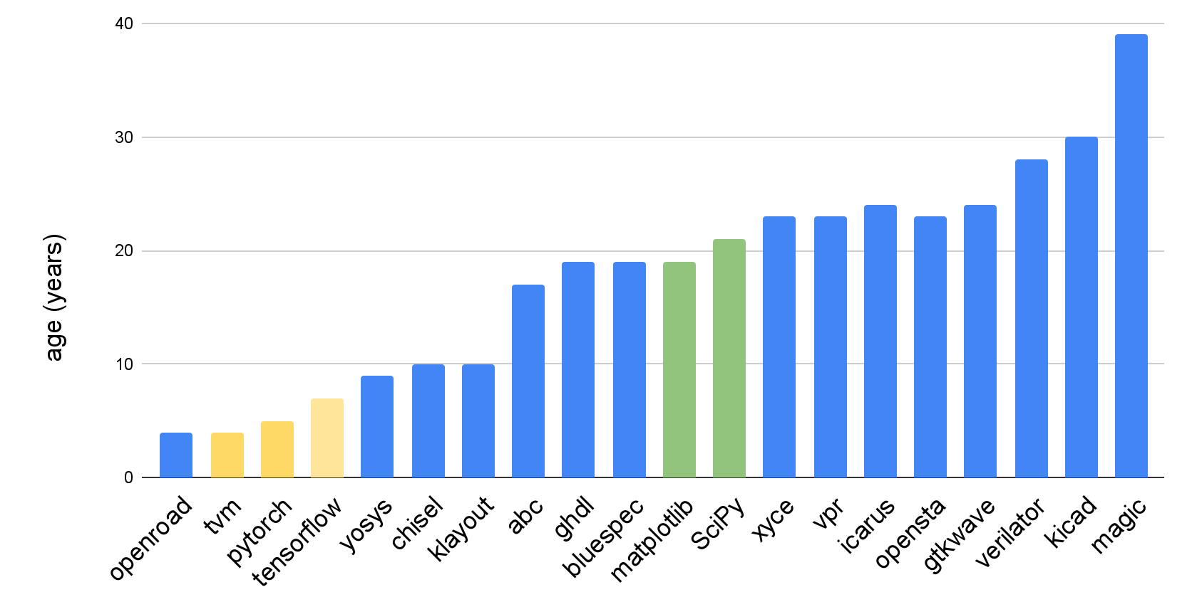
Reminder: Software is a Lifetime of Maintenance….
Notes:
pg 14

Slide 7
Public Service Announcement
OpenROAD: https://github.com/The-OpenROAD-Project/OpenROAD
OpenSTA: https://github.com/The-OpenROAD-Project/OpenSTA
Align: https://github.com/ALIGN-analoglayout/ALIGN-public
Magical: https://github.com/magical-eda/MAGICAL
ACT: https://github.com/asyncvlsi/act
Xyce: https://github.com/Xyce/Xyce
SystemC-TLM-lib: https://github.com/Xilinx/libsystemctlm-soc
Pono: https://github.com/upscale-project/pono
LSOracle: https://github.com/lnis-uofu/LSOracle
OpenFPGA: https://github.com/lnis-uofu/OpenFPGA
PRGA: https://github.com/PrincetonUniversity/prga
BlackParrot: https://github.com/black-parrot/black-parrot
OpenFASOC: https://github.com/idea-fasoc/OpenFASOC
Were IDEA/POSH successful?
Dunno, you be the judge!
Summary of state of EDA/IP…
https://github.com/aolofsson/awesome-hardware-tools
https://github.com/aolofsson/awesome-opensource-hardware
Notes:
also: pymtl3,

