Slide 1
Causal Inference in Machine Learning
Bianca Granato
September 10, 2019
QLS Machine Learning Group

Slide 2
Causality: X causes Y
Necessary
Y implies X occurred
X doesn’t imply Y will occur
but-for: Y would not have occurred but for the occurrence of X
Sufficient
X implies Y will occur
Y doesn’t imply X occurred
Contributory
X and Z together cause Y
neither X nor Z are sufficient, may not be necessary either

Slide 3
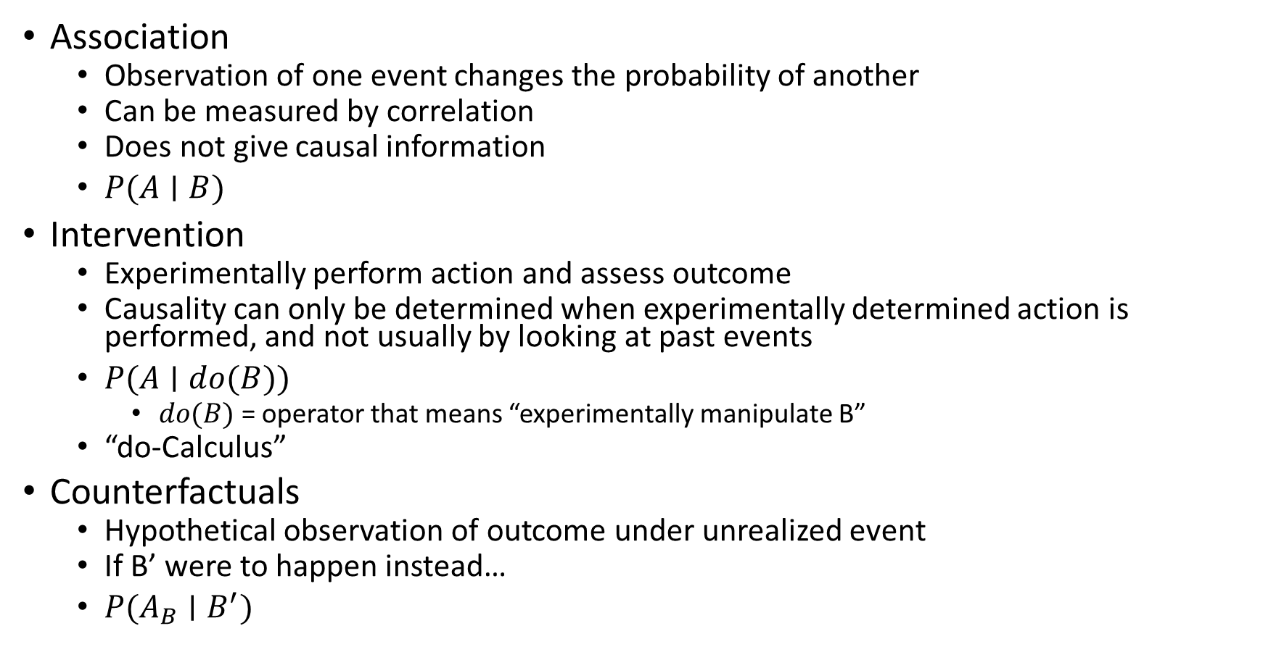
Ladder of causation
Association
Observation of one event changes the probability of another
Can be measured by correlation
Does not give causal information
$P(A∣B)$
Intervention
Experimentally perform action and assess outcome
Causality can only be determined when experimentally determined action is performed, and not usually by looking at past events
$P(A∣do(B))$
$do(B)$ = operator that means “experimentally manipulate B”
“do-Calculus”
Counterfactuals
Hypothetical observation of outcome under unrealized event
If B’ were to happen instead…
$P(A_{B}∣B^{′})$

Slide 4
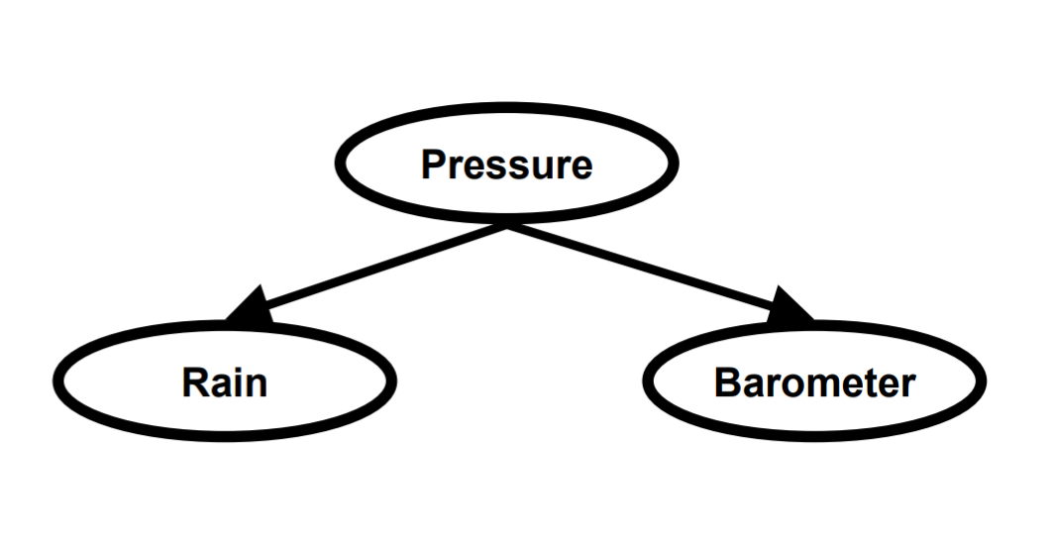
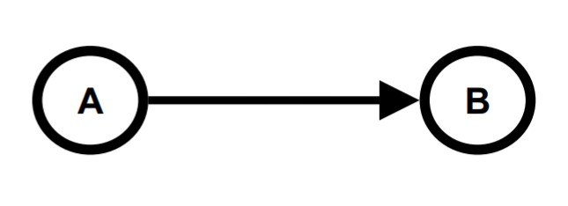
Directed Acyclic Graphs
Directed = one variable causes change in another (but not vice versa)
Acyclic = no closed loops (no feedback between variables)
Graphically demonstrate assumptions of model
A causes B
Pressure changes cause both rain and barometer response

Slide 5
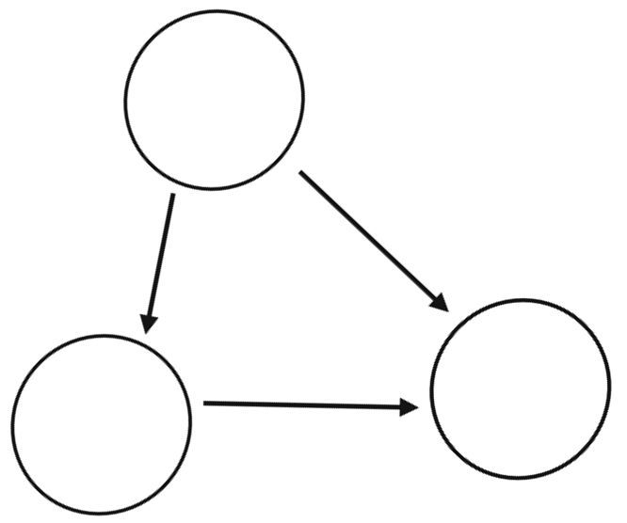
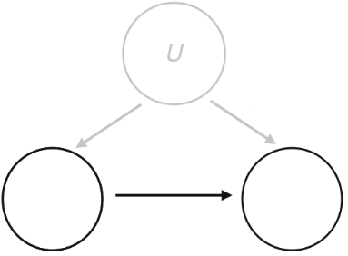
Confounding
C
If A causes B, we assume nothing else does.
Any factor that causes both A and B is said to be a confounder
They can be adjusted for via interaction factors, or experimentally controlled
Most models assume all existing confounders are known and measured: “No Unmeasured Confounding”
Unmeasured confounders can be very problematic…
B
A
A
B

Slide 6
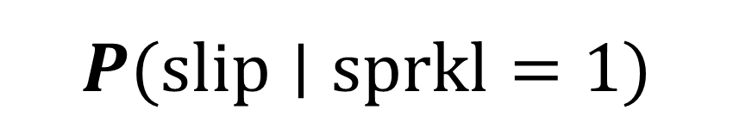

Probability vs. Conditional
$$P(slip)$$
$$P(slip∣sprkl=1)$$
Season
Season
Sprinkler
Rain
Sprinkler
= on
Rain
Wet
Wet
Slippery
Slippery

Slide 7
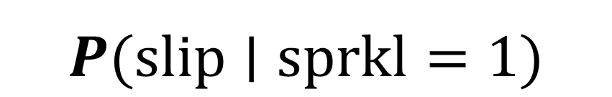
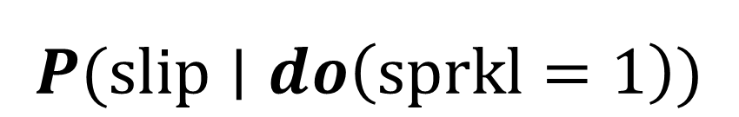
Conditional vs. Intervention
$$P(slip∣sprkl=1)$$
$$P(slip∣do\left(sprkl=1\right))$$
Season
Season
Sprinkler
= on
Rain
Sprinkler
= on
Rain
Wet
Wet
Slippery
Slippery

Slide 8
Types of question
prediction
Would the pavement be slippery if we find the sprinkler off?
intervention
Would the pavement be slippery if we make sure that the sprinkler is off?
counterfactual
Would the pavement be slippery had the sprinkler been off, given that the pavement is in fact not slippery and the sprinkler is on?

Slide 9
Simulation study
Just for fun ☺

Slide 10
Outcome
Variable of interest
Outcome can have a positive connotation (e.g. being cancer-free)
Event usually has negative connotation (e.g. death)
Function of covariates, treatment received, and treatment effects
Covariates: anything you can measure, not experimentally determined
Treatment: usually medication vs. placebo, but sometimes new medication vs. old medication or new treatment vs. standard treatment (esp. disease studies)
Treatment effect: how treatment will be received (beneficial? harmful?), a function of covariates
Can be continuous (e.g. blood pressure, weight), categorical (e.g. high vs. low vs. typical blood pressure) or binary (e.g. obese vs. not obese)

Slide 11
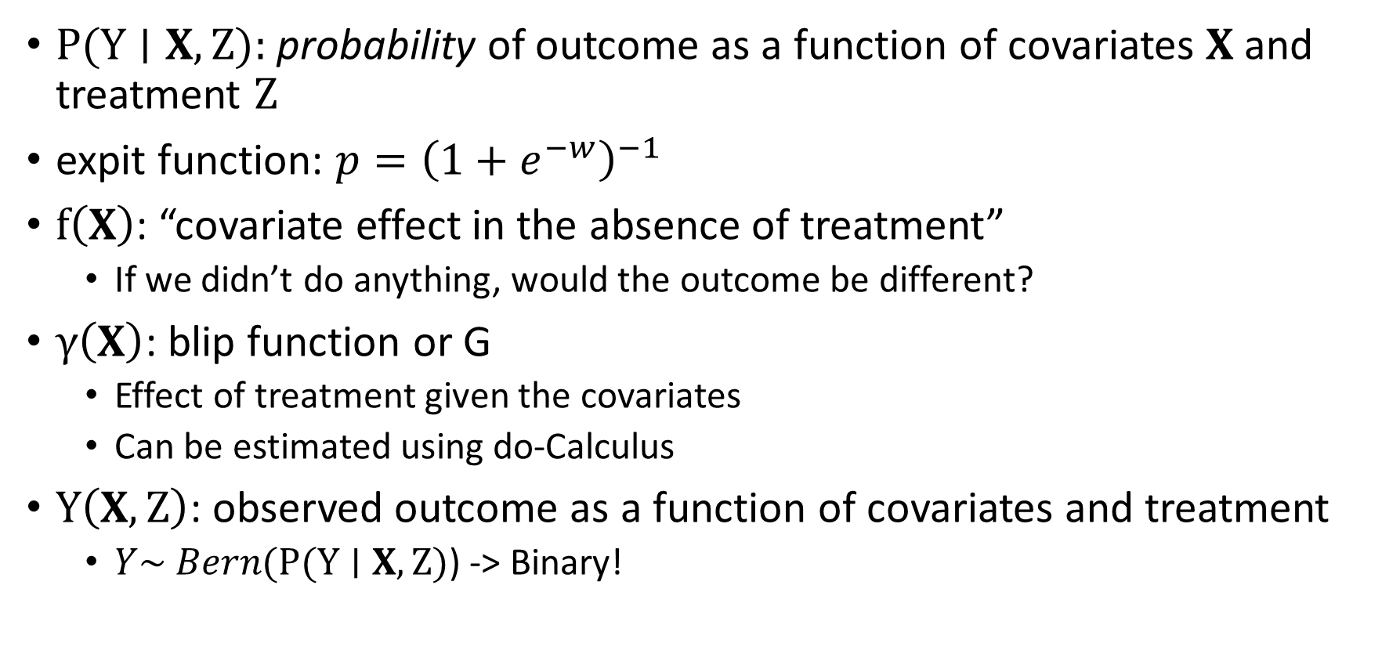
$$P(Y∣X,Z)=expit( f\left(X\right)+Z×γ\left(X\right) )$$
$P(Y∣X,Z)$: probability of outcome as a function of covariates $X$and treatment $Z$
expit function: $p={\left(1+e^{−w}\right)}^{−1}$
$f\left(X\right)$: “covariate effect in the absence of treatment”
If we didn’t do anything, would the outcome be different?
$γ\left(X\right)$: blip function or G
Effect of treatment given the covariates
Can be estimated using do-Calculus
$Y\left(X,Z\right)$: observed outcome as a function of covariates and treatment
$Y\sim Bern(P(Y∣X,Z)$) -> Binary!

Slide 12
G-estimation
Treatment effect is seen as a reduction in the probability of outcome under enforced treatment and enforced placebo
$$P\left(Y ∣ X,do\left(Z=1\right)\right)−P\left(Y ∣ X,do\left(Z=0\right)\right)$$

Slide 13
References
Causal Inference in Machine Learning - Machine Learning Tutorial Series @ Imperial College (Ricardo Silva) http://www.homepages.ucl.ac.uk/~ucgtrbd/talks/imperial_causality.pdf
Pearl, Judea. Causality, Cambridge University Press, 2009. http://ebookcentral.proquest.com/lib/mcgill/detail.action?docID=1103807
Chakraborty, B., & Moodie, E. (2013). Statistical methods for dynamic treatment regimes: Springer.
https://en.wikipedia.org/wiki/Causal_model
https://en.wikipedia.org/wiki/Causality
Interesting people to look into: Judea Pearl, Yoshua Bengio, Susan Athey

