Slide 1

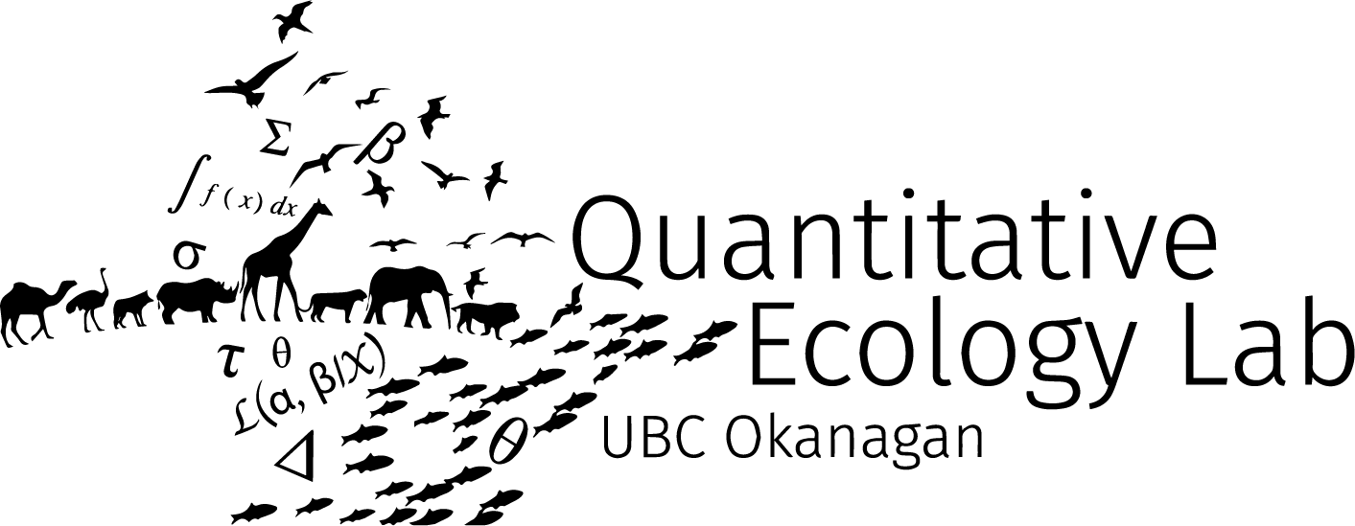


How climate change will shape the future of human wildlife conflict in BC’s protected areas
Animated map of usable area? A figure of the central results for a teaser
Stefano Mezzini – Ph.D. Biol.

Slide 2
Moving in a changing world

Slide 3
Maintaining an energetic balance
Animals require energy to survive
Move to collect resources
Collect more than you spend
Maintain an energetic balance

Slide 4
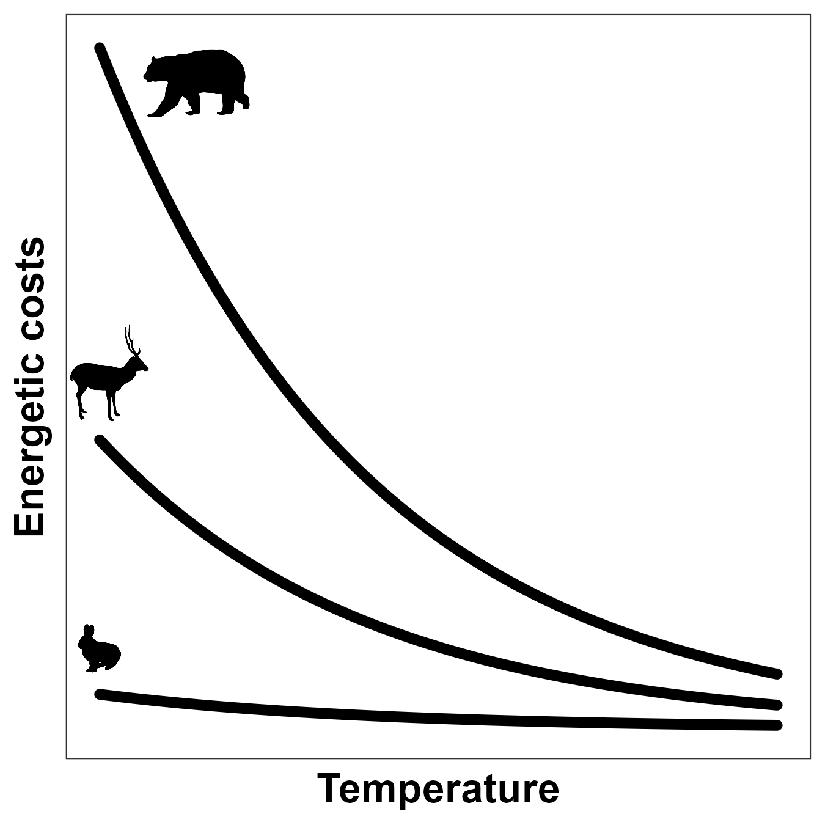

Energetic costs depends on temperature
$$I = I0 M^{3/4} e^{−cT}$$
(Brown et al. 2004)

Slide 5
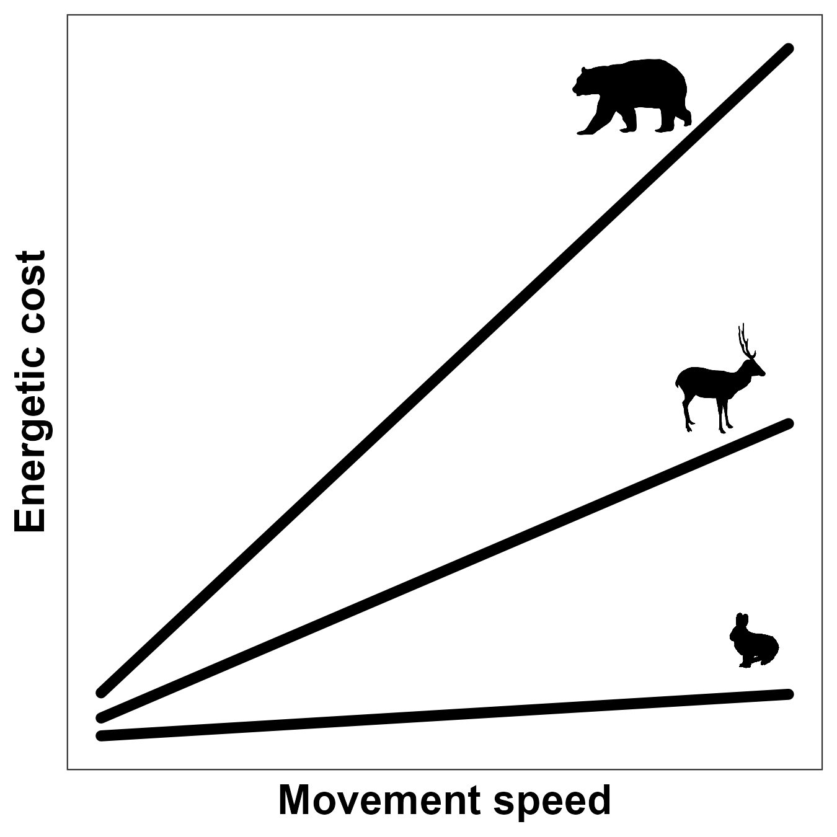
Movement comes at a cost
$$E=10.7 M^{−0.684} v+6.03 M^{−0.697}$$
(Taylor et al. 1982)

Slide 6
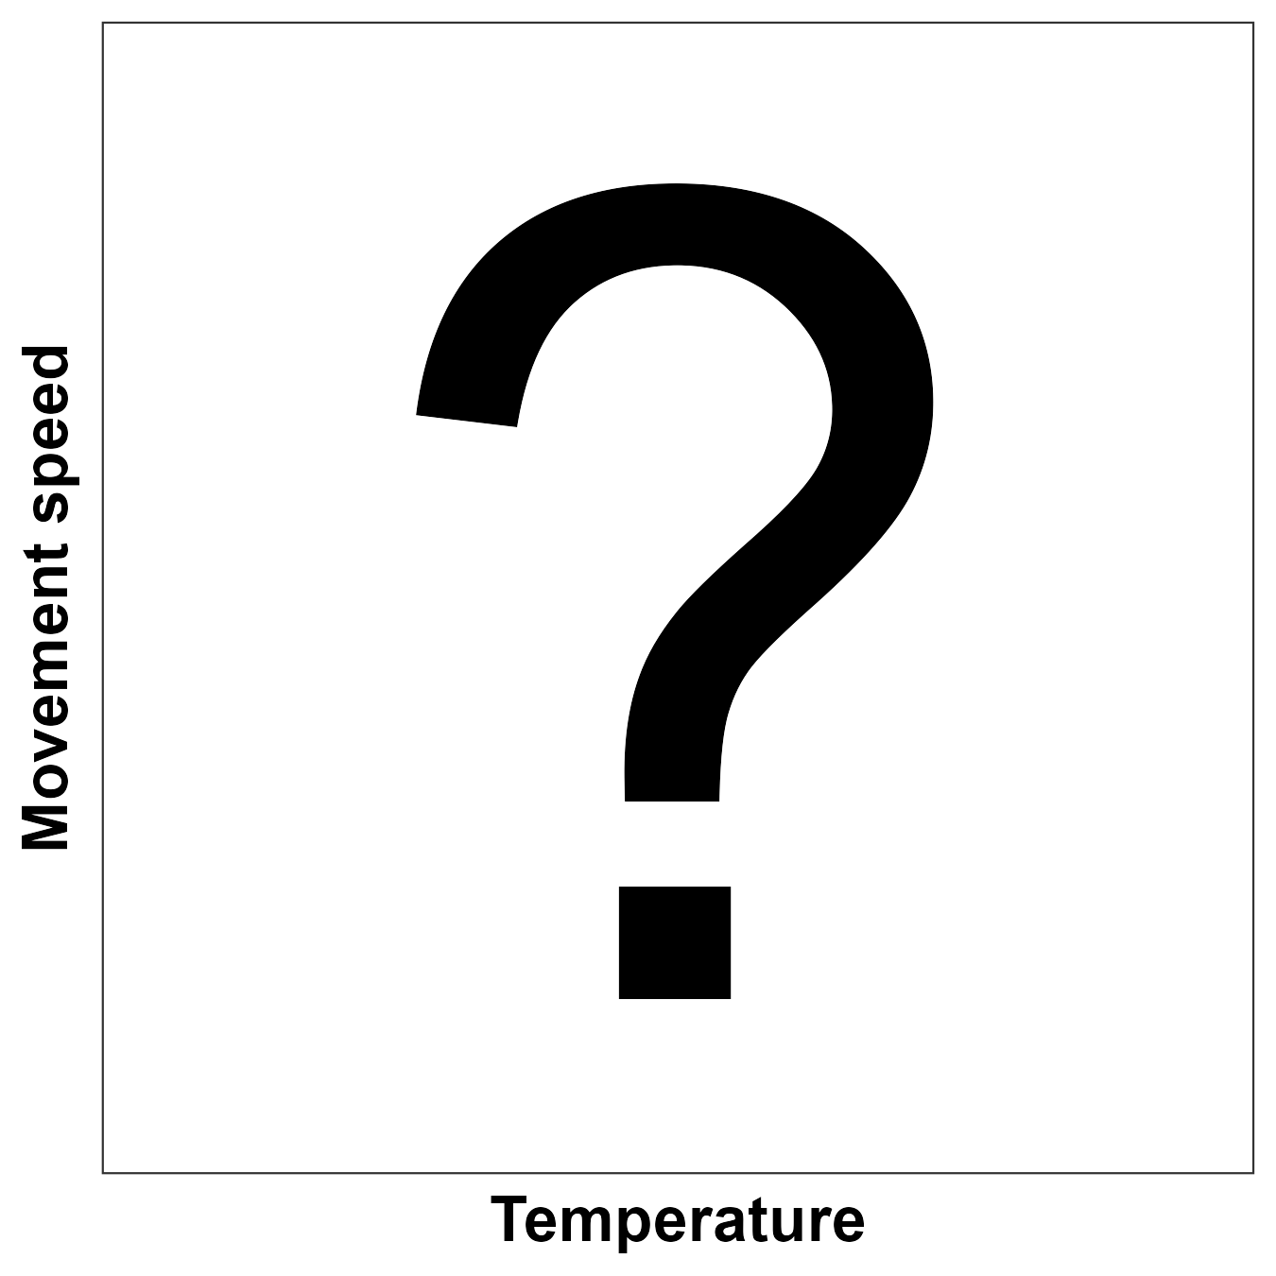
Does speed depend on temperature?

Slide 7
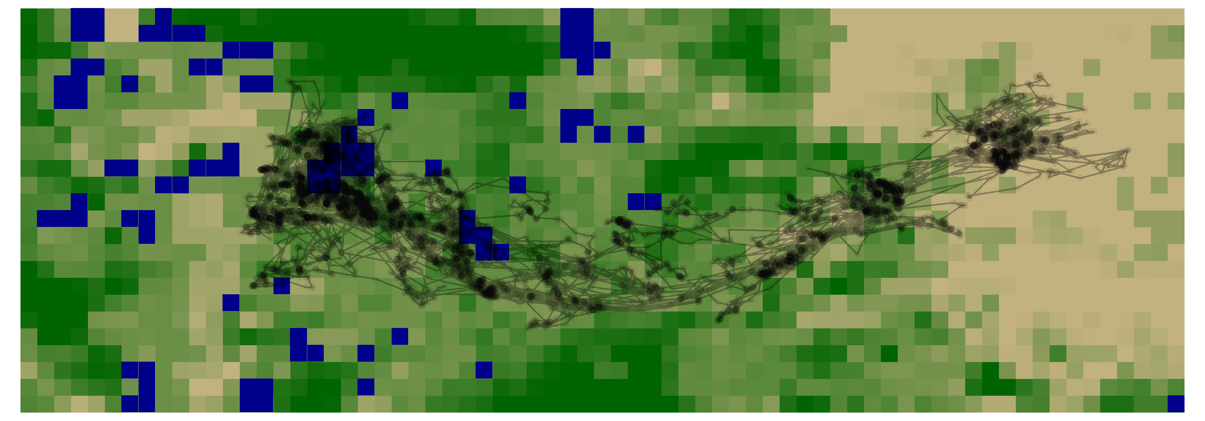
Optimizing movement
Maximize energetic intake
Minimize movement costs
Animals use space differently
(Dickie et al. 2022, Fisher & Burton 2017)

Slide 8
Predicting animal space use
Predict spatial needs and use
Proactive conservation
Effects of climate change on:
Spatial needs
Movement speed
Figure of CC predictions?

Slide 9
Elk in a dynamic landscape

Slide 10
Moving in a heterogeneous landscape
Search for good forage
Avoid difficult terrain
Adapt to temperature and precip
Raster used by RSF:
Forest with saplings
Grassland
Lake/river

Slide 11
Moving in a changing landscape
Forest burns
Lake/river freezes
⬇ temperature, ⬆ energetic costs
New leaf buds sprout
Alter raster used by RSF

Slide 12
Elk spatial preferences
Results from a single RSF
Results figure

Slide 13
Elk spatial preferences
Results from all elk RSFs
Results figure

Slide 14
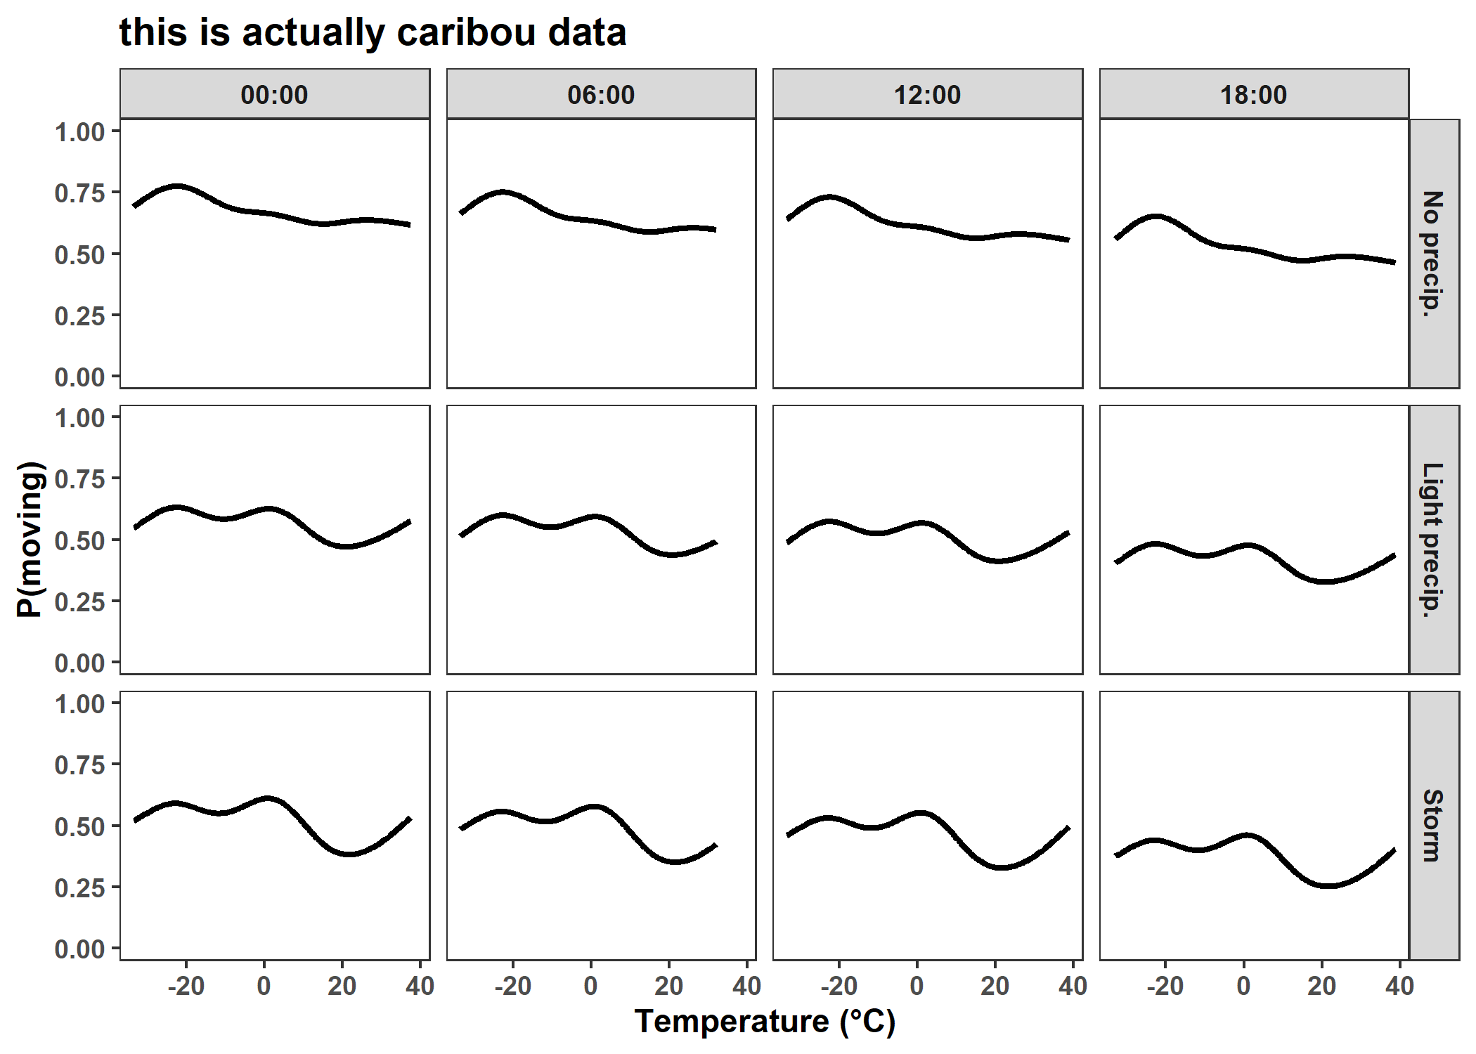
Elk movement in a heterogeneous environment
P(moving):
Unaffected by time
⬇ with rain or snow
Little effect of temp

Slide 15
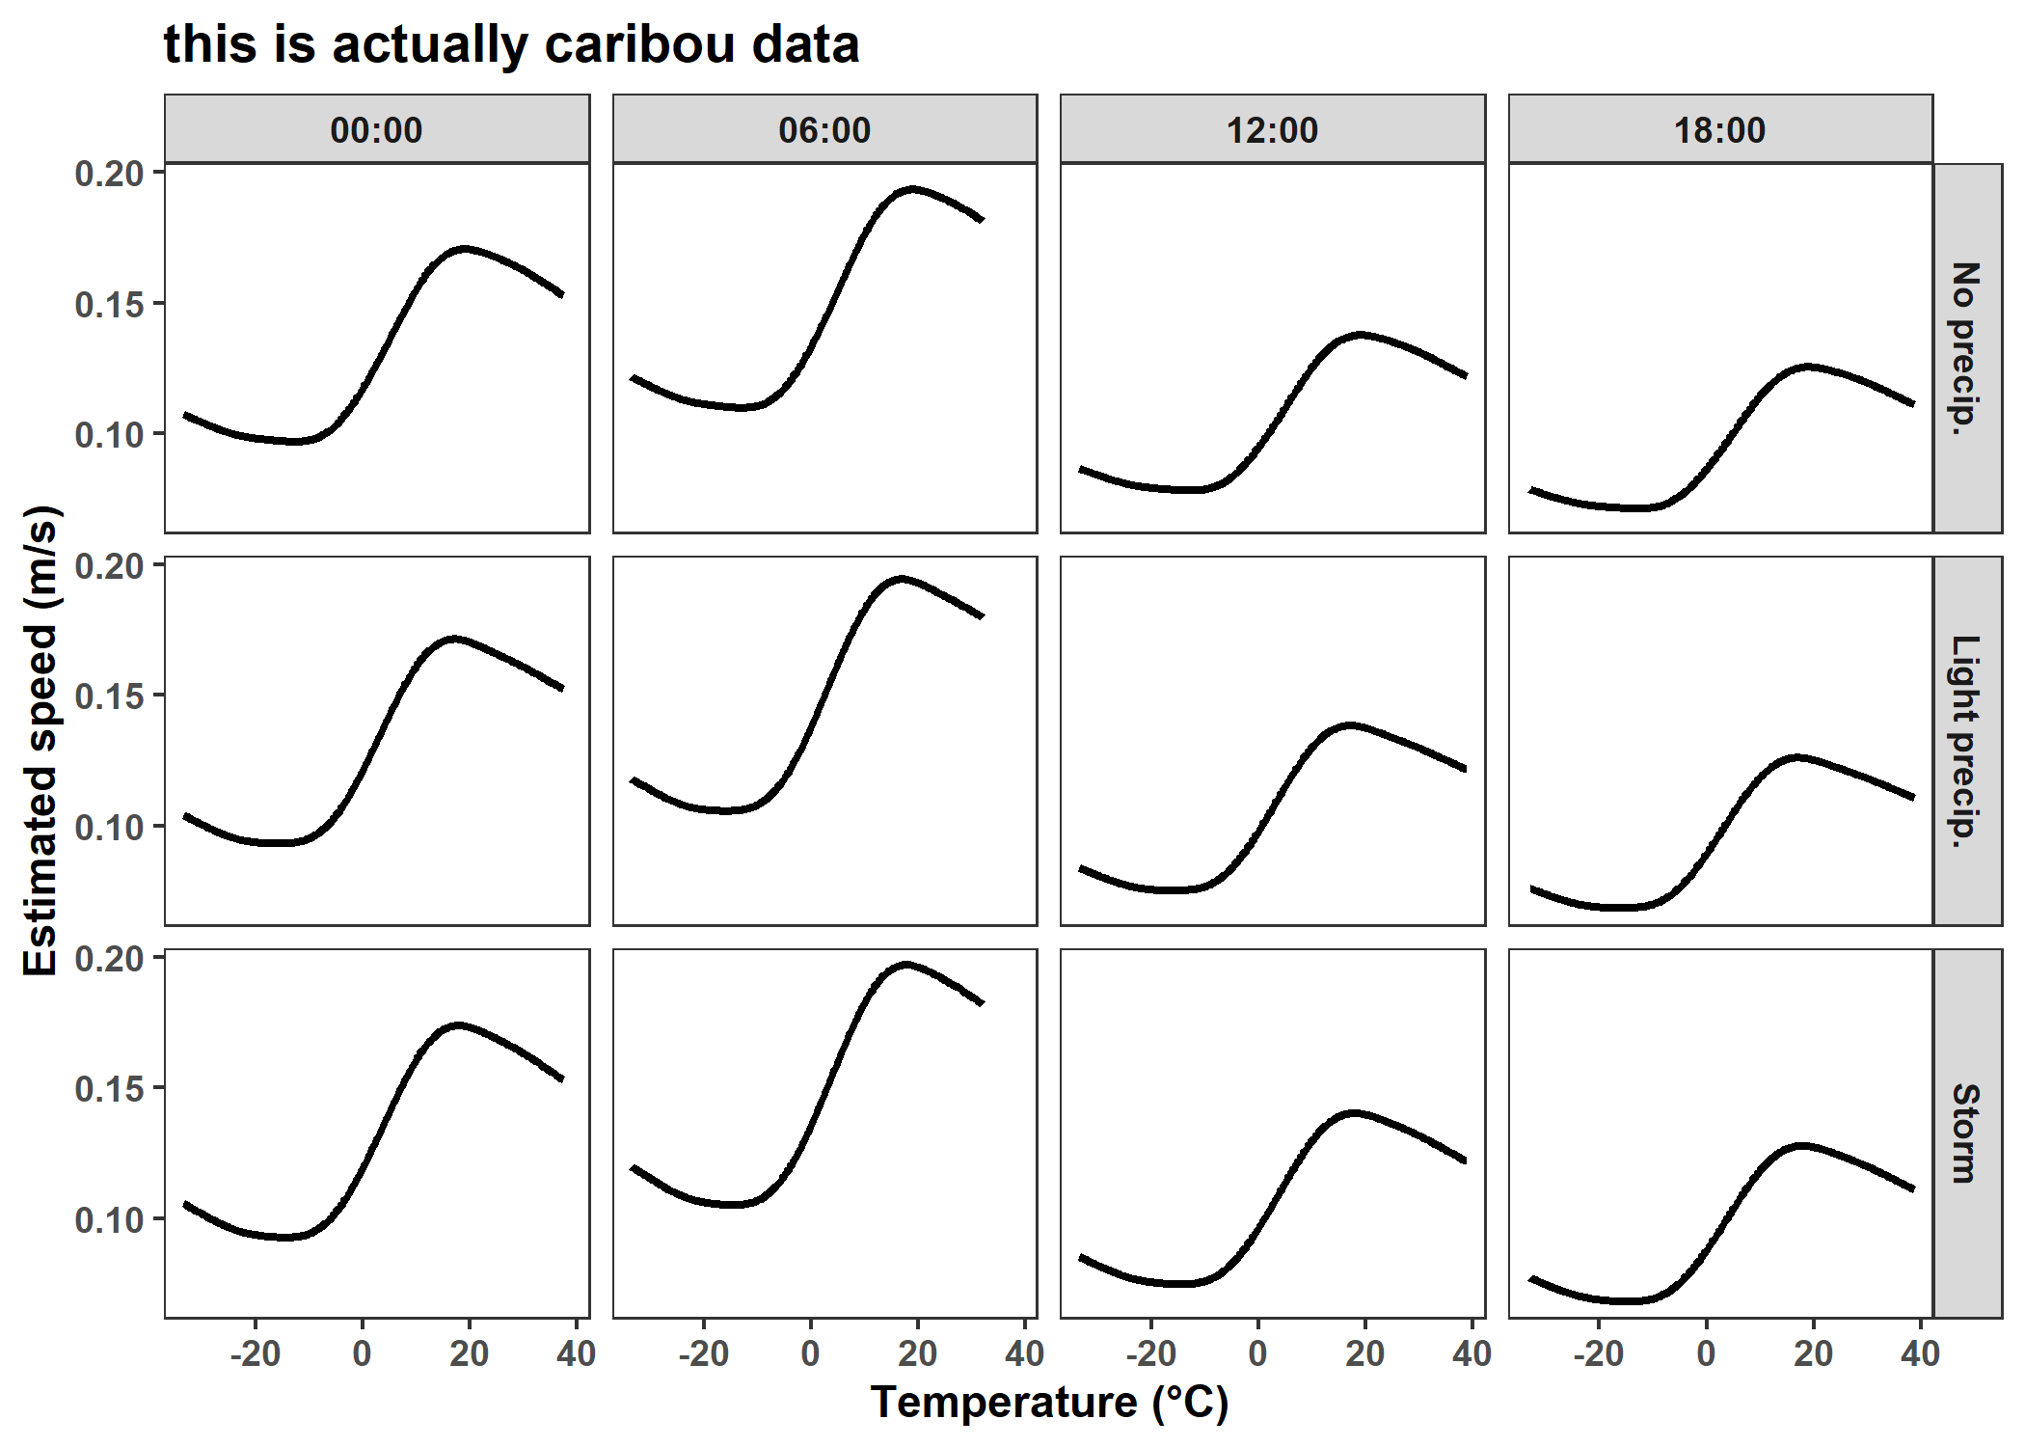
Elk movement in a heterogeneous environment
Speed:
Peaks at:
Early morning
~20°C
Little effect of precip
Drops if T < 20°C

Slide 16
Cougars in a dynamic landscape

Slide 17
Moving in a heterogeneous landscape
Search for good prey
Avoid difficult terrain
Raster used by RSF:
Forest with saplings
Grassland
Lake/river

Slide 18
Moving in a changing landscape
Forest burns
Lake/river freezes
⬇ temperature, ⬆ energetic costs
More prey are born
Alter raster used by RSF

Slide 19
Cougar spatial preferences
Results from all elk RSFs
Results figure

Slide 20
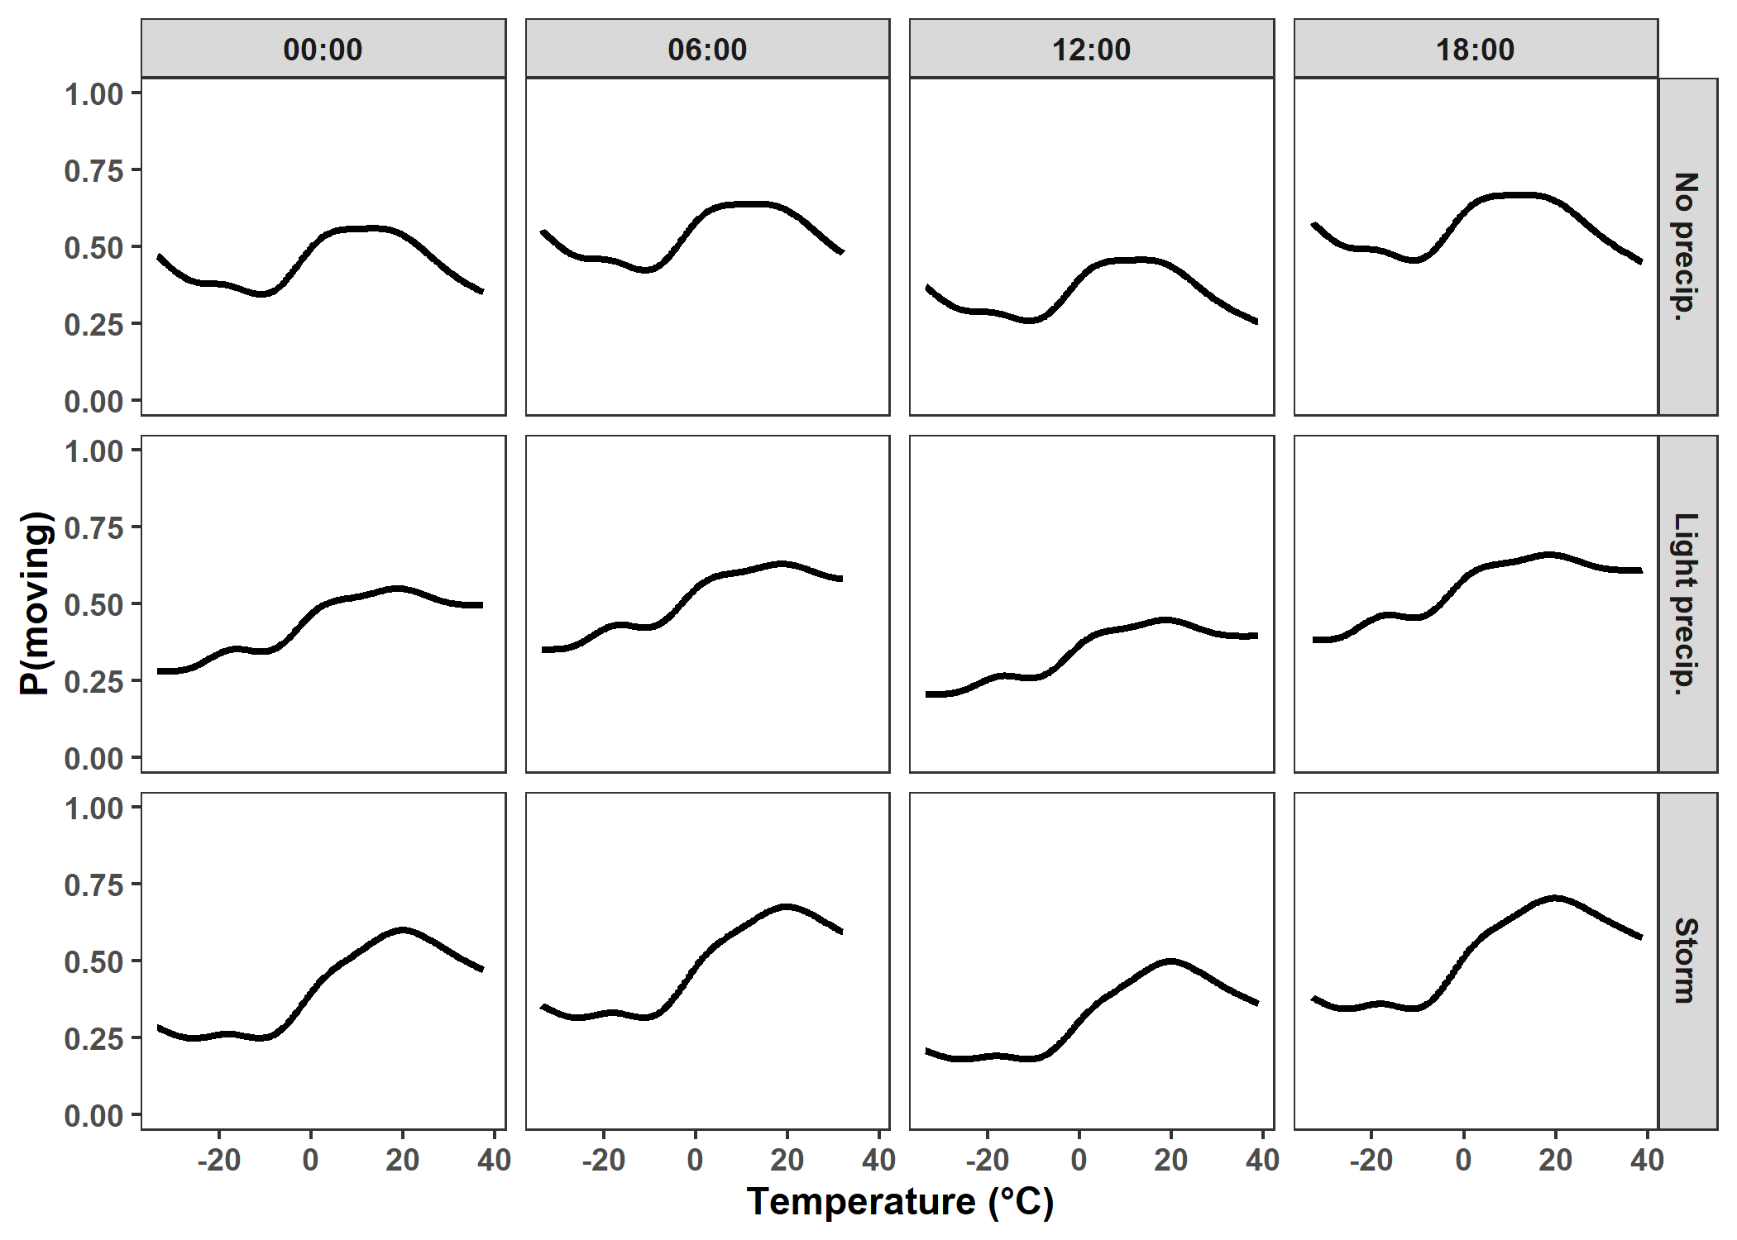
Cougar movement in a heterogeneous environment
P(moving):
⬇ at 12:00
Little effect of precip
⬆ with temperature

Slide 21
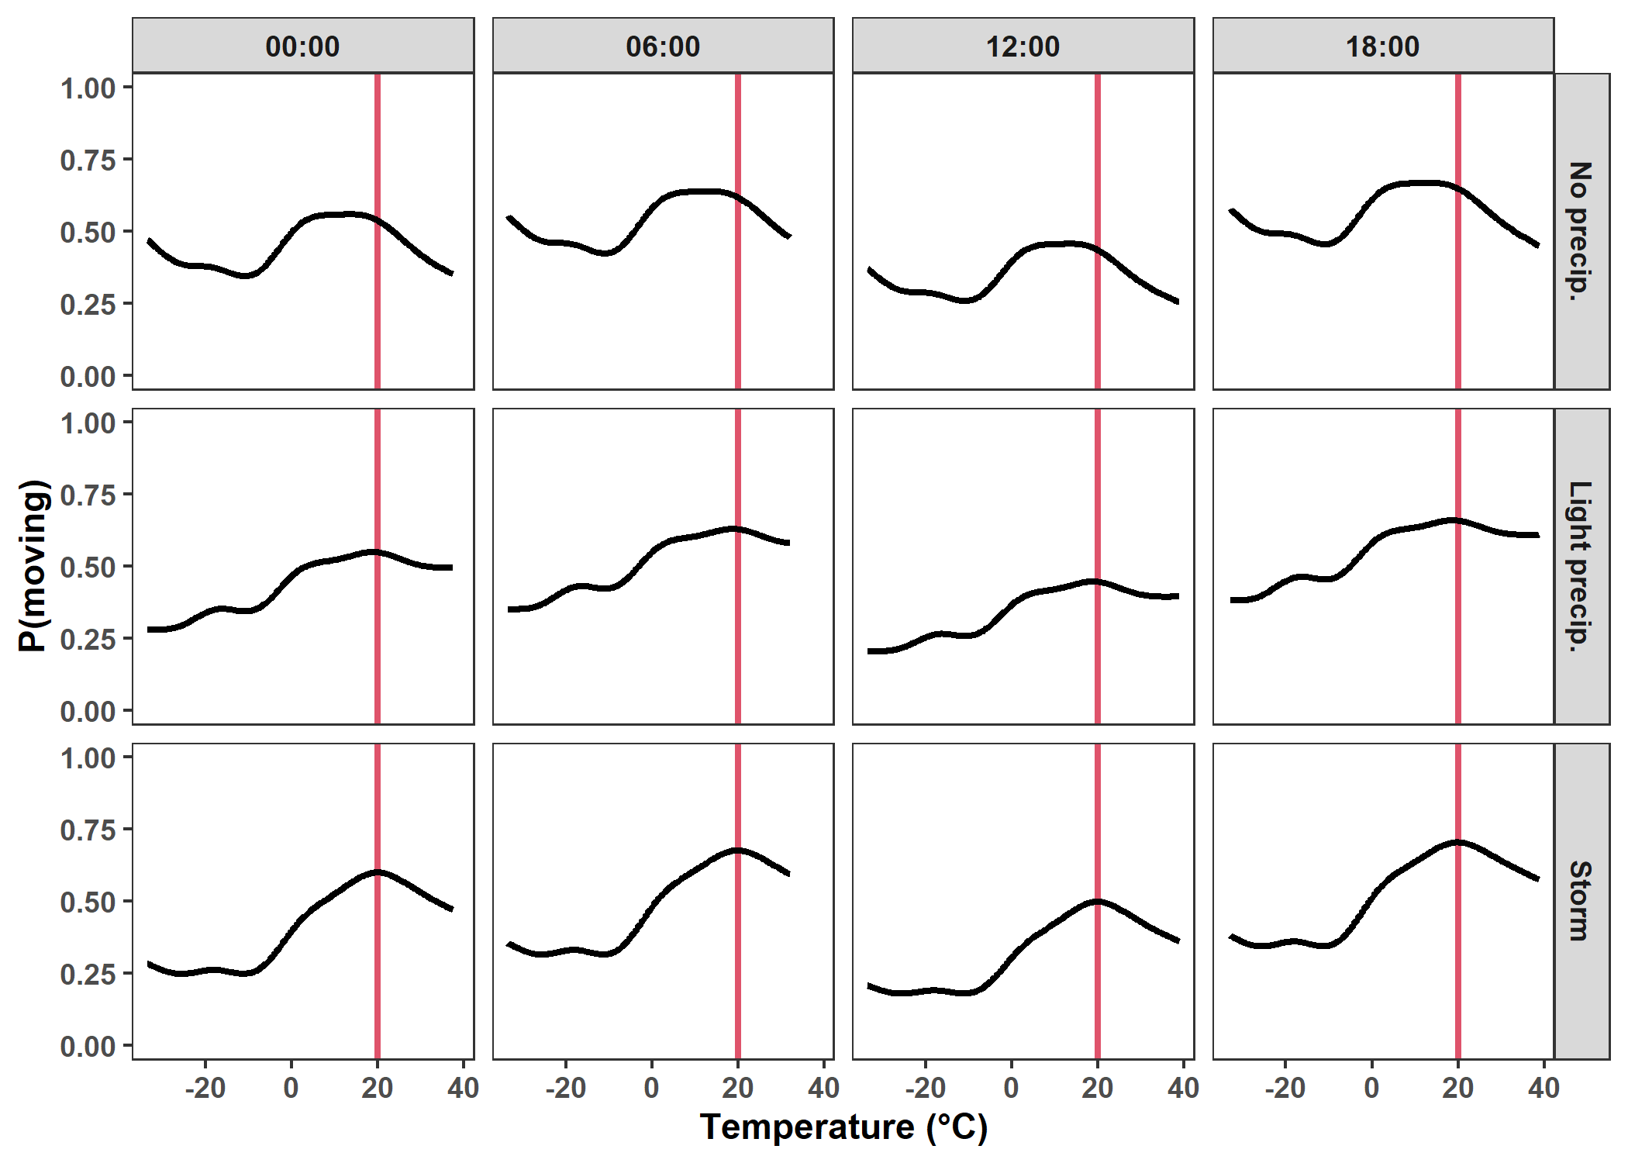
Cougar movement in a heterogeneous environment
P(moving):
⬇ at 12:00
Little effect of precip
⬆ with temperature
⬇ if T > 20°C

Slide 22
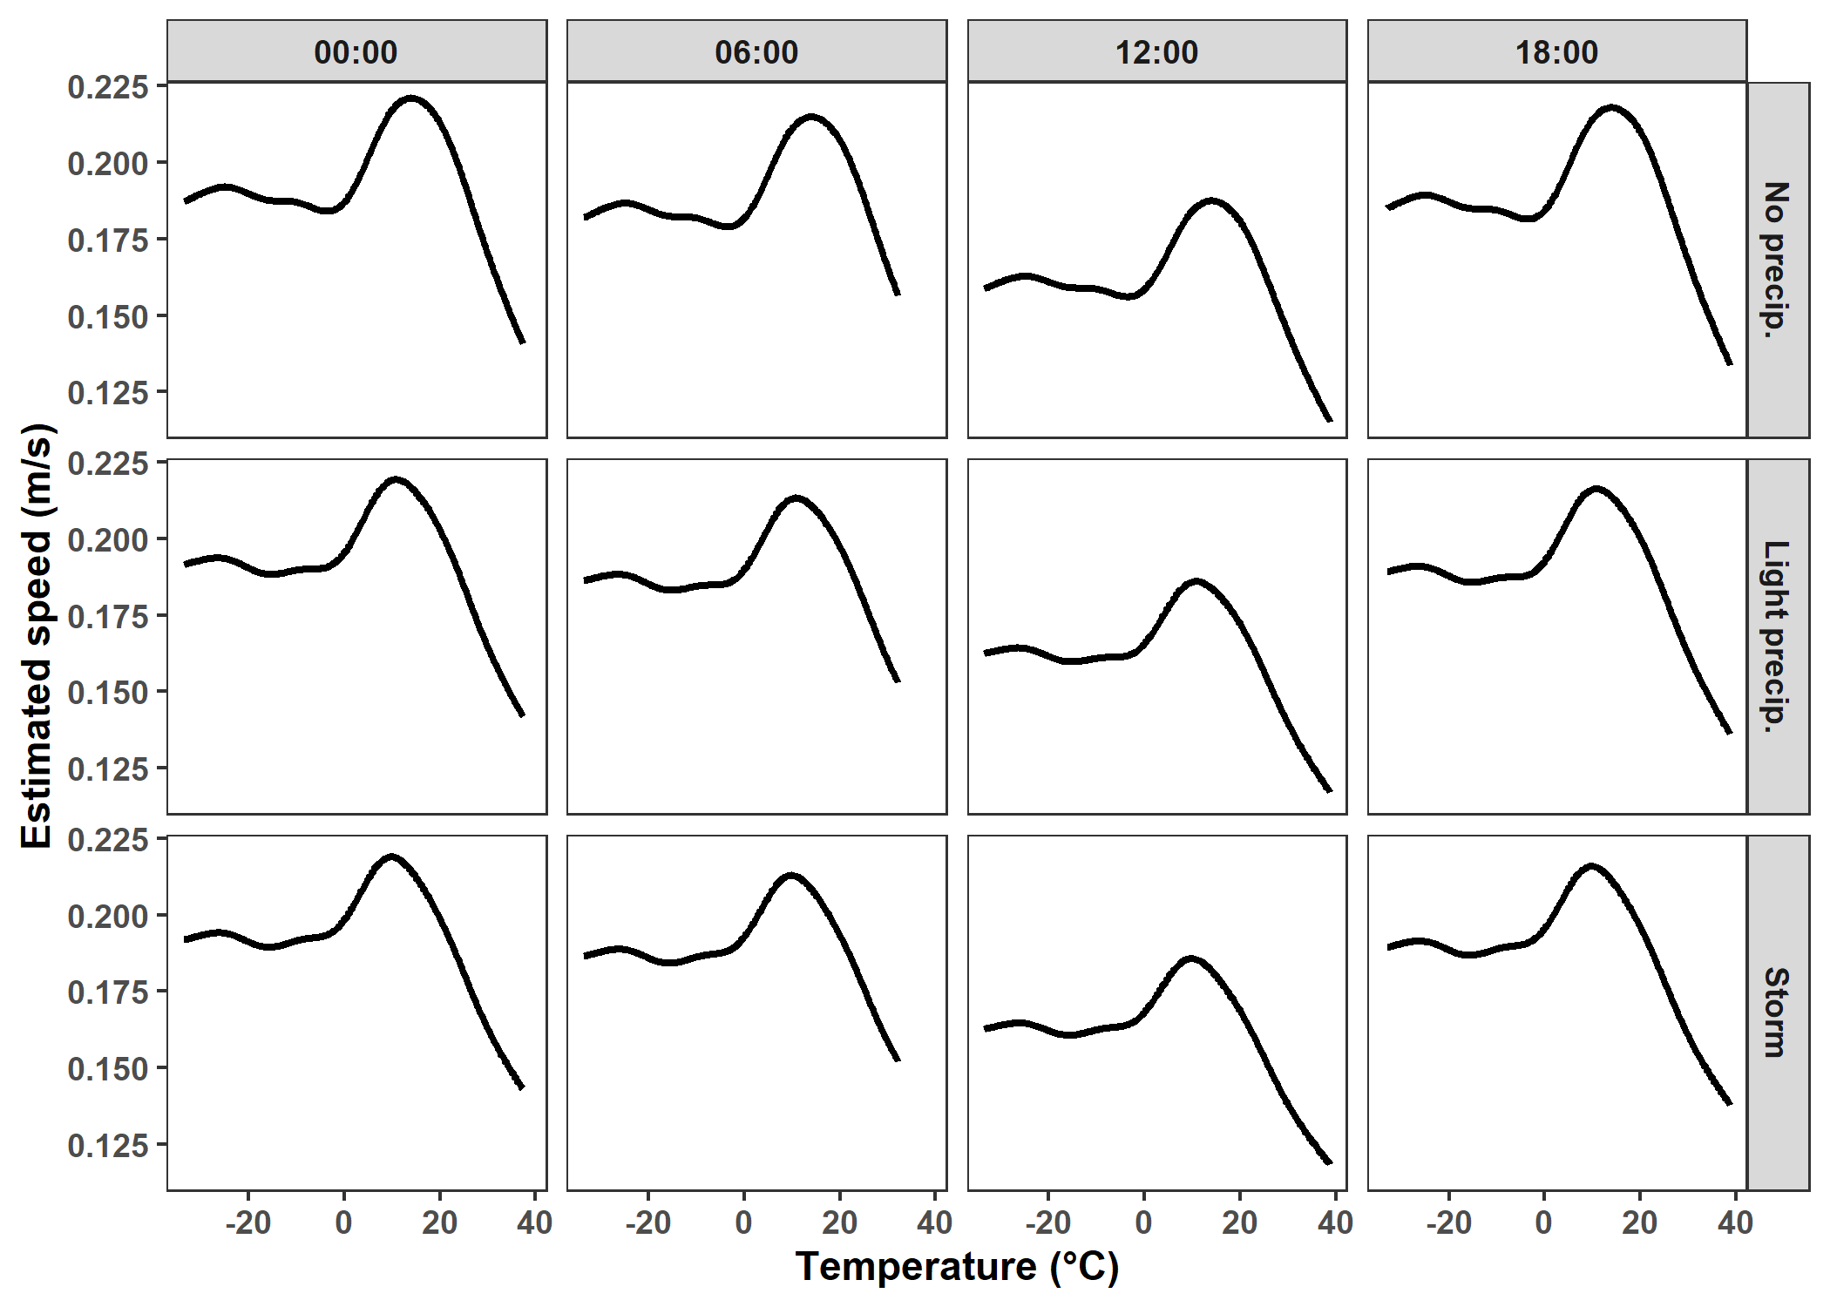
Cougar movement in a heterogeneous environment
Speed:
Peaks at:
Night/evening
T ~15°C
Little effect of precip

Slide 23
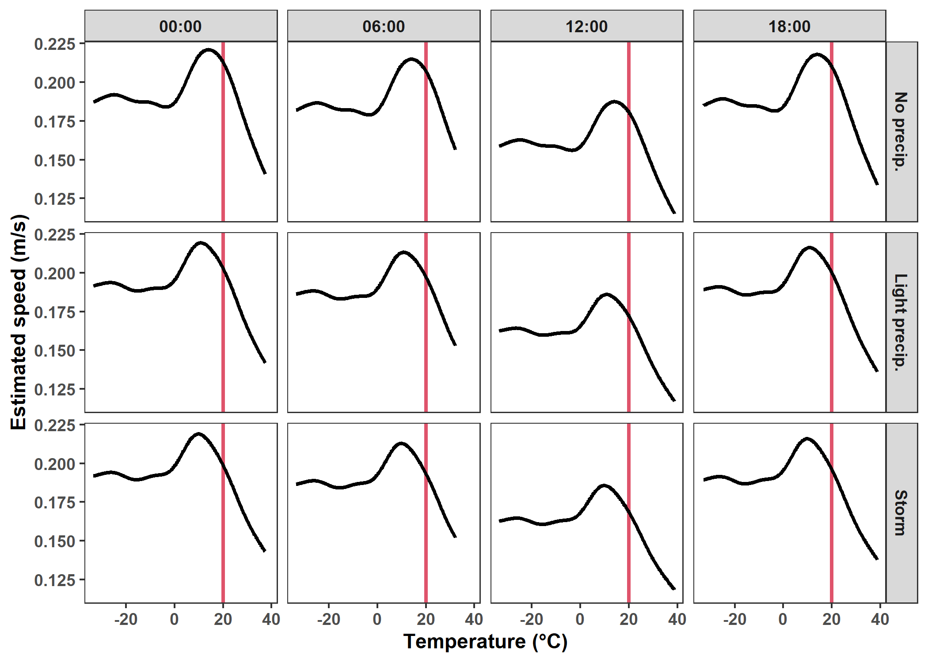
Cougar movement in a heterogeneous environment
Speed:
Peaks at:
Night/evening
T ~15°C
Little effect of precip
Drops if T > 20°C

Slide 24
A dynamic landscape

Slide 25
Food web effects
What happens if prey can’t move as easily but predators can?
Prey get eaten more easily
Prey are forced to move in suboptimal ways and waste energy
Diagram of interactions

Slide 26
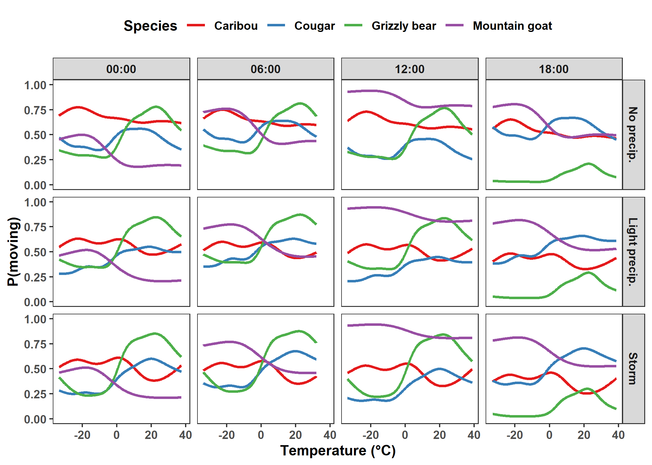
Trends in P(moving) between species

Slide 27
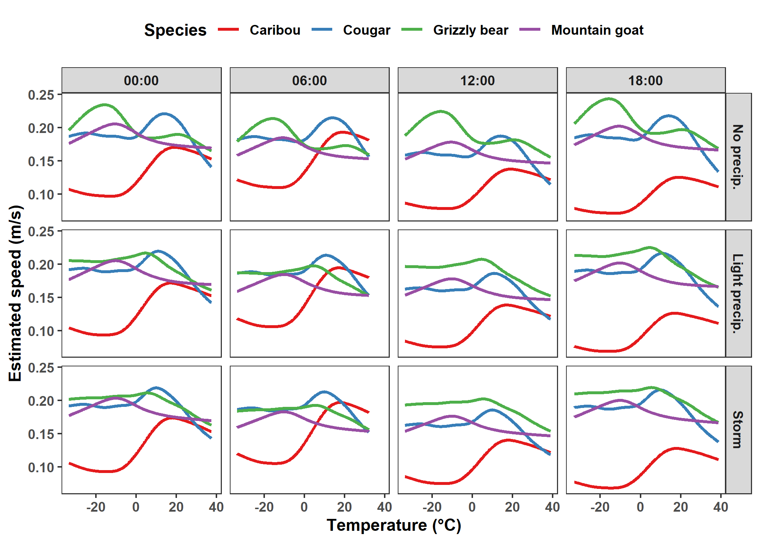
Trends in speeds between species

Slide 28
Predicting into the future
Climate change figure

Slide 29
Consequences for conservation

Slide 30
References
Dickie M., Serrouya R., Avgar T., McLoughlin P., McNay R.S., DeMars C., et al. (2022). Resource exploitation efficiency collapses the home range of an apex predator. Ecology. https://doi.org/10.1002/ecy.3642
Brown et al. 2004
Taylor et al. 1982

Slide 31







Acknowledgements

