Slide 1
Quantification and characterization of leakage errors
Jinwoong Kim (Mentor)
Dowon Baek
Inho Choi
Jeongwon Kim
Seong Hyeon Park

Slide 2

System
Characterization of Quantum Errors
Leakage
Traditional Randomized Benchmarking Scheme cannot distinguish different types of errors
Gate-errors
Seepage
Please use the light background slides for internal-only presentations. Dark background slides should be used for presentations given outside of the company.

Slide 3
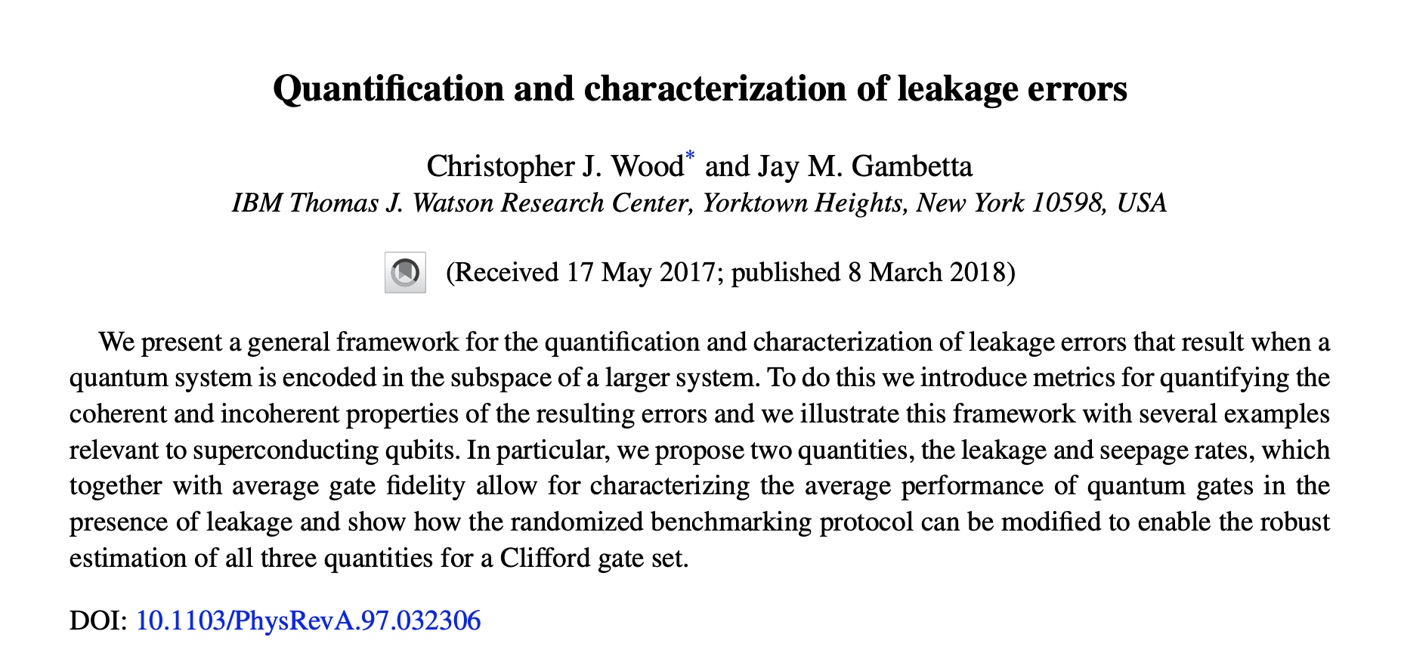
Protocols for Identifying Leakage Errors
Please use the light background slides for internal-only presentations. Dark background slides should be used for presentations given outside of the company.

Slide 4
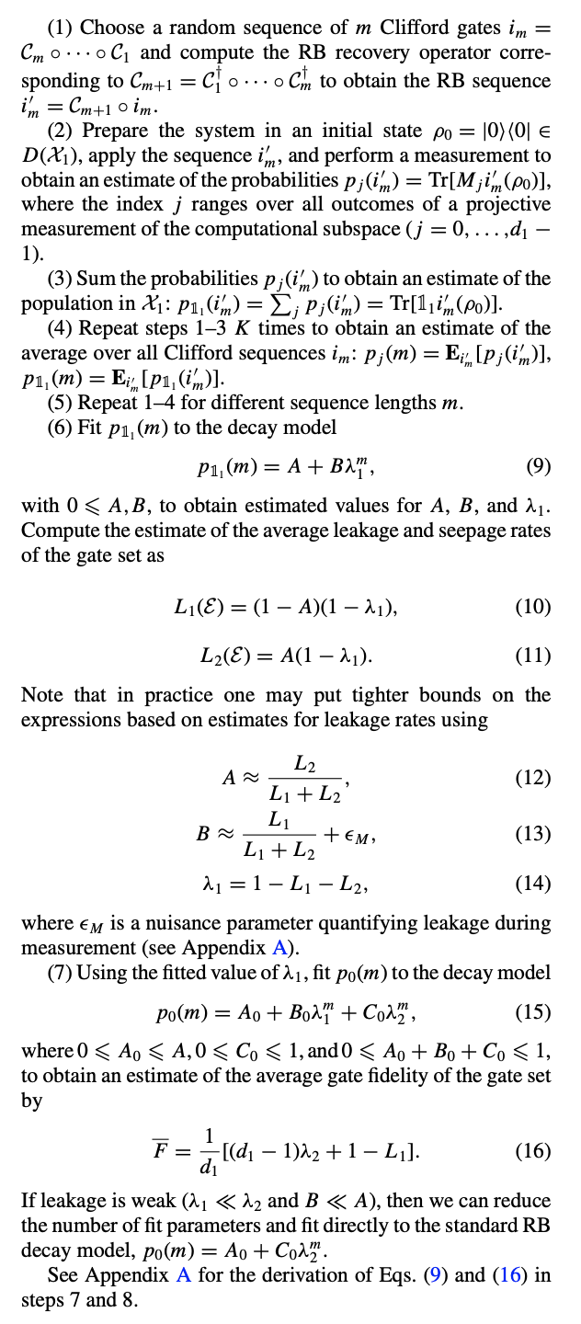
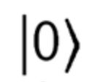
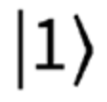
Leakage Randomized Benchmarking (LRB)
RB
A set of Clifford Gates
A set of Clifford Gates
LRB
A set of Clifford Gates
Leakage Estimation is possible with these two measurements
Please use the light background slides for internal-only presentations. Dark background slides should be used for presentations given outside of the company.

Slide 5



Leakage Randomized Benchmarking (LRB)
A set of Clifford Gates
LRB
A set of Clifford Gates

Slide 6
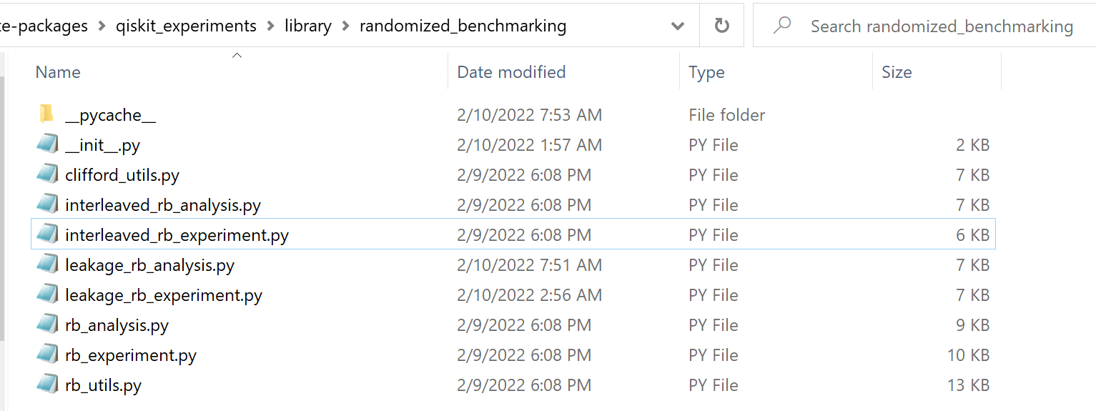
Implementation of libraries
Please use the light background slides for internal-only presentations. Dark background slides should be used for presentations given outside of the company.

Slide 7
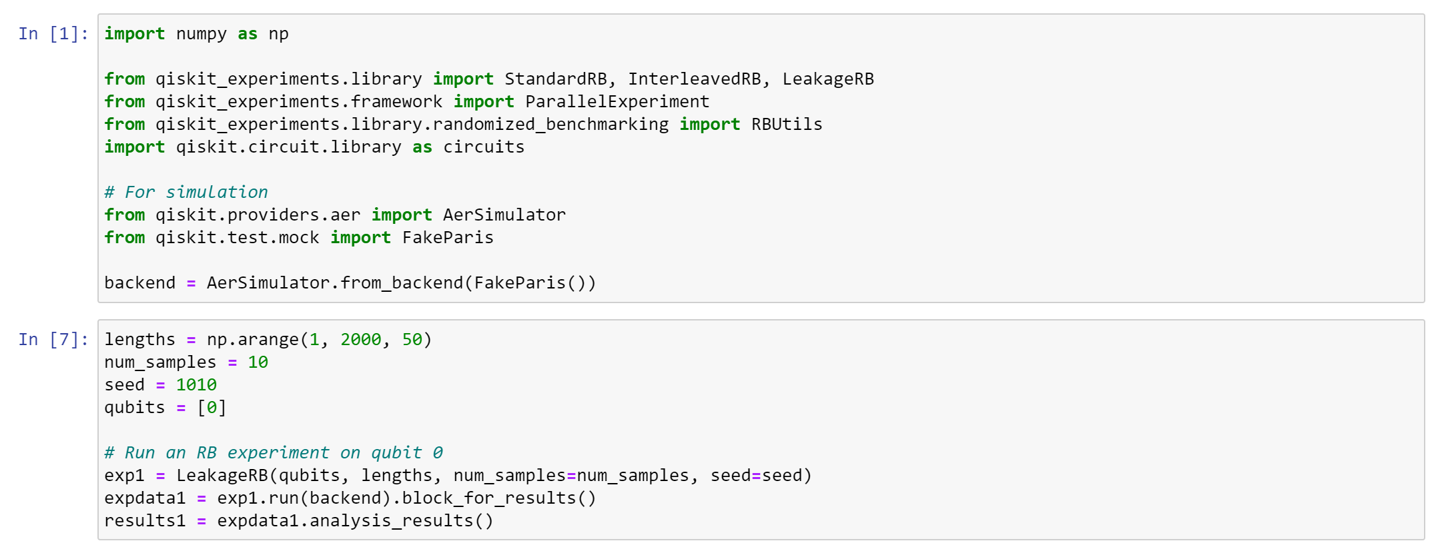
How to use our libraries
Please use the light background slides for internal-only presentations. Dark background slides should be used for presentations given outside of the company.

Slide 8
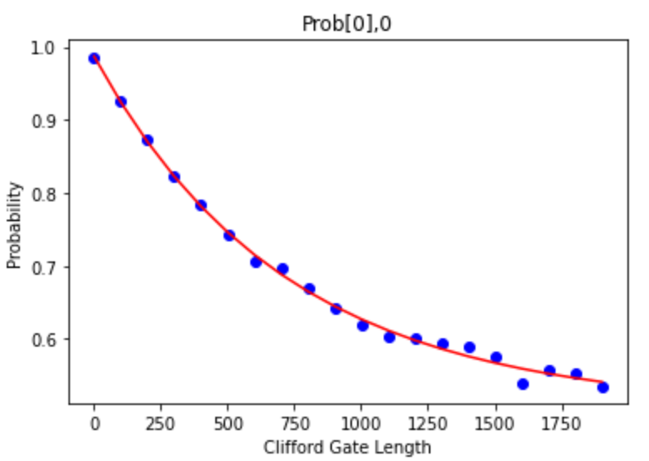
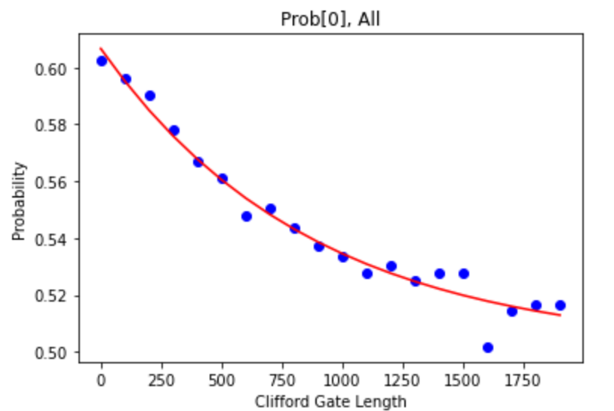
Fake-backend simulation
Please use the light background slides for internal-only presentations. Dark background slides should be used for presentations given outside of the company.

Slide 9
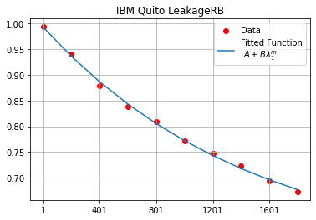
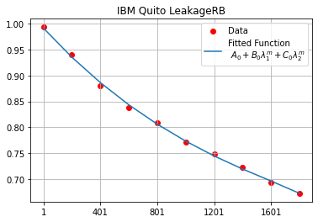
IBM Quito simulation
Please use the light background slides for internal-only presentations. Dark background slides should be used for presentations given outside of the company.

Slide 10
Technical Issues & Discussions
- Coherence between leakage errors and the system
- Further exploration of qiskit.experiments to succeed in complete class abstraction
- Extension to multi-qubit LRB scheme

