Slide 1
Basic HTML tags
Beginning Web Site Design Stanford University Continuing Studies CS 03
http://www.stanford.edu/group/csp/cs03/

Slide 2
What is HTML?
HTML, otherwise known as HyperText Markup Language, is the language used to create Web pages
Using HTML, you can create a Web page with text, graphics, sound, and video

Slide 3
HTML: HyperText Markup Language
HTML documents are simply text documents with a specific form
Documents comprised of content and markup tags
Content: actual information being conveyed
The markup tags tell the Web browser how to display the page
An HTML file must have an htm or html file extension
An HTML file can be created using a simple text editor

Slide 4
HTML Tags
HTML tags are used to mark-up HTML elements
Surrounded by angle brackets < and >
HTML tags normally come in pairs, like <tagname> (start tag) and </tagname> (end tag)
The text between the start and end tags is the element content
Not case-sensitive
Follow the latest web standards:
Use lowercase tags

Slide 5
Structural Tags
<HTML>
These tags enclose the entire Web page document.
</HTML>
<HEAD>
These tags enclose the Head part of the document
</HEAD>
<TITLE> These tags enclose the title of the document. This text appears in the title bar in the browser and on the bookmark list if someone bookmarks your web page.
</TITLE>

Slide 6
HTML Document Structure
Entire document enclosed within <html> and </html> tags
Two subparts:
Head
Enclosed within <head> and </head>
Within the head, more tags can be used to specify title of the page, meta-information, etc.
Body
Enclosed within <body> and </body>
Within the body, content is to be displayed
Other tags can be embedded in the body

Slide 7
Sample Structure of a Web Site
<HTML>
<HEAD>
<TITLE> John Q. Public's Web Page </TITLE>
</HEAD>
<BODY>
This is John Public's Webpage!
</BODY>
</HTML>

Slide 8
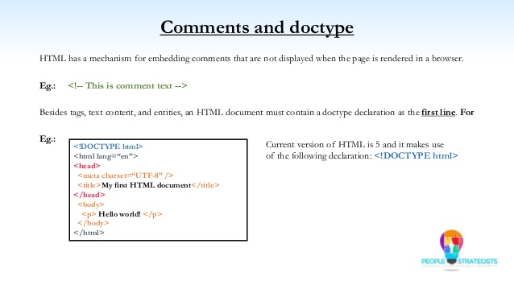
Comments and Doctype

Slide 9
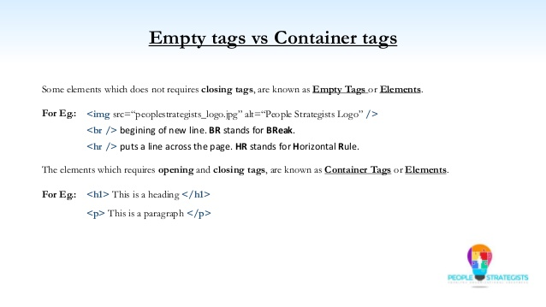
Empty Tags

Slide 10
HTML Attributes
All HTML elements can have attributes
Attributes provide additional information about elements
Attributes are always specified in the start tag
Attributes usually come in name/value pairs like: name="value"

Slide 11
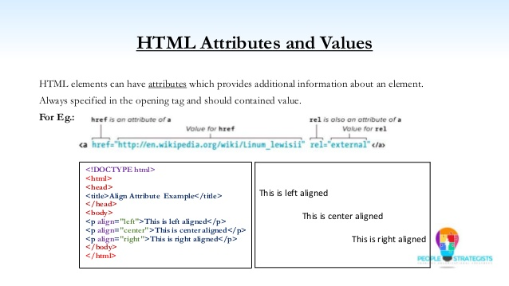
HTML attributes and values

Slide 12
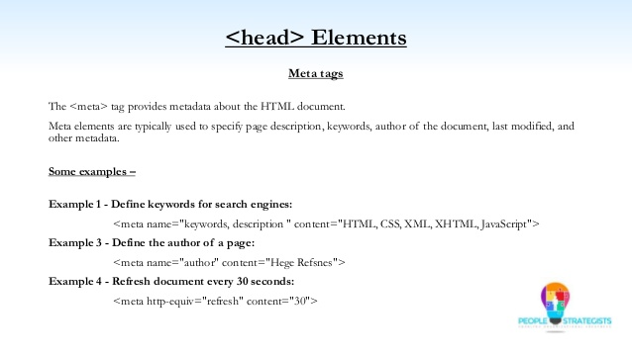
<head> elements

Slide 13
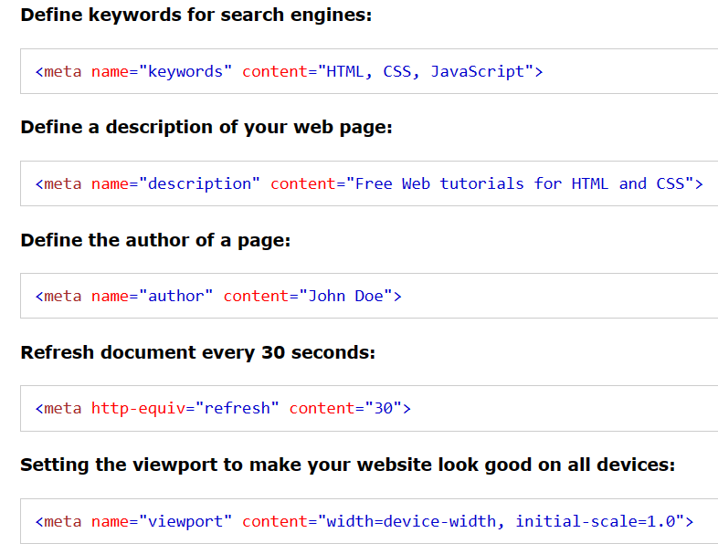

Slide 14
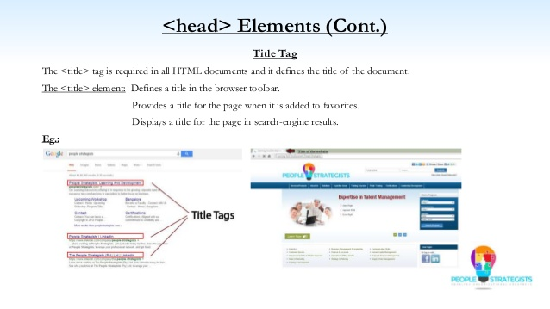
<head> elements contd..

Slide 15
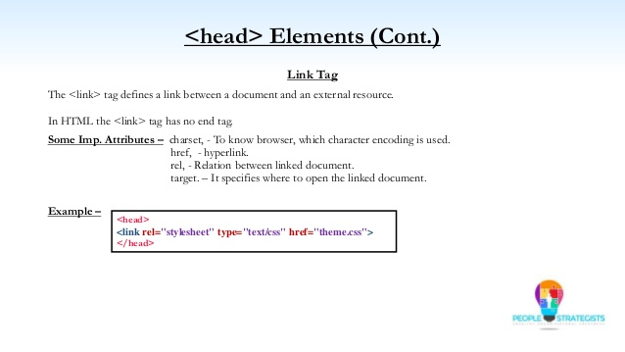
<head> elements contd..

Slide 16
We’ll Study…
HTML Basics (http://www.w3schools.com/html/html_intro.asp):
HTML Elements
HTML Headings
HTML Paragraphs
HTML Formatting
HTML Styles
HTML Images
HTML Tables
HTML Lists
HTML Forms
HTML Colors

Slide 17
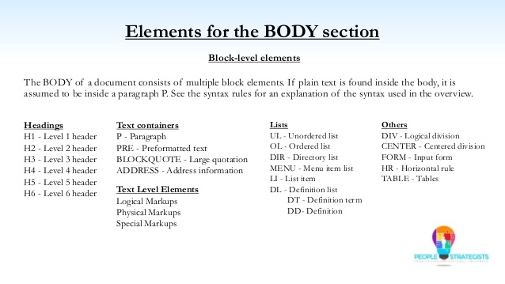
Elements of Body section

Slide 18
Nested Tags
Whenever you have HTML tags within other HTML tags, you must close the nearest tag first
Example:
<H1> <I> The Nation </I> </H1>

Slide 19
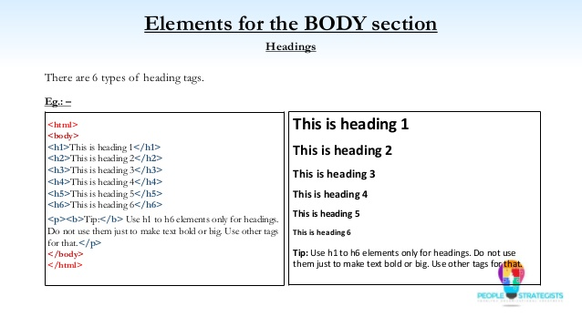
Elements of Body section Contd..

Slide 20
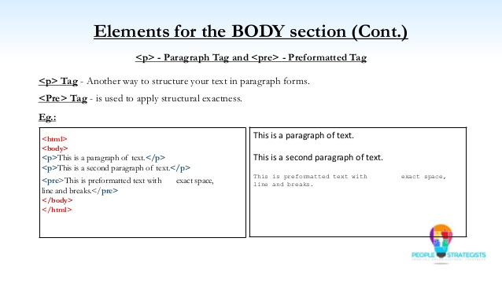
Elements of Body section Contd..

Slide 21
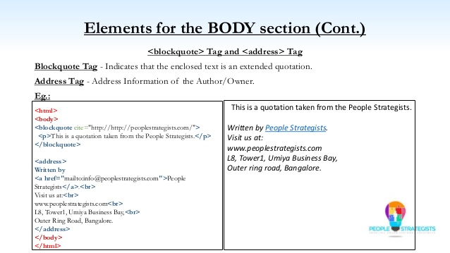
Elements of Body section Contd..

Slide 22
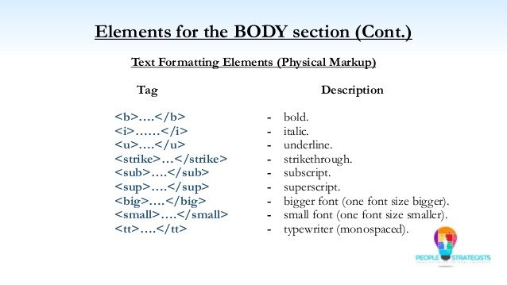
Elements of Body section Contd..

Slide 23
Horizontal Rule
The <HR> tag puts a graphical line across the page.
Ex:
Horizontal Rule Attributes:
NOSHADE -- A solid line with no shading
WIDTH="xx%/xx" -- Controls the width of the line. You may specify either percentage of the width of a page or actual pixel length
SIZE="xx" -- Controls the height of the line. You need to specify the
dimension in pixels.
ALIGN="left/center/right" -- This allows the line to be aligned to the left,
right, or center of the page

Slide 24
<Font> modifications (cont.)
One can combine font modifications:
<FONT SIZE="7" FACE="courier" COLOR="red">Big, Courier & Red</FONT>
Big, Courier & Red
<FONT SIZE="7"><FONT FACE="courier">Big & Courier</FONT> - Just Big</FONT>
Big & Courier - Just Big

Slide 25
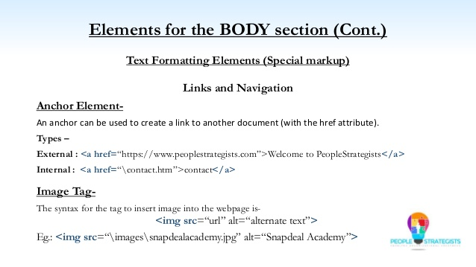
Text formatting elements

Slide 26
Graphics
To have a graphic appear on a webpage, web designers must to put the <IMG> tag in with the address where the graphic "lives":
<IMG SRC="http://www.someplace.com/images/fish.gif">
Graphics attributes:
alt="text": insert a description of the graphic for those who are using browsers that cannot process images (e.g., page readers for the blind)
width="xx/xx%": width in pixels/percentage
height="xx/xx%": height in pixels/percentage
border="xx": pixel length of the border surrounding the image.
hspace="xx": places a buffer of space horizontally around the image
vspace="xx": places a buffer of space vertically around the image
align="top/middle/bottom/right/left": aligns image in relation to the text (see next 2 slides)

Slide 27
Graphics (cont.)
<img src="http://www.someplace.com/images/fish.gif" align="top">All about Fish
<img src="http://www.someplace.com/images/fish.gif" align="middle">All about Fish
<img src="http://www.someplace.com/images/fish.gif" align="bottom">All about Fish
All about Fish
All about Fish
All about Fish

Slide 28
Graphics (cont.)
<img src="http://www.someplace.com/images/fish.gif" align="left">
<img src="http://www.someplace.com/images/fish.gif" align="right">

