Slide 1



supply_chain_dashboard
View in Power BI
Last data refresh:
12/23/2025 7:42:23 PM UTC
Downloaded at:
12/23/2025 7:43:56 PM UTC

Slide 2
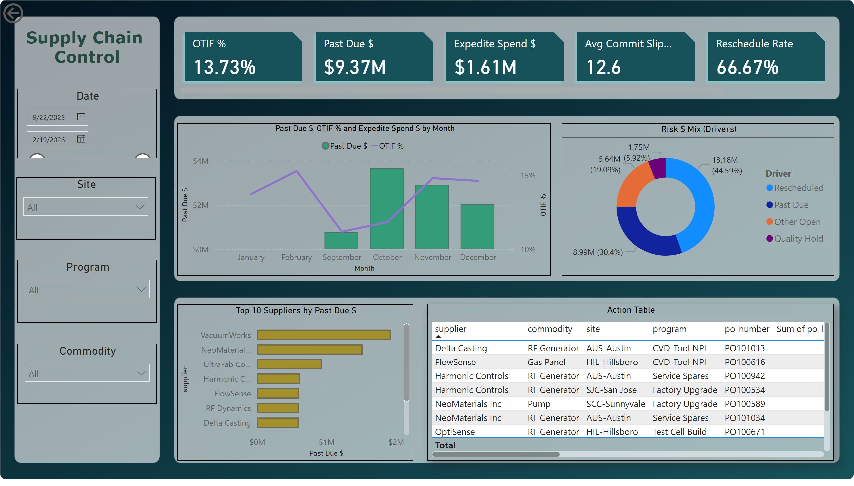
📃 Overview
Notes:
cardVisual
No alt text provided
lineClusteredColumnComboChart
No alt text provided
Top 10 Suppliers by Past Due $
No alt text provided
Action Table
No alt text provided
Risk $ Mix (Drivers)
No alt text provided
textbox
No alt text provided
actionButton
No alt text provided
Date
No alt text provided
Site
No alt text provided
Program
No alt text provided
Commodity
No alt text provided

