Slide 1
Make the Qubit Tune Itself
Closed-loop auto-calibration of a drifting three-level transmon, and what it does to a QAOA
QARC IIT (ISM) Dhanbad | Concetto'26 | Q-Blueprint
Notes:
DEMO SCRIPT, 0:00. One sentence: we built a simulated drifting transmon, an agent that recalibrates it from shot counts only, and measured what that does to a QAOA. Say that all numbers are simulation results with fixed seeds.

Slide 2
What we built
Three-level transmon with drifting detuning (OU + telegraph) and drive gain (sinusoid + OU), seed 2026
Agent sees only shot counts (500 µs per shot, readout errors 1% / 3%)
Primitives: amplitude (error amplification), Ramsey frequency (Bayesian), DRAG
Policies: P0 never, P1 fixed period, P2 health check then recalibrate
Judged by the hidden oracle gate error and a p=1 QAOA on a 4-ring
drift → gate → counts → estimate → decision → new controls (pulse only)
Oracle and hidden drift are never imported by agent code (AST test).
Notes:
0:30. Walk the loop left to right. Stress the information barrier: the agent gets integer counts only; the oracle error is used only for scoring. Controls change the pulse, not the transmon.

Slide 3
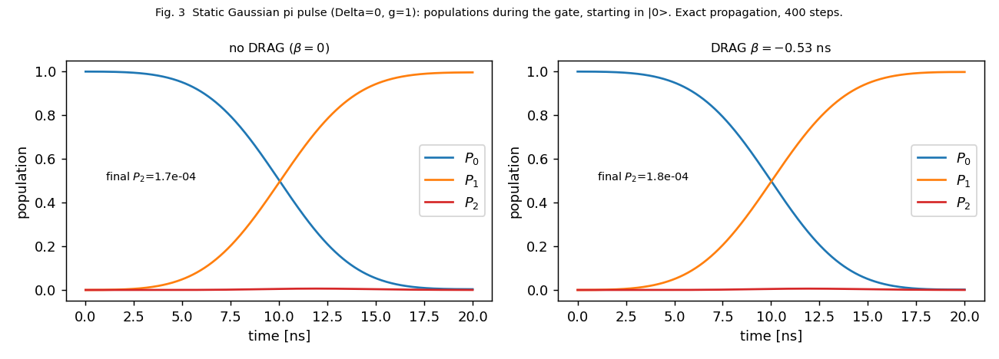
Plant check: the static π pulse
β = 0: error 2.5e-3, leakage 1.7e-4
Best β = −0.313 ns (first order: −0.53 ns)
Best error: 1.75e-4 (π), 1.4e-5 (π/2)
Propagator: unitary to 1e-13, 2nd-order convergent
Simulation, Δ=0, g=1, α/2π=−300 MHz, t_g=20 ns.
Notes:
1:15. Show populations. Point out that leakage is tiny (1.7e-4) but the beta=0 error is 2.5e-3: it is mostly a coherent Stark tilt, which DRAG cancels at about 0.59/|alpha|, not 1/|alpha|.

Slide 4
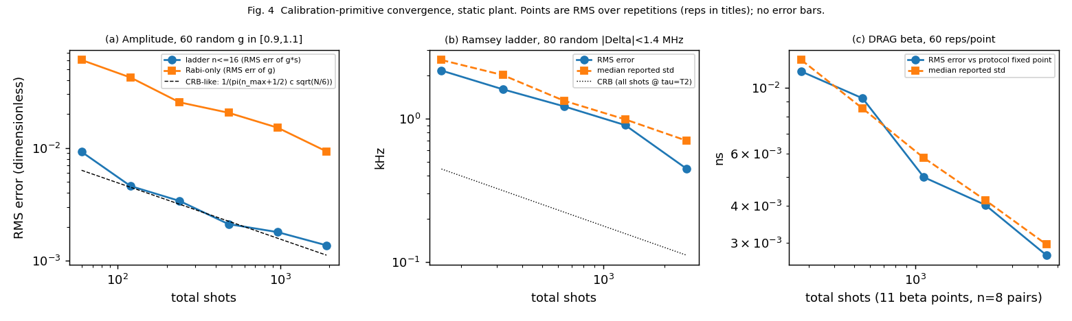
Calibration primitives converge
Amplitude: RMS 9e-3 → 1.4e-3 (60 → 1920 shots); Ramsey ladder aliases beyond 1.67 MHz, as predicted
DRAG: 0.011 → 0.0027 ns; order matters: frequency first
Notes:
2:00. One figure, three panels. Say: amplitude and Ramsey errors fall with shots; DRAG fit is bounded to the physical fringe rate; DRAG must be calibrated after frequency (0.016 ns shift per 100 kHz residual).

Slide 5
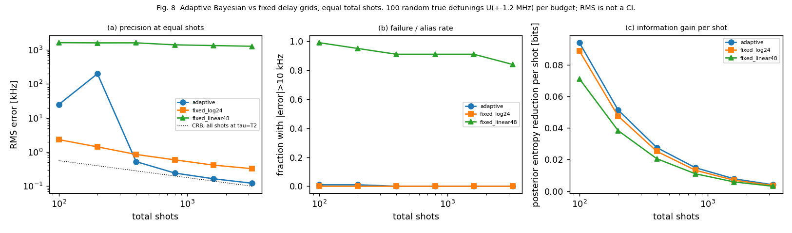
Adaptive Bayesian Ramsey vs fixed grid
0.5 kHz RMS: ~420 shots adaptive vs ~1,110 fixed log grid (2.7×)
Honest limit: at N ≤ 200 adaptive has ~1% alias failures; fixed grid is safer
Uniform linear grid aliases (84–99% failures)
100 random detunings per budget. RMS, not a confidence interval.
Notes:
3:00. Equal total shots. Adaptive wins at 400 shots and above (about 2.7 times fewer shots for 0.5 kHz). Be upfront: below 200 shots it has a 1 percent alias-failure rate and is worse.

Slide 6
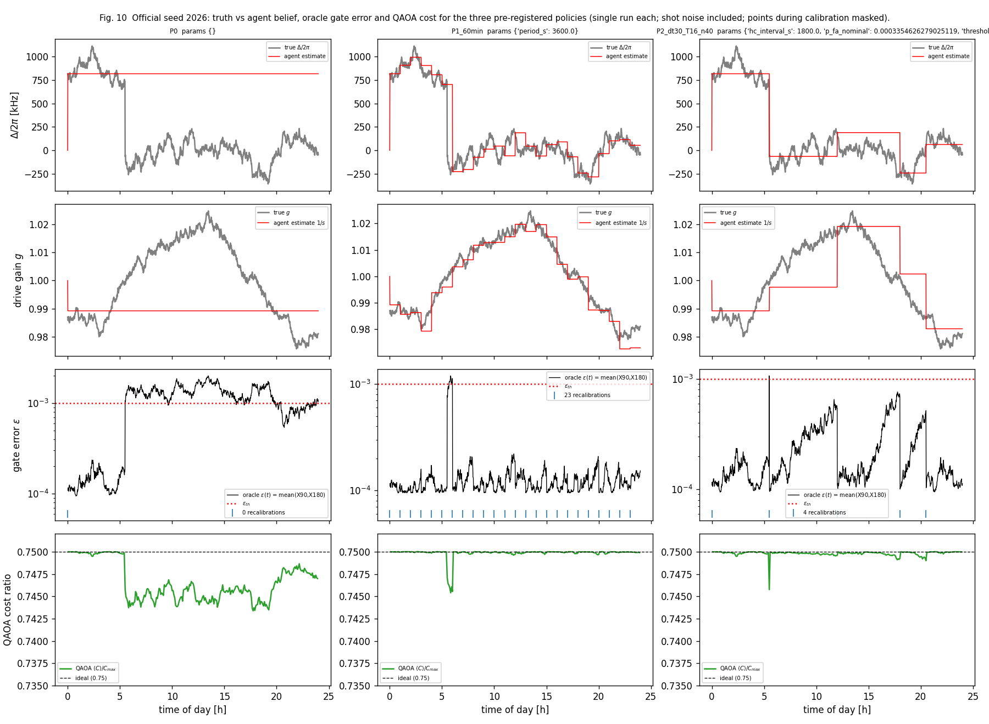
One day, official seed 2026
P0: error above 1e-3 for much of the day after the jump
P1 (60 min): recovers within the hour
P2: detects the jump, then recalibrates 3 more times
Cold calibration: ~2,600 shots (1.3 s); warm: ~520 shots (0.26 s)
Truth (grey) vs agent belief (red). Single run per policy, shot noise included.
Notes:
4:00. Left to right: P0 keeps its +815 kHz belief after the jump at 5.5 h and the error stays above threshold; P1 spikes then recovers; P2 catches the jump at the next check. Single run each.

Slide 7
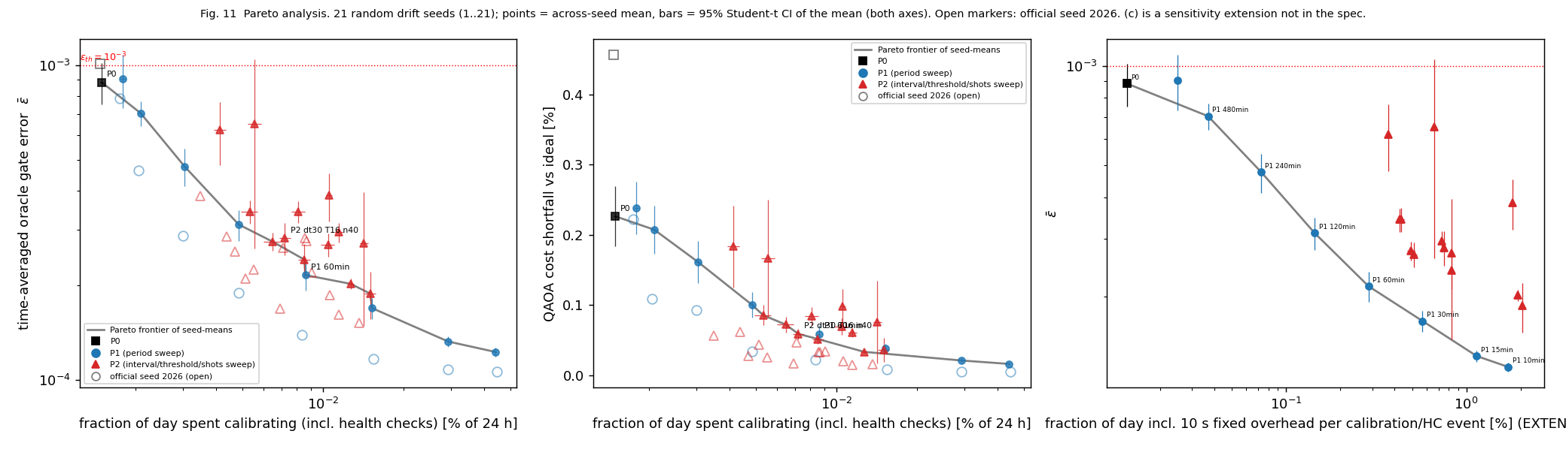
Pareto: cost vs gate error (21 seeds)
P1 60 min: error 2.15e-4 ± 0.23e-4 (95% CI) vs 8.84e-4 for P0, at 0.0086% of the day
P2 gives no clear gain when health-check shots count as downtime: +6.7e-5 error for 0.0014 points less time
With a 10 s overhead per event P2 leaves the frontier; if checks are free it fills the middle
Points: seed means. Bars: 95% t-interval of the mean, 21 seeds. Open markers: seed 2026.
Notes:
5:00. Key message: calibration is almost free in this model, so periodic recalibration wins. P2 gives no clear gain when health-check shots count as downtime; paired difference is +6.7e-5, CI 3.2e-5 to 1.0e-4.

Slide 8
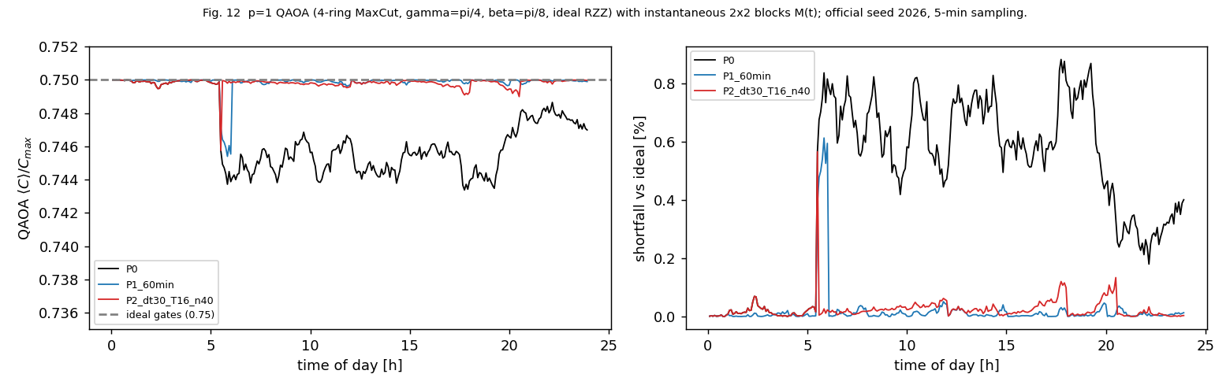
From hardware error to QAOA cost
Ideal ⟨C⟩/C_max = 0.75
Policy spends y of the day calibrating; QAOA within z = 0.5% of ideal for w of the day
Telegraph jump hurts QAOA most (0.176% shortfall)
Policy | y | w (z=0.5%)
P0 | 0.0015% | 88.0%
P1, 60 min | 0.0086% | 97.2%
P2, 30 min | 0.0072% | 97.1%
21 seeds, 95% CI of the mean; y includes health checks. Official seed P0: w = 44.3%.
Notes:
6:00. Read the sentence for P1: spends 0.0086 percent of the day calibrating, within 0.5 percent of ideal for 97.2 percent of the day. The p=1 ring QAOA is forgiving: even P0 loses only 0.23 percent on average.

Slide 9
Takeaways and limits
Recalibrating every 30–60 min keeps error near the 0.94e-4 floor at under 0.02% of the day
Frequency jump hurts the algorithm most; gain drift hurts raw gate error most
Adaptive Bayesian design saves ~2.7× shots at ≥ 400 shots; not at tiny budgets
Negative result: health-check policy gives no clear gain over periodic recalibration under the specified accounting
Limits
Oracle is coherent only; idle-detuning phase in QAOA not modelled
Sweep ranges chosen after looking at the official seed; only 3 headline policies pre-registered
Developed with AI assistance (Claude, Anthropic); cited in the report
Notes:
7:00. Close with the honest points. Invite questions. Likely viva questions: why mode-based posterior summary, why DRAG optimum is 0.59 over alpha, why P2 loses, how the barrier is enforced.

