Slide 1
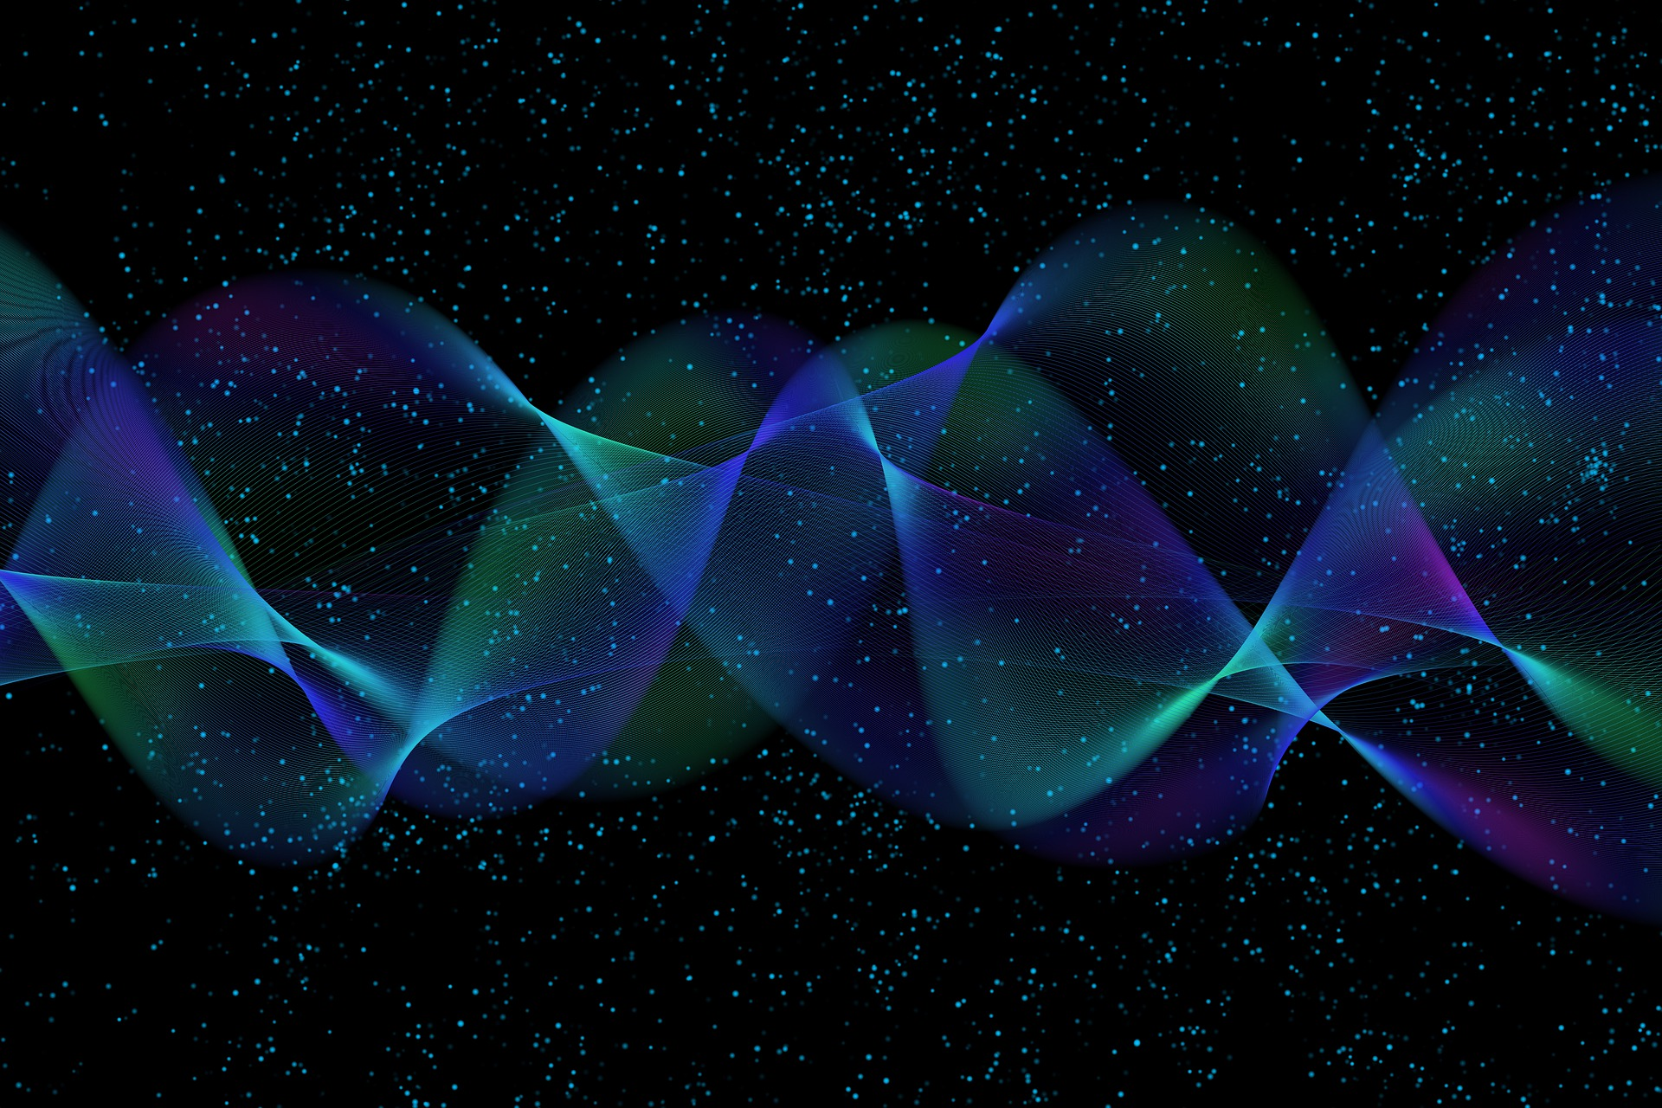
Quantum Computing
3. Qubit
Quantum Computing Insitute
https://qcict.org
Prof. Aleksandar Radovanovic
alex@qcict.org

Slide 2
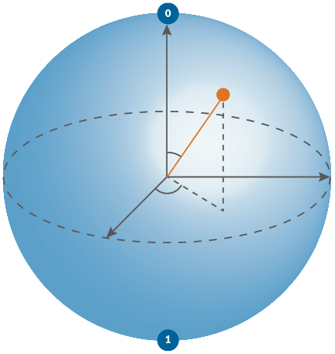

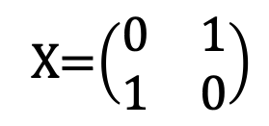
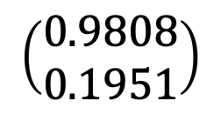
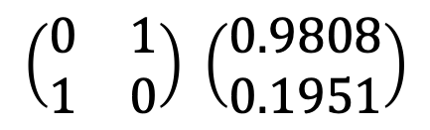
Model of Quantum Computation
matehematical unit of processing
matrix-vector multiplication
unit of data
qubit/vector
unit of processing
quantum gate/matrix
algorithm
quantum circuit
program
quantum circuit desciption
$$\left(\begin{matrix}0.9808 \\ 0.1951\end{matrix}\right)$$
+
X=$\left(\begin{matrix}0 & 1 \\ 1 & 0\end{matrix}\right)$
$$\left(\begin{matrix}0 & 1 \\ 1 & 0\end{matrix}\right) \left(\begin{matrix}0.9808 \\ 0.1951\end{matrix}\right)$$
+
H
circuit.x (qreg_q[0])
circuit.h (qreg_q[0])
circuit.measure (qreg_q[0], creg_c[0])
Notes:
The basic unit of quantum information is the quantum bit, or qubit. Mathematically, a qubit is represented by a two-dimensional state vector.
The basic unit of quantum processing is the quantum gate. Mathematically, a quantum gate is represented by a unitary matrix.
Quantum computation consists of successive transformations of the qubit state. Geometrically, these transformations can be visualized as rotations of the vector. Mathematically, they are represented by multiplying the qubit state vector by the matrix corresponding to a quantum gate, producing a new quantum state.
A quantum algorithm is commonly represented as a quantum circuit. Although the term "quantum circuit" might suggest a hardware circuit, it is actually a flowchart-like diagram that shows the sequence of quantum gates applied to the qubits during program execution.
Finally, a quantum program is a description of a quantum circuit written in a programming language, typically Python or a quantum assembly language such as OpenQASM.

Slide 3
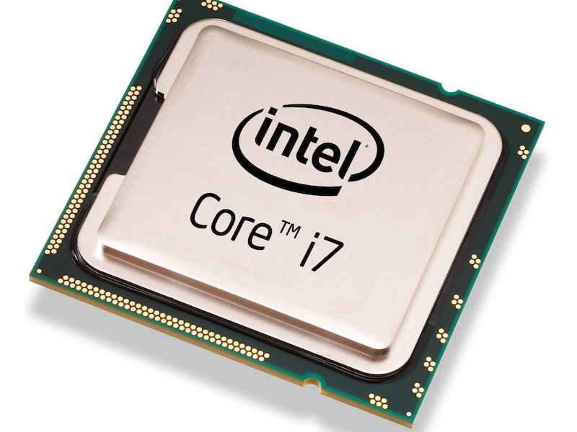
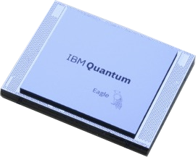
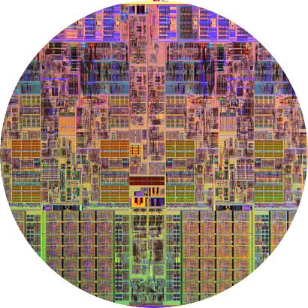
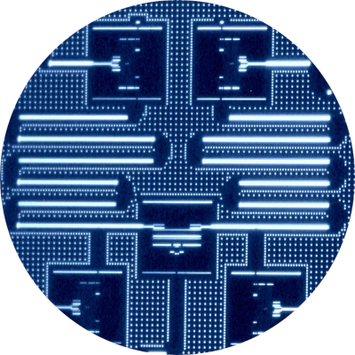

Classical vs Quantum Bit
classical
processor
CPU
quantum
processor
QPU
The basic unit of data is a quantum bit (qubit).
A physical qubit is a quantum object, such as as uperconducting circuit, an atom, or a photon.
A logical qubit is described by a state vector (ket) on the unit sphere.
The basic unit of data is a bit.
A physical bit: a voltage level
A logical bit is either 0 or 1.
|0⟩
1
5V
0
0V
|1⟩
Notes:
In a classical computer, the basic unit of data is a bit. At the machine level, a bit is typically represented by an electrical voltage controlled by a transistor-based circuit called a flip-flop. A high voltage represents bit 1, and a low voltage represents bit 0.
A logical bit can be either 0 or 1.
In quantum computing, the basic unit of data is a quantum bit (qubit).
A physical qubit is a quantum object, such as a superconducting circuit, an atom, or a photon.
A logical qubit is described by a state vector, or ket vector, on the unit sphere, with basis states ∣0⟩ and ∣1⟩ corresponding to the two possible classical bit values.

Slide 4



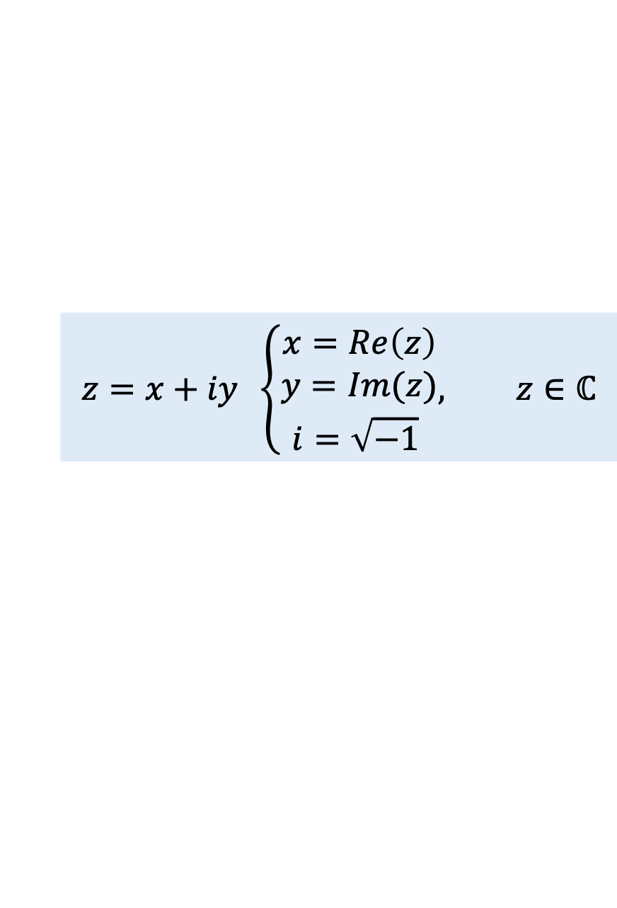








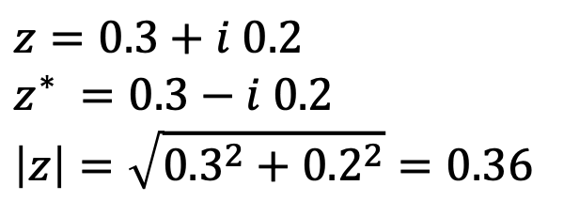





MathBox: Complex Numbers
ordered pair of real numbers
$$Im$$
$$z =x+iy$$
$$z=x+iy \left\{\begin{aligned}x=Re\left(z\right) \\ y=Im(z) \\ i=\sqrt{−1} \end{aligned}, z∈ℂ\right.$$
$$0.2i$$
$$z =0.3+i 0.2$$
$$\left|z\right|=\sqrt{x^{2}+y^{2}}=\sqrt{zz^{∗}}$$
$$0.1i$$
The complex conjugate
The modulus
$$z^{∗} =x−iy$$
$$\left|z\right|=\sqrt{x^{2}+y^{2}}=\sqrt{zz^{∗}}$$
O
0$.1$
$$0.2$$
$$0.3$$
$$Re$$
$$−0.1i$$
$$z^{∗} =0.3−i 0.2$$
Example:
$$z=0.3+i 0.2$$
$$z^{∗} =0.3−i 0.2$$
$$\left|z\right|=\sqrt{{0.3}^{2}+{0.2}^{2}}=0.36$$
$$−0.2i$$
$$z^{∗} =x−iy$$
Notes:
A complex number is an ordered pair of real numbers, for example, $x$ and $y$, written in algebraic form as: $z=x+iy$. The set of all complex numbers is denoted by the double-struck letter $ℂ$.
$x$ is the real part, and $y$ is the imaginary part of the complex number $z$.
$i$ is the imaginary unit, defined as $i=\sqrt{−1}$. ​
The complex conjugate of a number flips the sign of its imaginary part. We denote it by a star superscript, for example $z^{∗}$.
The absolute value (or modulus) of a complex number is the square root of the sum of its real part squared and imaginary part squared.
A complex number can be visually represented as a point in the complex plane, with coordinates $x$ and $y$:
$x$ lies on the horizontal (real) axis.
$y$ lies on the vertical (imaginary) axis.
A vector drawn from the origin to this point is called the position vector, or radius vector, of the complex number. The length of this vector equals the modulus of the complex number.
The example shows a complex number: $z=0.3+i 0.2$, its conjugate $z^{∗} =0.3−i 0.2$ and it modulus $\left|z\right|$.

Slide 5








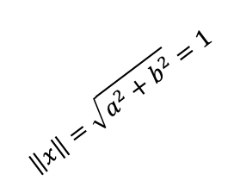









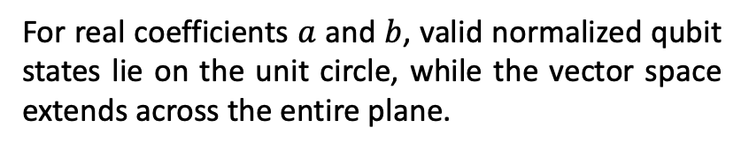


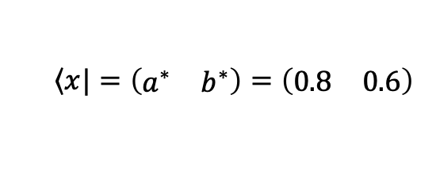




MathBox: Vectors in braket (Dirac) Notation
$$y$$
1
$$\left|1\right\rangle =\left(\begin{matrix}0 \\ 1\end{matrix}\right)$$
ket vector
$$\left|x\right\rangle =\left(\begin{matrix}a \\ b\end{matrix}\right)=\left(\begin{matrix}0.8 \\ 0.6\end{matrix}\right)$$
$$\left|1\right\rangle =\left(\begin{matrix}0 \\ 1\end{matrix}\right)$$
0$.8$
bra vector
$$\left\langle x\right.|=\left(\begin{matrix}a^{∗} & b^{∗}\end{matrix}\right)=\left(\begin{matrix}0.8 & 0.6\end{matrix}\right)$$
$$\left|x\right\rangle =a\left|0\right\rangle +b\left|1\right\rangle$$
0$.6$
$$(a.b)$$
0$.4$
$$\left\|x\right\|=\sqrt{a^{2}+b^{2}}=1$$
$$b\left|1\right\rangle$$
$$b$$
0$.2$
$$x$$
$$\left|0\right\rangle =\left(\begin{matrix}1 \\ 0\end{matrix}\right)$$
$$\left|0\right\rangle =\left(\begin{matrix}1 \\ 0\end{matrix}\right)$$
$$x$$
O
0$.2$
0$.4$
0$.6$
0$.8$
$$1$$
$$a\left|0\right\rangle$$
vector space
$$a$$
For real coefficients $a$ and $b$, valid normalized qubit states lie on the unit circle, while the vector space extends across the entire plane.
Notes:
A two-dimensional vector can be visualized as an arrow starting at the origin O and ending at the point determined by the coordinates $a$ and $b$.
In quantum computing, a vector representing the state of a quantum system is called a state vector. State vectors are usually written in bra-ket, or Dirac notation, named after physicist Paul Dirac. A column vector is written as ∣x⟩, pronounced “ket x,” while the corresponding row vector is written as ⟨x∣, pronounced “bra x.” If the elements of the ket vector are complex numbers, the corresponding bra contains their complex conjugates.
Another property of a state vector is that it always has length, or norm, equal to 1. A vector of length 1 is called a unit vector. We also say that the vector is normalized.
There are two special vectors, ∣0⟩ with coordinates (1,0) and ∣1⟩ with coordinates (0,1). These vectors are called basis vectors. The binary labels ∣0⟩ and ∣1⟩ serve only as identifiers. They are simply names for the vectors and are not typically used for binary operations.
The vector $\left|x\right\rangle$ can be expressed as a linear combination $\left|x\right\rangle =a\left|0\right\rangle +b\left|1\right\rangle$. A linear combination is formed by multiplying vectors by coefficients and then adding them together. Here, $a$ and $b$ are weights that determine the contributions of the basis vectors ∣0⟩ and ∣1⟩.
By choosing different real values of the coefficients $a$ and $b$, infinitely many vectors can be created. Together, these vectors form a vector space.
A vector space is a collection of vectors in which adding two vectors or multiplying a vector by a scalar always produces another vector in the same space.

Slide 6
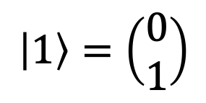



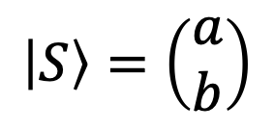
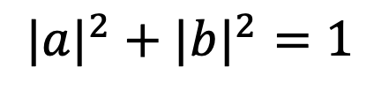



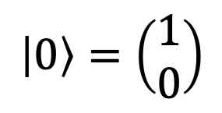
State Vector Representation of a Qubit
$$\left|1\right\rangle =\left(\begin{matrix}0 \\ 1\end{matrix}\right)$$
$$1$$
$$\left|S\right\rangle =\left(\begin{matrix}a \\ b\end{matrix}\right)$$
$$=a\left|0\right\rangle +b\left|1\right\rangle$$
linear combination (superposition)
$$b$$
$${|a|}^{2}+|{b|}^{2}=1$$
$$\left|0\right\rangle =\left(\begin{matrix}1 \\ 0\end{matrix}\right)$$
$$a$$
O
$$1$$
normalization condition:
$${|a|}^{2}+{|b|}^{2}=1$$
Notes:
A qubit state can be represented both geometrically and algebraically as a vector. Geometrically, it is represented as a directed line segment, while algebraically it is represented as a column vector.
For a single qubit, the unit vectors
$$\left|0\right\rangle =\left(\begin{matrix}1 \\ 0\end{matrix}\right), \left|1\right\rangle =\left(\begin{matrix}0 \\ 1\end{matrix}\right)$$
form a set of basis vectors. Their algebraic representations, $\left(\begin{matrix}1 \\ 0\end{matrix}\right)$ and $\left(\begin{matrix}0 \\ 1\end{matrix}\right)$ are called column vectors. Every qubit state can be expressed as a weighted sum, or linear combination, of these basis vectors. :
$$\left|S\right\rangle =\left(\begin{matrix}a \\ b\end{matrix}\right)=a\left|0\right\rangle +b\left|1\right\rangle$$
The coefficients $a$ and $b$ determine the contribution of each basis vector to the resulting state vector. This linear combination of basis vectors is called a superposition.
Geometrically, the linear combination can be viewed as vector addition: the resulting vector is the diagonal of the parallelogram formed by the two scaled basis vectors $a\left|0\right\rangle$ and $b\left|1\right\rangle$.
A valid qubit state must have unit length. Applying the Pythagorean theorem gives
$${|a|}^{2}+|{b|}^{2}=1$$
This is called the normalization condition. In the current two-dimensional geometric representation, all normalized state vectors lie on the unit circle.

Slide 7
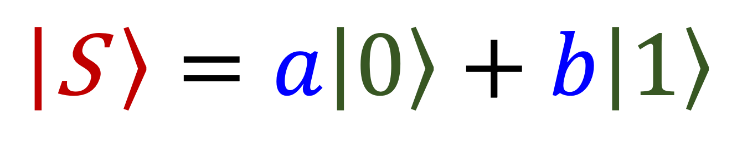
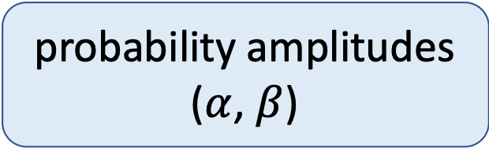
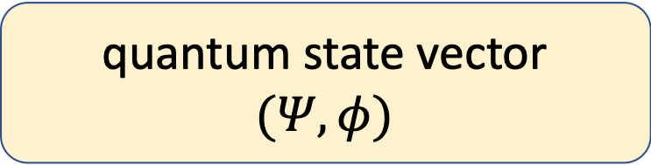
Superposition as a Linear Combination
quantum state vector
$$(Ψ,φ)$$
computational basis vectors
$$\left|\text{S} \right\rangle =a\left|\text{0}\right\rangle +b\left|\text{1}\right\rangle$$
probability amplitudes
($α$, $β$)
Notes:
The linear combination $\left|\text{S} \right\rangle =a\left|\text{0}\right\rangle +b\left|\text{1}\right\rangle$ is fundamental in quantum computing, as it describes a qubit's state in superposition. In this course, we will label a general state vector as $\left|\text{S} \right\rangle$. Greek letters such as $ψ, φ,α,β$ are also commonly used in scientific literature e.g., $\left|ψ\right\rangle =α\left|\text{0}\right\rangle +β\left|\text{1}\right\rangle$.
The coefficients $a$ and $b$, which we visualized as the state vector’s coordinates, are generally complex numbers known as probability amplitudes.

Slide 8


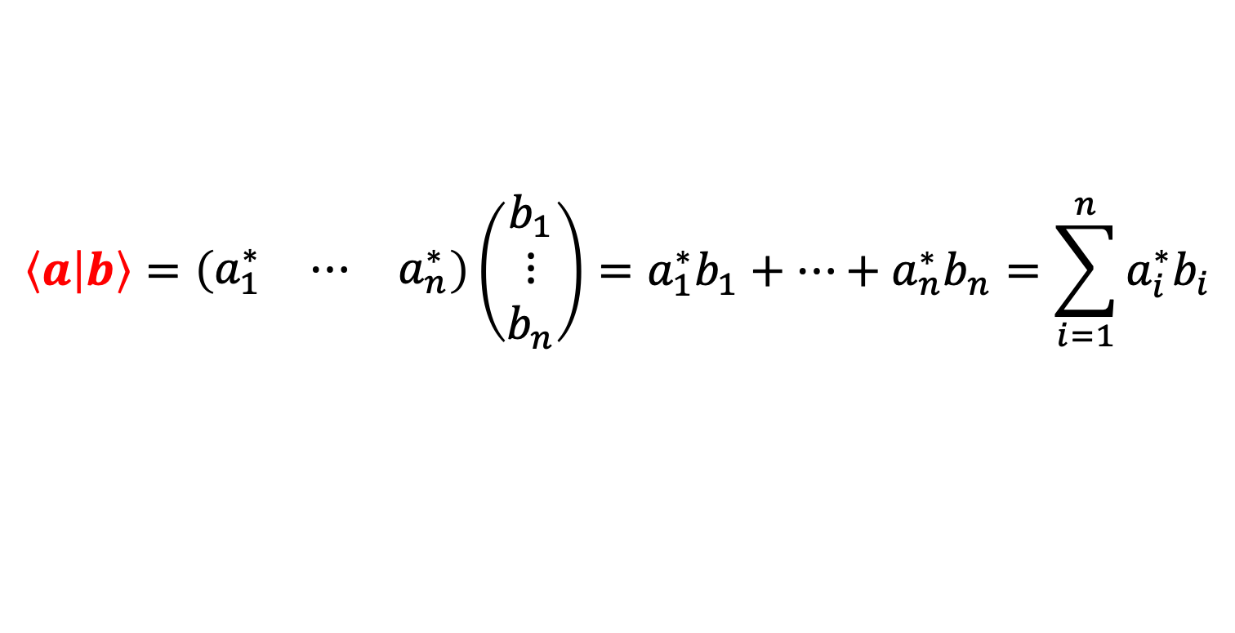
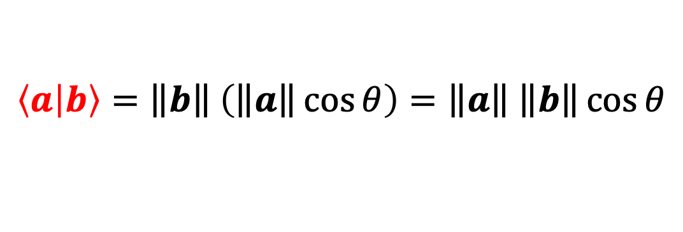
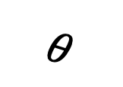

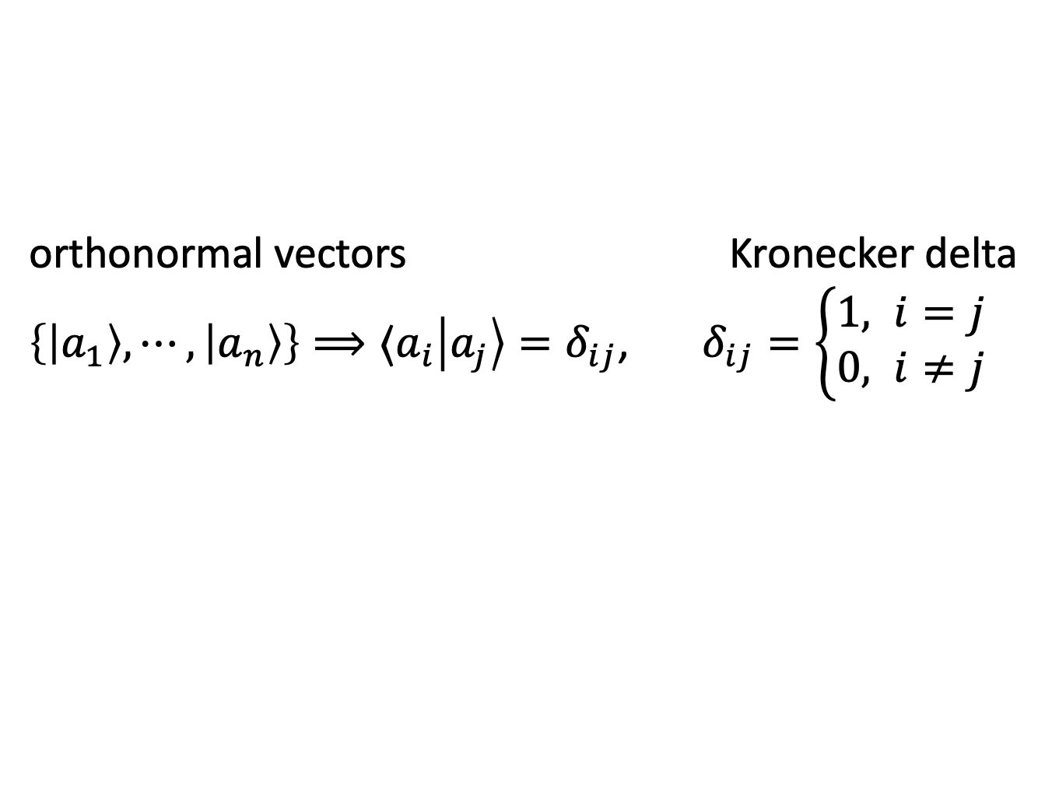
MathBox: Inner product
$$Inner product =length of b × \text{p}\text{rojection} \text{of} a \text{onto} b$$
$$\left\langle a | b\right\rangle =\left\|\left.b\right\|\right. \left(\left\|\left.a\right\|\right.\cos{θ}\right)=\left\|\left.a\right\|\right. \left\|\left.b\right\|\right.\cos{θ}$$
$$a$$
$$\left\langle a | b\right\rangle =\left(\begin{matrix}a_{1}^{∗} & ⋯ & a_{n}^{∗}\end{matrix}\right)\left(\begin{matrix}b_{1} \\ ⋮ \\ b_{n}\end{matrix}\right)=a_{1}^{∗}b_{1}+⋯+a_{n}^{∗}b_{n}=\sum_{i=1}^{n}{a_{i}^{∗}b_{i}}$$
$$θ$$
$$b$$
Properties:
orthonormal vectors Kronecker delta
$\left\{\left|a_{1}\right\rangle , ⋯, \left|a_{n}\right\rangle \right\}⟹⟨a_{i}\left|a_{j}\right\rangle =δ_{ij}$, $δ_{ij}=\left\{\begin{matrix}1, i=j \\ 0, i≠j\end{matrix}\right.$
$\left.\begin{matrix} & \left\langle a | a\right\rangle =1 \\ a⊥b & ⟨a\left|b\right\rangle =0\end{matrix}\right\}$,
Notes:
The inner product is one of the fundamental mathematical operations used to describe quantum states and their properties.
The geometric interpretation of the inner product is based on vector projection. It is defined as the length of vector $b$ multiplied by the length of the projection of vector $a$ onto the direction $b$:
$$\left\langle a | b\right\rangle =\left\|\left.b\right\|\right. \left(\left\|\left.a\right\|\right.\cos{θ}\right)=\left\|\left.a\right\|\right. \left\|\left.b\right\|\right.\cos{θ}$$
In quantum computing, vectors may have many dimensions and their components can be complex numbers. In this case, the inner product is defined algebraically as the bra–ket product $\left\langle ∙ | ∙\right\rangle$.
Two properties of the inner product are used throughout quantum computing.
First, the inner product of a unit vector with itself is 1. Geometrically, this follows because the angle between a vector and itself is 0°, and cos(0)=1.
Second, the inner product of two orthogonal unit vectors is 0. Geometrically, this follows because the angle between orthogonal vectors is 90°, and cos(π/2)=0.
When two vectors are both unit vectors and orthogonal to each other, they are called orthonormal vectors. A set of vectors $\left\{\left|a_{1}\right\rangle , \left|a_{2}\right\rangle , ⋯, \left|a_{n}\right\rangle \right\}$ is orthonormal if $⟨a_{i}\left|a_{j}\right\rangle =δ_{ij}$ where $δ_{ij}$ is the Kronecker delta: it equal 1 when $i=j$ and 0 otherwise
$$δ_{ij}=\left\{\begin{matrix}1, i=j \\ 0, i≠j\end{matrix}\right.$$

Slide 9
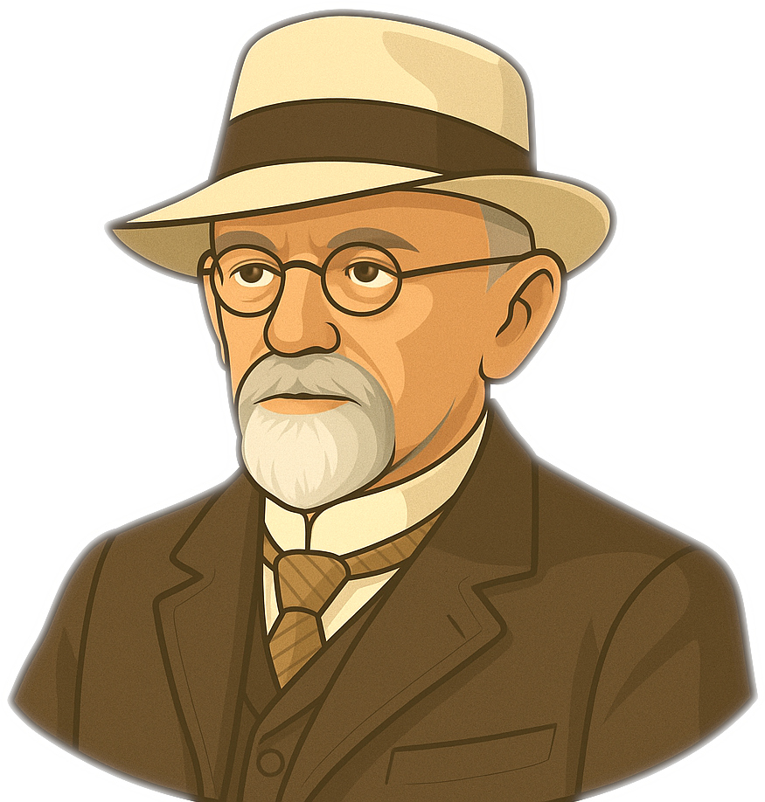
MathBox: Hilbert Space
Quantum states are represented by normalized vectors in a Hilbert space.
In quantum computing, a Hilbert space is a complex vector space equipped with an inner product.
Vector Space
Normed Space
Inner Product Space
David Hilbert (1862–1943)
Hilbert Space
Euclidean
space
Notes:
Quantum states are represented by normalized vectors in a Hilbert space.
A Hilbert space is a vector space over the complex numbers equipped with an inner product. It supports vector addition, scalar multiplication, and the inner product, allowing vector lengths, angles, projections, orthogonality, and normalization to be defined.

Slide 10
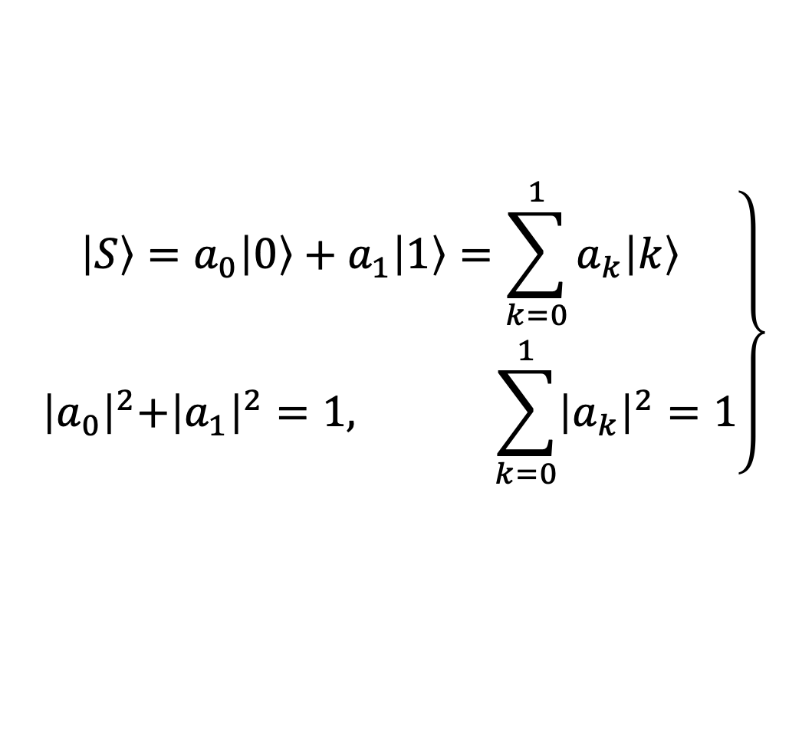
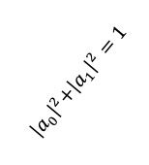
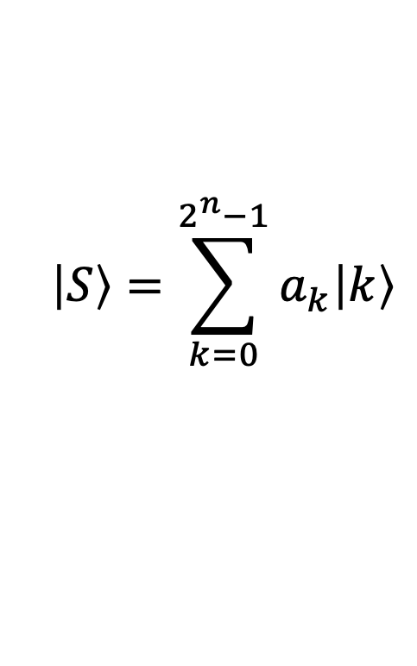
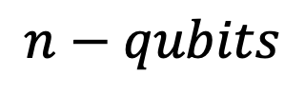

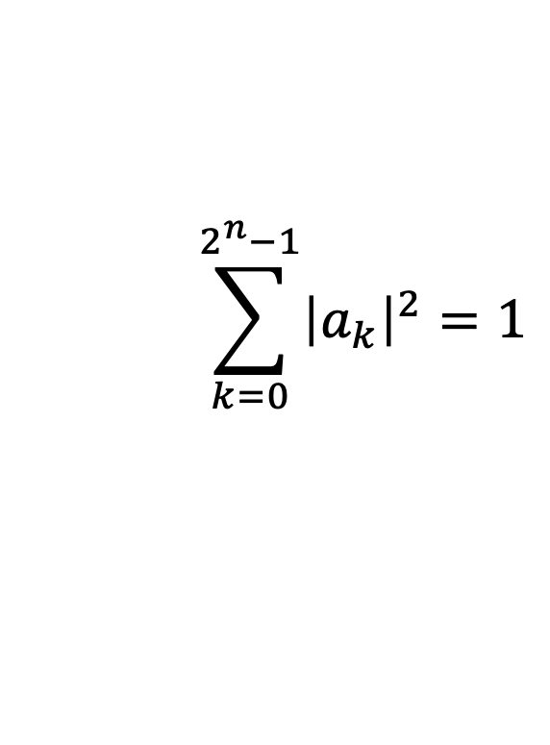

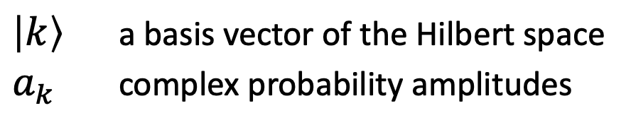



QMBox: Postulate 1 - Quantum State Postulate
A pure quantum state of an isolated quantum system is represented by a unit vector in a complex Hilbert space.
A pure state: state that is completely described by a single vector of length 1.
$$\left.\begin{matrix}\left|S\right\rangle =a_{0}\left|0\right\rangle +a_{1}\left|1\right\rangle =\sum_{k=0}^{1}{a_{k}\left|k\right\rangle } \\ { \left|a_{0}\right|}^{2}+{\left|a_{1}\right|}^{2}=1, \sum_{k=0}^{1}{{\left|a_{k}\right|}^{2}=1}\end{matrix}\right\}$$
$$\left|S\right\rangle =\sum_{k=0}^{2^{n}−1}{a_{k}\left|k\right\rangle }$$
$$\sum_{k=0}^{2^{n}−1}{{\left|a_{k}\right|}^{2}=1}$$
$$n−qubits$$
$$\left|1\right\rangle$$
$$\left|S\right\rangle$$
$$a_{1}$$
$\left|k\right\rangle$ a basis vector of the Hilbert space
$a_{k}$ complex probability amplitudes
$${ \left|a_{0}\right|}^{2}+{\left|a_{1}\right|}^{2}=1$$
$$\left|0\right\rangle$$
O
$$a_{0}$$
Notes:
Having introduced complex numbers, inner products, and Hilbert spaces, we now have the mathematical tools needed to state the first postulate of quantum mechanics.
The postulates of quantum mechanics describe the principles governing physical systems at the quantum level. The first postulate, known as the quantum state postulate, says that:
A pure quantum state of an isolated quantum system is represented by a unit vector in a complex Hilbert space.
A pure state is a quantum state that is completely described by a single unit vector.
The state of a single qubit is represented by a unit vector in a two-dimensional complex Hilbert space. This vector is expressed as a linear combination of the basis vectors, whose probability amplitudes satisfy the normalization condition. Here, $\left|k\right\rangle$ denotes the basis vectors ($\left|0\right\rangle$) and $\left|1\right\rangle$) of the Hilbert space, and $a_{k}$ ($a_{0}$ and $a_{1}$) are the corresponding complex probability amplitudes.
For an n-qubit system, the quantum state is represented as a linear combination of all basis vectors of the Hilbert space, with complex probability amplitudes as coefficients. A single qubit lives in a 2D space, two qubits in a 4D space, and n qubits in a 2ⁿ-dimensional space.
The key point is: no matter how many qubits we have, their combined state is always described by a single unit vector.

Slide 11

Bloch sphere
Notes:
Another useful representation of the quantum state of a single qubit is the Bloch sphere.

Slide 12






Bloch Sphere
$$z$$
$$\left|0\right\rangle$$
$$\left|S\right\rangle$$
$$y$$
$$x$$
$$\left|1\right\rangle$$
Felix Bloch (1905-1983)
Notes:
The Bloch sphere is named after physicist Felix Bloch, who developed this representation to visualize the states of two-level quantum systems.
The Bloch sphere is a geometric representation of the quantum state of a single qubit. Each pure quantum state is represented by a point on the surface of the sphere and the corresponding vector from the center of the sphere.
The basis vectors ∣0⟩ and ∣1⟩ are represented by points at the poles of the sphere. All other points correspond to qubit states that are in a superposition of these two basis states.

Slide 13







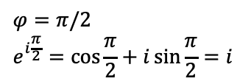

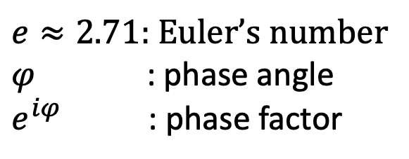
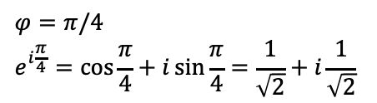






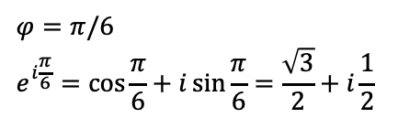










MathBox: Euler’s Formula
$$Im$$
$$i$$
$$e^{iφ}=\cos{φ}+i\sin{φ}$$
$$z$$
$e≈2.71$: Euler’s number
$φ$ : phase angle
$e^{iφ}$ : phase factor
$$e^{iφ}$$
$$\sin{φ}$$
$$φ$$
Leonhard Euler
(1707-1783)
O
$$\cos{φ}$$
$$Re$$
$$1$$
$$φ=0$$
$$e^{i0}=\cos{0}+i\sin{0=1}$$
$$φ=π/6$$
$$e^{i\frac{π}{6}}=\cos{\frac{π}{6}}+i\sin{\frac{π}{6}}=\frac{\sqrt{3}}{2}+i\frac{1}{2}$$
$$φ=π/4$$
$$e^{i\frac{π}{4}}=\cos{\frac{π}{4}}+i\sin{\frac{π}{4}=\frac{1}{\sqrt{2}}+i\frac{1}{\sqrt{2}}}$$
$$φ=π/2$$
$$e^{i\frac{π}{2}}=\cos{\frac{π}{2}}+i\sin{\frac{π}{2}=i}$$
$$i$$
$$i$$
$$i$$
$$i$$
$$\frac{i}{\sqrt{2}}$$
$$\frac{i}{2}$$
$$φ$$
$$φ$$
$$φ$$
O
$$1$$
O
$$\frac{\sqrt{3}}{2}$$
$$1$$
O
$$\frac{1}{\sqrt{2}}$$
$$1$$
O
$$1$$
Notes:
Before introducing the Bloch sphere, it is useful to first understand the phase factor.
Consider the unit complex number and its associated vector shown in the figure. Its real part is $\cos{φ}$, and its imaginary part is $\sin{φ}$. This means that the complex number can be written as $\cos{φ}+i\sin{φ}$. Euler's formula shows that the same complex number can be written more compactly as $e^{iφ}=\cos{φ}+i\sin{φ}$, where
$e≈2.71$ is Euler’s number.
$φ$ is the phase angle,
$e^{iφ}$ is called a phase factor and it has modulus 1.
Although $e$ is usually associated with exponential growth, Euler's formula shows that an imaginary exponent transforms exponential functions into rotations on the unit circle. As the angle $φ$ increases, the complex number and its associated vector rotate around the origin. Since this rotation is captured by the phase factor $e^{iφ}$, multiplying any complex number by $e^{iφ}$ rotates it by $φ$ around the origin.

Slide 14












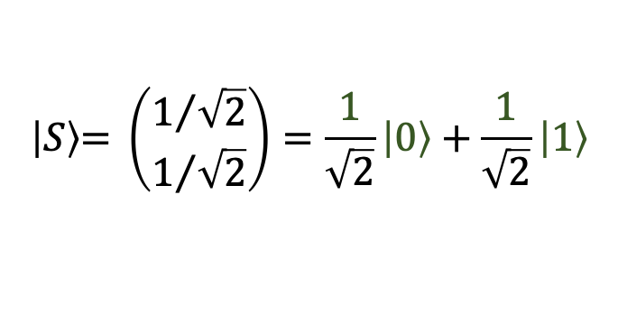


2D Vector Model vs. Bloch Sphere Model
$$z$$
$$\left|S\right\rangle \text{= }\left(\begin{matrix}1/{\sqrt{2}} \\ 1/{\sqrt{2}}\end{matrix}\right)=\frac{1}{\sqrt{2}}\left|\text{0}\right\rangle +\frac{1}{\sqrt{2}}\left|\text{1}\right\rangle$$
$$z$$
$$\left|0\right\rangle$$
$$\left|1\right\rangle$$
$$a_{1}=\frac{1}{\sqrt{2}}$$
$$\left|S\right\rangle$$
$$\left|0\right\rangle$$
$$θ$$
$$x$$
$$a_{0}=\frac{1}{\sqrt{2}}$$
$$φ$$
$$y$$
$$x$$
$$\left|1\right\rangle$$
2D model
Bloch sphere
Notes:
In the two-dimensional model, the qubit state vector moves along the unit circle, with real probability amplitudes $a_{0}$ and $a_{1}$ as its coordinates. The basis vectors ∣0⟩ and ∣1⟩ are orthonormal and aligned along the x- and z-axes, respectively. The image shows a qubit in an equal superposition of basis vectors, with probability amplitudes of $1/{\sqrt{2}}$. The normalization condition is automatically satisfied because all qubit state vectors end on the unit circle.
In the Bloch sphere representation, a qubit state is represented by a vector whose direction is determined by the polar angle θ and the phase angle $φ$. The angle θ, measured from the positive z-axis, determines the position of the vector between the North Pole (∣0⟩) and the South Pole (∣1⟩). The phase angle $φ$ determines the rotation of the vector around the z-axis and corresponds to the relative phase factor $e^{iφ}$ in the qubit state.
For $φ=0$ or $φ=π$, the Bloch vector lies in the xz-plane, and the qubit state has only real probability amplitudes. This plane is highlighted in green in the figure. For all other values of $φ$, the qubit state has complex probability amplitudes.

Slide 15




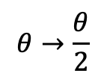




















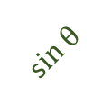

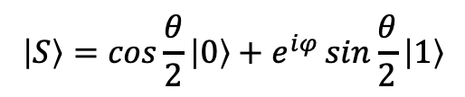




Anatomy of the Bloch sphere
$$z$$
$$\left|0\right\rangle$$
$$z$$
$$\left|0\right\rangle$$
$$z$$
$$\left|0\right\rangle$$
(1)
(2)
(3)
$$\left|S\right\rangle$$
$$\left|S\right\rangle$$
$$\left|S\right\rangle$$
$$θ$$
$$θ$$
$$θ$$
$$c\text{os} θ$$
$$c\text{os} θ$$
$$c\text{os} θ$$
$$φ$$
$$φ$$
s$in θ$
$$y$$
$$y$$
$$y$$
$$\left|1\right\rangle$$
$$\left|1\right\rangle$$
${ e}^{iφ}$s$in θ$
${ e}^{iφ}$s$in θ$
$$x$$
$$x$$
$$x$$
$$\left|1\right\rangle$$
$$θ→\frac{θ}{2}$$
$$\left|S\right\rangle =cos{θ}\left|0\right\rangle +\sin{θ}\left|1\right\rangle$$
$${ e}^{iφ}$$
$$\left|S\right\rangle =cos{θ}\left|0\right\rangle +{ e}^{iφ}sin{θ}\left|1\right\rangle$$
$$\left|S\right\rangle =\cos{\frac{θ}{2}}\left|0\right\rangle +e^{iφ}\sin{\frac{θ}{2}}\left|1\right\rangle$$
$$\left|S\right\rangle =\left(\begin{matrix}\cos{\frac{θ}{2}} \\ e^{iφ}\sin{\frac{θ}{2}}\end{matrix}\right)$$
$$0≤θ≤π, 0≤φ≤2π$$
Notes:
To understand the Bloch sphere, we begin with a simplified geometric model and then extend it to the standard Bloch sphere representation.
Consider a unit vector ∣S⟩ drawn from the center of a unit sphere to a point on its surface. Let the vector initially lie in the xz-plane and make an angle θ with the positive z-axis. The basis vectors are ∣0⟩, aligned with the z-axis, and ∣1⟩, aligned with the x-axis. We can now represent ∣S⟩ as ∣S⟩=cosθ ∣0⟩+sinθ ∣1⟩.
If the vector ∣S⟩ is now rotated by an angle $φ$ in the xy plane, the component sinθ ∣1⟩ acquires a phase factor ${ e}^{iφ}$. The state becomes ∣S⟩=cosθ ∣0⟩+${ e}^{iφ}$sinθ ∣1⟩. The factor ${ e}^{iφ}$ is called the relative phase because it affects only one component of the state. In this model, for θ=0 the state is ∣0⟩, for θ=π/2 it becomes ∣1⟩, and for θ=π it becomes −∣0⟩. Thus, the transition from ∣0⟩ to ∣1⟩ is completed halfway through the sphere, leaving the remaining half without introducing new physical states.
To use the entire sphere, we replace θ with θ/2. This ensures that the full range from 0 to π corresponds to the transition from ∣0⟩ at the North Pole to ∣1⟩ at the South Pole, rather than reaching ∣1⟩ at the equator. This leads to the standard Bloch sphere representation of a qubit state:
$$\left|S\right\rangle =\left(\begin{matrix}\cos{\frac{θ}{2}} \\ e^{iφ}\sin{\frac{θ}{2}}\end{matrix}\right)$$

Slide 16
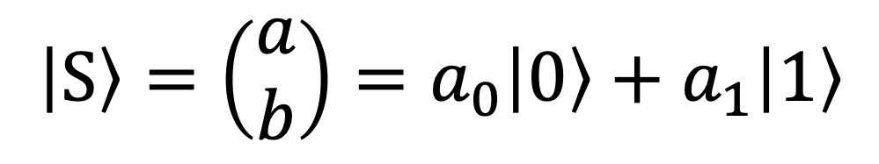
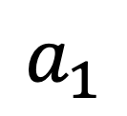
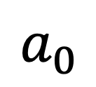
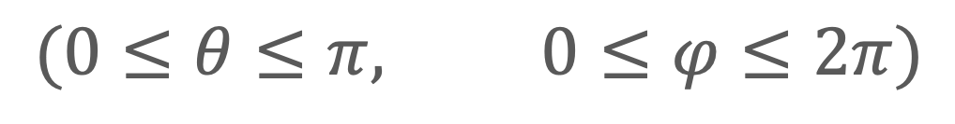

Qubit State Equations
$$\left|\text{S}\right\rangle =\left(\begin{matrix}a \\ b\end{matrix}\right)=a_{0}\left|\text{0}\right\rangle +a_{1}\left|\text{1}\right\rangle$$
$$a_{0}$$
$$a_{1}$$
$$\left|S\right\rangle =\left(\begin{matrix}\cos{\frac{θ}{2}} \\ e^{iφ}\sin{\frac{θ}{2}}\end{matrix}\right)=\cos{\frac{θ}{2}}\left|0\right\rangle +e^{iφ}\sin{\frac{θ}{2}}\left|1\right\rangle$$
$$(0≤θ≤π, 0≤φ≤2π)$$
Notes:
We can now compare the two representations of a qubit state.
In the first equation, the qubit state is expressed as a linear combination of the basis vectors ∣0⟩ and ∣1⟩, with complex probability amplitudes $a_{0}$​ and $a_{1}$.
In the second equation, the same state is expressed in Bloch sphere form, where the probability amplitudes are parameterized by the polar angle $θ$ and the phase angle $φ$.

Slide 17





Standard Basis: $\{\left|0\right\rangle ,\left|1\right\rangle \}$
$$z$$
$$\left|0\right\rangle$$
$$\begin{matrix}\left|S\right\rangle \underset{→}{θ=0,φ=0} & =\cos{0}\left|0\right\rangle +e^{i0}\sin{0}\left|1\right\rangle & =\left|0\right\rangle \\ \left|S\right\rangle \underset{→}{θ=π,φ=0} & =\cos{\frac{π}{2}}\left|0\right\rangle +e^{i0}\sin{\frac{π}{2}}\left|1\right\rangle & =\left|1\right\rangle \end{matrix}$$
$$y$$
$$\left|1\right\rangle$$
$$x$$
Notes:
By varying the parameters θ and $φ$, different basis vectors can be defined, relative to which all other vectors in the qubit vector space are described.
The vector pair {∣0⟩,∣1⟩} forms the standard basis along the z-axis. These vectors correspond to Bloch sphere angles θ=0, $φ$=0, and θ=π, $φ$=0.

Slide 18



Diagonal Basis: $\left\{\left|+\right\rangle ,\left|−\right\rangle \right\}$
$$z$$
$$\begin{matrix}\begin{matrix}\left|S\right\rangle \underset{→}{θ=\frac{π}{2},φ=0} & =\cos{\frac{π}{4}}\left|0\right\rangle +e^{i0}\sin{\frac{π}{4}}\left|1\right\rangle \\ & =\frac{\left|0\right\rangle +\left|1\right\rangle }{\sqrt{2}}=\left|+\right\rangle \\ \left|S\right\rangle \underset{→}{θ=\frac{π}{2},φ=π} & =\cos{\frac{π}{4}}\left|0\right\rangle +e^{iπ}\sin{\frac{π}{4}}\left|1\right\rangle \\ & =\frac{\left|0\right\rangle −\left|1\right\rangle }{\sqrt{2}}=\left|−\right\rangle \end{matrix}\end{matrix}$$
$$\left|−\right\rangle$$
$$y$$
$$\left|+\right\rangle$$
$$x$$
Notes:
The vector pair $\{\left|+\right\rangle ,\left|−\right\rangle \}$ forms the diagonal basis along the $x$ axis, where
$$\left|+\right\rangle =\frac{\left|0\right\rangle +\left|1\right\rangle }{\sqrt{2}} and \left|−\right\rangle =\frac{\left|0\right\rangle −\left|1\right\rangle }{\sqrt{2}}$$
These vectors correspond to Bloch sphere angles:
$θ=π/2$, $φ=0$ for $\left|+\right\rangle$, and
$θ=π/2$, $φ=π$ for $\left|−\right\rangle$

Slide 19



Circular basis: $\left\{\left|+i\right\rangle ,\left|−i\right\rangle \right\}$
$$z$$
$$\begin{matrix}\begin{matrix}\left|S\right\rangle \underset{→}{θ=\frac{π}{2},φ=\frac{π}{2}} & =\cos{\frac{π}{4}}\left|0\right\rangle +e^{i\frac{π}{2}}\sin{\frac{π}{4}}\left|1\right\rangle \\ & =\frac{\left|0\right\rangle +i\left|1\right\rangle }{\sqrt{2}}=\left|+i\right\rangle \\ \left|S\right\rangle \underset{→}{θ=\frac{π}{2},φ=\frac{3π}{2}} & =\cos{\frac{π}{4}}\left|0\right\rangle +e^{i\frac{3π}{2}}\sin{\frac{π}{4}}\left|1\right\rangle \\ & =\frac{\left|0\right\rangle −i\left|1\right\rangle }{\sqrt{2}}=\left|−i\right\rangle \end{matrix}\end{matrix}$$
$$\left|−i\right\rangle$$
$$\left|+i\right\rangle$$
$$y$$
$$x$$
Notes:
The vector pair $\{\left|+i\right\rangle ,\left|−i\right\rangle \}$ forms the circular basis along the y-axis, where
$$\left|i+\right\rangle =\frac{\left|0\right\rangle +i\left|1\right\rangle }{\sqrt{2}} and \left|i−\right\rangle =\frac{\left|0\right\rangle −i\left|1\right\rangle }{\sqrt{2}}$$
These vectors correspond to Bloch sphere angles:
$θ=π/2$, $φ=π/2$ for $\left|+i\right\rangle$, and
$θ=π/2$, $φ=3π/2$ for $\left|−i\right\rangle$

Slide 20





The Breitbart Bases : $\left\{\left|b_{0}\right\rangle ,\left|b_{1}\right\rangle \right\},\left\{\left|{b′}_{0}\right\rangle ,\left|{b′}_{1}\right\rangle \right\}$
$$z$$
$$\left|{b′}_{0}\right\rangle$$
$$\left|b_{0}\right\rangle$$
$$\begin{matrix}\left|b_{0}\right\rangle & =\cos{\frac{π}{8}}\left|0\right\rangle +\sin{\frac{π}{8}}\left|1\right\rangle \\ \left|b_{1}\right\rangle & =−sin{\frac{π}{8}}\left|0\right\rangle +\cos{\frac{π}{8}}\left|1\right\rangle \end{matrix}$$
$$\left|b_{1}\right\rangle$$
$$y$$
$$\left|{b′}_{1}\right\rangle$$
$$x$$
Notes:
The Breitbart bases, also known as intermediate bases, refer to sets of basis states that lie between the computational basis {∣0⟩,∣1⟩, the diagonal basis {∣+⟩,∣−⟩.
The Breitbart basis consists of real vectors in the xz-plane of the Bloch sphere. The basis vectors are at an angle of π/4 relative to the coordinate axes in the plane.
These bases are often used in quantum cryptography.

Slide 21



















Qubit state visualization using a bar chart
$$\left|S\right\rangle \text{=}\frac{1}{\sqrt{2}}e^{0}\left|0\right\rangle +\frac{1}{\sqrt{2}}e^{i\frac{3π}{8}}\left|1\right\rangle$$
$$\left|S\right\rangle \text{=}\text{0.951}\left|0\right\rangle −0.309\left|1\right\rangle$$
$$1$$
$$0.951$$
$$1$$
$$π/2$$
$$\frac{1}{\sqrt{2}}$$
$$\left|0\right\rangle$$
$$0$$
$$π$$
$$\left|1\right\rangle$$
$$2π$$
$$0$$
$$−0.309$$
$$\left|0\right\rangle$$
$$\left|1\right\rangle$$
$$3π/2$$
$$−1$$
Notes:
A qubit is often visualized using a bar chart, where the horizontal axis represents the basis states ∣0⟩ and ∣1⟩, and the height of each bar corresponds to the probability amplitude. The image shows a qubit visualization where the probability amplitudes are real numbers, such as 0.951 and -0.309.
A phase-aware bar chart is shown in the image on the right. Here, the bar heights are proportional to the magnitude of the amplitudes, while the colors indicate the phase angles, as depicted in the circular legend on the right.
In this example:
The phase angle of ∣0⟩ is 0, shown in blue.
The phase angle of ∣1⟩ is 3π/8, shown in a shade of purple.

Slide 22
Quantum Measurement
Notes:
The value of a qubit is obtained through quantum measurement. The term "measurement" comes from quantum mechanics and was introduced by physicists developing quantum hardware.
In computing, the term "reading a qubit" might be more appropriate, but "measurement" remains the standard terminology.

Slide 23








Born Rule
$$\left|S\right\rangle =a\left|0\right\rangle + b\left|1\right\rangle$$
a
b
$$2$$
$$2$$
$$a^{}$$
$$b^{}$$
Max Born (1882-1970)
$$\begin{aligned}&\begin{matrix}\left|S\right\rangle =a\left|0\right\rangle +b\left|1\right\rangle \underset{→}{measuremente}\left\{\begin{matrix}\left|0\right\rangle with probability {P\left(0\right)=\left|a\right|}^{2} \\ \left|1\right\rangle with probability P\left(1\right)={\left|b\right|}^{2}\end{matrix}\right. \\ \\ where {\left|a\right|}^{2}+{\left|b\right|}^{2}=1 normalization constraint\end{matrix}\#\end{aligned}$$
Born rule
Notes:
One of the fundamental rules of quantum mechanics that explains the outcome of quantum measurement is Born’s rule, named after the German physicist Max Born.
To illustrate this rule, imagine a qubit as a spinning coin, appearing to be in a superposition of heads and tails, marked 0 and 1. The 'superposition' state of the coin can be expressed as 𝑎|0⟩ + 𝑏|1⟩, where the coefficient 𝑎 represents the weight pulling the outcome toward 0, and 𝑏 represents the weight pulling it toward 1.
If we touch the coin, the superposition is disrupted, and the coin lands on either 0 with a probability proportional to 𝑎, or on 1 with a probability proportional to 𝑏.
In the 1920s, Max Born proposed a rule that connects these coefficients to the probabilities of outcomes in the quantum world. According to the Born rule, when a quantum system is measured, it collapses to one of the possible states, with the probability of each outcome equal to the square of the corresponding probability amplitude.
This means that a qubit in a superposition collapses to ∣0⟩ with probability |𝑎|² or to ∣1⟩ with probability |𝑏|² when it is measured. This is why the coefficients 𝑎 and 𝑏 are called probability amplitudes. Since probabilities must be real numbers, but the probability amplitudes may be complex, the probability of each outcome is given by the squared modulus of the corresponding amplitude.
Because a measurement always produces one of the possible outcomes, the total probability of all outcomes must equal 1. Therefore, the normalization condition |𝑎|² + |𝑏|² = 1, must hold. This gives the normalization condition a physical interpretation: the sum of the probabilities of all possible measurement outcomes is equal to 1. Earlier, we derived the same condition geometrically from the vector model using the Pythagorean theorem.
Finally, after the superposition collapses, the coin remains in one of the two states, and repeated measurements on a stationary coin will yield the same result.

Slide 24





The Most Famous Footnote in Science
wavefunction $Φ(x)$
$$Φ^{2}(x)$$
|a|²
position
$$x_{0}$$
$$x$$
Max Born, On the Quantum Mechanics of Collision, 1926
Notes:
An interesting anecdote is connected with Max Born's famous 1926 paper, On the Quantum Mechanics of Collisions, shown here in its English translation.
In quantum mechanics, the state of a particle is described by a mathematical function called the wave function. In the original paper, Born wrote (highlighted here in red) that the probability of finding a particle at a particular position is proportional to the value (amplitude) of its wave function at that position.
After the paper was published, Born realized that the probability is not proportional to the amplitude itself, but to the square of its absolute value. In an added footnote, he corrected the original statement. This simple correction became one of the fundamental principles of quantum mechanics and is now known as the Born rule. The footnote is often regarded as one of the most famous in the history of physics, as it contained the key insight that later earned Born the Nobel Prize.
In the illustration, the blue graph shows the wave function, while the red graph shows the square of its absolute value. Suppose we want to find the probability of detecting the particle at position$x_{0}$​. According to the Born rule, that probability is determined by the value of the lower graph at $x_{0}$​.

Slide 25












Born Rule Revisited
$$\left\langle \left.0\right|\right.$$
$\left\langle 0 | 0\right\rangle =1$, $\left\langle 0 | 1\right\rangle =0$
$$\left|S\right\rangle =a\left|0\right\rangle +b\left|1\right\rangle$$
$\left\langle 0 | S\right\rangle$= $a\left\langle 0 | 0\right\rangle +b\left\langle 0 | 1\right\rangle$
$$\left\langle 0 | S\right\rangle =a$$
$$\left\langle \left.1\right|\right.$$
$\left\langle 1 | 0\right\rangle =1$, $\left\langle 1 | 1\right\rangle =1$
$$\left|S\right\rangle =a\left|0\right\rangle +b\left|1\right\rangle$$
$\left\langle 1 | S\right\rangle$= $a\left\langle 1 | 0\right\rangle +b\left\langle 1 | 1\right\rangle$
$$\left\langle 1 | S\right\rangle =b$$
The inner product extracts the probability amplitude associated with a basis state.
Born rule
$$\begin{matrix}P\left(0\right)= & {\left|a\right|}^{2} \\ & \\ P\left(1\right)= & {\left|b\right|}^{2}\end{matrix}$$
$$\begin{matrix}P\left(0\right)= & {\left|\left\langle 0 | S\right\rangle \right|}^{2} \\ & \\ P\left(1\right)= & {\left|\left\langle 1 | S\right\rangle \right|}^{2}\end{matrix}$$
Notes:
The Born rule can be expressed in a more general mathematical form using inner products.
Suppose the qubit is in the state: $\left|S\right\rangle =a\left|0\right\rangle +b\left|1\right\rangle$
Taking the inner product with the basis vector $\left\langle \left.0\right|\right.$ gives: $\left\langle 0 | S\right\rangle$= $a\left\langle 0 | 0\right\rangle +b\left\langle 0 | 1\right\rangle$
Because the computational basis is orthonormal: $\left\langle 0 | 0\right\rangle =1$, $\left\langle 0 | 1\right\rangle =0,$ we get $\left\langle 0 | S\right\rangle =a$
Similarly,
Taking the inner product with the basis vector $\left\langle \left.1\right|\right.$ gives: $\left\langle 1 | S\right\rangle$= $a\left\langle 1 | 0\right\rangle +b\left\langle 1 | 1\right\rangle$
Because the computational basis is orthonormal: $\left\langle 1 | 0\right\rangle =0$, $\left\langle 1 | 1\right\rangle =1$ we get $\left\langle 1 | S\right\rangle =b$
In other words, the inner product extracts the probability amplitude associated with each basis state.
If we now replace the probability amplitudes in the Born rule with their inner-product expressions, we obtain a more general form of the Born rule. The probability of each measurement outcome is given by the squared modulus of the inner product between the corresponding basis state and the quantum state being measured.
$$P\left(0\right)={\left|\left\langle 0 | S\right\rangle \right|}^{2}, P\left(1\right)={\left|\left\langle 1 | S\right\rangle \right|}^{2}$$

Slide 26

QMBox: Postulate 2 - Measurement Postulate / Born Rule
If a quantum system in state $\left|S\right\rangle$is measured in an orthonormal basis $\left\{\left|k\right\rangle \right\}$ the probability of obtaining outcome $k$ is
$$P\left(k\right)={\left|\left\langle k | S\right\rangle \right|}^{2}$$
Max Born (1882 – 1970)
Notes:
Using the previous results, we can now state the measurement postulate of quantum mechanics:
If a quantum system in state $\left|S\right\rangle$is measured in an orthonormal basis $\left\{\left|k\right\rangle \right\}$, the probability of obtaining outcome $k$ is equal to the squared modulus of the inner product between the basis state $\left|k\right\rangle$ and the quantum state $\left|S\right\rangle$.

Slide 27









Histogram of Measurement Results
number of times an outcome occurs​
total number of measurement
relative frequency = (experimental probability)
1
≈
$$\left|0\right\rangle$$
$${|a|}^{2}$$
0.64
$$\left(\begin{matrix}a \\ b\end{matrix}\right)$$
$$\left|S\right\rangle =a\left|0\right\rangle +b\left|1\right\rangle$$
outcome n n/1000
0 640 0.64
1 360 0.36
≈
0.36
$${|b|}^{2}$$
640 times
360 times
$$\left|1\right\rangle$$
0
0
1
Notes:
In quantum computing, we are primarily interested in the statistical outcome of measurements.
As an analogy, imagine measuring a qubit using two electromagnets placed at the North and South Poles of the Bloch sphere and connected to a measurement instrument. When the magnets are switched on, they pull the Bloch vector toward one of the two poles. The Born rule tells us that the vector reaches the North Pole with probability |𝑎|², giving the result 0, or the South Pole with probability |𝑏|², giving the result 1.
To determine the properties of a qubit before measurement, we repeat the same experiment many times. After each measurement, the qubit collapses to either ∣0⟩ or ∣1⟩, so it must be prepared again in the same initial state before the next measurement.
The process is repeated many times, and each outcome is recorded. The relative frequency, or experimental probability, of each outcome is calculated by dividing the number of times that outcome occurs by the total number of measurements.
For example, suppose the measurement is repeated 1,000 times. If the result 0 is obtained 640 times and the result 1 is obtained 360 times, the estimated probabilities are 0.64 and 0.36 respectively.
These results are typically displayed as a histogram. The horizontal axis represents the possible measurement outcomes, while the vertical axis shows the estimated probability of each outcome. From this histogram, we can estimate that the qubit was in a superposition with probability amplitudes of approximately 0.8 for |0⟩ and 0.6 for |1⟩ since $\sqrt{0.64}=0.8$ and $\sqrt{0.36}=0.6$. However, the histogram provides no information about the relative phase between the two amplitudes.
As a result, many different qubit states can produce exactly the same measurement histogram. This illustrates a fundamental property of quantum mechanics: a single measurement cannot reveal the complete information encoded in a quantum state.

Slide 28




Quantum Algorithm
$$\frac{\left|0\right\rangle +\left|1\right\rangle }{\sqrt{2}}$$
$$\frac{\left|0\right\rangle +\left|1\right\rangle }{\sqrt{2}}$$
|+⟩
1
1
|1⟩
$$\frac{\left|0\right\rangle +\left|1\right\rangle }{\sqrt{2}}$$
quantum algorithm
0
0
0
1
0
1
Notes:
When analysing measurement results, it is important to remember that qubit states are not random but are controlled by quantum programs.
At the start of a quantum algorithm, qubits are typically placed in an equal superposition of both possible outcomes. Measuring the qubit at this stage would yield a completely random result, either 0 or 1.
The goal of the quantum algorithm is to manipulate the qubit’s state so that measurement produces the correct result with high probability.
For example, suppose 0 represents "no rain" and 1 represents "rain." A quantum algorithm, which may take additional parameters into account, adjusts the probability amplitudes to produce an accurate prediction. In this case, if the algorithm determines that rain is likely, it maximizes the probability of measuring 1.

Slide 29
Quantum register
Notes:
To enable a quantum computer to perform useful tasks, it requires several qubits, which are organized into quantum registers.

Slide 30




MathBox: Kronecker (tensor) product
$$A=\left(\begin{matrix}a_{11} & ⋯ & a_{1n} \\ a_{21} & ⋯ & a_{2n} \\ ⋮ & & ⋮ \\ a_{m1} & ⋯ & a_{mn}\end{matrix}\right), B=\left(\begin{matrix}b_{11} & ⋯ & b_{1n} \\ b_{21} & ⋯ & b_{2n} \\ ⋮ & & ⋮ \\ b_{m1} & ⋯ & b_{mn}\end{matrix}\right)$$
$$A⊗B=\left(\begin{matrix}a_{11}(B) & a_{12}(B) & ⋯ & a_{1n}(B) \\ a_{21}(B) & a_{22}(B) & ⋯ & a_{2n}(B) \\ ⋮ & ⋮ & a_{ij}(B) & ⋮ \\ a_{m1}(B) & a_{m2}(B) & ⋯ & a_{mn}(B)\end{matrix}\right)$$
Leopold Kronecker
(1823 – 1891)
Example:
$$\left(\begin{matrix}1 \\ 2\end{matrix}\right)⊗\left(\begin{matrix}3 \\ 4\end{matrix}\right)=\left(\begin{matrix}1\left(\begin{matrix}3 \\ 4\end{matrix}\right) \\ 2\left(\begin{matrix}3 \\ 4\end{matrix}\right)\end{matrix}\right)=\left(\begin{matrix}3 \\ 4 \\ 6 \\ 8\end{matrix}\right)$$
$$\left(\begin{matrix}1 & 2 \\ 3 & 4\end{matrix}\right)⊗\left(\begin{matrix}5 & 6 \\ 7 & 8\end{matrix}\right)=\left(\begin{matrix}1\left(\begin{matrix}5 & 6 \\ 7 & 8\end{matrix}\right) & 2\left(\begin{matrix}5 & 6 \\ 7 & 8\end{matrix}\right) \\ 3\left(\begin{matrix}5 & 6 \\ 7 & 8\end{matrix}\right) & 4\left(\begin{matrix}5 & 6 \\ 7 & 8\end{matrix}\right)\end{matrix}\right)=\left(\begin{matrix}5 & 6 & 10 & 12 \\ 7 & 8 & 14 & 16 \\ 15 & 18 & 20 & 24 \\ 21 & 24 & 28 & 32\end{matrix}\right)$$
Notes:
Given two matrices, A and B, the Kronecker product is an operation that forms a new matrix by multiplying each element of the first matrix by the entire second matrix. In quantum computing literature, this operation is often also referred to as the tensor product.
For example, we can take the Kronecker product of two vectors: each element of the first vector is multiplied by the entire second vector.
Similarly, we can find the Kronecker product of two matrices, where each element of the first matrix is multiplied by the entire second matrix.
We can notice that the Kronecker product increases the size of the resulting vector or matrix.
If the first vector has $m$ elements and the second has $n$ elements, their Kronecker product has $mn$ elements.
Similarly, if $A$ is an $m×n$ matrix and $B$ is a p$×q$ matrix, then $A⊗B$ is an $mn×pq$ matrix.
This increase in dimension is particularly important in quantum computing. A single qubit is represented by a vector with 2 elements. Taking the Kronecker product of two qubit vectors produces a vector with $2×2=4$ elements. For three qubits, the resulting vector has $2×2×2=8$ elements. In general, the state of $N$ qubits is represented by a vector with $2^{N}$ elements.

Slide 31






Combining Two Qubits
$\left|S1\right\rangle$=a $\left|0\right\rangle$+b $\left|1\right\rangle$= $\left(\begin{matrix}a \\ b\end{matrix}\right)$
$\left|S\right\rangle \text{=}\left|S1\right\rangle$ $⊗$ $\left|S2\right\rangle$ $=\left(\begin{matrix}a \\ b\end{matrix}\right)$ $⊗\left(\begin{matrix}c \\ d\end{matrix}\right)=\left(\begin{matrix}ac \\ ad \\ bc \\ bd\end{matrix}\right)$
$$\left|S1\right\rangle$$
or
$$\left|S2\right\rangle$$
$\left|S\right\rangle \text{=}\left|S1\right\rangle$ $⊗$ $\left|S2\right\rangle$ $=ac\left|00\right\rangle +$ $ad\left|01\right\rangle +bc\left|10\right\rangle +\text{b}\text{d} \left|11\right\rangle$
$${where \left|ac\right|}^{2}+{\left|ad\right|}^{2}+{\left|bc\right|}^{2}+{\left|bd\right|}^{2}=1$$
$\left|S2\right\rangle =$c$\left|0\right\rangle$+d $\left|1\right\rangle \text{= }\left(\begin{matrix}c \\ d\end{matrix}\right)$
Notes:
Consider a quantum register consisting of two qubits, represented by the state vectors |S₁⟩ and |S₂⟩.
Unlike classical bits, which can be described individually, multiple qubits are described by a single joint quantum state. To obtain the joint state of two qubits, we combine their state vectors by taking their Kronecker product $\left|S1\right\rangle$ $⊗$ $\left|S2\right\rangle$. The result shows that the two-dimensional state space of each qubit is combined into a four-dimensional state space for the two-qubit register.
Since ket vectors are shorthand notation for column vectors, the same result can be obtained by multiplying the kets algebraically using the ket product.
When the two qubits are measured, the state of the register collapses to one of the computational basis states $\left|00\right\rangle$, $\left|01\right\rangle$, $\left|10\right\rangle$ or $\left|11\right\rangle$, producing a two-bit outcome. According to the Born rule, the probability of each outcome is equal to the squared magnitude of its corresponding probability amplitude.
Importantly, the normalization rule now applies to the joint state, meaning that the sum of the squared magnitudes of all probability amplitudes must equal 1.

Slide 32







Combining n Qubits
$$=\left(\begin{matrix}a_{0} \\ a_{1} \\ a_{2} \\ a_{3} \\ a_{4} \\ a_{5} \\ a_{6} \\ a_{7}\end{matrix}\right)$$
3 qubits
$$\left|S_{0}\right\rangle$$
$$\left|S\right\rangle =a_{0}\left|000\right\rangle +a_{1}\left|001\right\rangle +a_{2}\left|010\right\rangle +a_{3}\left|011\right\rangle$$
+ $a_{4}\left|100\right\rangle +a_{5}\left|101\right\rangle +a_{6}\left|110\right\rangle +a_{7}\left|111\right\rangle$
$$\left|S_{1}\right\rangle$$
$n$qubits:
$$\begin{matrix}\left|S\right\rangle =\sum_{k=0}^{2^{n}−1}{a_{k}}\left|k\right\rangle & where \sum_{k=0}^{2^{n}−1}{{\left|a_{k}\right|}^{2}}=1\end{matrix}$$
$$\left|S_{n−1}\right\rangle$$
Notes:
Adding more qubits causes the vector space to grow exponentially. For example, 3 qubits create an 8-dimensional space, 4 qubits create a 16-dimensional space, and 300 qubits form a space with more dimensions than the number of atoms in the universe.
In general, a system of n qubits spans a $2^{n}$-dimensional vector space, where the quantum state vector is represented as a superposition of $2^{n}$ components. Regardless of the dimensionality, the normalization condition must always hold, meaning the sum of the squares of all probability amplitudes must equal 1.

Slide 33

Q Sphere
Q-Sphere: visualization of multi-qubit basis states:
The size of a point is proportional to
the probability amplitude.
The color represents the phase of the qubit state.
Notes:
The combined state of up to 5 qubits can be visualized using a Q-sphere, where basis states appear as points on the sphere’s surface. For systems with more than 5 qubits, the Q-sphere becomes difficult to interpret.
The basis state |00...0⟩ is positioned at the north pole, while |11...1⟩ is at the south pole.
Between them, rings at equal intervals contain basis states with the same number of 1s.
The size of each point is proportional to its probability amplitude.
The colour of each point represents the phase of the basis state vector.

Slide 34
Registers
Open Quantum Assembly Language
(QASM 2.0)
qubits qa[2];
qubits qb[3];
bits ca[2];
bits cb[3];
Notes:
Unlike classical programming languages, where bits are often grouped into fixed-size data types or hardware-defined registers, quantum programming languages do not require a predefined register structure. Instead, the programmer groups qubits and classical bits into registers of any desired size. A quantum register is treated as an indexed array of qubits, with indexing starting at 0.
The image shows two quantum registers:
qa, containing two qubits, and
qb, containing three qubits.
Below them are classical registers:
ca, with two classical bits, and
cb, with three classical bits.
In IBM's Open Quantum Assembly Language (OpenQASM), registers are declared at the beginning of a program using the keywords:
qubits for quantum registers
bits for classical registers.
The register name follows the keyword, and the number of qubits or classical bits is specified in square brackets. Every OpenQASM statement ends with a semicolon.

Slide 35








Register Measurement
$$q_{0}$$
$$c_{0}$$
$$\left|S\right\rangle =a_{0}\left|00\right\rangle +a_{1}\left|01\right\rangle +a_{2}\left|10\right\rangle +a_{3}\left|11\right\rangle$$
$$\left|S\right\rangle$$
$$q_{1}$$
$$c_{1}$$
$$where {\left|a_{0}\right|}^{2}+{\left|a_{1}\right|}^{2}+{\left|a_{2}\right|}^{2}+{\left|a_{3}\right|}^{2}=1$$
$${P(00)=\left|a_{0}\right|}^{2}$$
$${P(01)=\left|a_{1}\right|}^{2}$$
$${P(10)=\left|a_{2}\right|}^{2}$$
$${P(11)=\left|a_{3}\right|}^{2}$$
$$\left|S\right\rangle =\sum_{k=0}^{2^{n}−1}{a_{k}}\left|k\right\rangle ⟹ \left\{\begin{matrix}k \\ \left|k\right\rangle \end{matrix}\right., P\left(k\right)={\left|a_{k}\right|}^{2}$$
Notes:
As the final step of a quantum program, the qubits are measured and the results are stored in a classical register.
For example, consider a two-qubit register in the state |S⟩, which is a superposition of all four computational basis states: |00⟩, |01⟩, |10⟩, and |11⟩, with probability amplitudes a₀, a₁, a₂, and a₃. Since the state must be normalized, the sum of the squared magnitudes of the probability amplitudes is equal to 1:
$${\left|a_{0}\right|}^{2}+{\left|a_{1}\right|}^{2}+{\left|a_{2}\right|}^{2}+{\left|a_{3}\right|}^{2}=1$$
If qubits are measured, the probability of obtaining each possible outcome is given by the squared magnitude of the corresponding probability amplitude. The measurement outcome is stored in the two-bit classical register $c$, which contains one of the four possible bit strings: 00, 01, 10, or 11.
This rule generalizes to an n-qubit register, whose state is a linear combination of $2^{n}$ computational basis states. Measuring all n qubits collapses the register to one of these basis states, |𝑘⟩, producing the corresponding n-bit output 𝑘 with probability ${\left|a_{k}\right|}^{2}$.

Slide 36




Partial Measurement
$$\left|S\right\rangle =a_{0}\left|00\right\rangle +a_{1}\left|01\right\rangle +a_{2}\left|10\right\rangle +a_{3}\left|11\right\rangle$$
$$q_{0}$$
$$c_{0}$$
$$\begin{matrix}P\left(0\right)= {\left|a_{0}\right|}^{2}+{\left|a_{1}\right|}^{2}, & P\left(1\right)= {\left|a_{2}\right|}^{2}+{\left|a_{3}\right|}^{2}\end{matrix}$$
$$q_{1}$$
If 0 is measured:
$\left|S\right\rangle =a_{0}\left|00\right\rangle +a_{1}\left|01\right\rangle +a_{2}\left|10\right\rangle +a_{3}\left|11\right\rangle =$ $a_{0}\left|00\right\rangle +a_{1}\left|01\right\rangle$
$$n=\sqrt{{\left|a_{0}\right|}^{2}+{\left|a_{1}\right|}^{2}}⟹\left|S\right\rangle =\frac{a_{0}}{\sqrt{{\left|a_{0}\right|}^{2}+{\left|a_{1}\right|}^{2}}}\left|00\right\rangle +\frac{a_{1}}{\sqrt{{\left|a_{0}\right|}^{2}+{\left|a_{1}\right|}^{2}}}\left|01\right\rangle$$
$$\begin{matrix}P\left(0\right)= \frac{{\left|a_{0}\right|}^{2}}{{\left|a_{0}\right|}^{2}+{\left|a_{1}\right|}^{2}}, & P\left(1\right)= \frac{{\left|a_{1}\right|}^{2}}{{\left|a_{0}\right|}^{2}+{\left|a_{1}\right|}^{2}}\end{matrix}$$
Notes:
Consider again a two-qubit register, but now the measurement gate is applied to only one of the qubits. A measurement that does not involve the entire register is called a partial measurement.
According to the Born rule, the probability of measuring the first qubit as 0 is equal to the sum of the squared magnitudes of the probability amplitudes of all basis states whose first qubit is 0. Similarly, the probability of measuring the first qubit as 1 is equal to the sum of the squared magnitudes of the probability amplitudes of all basis states whose first qubit is 1.
After the measurement, the quantum state changes. If the measurement outcome is 0, the first qubit collapses to the state ∣0⟩, while the second qubit generally remains in a superposition of its basis states. All basis states that are inconsistent with the measurement outcome disappear from the state vector. In the illustration, these terms are crossed out.
To preserve the normalization condition, the remaining probability amplitudes are renormalized by dividing them by a normalization factor $n$, which is the square root of the total probability of the remaining terms.
If the second qubit is measured afterward, the probabilities of obtaining 0 or 1 are again determined by the Born rule, using the renormalized probability amplitudes.

Slide 37

Questions?

