Slide 1

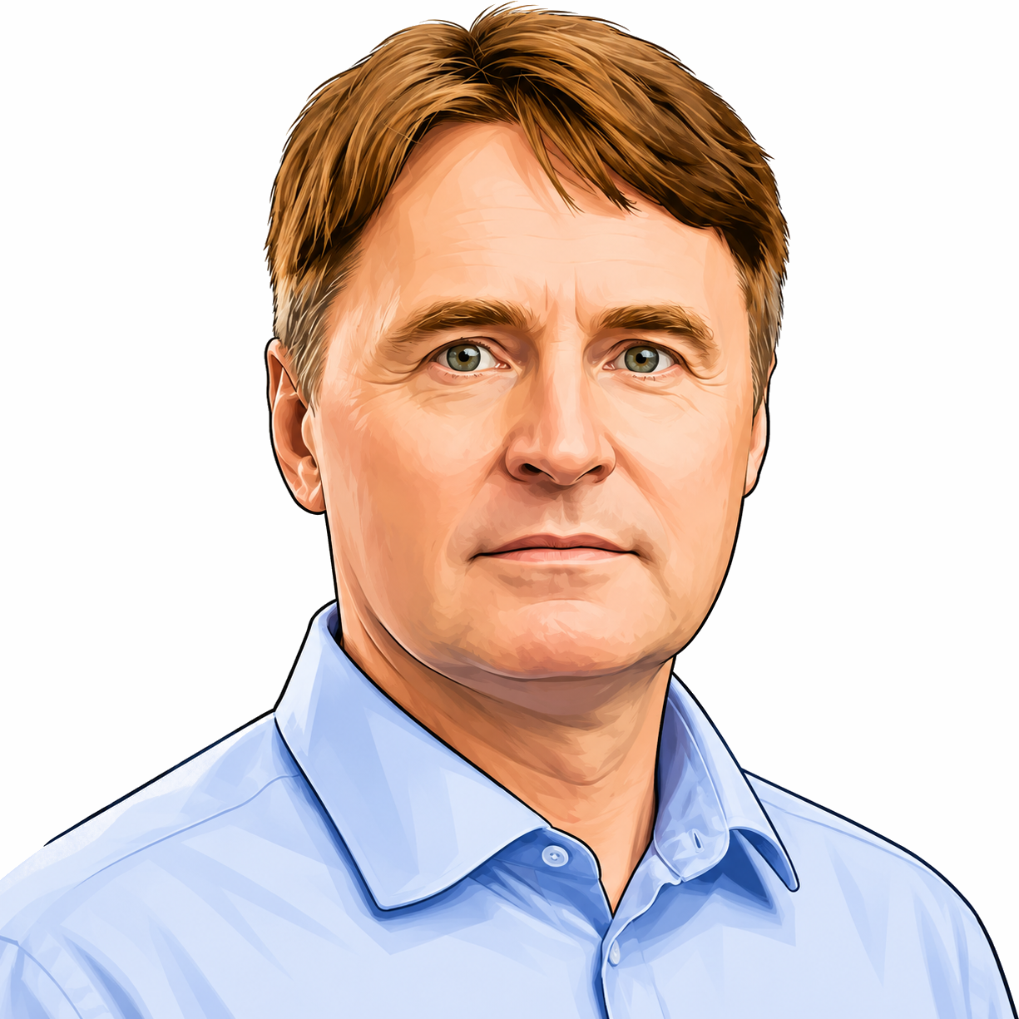
Q u a n t u m C o m p u t I n g I n s t I t u t e
Cape Town, South Africa
Welcome to the QCICT Quantum Computing Course.
The course builds on quantum computing courses taught by Prof. Aleksandar Radovanovic at the University of the Western Cape in Cape Town and the School of Computing, Union University in Belgrade. It continues to evolve through teaching experience and advances in quantum computing.
Prof. Aleksandar Radovanović

Slide 2
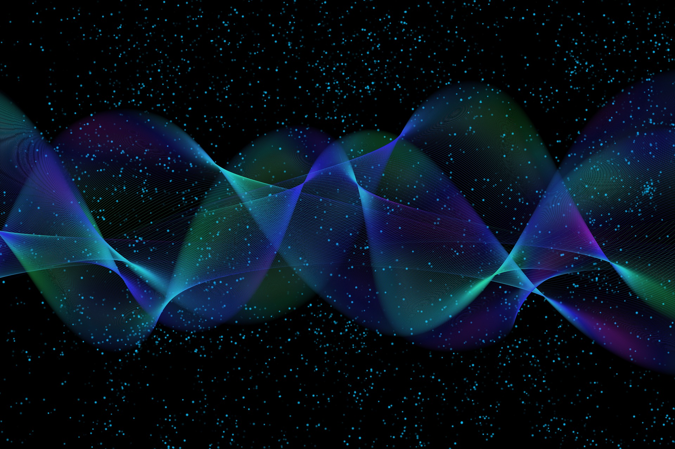
Quantum Computing
1 - Introduction
Prof. Aleksandar Radovanovic
alex@qcict.org

Slide 3
What is Quantum Computer?
A quantum computer is a type of computer that uses the principles of quantum mechanics to perform computations.
Quantum computing is a multidisciplinary field that combines aspects of computer science, quantum mechanics, and mathematics.
Notes:
A quantum computer is a type of computer that uses the principles of quantum mechanics to perform computations.
Quantum computing is a multidisciplinary field that combines aspects of computer science, quantum mechanics, and mathematics.

Slide 4


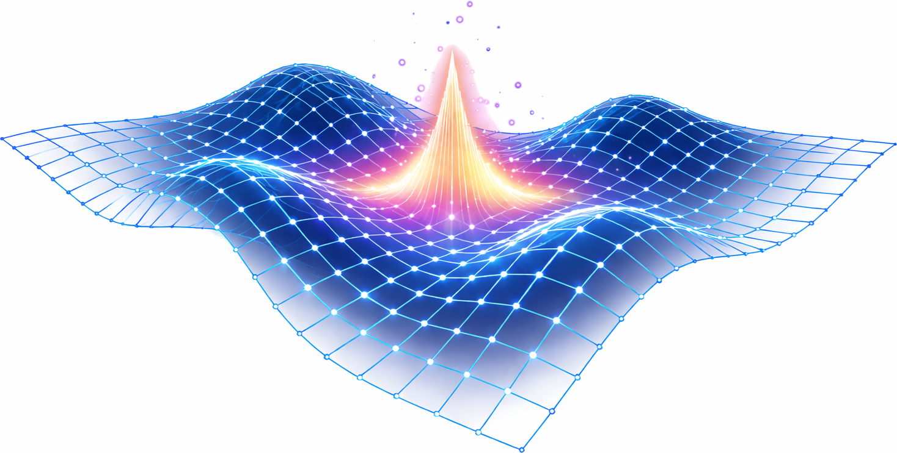



Quantum mechanics
speed
$$3×{10}^{8}m/s$$
size
Classical Mechanics
Relativistic Mechanics
(everyday motion)
(high-speed motion)
Quantum Mechanics
Quantum Field Theory
(microscopic systems)
(quantum fields)
$${10}^{−9}m$$
quantum: amount
A branch of physics that deals with the properties of matter and energy at the atomic and subatomic levels.
Notes:
Let’s start with a general definition of quantum mechanics.
The word 'quantum' comes from the Latin word meaning 'amount.' It refers to the smallest discrete units of energy, charge, matter, or other physical quantities.
Quantum mechanics is a branch of physics that deals with the properties and behavior of matter and energy at the atomic and subatomic levels, typically on the scale of nanometers and smaller.

Slide 5
A brief history of quantum computing
first hardware
theoretical work
Google
(2019)
D-Wave One
(2011)
early ideas
Lov Grover
(1996)
Peter Shor
(1994)
David Deutsch
(1985)
Richard Feynman
(1982)
Paul Benioff
(1980)
Yuri Manin
(1980)
Notes:
The history of quantum computing dates back to the 1980s. Russian scientist Yuri Manin, in his book Computable and Noncomputable, introduced the idea of using the principles of quantum mechanics for computation.
That same year, Paul Benioff proposed the concept of a quantum Turing machine and theoretically demonstrated that such a machine would not violate the laws of physics.
In 1982, Nobel laureate Richard Feynman suggested the idea of a quantum computer. Unlike classical computers that process information as binary 0s and 1s, Feynman proposed a machine that could allow data to exist as both 0 and 1 at the same time.
David Deutsch made a key contribution to quantum computing in 1985 by formulating the first quantum algorithm and proving that quantum computers can outperform classical ones in certain tasks.
More quantum algorithms were developed in the 1990s. Mathematician Peter Shor created an algorithm for factoring large numbers, while Lov Grover developed a quantum algorithm for database search.
In 2011, the Canadian company D-Wave released the the first quantum machine called D-Wave One.
The next landmark moment in the history of quantum computing occurred in 2019, when Google demonstrated so called "quantum advantage." Google’s quantum computer solved a problem in 200 seconds that would take a classical supercomputer about 10,000 years.

Slide 6
A quantum advantage example: classical vs quantum search
N = 1 trillion (${10}^{12}$) records / 1 µs = to check a record
7 days
1 sec
NSA
Notes:
A quantum advantage is the point where a quantum computer can solve a problem faster or more efficiently than the best known classical algorithms.
Quantum advantage can be demonstrated in a search problem. Imagine the problem faced by a national security agency that records all phone calls.
Suppose such an agency has a trillion records and needs to find one or more connected to an event of interest. The records are unstructured, since neither the call time nor the names of the parties are known.
If a classical computer scanned the records at the speed of one microsecond per record, it would take about a week to locate the call.
A quantum computer running at the same speed could find it in just one second. This alone explains why the armies and agencies of major countries are so interested in quantum computers.
In this quantum computing course, we will go into detail on Grover’s algorithm, which enables quantum search through unstructured data.

Slide 7
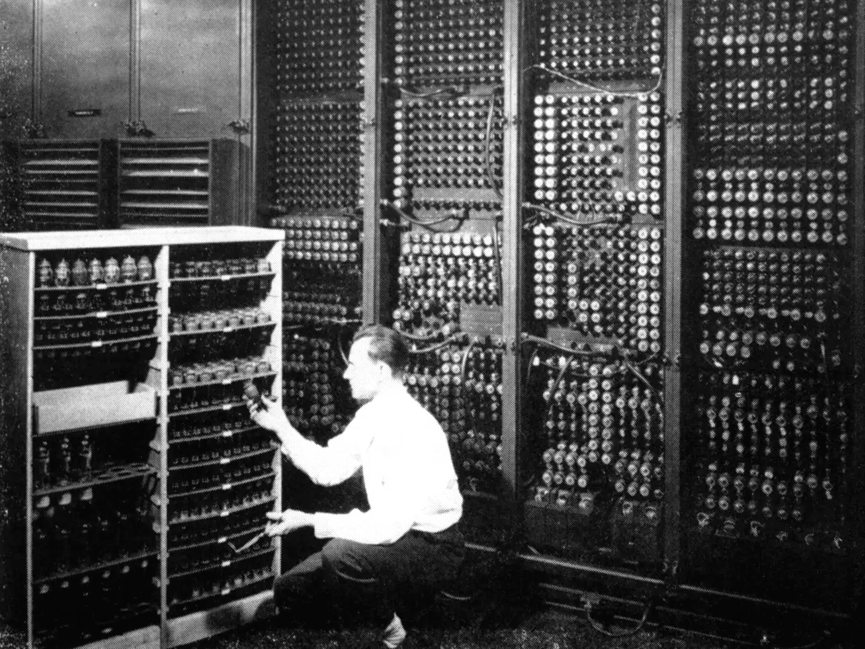
Multidimensionality
Notes:
A quantum computer is not just a faster version of a classical computer, just as an airplane is not a faster car.
A car moves in two dimensions, while an airplane adds a third dimension of movement. Similarly, a classical computer operates in the two-dimensional space of zeros and ones, while a quantum computer processes information in a multidimensional space.

Slide 8
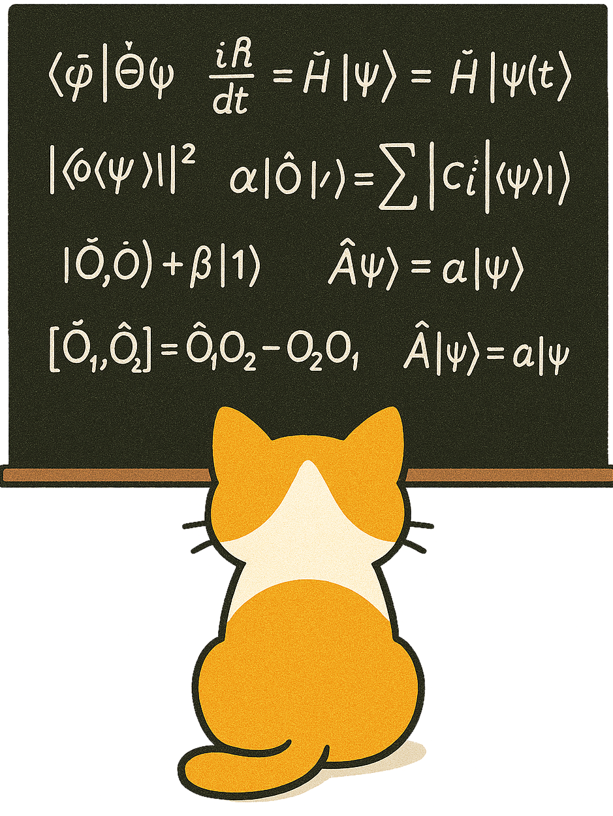
The Wonders of
Quantum Mechanics
Key Quantum Principles Behind the Power of Quantum Computers
8

Slide 9
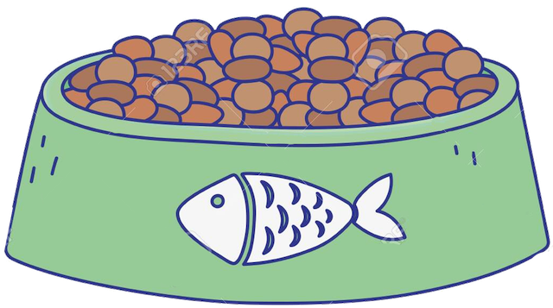

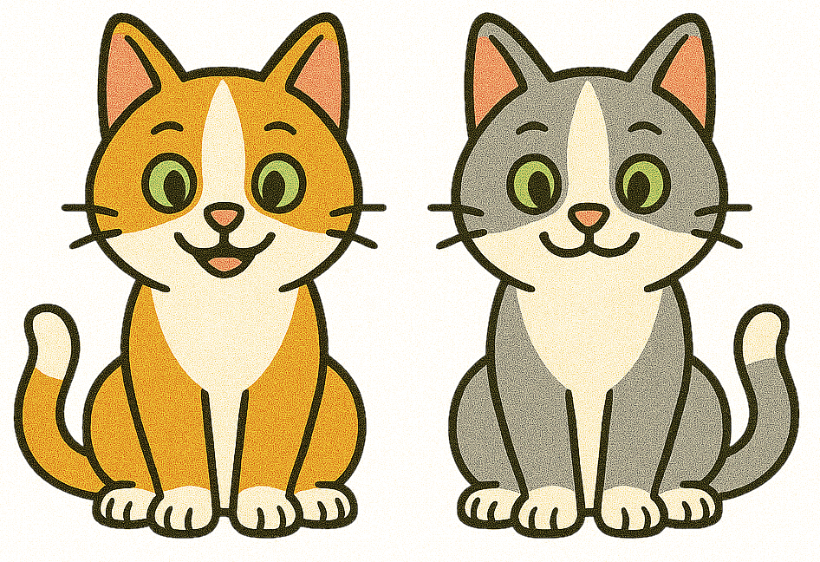

Three principles of quantum computing
1. SUPERPOSITION
2. INTERFERENCE
3. ENTANGLEMENT
The principle of quantum superposition allows a quantum object to exist in multiple states at the same time, enabling large-scale parallel processing.
The principle of quantum interference, similar to water waves that amplify or cancel each other out, allows for the amplification of desired results while suppressing unwanted outcomes.
The principle of quantum entanglement allows entangled quantum objects to behave in perfect sync, like twins sharing the same thought at the same moment.
Notes:
Quantum computers operate on three main principles of quantum mechanics
The principle of quantum superposition allows a quantum object to exist in multiple states at the same time. This property allows parallel processing on a large scale.
The principle of quantum interference, similar to water waves that amplify or cancel each other out, allows for the amplification of desired results while suppressing unwanted outcomes.
The principle of quantum entanglement allows entangled quantum objects to behave in perfect sync, like twins sharing the same thought at the same moment.

Slide 10

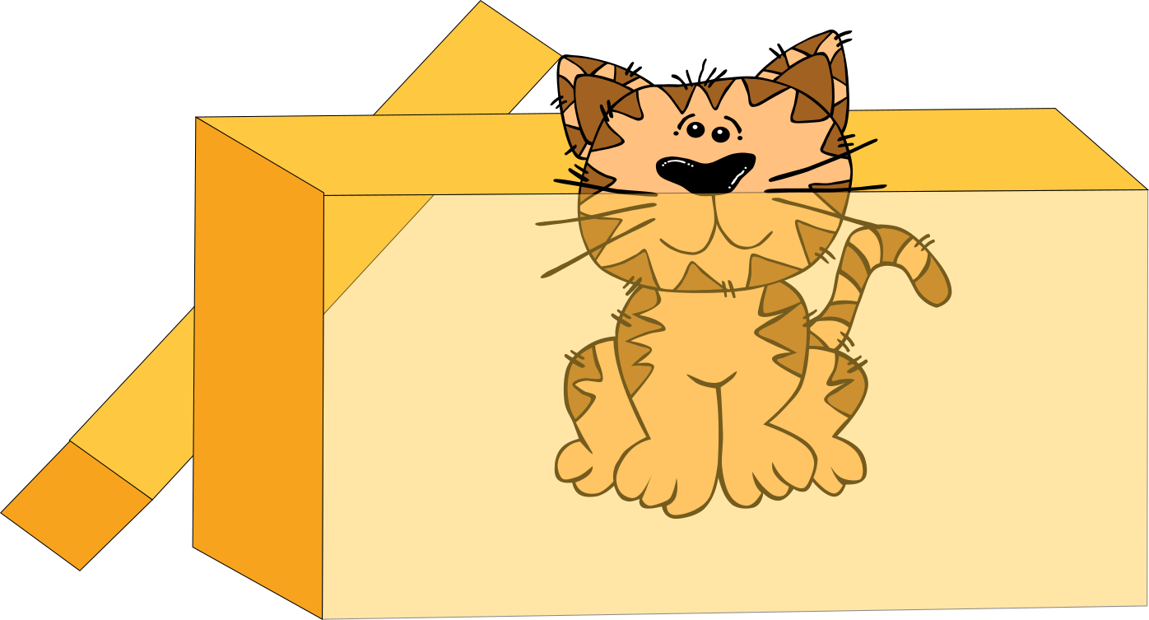
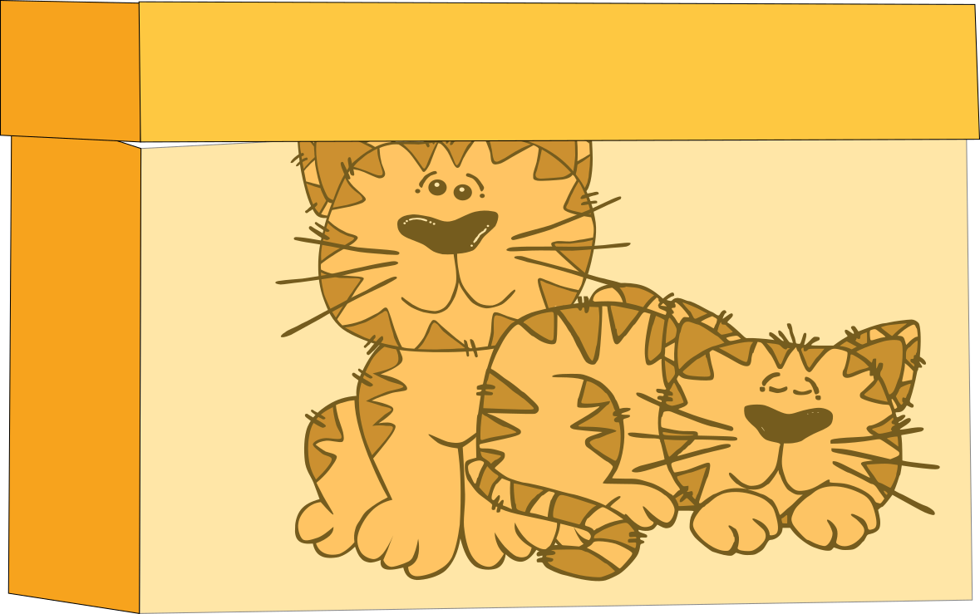
Quantum superposition
observation - measurement
superposition
quantum state
classical state
Superposition is a phenomenon in which a quantum object, completely isolated from its environment, exists in multiple states simultaneously.
Notes:
Superposition is a phenomenon in which a quantum object, completely isolated from its environment, exists in multiple states simultaneously. The condition of such an object, governed by the laws of quantum mechanics, is called a quantum state.
In our example, a cat enclosed in a quantum box is in two states at the same time: sitting and lying down.
When the box is opened and the cat is observed, its quantum state collapses into one of the two possibilities, and we observe it either sitting or lying down.
This interaction between our macroscopic world and the quantum micro-world causes the quantum system to collapse into a single state. The collapse occurs randomly, and it is impossible to predict the outcome with absolute certainty.

Slide 11
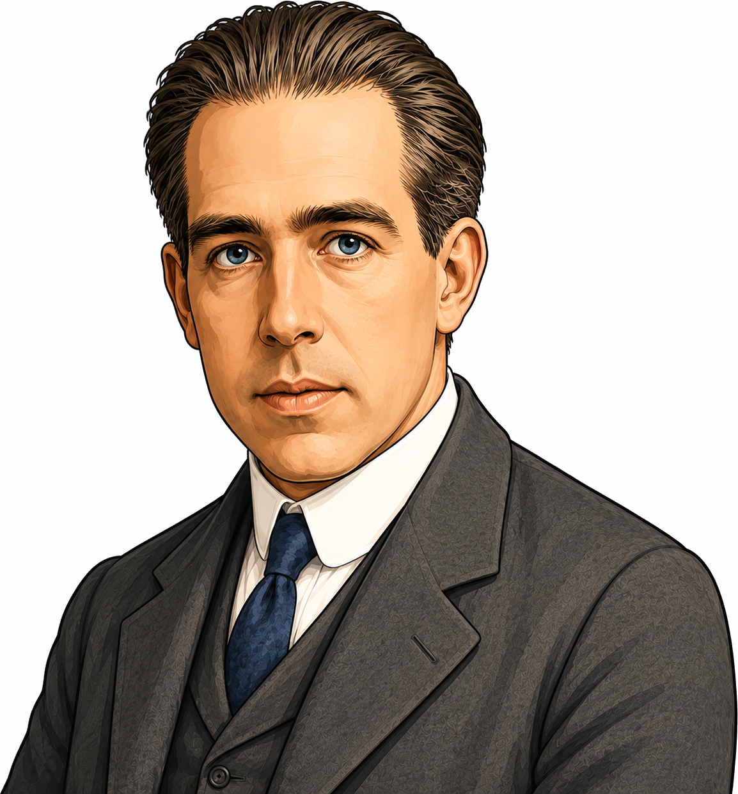
Copenhagen interpretation
Niels Bohr
(1885 – 1962)
Werner Heisenberg
(1901 - 1976)
Max Born
(1882 - 1970)
Notes:
The physical interpretation of quantum superposition and quantum collapse remains an open question in physics. The first comprehensive interpretation of quantum mechanics, developed during the 1920s by Niels Bohr, Werner Heisenberg, and Max Born, became known as the Copenhagen interpretation because many of its central ideas were developed at Bohr's institute in Copenhagen.
According to the Copenhagen interpretation, a quantum system may exist in a superposition of several possible states before measurement. When the system interacts with a measuring device, the superposition collapses to a single outcome.

Slide 12



Basic concepts
Quantum Superposition:
A quantum system can exist
in two states at the same time.
Quantum State:
The state of a physical system,
described by quantum mechanics.
≈
≈
Quantum Collapse:
When observed/measured,
a quantum object randomly
collapses into one possible state.
or
Classical State:
The state of a physical system,
described by classical mechanics.
Notes:
Quantum State:
The state of a physical system, described by quantum mechanics.
Quantum Superposition:
A quantum system can exist in two states at the same time.
Quantum Collapse:
When observed/measured, a quantum object randomly collapses into one possible state.
Classical State:
The state of a physical system, described by classical mechanics.

Slide 13



Many-Worlds Interpretation
Hugh Everett III
(1930-1982)
Notes:
Another theory, known as the Many-Worlds Interpretation, was proposed by Hugh Everett III in 1957. It suggests that every state in a superposition occurs in a different parallel world. According to this idea, each decision or event causes the universe to split, creating multiple branches where each branch represents a different outcome of the quantum process.
For example, imagine our cat, which was running, decides to stop. This decision branches the universe: in one world, the cat sits down, while in another, it lies down.

Slide 14
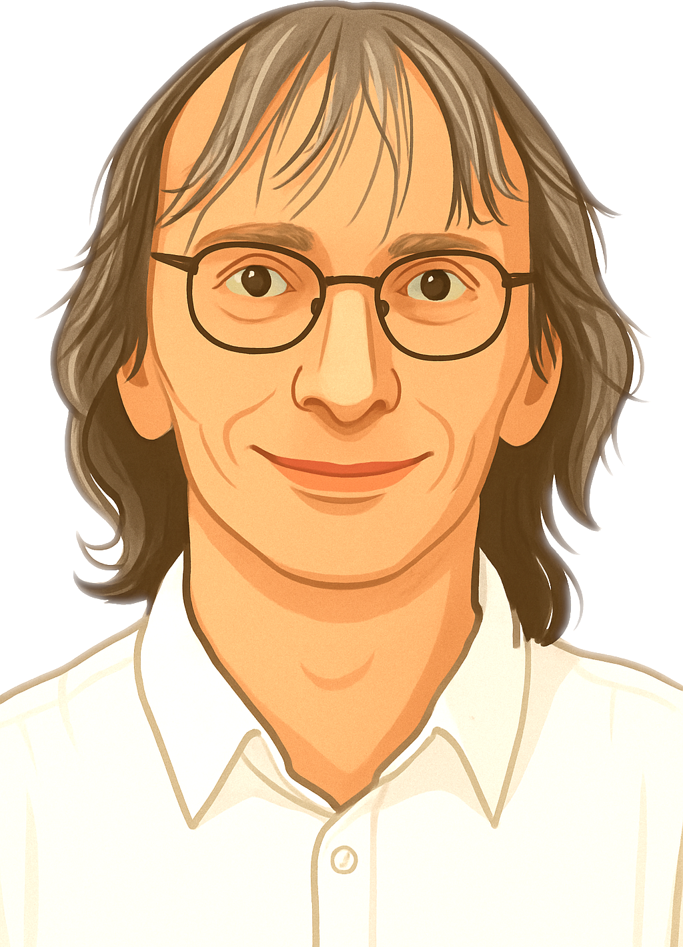
David Deutsch quantum computation theory
1+1=2
Notes:
David Deutsch, a proponent of the many-worlds theory, argues that a quantum computer in a state of superposition performs calculations across parallel worlds. The result of the computation emerges from the interference of different outcomes obtained from each of these worlds.

Slide 15


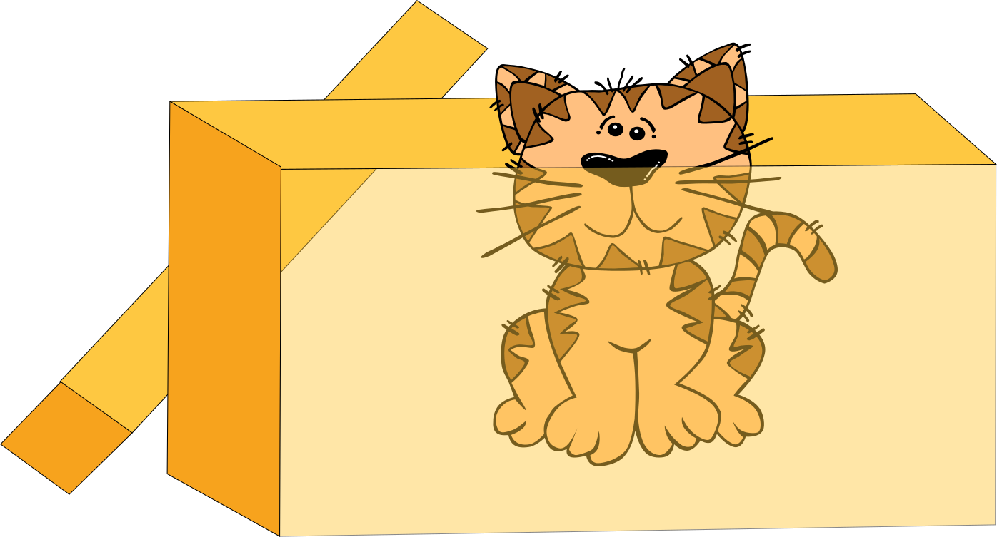

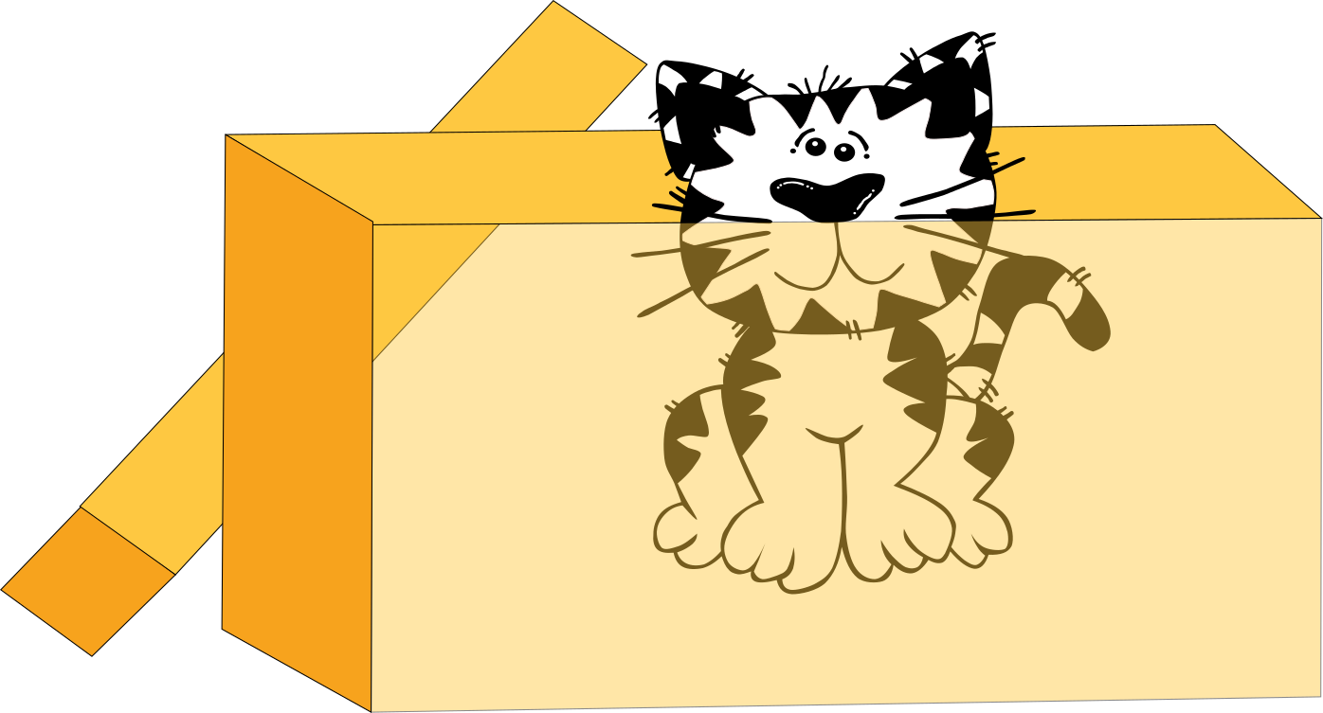
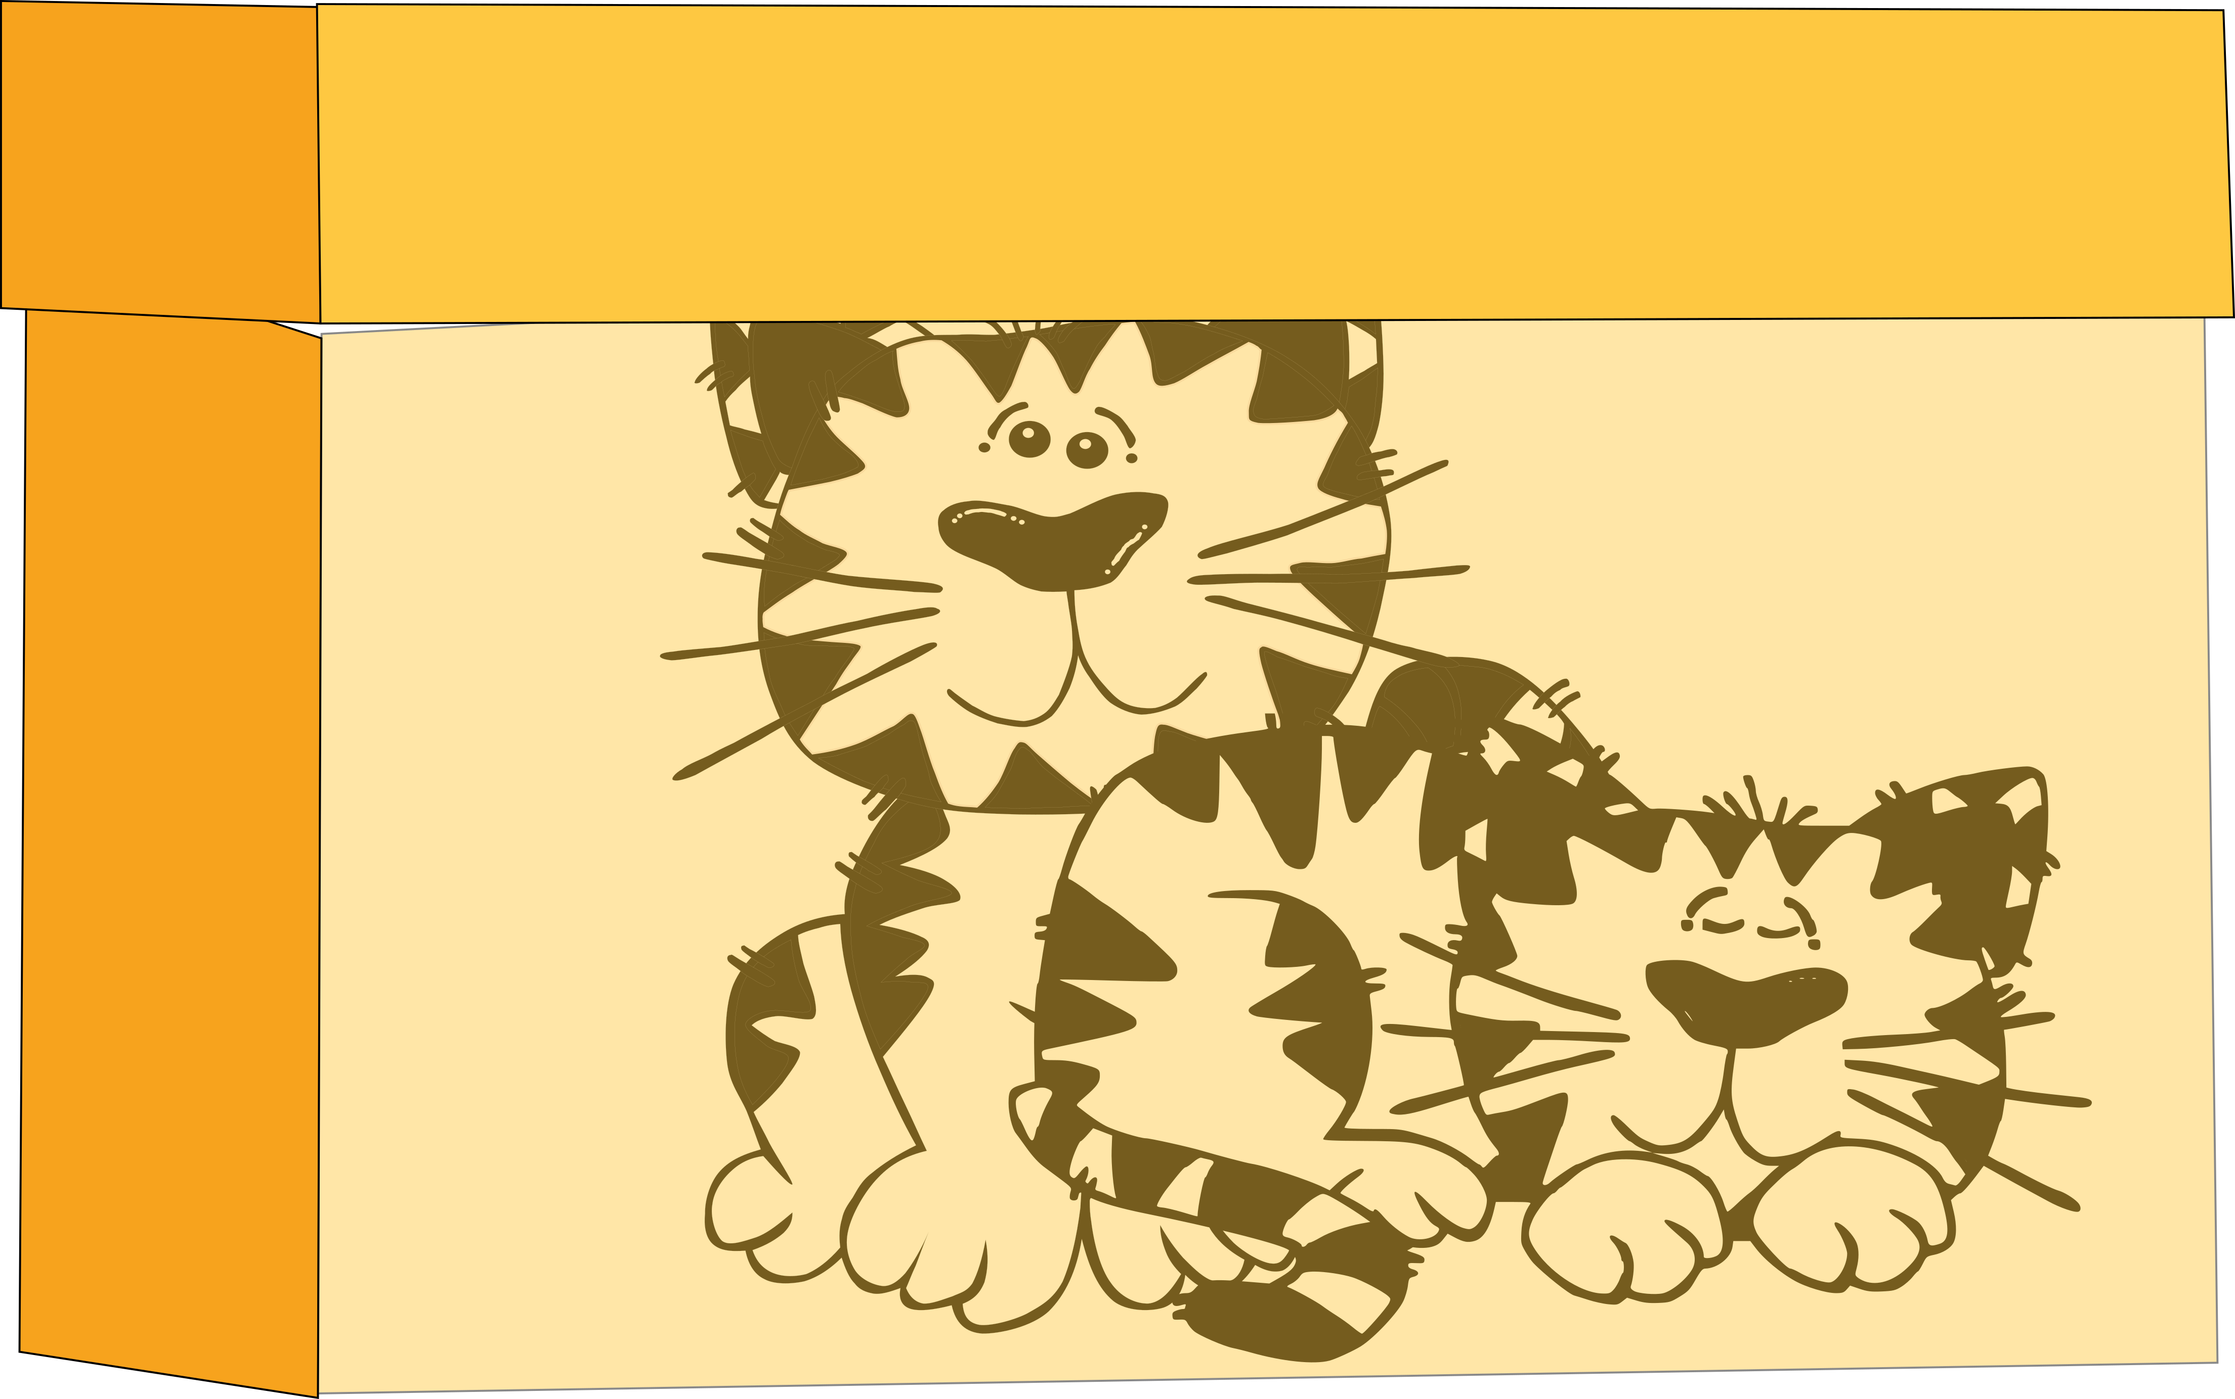
Quantum entanglement
Alice
Bob
Spooky action at a distance.
Charlie
Notes:
Another important phenomenon of quantum mechanics is quantum entanglement.
In this thought experiment, Charlie places a yellow cat and its twin, the white cat, into two quantum boxes. Both cats are in superposition and are entangled, meaning whatever happens to one instantly happens to the other, without any direct contact.
Charlie sends one box to Alice and the other to Bob. When Alice opens her box, she finds the yellow cat sitting.
Later, Bob opens his box and also finds the white cat sitting. If Alice had found the yellow cat lying down, Bob would have found the white cat lying down too.
Entanglement means that two quantum objects can share a state and stay perfectly in sync. Any change in one immediately shows up in the other, even across distance. But once either object interacts with the outside world, the entanglement breaks, and both collapse into the same definite state.
Einstein famously called this “spooky action at a distance.

Slide 16
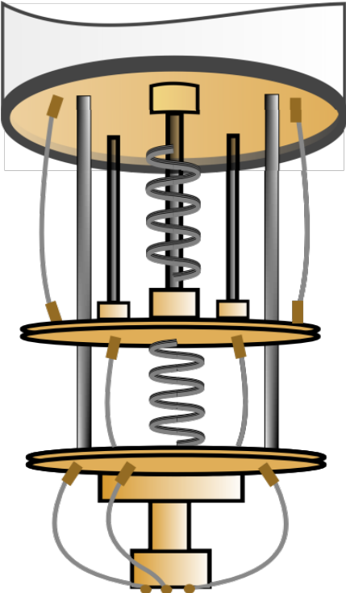

Quantum coin flipping game
Simon, a quantum computer, challenges Bob to a quantum coin flipping game.
Notes:
As an illustration of quantum superposition, let us describe a game in which Simon, a quantum computer, challenges Bob to a quantum coin flipping game.

Slide 17

2.
Bob flips a coin, observes the side it lands on, and places it inside a quantum box.
Simon wins!
≈
≈
Simon claims that, regardless of Bob's move, he will turn the coin back to its original position.
≈
It's Bob's turn to flip the coin!
≈
It’s Simon’s turn, and he flips the coin without taking it out of the box.
Notes:
The game starts with Bob, who flips a coin, observes the side it lands on, and places it inside a quantum box so no one can see it.
It’s Simon’s turn, and he flips the coin without taking it out of the box.
It's Bob's turn to flip the coin as many time he wishes!
Simon claims that, regardless of Bob's move, he will turn the coin back to its original position.
The box is opened, the coin is indeed in the same position as at the beginning, and Simon wins.

Slide 18

≈
≈
≈
≈
Bob asks for a rematch,
but Simon always wins.
How is that possible?
Notes:
Bob knows that Simon’s chances of winning should only be 50%, so he asks for a rematch. This time, the coin lands on side 0. Once again, Simon, Bob, and then Simon take their turns, but in the end, Simon wins again. How is that possible?

Slide 19
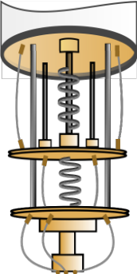

Simon reveals to Bob that the secret lies in quantum superposition
In the final move, Simon removes the superposition, and according to the laws of quantum mechanics, the coin returns to its state from before the superposition.
On his turn, Simon places the coin into a superposition, where it exists on both side 0 and side 1 simultaneously.
For example, the game starts with side 0 facing up.
No matter how many times Bob turns the coin, the superposition remains unchanged.
Notes:
Simon reveals to Bob that the secret lies in quantum superposition. For example, the game starts with side 0 facing up.
On his turn, Simon places the coin into a superposition, where the coin exists in both states—side 0 and side 1—at the same time.
No matter how many times Bob flips the coin, the superposition remains intact.
In the final move, Simon removes the superposition, and according to the laws of quantum mechanics, the coin returns to its original state before the superposition—the state in which Bob placed it in the box.

Slide 20
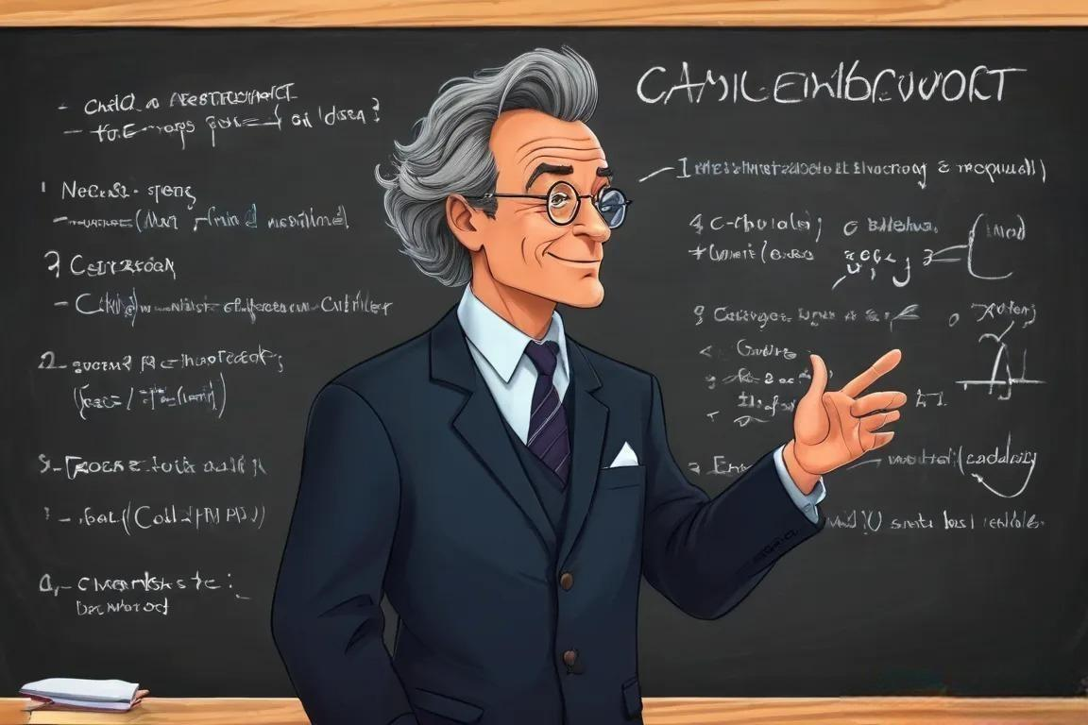
If you think you understand quantum mechanics, you don't understand quantum mechanics
Shut up and calculate!
Richard Feynman
David Mermin
Notes:
Highlighting the mysteries of quantum mechanics, Nobel Prize-winning physicist Richard Feynman once said: 'If you think you understand quantum mechanics, you don't understand quantum mechanics.’
Another physicist, David Mermin, emphasizing the practical use of quantum mechanics, said: 'Shut up and calculate!’
Together, they capture the paradox of quantum mechanics: its true nature remains the mystery, but it works perfectly in practice.

Slide 21

Classical vs quantum data: bit vs qubit
10001001010100000100111001000111000011010000101000011010000010 ...
classical computer: BIT
Quantum computer: QUBIT
0 or 1
0 and 1
Notes:
As a consequence of different physical laws they follow, classical and quantum computers work with different types of data.
Classical computers process data represented as sequences of zeros and ones. The fundamental unit of classical data is the bit, which, like our example coin, can be either 0 or 1.
On the other hand, the fundamental unit of quantum data is the quantum bit, or qubit. Thanks to the principle of superposition, a qubit can exist as both 0 and 1 at the same time.

Slide 22
Quantum bit or qubit in bra-ket notation [from bracket]
∣0⟩
∣1⟩
a∣0⟩+b∣1⟩
Notes:
To replace our cat and coin models with a mathematical description, we use braket notation (from bracket). The qubit states are called ket-0 and ket-1, and their superposition is described as a weighted sum.

Slide 23
Quantum
hardware
23

Slide 24
Quantum bit or qubit
Atomic
∣0⟩
∣1⟩
∣0⟩ ∣1⟩ a∣0⟩+b∣1⟩
a∣0⟩+b∣1⟩
Superconducting
Photonic
Notes:
There are a few ways to make a physical qubit.
Atomic and Ionic Qubits use the energy levels of electrons. An electron, shown as a red dot, at a lower energy level represents qubit ∣0⟩. An electron at a higher energy level represents qubit ∣1⟩, while an electron simultaneously occupying both energy levels represents a qubit in superposition of the two.
Photonic Qubits are defined by the polarization of photons of light. Photons can be polarized using a polarization filter so that the electric field oscillates in a single plane. Horizontally polarized light represents qubit ∣0⟩, vertically polarized light represents qubit ∣1⟩, and diagonally polarized light represents a qubit in superposition.
Superconducting Qubits are defined by the direction of electrical current in a superconductor. Qubit ∣0⟩ is represented by current flowing clockwise, producing a downward magnetic field. Qubit ∣1⟩ is represented by current flowing counterclockwise, producing an upward magnetic field. A qubit in superposition has current flowing in both directions simultaneously, generating both magnetic fields. There are also other technologies that utilize different physical properties of superconducting circuits..

Slide 25
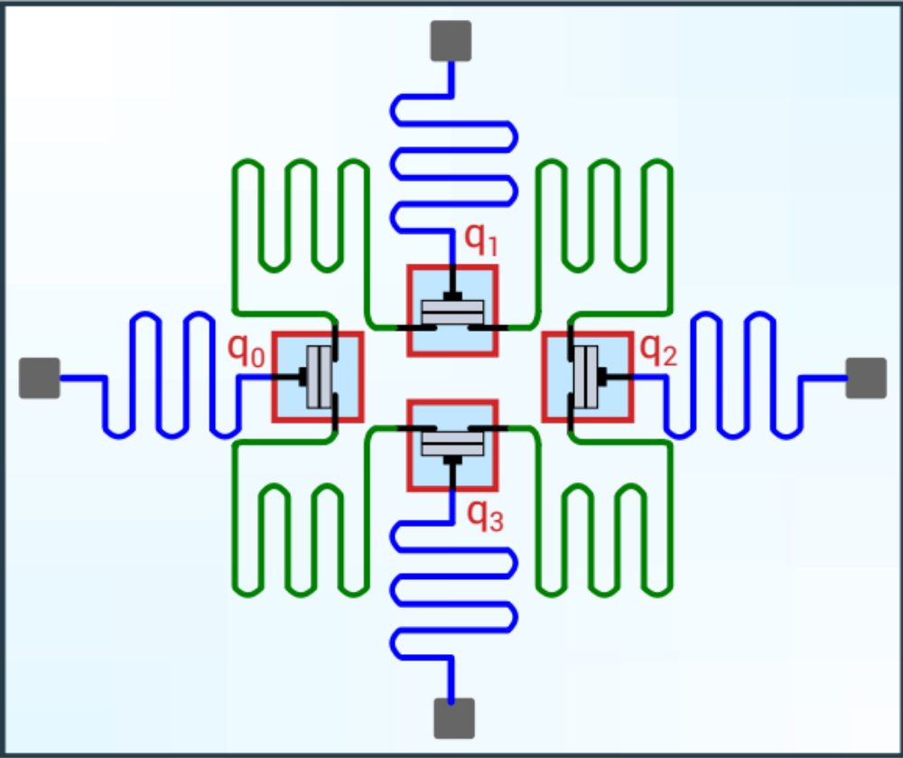
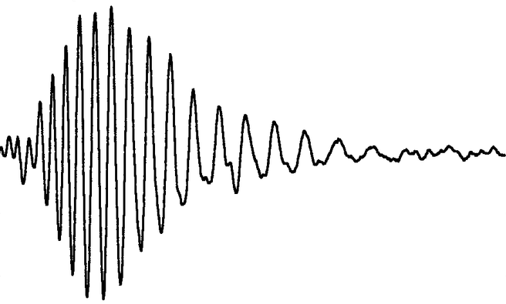

Superconducting quantum processor (QPU)
Superconducting Quantum Processor (QPU)
∣1⟩
∣0⟩
Qubit as two-levels superconducting circuit
gates as microwave pulses
Notes:
The slide shows the conceptual design of a superconducting quantum processor, or quantum processing unit, with four qubits labeled q0 to q3. In this case, the energy level of the superconducting electrical circuit determines the state of a qubit.
In addition to the qubits, there are several snake-like microwave antennas. The green antennas transmit microwave pulses to control the states of the qubits, while the blue antennas read the qubit states.

Slide 26
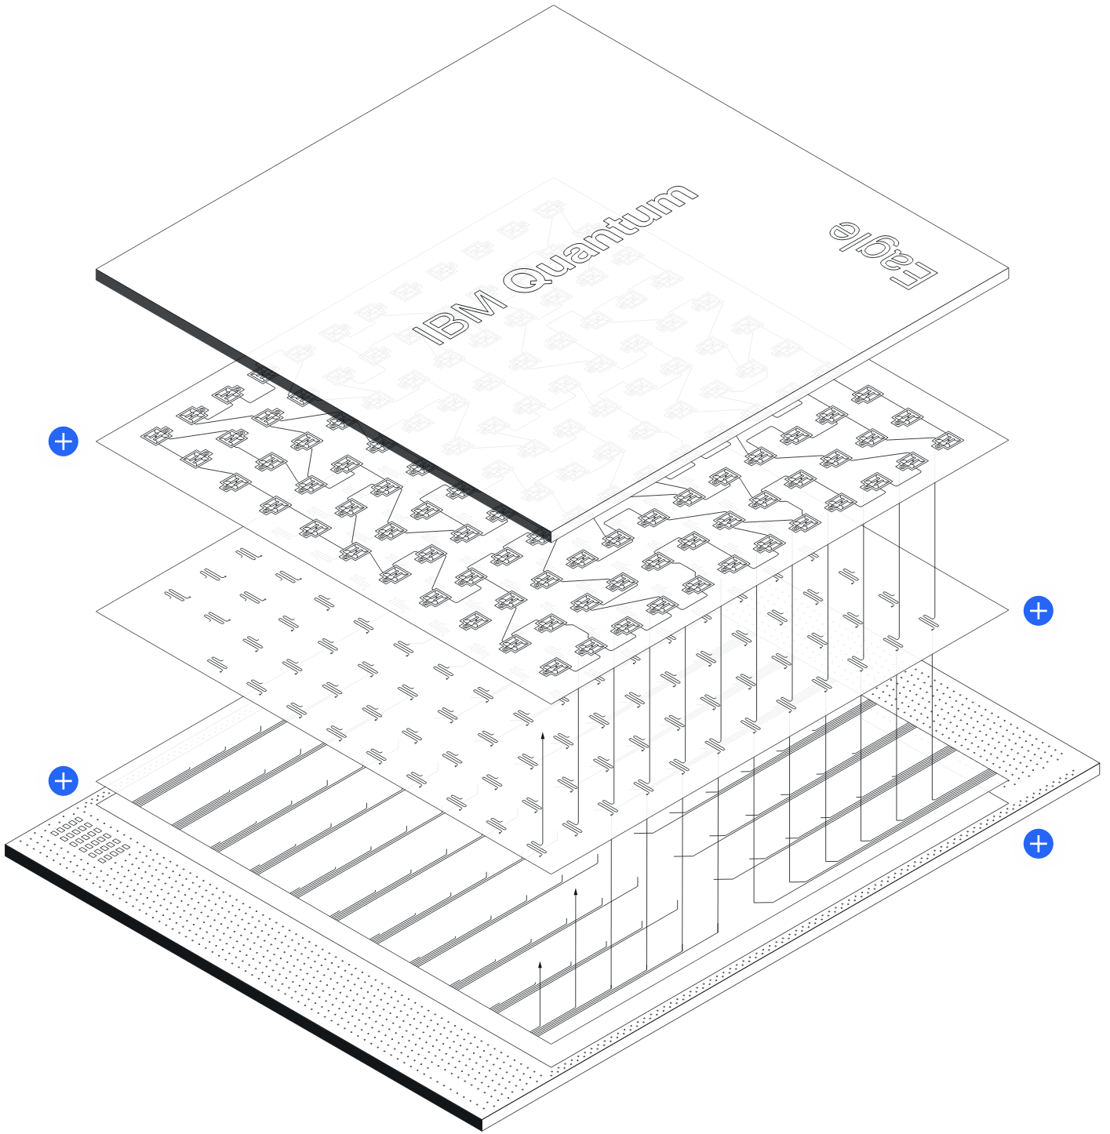
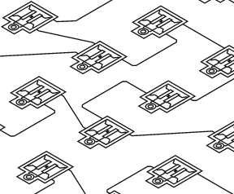
IBM Eagle – 127 qubits
qubit plane
resonator plane
wiring plane
interplane wiring
Notes:
As a real-world example, this slide shows IBM’s Eagle processor, which has 127 qubits. The principle is similar to that described on the previous slide, but the processor has a three-dimensional, multilayer structure. It consists of a qubit plane, a microwave resonator plane, a wiring plane, and interplane connections.
Newer processors follow a similar principle, but with a higher component density. Technologies are also being developed to interconnect multiple quantum processors, allowing the capacity of a quantum computer to be increased by combining multiple QPUs.

Slide 27



Binary machines
data types
binary
int
float
string
list
RAM
INPUT
OUTPUT
|0⟩
|0⟩
|0⟩
|0⟩
|0⟩
0
1
1
0
1
Notes:
Quantum computers at their current level of development are binary machines in the sense that their input and output consist of binary numbers, typically ranging from 4 to 1000 bits in length. Additionally, quantum computers do not operate with complex data types or have working memory.
In practice, quantum computers integrate with classical systems and are programmable via libraries of existing programming languages such as Python.

Slide 28
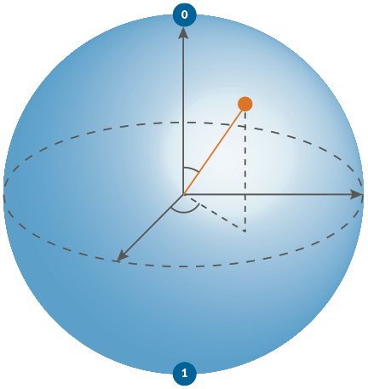
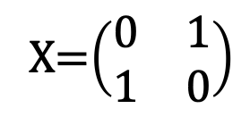
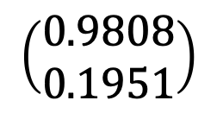
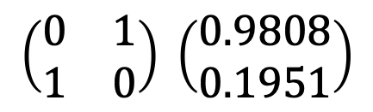
Layered Model of Quantum Computing
mathematical model
matrix-vector multiplication
unit of information
qubit/vector
unit of processing
quantum gate/matrix
algorithm
quantum circuit
program
quantum circuit desciption
$$\left(\begin{matrix}0.9808 \\ 0.1951\end{matrix}\right)$$
+
X=$\left(\begin{matrix}0 & 1 \\ 1 & 0\end{matrix}\right)$
$$\left(\begin{matrix}0 & 1 \\ 1 & 0\end{matrix}\right) \left(\begin{matrix}0.9808 \\ 0.1951\end{matrix}\right)$$
+
H
circuit.x (qreg_q[0])
circuit.h (qreg_q[0])
circuit.measure (qreg_q[0], creg_c[0])
Notes:
Quantum computing can be described through five interconnected layers, ranging from the qubit as the basic unit of quantum information to the quantum program.
The basic unit of information in quantum computing is the quantum bit, or qubit. Mathematically, a qubit is represented by a vector defined by two coordinates, which represent two basis states in superposition. The vector can be visualized as rotating on the surface of a unit sphere.
The basic unit of quantum processing is a quantum gate. Mathematically, a quantum gate is represented by a matrix. Physically, the quantum gate is nothing more than a microwave pulse, transmitted from a microwave antenna within the QPU, that controls the state of the qubit.
Quantum processing can be visualized as rotations of a qubit vector around a sphere. Mathematically, each rotation is represented by multiplying the qubit vector by a matrix corresponding to a quantum operation. The result is a new position of the vector on the surface of the sphere.
A quantum algorithm is visualized as a diagram called a quantum circuit. Although the term "quantum circuit" might suggest a hardware diagram, it is actually a flowchart-like representation of a program that shows the sequence of quantum gates that a qubit undergoes during program execution.
A quantum program is a description of a quantum circuit in a programming language, typically in quantum assembly language or Python.

Slide 29
Qubit
29

Slide 30
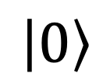
Qubit as a vector
energy level
atom
$$\left|\text{0}\right\rangle$$
Notes:
Imagine we have a knob that adjusts the energy level of an atomic qubit.
An atom at a lower energy level is represented by a horizontal vector, ∣0⟩.

Slide 31
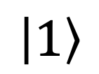
Qubit as a vector
$$\left|\text{1}\right\rangle$$
energy level
atom
Notes:
An atom at a higher energy level is represented by a vertical vector, ∣1⟩.

Slide 32
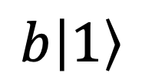
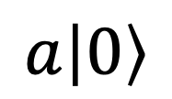
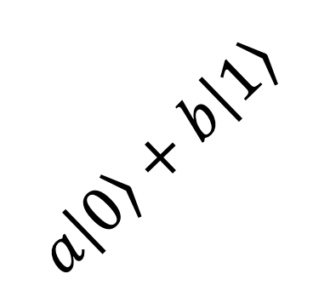
Qubit as a vector
$$a\left|\text{0}\right\rangle +b\left|\text{1}\right\rangle$$
$$b\left|\text{1}\right\rangle$$
$$a\left|\text{0}\right\rangle$$
energy level
atom
Notes:
An atom that exists in both energy levels represents a qubit in a superposition of ∣0⟩ and ∣1⟩. From a geometric perspective, superposition is simply the sum of two vectors, ∣0⟩ and ∣1⟩, each scaled by a certain factor. These factors, a and b, determine the extent to which the vectors ∣0⟩ and ∣1⟩ contribute to the superposition.

Slide 33
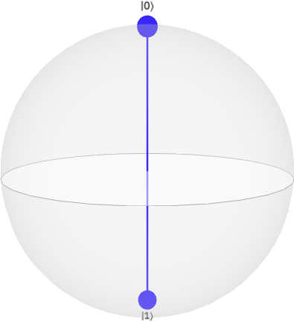
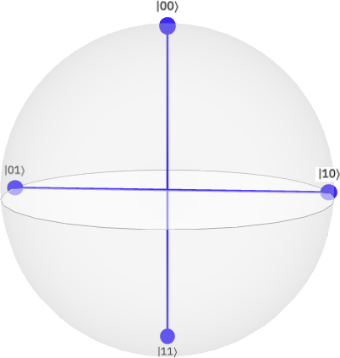
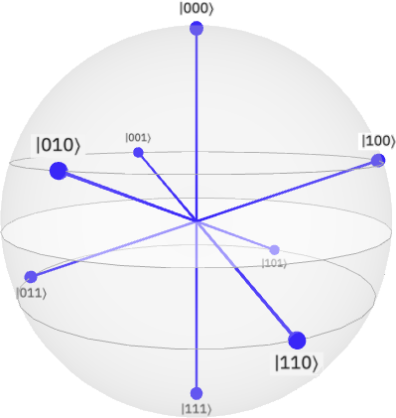
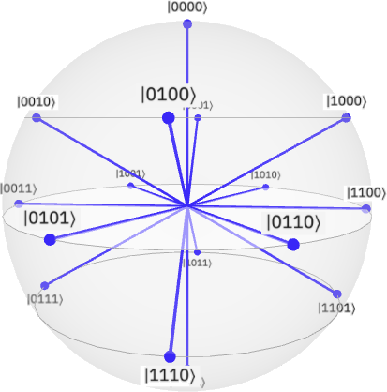
The Power of Quantum Superposition
1 bit:
1 of 2 states
2 bits:
1 of 4 states
3 bits :
1 of f 8 states
4 bits :
1 of 16 states
167 bits
1 of 10 ⁵⁰states
…
1 qubit:
superposition
of 2 states
2 qubits :
superposition
of 4 states
3 qubits :
superposition
of 8 states
4 qubits :
superposition
of 16 states
167 qubits:
superposition
of 10⁵⁰ states
…
Notes:
To illustrate the significance of superposition, imagine that each point represents one possible state of a classical bit or a qubit.
At any given moment, a classical bit can have the value 0 or 1, meaning that it can be in only one of two possible states. A qubit, on the other hand, can be in a superposition of both states.
Two classical bits can encode the numbers from 0 to 3, but at any given moment they can be in only one of four possible states. Two qubits, however, can be in a superposition of all four states.
The same applies to three bits: they can be in one of eight possible states, while three qubits can be in a superposition of all eight states.
This number grows exponentially as 2n, where n is the number of bits or qubits.
Now imagine 167 bits. They have approximately 10⁵⁰ possible states, roughly the number of atoms in the Earth. At any given moment, however, the 167 bits can occupy only one of these states. With 167 qubits, the number of possible states is the same, but the qubits can be in a superposition of up to 10⁵⁰ states. With 300 qubits, this number increases to 10⁹⁰ states - far more than the estimated 10⁸⁰ atoms in the observable universe.

Slide 34

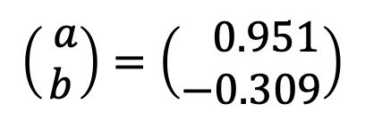
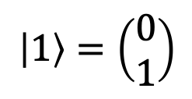
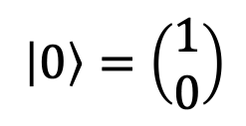
A qubit on a sphere
$$\left(\begin{matrix} a \\ b\end{matrix}\right)=\left(\begin{matrix} 0.951 \\ −0.309\end{matrix}\right)$$
$$\left|0\right\rangle =\left(\begin{matrix}1 \\ 0\end{matrix}\right)$$
$$\left|1\right\rangle =\left(\begin{matrix}0 \\ 1\end{matrix}\right)$$
Latitude – measures how far north or south a point is from the Equator.
Longitude – measures how far east or west a point is from the Prime Meridian.
Notes:
We can imagine our qubit traveling around the globe, with its position defined by coordinates similar to coordinates on a Google map. By convention, a qubit at the North Pole has coordinates [1,0], written as a column vector. A qubit at the South Pole has coordinates [0,1].
As the qubit moves across the sphere, its coordinates change. These coordinates are just numbers that describe the qubit’s position on the sphere. In this example, the qubit is described by the numbers 0.951 and –0.309. A qubit can take infinitely many positions on the sphere.

Slide 35
A qubit on a sphere
z
θ
r = 1
complex plane
φ
y
x
Notes:
The coordinates of a qubit can also be expressed in spherical coordinates using a radial distance of 1 and two angles.
The polar angle θ determines the angular distance from the poles, which is the angle between the qubit vector and the z-axis.
The azimuthal angle ϕ represents the angular distance from the x-axis.

Slide 36



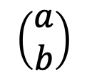
Qubit measurement
80%
$$\left|0\right\rangle$$
≈
$$\left(\begin{matrix}a \\ b\end{matrix}\right)$$
20%
≈
0
1
0
1
$$\left|1\right\rangle$$
Measurement reduces the qubit to a single bit: 0 or 1
Notes:
A qubit’s state evolves during computation. To read the final result, we measure it at the end. Imagine the measurement as placing two magnets at the poles of a sphere. When the magnets are activated and a measurement is made, the qubit collapses to one of the two poles of the Bloch sphere, ∣0⟩ or ∣1⟩, and the instrument records the result as 0 or 1.This means we lose all the rich qubit information and end up with just one bit: 0 or 1. In other words, measurement reduces the qubit to a single bit: 0 or 1.
To learn more about a qubit, we can repeatedly prepare it in the same superposition and measure it many times. By recording the outcomes, we can build a histogram showing how many times we obtain ∣0⟩ and how many times we obtain ∣1⟩. Since the state vector is closer to the north pole, representing ∣0⟩, the histogram shows that outcome 0 occurs more frequently than outcome 1.

Slide 37

Probabilistic computing
1
100%
1+1=?
= 0
75%
1+1=?
= 2
50%
25%
1+1=?
= 1
0
1
2
3
Repeat the computation ≥ 1000.
Draw a histogram.
Notes:
This raises another question: if the result of a computation is random, how do we know is it correct?
For example, if we ask a quantum computer what 1 + 1 equals, we might get a different result each time we ask the question. It is not that a quantum computer cannot add two numbers, but because quantum mechanics adds randomness to the measurement process we might sometimes get wrong results.
To assess the result, we repeat the computation many times and represent the counts of outcomes as a histogram. Results with low frequency are discarded due to quantum uncertainty, and the result with the highest frequency is taken as the correct one.
In some applications, the probability distribution itself is the desired result. Some examples are weather forecast or generative machine learning. We want AI to produce text, drawings, or music that is similar, but not identical to the pattern provided.
For these reasons, quantum computing is often called probabilistic computing.

Slide 38
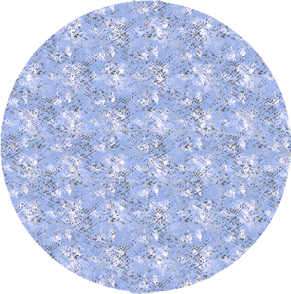
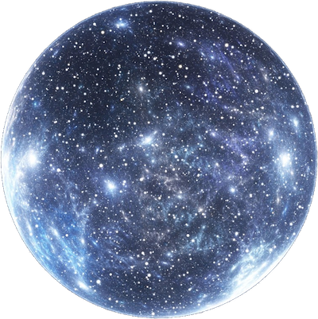
One qubit, two qubits, …. universe
1 bit:
1 of 2 values
2 bits:
1 of 4 values
3 bits:
1 of 8 values
4 bits:
1 of 16 values
10¹⁸ bits:
10¹⁶ FP values
…
1 qubit:
2 values
simultaneously
2 qubits:
4 values
simultaneously
3 qubits:
8 values
simultaneously
4 qubits:
16 values
simultaneously
300 qubits: 10⁹⁰
FP values
simultaneously
…
Notes:
To perform a useful computation, we need more than one qubit, which unlocks the enormous power of superposition.
To illustrate this, imagine a sphere where each point on its surface represents a unique piece of information. More points mean more information.
A classical bit is represented by a single point on a sphere, being either 0 or 1. However, a qubit is a combination of both 0 and 1, occupying two points.
Two classical bits, can occupy one of four possible points on the sphere at a time, while two qubits take all four points.
Three classical bits can occupy one of eight possible points, while three qubits can occupy all eight points.
With each additional bit or qubit, the number of possible states increases exponentially as 2^{n}, where n is the number of bits or qubits.
The total number of bits in the memory of the largest supercomputers today is approximately 10¹⁸ which can store about 10¹⁶ floating-pont numbers. In comparison, with just 300 qubits, it is possible to represent about 10⁹⁰ values — far exceeding the estimated 10⁸⁰ atoms in the universe.
Even if the entire Earth were converted into a computer with each atom as a bit, it would only provide around 10⁵⁰ bits. This is equivalent to the capacity of a quantum computer with just 166 qubits. For comparison, modern quantum computers already have more than 1,000 qubits.

Slide 39

Quantum
processing
How quantum computer process information.
39

Slide 40


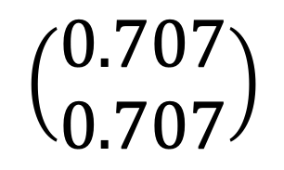
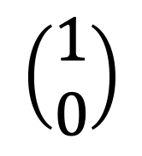
Rotation as a basic instruction
$$\left(\begin{matrix}1 \\ 0\end{matrix}\right)$$
$$\left(\begin{matrix}0.707 \\ 0.707\end{matrix}\right)$$
Notes:
The basic unit of data processing in quantum computing is the rotation of a qubit’s vector. This rotation updates qubit’s coordinates, which represent our data.
Rotations are performed by quantum gates, similar to a car moving a qubit from one point to another on a globe. In this example, the qubit’s vector rotates from (1,0) to (0.7,0.7).

Slide 41
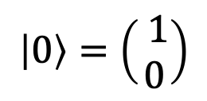
Rotation as a basic instruction
z
$$\left|\text{0}\right\rangle =\left(\begin{matrix} 1 \\ 0\end{matrix}\right)$$
θ
y
x
Notes:
Rotation is mathematically described by a rotation matrix. Multiplying this matrix by the initial qubit’s coordinates produces new coordinates. This example shows a matrix that rotates a qubit vector about the y-axis by an angle θ.

Slide 42



Rotation as a basic instruction
$$z$$
φ
$$y$$
$$x$$
Notes:
Similarly, a qubit can be rotated about the z-axis or the x-axis. In this example, the matrix rotates the qubit by an angle ϕ about the z-axis.

Slide 43

H
+
Ry
+
P
(pi/2)
Rx
U
Quantum circuits
43
Notes:
However, it is difficult to think about quantum operations in terms of rotation matrices. That’s why quantum operations are usually represented using quantum circuits.

Slide 44
A quantum program as a quantum circuit
QUANTUM GATE:
unit of processing
MEASUREMENT:
reading the result
QUBIT:
quantum data
BIT:
result of the computation
q
c
H
|0⟩
0 or 1
time
h q;
c = measure q;
Notes:
A quantum circuit is similar to a flowchart in classical computing. It consists of a line along which a qubit travels through time. In this example, we have one qubit, named ‘q’, which is initialized to ∣0⟩.
As it moves through the circuit, the qubit encounters various quantum gates, each performing a specific operation. Gates are represented as named squares or circles.
At the end of the circuit, a special gate called the measurement gate reads the state of the qubit and produces the result as a single classical bit: 0 or 1.
A quantum program in quantum assembly language is a textual description of a circuit. It contains a list of gates acting on a qubit. In this example, we have an H gate acting on qubit ‘q’, which is then read (measured), and the result is stored in bit ‘c’., instructions are terminated with a semicolon (;)

Slide 45



Quantum Gates
symbol name operator instruction
q
H
1
2
1 1
1 -1
h q;
H
H =
$$z$$
$$y$$
$$x$$
Notes:
There are about 20 quantum gates, each represented by a graphical symbol and a name. In this case, it is an ‘H’ gate.
Operation of a gate is described by a matrix operator that performs a specific action. In this example, the H gate rotates the qubit vector about a diagonal of the sphere.
Each quantum gate is associated with a quantum assembly language instruction, which typically consists of the gate name followed by the name of the qubit the gate acts upon. All instructions are terminated with a semicolon (;).

Slide 46
Building a Multi-Qubit Circuit
h q[0];
x q[2];
cx q[0], q[1];
p(pi/2) q[2];
c = measure q;
q[0]
H
q[1]
+
q[2]
+
P
(pi/2)
Notes:
To perform useful computations, quantum circuits usually involve multiple qubits.
In this example, there are three qubits, grouped in a register called q. Each qubit has its own horizontal line, and the gates placed along the line show the operations applied to it.
Operations on different qubits can often be performed at the same time. This allows the circuit to be organized into layers, with the operations in each layer executed together. Here, the circuit has three layers.
The circuit can then be written as a quantum assembly language program by listing the gates from left to right, and from top to bottom within each layer.
In this example:
On the first vertical layer, we have: h q[0]; x q[2];
On the second layer, there is a cx gate acting on the first and second qubits, and a p gate acting on the third qubit.
On the third layer, there are three measurement gates that measure all three qubits, producing a three-bit result

Slide 47
Practical
programming

Slide 48
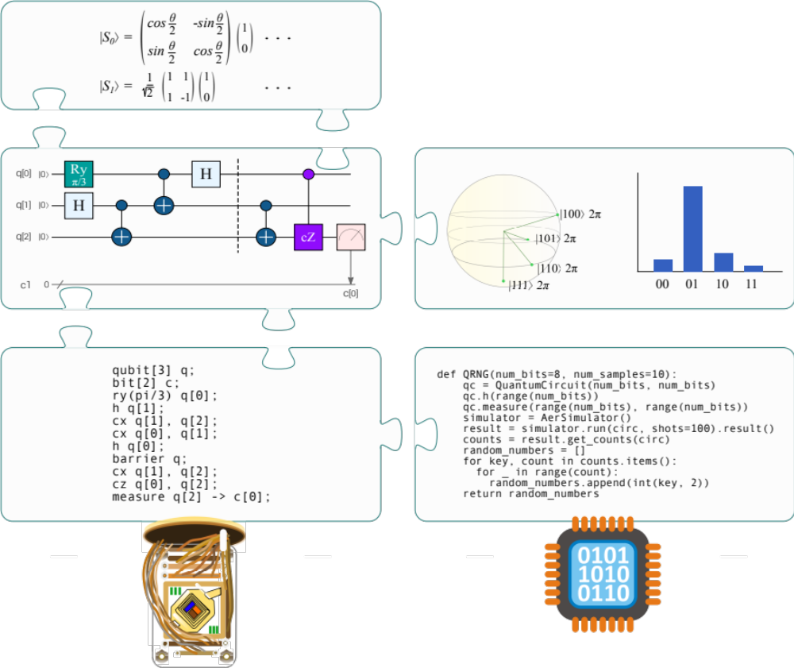
Programming model
linear algebra
visualization
quantum circuit
Quantum
assembly language
Python
QPU
CPU
Python
Notes:
The image illustrates the general programming model of a quantum computer.
The mathematical foundation of quantum computing is linear algebra. The mathematical model of an algorithm is visualized as a quantum circuit.
The textual description of the quantum circuit constitutes the program's source code. This source code is then translated into machine instructions that are executed on the quantum processor. A quantum code can also be written in quantum Python, which allows hybrid classical-quantum programming, where the quantum code is executed on a QPU and its results are used in a classical program running on a CPU.
Visualization plays an important role in quantum computing, from representing qubits states to showing the results.

Slide 49
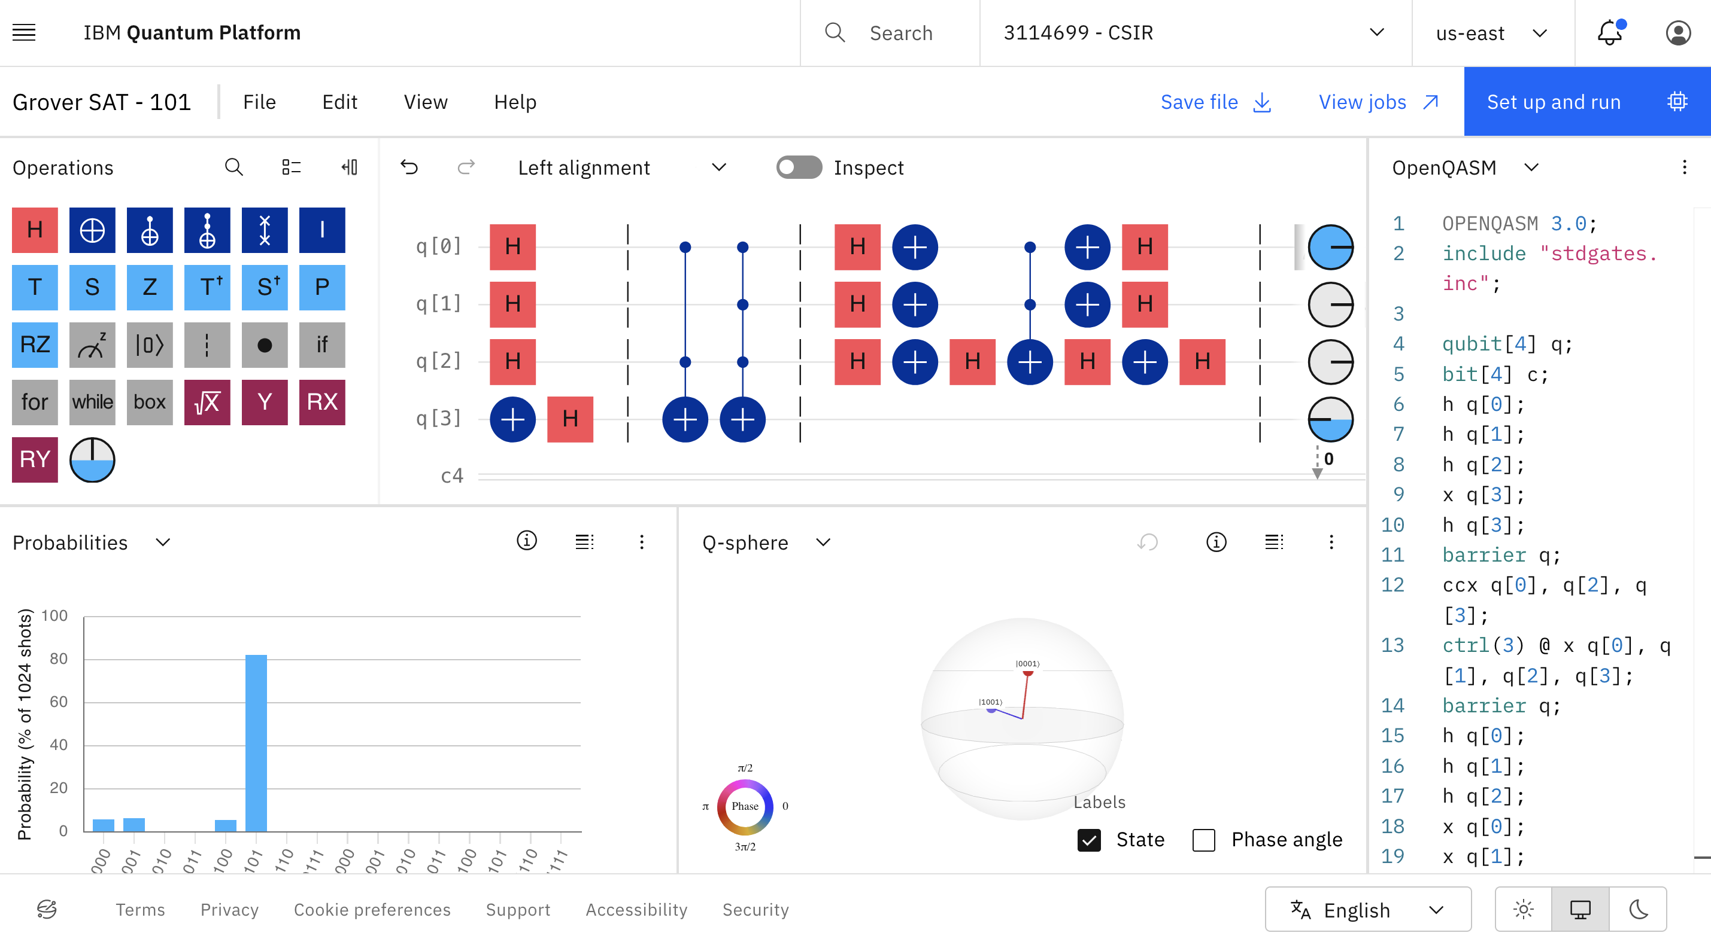
Notes:
All the tools needed to experiment with quantum computers are available online, and real quantum processors can be accessed through quantum cloud services.
This is an example of IBM’s online tool, Quantum Composer, which can be accessed through a web browser. Quantum circuits are created by simply dragging and dropping quantum gates from the left panel onto the circuit diagram in the center. At the same time, the corresponding program code is automatically generated in the selected programming language and displayed on the right.
The state of the quantum system is visualized in the lower part of the workspace. In the top-right corner, there is a button for running the program. The program is sent to IBM’s cloud platform, where it can be executed on a quantum processor.

Slide 50





Quantum clouds
Quantum Assembly Language (QASM)
Notes:
In addition to IBM’s quantum cloud platform, there are other platforms, such as Amazon Braket and Microsoft Azure Quantum. These platforms provide access to quantum processors from different manufacturers, including companies such as IonQ, Rigetti, IQM, AQT, and QuEra.
The execution time depends on the selected processor, its availability, and the queue. Small quantum programs may execute very quickly, but the waiting time for access to a processor is not guaranteed and can be considerably longer.
The cost also depends on the platform, processor, and number of executions, or shots. On Amazon Braket, for example, the cost typically consists of a fixed charge per task plus an additional charge for each shot. In our practical exercises, we will use free resources and quantum simulators.
Regarding programming languages and tools, one of the best-known languages for describing quantum programs is OpenQASM (Open Quantum Assembly Language). Qiskit is IBM’s software development kit (SDK) for programming quantum computers in Python.

Slide 51
Rose’s Law
Rose’s Law: qubits in processors double every 18 months.
Notes:
In classical computing, increasing processing power has historically been closely associated with increasing the number of transistors in a microprocessor. Moore’s Law states that the number of transistors on an integrated circuit doubles approximately every two years.
Quantum computing scales differently. Adding just one qubit doubles the number of states that can be represented in superposition, from 2^{n} to 2^{{n+1}}. A commonly cited quantum counterpart to Moore’s Law is Rose’s Law, which suggests that the number of qubits in quantum processors doubles approximately every 18 months.
The graph illustrates the growth in the number of qubits in quantum processors developed by leading manufacturers. Quantum processors have already crossed the 1,000-qubit threshold, demonstrating the rapid growth in the scale of quantum hardware.

Slide 52
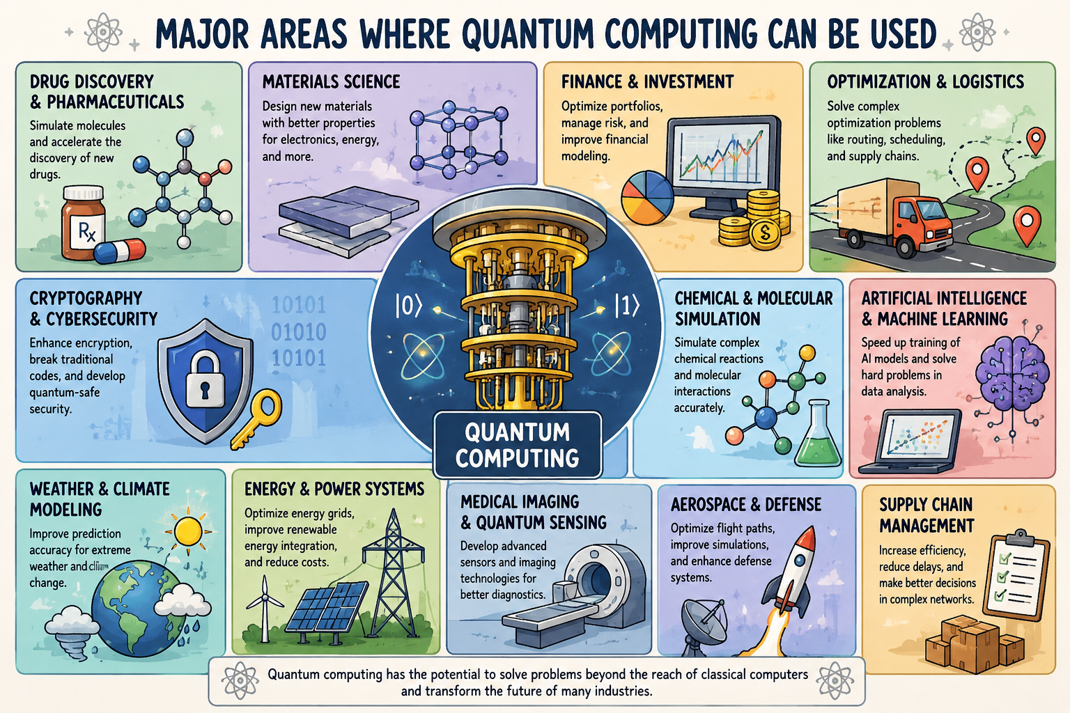
Novi materijali
Notes:
Quantum computing is finding applications in machine learning, simulation, optimization, cryptography, finance, signal processing, and the discovery of new materials and molecules. While classical computers will remain essential, the field is advancing rapidly.

Slide 53

Questions?

