Slide 1

Quantum Computing
2. Mathematical foundations
Prof. Aleksandar Radovanovic
aradovanovic@uwc.ac.za

Slide 2
Content
Complex Numbers
Matrices
Vectors and Vector Spaces
Linear Transformations
Operators
Modular Arithmetic
Boolean Algebra
Eigenvalues and Eigenvectors

Slide 3
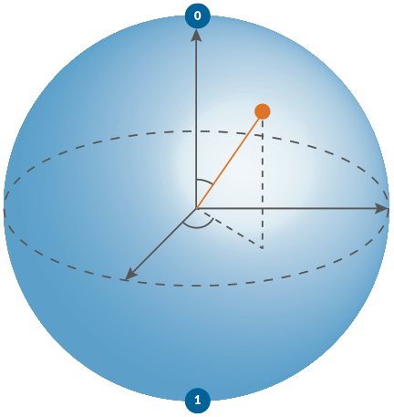

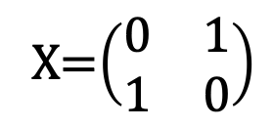
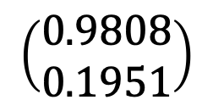
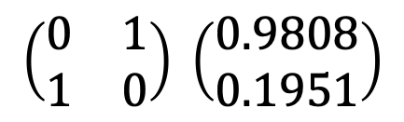
Model of Quantum Computation
matehematical unit of processing
matrix-vector multiplication
unit of data
qubit/vector
unit of processing
quantum gate/matrix
algorithm
quantum circuit
program
quantum circuit desciption
$$\left(\begin{matrix}0.9808 \\ 0.1951\end{matrix}\right)$$
+
X=$\left(\begin{matrix}0 & 1 \\ 1 & 0\end{matrix}\right)$
$$\left(\begin{matrix}0 & 1 \\ 1 & 0\end{matrix}\right) \left(\begin{matrix}0.9808 \\ 0.1951\end{matrix}\right)$$
+
H
circuit.x (qreg_q[0])
circuit.h (qreg_q[0])
circuit.measure (qreg_q[0], creg_c[0])
Notes:
To start, it is useful to revisit the quantum computation model.
The basic unit of quantum information is the quantum bit, or qubit. Mathematically, a qubit is represented by a two-dimensional state vector.
The basic unit of quantum processing is the quantum gate. Mathematically, a quantum gate is represented by a unitary matrix.
Quantum computation consists of successive transformations of the qubit state. Geometrically, these transformations can be visualized as rotations of the vector. Mathematically, they are represented by multiplying the qubit state vector by the matrix corresponding to a quantum gate, producing a new quantum state.
A quantum algorithm is commonly represented as a quantum circuit. Although the term "quantum circuit" might suggest a hardware circuit, it is actually a flowchart-like diagram that shows the sequence of quantum gates applied to the qubits during program execution.
Finally, a quantum program is a description of a quantum circuit written in a programming language, typically Python or a quantum assembly language such as OpenQASM.

Slide 4





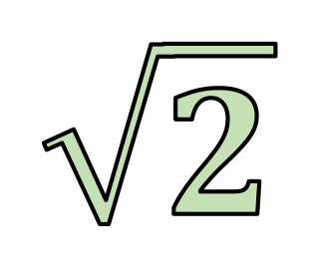
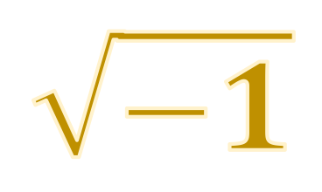

Constants
$$\sqrt{−1}$$
$$1$$
$$π$$
$$e$$
$$i$$
$$\sqrt{2}$$
$$0$$
Notes:
To start, it is useful to introduce a few mathematical constants that appear frequently in quantum computing. These constants appear frequently in quantum computing, particularly in complex numbers, trigonometric functions, and quantum states.

Slide 5
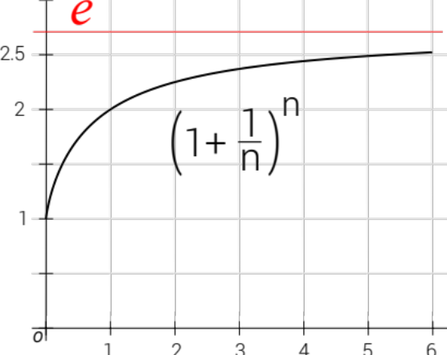

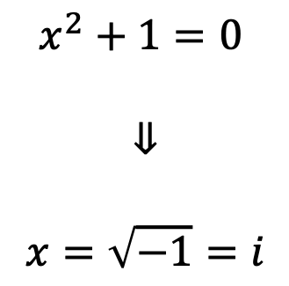
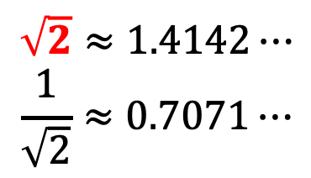

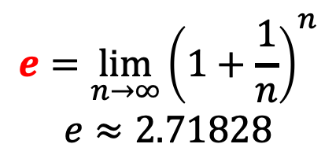

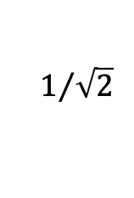

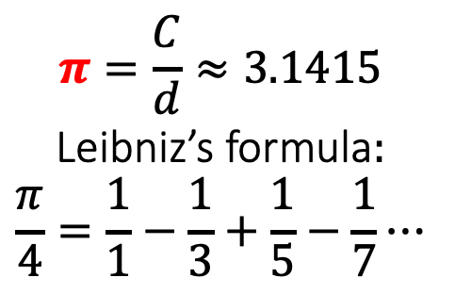


Important mathematical constants
circumference : $C$
$$r$$
1
$$i$$
$$r$$
45°
$$1rad$$
$$1/{\sqrt{2}}$$
1
$$d$$
$$x^{2}+1=0$$
$$⇓$$
$$x=\sqrt{−1}=i$$
$$\begin{matrix}π=\frac{C}{d}≈3.1415 \\ \text{Leibniz}\text{’}\text{s} \text{formula}: \\ \frac{π}{4}=\frac{1}{1}−\frac{1}{3}+\frac{1}{5}−\frac{1}{7}⋯\end{matrix}$$
$$\begin{matrix}\sqrt{2}≈1.4142⋯ \\ \frac{1}{\sqrt{2}}≈0.7071⋯\end{matrix}$$
$$\begin{matrix}e=\lim_{n→∞}{{\left(1+\frac{1}{n}\right)}^{n}} \\ e≈\text{2}\text{.}\text{71828}\end{matrix}$$
Notes:
There are several mathematical constants that frequently appear in quantum mechanics and quantum computing.
Constant, $\sqrt{2}$, and its reciprocal, $1/\sqrt{2}$ , often come up in quantum mechanics and quantum computing. They usually appear as results of operations on a unit circle or a unit sphere with radius 1.
Pi ($π$) is usually defined as the ratio of a circle’s circumference to its diameter, but there are other definitions too. For example, Leibniz’s formula gives $π$ as an infinite series. In quantum mechanics, $π$ is linked to the energy levels of hydrogen atoms.
The number $π$ is closely linked to measuring angles in radians, which is the natural unit for angles in math. One radian is the angle that covers an arc the same length as the radius. Since C=2𝝅r, a full circle is C=2𝝅 radians. Common angles are easy to write as fractions of 𝝅. For example, a right angle (90°) is 𝝅/2 radians.
The Imaginary Unit ($i$) is defined as the solution to the equation: $x^{2}+1=0$. In other words $x=\sqrt{−1}=i$.
Euler’s number ($e$) is another important constant, and it can be defined in several ways. One way is through compounded growth. As $n$ gets larger and larger, this expression approaches the value $e$, which is about 2.718.

Slide 6
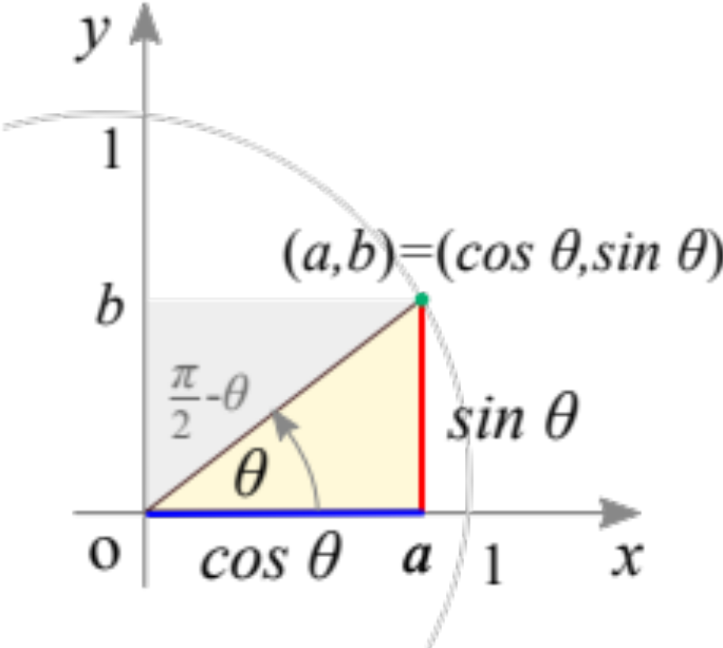

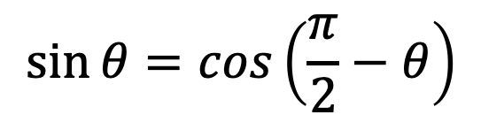
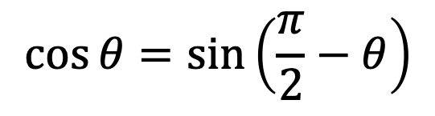

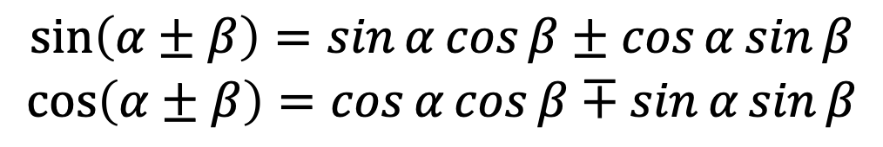

Important Trigonometric Functions
$$\sin{θ}=b$$
$$\cos{θ=a}$$
Pythagorean trigonometric identity
$$\sin^{2}{θ}+\cos^{2}{θ=1}$$
$$\sin{θ}=\cos\left(\frac{π}{2}−θ\right)$$
$$\cos{θ}=\sin\left(\frac{π}{2}−θ\right)$$
$$\begin{matrix}\sin\left(α±β\right)=\sin{α}\cos{β±\cos{α}\sin{β}} \\ \cos\left(α±β\right)=\cos{α}\cos{β∓\sin{α}\sin{β}}\end{matrix}$$
Notes:
The unit circle and unit sphere appear frequently in quantum computing. A unit circle or unit sphere simply has a radius of 1. Functions such as sine and cosine help describe points at different angles around them.
On the unit circle, sine and cosine describe the position of a point for a given angle θ. In the example shown, $\sin{θ}=b$ and $\cos{θ=a}$. Because the radius is 1, they satisfy the Pythagorean identity $a^{2}+b^{2}=1$, that is, $\sin^{2}{θ}+\cos^{2}{θ=1}$.
The diagram also shows that sine and cosine are closely related through complementary angles. Two angles are complementary when they add up to π/2, allowing sine to be expressed as cosine, and vice versa.
Other useful trigonometric identities describe the sine and cosine of sums and differences of angles.

Slide 7
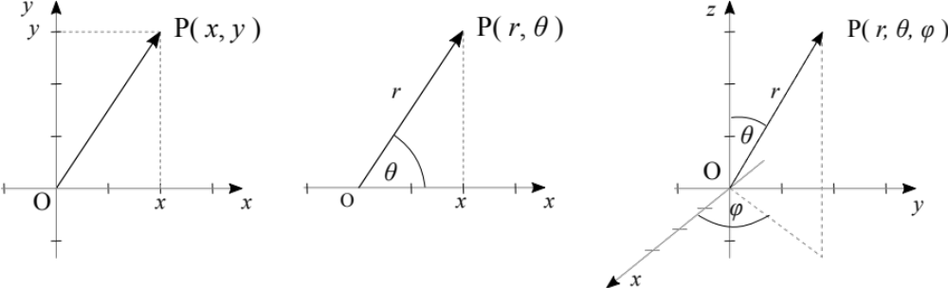
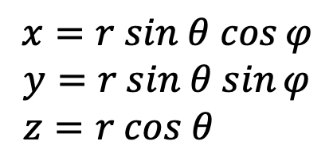
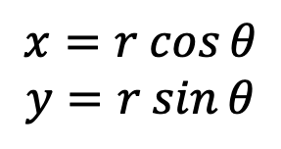
Coordinate systems
Cartesian coordinate system
Polar coordinate system
Spherical coordinate system
$$x=r sin θ cos{φ}$$
$$y=r sin θ sin{φ}$$
$$z=r cos θ$$
$$x=r cos{θ}$$
$$y=r sin{θ}$$
Notes:
In the Cartesian coordinate system, a point is defined by its coordinates, which represent its distance from mutually perpendicular axes. These axes intersect at the origin O, with coordinates (0,0).
In the polar coordinate system, a point’s position is determined by its radial distance $r$ from a reference point (the pole O) and the polar angle $θ$ measured relative to a reference axis.
In the spherical coordinate system, a point is defined by three coordinates:
The radial distance $r$ from the origin.
The polar angle $θ$, which measures the angle from the vertical (polar) axis.
The azimuthal angle $φ$, which measures the angle between the projection of the point onto the xy-plane and the x-axis.
Using trigonometric functions, it’s easy to convert coordinates between these systems.

Slide 8

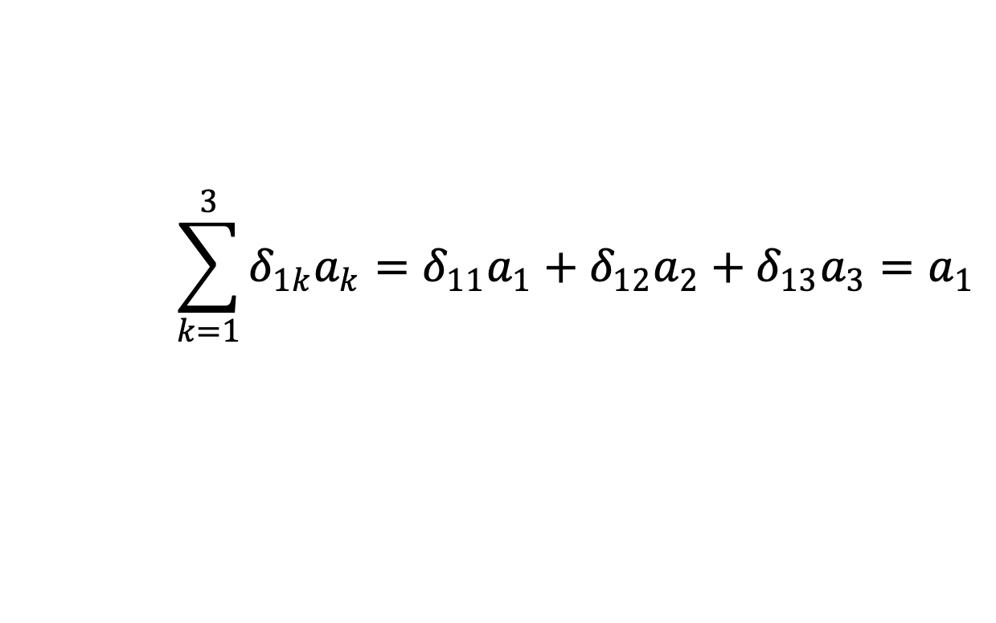
Kronecker delta function
$$δ_{jk}=\left\{\begin{matrix}1 & j=k \\ 0 & j≠k\end{matrix} \right.$$
A filtering function example:
Leopold Kronecker (1823-1891)
$$\sum_{k=1}^{3}{δ_{1k}a_{k}=δ_{11}a_{1}+δ_{12}a_{2}+δ_{13}a_{3}=a_{1}}$$
Notes:
The Kronecker delta function is a function of two variables, e.g. $j$ and $k$, that returns 1 if they are equal and 0 if they are different.
This function is commonly used as a filtering function, for example, to extract a specific term from a sum.
The function is named after the German mathematician Leopold Kronecker.

Slide 9

Complex numbers
Notes:
In linear algebra for quantum computing, complex numbers play a key role. They were introduced into quantum mechanics by Schrödinger and Heisenberg in the 1920s.
In the 1960s, there was a proposal to replace complex numbers with real numbers in quantum mechanics, but this idea did not gain widespread acceptance.

Slide 10



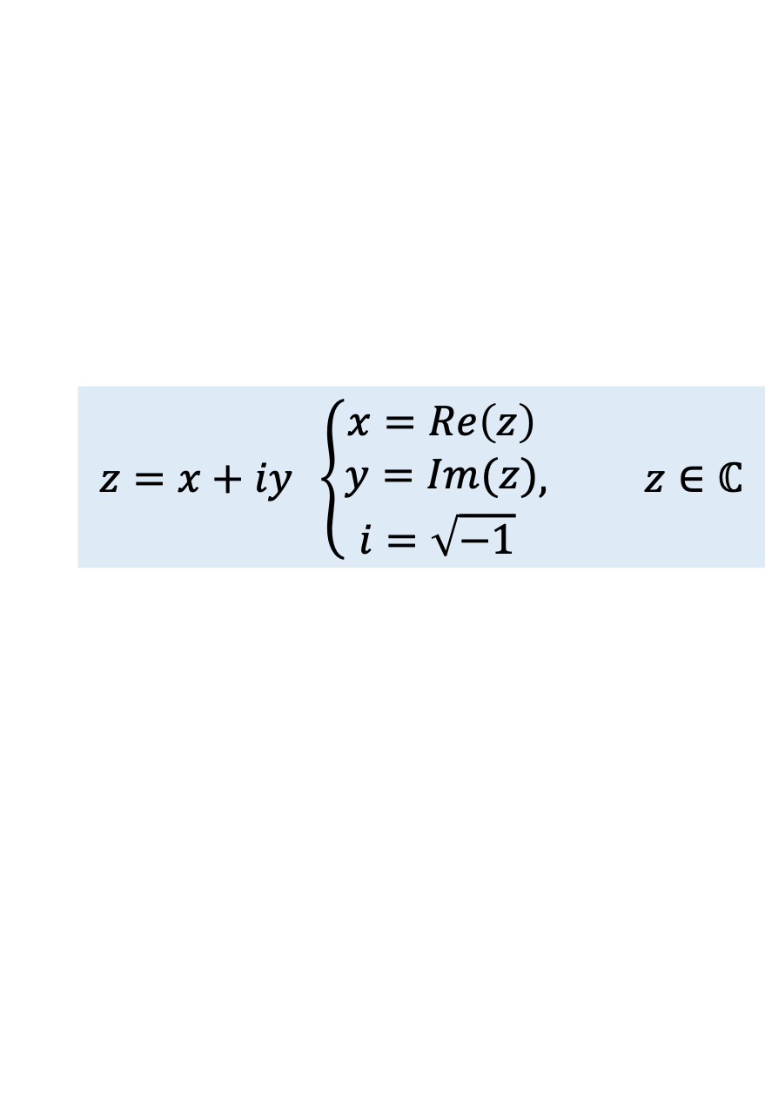









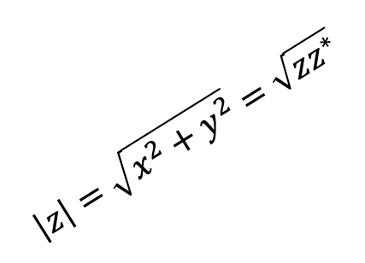
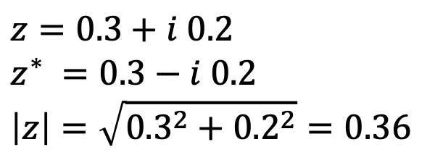






Complex numbers
$$z=x+iy \left\{\begin{aligned}x=Re\left(z\right) \\ y=Im(z) \\ i=\sqrt{−1} \end{aligned}, z∈ℂ\right.$$
$$Im$$
$$z =x+iy$$
$$0.2i$$
$$z =0.3+i 0.2$$
$$\left|z\right|=\sqrt{x^{2}+y^{2}}=\sqrt{zz^{∗}}$$
The complex conjugate
The modulus
$$0.1i$$
$$i\left|z\right|sin{φ}$$
$$\left|z\right|=\sqrt{x^{2}+y^{2}}=\sqrt{zz^{∗}}$$
$$φ$$
$$\left|z\right|cos{φ}$$
$$z^{∗} =x−iy$$
O
0$.1$
$$0.2$$
$$0.3$$
$$Re$$
$$−0.1i$$
Example:
$$z=0.3+i 0.2$$
$$z^{∗} =0.3−i 0.2$$
$$\left|z\right|=\sqrt{{0.3}^{2}+{0.2}^{2}}=0.36$$
$$z^{∗} =0.3−i 0.2$$
$$−0.2i$$
$$z^{∗} =x−iy$$
Notes:
A complex number is an ordered pair of real numbers, for example, $x$ and $y$, written in algebraic form as: $z=x+iy$. The set of all complex numbers is denoted by the double-struck letter $ℂ$.
$x$ is the real part, and $y$ is the imaginary part of the complex number $z$.
$i$ is the imaginary unit, defined as $i=\sqrt{−1}$. ​
The complex conjugate of a number flips the sign of its imaginary part. We denote it by a star superscript, for example $z^{∗}$.
The absolute value (or modulus) of a complex number is the square root of the sum of its real part squared and imaginary part squared.
A complex number can be visually represented as a point in the complex plane, with coordinates $x$ and $y$:
$x$ lies on the horizontal (real) axis.
$y$ lies on the vertical (imaginary) axis.
This point is connected to a vector, called the radius vector of the complex number. The length of this vector equals the modulus of the complex number.
Here is a simple example of a complex number: $z=0.3+i 0.2$, its conjugate $z^{∗} =0.3−i 0.2$ and it modulus.

Slide 11








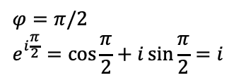

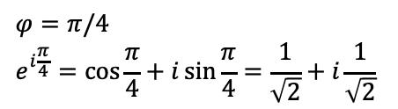





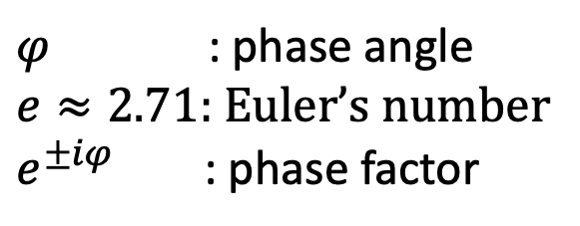
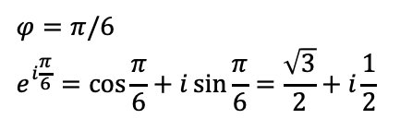









Euler’s formula
$$Im$$
$$i$$
$$e^{±iφ}=\cos{φ}±i\sin{φ}$$
$φ$ : phase angle
$e≈2.71$: Euler’s number
$e^{±iφ}$ : phase factor
$$e^{iφ}$$
$$i\sin{φ}$$
$$φ$$
Leonhard Euler
(1707-1783)
O
$$\cos{φ}$$
$$Re$$
$$1$$
$$φ=0$$
$$e^{i0}=\cos{0}+i\sin{0=1}$$
$$φ=π/6$$
$$e^{i\frac{π}{6}}=\cos{\frac{π}{6}}+i\sin{\frac{π}{6}}=\frac{\sqrt{3}}{2}+i\frac{1}{2}$$
$$φ=π/4$$
$$e^{i\frac{π}{4}}=\cos{\frac{π}{4}}+i\sin{\frac{π}{4}=\frac{1}{\sqrt{2}}+i\frac{1}{\sqrt{2}}}$$
$$φ=π/2$$
$$e^{i\frac{π}{2}}=\cos{\frac{π}{2}}+i\sin{\frac{π}{2}=i}$$
$$i$$
$$i$$
$$i$$
$$i$$
$$\frac{i}{\sqrt{2}}$$
$$\frac{i}{2}$$
$$φ$$
$$φ$$
$$φ$$
O
$$1$$
O
$$\frac{\sqrt{3}}{2}$$
$$1$$
O
$$\frac{1}{\sqrt{2}}$$
$$1$$
O
$$1$$
Notes:
Euler’s formula provides the exponential representation of a complex number.
Consider the complex number shown in the figure: its real part is $\cos{φ}$ and its imaginary part is $\sin{φ}$. This number can be written as $\cos{φ}+i\sin{φ}$.
Euler’s formula states that this same number can also be expressed as $e^{iφ}$, where:
$$e^{iφ}=\cos{φ}+i\sin{φ}$$
$φ$ is the phase angle,
$e≈2.71$ is Euler’s number.
$e^{iφ}$ is called a phase factor and it has modulus 1.
As the angle $φ$ increases, the complex number and its associated vector rotate around the origin. Since this rotation is captured by the phase factor $e^{iφ}$, multiplying any complex number by $e^{iφ}$ rotates it by $φ$ around the origin.
A particularly elegant result is Euler’s identity: ${ e}^{iπ}+1=0$, often considered the most beautiful equation in mathematics, as it elegantly connects five fundamental constants: $e,π,i,0 i 1$.

Slide 12







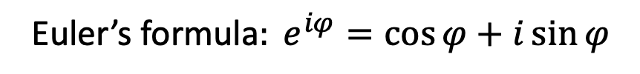


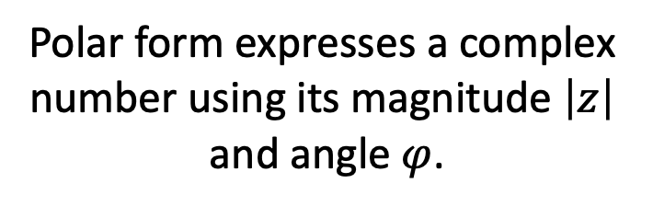







Polar form of a complex number
$$i$$
$$Im$$
$z=x+iy$ $=\left|z\right|\left(\cos{φ+i\sin{φ}}\right)$
$$y$$
$$z^{∗}=x−iy=\left|z\right|\left(\cos{φ−i\sin{φ}}\right)$$
$${\text{Euler}\text{’}\text{s} \text{formula}: e}^{iφ}=cos{φ}+i\sin{φ}$$
$$\left|z\right|$$
$$\sin{φ}$$
$$z =|z|{\left(\cos{φ}+i\sin{φ}\right)=|z|e}^{iφ}$$
$$φ$$
$$Re$$
$$z^{∗}=|z|{\left(\cos{φ}−i\sin{φ}\right)=|z|e}^{−iφ}$$
O
$$\cos{φ}$$
$$x$$
$$1$$
$${{(e}^{iφ})}^{n}=e^{iφn}$$
Polar form expresses a complex number using its magnitude $\left|z\right|$
and angle $φ$.
De Moivre’s formula
$${(\cos{φ}+i\sin{φ})}^{n}=\cos{nφ+i\sin{nφ}}$$
Notes:
Complex numbers are often expressed in polar form using its modulus $\left|z\right|$ and angle $φ$, instead of real and imaginary parts. The phase angle $φ$ is measured counterclockwise from the positive real axis.
By expressing: $x=rcos{φ}$, $y=rsin{φ}$ we obtain the polar form of a complex number
$$z=\left|z\right|\left(\cos{φ+i\sin{φ}}\right)$$
Using Euler’s formula, this can be rewritten in exponential form: ${z=\left|z\right|e}^{iφ}$
Another useful formula is De Moivre’s formula, which extends Euler’s formula to integer powers:
$${(\cos{φ}+i\sin{φ})}^{n}=\cos{nφ+i\sin{nφ}}$$

Slide 13

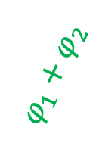




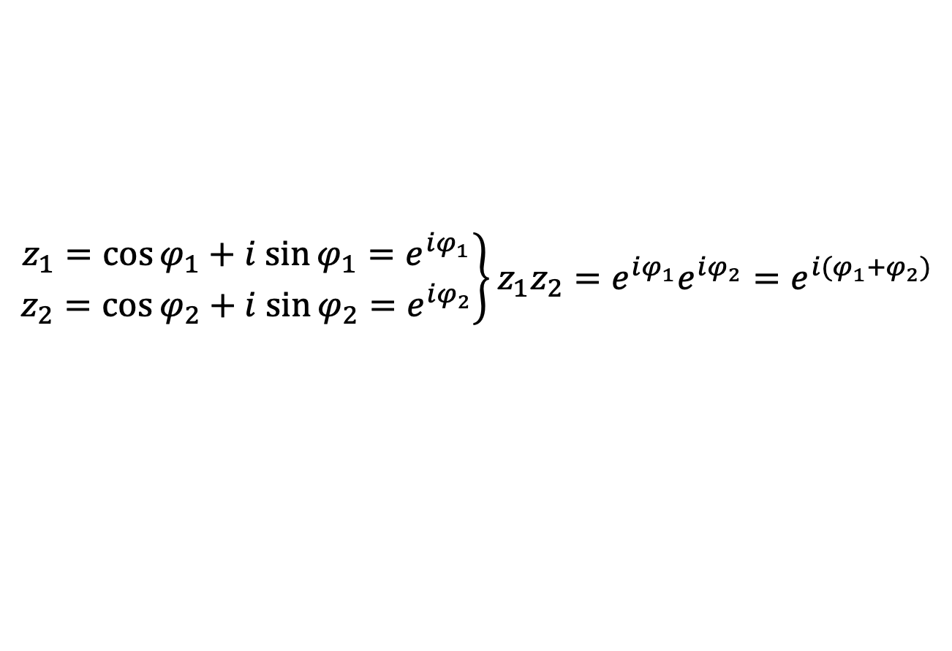


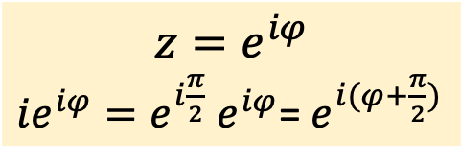
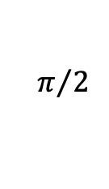






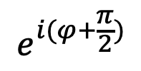




Complex numbers on the unit circle
$$Im$$
$$Im$$
$$z=e^{iφ}$$
${{ie}^{iφ}=e}^{i\frac{π}{2}}$ $e^{iφ}$= $e^{i(φ+\frac{π}{2})}$
$$|∙i$$
$$z_{1}z_{2}$$
$$e^{i(φ+\frac{π}{2})}$$
$$i$$
$$i$$
$$z_{2}$$
$$φ_{1}+φ_{2}$$
$$z_{1}$$
$$z=e^{iφ}$$
$$φ_{2}$$
$$\sin{φ_{1}}$$
$$π/2$$
$$φ_{1}$$
$$Re$$
$$φ$$
$$Re$$
$$\cos{φ_{1}}$$
$$1$$
$$1$$
$$\left.\begin{matrix}z_{1}=\cos{φ_{1}+i sin{φ_{1}=e^{iφ_{1}}}} \\ z_{2}=\cos{φ_{2}+i sin{φ_{2}=e^{iφ_{2}}}}\end{matrix}\right\}z_{1}z_{2}=e^{iφ_{1}}e^{iφ_{2}}=e^{{i(φ}_{1}+φ_{2})}$$
Notes:
In quantum computing, complex numbers lie on the unit circle, meaning their modulus is always 1, which simplifies many formulas.
For example, the left diagram shows complex numbers, $z_{1}$​ and $z_{2}$​, defined by their phase angles $φ_{1}$​ and $φ_{2}$.
When multiplying these two numbers, their phase angles add, following the exponentiation rule:
$$z_{1}z_{2}=e^{iφ_{1}}e^{iφ_{2}}=e^{{i(φ}_{1}+φ_{2})}$$
In other words, the product of two complex numbers on the unit circle results in a complex number whose phase angle is the sum of the phase angles of the factors.
A particularly interesting consequence of this rule is that multiplying a complex number by $i$ corresponds to a 90° rotation as ${i=e}^{iπ/2}$. Similarly, multiplying by $−i$ corresponds to a rotation of 3π/2 (or -90°).

Slide 14

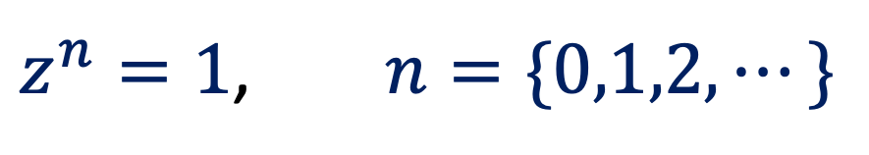
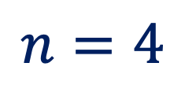
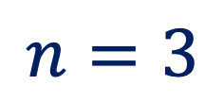
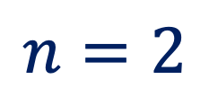
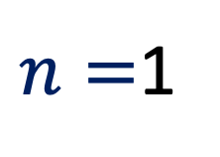

n-th roots of unity
$z^{n}=1$, $n=\{0,1,2,⋯\}$
$$Im$$
$$Re$$
$n=$1
$$n=2$$
$$n=3$$
$$n=4$$
Notes:
Another important concept in quantum computing is the $n$-th roots of unity, which are used to describe and control phase shifts in a qubit state.
The $n$-th roots of unity are $n$ equally spaced points on the unit circle in the complex plane. They are the solutions to the equation $z^{n}=1$.
These solutions correspond to discrete phase angles on the unit circle in the complex plane.

Slide 15

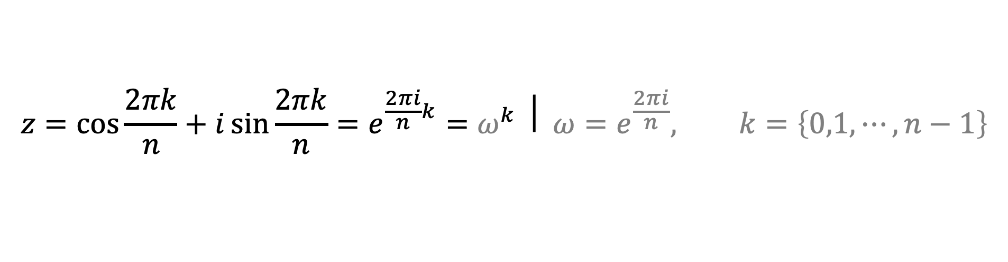

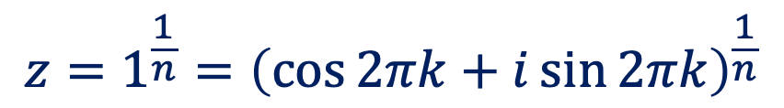
n-th roots of unity
Fundamental Theorem of Algebra
$$z^{n}=1$$
$n$ solutions
$$z^{n}=1=e^{i2πk}=\cos{2πk+i\sin{2πk}}, k=\left\{0,1,⋯,n−1\right\}$$
$$z=1^{\frac{1}{n}}={\left(\cos{2πk+i\sin{2πk}}\right)}^{\frac{1}{n}}$$
$${\text{De} \text{Moivre}\text{’}\text{s} \text{theorem}\text{:} \left(\cos{x+i\sin{x}}\right)}^{n}=\cos{nx+i\sin{nx}}$$
$$z=\cos{\frac{2πk}{n}+i\sin{\frac{2πk}{n}}}=\left.e^{\frac{2πi}{n}k}=ω^{k} \right| {ω=e}^{\frac{2πi}{n}}, k=\left\{0,1,⋯,n−1\right\}$$
Notes:
By the Fundamental Theorem of Algebra, every complex polynomial of degree n has exactly $n$ complex solutions. Since the equation $z^{n}=1$ is a polynomial of degree $n$, its $n$ solutions are called the n-th roots of unity.
To find these $n$ solutions, we express the number 1 using Euler's formula, knowing that $e^{i2π}=1$. Since this equation has exactly $n$ complex solutions, we label them with $k$ ranging from 0 to $n−1$.
Next, we take the n-th root of both sides of the equation, which introduces an exponent of $1/n$ on the right-hand side.
Now we use De Moivre’s theorem to find the $n$-th roots of unity. These solutions have phase angles $2πk/n$, which means the unit circle is split into $n$ equally spaced points — the roots of unity we’re looking for.
In quantum computing, these roots are commonly written in exponential form and represented by the lowercase Greek letter $ω$, with ${ω=e}^{\frac{2πi}{n}}$

Slide 16


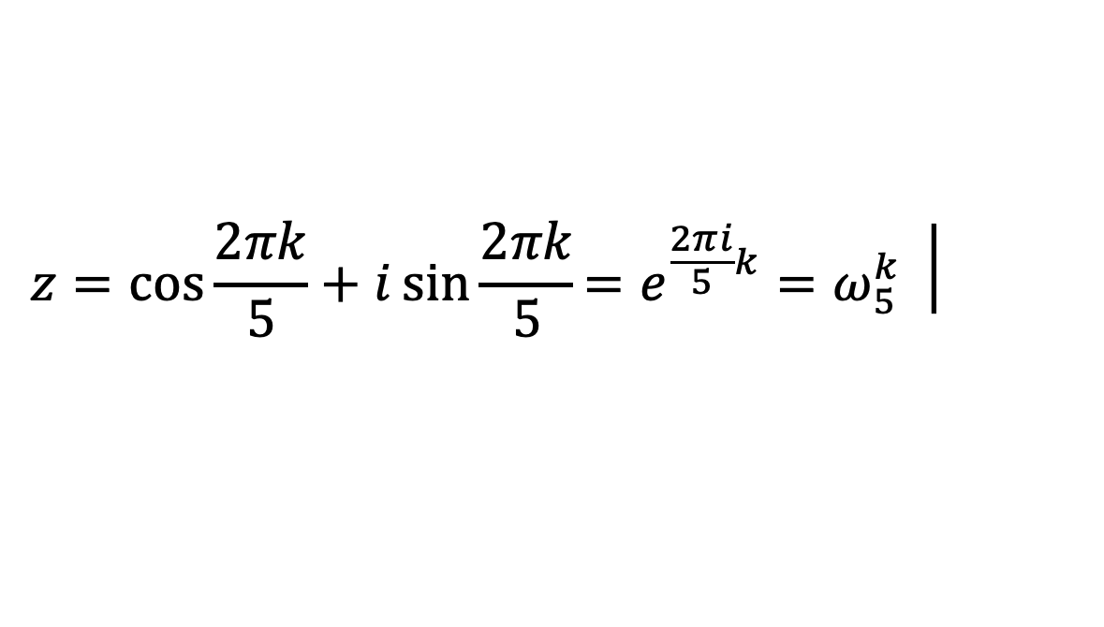


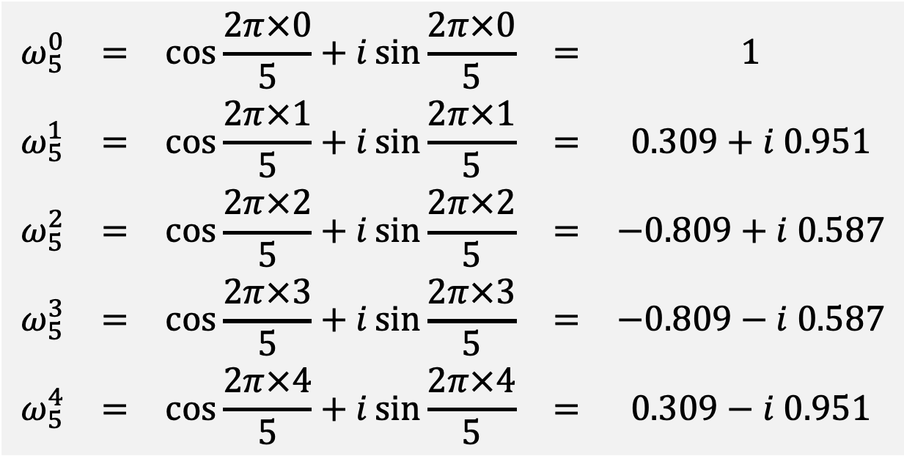








Example of finding the 5th roots of unity
$$z=\cos{\frac{2πk}{5}+i\sin{\frac{2πk}{5}}}\left.={e^{\frac{2πi}{5}k}=ω}_{5}^{k} \right|$$
$$k=\left\{0,1,2,3,4\right\}$$
$$Im$$
$$\begin{matrix}ω_{5}^{0} & = & \cos{\frac{2π×0}{5}+i\sin{\frac{2π×0}{5}}} & = & 1 \\ ω_{5}^{1} & = & \cos{\frac{2π×1}{5}+i\sin{\frac{2π×1}{5}}} & = & 0.309+i 0.951 \\ ω_{5}^{2} & = & \cos{\frac{2π×2}{5}+i\sin{\frac{2π×2}{5}}} & = & −0.809+i 0.587 \\ ω_{5}^{3} & = & \cos{\frac{2π×3}{5}+i\sin{\frac{2π×3}{5}}} & = & −0.809−i 0.587 \\ ω_{5}^{4} & = & \cos{\frac{2π×4}{5}+i\sin{\frac{2π×4}{5}}} & = & 0.309−i 0.951\end{matrix}$$
$$i$$
$$ω_{5}^{1}$$
$$ω_{5}^{2}$$
$$2π/5$$
$$Re$$
$$−1$$
$$1$$
$$ω_{5}^{3}$$
$$−i$$
$$ω_{5}^{4}$$
Notes:
As an example, let’s find the 5th roots of unity.
By applying the formula, we get 5 roots. From these results, we observe:
The first root is 1.
All roots are evenly spaced by $2π/5$​ radians on the complex plane.
The roots are periodic, meaning they repeat with a period of $n=5$.

Slide 17



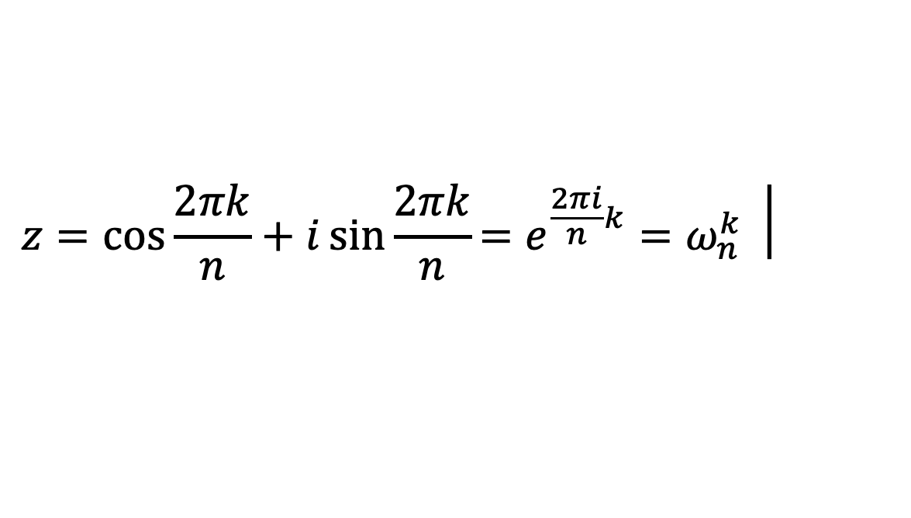







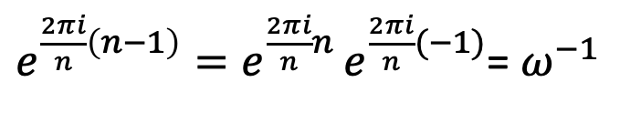






Some properties of the n-th roots of unity
$$z=\cos{\frac{2πk}{n}+i\sin{\frac{2πk}{n}}}\left.={e^{\frac{2πi}{n}k}=ω}_{n}^{k} \right|$$
$$k=\left\{0,1,⋯,n−1\right\}$$
1)
$$1+ω+ω^{2}+⋯+ω^{n−1}=0$$
$$i$$
$$ω_{5}^{1}$$
$$ω_{5}^{2}$$
2)
$$1+ω^{m}+ω^{2m}+⋯+ω^{\left(n−1\right)m}=0$$
3)
$$m=0→1+1+1+⋯+1=n$$
$$2π/5$$
$$Re$$
$$−1$$
$$1$$
4)
$$ω^{n−1}=ω^{−1}$$
$e^{\frac{2πi}{n}\left(n−1\right)}=e^{\frac{2πi}{n}n }e^{\frac{2πi}{n}(−1)}$= $ω^{−1}$
$$ω_{5}^{3}$$
5)
$$1×ω×ω^{2}×⋯×ω^{n−1}={(−1)}^{n−1}$$
$$−i$$
$$ω_{5}^{4}$$
Notes:
Some properties of the n-th roots of unity are:
Sum of all roots:
The sum of all n-th roots of unity is zero because they are evenly spaced points around the unit circle in the complex plane. If you add them as vectors, they cancel each other out because they’re perfectly balanced around the origin.
Summing powered roots:
If you raise each root of unity to a power $m$ (not a multiple of $n$) and add them, the sum is still zero. This is because the points stay evenly spaced around the circle, so they balance out.
Special case $m=0$:
When $m=0$, summing all roots gives $n$.
Negative exponents and circular motion:
Since $ω^{n−1}=ω^{−1}$, moving $n−1$ steps forward around the unit circle is the same as moving 1 step backward. This means we can describe movement along the unit circle using either positive or negative steps.
Product of all roots:
The product of all n-th roots of unity is ±1, depending on whether n is even or odd..

Slide 18
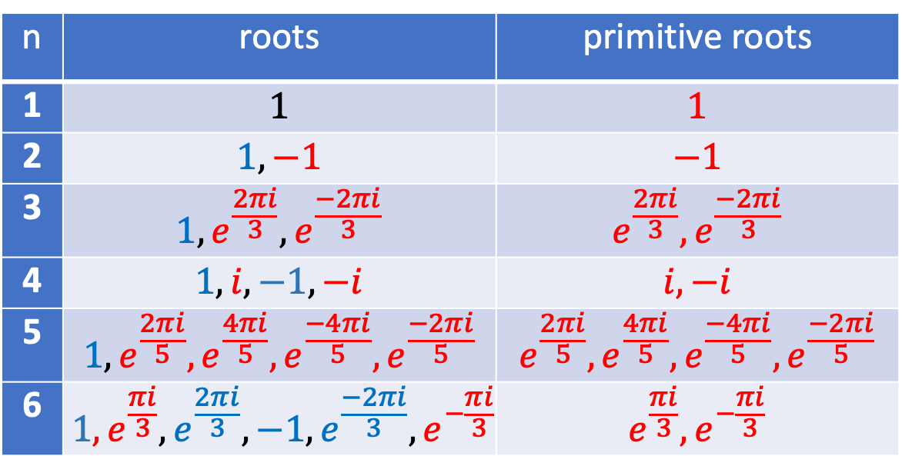
Primitive roots of unity
n | roots | primitive roots
1 | $$1$$ | $$1$$
2 | $$1,−1$$ | $$−1$$
3 | $$1,e^{\frac{2πi}{3}},e^{\frac{−2πi}{3}}$$ | $$e^{\frac{2πi}{3}},e^{\frac{−2πi}{3}}$$
4 | $$1,i,−1,−i$$ | $$i,−i$$
5 | $$1,e^{\frac{2πi}{5}},e^{\frac{4πi}{5}},e^{\frac{−4πi}{5}},e^{\frac{−2πi}{5}}$$ | $$e^{\frac{2πi}{5}},e^{\frac{4πi}{5}},e^{\frac{−4πi}{5}},e^{\frac{−2πi}{5}}$$
6 | $${1, e}^{\frac{πi}{3}},e^{\frac{2πi}{3}},−1,e^{\frac{−2πi}{3}},e^{−\frac{πi}{3}}$$ | $$e^{\frac{πi}{3}},e^{−\frac{πi}{3}}$$
An n-th root of unity is called primitive if it is not simultaneously an m-th root of unity for any smaller m.
Notes:
An n-th root of unity is called primitive if it is not simultaneously an m-th root of unity for any smaller m. The table shows examples for roots from n=1 to n=6, where the primitive n-th roots of unity are marked in red.
These numbers play an important role in signal processing algorithms and cryptography, where they are used in Fourier transforms, error-correcting codes, and quantum algorithms. For example, a primitive n-th root of unity completes a full revolution around the unit circle when raised to the power of n. This property is used in modern cryptographic systems like lattice-based cryptography.

Slide 19
Mathematical Framework
Linear algebra
Matrices
Vectors
Notes:
With these basic mathematical tools in place, the next step is linear algebra, which provides the main mathematical framework for representing quantum states and operations.

Slide 20





Linear algebra
②
Linear algebra is a branch of mathematics that studies vectors, vector spaces, matrices, linear transformations, and linear operators.
①
②
A function $f$ is linear if it satisfies the following properties:
$$f\left(a+b\right)=f\left(a\right)+f(b)$$
additivity
$$f\left(ax\right)=af\left(x\right)$$
homogeneity
These two properties together define
the superposition principle
③
$$f\left(a_{1}x_{1}+a_{2}x_{2}\right)=a_{1}f\left(x_{1}\right)+a_{2}f(x_{2})$$
linear combination
Notes:
Linear algebra is a branch of mathematics that studies vectors, vector spaces, matrices, linear transformations, and linear operators. The term "linear" means straight or proportional.
Let’s explain linearity with a simple example. if Bob takes math lessons at 5 Rands each, one lesson costs 5 Rands, two lessons cost 10 Rands, and so on. The cost goes up evenly with the number of lessons, making a straight-line relationship.
Linear functions satisfy two key properties: additivity and homogeneity.
Additivity means that if you add two inputs first and then apply the function, you get the same result as applying the function to each input separately and then adding the results..
Homogeneity means that if you multiply the input by a number first and then apply the function, it’s the same as applying the function first and then multiplying the result by that number.
Together, these properties define the superposition principle.
The expression $a_{1}x_{1}+a_{2}x_{2}$ is called a linear combination. It’s made by multiplying each variable by a constant and then adding the results.
This property means that when you take a linear combination of inputs, you get a linear combination of outputs. This is the main idea behind the superposition principle in linear algebra and quantum mechanics.

Slide 21

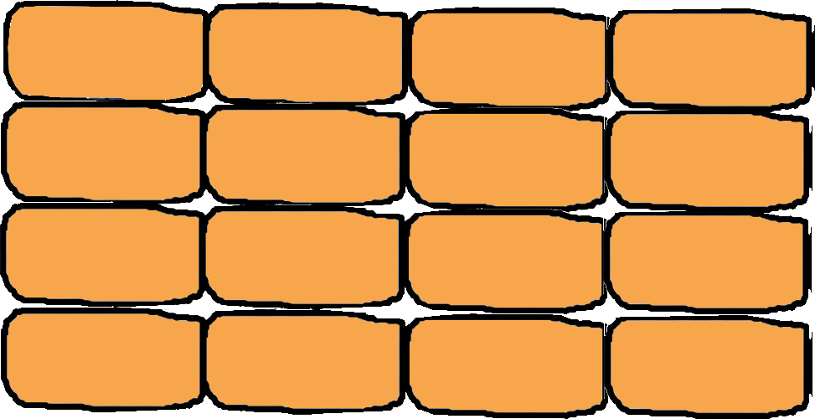
Matrices
1
0
0
0
0
1
0
0
0
0
1
0
0
0
0
1

Slide 22
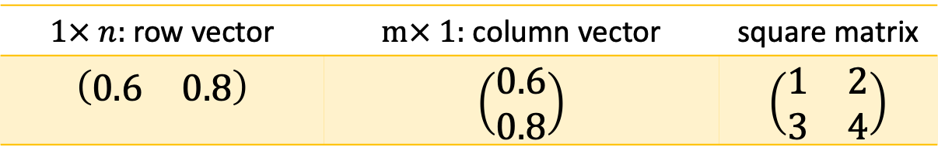
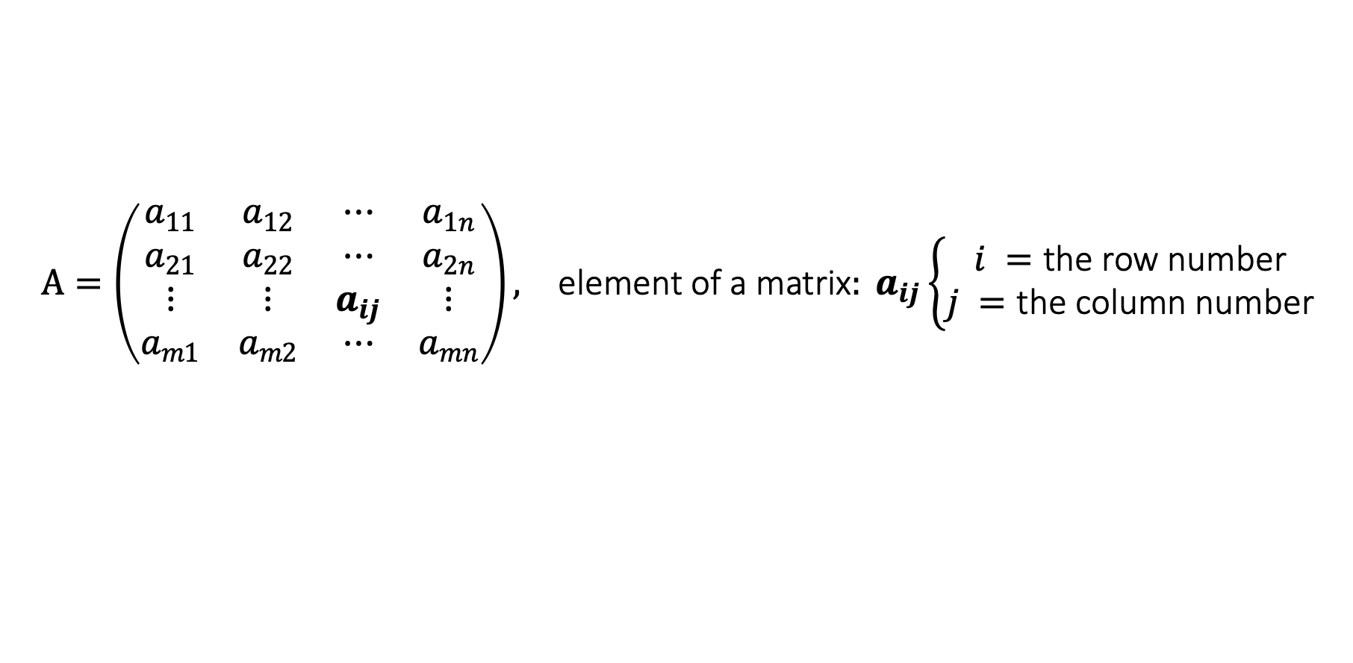
Matrix
A matrix is a is a rectangular array or table of numbers, symbols or expressions organized into horizontal rows and vertical columns. The format of a matrix is given as $m×n$, where: $m$ is the number of rows, and $n$ is the number of columns.
$$\begin{matrix}A=\left(\begin{matrix}a_{11} & a_{12} & ⋯ & a_{1n} \\ a_{21} & a_{22} & ⋯ & a_{2n} \\ ⋮ & ⋮ & a_{ij} & ⋮ \\ a_{m1} & a_{m2} & ⋯ & a_{mn}\end{matrix}\right), & \text{element} \text{of} \text{a} \text{matrix}: a_{ij}\left\{\begin{matrix}i =\text{the} \text{row} \text{number} \\ j =\text{the} \text{column} \text{number}\end{matrix}\right.\end{matrix}$$
The elements $a_{ij}$for which $i=j$ form the main diagonal of the matrix.
$The sum of the elements on the main diagonal is the trace of the matrix::tr(A)$
Matrix Types by Dimension in Quantum Computing
$1× n:$ row vector | $m× 1:$ column vector | square matrix
$$\left(\begin{matrix}0.6 & 0.8\end{matrix}\right)$$ | $$\left(\begin{matrix}0.6 \\ 0.8\end{matrix}\right)$$ | $$\left(\begin{matrix}1 & 2 \\ 3 & 4\end{matrix}\right)$$
Notes:
A matrix is a is a rectangular array or table of numbers, symbols or expressions organized into horizontal rows and vertical columns.
Each element of a matrix is denoted as $a_{ij}$​, where:
$i$ represents the row number, and
$j$ represents the column number.
The elements $a_{ij}$ for which $i=j$ form the main diagonal of the matrix. The trace of a matrix, denoted as $tr(A)$, is the sum of the elements along the main diagonal.
In quantum computing, we mostly use three kinds of matrices by dimension: row vectors, column vectors and square matrices.
Row vector is a matrix with one row.
Column vector: is a matrix with one column.
Square matrix: is a matrix with the same number of rows and columns.

Slide 23
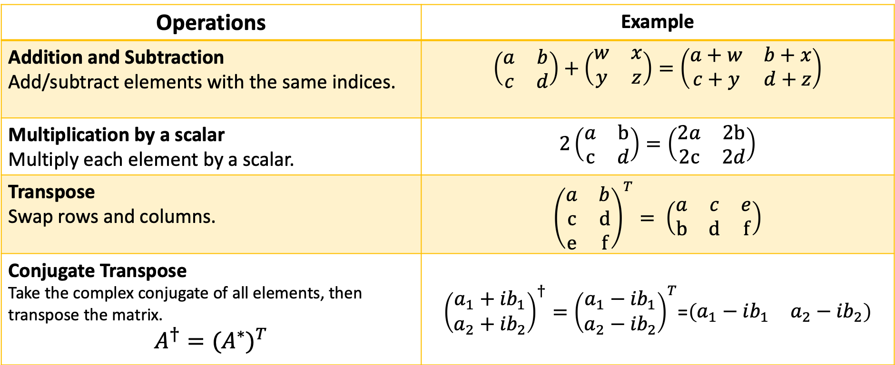
Basic matrix operations
Operations | Example
Addition and Subtraction Add/subtract elements with the same indices. | $\left(\begin{matrix}a & b \\ c & d\end{matrix}\right)+\left(\begin{matrix}w & x \\ y & z\end{matrix}\right)=\left(\begin{matrix}a+w & b+x \\ c+y & d+z\end{matrix}\right)$
Multiplication by a scalar Multiply each element by a scalar. | $2\left(\begin{matrix}a & b \\ c & d\end{matrix}\right)=\left(\begin{matrix}2a & 2b \\ 2c & 2d\end{matrix}\right)$
Transpose Swap rows and columns. | ${\left(\begin{matrix}a & b \\ c & d \\ e & f\end{matrix}\right)}^{T}= \left(\begin{matrix}a & c & e \\ b & d & f\end{matrix}\right)$
Conjugate Transpose Take the complex conjugate of all elements, then transpose the matrix. $$A^{†}={(A^{∗})}^{T}$$ | ${\left(\begin{matrix}a_{1}+{ib}_{1} \\ a_{2}+{ib}_{2}\end{matrix}\right)}^{†}={\left(\begin{matrix}a_{1}−{ib}_{1} \\ a_{2}−{ib}_{2}\end{matrix}\right)}^{T}$=$\left(\begin{matrix}a_{1}−ib_{1} & a_{2}−{ib}_{2}\end{matrix}\right)$
Notes:
Addition and Subtraction:
Two matrices are added or subtracted by performing element-wise operations on corresponding indices.
Scalar Multiplication:
A matrix is multiplied by a scalar by multiplying each element by the scalar.
Transpose:
The transpose of a matrix is obtained by swapping its rows and columns.
Conjugate Transpose:
The conjugate transpose of a matrix is found by taking the complex conjugate of each element and then transposing the matrix. Conjugate Transpose is denoted by a superscript dagger (†).

Slide 24


Matrix multiplication
Matrices can be multiplied only if the number of columns in the left matrix equals the number of rows in the right matrix.
Matrix multiplication is performed by taking each element of the $i$-th row of the left matrix, multiplying it with the corresponding element of the $j$-th column of the right matrix, and summing the products. This sum becomes the $c_{ij}$ element of the resulting matrix.
  $$\begin{matrix}c_{ij}=a_{i1}b_{1j}+a_{i2}b_{2j}+⋯+a_{in}b_{nj}=\sum_{k=1}^{n}{a_{ik}b_{kj}}\end{matrix}$$
This process is repeated for all rows of the left matrix..
Notes:
Matrices can be multiplied only if the number of columns in the left matrix equals the number of rows in the right matrix.
Matrix multiplication is performed by taking each element of the $i$-th row of the left matrix, multiplying it with the corresponding element of the $j$-th column of the right matrix, and summing the products. This sum becomes the $c_{ij}$ element of the resulting matrix.
This process is repeated for all rows of the left matrix.

Slide 25


Tensor/Kronecker product
$$A⊗B=\left(\begin{matrix}\left.a_{11}(B\right) & \left.a_{12}(B\right) & ⋯ & \left.a_{1n}(B\right) \\ \left.a_{21}(B\right) & \left.a_{22}(B\right) & ⋯ & \left.a_{2n}(B\right) \\ ⋮ & ⋮ & \left.a_{ij}(B\right) & ⋮ \\ \left.a_{m1}(B\right) & \left.a_{m2}(B\right) & ⋯ & \left.a_{mn}(B\right)\end{matrix}\right)$$
$$\begin{matrix}\left(\begin{matrix}1 & 2 \\ 3 & 4\end{matrix}\right)⊗\left(\begin{matrix}a & b \\ c & d\end{matrix}\right) = & \left(\begin{matrix}1\left(\begin{matrix}a & b \\ c & d\end{matrix}\right) & 2\left(\begin{matrix}a & b \\ c & d\end{matrix}\right) \\ 3\left(\begin{matrix}a & b \\ c & d\end{matrix}\right) & 4\left(\begin{matrix}a & b \\ c & d\end{matrix}\right)\end{matrix}\right)= & \left(\begin{matrix}a & b & 2a & 2b \\ c & d & 2c & 2d \\ 3a & 3b & 4a & 4b \\ 3c & 3d & 4c & 4d\end{matrix}\right)\end{matrix}$$
Example:
Notes:
The tensor (Kronecker) product is an operation between two matrices in which each element of the first matrix multiplies the entire second matrix, resulting in a block-structured matrix. This results in a larger matrix with dimensions significantly greater than those of the original matrices.
Both types of matrix multiplication play a crucial role in quantum computing:
Standard matrix multiplication represents sequential transformations on a qubit, where each matrix corresponds to a single transformation.
The Kronecker product represents parallel transformations acting on multiple qubits simultaneously.
Note: Machine learning does not use the strict tensor/Kronecker product; instead, the word tensor usually just means a multidimensional array, with multiplication done as normal matrix or vector operations..

Slide 26
Key matrix types in quantum computing
Identity Matrix
$$I=\left(\begin{matrix}1 & 0 \\ 0 & 1\end{matrix}\right)$$
𝐼=(■(1&0@0&1))
Orthogonal Matrix
A square matrix which, when multiplied by its transpose, results in the identity matrix.
A square matrix with ones on the main diagonal and zeros elsewhere.
$${AA}^{T}=A^{T}A=I$$
〖𝐴𝐴〗^𝑇=𝐴^𝑇 𝐴=𝐼
Hermitian Matrix
A square matrix that is equal to its conjugate transpose.
$${A=A}^{†}$$
〖𝐴=𝐴〗^†
Unitary Matrix
$${AA}^{†}=A^{†}A=I$$
〖𝐴𝐴〗^†=𝐴^† 𝐴=𝐼
A square matrix which, when multiplied by its conjugate transpose, results in the identity matrix.
Notes:
The most important matrix types used in quantum computing are identity, orthogonal, Hermitian, and unitary matrices.
Identity Matrix: A square matrix with ones on the main diagonal and zeros elsewhere. It acts as the equivalent of a no-operation (NOP) instruction in classical computing. The identity matrix is useful because multiplying by it doesn’t change the result, but it can help organize and set up matrix transformations.
Orthogonal Matrix: An orthogonal matrix is a square matrix whose transpose, when multiplied by the original, gives the identity matrix. Multiplying a vector by an orthogonal matrix can change its orientation but keeps its size the same. Multiplying it afterward by the matrix’s transpose brings the vector back to its original position. This shows that such transformations are reversible, which is an important property of quantum computing operations.
Hermitian Matrix: A square matrix that is equal to its conjugate transpose. Its diagonal elements are always real numbers, while the elements above the diagonal are complex conjugates of those below.
Unitary Matrix: A unitary matrix is a square matrix whose conjugate transpose, when multiplied by the original, gives the identity matrix. Unitary matrices can be seen as the complex extension of orthogonal matrices. While orthogonal matrices describe transformations in real space, unitary matrices describe transformations in complex space, making them fundamental tools for qubit transformations.

Slide 27






Determinant and special unitary groups
$$A=\left(\begin{matrix}a & b \\ c & d\end{matrix}\right)$$
$$\det\left(A\right)=\left(\begin{matrix}a & b \\ c & d\end{matrix}\right)=ad−bc$$
(second-order determinant)
Laplace expansion
$$B=\left(\begin{matrix}a & b & c \\ d & e & f \\ g & h & i\end{matrix}\right)\underset{→}{det(B)}\left(\begin{matrix}a & & \\ & e & f \\ & h & i\end{matrix}\right)−\left(\begin{matrix} & b & \\ d & & f \\ g & & i\end{matrix}\right)+\left(\begin{matrix} & & c \\ d & e & \\ g & h & \end{matrix}\right)$$
$$×$$
$$×$$
$$×$$
$$\det\left(B\right)=a\left(ei−fh\right)−b\left(di−fg\right)+c(dh−eg)$$
Special unitary groups of degree $n$, denoted as $SU\left(n\right)$, are $n×n$ matrices whose determinants are equal to 1.
Notes:
The determinant of a matrix is a scalar value that depends on all elements of a square matrix.
To compute determinants, it helps to start with the 2×2 case, which is simply the difference between the products of the diagonal elements:
$$det\left(\begin{matrix}a & b \\ c & d\end{matrix}\right)=ad−bc$$
This is known as the second-order determinant.
For bigger matrices, we use the Laplace expansion, or cofactor expansion. In this method:
We choose an element from a selected row or column,
then exclude that element’s row and column from the matrix.
We calculate the determinant of the remaining submatrix and multiply it by the chosen element.
This is done for each element in the selected row or column.
The results are added together, with the signs alternating between + and −.
If any submatrix is larger than 2×2, we apply the same process recursively until we reach 2×2 determinants.
Special Unitary Groups
Matrices with determinant 1 are of special interest in quantum computing because they ensure that the transformation doesn’t change the overall size or add an overall phase to the quantum state. These matrices form special unitary groups (denoted SU). The special unitary group of degree n, denoted SU(n), consists of all n×n unitary matrices with a determinant of 1. The groups SU(2) and SU(4) are particularly important, as they describe single-qubit and two-qubit gates, respectively.

Slide 28




Pauli matrices
$${X=σ}_{1}=σ_{x}=\left(\begin{matrix}0 & 1 \\ 1 & 0\end{matrix}\right)$$
$${Y=σ}_{2}=σ_{y}=\left(\begin{matrix}0 & −i \\ i & 0\end{matrix}\right)$$
$${Z=σ}_{3}=σ_{z}=\left(\begin{matrix}1 & 0 \\ 0 & −1\end{matrix}\right)$$
Wolfgang Pauli (1900–1958)
$${I=σ}_{0}=\left(\begin{matrix}1 & 0 \\ 0 & 1\end{matrix}\right)$$
Notes:
Among the most important matrices in quantum computing are the Pauli matrices, which are both Hermitian and unitary. Their diagonal elements are real, and in the Pauli-Y matrix, the off-diagonal elements are complex conjugates of each other.
The Pauli matrices are named after physicist Wolfgang Pauli. They form a set of three $2×2$ matrices, often considered together with the identity matrix. In quantum physics, they are commonly denoted by the Greek letter σ, while in quantum computing they are usually denoted by the italic capital letters X, Y, and Z.

Slide 29

Hadamard matrix
$$H=\frac{1}{\sqrt{2}}\left(\begin{matrix}1 & 1 \\ 1 & −1\end{matrix}\right)$$
Jacques Hadamard
(1865-1963)
James Sylvester
(1865-1963)
Notes:
Another important matrix in quantum computing is the Hadamard matrix, named after the French mathematician Jacques Hadamard. However, it was first discovered 26 years earlier by the English mathematician James Sylvester, though the name Hadamard matrix remained in use.
Sylvester originally referred to this matrix as an "anallagmatic pavement" because placing any two rows or columns side by side results in exactly half of the adjacent cells having the same sign and the other half having opposite signs. If the cells with 1s are colored black and the cells with -1s are colored white, then the matrix has alternating black and white square.
This matrix is fundamental in quantum computing because many quantum algorithms begin by applying the Hadamard transform, which places a qubit into superposition.

Slide 30

Vectors

Slide 31




















Vectors
2-dimensional vector
3-dimensional vector
n-dimensional vector
$$z$$
$$y$$
$$a_{3}$$
$(a_{1}$ $a_{2} a_{3}$)
$$\left|v\right\rangle =\left(a_{1} a_{2}⋯ a_{n}\right)$$
$$\left|v\right\rangle =\left(\begin{matrix}a_{1} \\ a_{2} \\ ⋮ \\ a_{n}\end{matrix}\right)$$
$$a_{2}$$
$(a_{1}$ $a_{2}$)
$$\left|v\right\rangle =\left(\begin{matrix}a_{1} \\ a_{2} \\ a_{3}\end{matrix}\right)$$
$$\left|v\right\rangle =\left(\begin{matrix}a_{1} \\ a_{2}\end{matrix}\right)$$
$$a_{2}$$
$$a_{1}$$
$$O$$
$$O$$
$$a_{1}$$
$$x$$
$$x$$
$$y$$
Norms:
$$\left\|v\right\|=\sqrt{a_{1}^{2}+a_{2}^{2}}$$
$$\left\|v\right\|=\sqrt{a_{1}^{2}+a_{2}^{2}+a_{3}^{2}}$$
$$\left\|v\right\|=\sqrt{a_{1}^{2}+a_{2}^{2}+⋯a_{n}^{2}}$$
Notes:
A vector in a plane (shown on the left) is described by an ordered pair of numbers representing its horizontal and vertical distance from the origin. Geometrically, a vector is depicted as an arrow starting at the origin and ending at the given coordinates. The values $(a_{1}$, $a_{2}$) are called the components of the vector. A vector can be written in two equivalent forms:
As a row vector: $(a_{1}$ $a_{2}$), where the components are arranged horizontally.
As a column vector: $\left(\begin{matrix}a_{1} \\ a_{2}\end{matrix}\right)$ where the components are arranged vertically.
Similarly, in a three-dimensional coordinate system, a vector is represented by an ordered triple of coordinates.
More generally, a vector is an ordered set of $n$ numbers. The number $n$ determines the dimension of the vector. $F$or $n>3$, vectors exist in higher-dimensional spaces that cannot be directly visualized.
The length, norm, or magnitude of a vector is computed using a generalized version of the Pythagorean theorem. In any number of dimensions, the norm of a vector is given by the square root of the sum of the squares of its components.

Slide 32
Dirac / bra c ket notation
Paul Dirac (1902-1984)
Notes:
In the 1930s, The English physicist Paul Dirac developed a simple and elegant notation for representing complex vectors. This notation, known as Dirac or bra-ket notation, is now widely used not only in physics but also in quantum computing.
The name bra-ket comes from the English word bracket and reflects the fact that the notation uses angle brackets.

Slide 33



Bra-ket
$$\left|a\right\rangle =\left(\begin{matrix}a_{1} \\ ⋮ \\ a_{n}\end{matrix}\right)$$
A ket vector is a column vector :
A bra vector is a row vector :
$$⟨a|=\left(\begin{matrix}a_{1}^{∗} & ⋯ & a_{n}^{∗}\end{matrix}\right)$$
Bra and ket vectors are mutual
conjugate transposes and are
called dual vectors
$$⟨a|={\left|a\right\rangle }^{†}$$
Notes:
In Dirac notation, a ket vector is a column vector written between a vertical bar and a right angle bracket, denoted as $\left|a\right\rangle$, and read as ket a.
A bra vector is the conjugate transpose of a ket vector. It is written between a left angle bracket and a vertical bar, denoted as $⟨a|$, and read as bra a.
Bra and ket vectors are mutual conjugate transposes and are called dual vectors.

Slide 34













Scalar multiplication and vector addition
$$y$$
$$y$$
$$\left|a\right\rangle +\left|b\right\rangle =\left(\begin{matrix}1 \\ 2\end{matrix}\right)+\left(\begin{matrix}2 \\ 1\end{matrix}\right)=\left(\begin{matrix}3 \\ 3\end{matrix}\right)=\left|c\right\rangle$$
3
$$2\left|a\right\rangle =2\left(\begin{matrix}a_{1} \\ a_{2}\end{matrix}\right)=2\left(\begin{matrix}1.5 \\ 1\end{matrix}\right)=\left(\begin{matrix}3 \\ 2\end{matrix}\right)$$
3
2
2
$$\left|c\right\rangle$$
$$2\left|a\right\rangle$$
$$\left|a\right\rangle$$
1
1
$$\left|a\right\rangle$$
$$\left|b\right\rangle$$
-1
O
1
2
3
$$x$$
-1
O
1
2
3
$$x$$
-1
-1
$$k\left|a\right\rangle =k\left(\begin{matrix}a_{1} \\ ⋮ \\ a_{n}\end{matrix}\right)$$
$$\left|a\right\rangle ±\left|b\right\rangle =\left(\begin{matrix}a_{1} \\ ⋮ \\ a_{n}\end{matrix}\right)±\left(\begin{matrix}b_{1} \\ ⋮ \\ b_{n}\end{matrix}\right)=\left(\begin{matrix}{a_{1}±b}_{1} \\ ⋮ \\ {a_{n}±b}_{n}\end{matrix}\right)$$
Notes:
Multiplying a vector by a scalar means multiplying each of its components by that scalar. This operation stretches or shrinks the vector without changing its direction. If the scalar is negative, the vector also reverses direction. In the illustration, the vector ∣a⟩ is multiplied by the scalar 2, making it twice as long.
Vectors are added and subtracted by combining their corresponding components. Geometrically, in a plane, vectors can be added using the parallelogram rule: the sum of two vectors originating from the same point is given by the diagonal of the parallelogram formed by these vectors. In the illustration, the vector ∣c⟩ is obtained by adding the corresponding coordinates of the vectors ∣a⟩ and ∣b⟩.

Slide 35

Properties of vector addition and scalar multiplication
Vector addition follows several fundamental properties:
$\left|a\right\rangle +\left|b\right\rangle =\left|b\right\rangle +\left|a\right\rangle$ commutativity
$\left(\left|a\right\rangle +\left|b\right\rangle \right)+\left|c\right\rangle =\left|a\right\rangle +(\left|b\right\rangle +\left|c\right\rangle )$ associativity
$\left|a\right\rangle +0=\left|a\right\rangle$ the zero vector $0$ acts as an identity
element for addition.
$\left|a\right\rangle +\left(−\left|a\right\rangle \right)=\left(−\left|a\right\rangle \right)+\left|a\right\rangle =0$ every vector has its negative
If $\left|a\right\rangle$ and $\left|b\right\rangle$ belong to a set $V$ ($\left|a\right\rangle ,\left|b\right\rangle ∈V$), then their sum $(\left|a\right\rangle +\left|b\right\rangle )$ also belongs to $V$. This means vector addition is a closed operation within the set.
Linearity: properties of scalar multiplication and vector addition
$\left(k_{1}+k_{2}\right)\left|a\right\rangle =k_{1}\left|a\right\rangle +k_{2}\left|a\right\rangle$ distributivity of scalar addition
$k_{1}\left(\left|a\right\rangle +\left|b\right\rangle \right)=k_{1}\left|a\right\rangle +k_{1}\left|b\right\rangle$ distributivity of vector addition
$k_{1}(k_{2}\left|a\right\rangle )={(k}_{1}k_{2})\left|a\right\rangle$ associativity of scalar multiplication
Notes:
Vector addition follows several fundamental properties:
$\left|a\right\rangle +\left|b\right\rangle =\left|b\right\rangle +\left|a\right\rangle$ commutativity
The order of addition does not change the result.
$\left(\left|a\right\rangle +\left|b\right\rangle \right)+\left|c\right\rangle =\left|a\right\rangle +(\left|b\right\rangle +\left|c\right\rangle )$ associativity
Grouping does not affect the sum.
$\left|a\right\rangle +0=\left|a\right\rangle$ existence of a Neutral Element.
The zero vector $0$ acts as an identity element for addition.
$\left|a\right\rangle +\left(−\left|a\right\rangle \right)=\left(−\left|a\right\rangle \right)+\left|a\right\rangle =0$ every vector has its negative
Every vector has an additive inverse (its negative) that results in the zero vector.
If $\left|a\right\rangle$ and $\left|b\right\rangle$ belong to a set $V$ ($\left|a\right\rangle ,\left|b\right\rangle ∈V$), then their sum $(\left|a\right\rangle +\left|b\right\rangle )$ also belongs to $V$. This means vector addition is a closed operation within the set.
Linearity: properties of scalar multiplication and vector addition
$\left(k_{1}+k_{2}\right)\left|a\right\rangle =k_{1}\left|a\right\rangle +k_{2}\left|a\right\rangle$ distributivity of scalar addition
A sum of scalars multiplying a vector distributes over the scalars.
$k_{1}\left(\left|a\right\rangle +\left|b\right\rangle \right)=k_{1}\left|a\right\rangle +k_{1}\left|b\right\rangle$ distributivity of vector addition
A scalar multiplying a sum of vectors distributes over the vectors.
$k_{1}(k_{2}\left|a\right\rangle )={(k}_{1}k_{2})\left|a\right\rangle$ associativity of scalar multiplication
The order of scalar multiplication does not affect the result.
These properties are fundamental in linear algebra and quantum computing, where vectors represent quantum states, and operations on them obey these algebraic rules.

Slide 36





Inner product
$$⟨a|\left|b\right\rangle =⟨a\left|b\right\rangle =\left(\begin{matrix}a_{1}^{∗} & ⋯ & a_{n}^{∗}\end{matrix}\right)\left(\begin{matrix}b_{1} \\ ⋮ \\ b_{n}\end{matrix}\right)=a_{1}^{∗}b_{1}+⋯+a_{n}^{∗}b_{n}=\sum_{i=1}^{n}{a_{i}^{∗}b_{i}=z}$$
$⟨a\left|b\right\rangle =\left(\left\|a\right\|\cos{θ}\right)\left\|b\right\|=\left\|a\right\|$ $\left\|b\right\|\cos{θ}$
parallel vectors: | $θ=0, \cos{θ}=1$ | $⟨a\left|b\right\rangle =\left\|a\right\| \left\|b\right\|$
anti-parallel vectors: | $θ=π, \cos{θ}=−1$ | $⟨a\left|b\right\rangle =−\left\|a\right\| \left\|b\right\|$
orthogonal vectors: | $θ=π/2, \cos{θ}=0$ | $⟨a\left|b\right\rangle =0$
$$\left|a\right\rangle$$
$$θ$$
$$\left|b\right\rangle$$
$−\left\|a\right\| \left\|b\right\|≤⟨a\left|b\right\rangle ≤\left\|a\right\|\left\|b\right\| \left|⟨a\left|b\right\rangle \right|≤ \left\|a\right\| \left\|b\right\|$
Cauchy-Schwarz inequality
Notes:
In quantum computing, the inner product is particularly important. It is defined as the product of a bra and a ket vector. The result of the inner product is a scalar, which can be either real or complex.
Geometrically, the inner product of two vectors 𝒂 and 𝒃 equals the length of 𝒂's projection onto 𝒃 (‖𝒂‖cosθ) multiplied by the length of 𝒃 (‖𝒃‖).
The inner product provides information about the collinearity of vectors and the magnitude of one vector's projection onto another. For parallel and anti-parallel vectors, the inner product is equal to the product of their magnitudes. Two vectors are orthogonal (perpendicular) if their inner product is zero.
It is interesting to note that the absolute value of the inner product of two vectors is always less than or equal to the product of their norms. This follows from the fact that the inner product depends on the cosine of the angle between the vectors, which can only take values between -1 and 1. This principle is known as the Cauchy-Schwarz inequality, which states that the inner product never exceeds the product of the vector norms in magnitude.

Slide 37

Inner product properties in quantum computing
The norm: the square root of its inner product with itself. | $$\left\|\left|a\right\rangle \right\|=\sqrt{⟨a\left|a\right\rangle }$$
A vector is normalized, if its inner product with itself equals 1. | $$⟨a\left|a\right\rangle =1$$
Two vectors are orthogonal if their inner product is 0. | $$⟨a\left|b\right\rangle =0$$
The condition of orthonormality. | $$⟨a_{i}\left|a_{j}\right\rangle =δ_{ij}=\left\{\begin{matrix}0 & if i≠j \\ 1 & if i=j\end{matrix} \right.$$
The conjugate symmetry. | $$⟨a\left|b\right\rangle ={⟨b\left|a\right\rangle }^{∗}$$
Linearity with respect to the ket vector. | $$⟨a\left|zb\right\rangle =z⟨a\left|b\right\rangle$$ $$⟨za\left|b\right\rangle =z^{∗}⟨a\left|b\right\rangle$$
Notes:
The table presents several properties of the inner product that are commonly used in quantum computing.
The norm of a vector is defined as the square root of its inner product with itself.
A vector is considered normalized, or of unit length, if its inner product with itself equals one. In quantum computing, all state vectors must be normalized.
Two vectors are orthogonal if their inner product is zero. The condition of orthonormality, which indicates whether vectors are both normalized and orthogonal, is particularly important. This condition is expressed using the Kronecker delta.
When the indices are equal, meaning we refer to the same vector, the inner product with itself must be one to confirm that the vector is normalized.
When the indices are different, meaning we refer to two distinct vectors, the inner product must be zero, indicating that they are orthogonal to each other.
The property of conjugate symmetry states that swapping the order of vectors in an inner product results in the complex conjugate of the original inner product.
Linearity with respect to the ket vector means that a scalar multiplying the ket can be factored out of the inner product as is. However, if the scalar multiplies the bra vector, its complex conjugate can be factored out of the inner product.

Slide 38






Outer product
Outer product
Outer product with itself
The outer product is the product of a ket vector and a bra vector. The outer product produces a matrix.
In quantum mechanics, the outer product of a state vector with itself, $ρ=\left|a\right\rangle ⟨a|$, is called a density matrix
$$\left|a\right\rangle =\left(\begin{matrix}a_{1} \\ a_{2}\end{matrix}\right), \left|b\right\rangle =\left(\begin{matrix}b_{1} \\ b_{2}\end{matrix}\right)$$
$$\left|a\right\rangle ⟨b|=\left(\begin{matrix}a_{1} \\ a_{2}\end{matrix}\right)\left(\begin{matrix}b_{1}^{∗} & b_{2}^{∗}\end{matrix}\right)=\left(\begin{matrix}a_{1}b_{1}^{∗} & a_{1}b_{2}^{∗} \\ a_{2}b_{1}^{∗} & a_{2}b_{2}^{∗}\end{matrix}\right)$$
$$ρ=\left|a\right\rangle ⟨a|=\left(\begin{matrix}a_{1}a_{1}^{∗} & a_{1}a_{2}^{∗} \\ a_{2}a_{1}^{∗} & a_{2}a_{2}^{∗}\end{matrix}\right)=\left(\begin{matrix}{\left|a_{1}\right|}^{2} & a_{1}a_{2}^{∗} \\ a_{2}a_{1}^{∗} & {\left|a_{2}\right|}^{2}\end{matrix}\right)$$
$$Tr\left(\left|a\right\rangle ⟨a|\right)=a_{1}a_{1}^{∗}+a_{2}a_{2}^{∗}=\left\langle a | a\right\rangle$$
diagonal and inner product
$$Tr\left(\left|a\right\rangle ⟨b|\right)=a_{1}b_{1}^{∗}+a_{2}b_{2}^{∗}=\left\langle b | a\right\rangle$$
for a normalized vector, this sum is equal to one.
$$Tr\left(\left|a\right\rangle ⟨a|\right)=1$$
Notes:
The outer product is another important operation involving vectors. It is formed by multiplying a ket vector by a bra vector. Unlike the inner product, which produces a single number, the outer product produces a matrix.
For example, if the ket $\left|a\right\rangle$ has two components, $a_{1}$ and $a_{2}$, and the bra $⟨b|$ has components $b_{1}^{∗}$ and $b_{2}^{∗}$, their outer product $\left|a\right\rangle ⟨b|$ produces a two-by-two matrix. Each element of the ket is multiplied by each element of the bra.
An especially important case in quantum mechanics occurs when a state vector is multiplied by its own bra. The outer product $\left|a\right\rangle ⟨a|$ is called the density matrix of a pure state, usually denoted by $ρ$.
Notice that the diagonal elements of this matrix are ${\left|a_{1}\right|}^{2}$ and ${\left|a_{2}\right|}^{2}$. Their sum is the trace of the density matrix. For a normalized quantum state, this sum is equal to one.

Slide 39






Dirac notation cheatsheet
$\left|a\right\rangle$ $\left|b\right\rangle =\left|a\right\rangle$ ⨂ $\left|b\right\rangle =\left(\begin{matrix}a_{1} \\ ⋮ \\ a_{n}\end{matrix}\right)$ ⨂ $\left(\begin{matrix}b_{1} \\ ⋮ \\ b_{n}\end{matrix}\right)$
$$\left|a\right\rangle =\left(\begin{matrix}a_{1} \\ ⋮ \\ a_{n}\end{matrix}\right)$$
ket-ket product is the Kronecker product
a ket is a column vector
$$⟨a\left|b\right\rangle =\left(\begin{matrix}a_{1}^{∗} & ⋯ & a_{n}^{∗}\end{matrix}\right)\left(\begin{matrix}b_{1} \\ ⋮ \\ b_{n}\end{matrix}\right)$$
$$⟨a|=\left(\begin{matrix}a_{1}^{∗} & ⋯ & a_{n}^{∗}\end{matrix}\right)$$
bra-ket product is the inner product
a bra is a row vector
$$\left|a\right\rangle ⟨b|=\left(\begin{matrix}a_{1} \\ ⋮ \\ a_{n}\end{matrix}\right)\left(\begin{matrix}b_{1}^{∗} & ⋯ & b_{n}^{∗}\end{matrix}\right)$$
$$⟨a|={\left|a\right\rangle }^{†}$$
bra and ket are complex conjugates of each other
ket-bra product is the outer product
Notes:
Dirac or Bra-Ket Notation:
A ket is a column vector, and a bra is a row vector.
Bra and ket are dual vectors and complex conjugates of each other.
A ket-ket product is the Kronecker product of two vectors. The ⨂ symbol is often omitted.
A bra-ket product represents the inner product.
A ket-bra product represents the outer product.

Slide 40
Vector spaces
A vector space is a collection of vectors that can be added together and multiplied by scalars.
A Hilbert space is a complete inner product space over the field of complex numbers.
A vector space over the field of complex numbers, equipped with an inner product, is called a complex inner product space
David Hilbert (1862–1943)
Notes:
A vector space is a set of vectors that can be added together and multiplied by scalars.
A vector space over the complex numbers with a defined inner product is called a unitary space.
Quantum computers operate in a Hilbert space, named after mathematician David Hilbert. A Hilbert space is a complete vector space with an inner product. In general terms, completeness means that the limit of any converging sequence of vectors remains within the space.
In practice, quantum computing does not require a detailed study of vector space theory. It is sufficient to know that quantum states are represented by vectors in a complex vector space with an inner product, while operations on these states are represented by unitary matrices.

Slide 41











Basis Vectors
A set of vectors forms a basis of a vector space if any vector in that space can be expressed as a sum of the basis vectors multiplied by scalars.
$$y$$
$$\left|v\right\rangle =2\left|e_{1}\right\rangle +1\left|e_{2}\right\rangle$$
$$1$$
$$\left|e_{2}\right\rangle$$
$$\left|v\right\rangle =c_{1}\left|e_{1}\right\rangle +c_{2}\left|e_{2}\right\rangle =\sum_{k=1}^{n=2}{c_{k}\left|e_{k}\right\rangle }$$
$$O$$
$$\left|e_{1}\right\rangle$$
$$\left|e_{1}\right\rangle$$
$$x$$
$$1$$
$$2$$
Notes:
Just as letters in an alphabet are used to form words, vectors in a vector space are constructed from basis vectors. A set of vectors forms a basis of a vector space if any vector in that space can be expressed as a sum of the basis vectors, each multiplied by a scalar. This sum is called a linear combination.
In the example shown, $\left|e_{1}\right\rangle$ and $\left|e_{2}\right\rangle$ are the basis vectors of a two-dimensional vector space. These vectors are orthogonal and have unit length. Any vector $\left|v\right\rangle$ in this space can be expressed as a linear combination of the basis vectors.
Basis vectors are linearly independent, meaning that none of them can be written as a linear combination of the others.

Slide 42




Higher-dimensional spaces
basis of a two-dimensional space:
$$\left|e_{1}\right\rangle =\left(\begin{matrix}1 \\ 0\end{matrix}\right),\left|e_{2}\right\rangle =\left(\begin{matrix}0 \\ 1\end{matrix}\right)$$
$$\left|e_{1}\right\rangle =\left(\begin{matrix}1 \\ 0 \\ 0 \\ 0\end{matrix}\right),\left|e_{2}\right\rangle =\left(\begin{matrix}0 \\ 1 \\ 0 \\ 0\end{matrix}\right),\left|e_{3}\right\rangle =\left(\begin{matrix}0 \\ 0 \\ 1 \\ 0\end{matrix}\right),\left|e_{4}\right\rangle =\left(\begin{matrix}0 \\ 0 \\ 0 \\ 1\end{matrix}\right)$$
basis of a four-dimensional space:
$$\left|e_{1}\right\rangle =\left(\begin{matrix}1 \\ 0 \\ ⋮ \\ 0\end{matrix}\right),\left|e_{2}\right\rangle =\left(\begin{matrix}0 \\ 1 \\ ⋮ \\ 0\end{matrix}\right), ⋯ \left|e_{n}\right\rangle =\left(\begin{matrix}0 \\ 0 \\ ⋮ \\ 1\end{matrix}\right)$$
basis of a n-dimensional space:
$$\left|v\right\rangle =c_{1}\left|e_{1}\right\rangle +c_{2}\left|e_{2}\right\rangle +⋯+c_{n}\left|e_{n}\right\rangle =\sum_{k=1}^{n}{c_{k}\left|e_{k}\right\rangle }$$
Notes:
Basis vectors also exist in higher-dimensional spaces. Vectors in higher-dimensional spaces are also determined by a linear combination of the basis vectors of these spaces.
Notice that a basis vector with index $i$ has a 1 in the $i$-th position, while all other elements are zero.

Slide 43
Linear Transformations and Linear Operators
Notes:
In quantum computing, data processing is based on linear transformations of quantum states. These transformations are described by linear operators, which are represented by matrices.

Slide 44












Linear transformations
$$Ax=y$$
$$y$$
$$1$$
$$A\left|x\right\rangle =\left(\begin{matrix}0 & −1 \\ 1 & 0\end{matrix}\right)\left(\begin{matrix}1 \\ 1\end{matrix}\right)$$
$$\left|y\right\rangle$$
$$\left|x\right\rangle$$
$$=\left(\begin{matrix}−1 \\ 1\end{matrix}\right)=\left|y\right\rangle$$
$$O$$
$$x$$
$$−1$$
$$1$$
Properties:
Additivity: $T\left(\left|a\right\rangle +\left|b\right\rangle \right)=T\left|a\right\rangle +T\left|b\right\rangle$
Homogeneity: $T\left(c\left|a\right\rangle \right)=cT\left|a\right\rangle$
Notes:
An equation of the form $Ax=y$, where $A$ is a matrix and $x$ is a vector, is typically viewed as either a matrix equation or a matrix-vector product. When a matrix multiplies a vector, the result is another vector.
For example, when the matrix $A$ multiplies a vector $\left|x\right\rangle$.
the result is a rotation of this vector by π/2. We say that the matrix $A$ has performed a linear transformation, and such a matrix is called an operator.
In general, a linear transformation maps vectors from one vector space to another (or to itself) while preserving vector addition and scalar multiplication. This means that for a transformation $T$, vectors $\left|a\right\rangle$ and $\left|b\right\rangle$, and a scalar $c$, the following properties hold:
Additivity: Applying a transformation to the sum of two vectors gives the same result as transforming each vector separately and then adding the results.
Homogeneity: Scaling a vector before transformation gives the same result as transforming the vector first and then scaling it.
These properties ensure that the transformation maintains the relationships between vectors in the vector space.

Slide 45


















Rotation operators
$$y$$
$$\left|e_{1}\right\rangle =\left(\begin{matrix}1 \\ 0\end{matrix}\right)⟶\left(\begin{matrix}\cos{θ} \\ \sin{θ}\end{matrix}\right), { e}_{2}=\left(\begin{matrix}0 \\ 1\end{matrix}\right)⟶\left(\begin{matrix}−sin{θ} \\ \cos{θ}\end{matrix}\right)$$
$$\left(\begin{matrix}−sin{θ} \\ \cos{θ}\end{matrix}\right)$$
$$\cos{θ}$$
$$\left|v\right\rangle$$
$$\left|e_{2}\right\rangle$$
$$\left|v\right\rangle$$
$$\left(\begin{matrix}1 & 0 \\ 0 & 1\end{matrix}\right)⟶\left(\begin{matrix}\cos{θ} & −sin{θ} \\ \sin{θ} & \cos{θ}\end{matrix}\right)=R_{θ}$$
$$\left|e_{2}\right\rangle$$
$$\left(\begin{matrix}\cos{θ} \\ \sin{θ}\end{matrix}\right)$$
$$θ$$
$$\left|e_{1}\right\rangle$$
$$θ$$
$$−sin{θ}$$
$$\left|e_{1}\right\rangle$$
$$x$$
$$\cos{θ}$$
$\left|v\right\rangle =\left(\begin{matrix}a_{1} \\ a_{2}\end{matrix}\right)⟶\left(\begin{matrix}\cos{θ} & −sin{θ} \\ \sin{θ} & \cos{θ}\end{matrix}\right)\left(\begin{matrix}a_{1} \\ a_{2}\end{matrix}\right)=$ $\left(\begin{matrix}a_{1}cos{θ} & −a_{2}sin{θ} \\ a_{1}sin{θ} & a_{1}cos{θ}\end{matrix}\right)$
$$R_{θ}R_{θ}^{† }=\left(\begin{matrix}\cos{θ} & −sin{θ} \\ \sin{θ} & \cos{θ}\end{matrix}\right)\left(\begin{matrix}\cos{θ} & \sin{θ} \\ −sin{θ} & \cos{θ}\end{matrix}\right)=\left(\begin{matrix}1 & 0 \\ 0 & 1\end{matrix}\right)=I$$
Notes:
One of the key operations in quantum computing is rotation, as it enables precise control over a qubit’s state. For this reason, it is important to understand how a rotation operator functions.
Consider a vector $\left|v\right\rangle$ and suppose we want to rotate this vector by an angle $θ$.
Since a vector is defined relative to its basis, we can rotate the basis vectors and then express the same vector in this new basis.
In the first step, we rotate the basis vectors and determine their new coordinates:
The coordinates of the vector $\left|e_{1}\right\rangle$ transforms to $(cos{θ},\sin{θ})$.
The coordinates of the vector $\left|e_{2}\right\rangle$ transforms to $(−sin{θ},\cos{θ})$.
By arranging these transformed basis vectors as columns, we construct the rotation matrix (or rotation operator) $R_{θ}$. The first column of $R_{θ}$​ represents the new coordinates of $\left|e_{1}\right\rangle$.The second column represents the new coordinates of $\left|e_{2}\right\rangle$.
This rotation matrix, when multiplied by a vector, changes the vector’s direction while keeping its length the same.
By multiplying $R_{θ}$​ with its conjugate transpose $R_{θ}^{† }$​, we obtain the identity matrix. i.e. $R_{θ}R_{θ}^{† }=I$. In other words, the transformation matrix is unitary. This means that applying $R_{θ}$ followed by $R_{θ}^{† }$ returns any vector to its original state, showing that the transformation is reversible. This implies that quantum computing operations are also reversible.

Slide 46






Application of operators in quantum computing
operator $U$ acts on a ket vector
from the right
Conjugate transpose of the operator acts on a bra vector from the left
$$\begin{matrix}U\left|a\right\rangle =\left|b\right\rangle & & & \left\langle b\right|U^{†}=\left\langle a\right| \end{matrix}$$
Operators are applied from right to left :
$$\left(UV\right)\left|a\right\rangle =U\left(V\left|a\right\rangle \right)$$
$$U\left|a\right\rangle =U\left(\sum_{k}{a_{k}\left|e_{k}\right\rangle }\right)=\sum_{k}{a_{k}U\left|e_{k}\right\rangle }$$
An operator acts on all components of a vector.
Sandwich expression: the inner product of vector $\left|a\right\rangle$ with the vector $\left|b\right\rangle$ after the application of operator $U$.
$$⟨a\left|U|b\right\rangle$$
Notes:
In Dirac notation, an operator $U$ acts on a ket vector from the right while its conjugate transpose (also called the adjoint or Hermitian conjugate) acts on a bra vector from the left.
Operators are applied from right to left, starting with the operator closest to the vector. If multiple operators are applied, the one nearest the vector acts first.
When an operator is applied to a vector, it acts on all components of the vector.
The expression $⟨a\left|U|b\right\rangle$ represents the inner product between the vector $\left|a\right\rangle$ and the transformed vector $U\left|b\right\rangle$ , meaning $\left|b\right\rangle$ is first modified by $U$ before taking the inner product. Depending on the choice of vectors and the operator, $⟨a\left|U|b\right\rangle$ can represent different quantities.

Slide 47













Projectors
$$P_{1}=\left|e_{1}\right\rangle ⟨e_{1}|$$
$\left|v\right\rangle =$ $a_{1}$ $\left|e_{1}\right\rangle$+ $a_{2}\left|e_{2}\right\rangle$
$$|∙\left|e_{1}\right\rangle \left\langle e_{1}\right|$$
$$\left|e_{2}\right\rangle$$
$$\left|e_{1}\right\rangle \left\langle e_{1}\right|\left|v\right\rangle =\left|e_{1}\right\rangle \left\langle e_{1}\right| \left(a_{1}\left|e_{1}\right\rangle +a_{2}\left|e_{2}\right\rangle \right)$$
$$1$$
$$0$$
$$=\left|e_{1}\right\rangle \left(a_{1}⟨e_{1}\left|e_{1}\right\rangle +a_{2}⟨e_{1}\left|e_{2}\right\rangle \right)=a_{1}\left|e_{1}\right\rangle$$
$$\left|v\right\rangle = a_{1} \left|e_{1}\right\rangle \text{+ }a_{2}\left|e_{2}\right\rangle$$
$$\left|e_{1}\right\rangle$$
$\left|e_{1}\right\rangle \left\langle e_{1}\right|\left|v\right\rangle =$ $a_{1}\left|e_{1}\right\rangle$
$$a_{1}\left|e_{1}\right\rangle$$
Notes:
Projectors are special operators used to extract specific components of a vector. A projector acts like a light that casts a shadow of a vector onto a chosen basis, revealing the component of the vector along that basis.
In the illustration, the projector $P_{1}$​ "illuminates" the vector $\left|v\right\rangle$, revealing its $a_{1}$​ component.
Let the vector $\left|v\right\rangle$ be expressed as a linear combination of basis vectors.
Applying the projector $P_{1}$​ to both sides of this equation results in a new expression.
We can now use the properties of the inner product to remove the orthogonal terms.
As a result, the projector extracts the part of $\left|v\right\rangle$ that lies along ∣$\left|e_{1}\right\rangle$.

Slide 48



The completeness relation
$$\sum_{i}{\left|e_{i}\right\rangle ⟨e_{i}|=I}$$
The sum of the outer products of a complete set of orthonormal basis vectors is
equal to the identity matrix.
$$\left|0\right\rangle ⟨0|+\left|1\right\rangle ⟨1|=\left(\begin{matrix}1 \\ 0\end{matrix}\right)\left(\begin{matrix}1 & 0\end{matrix}\right)+\left(\begin{matrix}0 \\ 1\end{matrix}\right)\left(\begin{matrix}0 & 1\end{matrix}\right)=\left(\begin{matrix}1 & 0 \\ 0 & 1\end{matrix}\right)=I$$
Example:
$$\left|a\right\rangle =\sum_{i}{\left|e_{i}\right\rangle ⟨e_{i}|}\left|a\right\rangle =\sum_{i}{\left|e_{i}\right\rangle ⟨e_{i}\left|a\right\rangle }$$
Vector decomposition:
Notes:
The completeness relation states that the sum of the outer products of a complete set of orthonormal basis vectors is equal to the identity matrix.
For example, summing the outer products of the basis vectors in a two-dimensional space results in the identity matrix.
In quantum computing, the completeness relation is useful because it allows various expressions to be expanded using the identity matrix. This can help in simplifying expressions or rearranging terms.
For example, if we multiply the vector $\left|a\right\rangle$ by the completeness relation, we get a sum of inner products that represent the projections of the vector onto the basis vectors $\left|e_{i}\right\rangle$. The result of this operation is the decomposition of the vector $\left|a\right\rangle$ in terms of the basis vectors.

Slide 49






Expectation Value
Let $A$ be a linear operator acting on a Hilbert space, and let $\left|S\right\rangle$ be a normalized vector in that space. The expectation value of $A$ in the state $\left|S\right\rangle$ is defined as
$$⟨\left.A\right\rangle =\left\langle S | A | S\right\rangle$$
Example
$⟨\left.Z\right\rangle =\left\langle + | Z | +\right\rangle =\left(\frac{1}{\sqrt{2}}\left(\begin{matrix}1 & 1\end{matrix}\right)\right)$ $\left(\begin{matrix}1 & 0 \\ 0 & −1\end{matrix}\right)$ $\left(\frac{1}{\sqrt{2}}\left(\begin{matrix}1 \\ 1\end{matrix}\right)\right)$
$$\left|S\right\rangle =\left|+\right\rangle =\frac{\left|0\right\rangle +\left|1\right\rangle }{\sqrt{2}}$$
$⟨\left.Z\right\rangle =\left\langle + | Z | +\right\rangle =\left(\frac{1}{\sqrt{2}}\left(\begin{matrix}1 & 1\end{matrix}\right)\right)$ $\left(\frac{1}{\sqrt{2}}\left(\begin{matrix}1 \\ −1\end{matrix}\right)\right)$
$$Z=\left(\begin{matrix}1 & 0 \\ 0 & −1\end{matrix}\right)$$
$$⟨\left.Z\right\rangle =\frac{1}{2}\left(1∙1+1∙\left(−1\right)\right)=0$$
Notes:
Let $A$ be a linear operator acting on a Hilbert space, and let ∣S⟩ be a normalized vector in that space. The expectation value of $A$ in the state ∣S⟩ is defined as ⟨A⟩=⟨S∣A∣S⟩.
In other words, the expectation value is a single number obtained by applying the operator $A$ to the state ∣S⟩ and then taking the inner product of the resulting vector with the original state. In general, this number describes the relationship between the original state and the state obtained after applying the operator.
For example, the expectation value of the Pauli-Z operator in the ∣+⟩ state is calculated by first applying Z to the state ∣+⟩, and then taking the inner product with ⟨+∣. In this case, $⟨\left.Z\right\rangle =\left\langle + | Z | +\right\rangle =0$.
Expectation values are widely used in quantum computing to extract useful numerical information from quantum states and to evaluate the results of quantum computations.

Slide 50
Eigenvalues and eigenvectors
Notes:
The word eigen comes from German and means "own" or "characteristic," while value and vector are English words. Eigenvalues and eigenvectors are fundamental in quantum mechanics and quantum computing.

Slide 51








Eigenvalues and eigenvectors
eigenvalue equation
$$λy$$
$$A\left|x\right\rangle =λ\left|x\right\rangle$$
$$A\left|x\right\rangle =λ\left|x\right\rangle$$
$λ$. : eigenvalue
$\left|x\right\rangle$: eigenvector
$$y$$
$$\left|x\right\rangle$$
Example:
$$x$$
$$λx$$
$I\left|x\right\rangle =\left(\begin{matrix}1 & 0 \\ 0 & 1\end{matrix}\right)\left(\begin{matrix}x \\ y\end{matrix}\right)=\left(\begin{matrix}x \\ y\end{matrix}\right)⇒λ$=1
Notes:
If an operator $A$ acts on a nonzero vector ∣x⟩ and simply scales it by a factor $λ$ without changing its direction, then $λ$ is called an eigenvalue, and $\left|x\right\rangle$ is called an eigenvector of $A$. In simple terms, applying the operator to an eigenvector has the same effect as multiplying that vector by a scalar. This is expressed by the eigenvalue equation
$$A\left|x\right\rangle =λ\left|x\right\rangle$$
For example, applying the identity operator $I$ to any vector $\left|x\right\rangle$ gives the same vector:
$I\left|x\right\rangle =\left|x\right\rangle$. Therefore, the eigenvalue is $λ$=1, and every nonzero vector is an eigenvector of the identity operator.

Slide 52


Eigenspaces and Spectrum
$$A\left|x\right\rangle =λ\left|x\right\rangle$$
An eigenspace for an eigenvalue $λ$ is the set of all vectors satisfying the corresponding eigenvalue equation, together with the zero vector.
The set of all eigenvalues of an operator is called its spectrum.
An eigenvalue is degenerate if it corresponds to two or more linearly independent eigenvectors.
Notes:
Some concepts closely related to eigenvalues and eigenvectors are eigenspaces, spectra, and degeneracy.
The eigenspace corresponding to an eigenvalue $λ$ of an operator $A$ is the set of all vectors satisfying the eigenvalue equation for that eigenvalue, together with the zero vector.
The set of all eigenvalues of an operator is called its spectrum.
An eigenvalue $λ$ of an operator $A$ is degenerate if there are two or more linearly independent eigenvectors corresponding to the same eigenvalue.

Slide 53




Calculating eigenvalues and eigenvectors
$det (A−λ$I) = 0 $\underset{→}{λ} A\left|x\right\rangle =λ\left|x\right\rangle$
Example:
Eigenvalues and eigenvectors of the Pauli $X$ matrix:$X=\left(\begin{matrix}0 & 1 \\ 1 & 0\end{matrix}\right).$
$$det (X−λ\text{I}\text{)}=\text{det}\left[\left(\begin{matrix}0 & 1 \\ 1 & 0\end{matrix}\right)−λ\left(\begin{matrix}1 & 0 \\ 0 & 1\end{matrix}\right)\right]=\left(\begin{matrix}0−λ & 1 \\ 1 & 0−λ\end{matrix}\right)=0$$
$$\left(−λ\right)\left(−λ\right)−1=0→λ^{2}−1=0⟹λ_{1,2}=±1$$
X$\left|x\right\rangle =λ\left|x\right\rangle$for $λ=1$gives:
$$\left(\begin{matrix}0 & 1 \\ 1 & 0\end{matrix}\right)\left|x\right\rangle =\left|x\right\rangle →\left(\begin{matrix}0 & 1 \\ 1 & 0\end{matrix}\right)\left(\begin{matrix}a \\ b\end{matrix}\right)=\left(\begin{matrix}a \\ b\end{matrix}\right)→\left(\begin{matrix}b \\ a\end{matrix}\right)=\left(\begin{matrix}a \\ b\end{matrix}\right)⟹a=b$$
$$normalization \sqrt{a^{2}+b^{2} }=1 gives a=b=\frac{1}{\sqrt{2}}⟹\left|x\right\rangle =\left(\begin{matrix}1/{\sqrt{2}} \\ 1/{\sqrt{2}}\end{matrix}\right)$$
Notes:
The eigenvalues of an operator $A$ are determined by solving the characteristic equation:
$det \left(A−λI\right)=0$. Once the eigenvalues $λ$ are found, they are substituted into the eigenvalue equation to determine the corresponding eigenvectors.
As an example, consider the eigenvalues of the Pauli $X$ matrix.
The first step is to write the characteristic equation: $det (A−λ$I). Computing the determinant results in the equation: $λ^{2}−1=0$, which has the solutions: $λ_{1,2}=±1$.
To find the first eigenvector $\left|x\right\rangle =(a.b)$ we substitute $λ_{1}$ into the eigenvalue equation: X$\left|x\right\rangle =λ\left|x\right\rangle$. From this equation, we find that $a=b$. Since state vectors must be normalized, their norm must be 1:
${|a|}^{2}+{|b|}^{2}=1$. This condition is satisfied only when both coefficients are: $a=b=1/{\sqrt{2}}$. So, the eigenvector corresponding to $λ_{1}$ is: $\left|x\right\rangle =(1/{\sqrt{2}},1/{\sqrt{2}})$.
The second eigenvector is obtained in a similar way.

Slide 54



The spectral decomposition theorem
Any normal operator $A$, which satisfies $AA^{†}=A^{†}A$, can be expressed using spectral decomposition.
$$A=\sum_{i}{λ_{i}}\left|x_{i}\right\rangle \left\langle x_{i}\right|=\sum_{i}{λ_{i}}P_{i}$$
$λ_{i}$ eigenvalues of $A$,
$\left|x_{i}\right\rangle$ corresponding eigenvectors,
$P_{i}=\left|x_{i}\right\rangle \left\langle x_{i}\right|$ projection operators onto the eigenspaces.
Notes:
The Spectral Decomposition Theorem allows an operator to be expressed in a simpler form using its eigenvalues and eigenvectors.
The theorem states that a normal operator in a Hilbert space can be expressed as a sum of its eigenvalues multiplied by the corresponding projectors onto its eigenspaces.
Eigenvectors corresponding to different eigenvalues are mutually orthogonal, and normal operators satisfy the condition $AA^{†}=A^{†}A$. Thus, a normal operator commutes with its conjugate transpose and has an orthonormal basis of eigenvectors. Consequently, its action can be completely described in terms of its eigenvalues and the corresponding projectors.

Slide 55


Spectral decomposition of the Z operator
Perform the spectral decomposition of the Pauli Z operator, whose eigenvalues and eigenvectors are given as
$$Z=\left(\begin{matrix}1 & 0 \\ 0 & −1\end{matrix}\right), λ_{1,2}=±1, \left|x_{1}\right\rangle =\left(\begin{matrix}1 \\ 0\end{matrix}\right), \left|x_{2}\right\rangle =\left(\begin{matrix}0 \\ 1\end{matrix}\right)$$
$$\begin{matrix}Z= & \sum_{i}{λ_{i}}\left|x_{i}\right\rangle \left\langle x_{i}\right| \\ = & 1\left(\begin{matrix}1 \\ 0\end{matrix}\right)\left(\begin{matrix}1 & 0\end{matrix}\right)+\left(−1\right)\left(\begin{matrix}0 \\ 1\end{matrix}\right)\left(\begin{matrix}0 & 1\end{matrix}\right) \\ & \\ = & 1\left(\begin{matrix}1 & 0 \\ 0 & 0\end{matrix}\right)+\left(−1\right)\left(\begin{matrix}0 & 0 \\ 0 & 1\end{matrix}\right)\end{matrix}$$
Notes:
For example, if we know an operator Z together with its eigenvalues and eigenvectors, we can find its decomposition by simply using the formula. Each eigenvalue is multiplied by the ket-bra of its matching eigenvector, and the results are added together, giving us the sum of two simpler matrices.

Slide 56
Boolean algebra
George Boole (1815 — 1864)
Notes:
Boolean algebra is the study of logical operations. It was founded by George Boole, after whom it is named.
In quantum computing, Boolean algebra does not play as central a role as it does in classical computing, but it is still essential for working with logical expressions and certain computational tasks.

Slide 57


Basics of Boolean algebra
Variables: True (1) or False (0)
Operations | alt. name | Operator
AND | conjunction | $∧$ $∙$ AND
OR | disjunction | $∨$ $+$ OR
NOT | negation | $¬$ $`$ NOT
exclusive OR | exclusive disjunction | $⊕$ XOR
A Boolean expression is a logical statement that always evaluates to either true or false. It consists of logical operators and literals, where a literal is a variable or its negation:
$$\left(a AND b\right) OR (NOT a)$$
Notes:
in Boolean algebra, variables can only have two values: true or false. In programming languages, these are typically represented as constants True (1) and False (0).
The fundamental Boolean operators are:
AND – True if both inputs are true.
OR – True if at least one input is true.
NOT – Inverts the truth value.
XOR (exclusive OR – True if exactly one input is true.
Basic logical operations involve a single operator and one or two operands from the set {0,1}. More complex logical expressions are formed by combining Boolean variables and operators.
A Boolean expression is a logical statement that always evaluates to either true or false. It consists of logical operators and literals, where a literal is a variable or its negation.

Slide 58


Truth table for logical operations
$$a$$ | $$b$$ | $$a∧b$$ | $$a∨b$$ | $$a⊕b$$ | $$¬a$$
0 | 0 | 0 | 0 | 0 | 1
0 | 1 | 0 | 1 | 1 | 1
1 | 0 | 0 | 1 | 1 | 0
1 | 1 | 1 | 1 | 0 | 0
$x ⨁ y= y ⨁ x$
$x ⨁{\left(y ⨁{z}\right)}=\left(x ⨁{y}\right)⨁{ z}$
(a) $x ⨁ 0=x$ (b) $x ⨁ 1=\overline{x}$
(a) $x ⨁ \overline{x}=1$ (b) $x ⨁ x=0$
$x \left(y ⨁{z}\right)=xy ⨁{x z}$
Notes:
The table shows the truth table for logical operations, where the logical variables $a$ and $b$ take values from the set {0,1}.
In quantum computing, the exclusive OR (XOR) operation is of particular interest because it is reversible. This means that, given the result and one operand, the same operation can be used to determine the other operand.
For future reference, the slide gives some key properties of the XOR operation.

Slide 59

De Morgan’s laws
Definitions
Boolean expressions consisting solely of conjunctions ($∧/AND$) of literals,
without disjunctions (∨), are called conjunctive terms
Boolean expressions consisting solely of disjunctions ($∨/OR$) of literals,
without conjunctions (∧), are called clauses (or disjunctive clauses).
Augustus De Morgan
(1806 – 1871)
First De Morgan’s law
The negation of a conjunction is equivalent to the disjunction of the negations.:
$$¬\left(a∧b\right)=\left(¬a\right)∨\left(¬b\right)$$
Second De Morgan’s law
The negation of a disjunction is equivalent to the conjunction of the negations:
$$¬\left(a∨b\right)=\left(¬a\right)∧\left(¬b\right)$$
Notes:
Boolean expressions can be reduced to simpler forms using De Morgan’s laws, named after the British mathematician Augustus De Morgan.
De Morgan’s laws describe the relationship between the logical operations AND, OR, and NOT. They show how the negation of a logical expression can be distributed over its individual parts.
When an expression involving AND is negated, AND changes to OR, and each part of the expression is individually negated. Similarly, when an expression involving OR is negated, OR changes to AND, with each part again being negated.
In simple terms, when a negation is moved through a logical expression, AND and OR interchange.

Slide 60

Conjunctive Normal Form (CNF)
Conjunctive Normal Form (CNF) is a Boolean expression represented as a conjunction of multiple clauses
$$D_{i}$$
$D_{1}∧D_{2}∧⋯∧D_{n}$
where each clause
$$D_{i}=L_{i1}∨L_{i2}∨⋯∨L_{im}$$
is a disjunction of literals${ L}_{ij}$​.
c DIMACS CNF Example
p cnf 3 2
1 2 0
-1 -3 0
Notes:
Conjunctive Normal Form (CNF) is a Boolean expression represented as a conjunction of multiple clauses, where each clause is a disjunction of literals.
To represent Boolean expressions in a computer, they are commonly written in the DIMACS CNF format. The DIMACS CNF format is widely used for encoding Boolean formulas in Conjunctive Normal Form (CNF), especially in SAT (satisfiability) problems.
A DIMACS CNF file typically follows this structure:
The first line begins with the letter c, indicating a comment.
The second line starts with p, followed by the keyword cnf, the number of variables, and the number of clauses.
Each subsequent line represents a clause, written as a sequence of integers (representing literals), ending with 0 to mark the end of the clause.
Variables are represented by positive integers: ($x_{1}=1,x_{2}=2,x_{3}=3$) etc. A negated variable is indicated with a minus sign.
Within a clause, literals are implicitly combined by OR (∨), and the clauses themselves are implicitly combined by AND (∧) across lines.

Slide 61

Boolean vectors and vector spaces
A Boolean vector is an ordered n-tuple of binary values, e.g. $v=\left(1,01,1\right).$
Vectors, vector addition (⊕), and scalar multiplication (∧,∨) form a vector space.
A basis of the space is a set of linearly independent vectors, e.g. $e_{1}=\left(1,0,⋯0\right)$ , $e_{2}=\left(0,1,⋯0\right)$
Vectors are linearly independent if for every set of scalars $a_{i}$, the equation
  ${a_{1}e}_{1}+a_{2}e_{1}+⋯+a_{n}e_{n}=0$ implies that $e_{1}=e_{2}=⋯=e_{n}=0$
Every vector in a vector space can be expressed as a linear combination of the basis vectors
  ${{x=x}_{1}e}_{1}+x_{2}e_{1}+x_{3}e_{3}$
In a vector space, the inner product of two vectors is defined as
  $x= \left(x_{1},x_{2},⋯x_{n}\right),$ $y=\left(y_{1},y_{2},⋯y_{n}\right)$ $⇒〈x,y〉=x_{1}y_{1} ⨁ x_{2}y_{2}{ ⨁ ⋯ ⨁ x}_{n}y_{n}$
Two vectors are orthogonal if their inner product is 0: $〈x,y〉=0$
A function $f:{\left\{0,1\right\}}^{n}→\left\{0,1\right\}$ is called a Boolean function.
A vector Boolean function is a function $f:{\left\{0,1\right\}}^{n}→{\left\{0,1\right\}}^{m}$, that maps an n-bit binary input
to an m-bit binary output.
Notes:
A Boolean vector is an ordered n-tuple of binary values (0s and 1s), for example, $v=(1,01,1)$.
Boolean vectors, along with the operations of vector addition (⊕) and scalar multiplication (∧,∨ / AND/OR), form a Boolean vector space. The choice of the multiplication operator (∧ or ∨) depends on the specific problem being solved.
In a Boolean vector space, just like in a general vector space, a set of linearly independent vectors forms a basis for the space.
A set of Boolean vectors is linearly independent if no vector in the set can be represented as the modular sum (XOR) of the other vectors in the set. In this case, the coefficients $a_{i}$ are either 0 or 1, meaning that each vector is either included or excluded in the sum, without any scalar scaling.
Every vector in a Boolean vector space can be expressed as a linear combination of the basis vectors.
The inner product (dot product) of two Boolean vectors is defined as the modular sum (XOR) of the component-wise products obtained using the logical AND (∧) operation.
Two vectors are orthogonal if their inner product is 0.
A Boolean function is a mapping from a binary sequence to either 0 or 1. In other words, A Boolean function is a function $f:{\left\{0,1\right\}}^{n}→\left\{0,1\right\}$ that maps an n-bit binary input to either 0 or 1.
A vector Boolean function maps a binary sequence to another binary sequence. In other words, A vector Boolean function is a function $f:{\left\{0,1\right\}}^{n}→{\left\{0,1\right\}}^{m}$ that maps an n-bit binary input to an m-bit binary output.

Slide 62


Boolean functions
Definitions
A mapping $f:{\left\{0,1\right\}}^{n}→\left\{0,1\right\}$ is called a Boolean function.
A mapping $f:{\left\{0,1\right\}}^{n}→{\left\{0,1\right\}}^{m}$ is called a vector Boolean function.
Linear Boolean function
$f\left(x_{0},x_{1},{⋯x}_{n−1}\right)=a_{0}x_{0} ⨁ a_{1}x_{1}⨁⋯⨁ a_{n−1}x_{n−1}$ , where $a_{i}∈\left\{0,1\right\}$ are fixed constants.
Properties of linearity: $\begin{matrix}f\left(x⨁y\right)=f\left(x\right)⨁f\left(y\right), & f\left(a∙x\right)=af\left(x\right)\end{matrix}$
A linear function is constant if all its coefficients are zero ($a_{i}=0$) giving $f\left(x\right)=0$ for all inputs. The function $f\left(x\right)=1$ is also constant, but not linear.
A linear function is balanced if at least one coefficient is nonzero ($a_{i}=1$), producing an equal number of 0s and 1s over all possible inputs.
Every linear Boolean function is either constant or balanced.
Notes:
A function that maps a bit string to a single bit is called a Boolean function.
A function that maps a bit string to another bit string of the same or different length is called a vectorial Boolean function.
A linear Boolean function can be expressed as an XOR combination of its input variables. If a constant term is included, the function is called an affine Boolean function.
A Boolean function is constant if it always produces the same output, 0 or 1, regardless of the input.
A Boolean function is balanced if it produces 0 for half of all possible inputs and 1 for the other half.
Every linear Boolean function is either constant or balanced.

Slide 63
Modular arithmetic
?
Notes:
Modular arithmetic plays an important role in quantum computing because it enables efficient computation with periodic patterns and large numbers. Modular arithmetic is used in many quantum algorithms, particularly in cryptography, error correction, and the quantum Fourier transform.

Slide 64


Modular Arithmetic
(modulus)
(modulus)
congruence relation
$$\left.a≡b (mod n\right)⟺n|(a−b)$$
$a$ and $b$ have the same remainder when divided by $n$
Notes:
Quantum computing makes extensive use of modular arithmetic. It is a type of arithmetic in which integers “wrap around” after reaching a certain value called the modulus.
A simple example is a 12-hour clock: after 12, we return to 1 again. Here, 12 is the modulus. This illustrates the periodic nature of modular arithmetic, where values repeat after a fixed interval.
In mathematics, modular arithmetic is described using a congruence relation
$$\left.a≡b (mod n\right)⟺n|(a−b)$$
It means:
$a$ is congruent to $b$ modulo $n$ if and only if $n$ divides $(a−b)$. Equivalently, $(a−b)$ is divisible by $n$.

Slide 65



Modular exponential function $f\left(x\right)= a^{x}mod n$
Periodic function
$f\left(x\right)=a^{x} mod n→\left\{\begin{matrix}f\left(x_{=0}\right)=1 \\ f\left(x_{=r}\right)=1\end{matrix}\right.$
𝑓(𝑥)=𝑎^𝑥 𝑚𝑜𝑑 𝑛→{■8(𝑓(𝑥_(=0) )=1@𝑓(𝑥_(=𝑟) )=1)┤
$$f\left(x\right)=a^{x} mod n\underset{→}{a=7, N=15 }7^{x} mod 15$$
$$x$$ | $$7^{x}mod 15$$
0 | 1
1 | 7
2 | 4
3 | 13
4 | 1
5 | 7
period $=4$
Notes:
In cryptography and quantum computing, modular exponential functions are particularly important. A modular exponential function computes the exponent of a base $a$, then divides the result by a given modulus $N$, returning the remainder. This process is performed strictly within the set of integers.
Since modular functions are periodic, their values repeat at regular intervals. A classical method for finding the period of the function ${f\left(x\right)=a}^{x}(mod n)$ is to compute function values incrementally until a repeated value is found. Since $f\left(0\right)=1$, the function is evaluated step by step by increasing $x$ until it returns to 1.
The example demonstrates how to find the period of the function $7^{x} mod 15$ using this simple algorithm. From both the table and the graph, it is evident that the period of the function is 4, meaning the values repeat every four steps.

Slide 66
Questions?

