Slide 1


Excited States and Nonadiabatic Dynamics CyberTraining Workshop 2021
Project on:
Modeling the electron transfer in photoelectrochemical cells
By
Lili Rassouli
Second year PhD student in
Prof. Dupuis group
June 2021

Slide 2
My project : Modeling the electron transfer in photoelectrochemical cells, specifically on hematite semiconductor
Different parameters affect the efficiency of a photoelectrochemical cell. For instance, carrier lifetime and mobility are two critical characteristics of PECs. Knowing more detailed knowledge about the charge carrier structure and dynamics could lead to the discovery of better PEC materials
Define excited state processes
Libra
Newton-X
NEXMD
nano-qmflows
QXMD
CAT and FOX
DFTB+
CP2k
Quantum Espresso (QE)
COLUMBUS
Solid state and periodic systems
Libra
Quantum Espresso
Tutorials_Libra/6_dynamics/2_nbra_workflows
https://compchem-cybertraining.github.io/Cyber_Training_Workshop_2021/_episodes/08-nbra-workflows-libra
https://github.com/compchem-cybertraining/Tutorials_Libra/tree/master/6_dynamics/2_nbra_workflows

Slide 3
nonadiabatic molecular dynamics
Based on
Trajectory surface hopping (TSH) approaches
photoexcitation
Neglect-of-Back- Reaction Approximation (NBRA)
change of electronic states
BUT: Neglection of nuclear evolution
approximations
Single-particle approximation (SP)
Using 1-electron molecular orbitals (MOs)
Kohn−Sham (KS) orbitals
Slater determinants (SDs)

Slide 4
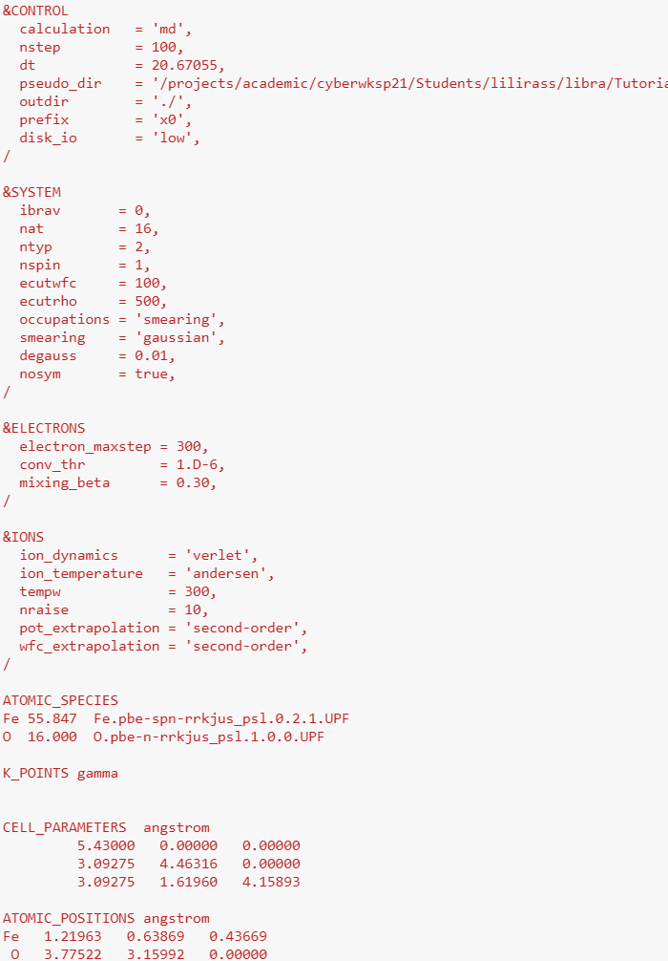
Step 1: molecular dynamics trajectory.
using the Quantum Espresso software package
Using PWscf (Plane-Wave Self-Consistent Field) sub-package
Parameters:
plane wave energy cut off = 100 Ry
charge density cut off of = 500 Ry
To have better convergence
100 fs of dynamics: 100 steps with a time-step of 1 fs:
nstep = 100,
dt = 20.67055, (Rydberg atomic units)
use Verlet algorithm to integrate Newton's equation

Slide 5
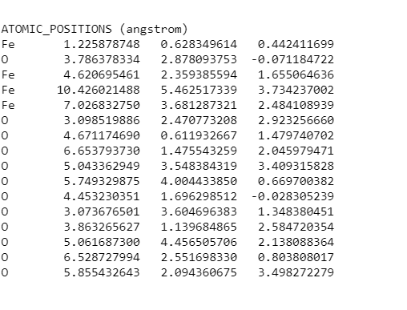
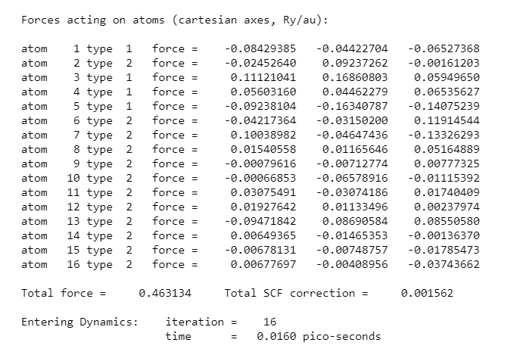
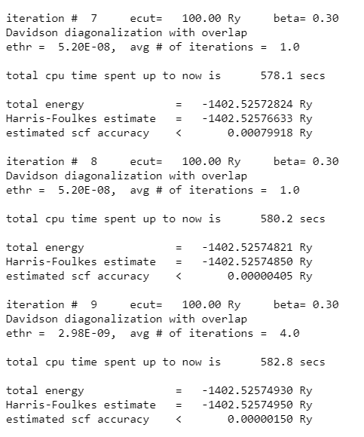
Step 1_Output:
X0.md.out
we have computed a 100 fs molecular dynamics trajectory of Hematite using the Quantum Espresso software package

Slide 6
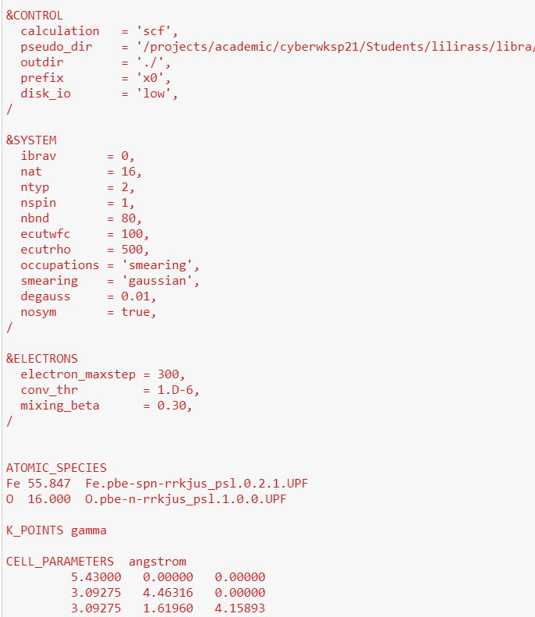
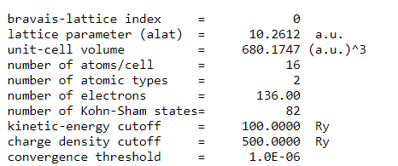
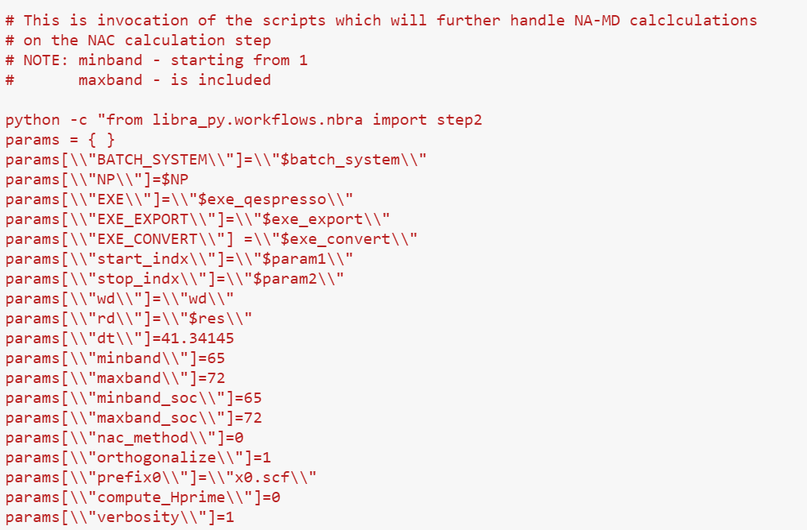
Step 2: computing the vibronic Hamiltonian
X0.md.out from step1
Calculating wavefunctions for each timestep using SCF calculation
at each molecular geometry
construct the vibronic Hamiltonian using calculated wavefunctions
Number of electrons = 136
Number of orbitals = 68
nbnd = number of orbitals + arbitrary number of excited orbitals
nbnd = 68 + 12 = 80
Submit.inp

Slide 7
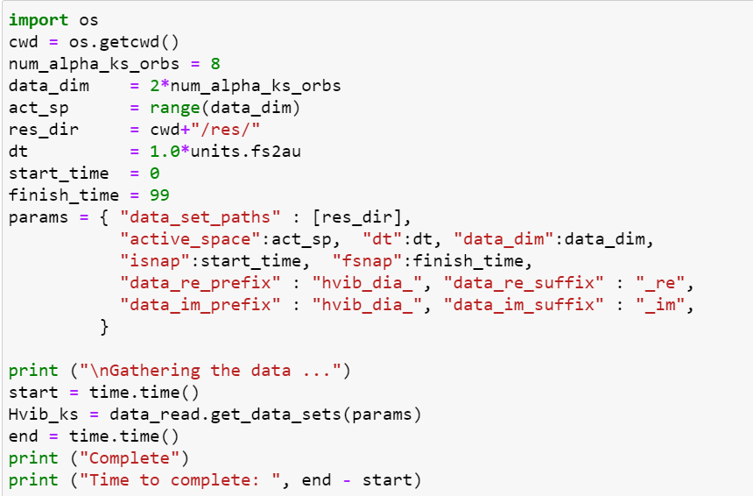
80
nbnd
.
.
72
maxband
69
Lumo
num_alpha_ks_orbs = 8
68
Homo
65
minband
.
.
.
2
1
indexing of the bands in this file starts from 1

Slide 8
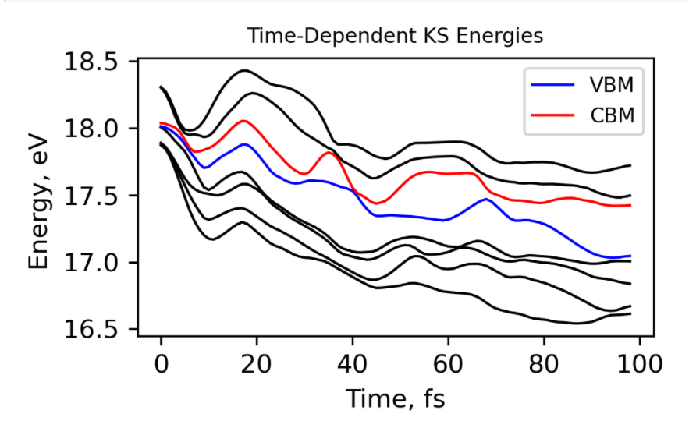
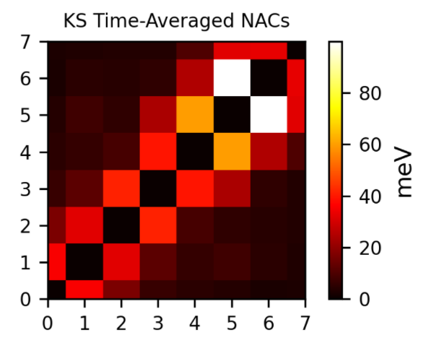
Step 2_Output
And res folder with the following data:
S: Overlap matrix for time-step "N" in the Kohn-Sham orbital basis
St: Time-derivative Overlap matrix for time-step "N" and "N+1" in the Kohn-Sham orbital basis
Hvib: Vibronic Hamiltonian matrix for the time-step "N" and "N+1" in the Kohn-Sham orbital basis

Slide 9
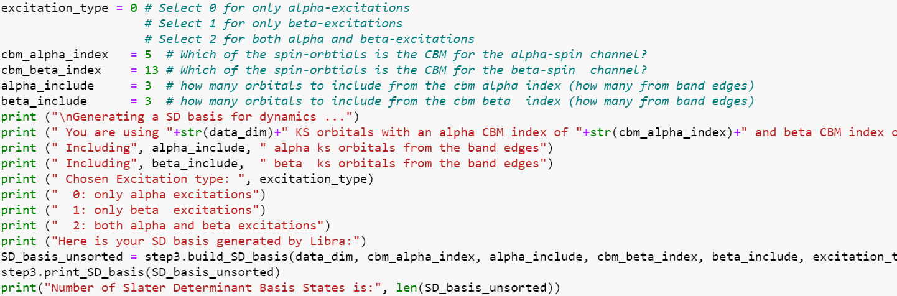
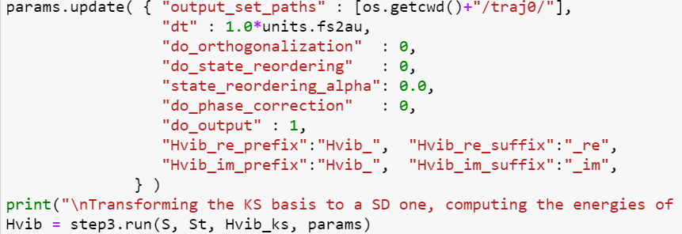
Step3
we will compute the energies and nonadiabatic couplings in the Slater determinant basis
According to vibronic Hamiltonian files from step 2
We use Libra to auto-generate a Slater determinant basis
Using S, St and Hvib from step2 to calculate vibronic Hamiltonian in the Slater Determinant basis.

Slide 10
generating a Slater determinant basis manually
Available KS orbitals for hematite
construct a Slater determinant basis according to KS orbitals
to manually construct 3 Slater determinants. The first one is the ground state determinant. The next two are the excitations
Alpha spin channel
Beta spin channel
[4, -12], [5, -12], [6, -12]
8
72
16
Ground state
7
15
6
6
14
6
14
5
13
5
69
Lumo
13
4
12
num_alpha_ks_orbs = 8
Excited states
4
68
Homo
12
6
6
3
11
5
5
2
10
1
65
9
4
4
12
4
12
4
indexing of the bands in this file starts from 1

Slide 11
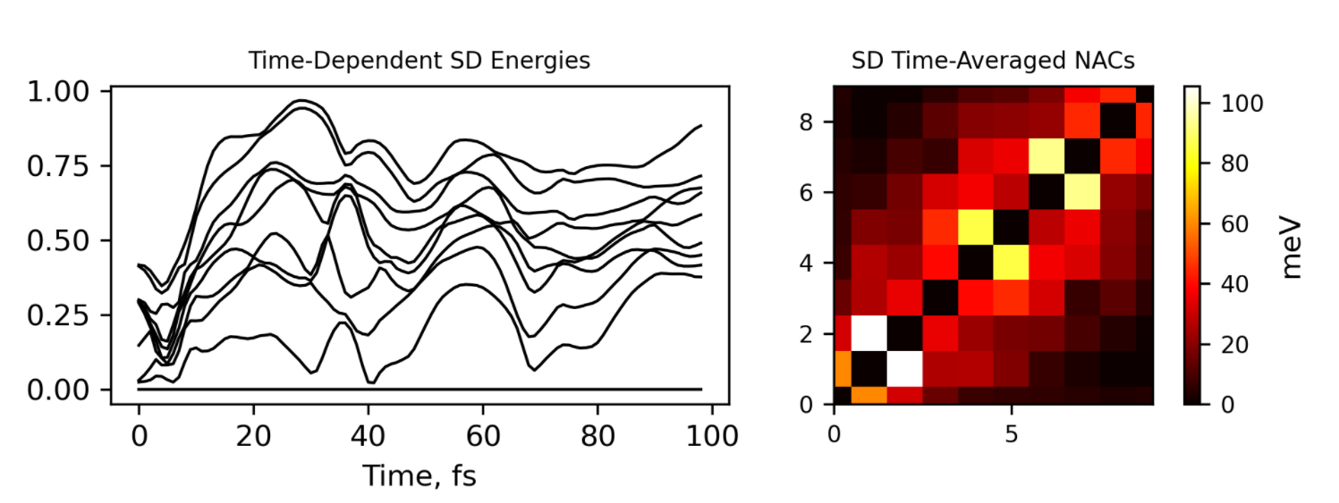
Step 3_ Output

Slide 12


Step 4: initialize a NBRA NAMD
To compute average decoherence times
To compute the energy gaps along the trajectory
To compute average energy gaps
To plot maps of dephasing times for all pairs of states
Indexing:
We have to define particular active space to be considered in the dynamics:
Pay attention that We have used 8 alpha and 8 beta in previous steps
At this step the index of the CBM and VBM are from 0 so homo would be 3 and Lumo would be 4 at this case.
We start from 0 here because the computer indexes the first row and column matrix elements from zero.
subset of 100 dynamics:

Slide 13
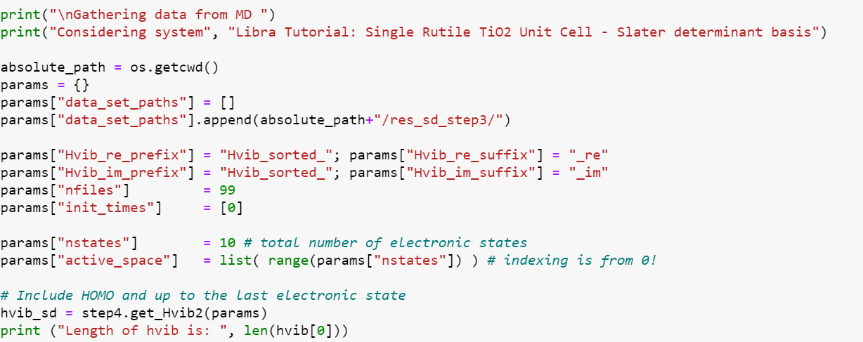
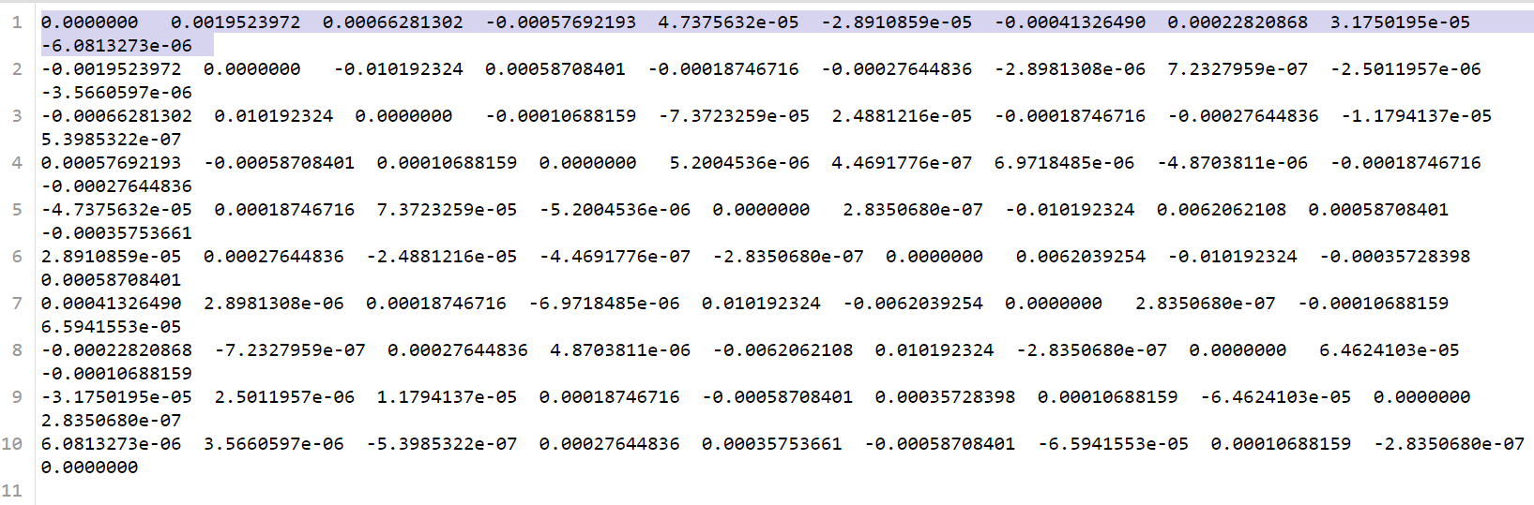
Read in the Slater determinant data
we had used Libra to auto-generate our Slater determinant basis. We should check how many Slater determinants are generated in step 3

Slide 14
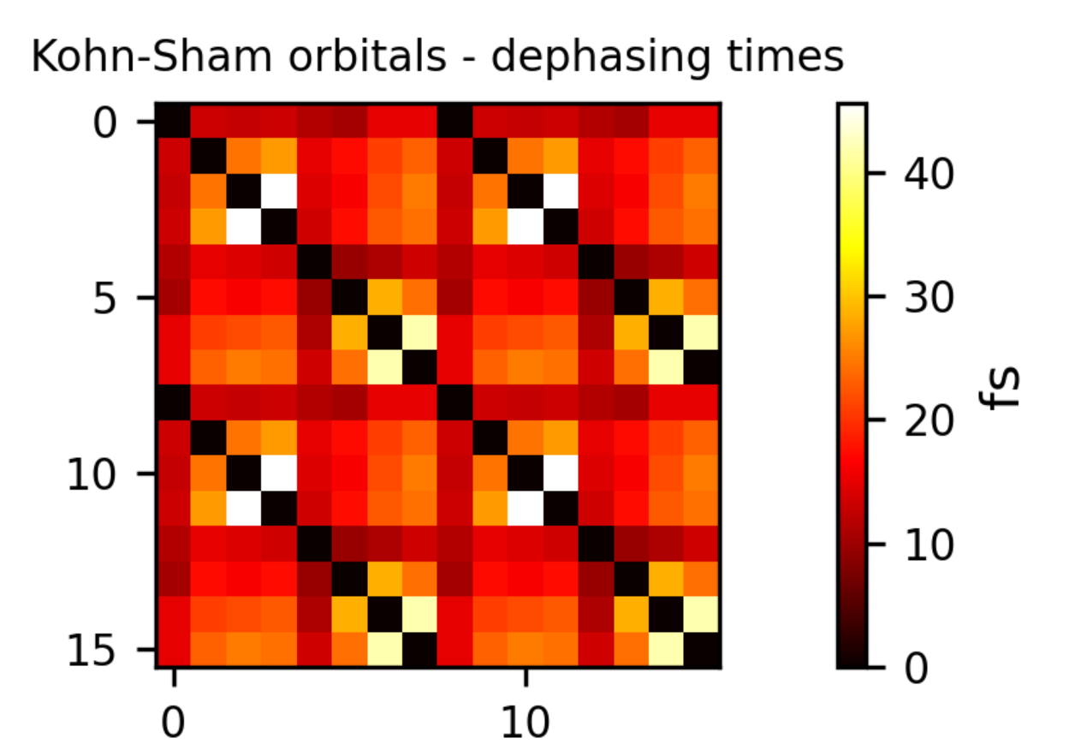
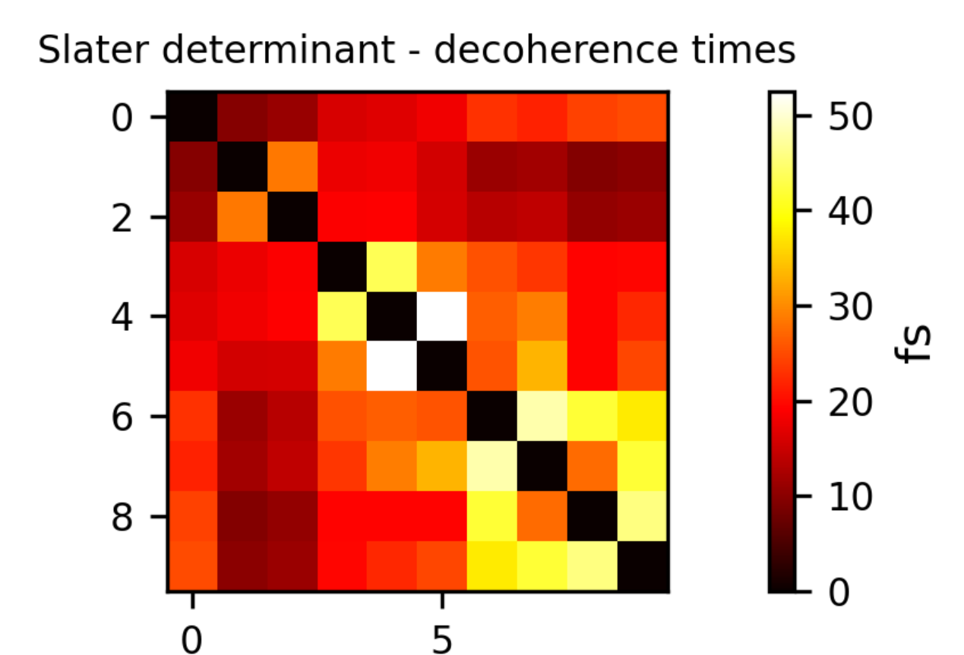
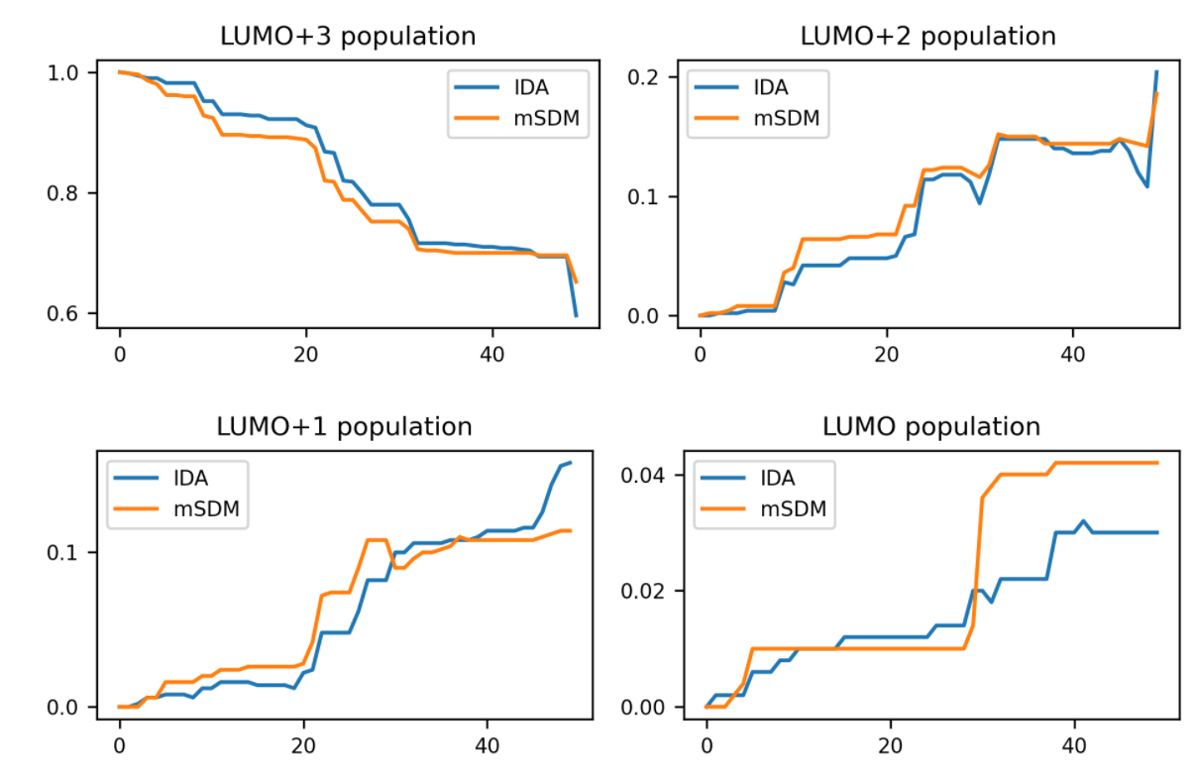
Step 4_ Output:
Population in Lumo orbitals with different decoherence_method

Slide 15
MY NEXT STEPS
Change the QE input file to consider spin-polarization and magnetization → change nspin
Run the code with CP2K instead of QE
Run the code for many- body treatment of excited states instead of single particle
Calculating the exciton lifetime

