Slide 1

How to turn your on-the-fly dynamics code into a simulator of nonlinear spectroscopic signals
via doorway-window method
Maxim F. Gelin

Slide 2
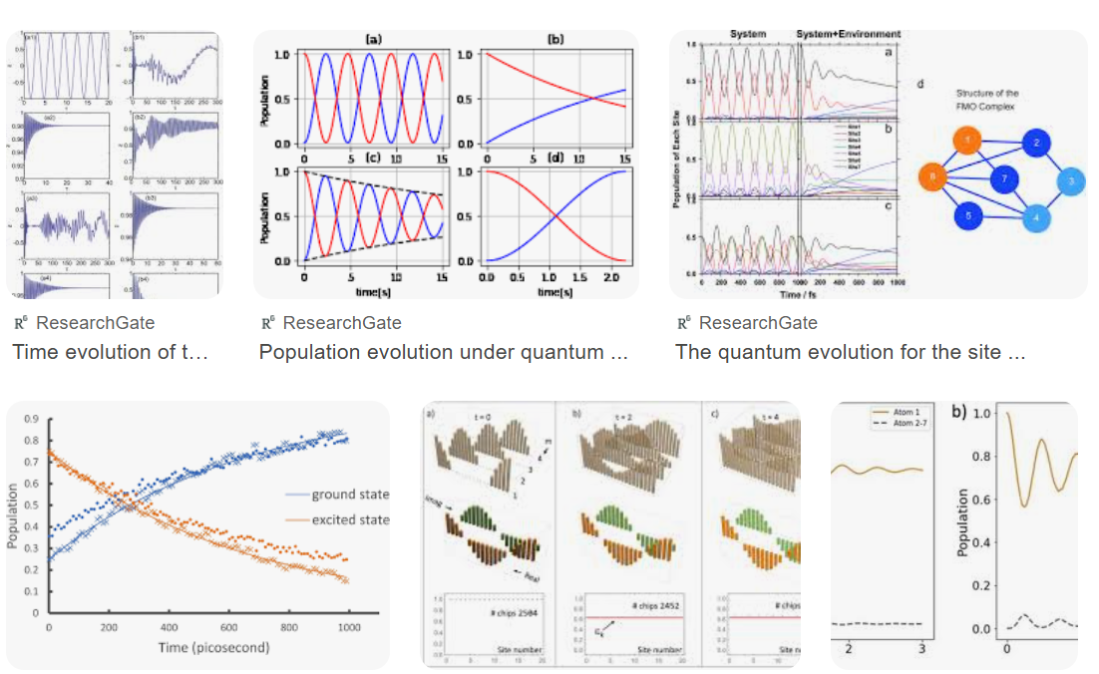
We, theoreticians, like to calculate population dynamics ...
What’s about spectroscopic signals?

Slide 3
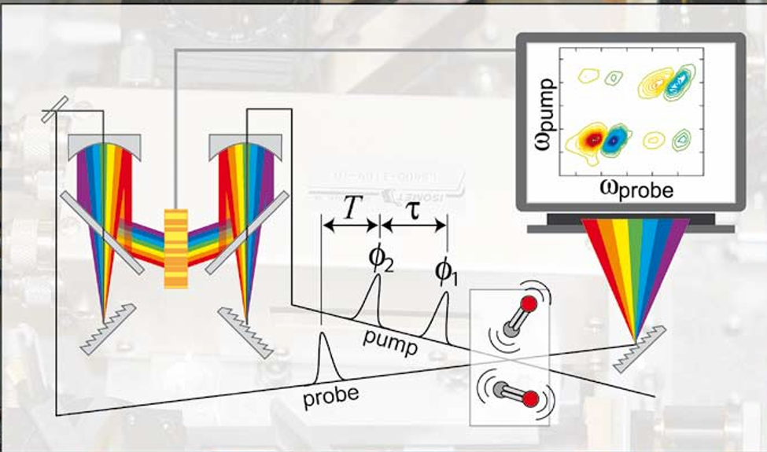
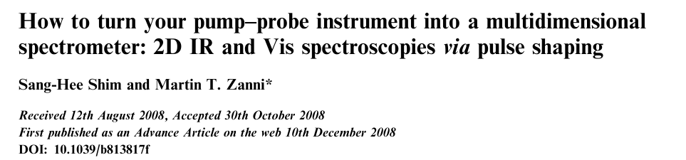
I decided to plagiarize/modify Zanni’s title:
How to turn your on-the-fly dynamics code into a simulator of nonlinear spectroscopic signals via doorway-window method

Slide 4

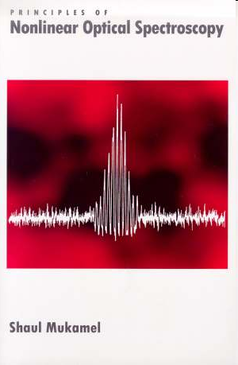
Fundamental notions and models (1995)
Computer revolution in theoretical spectroscopy
AI & ML & Quantum Computers
Ab initio parameterization of system Hamiltonians
The use of more realistic (therefore complex and multidimensional) models of molecular systems (HEOM and MCTDH are the game changers)
Simulation of spectroscopic signals on-the-fly

Slide 5
Before:
efficient analytical methods in many-body quantum dynamics
Memory function formalism, Mori formalism
Projection operator formalism
Variational methods
Davydov Ansatz
Thermo-Field Dynamic
Doorway-Window representation
Now:
efficient numerical methods in many-body quantum dynamics and theoretical spectroscopy

Slide 6
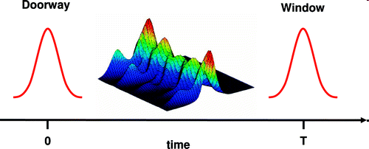
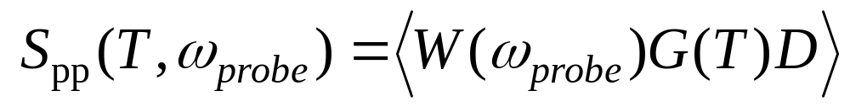
The doorway-window representation
Developed by Yan & Mukamel;
Extended by
Tanimura, Domcke & Stock, Novoderezkin
T >> pump & probe duration
W is responsible for time-frequency resolution
D is responsible
for wavepacket
excitation
Frequency of the second
(probe) pulse
Time delay between
the pulses
Time evolution G(T ) is not affected by optical dephasing:
We are seating in populations of the system density matrix

Slide 7
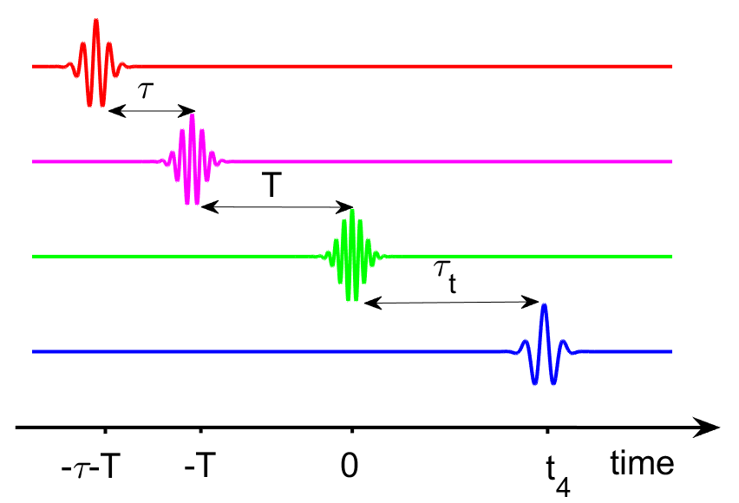
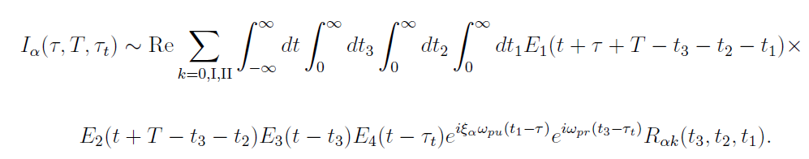
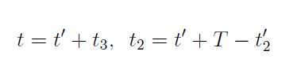
General 4-wave-mixing signal
Third-order response functions
DW change of integration variables

Slide 8
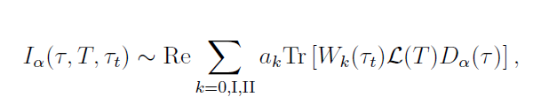
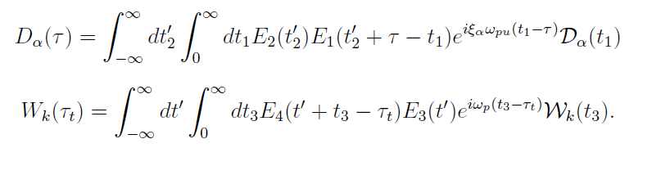
DW representation of 4-wave-mixing signals

Slide 9
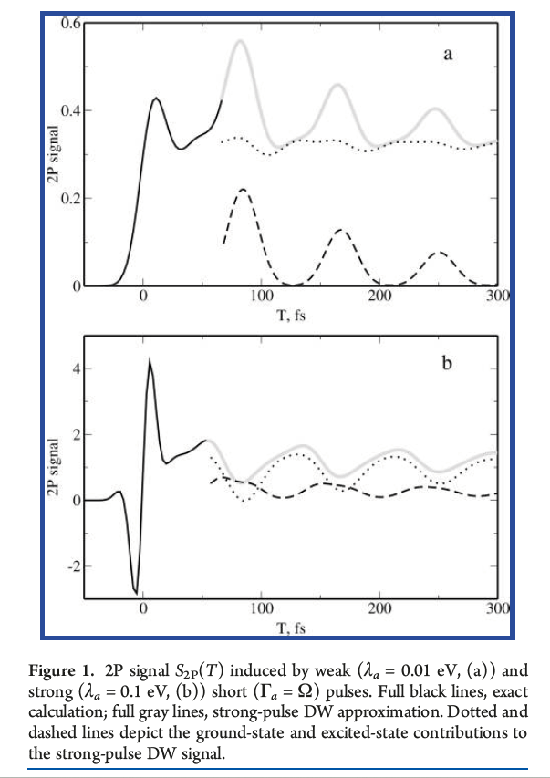
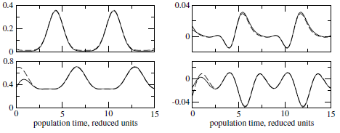
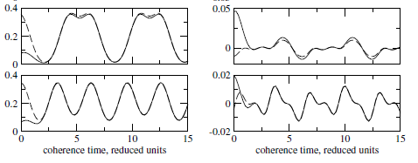
DW representation vs exact calculation
Pump-probe
Three-pulse photon echo

Slide 10
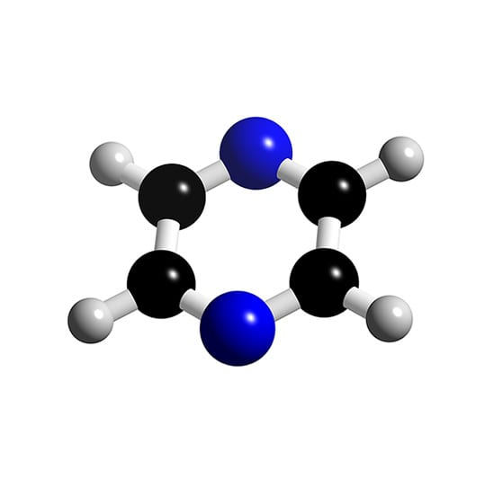
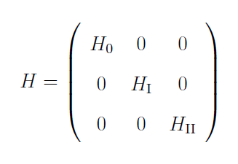
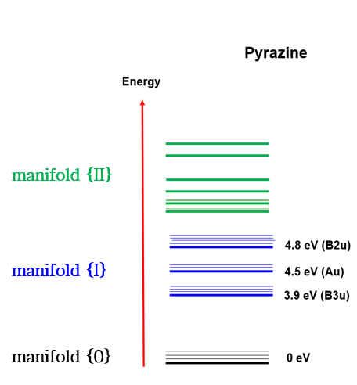
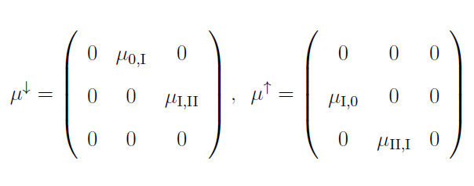


states f₁, f₂,…
states e₁, e₂,…
state g

Slide 11








For changing to classical trajectories, make three approximations
I. Classical approximation for electronic coherences:
II. Classical averaging
Trace over nuclear degrees of freedom is replaced by the sampling of classical trajectories from the classical Wigner distribution
Trace over electronic degrees of freedom remains
III. Classical population evolution
T-evolutions of
are replaced by evolutions over trajectories in the electronic ground state and lower-lying excited electronic states

Slide 12

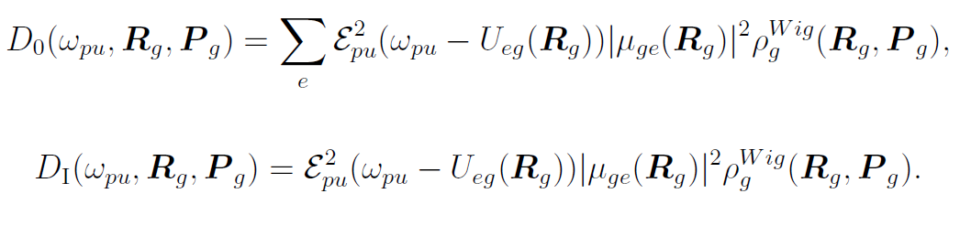
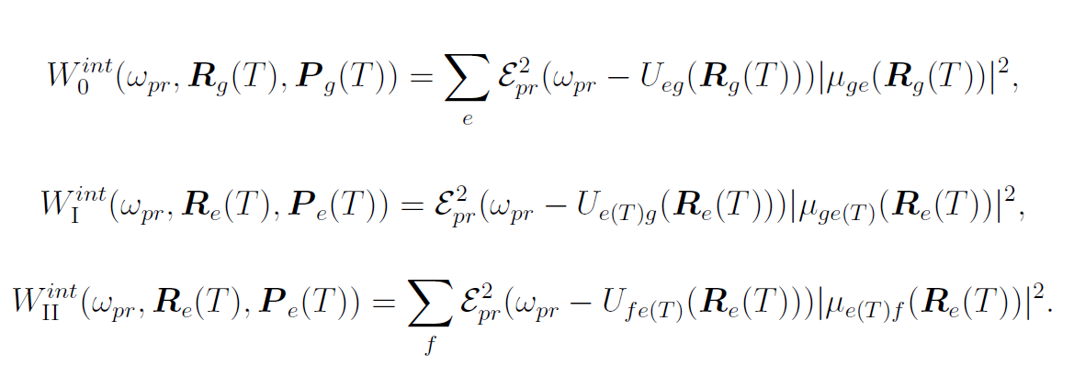
Transient absorption pump-probe

Slide 13






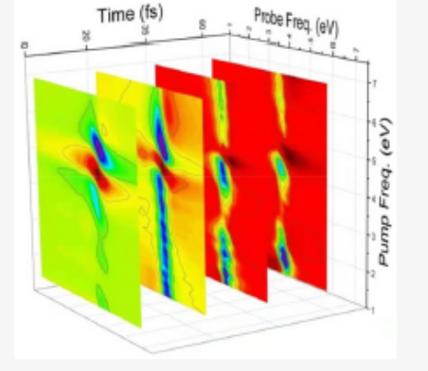
We need just electronic energies
and transition dipole moments
along trajectories to calculate
any nonlinear spectroscopic signal
The numerical effort is comparable
to that for the calculation of population evolutions

Slide 14
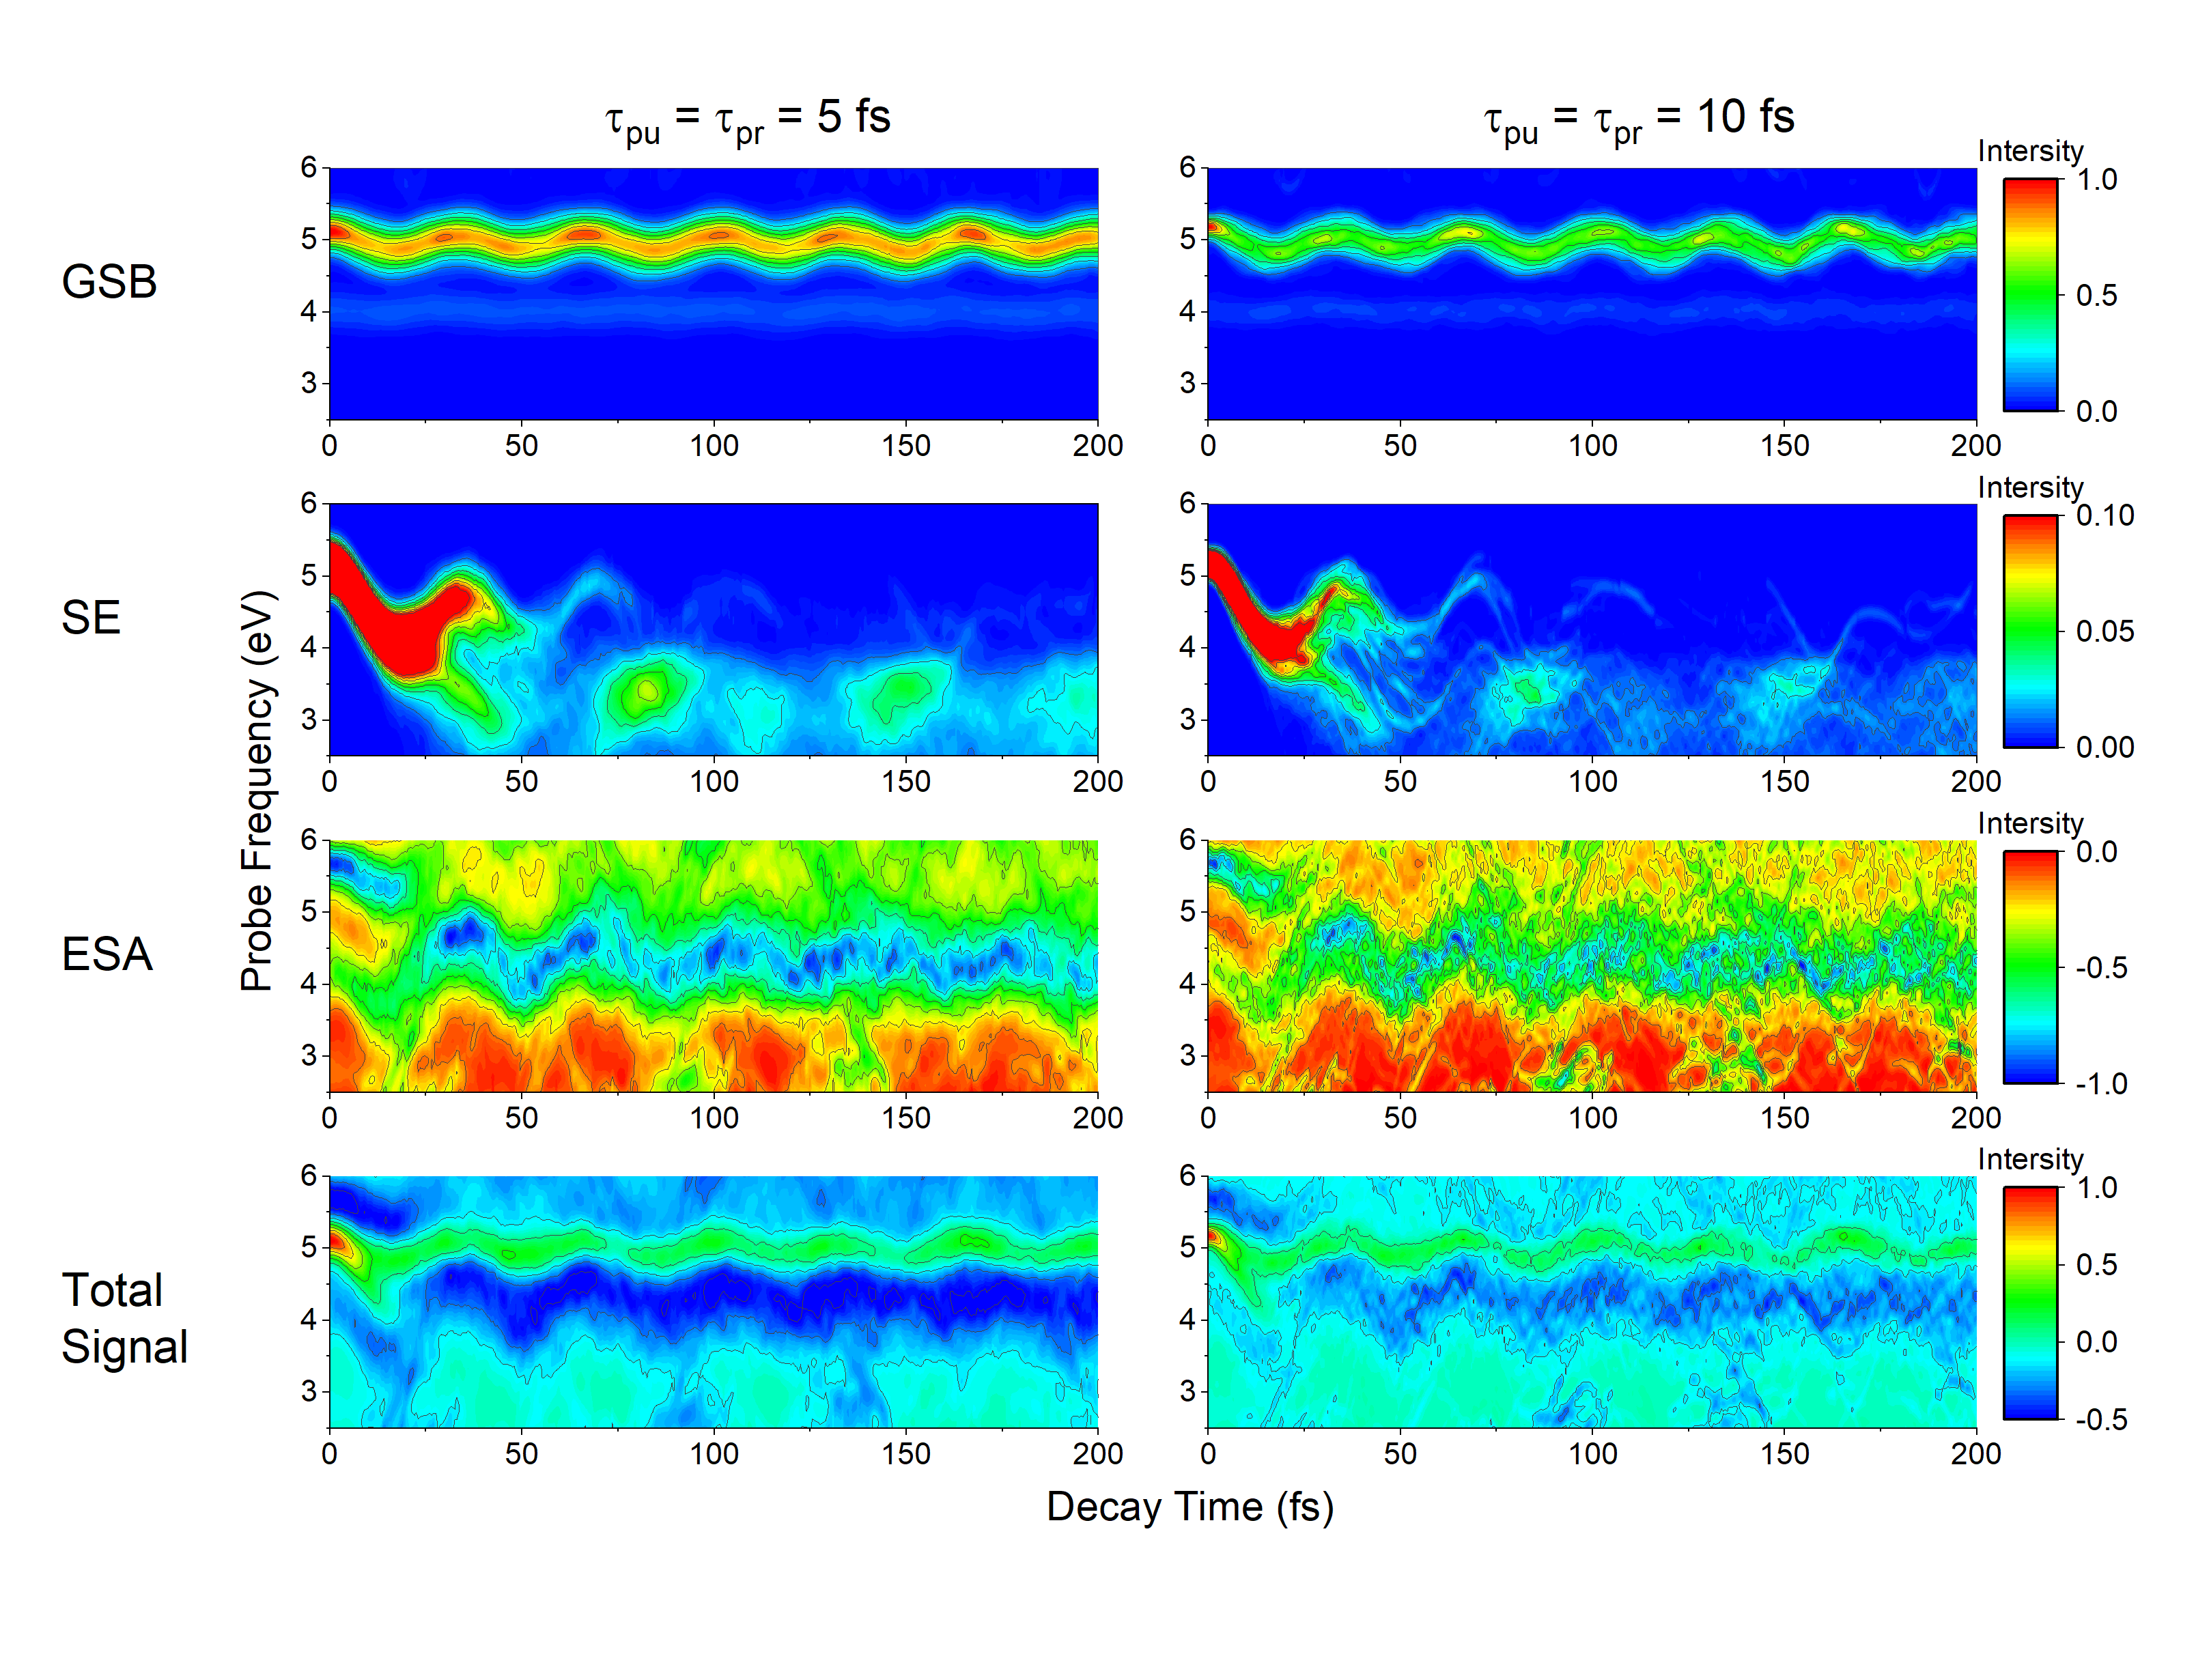
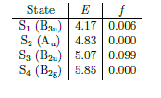
Signals for pyrazine: TA PP integral

Slide 15
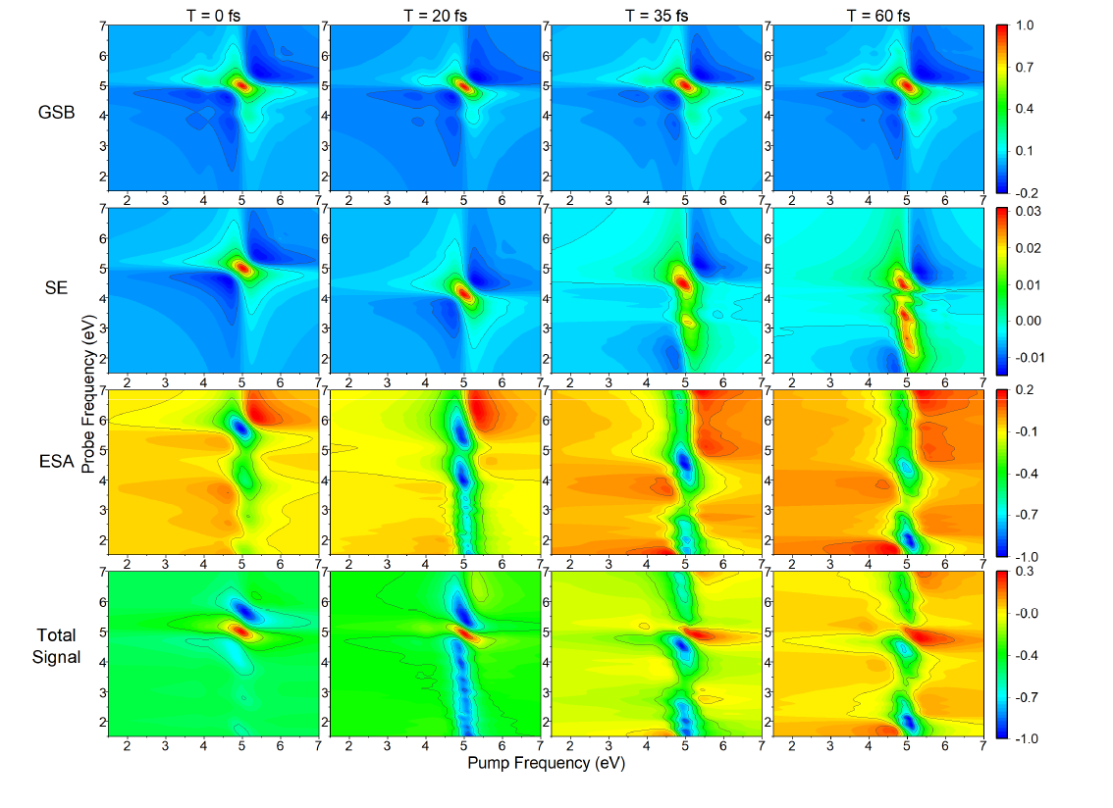
Signals for pyrazine: photon-echo 2D

Slide 16
What else?

Slide 17
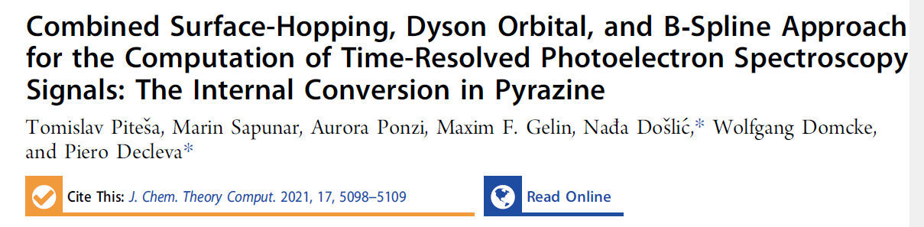
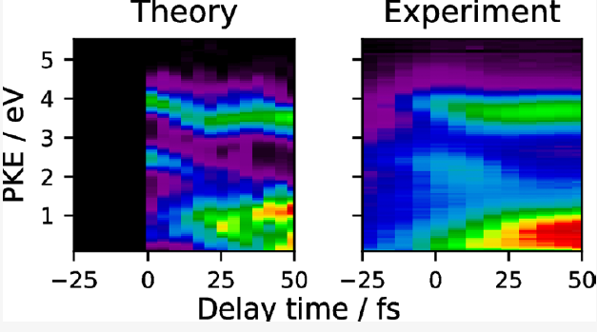

Slide 18
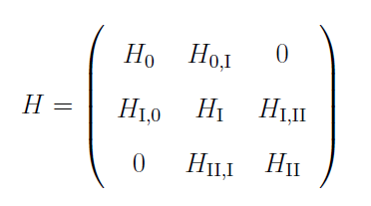
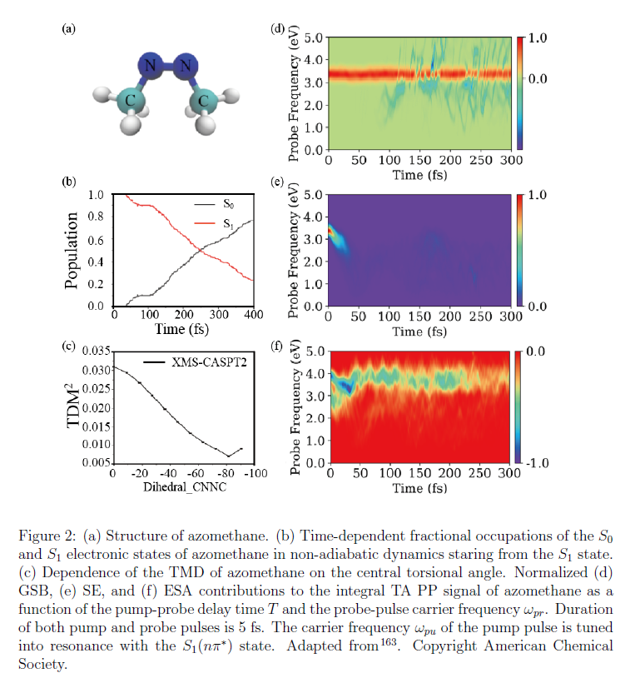
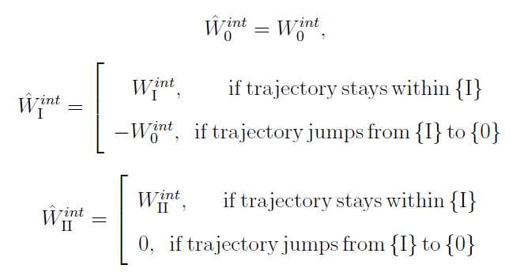
Coupled {0}-{I} manifolds

Slide 19

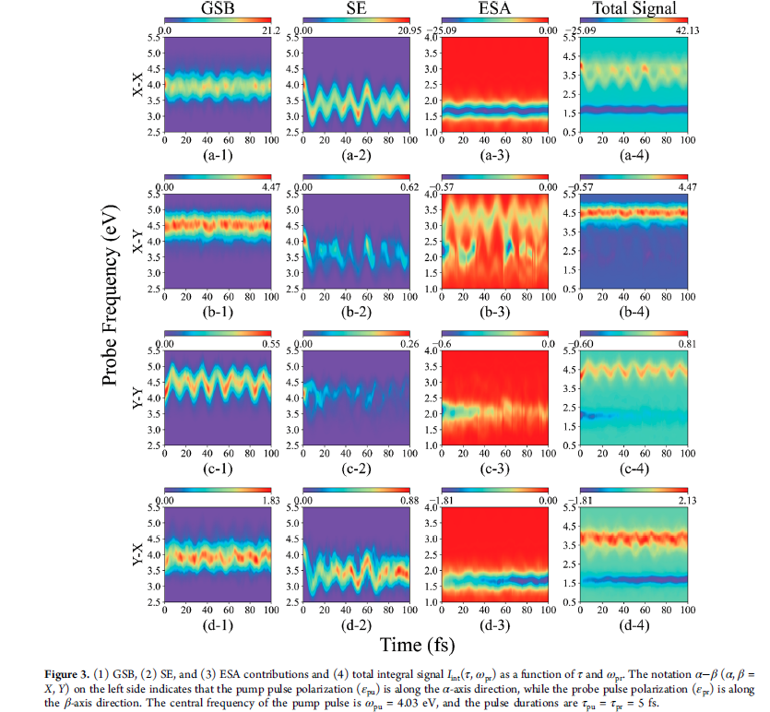
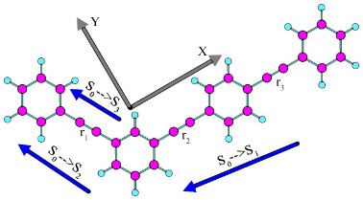
Polarization-sensitive signals

Slide 20
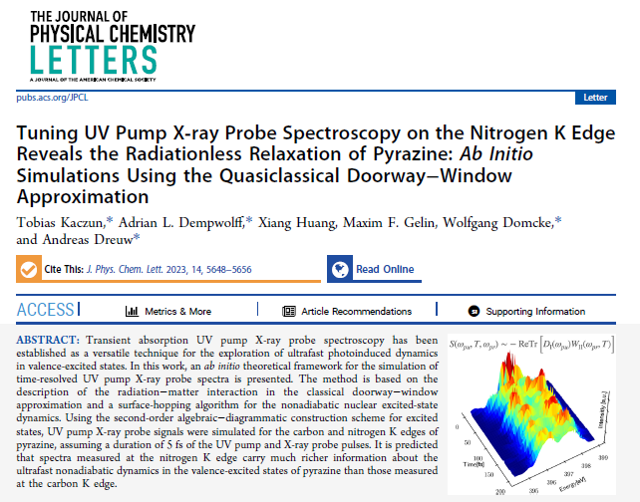
Vis pump – Xray probe

Slide 21
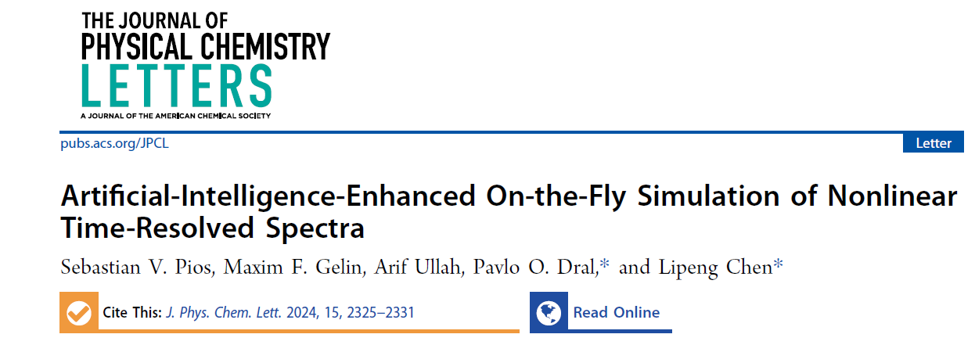
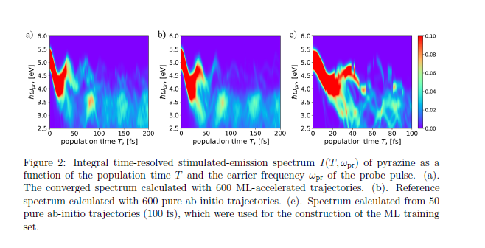
On-the-fly ML-enhanced simulations

Slide 22
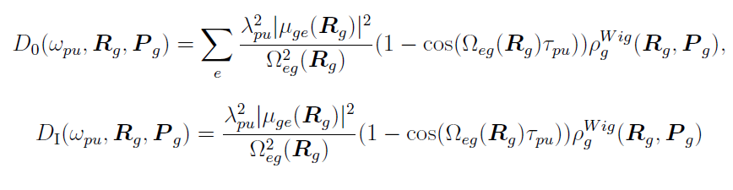

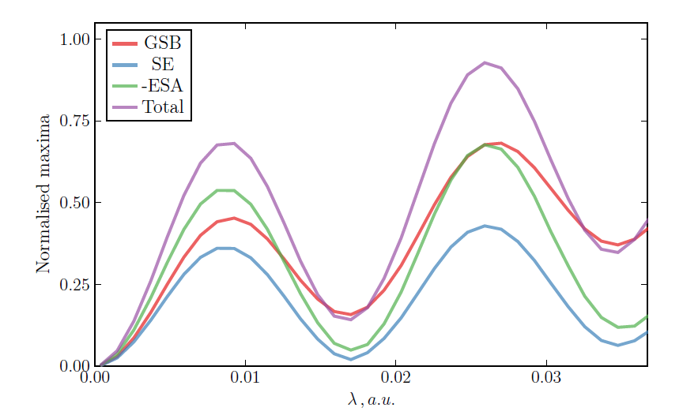
Strong-pump strong-probe

Slide 23
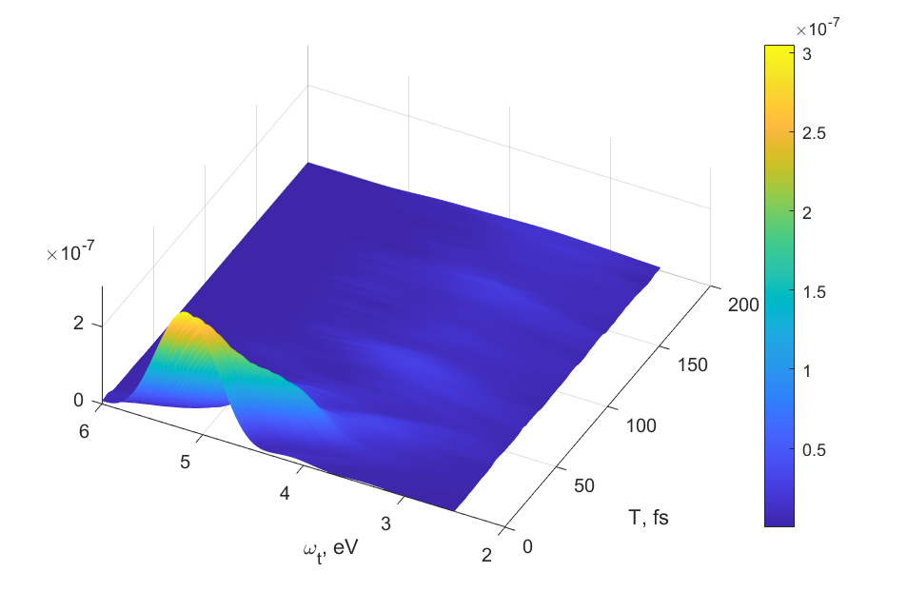
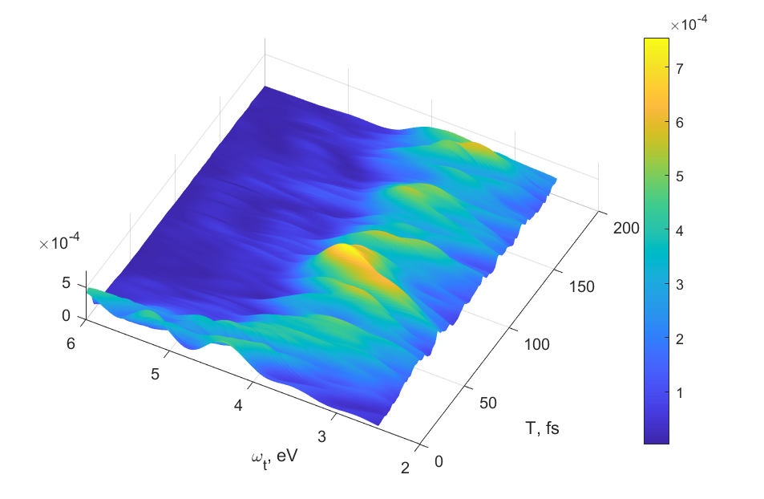
Strong-pump strong-probe

Slide 24
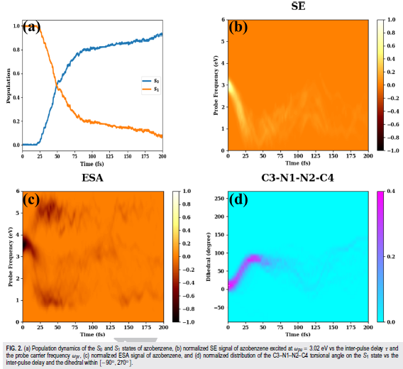
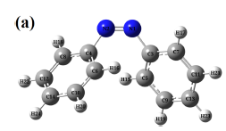
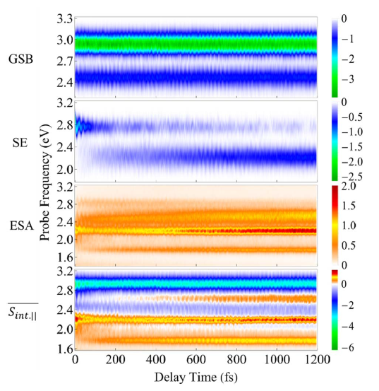
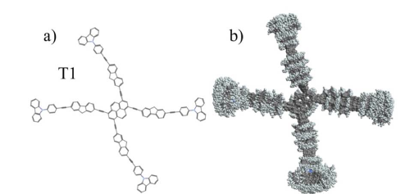
DW combined with
mapping approach
DW combined with
Ehrenfest dynamics

Slide 25
Plans for the future:
1. New signals
6-wave mixing,
UV/Vis pump – IR probe,
Odd-wave-mixing at interfaces
2. Better simulation methods
NAF (Jian Liu)
Account for electronic coherences
3. Comparison with numerically “exact” quantum simulations

Slide 26
Conclusions
The developed simulation method and protocol
Requires – as input -- electronic energies and dipole moments along classical trajectories in the electronic ground states and lower-laying excited electronic states
Works for any (quasi)classical trajectory method: Tully’s surface hopping, Ehrenfest, mapping approach, etc.
Fully accounts for pulse effects (shapes, durations, chirps)
Up to now, has been applied to the simulation of signals of femtosecond UV/vis spectroscopy, photo-electron spectroscopy. and visible pump X-ray probe spectroscopy
Allows simulation of femtosecond spectroscopic signals of realistic molecular systems under realistic experimental conditions (strong pulses of any shape) by using ab initio methods

Slide 27
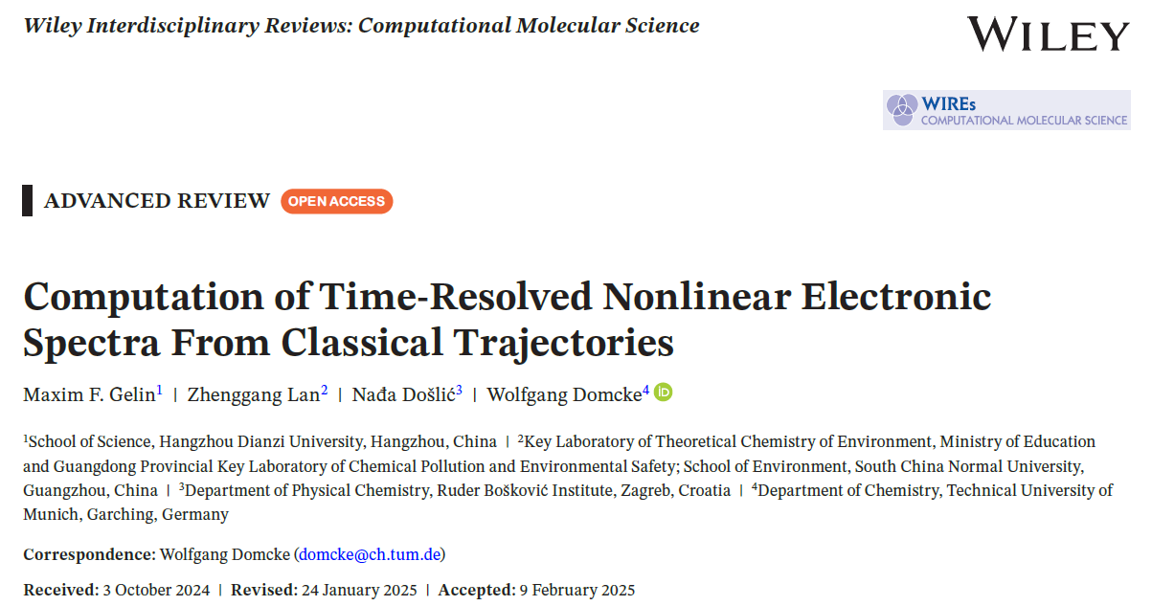
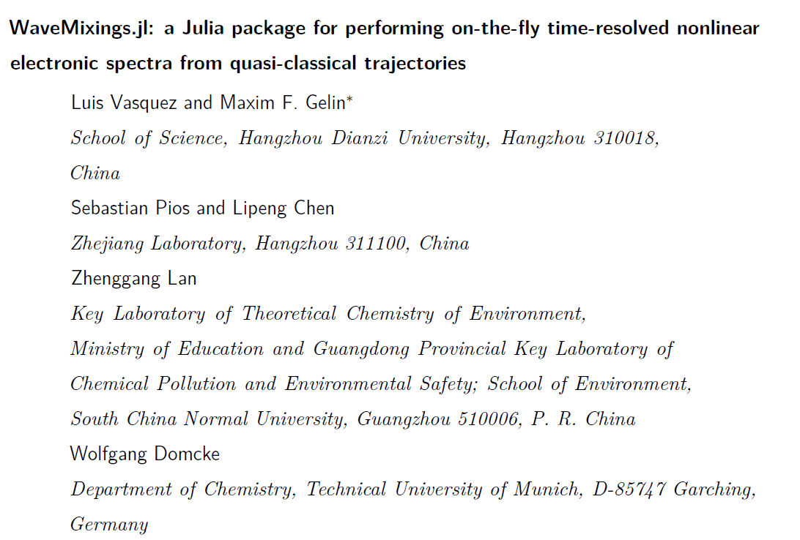
Theory:
Soft: WaveMixings.jl
https:// doi.org/10.5281/zenodo.15598121

Slide 28
Collaborators:
Xiang Huang,
Wolfgang Domcke
TUM, Munich, Germany
Zhenggang Lan
SCNU, Guangzhou, China
Weiwei Xie,
Nankai University, China
Nadja Došlić
Rude Boscovic Institute, Zagreb, Croatia
Lipeng Chen,
Sebastian Pios
Zhejiang Lab, Hangzhou, China
Pavlo Dral
Xiamen University, China
Sebastian Fernandez-Alberti
Quilmes University, Argentina
Luis Vasquez
Hangzhou Dianzi University,
Funding:
Hangzhou Dianzi University,
Startup
NSFC

Slide 31
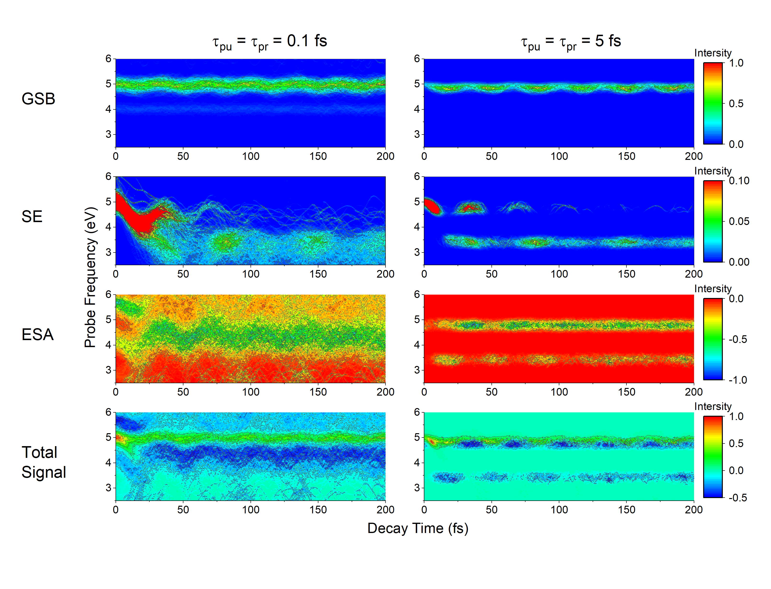
Signals for pyrazine: TA PP dispersed

Slide 32
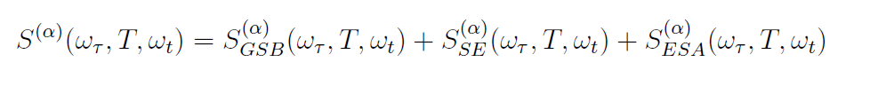
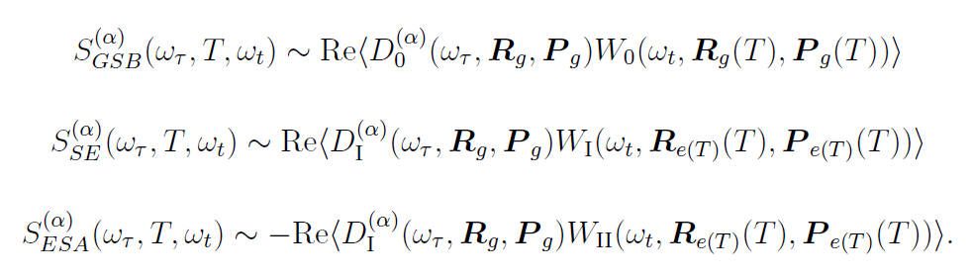
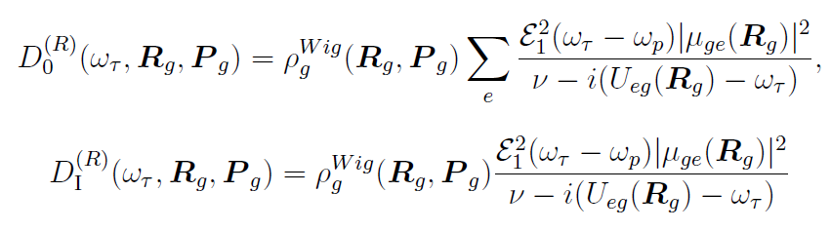
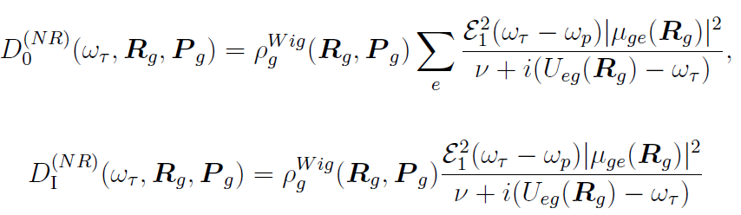
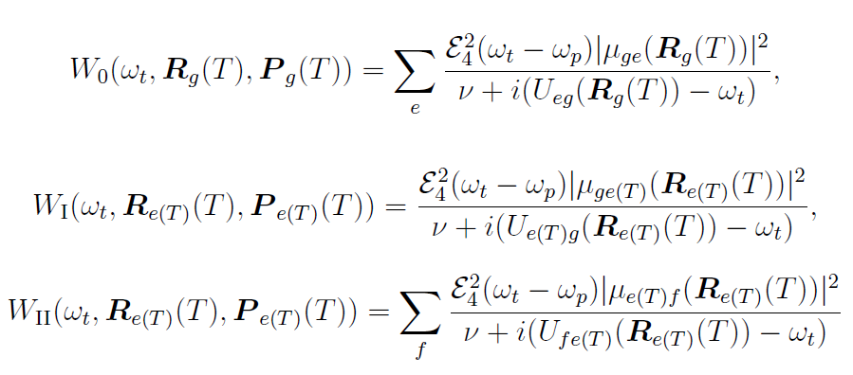
2D signal

Slide 33






(ii) On-the-fly simulations of nonlinear femtosecond spectroscopic signals

Slide 34


