Slide 1



09/16/2026
Meseret Simachew Bezabih
Strain-driven photochemical reactivity of a small molecule
Laboratory of computational photochemistry and photobiology
Center for Photochemical Sciences

Slide 2
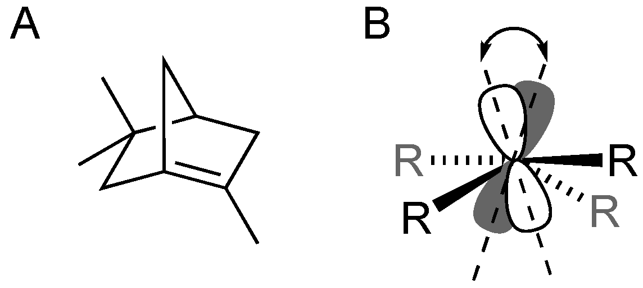
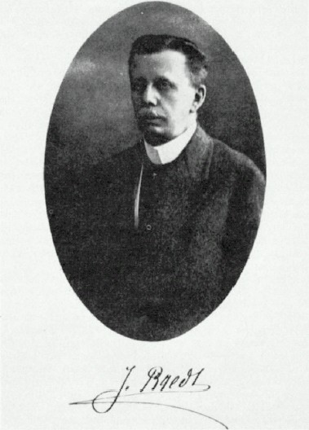
Introduction
Bridgehead olefins are a sub-class of polycyclic compounds containing a C=C double bond at the bridgehead position of a bicyclic system.
Poor pi-orbitals overlap
(A) A typical bridgehead olefins considered as too strained to exist. (B) The twisting of one p-orbital relative to the other as required to form a C=C bond in a strained bridgehead alkene.
Julius Bredt
[1855 - 1937]
Bredt, 1924
Why a computational study on norborn-1-ene?
No photochemistry studied before
The distorted C=C bond makes it to absorb photon at the longer wavelength
Size of the molecule allow us to use an accurate quantum chemical gradients available
Bredt’s rule: Double bonds at the bridgehead position in a bicyclic molecules of ring size <8 cannot synthesize.
Ann. Chem. 1924, 437, 1-13
Organics 2024, 5(3), 205-218
Notes:
Bridgehead olefin definition
Bredt was unable to synthesize this molecule. Why?
Highly strained that’s responsible for pi orbital alignment (B) or just mention the sentence of A and B.
Then he announces his rule “bredt rule” i.e. >= 8 ring sizes are only synthesize. So now continue with the examples

Slide 3
Details of computational methods
Work protocol of norborn-1-ene in MeCN solvent
GROMACS
[OPEN]MOLCAS/TINKER
2
Sampling
200 geometries and velocities @MM level
3
6
Simulation of thermal equilibration
@ MM/MD - 5000 ps
PBC–NPT @298 K
QM/MM thermal equilibration
@ MP2 MD 200 fs
@ RMS-CASPT2 MD 200 fs
QM/MM
200 SA3-RMS-CASPT2 200 fs
200 geometries and velocities @QM/MM level
QMMM model validation:
Expected Gaussian-like shape of dihedral angles and coordinates
1
GAUSSIAN
4
5
Geometry Optimization
@ MP2 - implicit solvent model PCM
Thermal population
200 initial conditions
(GS thermal equilibrium geometries)
𝜆max
Absorption Band
Compute the VEE & f
@ RMS-CASPT2 level
Olivucci M., et al. J. Phys. Chem. B 2023, 127, 10871−10879.
Blanco A. (2023), Impact of vibrational mode coupling on the isomerization of natural and synthetic molecular switches, Ph.D. dissertation, Pp. 48.
J. Am. Chem. Soc. 2026, 148, 17736−17744
Notes:
Make sure you explain everything very well here
1. What’s Boltzmann sampling distribution mean? Why energy minimization, thermal MM/MD equilibration, …etc? Why thermal QM/MM equilibration? Why equilibration to begin with? Can you just compute QM/MM directly instead going through this process?

Slide 4
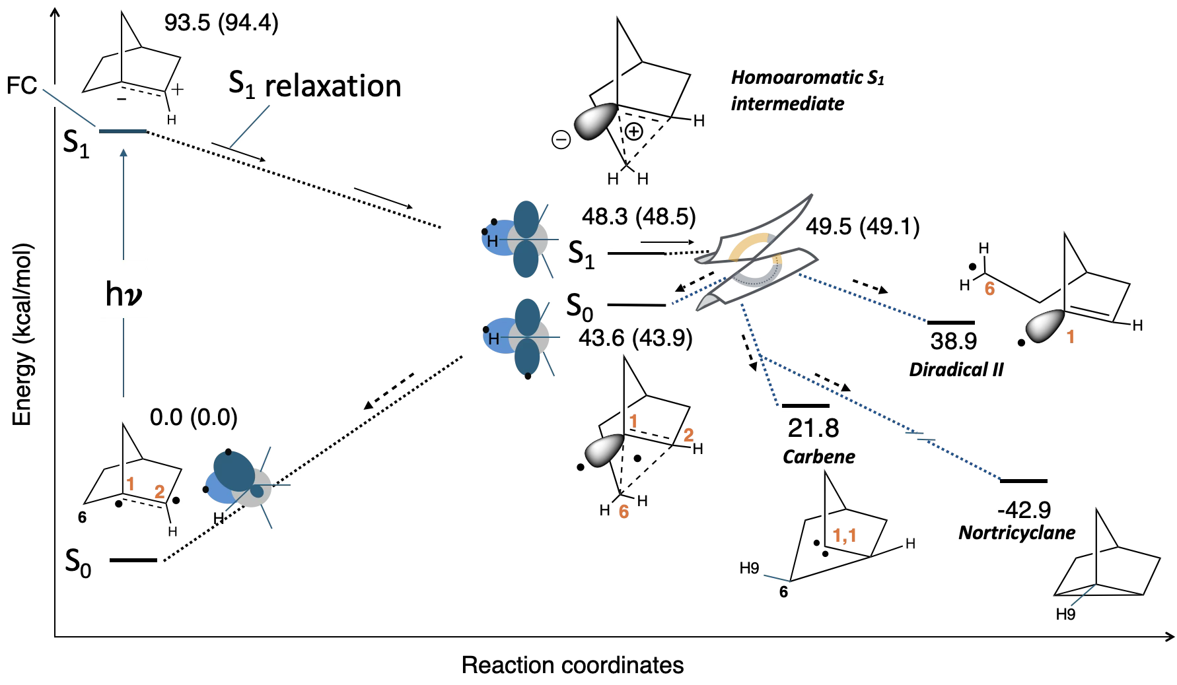
Potential energy surface
Diradical I
J. Am. Chem. Soc. 2026, 148, 17736−17744

Slide 5
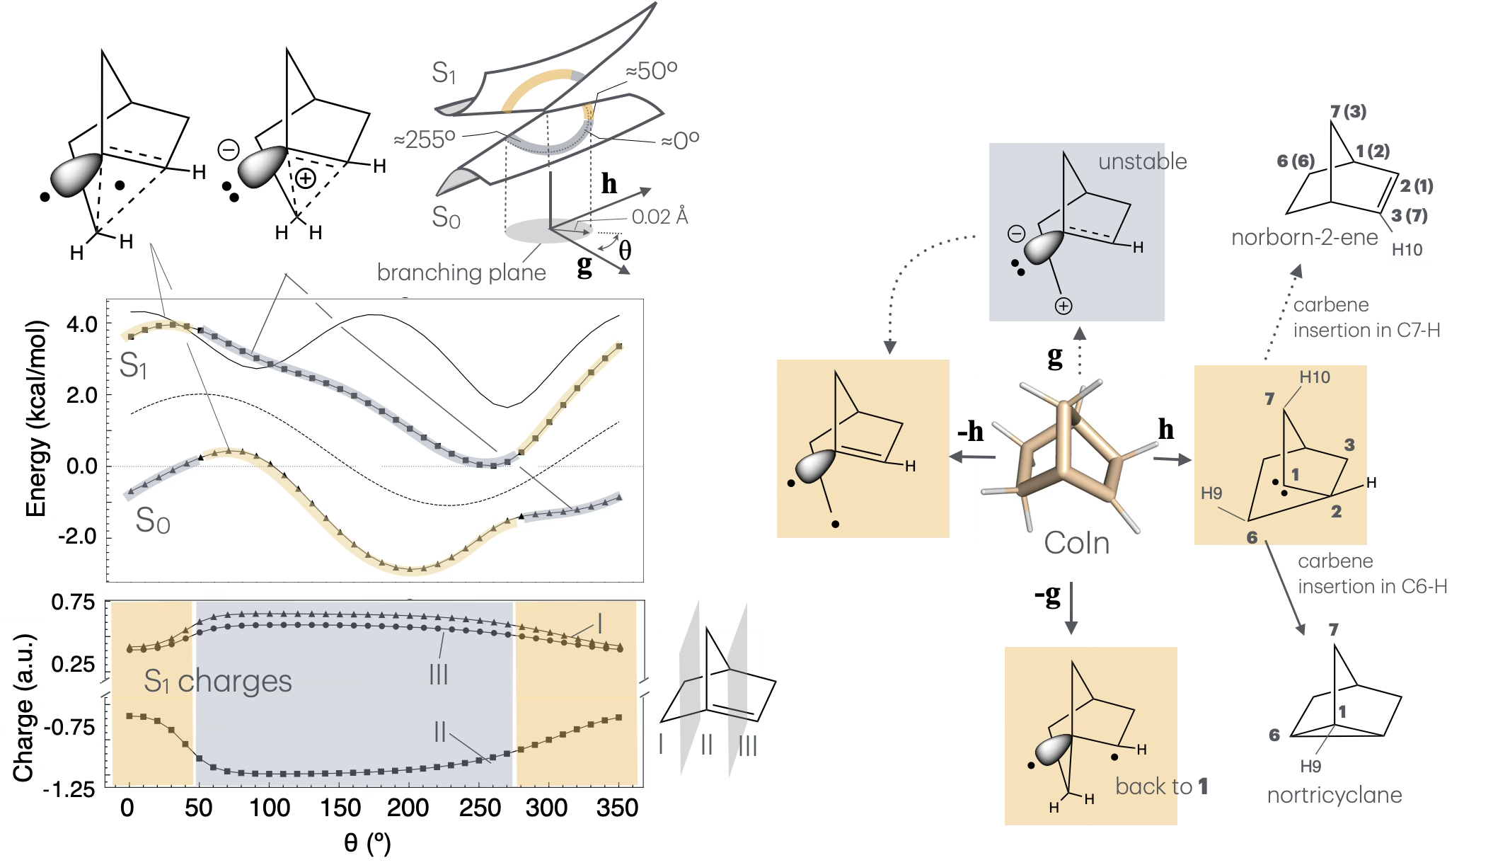
Analyzing conical intersection
A
B
J. Am. Chem. Soc. 2026, 148, 17736−17744

Slide 6
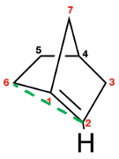
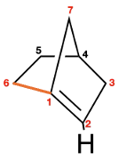
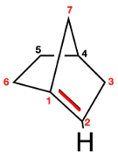
Quantum-classical dynamics
A
C
D
Key:
S₂ / S₁ CI – Unreactive
S₁ / S₀ CI – Productive
1.6 Å
2.3 Å
E
F
G
B
Diradical I (Å)
Diradical II (Å)
1.5 Å
C1=C2 bond length
Carbene
Nortricyclane
J. Am. Chem. Soc. 2026, 148, 17736−17744

Slide 7
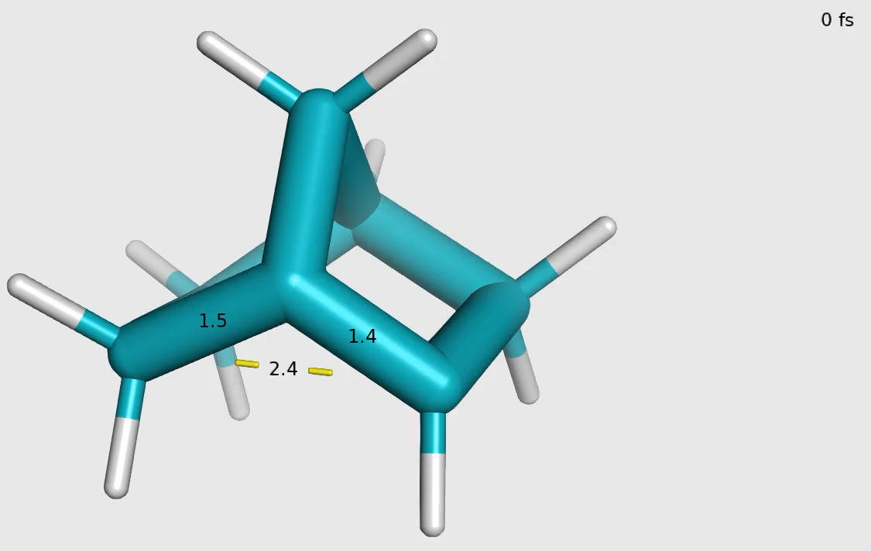
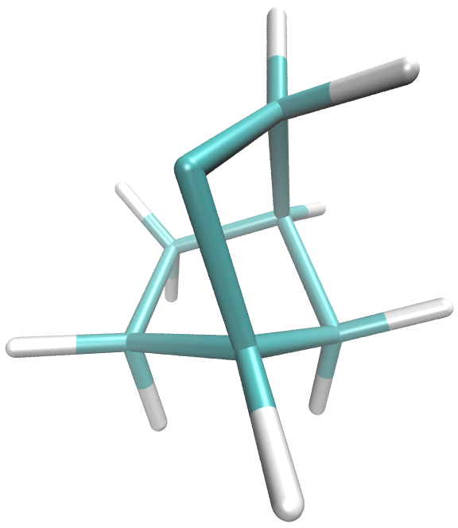
Representative photoproduct from trajectory
S_{1-min}
The movie shows the carbene product followed by the CoIn structure
Time evolution of norborn-1-ene

Slide 8
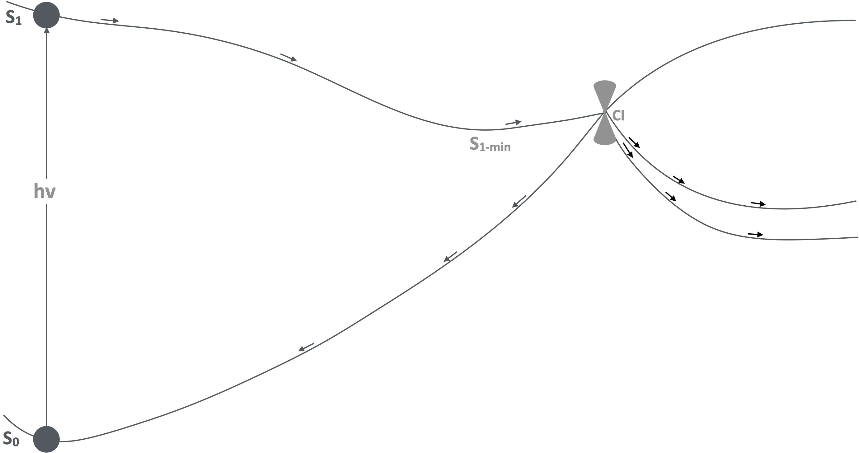

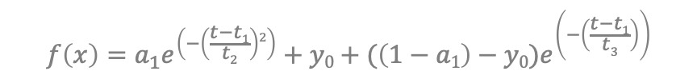
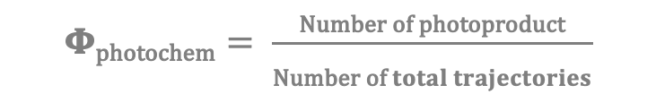
Excited state lifetime and QE
Quantum Efficiency
S₁ population
Fitting curve
$$\text{Φ}\text{photochem}= \frac{\text{Number of photoproduct}}{\text{Number of} total trajectories}$$
𝝉 = 75
a₁ = weight of gaussian decay component
y₀ = fitting parameter
t₁ = latency time
t₂ = decay time of gaussian component
t₃ = decay time of exponential component
$$f\left(x\right)=a_{1}e^{\left(−\left(\frac{t−t1}{t2}\right)2\right)}+y0+(\left(1−a1\right)−y0)e^{\left(−\left(\frac{t−t1}{t3}\right)\right)}$$
𝝉$=t_{1}+a1+t2+(1−a1−$ $y0)t3$
J. Am. Chem. Soc. 2026, 148, 17736−17744

Slide 9
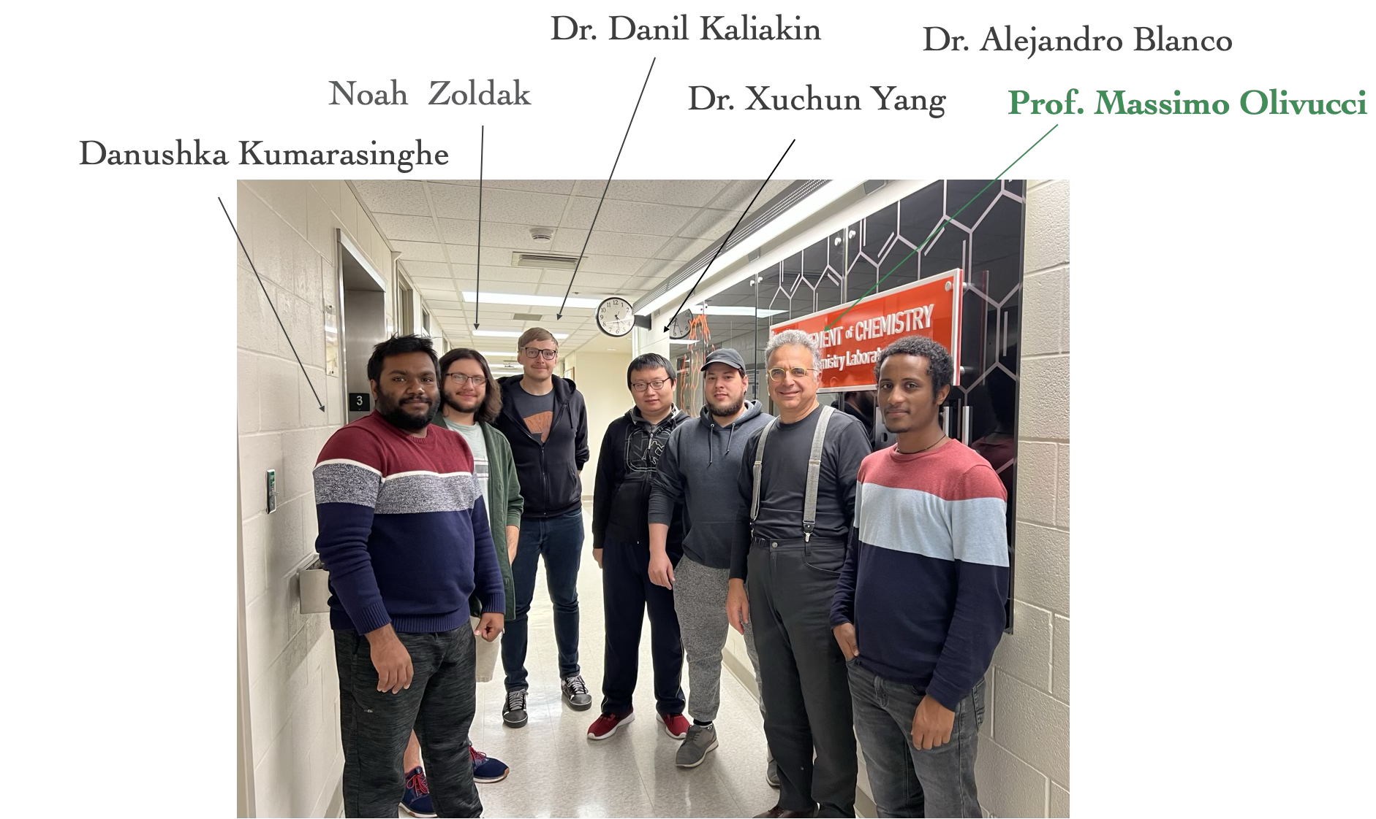



Acknowledgement
Siena Supercomputer Center

