Slide 1
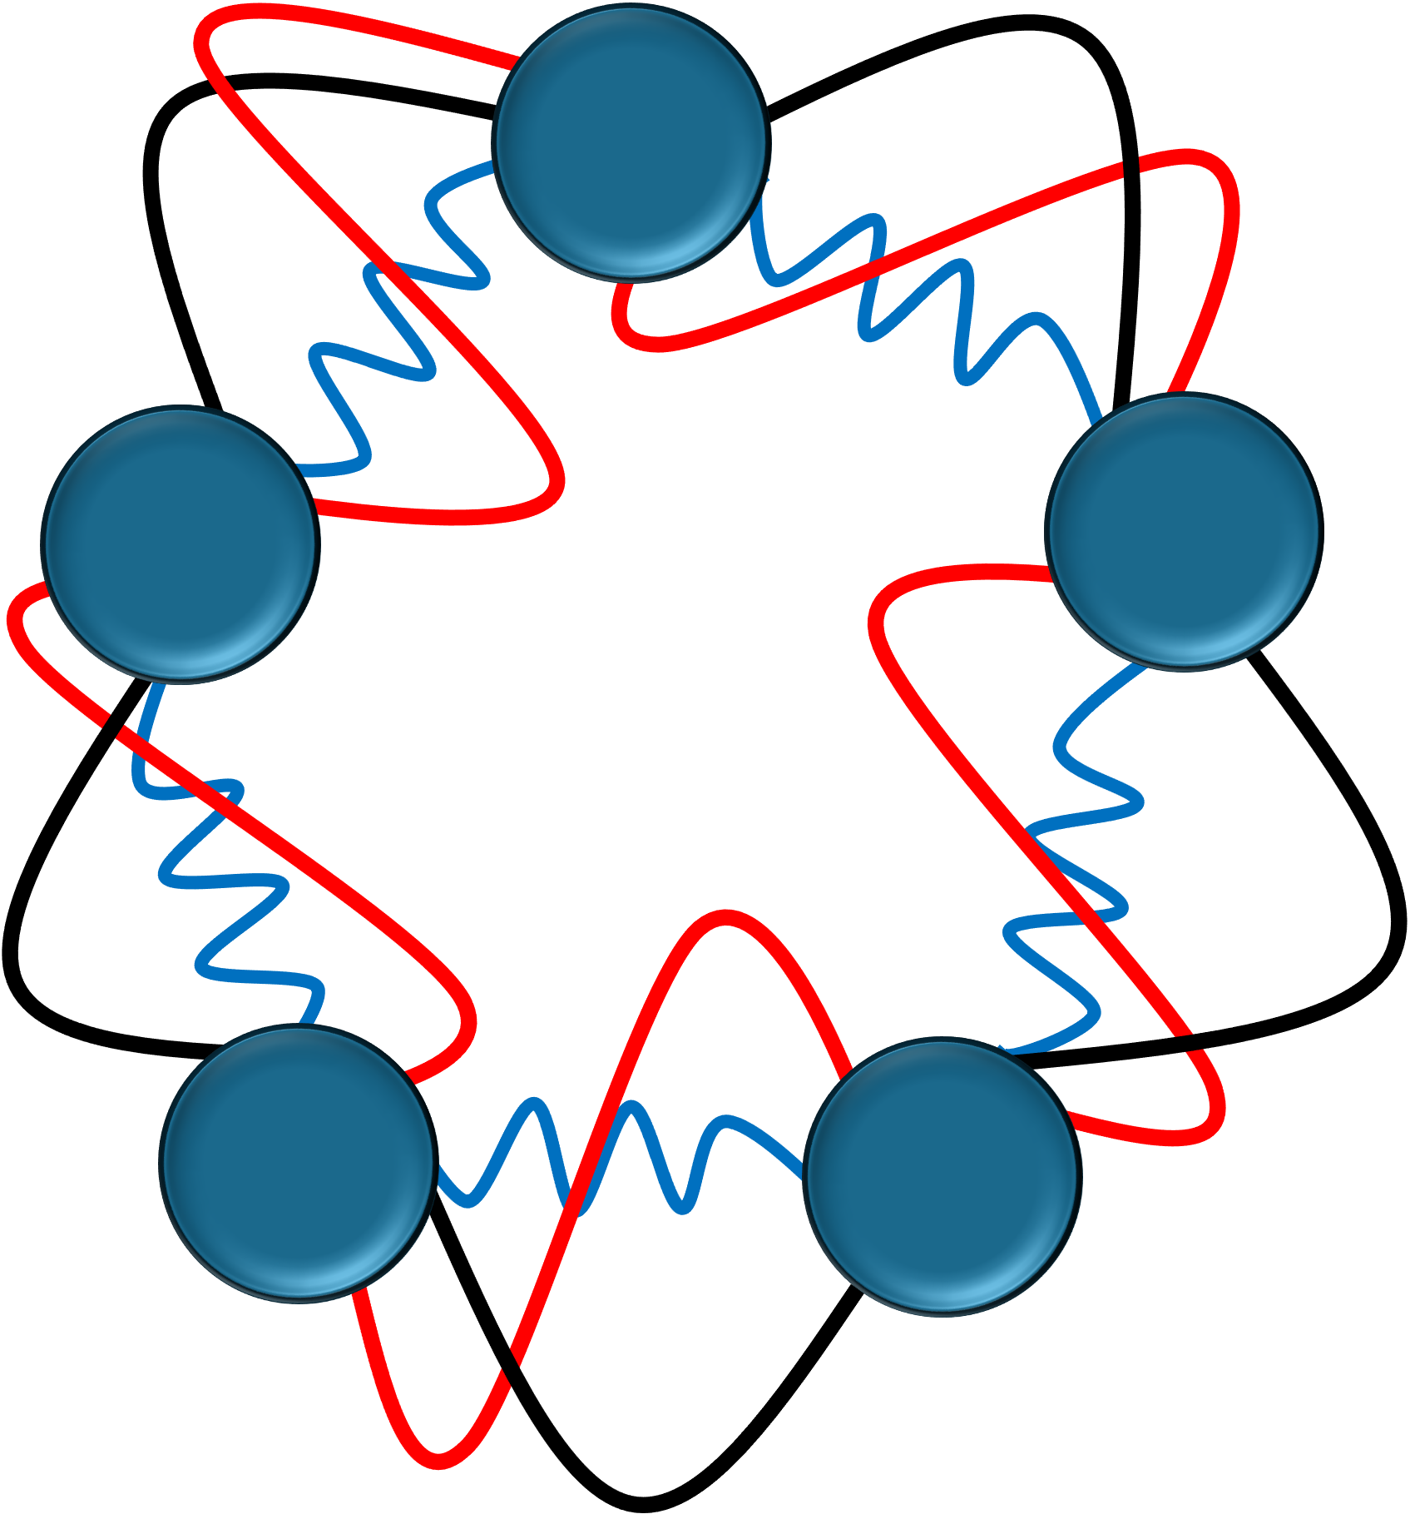
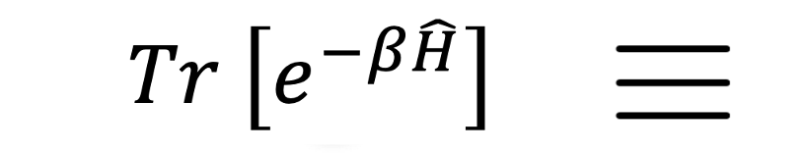
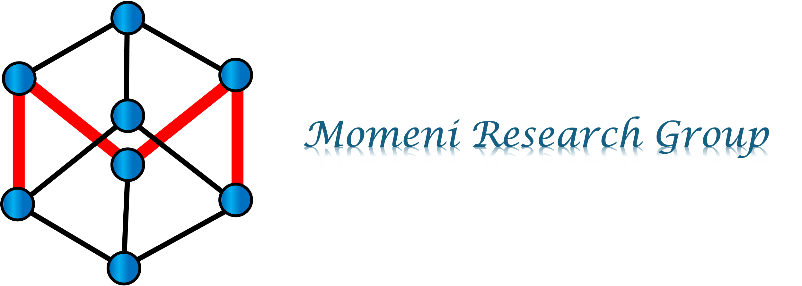
REAL-TIME DYNAMICS IN BEAD-FOURIER PATH INTEGRAL REPRESENTATION
MOHAMMAD R. MOMENI
Assistant Professor
University of Missouri–Kansas City (UMKC)
VISTA Seminar 91
June 4, 2025

Slide 2
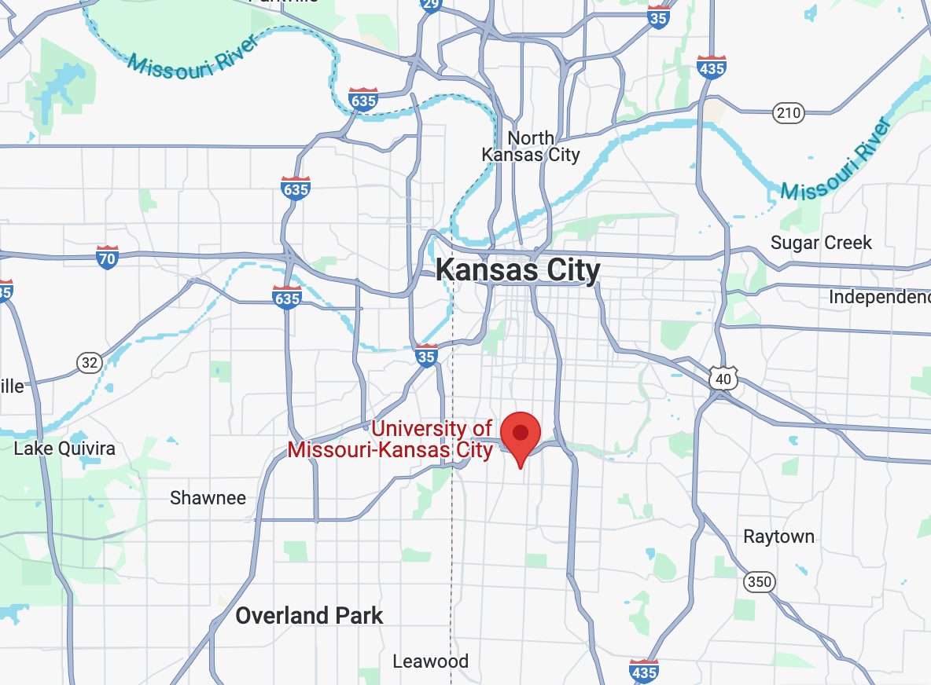
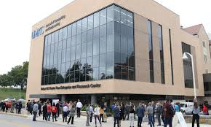
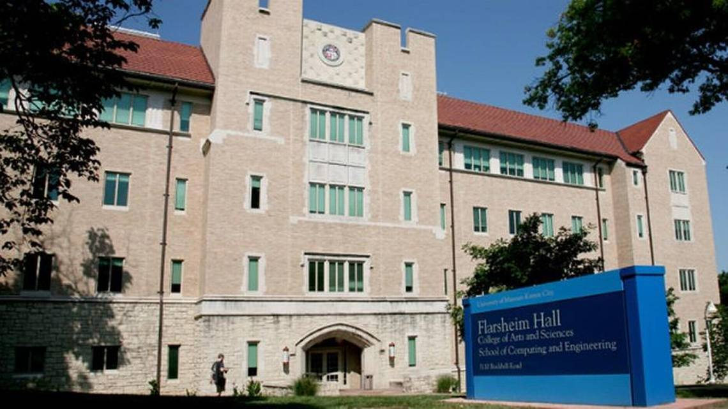
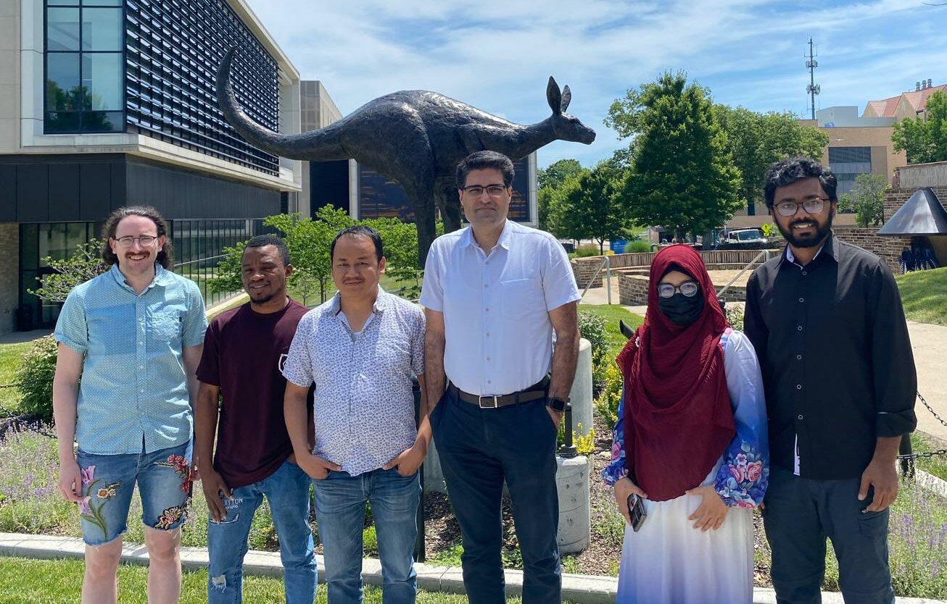
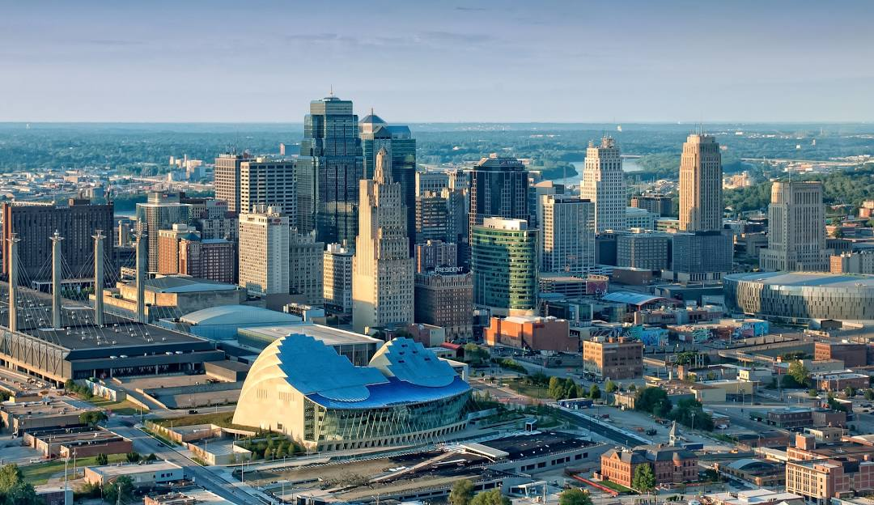
Momeni Research Group at UMKC
https://info.umkc.edu/momenigroup/

Slide 3
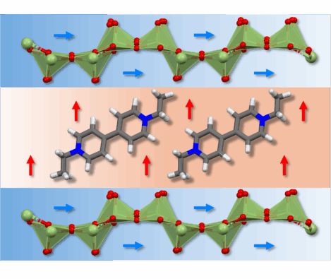
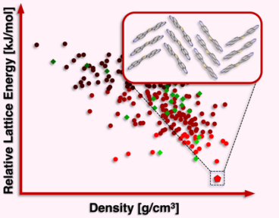
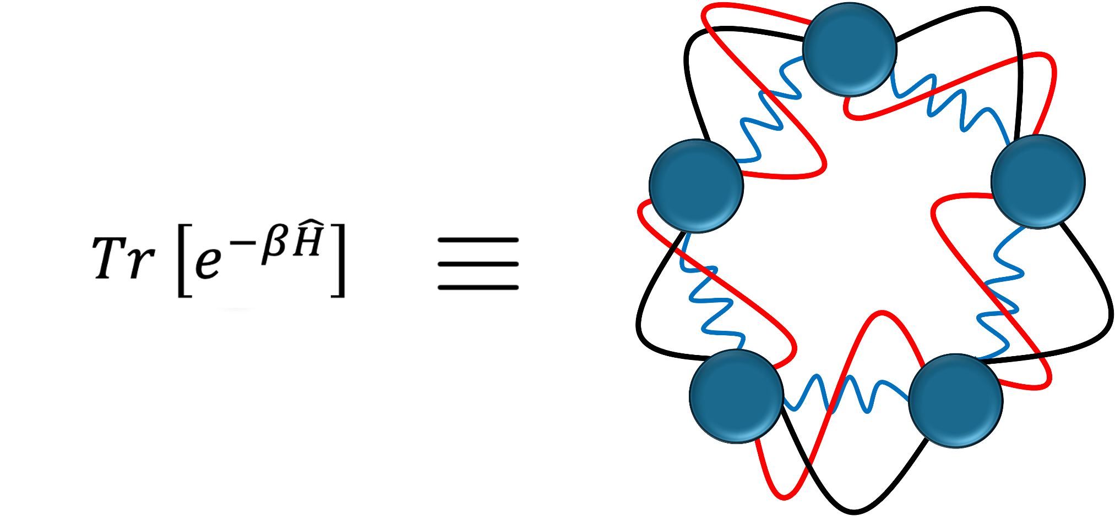
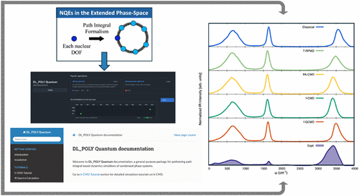
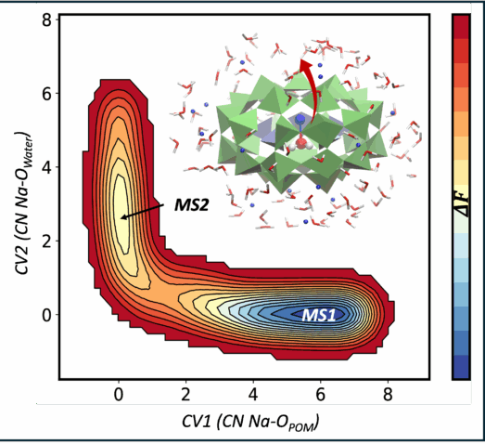
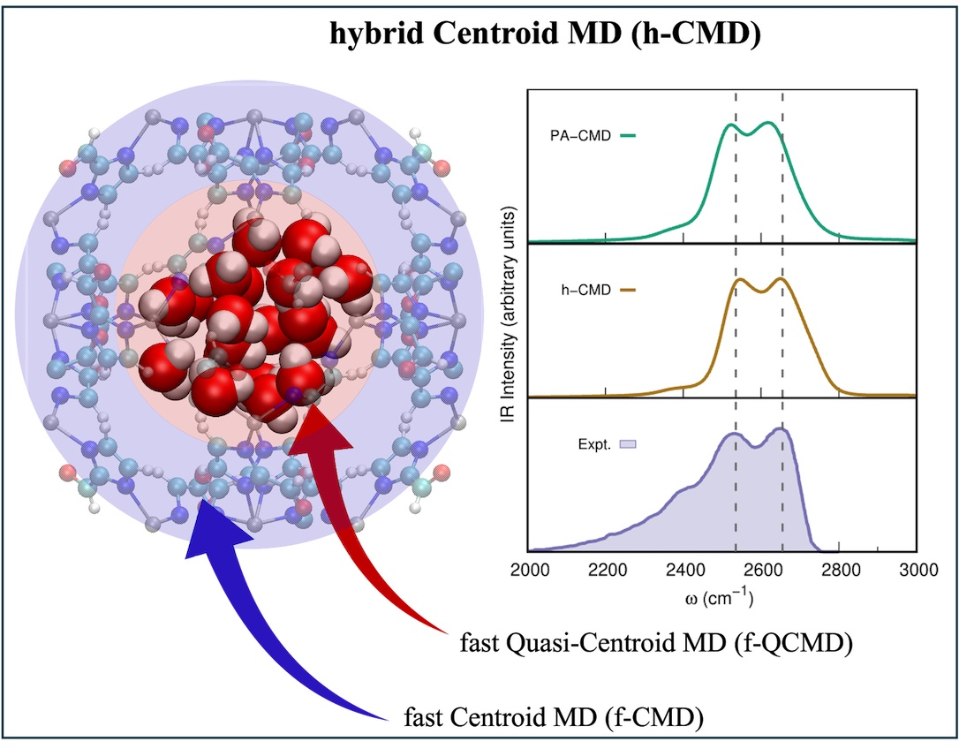

Real-Time Quantum Dynamic Methods
Data-Driven Design of Energetic Materials
Bead-Fourier Path Integrals
London & Momeni arXiv:2505.13707 [physics.chem-ph]
London & Momeni, In Preparation (2025).
Akter & Momeni J. Phys. Chem. C 129, 9518 (2025).
Akter et al. Langmuir 40, 24934 (2024).
Faruque et al. Cryst. Growth. Des. 24, 8950 (2024).
Quantum Vibrational Spectroscopy
Biased ML-MD/PIMD Simulations
Biased ML-MD
4G-HDcNNP-Enabled “Biased” Path Integrals Simulations
Parallel software for large-scale quantum dynamics simulations enabled by 4G-HDcNNPs
Limbu et al. J. Chem. Phys. 162, 014111 (2025).
Faruque, London, & Momeni, In Preparation (2025).
Adewuyi, et al. arXiv:2505.04644 [physics.chem-ph]
London et al. J. Phys. Chem. A 129, 4015 (2025).
London et al. J. Chem. Phys. 160, 132501 (2024).

Slide 4
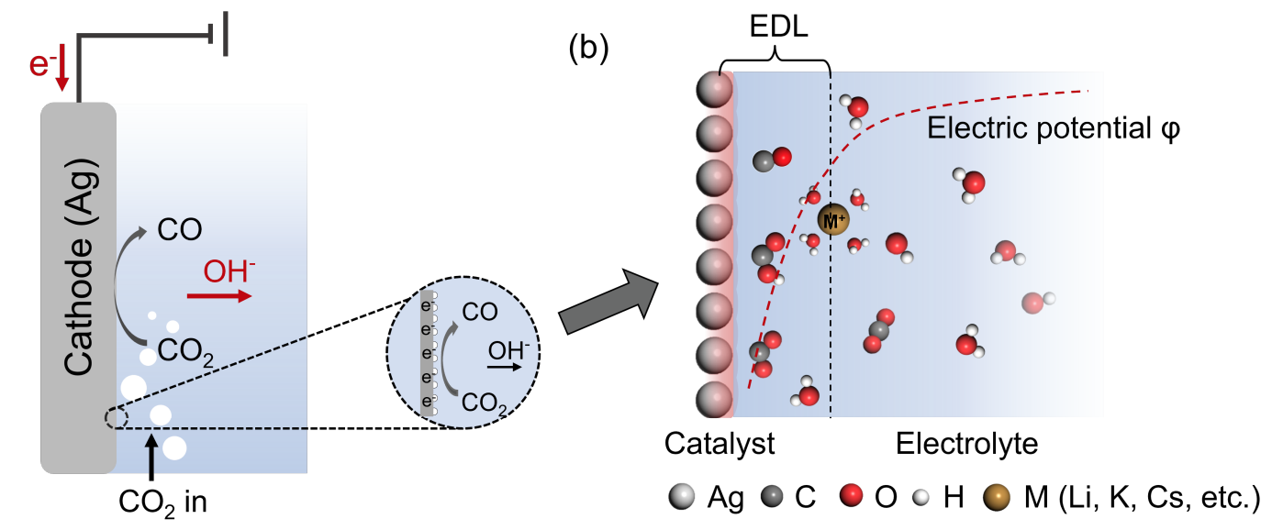
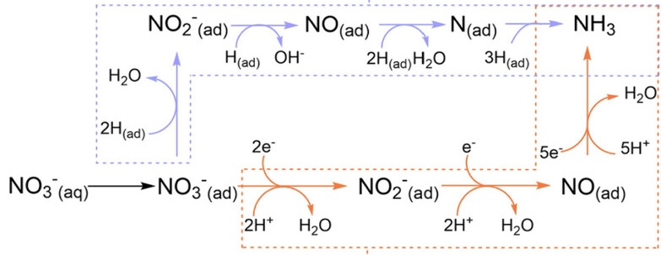
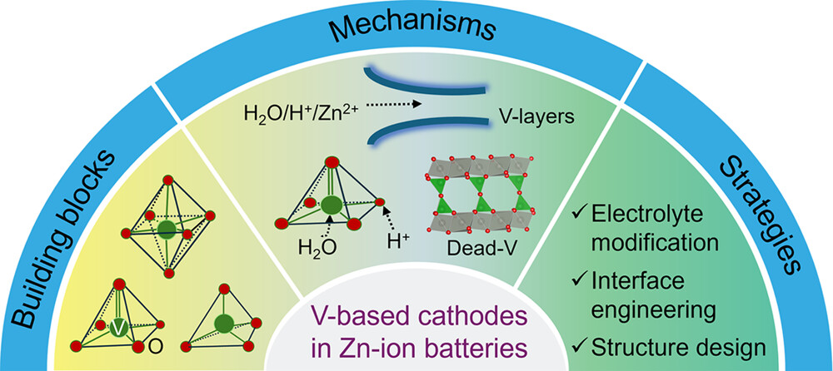
Probing Vibrational Spectra of Aqueous Electrochemical RXNs
Electrochemical CO₂ to CO and nitrate reduction reaction to ammonia (NO₃RR).
ACS Nano 18, 27833 (2024).
J. Mater. Chem. A 10, 9707 (2022).
Tian et al. ChemRxiv. 2025; doi:10.26434/chemrxiv-2025-n41q2
Aqueous Zn²⁺, Na⁺, and Mg²⁺ ion batteries for large-scale energy storage.
Probing interfaces with vibrational spectra:
Rigorous modeling without fittings or ad hoc parameterizations.
Acc. Chem. Res. 57, 2887 (2024).
An MD method for calculating TCFs (IR, vSFG, etc.) $→$ Real-Time Bead-Fourier
Accurate PESs $→$ 4G-HDcNNPs in DL_POLY Quantum

Slide 5
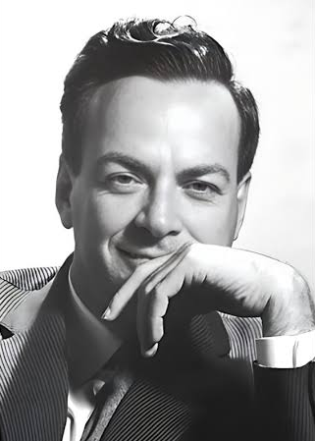
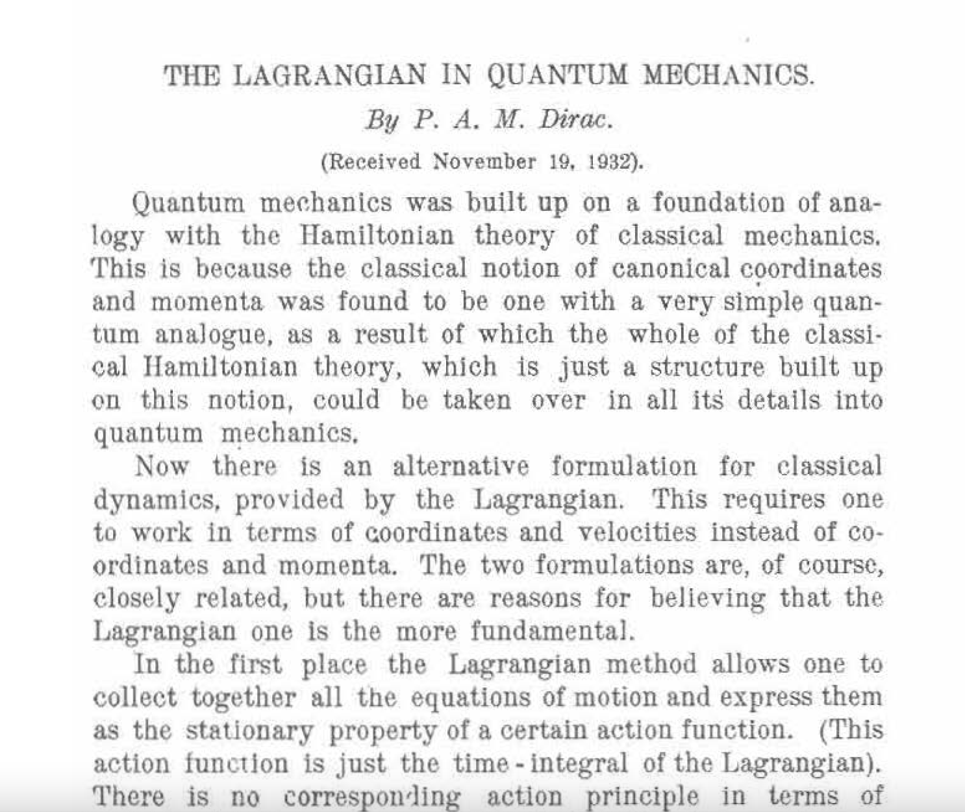
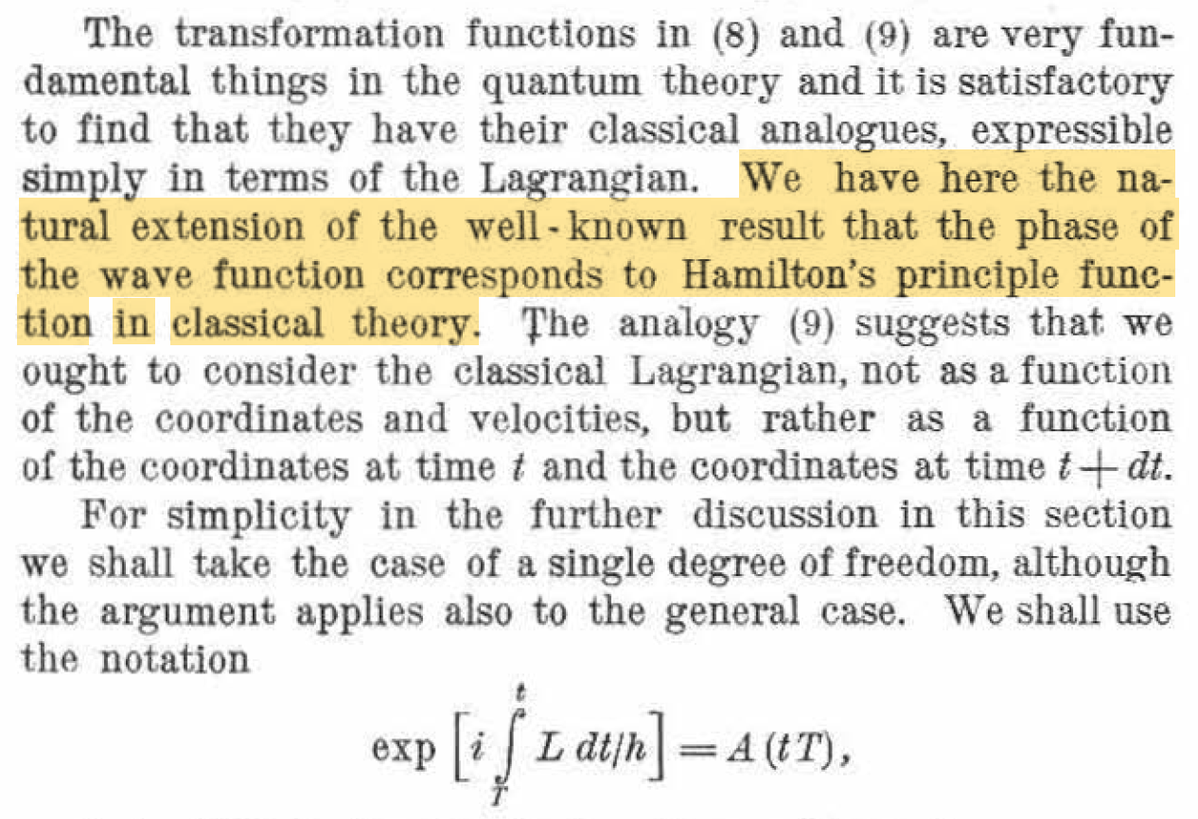
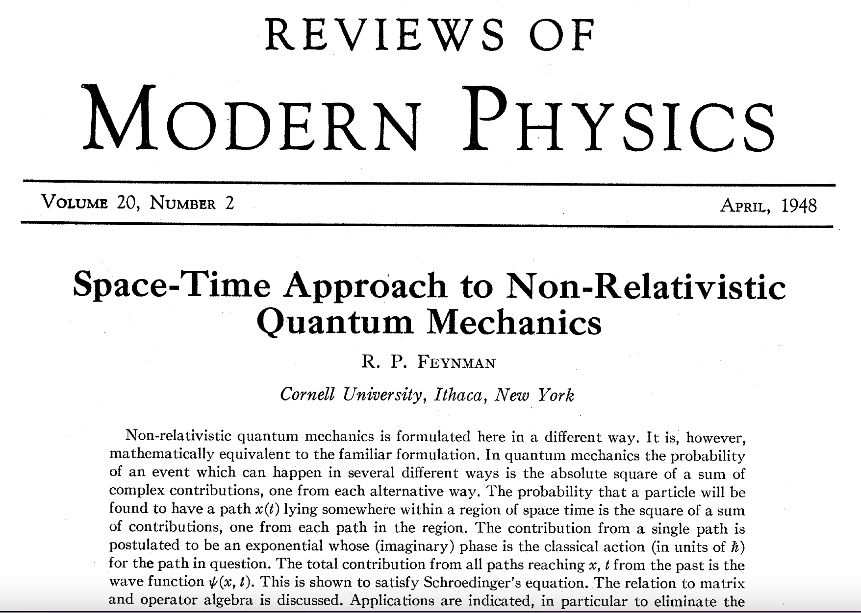
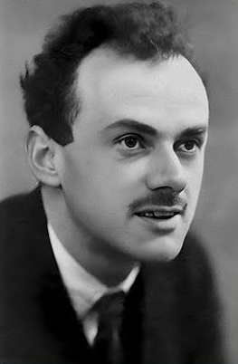
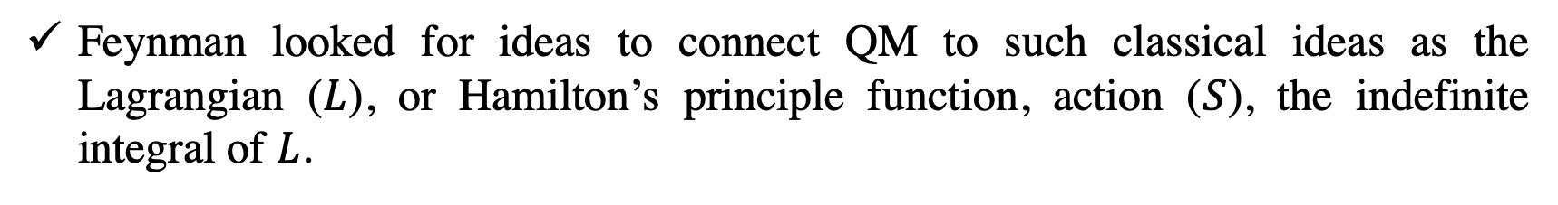
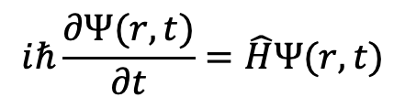
Feynman’s Path Integrals
Quantum mechanics is hard (exponential scaling)
$$iℏ\frac{∂Ψ(r,t)}{∂t}=\hat{H}Ψ(r,t)$$
Need better, more suitable methods for many particle systems in condensed phases where all other quantum mechanical effects are washed out.
Feynman looked for ideas to connect QM to such classical ideas as the Lagrangian ($L$), or Hamilton’s principle function, action ($S$), the indefinite integral of $L$.
1918-1988
1902-1984
Feynman changed the analogy to identity!

Slide 6
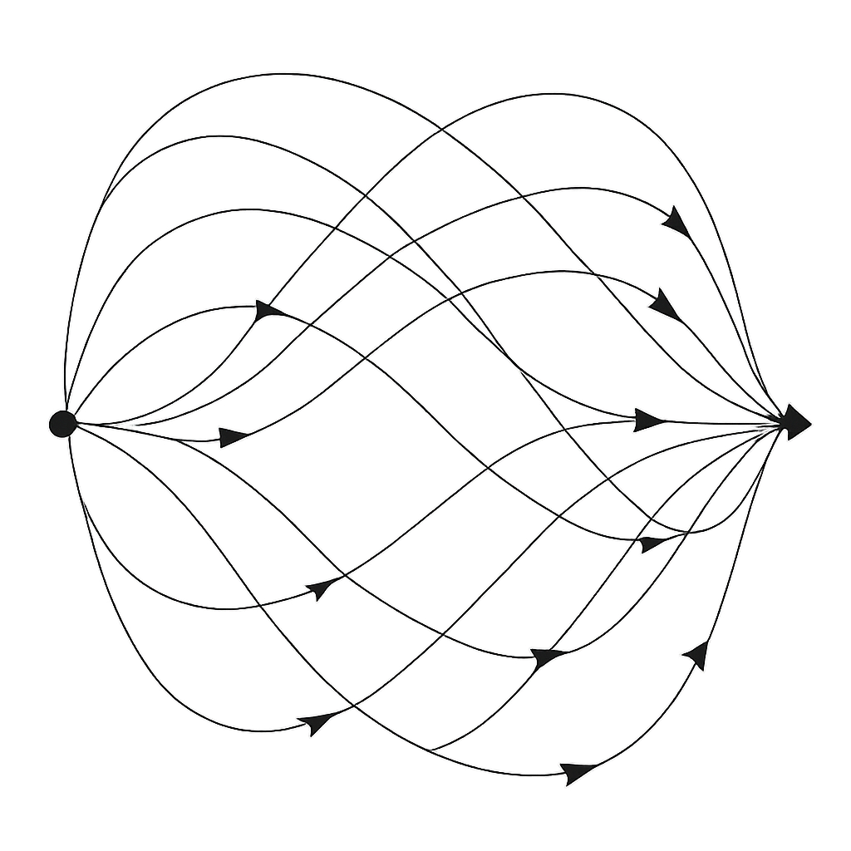
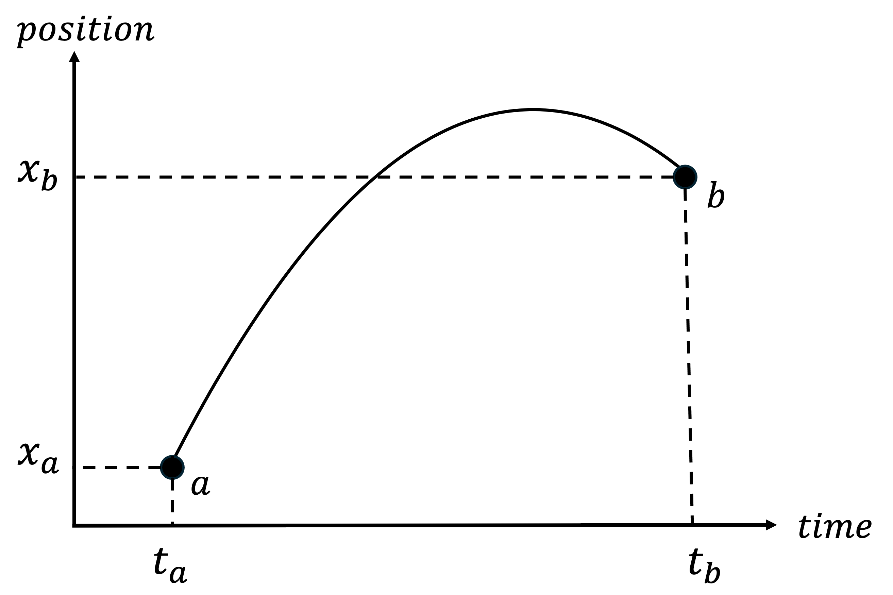
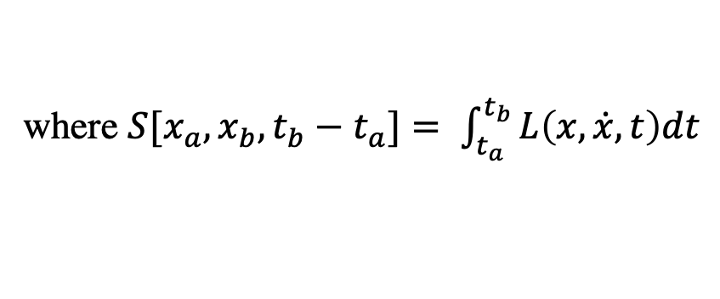
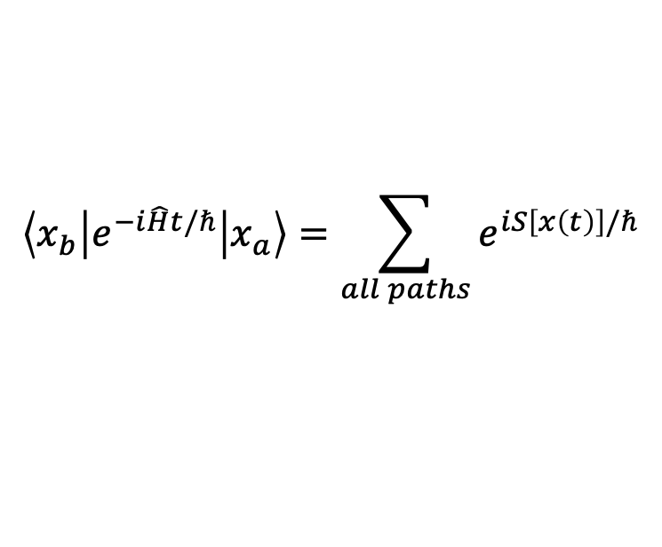
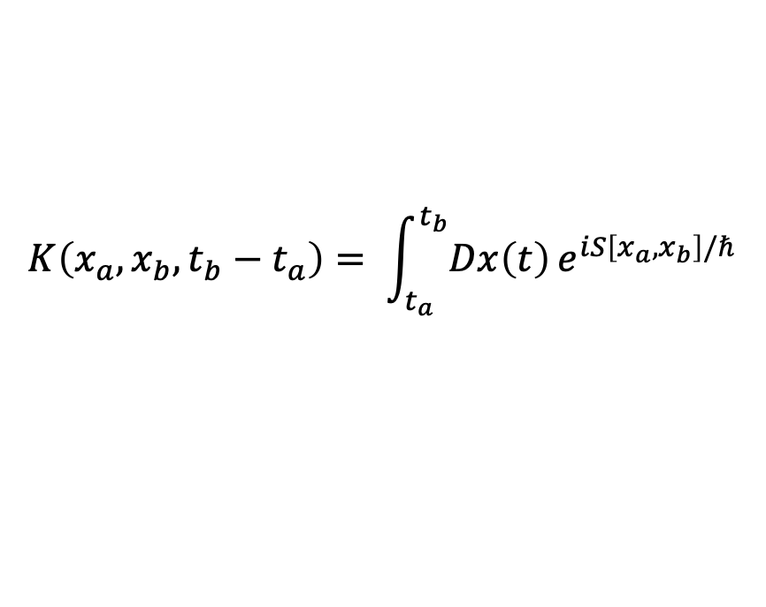

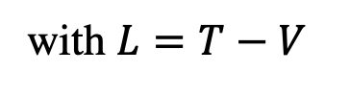
Feynman’s Path Integrals: Sum Over All Possible Paths
Feynman’s path integral states that to calculate the overall probability amplitude of a non-relativistic spin-less QM particle, we must consider, in addition to the classical path, all possible paths.
$$\left\langle x_{b} | e^{−i\hat{H}t/ℏ} | x_{a}\right\rangle =\sum_{all paths}{e^{iS\left[x\left(t\right)\right]/ℏ}}$$
where $S[x_{a},x_{b}, t_{b}−t_{a}]= \int_{t_{a}}^{t_{b}}{L\left(x,\dot{x},t\right)dt}$
with $L=T−V$
classical action functional along the path
Write the infinite sum over all paths in a less restrictive way as integrals:
$$K\left(x_{a},x_{b}, t_{b}−t_{a}\right)= \int_{t_{a}}^{t_{b}}{Dx\left(t\right)}e^{iS\left[x_{a},x_{b}\right]/ℏ}$$
$$P= {\left|K\right|}^{2} dx$$
probability
Feynman & Hibbs (1965). Quantum Mechanics and Path Integrals.

Slide 7
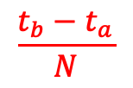
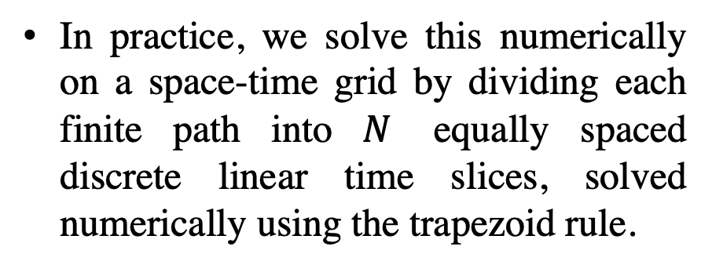
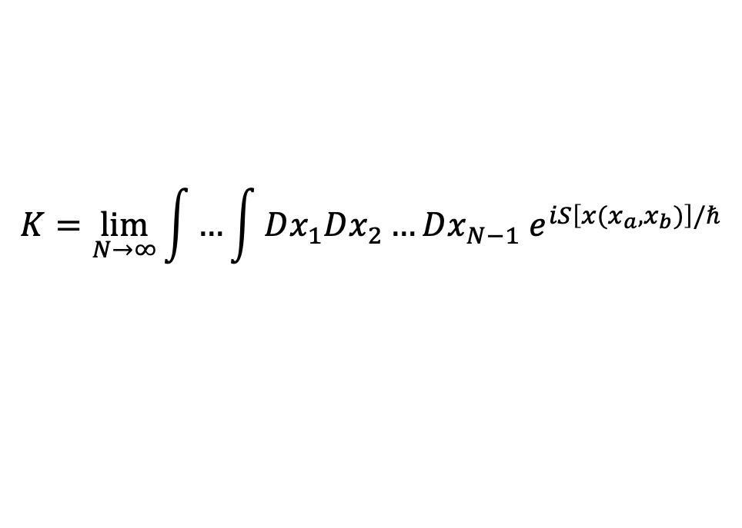
Feynman’s “Discretized” Path Integrals
In practice, we solve this numerically on a space-time grid by dividing each finite path into $N$ equally spaced discrete linear time slices, solved numerically using the trapezoid rule.
$$K=\lim_{N→∞}{\int{…\int{Dx_{1}Dx_{2}…{Dx_{N−1} e}^{iS\left[x(x_{a},x_{b})\right]/ℏ}}}}$$
$$\frac{t_{b}−t_{a}}{N}$$
The oscillatory phase (sign) problem: action changes quadratically with path variables (position) and leads to highly oscillatory amplitudes.
Morita J. Phys. Soc. Jap. 35, 980 (1973).

Slide 8
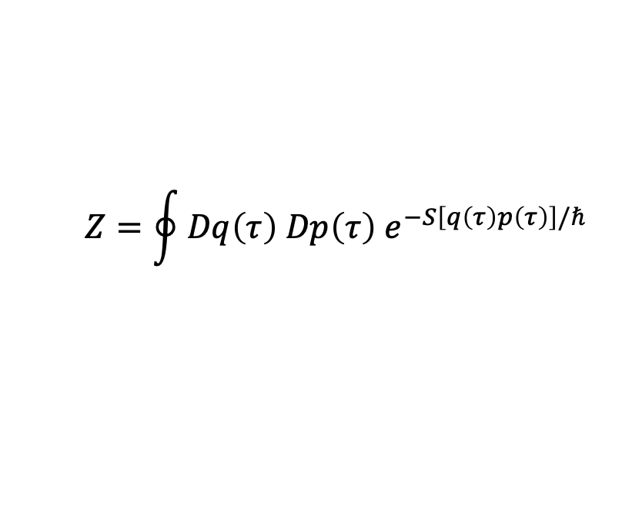



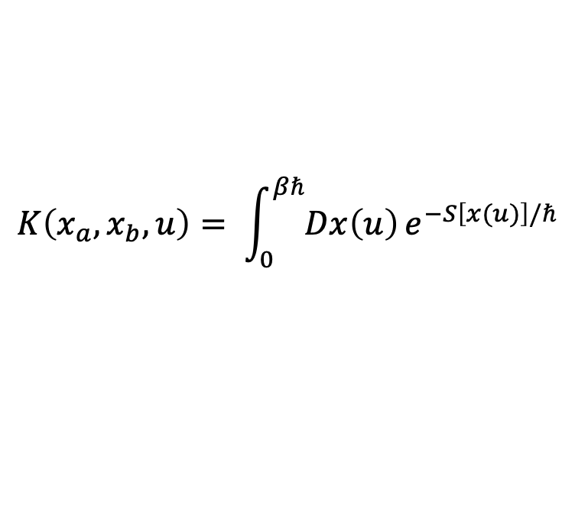
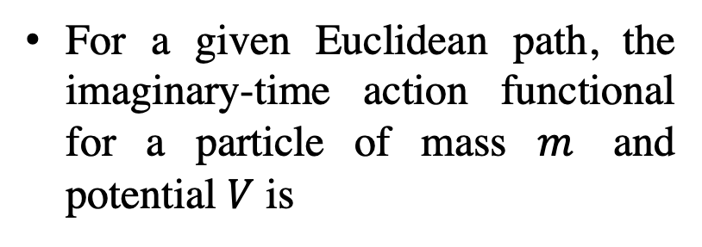

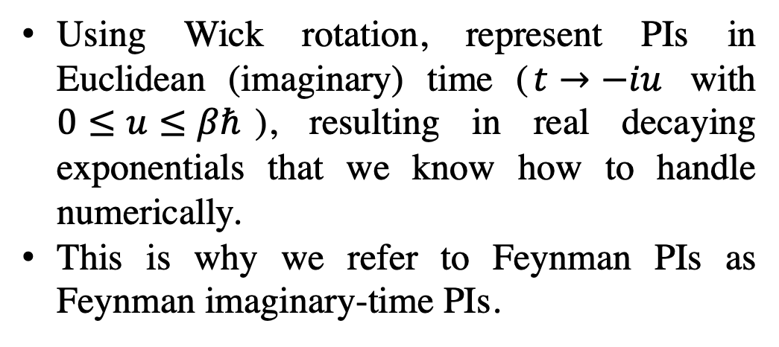

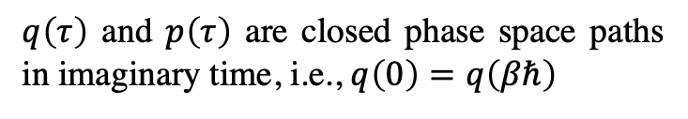
Feynman’s “Discretized” Imaginary-Time Path Integrals
Using Wick rotation, represent PIs in Euclidean (imaginary) time ($t→−iu$ with $0≤u≤βℏ$), resulting in real decaying exponentials that we know how to handle numerically.
This is why we refer to Feynman PIs as Feynman imaginary-time PIs.
$$K\left(x_{a},x_{b}, u\right)= \int_{0}^{βℏ}{Dx\left(u\right)}e^{−S\left[x(u)\right]/ℏ}$$
$$Reθ$$
$$t$$
$$Imθ$$
$$−iβℏ$$
$$Z=\oint{{Dq\left(τ\right) Dp\left(τ\right) e}^{−S\left[q\left(τ\right)p\left(τ\right)\right]/ℏ}}$$
Using phase space variables, the partition function is
$q\left(τ\right)$ and $p\left(τ\right)$ are closed phase space paths in imaginary time, i.e., $q\left(0\right)=q\left(βℏ\right)$
For a given Euclidean path, the imaginary-time action functional for a particle of mass $m$ and potential $V$ is
$$S \left[\left(q(u\right), p\left(u\right)\right]=\int_{0}^{βℏ}{du}\left[ip\left(u\right)\dot{q}\left(u\right)+\frac{m}{2}{\dot{q}}^{2}\left(u\right)+V\left[q\left(u\right)\right]\right]$$
Feynman & Hibbs (1965). Quantum Mechanics and Path Integrals.

Slide 9


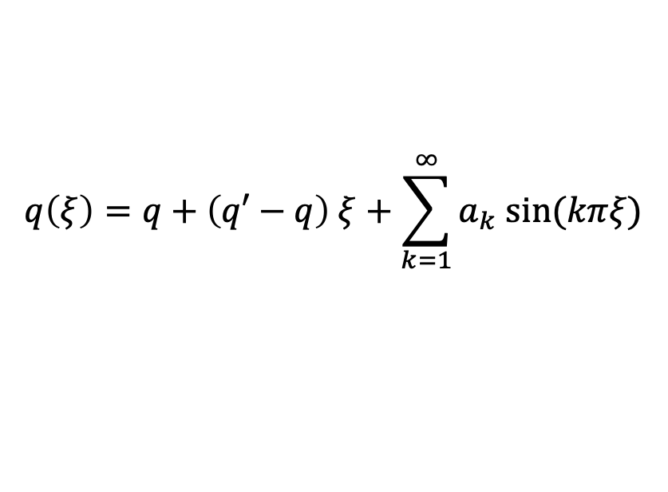
Fourier Path Integrals
In the Fourier path integral method, the imaginary time path is expanded in a Fourier sine series:
$$q\left(ξ\right)=q+\left(q′−q\right) ξ+\sum_{k=1}^{∞}{a_{k} sin⁡(kπξ)}$$
where $ξ= \frac{u}{βℏ}$
$$0≤ξ≤1$$
path starting and end points
Fourier amplitudes
Hundreds of Fourier terms needed even for simulations with heavy atoms.
Doll and Freeman JCP 80, 2239 (1984). Freeman and Doll JCP 80, 5709 (1984). Doll et al. Phys. Rev. Lett. 55, 1 (1985). Vorontsov-Velyaminov et al. Phys. Rev. E 55, 1979 (1997).

Slide 10
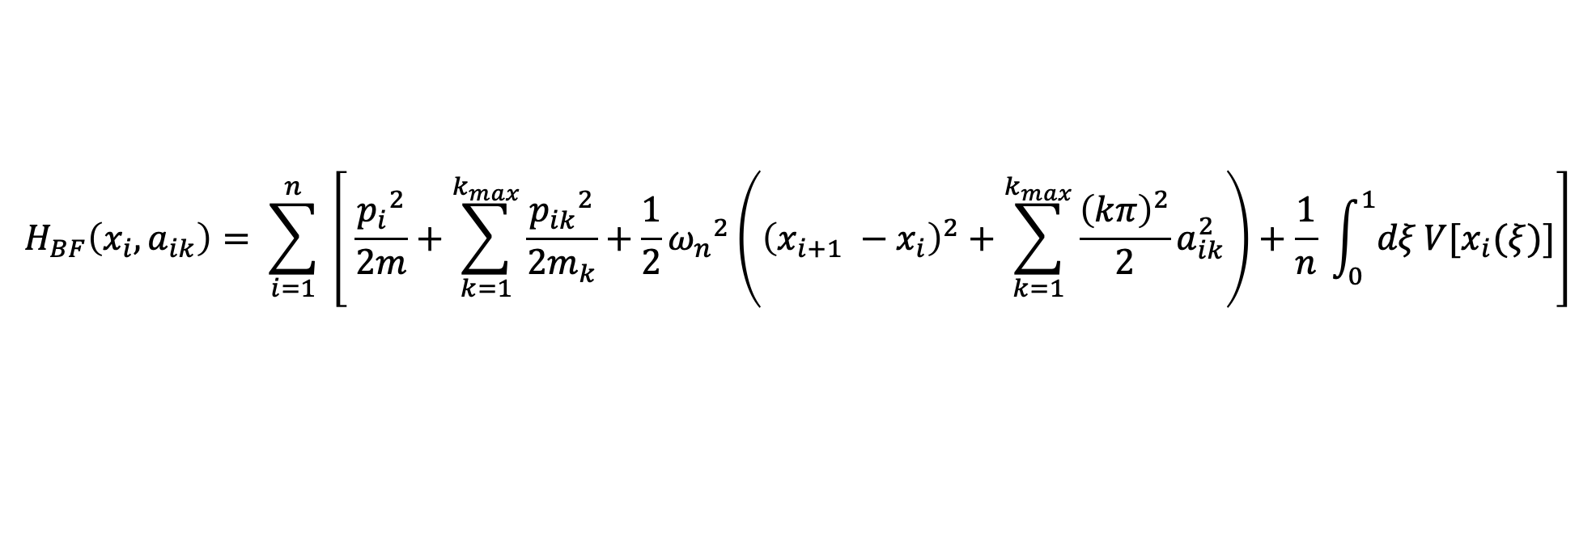
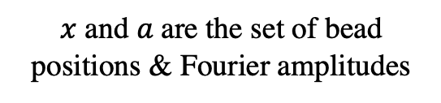
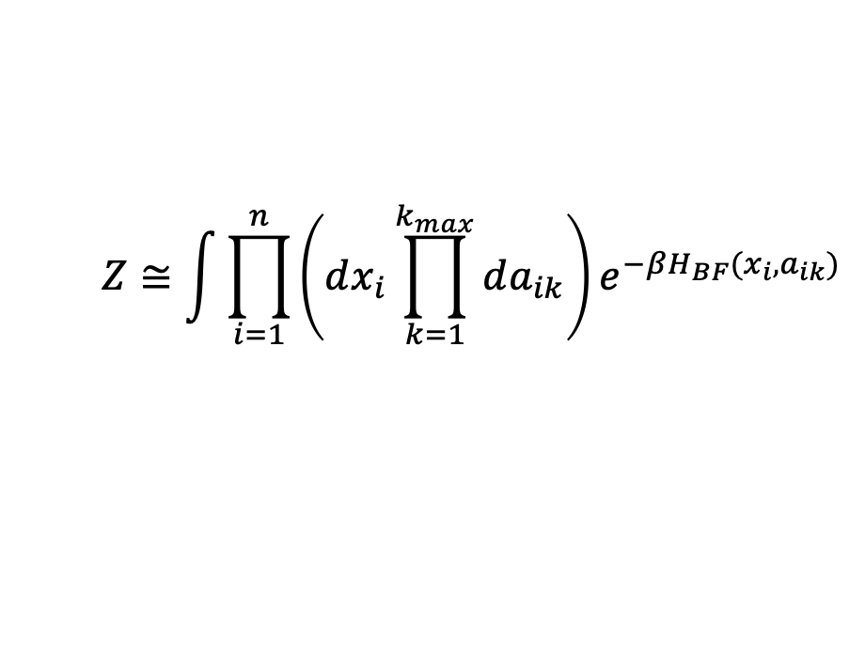
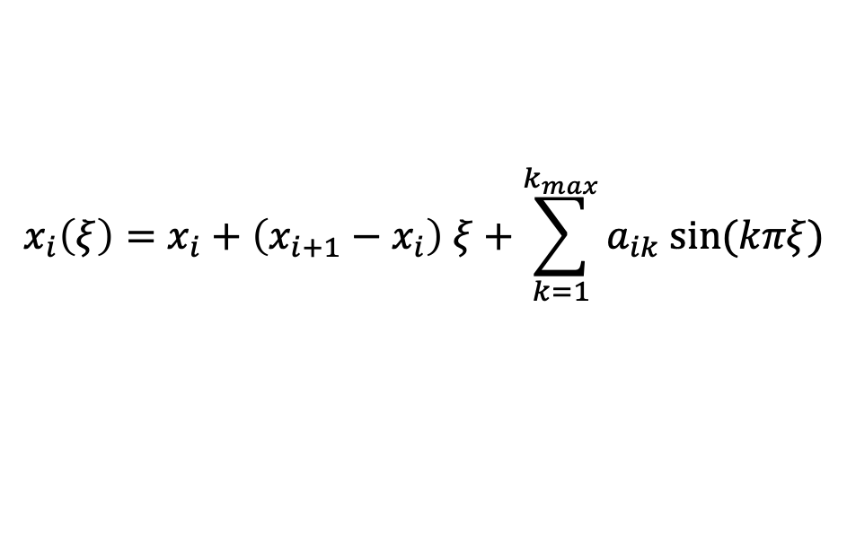
Bead-Fourier (BF-) PIMD and BF-RPMD
The bead-Fourier (BF) method combines bead and Fourier approaches to imaginary time PIs into one method. Here, each time slice is expanded in a Fourier sine series:
$$x_{i}\left(ξ\right)=x_{i}+\left(x_{i+1}−x_{i}\right) ξ+\sum_{k=1}^{k_{max}}{a_{ik} sin⁡(kπξ)}$$
$$Z≅\int{\prod_{i=1}^{n}{\left(dx_{i}\prod_{k=1}^{k_{max}}{da_{ik}}\right)}}e^{−βH_{BF}(x_{i},a_{ik})}$$
BF partition function:
$x$ and $a$are the set of bead positions & Fourier amplitudes
$$H_{BF}\left(x_{i},a_{ik}\right)= \sum_{i=1}^{n}{ \left[ \frac{{p_{i}}^{2}}{2m}+\sum_{k=1}^{k_{max}}{\frac{{p_{ik}}^{2}}{2m_{k}}}+\frac{1}{2}{ω_{n}}^{2}\left({\left(x_{i+1} −x_{i}\right)}^{2}+\sum_{k=1}^{k_{max}}{\frac{{\left(kπ\right)}^{2}}{2}a_{ik}^{2}}\right)+\frac{1}{n} \int_{0}^{1}{dξ}V[x_{i}(ξ)]\right]}$$
The two limiting cases easily recovered for pure bead ($k_{max}=0$) and pure Fourier ($n=1$) methods.
Similar to B-RPMD, in BF-RPMD, we use physical mass and no thermostatting.
Phys. Rev. E 55, 1979 (1997). Phys. Rev. E 67, 066710 (2003)

Slide 11

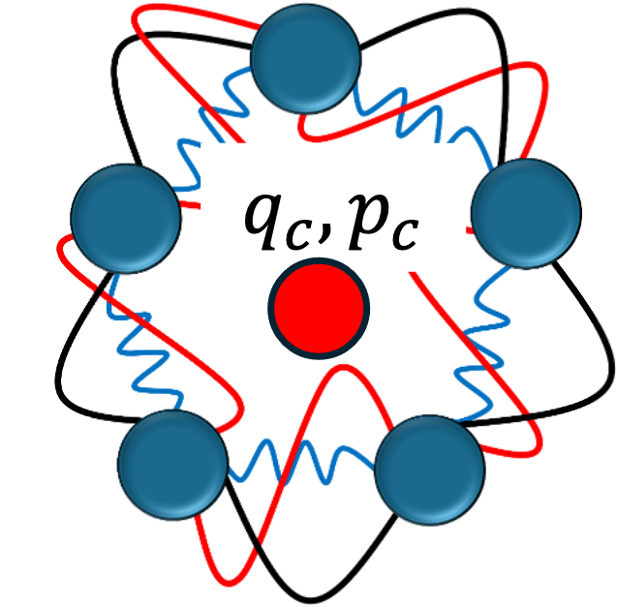
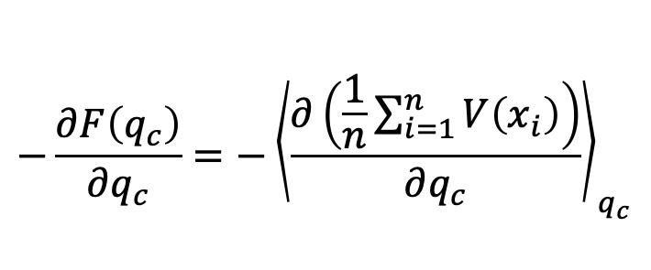
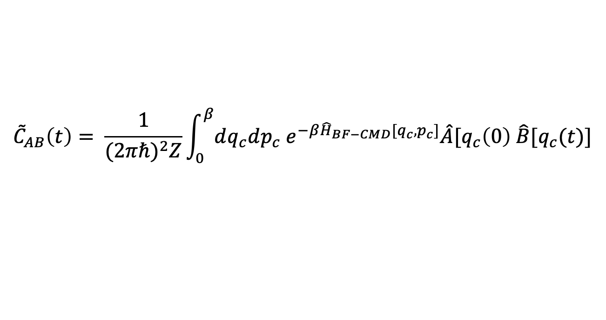
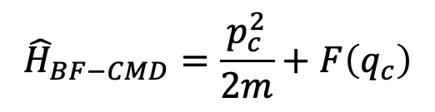
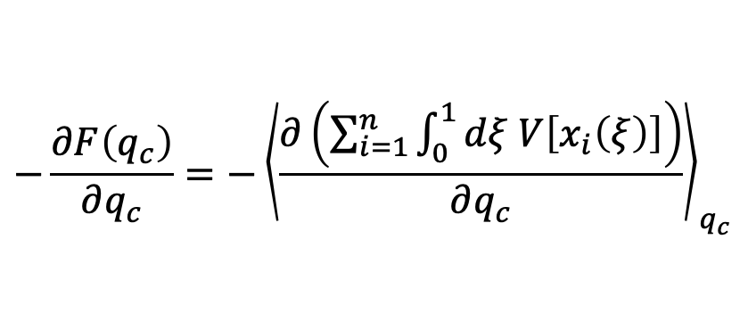
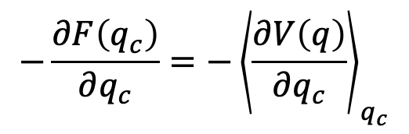
Introducing Bead-Fourier CMD (BF-CMD)
We extended BF-PIs to real-time methods through CMD.
Nathan London
$${\tilde{C}}_{AB}\left(t\right)= \frac{1}{{(2πℏ)}^{2}Z}\int_{0}^{β}{dq_{c}dp_{c}{ e}^{−β{\hat{H}}_{BF−CMD}[q_{c},p_{c}]}\hat{A}[q_{c}\left(0\right) \hat{B}[q_{c}(t)]}$$
$${\hat{H}}_{BF−CMD}=\frac{p_{c}^{2}}{2m}+F\left(q_{c}\right)$$
$$−\frac{∂F\left(q_{c}\right)}{∂q_{c}}={−\left\langle \frac{∂V\left(q\right)}{∂q_{c}}\right\rangle }_{q_{c}}$$
We use both continuous (left) and bead (right) estimators for calculating the centroid PMF:
$$−\frac{∂F\left(q_{c}\right)}{∂q_{c}}={−\left\langle \frac{∂\left(\sum_{i=1}^{n}{\int_{0}^{1}{dξ V\left[x_{i}\left(ξ\right)\right]}}\right)}{∂q_{c}}\right\rangle }_{q_{c}}$$
$$−\frac{∂F\left(q_{c}\right)}{∂q_{c}}={−\left\langle \frac{∂\left(\frac{1}{n}\sum_{i=1}^{n}{V\left(x_{i}\right)}\right)}{∂q_{c}}\right\rangle }_{q_{c}}$$
Cao and Voth JCP 100, 5093 (1994).
London and Momeni arXiv:2505.13707 [physics.chem-ph].

Slide 12


Curvature Problem of CMD for Quantum Vibrational Spectra
Treating the CMD curvature problem (artificial red-shift and broadening of the OH stretch) with QCMD, f-QCMD, Te-PIGS, ...
All these methods have their own limitations and computational complexities.
JCP 151, 054109 (2019).
JCP 155, 231101 (2021); JCP 157, 181102 (2022).

Slide 13


Curvature Problem of CMD for Quantum Vibrational Spectra
We developed the hybrid CMD (h-CMD) method for treating the “curvature problem” of CMD.
IR spectra of salt-in-water and water-in-salt Li-TFSI solutions
1m
5m
10m
20m
H₂O@MOF
Dil Limbu
h-CMD suffers where spectral features of interest become part of the large molecule/framework treated with f-CMD.
Limbu et al. JCP 162, 014111 (2025).
London et al. J. Phys. Chem. A 129, 4015 (2025).

Slide 14





Acknowledgement
Omar
Nathan
Dil
From L: Nathan London, Quadri Adewuyi, Dil Limbu, Mohammad Momeni, Suchona Akter, Md Omar Faruque

