Slide 1
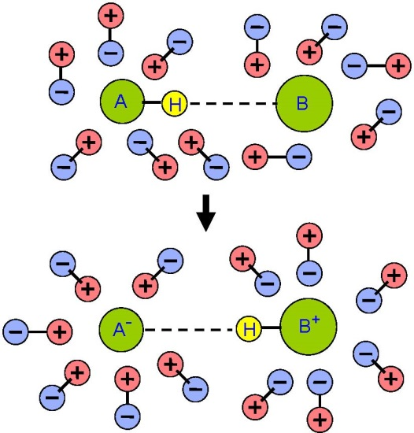
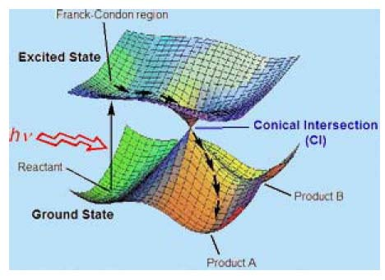
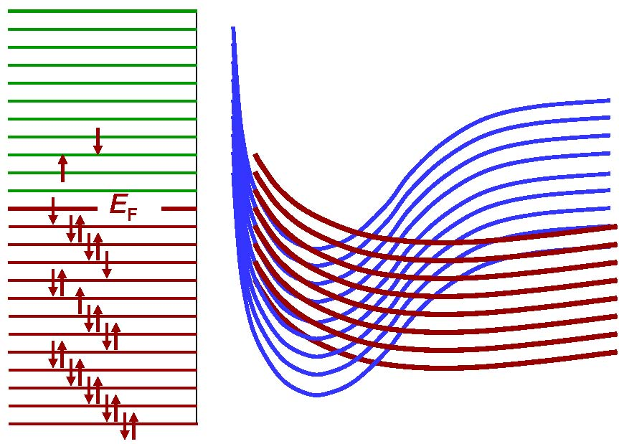
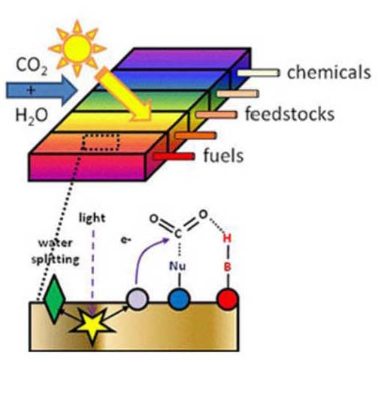
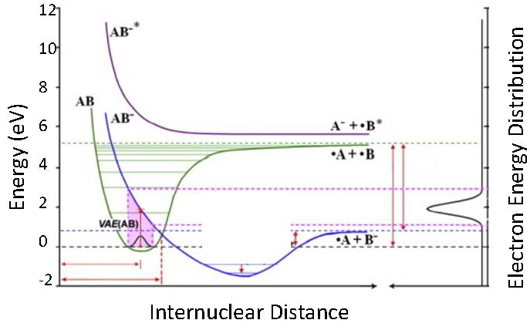
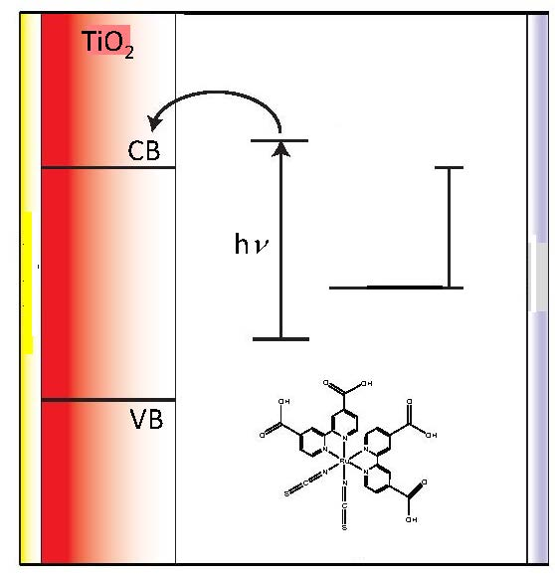
VISTA: Virtual International Seminar on Theoretical Advancements
Adventures with Surface Hopping

Slide 2
VISTA: Virtual International Seminar on Theoretical Advancements
Adventures with Surface Hopping
A historical view of my role in some of the
origins and developments of surface hopping
This will not be a scholarly review:
I will omit many important contributions by others

Slide 3
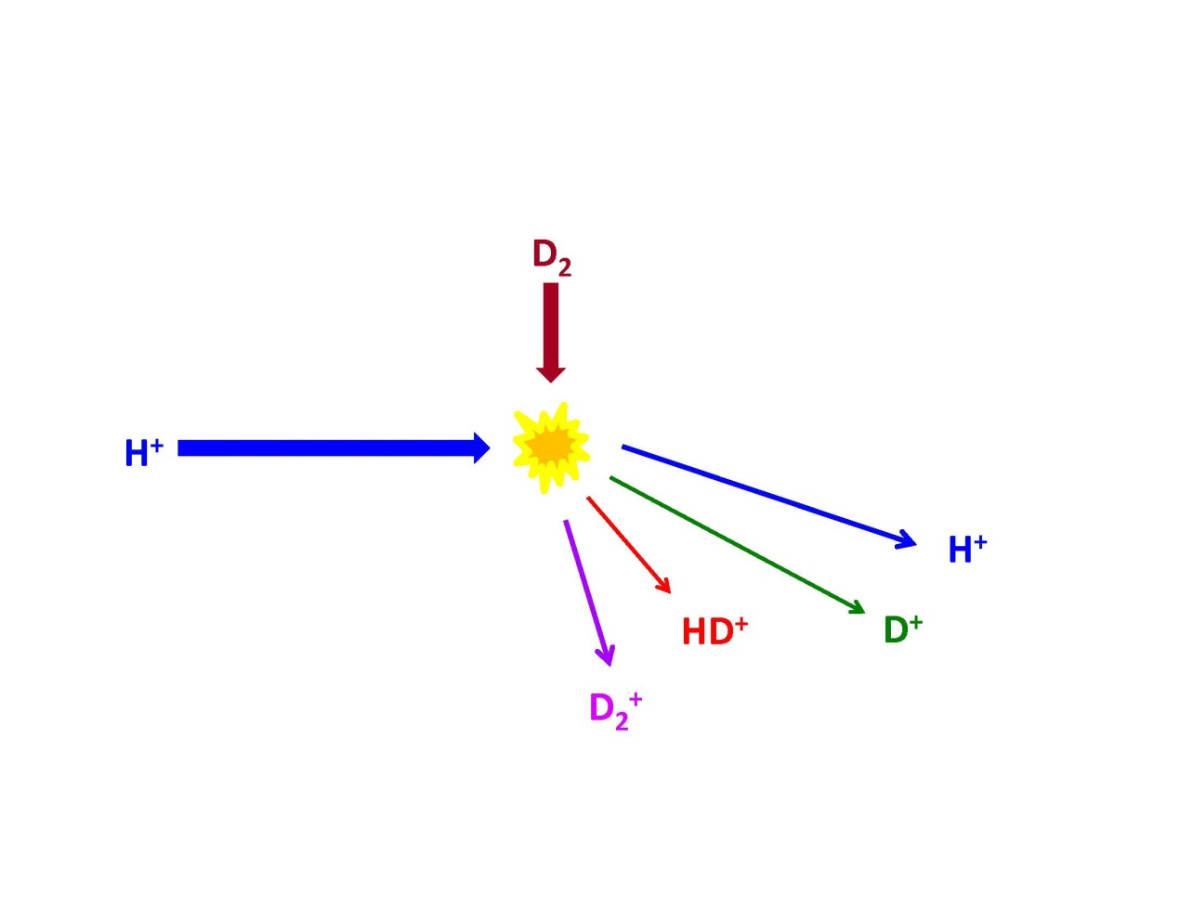
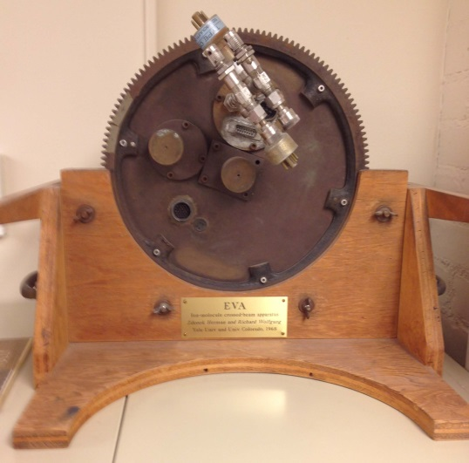
Molecular Beam Experiments of the Reaction of H⁺ with D₂
Collaboration with Zdenek Herman, Richard Wolfgang, …
1969 Univ Colorado Boulder
Detect the angular and
velocity distributions of ions

Slide 4
Theory: How hard can it be?
H₃⁺ : 3 nuclei, 2 electrons
simplest chemical reaction ?

Slide 5
Theory: How hard can it be?
H₃⁺ : 3 nuclei, 2 electrons
simplest chemical reaction ?
However: 2 potential energy surfaces !

Slide 6
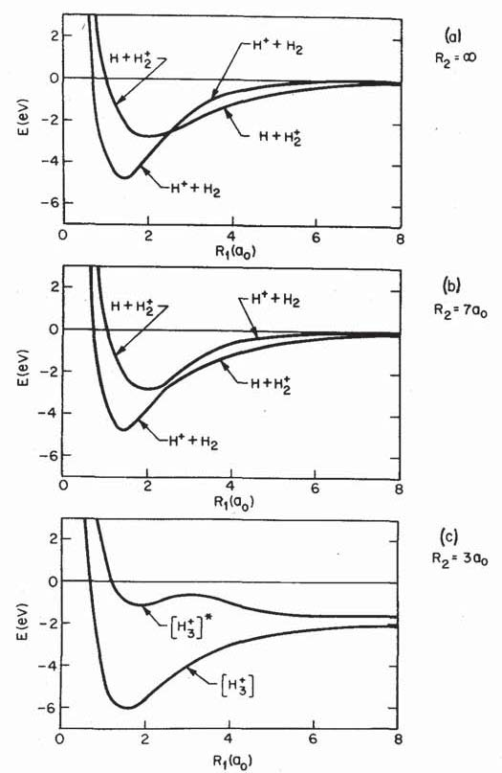
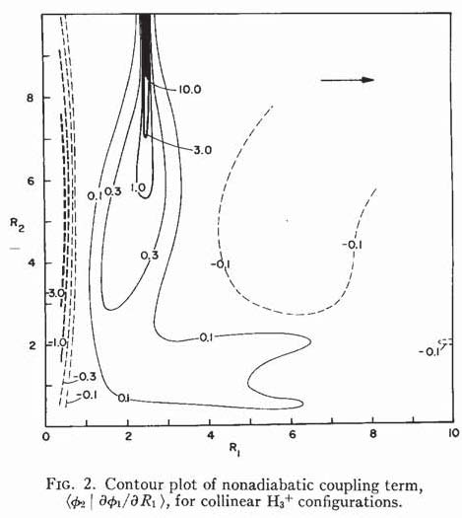
Compute Potential Energy Surfaces
and Nonadiabatic Coupling Vectors
Semiempirical Diatomics in Molecules
R₂=o
o
R₂(a₀)
R₂= 7a₀
R₁(a₀)
Nonadabatic coupling vector
R₂= 3a₀
Nonadiabatic coupling vector
R₁(a₀)

Slide 7
MIXED QUANTUM-CLASSICAL STRATEGIES
FOR NONADIABATIC DYNAMICS
V_{B}
V_{A}
Ehrenfest
(self-consistent field)
e.g., A. D. McLachlan, Mol. Phys. 1964

Slide 8
MIXED QUANTUM-CLASSICAL STRATEGIES
FOR NONADIABATIC DYNAMICS
V_{B}
V_{A}
Ehrenfest
(self-consistent field)
e.g., A. D. McLachlan, Mol. Phys. 1964

Slide 9
MIXED QUANTUM-CLASSICAL STRATEGIES
FOR NONADIABATIC DYNAMICS
V_{B}
V_{B}
V_{A}
V_{A}
Ehrenfest
(self-consistent field)
Trajectory Surface-Hopping
motion on individual
potential energy surfaces

Slide 10
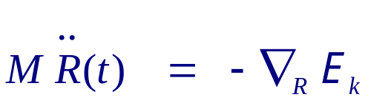
Surface Hopping (1971 Version)
1]
, i.e., classical motion on a single adiabatic p.e.s.

Slide 11
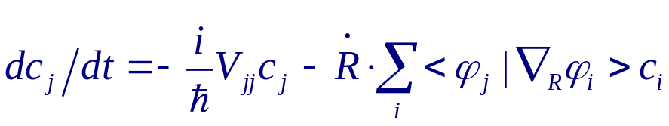
Surface Hopping (1971 Version)
1]
, i.e., classical motion on a single adiabatic p.e.s.
2] Electronic amplitudes along path:
Approximate |c_{k}|² by Landau-Zener formula

Slide 12
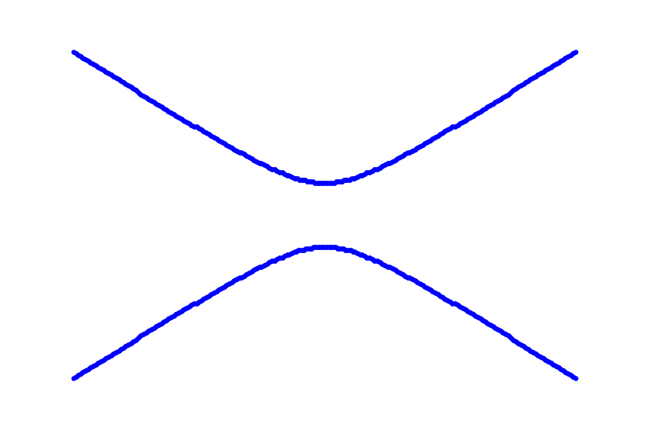
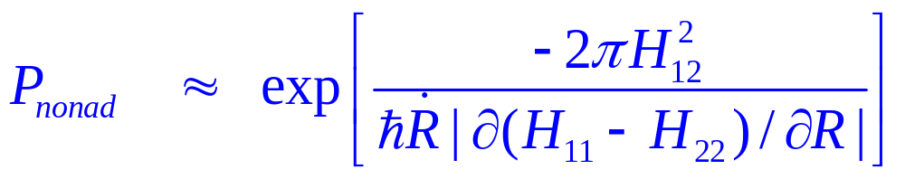
Landau-Zener Approximation: 1932
2 x 2 Hamiltonian matrix
?
Assumptions:
H₁₁ and H₂₂ linear
H₁₂ constant
3. Velocity constant
E(R)
?
R

Slide 13
Surface Hopping (1971 Version)
1]
, i.e., classical motion on a single adiabatic p.e.s.
2] Electronic amplitudes along path:
Approximate |c_{k}|² by Landau-Zener formula
3] Select electronic state by random number according to |c_{k}|²
Hops occur only at crossing points

Slide 14
Surface Hopping (1971 Version)
1]
, i.e., classical motion on a single adiabatic p.e.s.
2] Electronic amplitudes along path:
Approximate |c_{k}|² by Landau-Zener formula
3] Select electronic state by random number according to |c_{k}|²
Hops occur only at crossing points
4] Scale momentum in direction of coupling vector to conserve energy
P. Pechukas, Phys. Rev., 1969

Slide 15
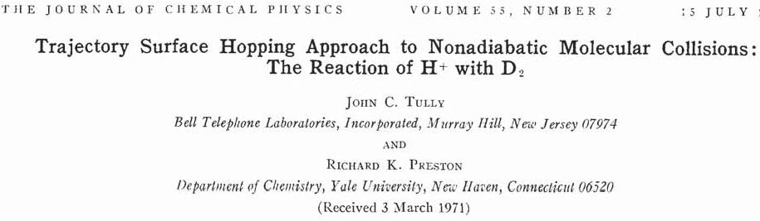

1971
1971 with graduate student Richard Preston
Used Brookhaven National Labs CDC 6600 supercomputer
“It takes a laser physicist to be a farmer” Richard Preston, 2010

Slide 16
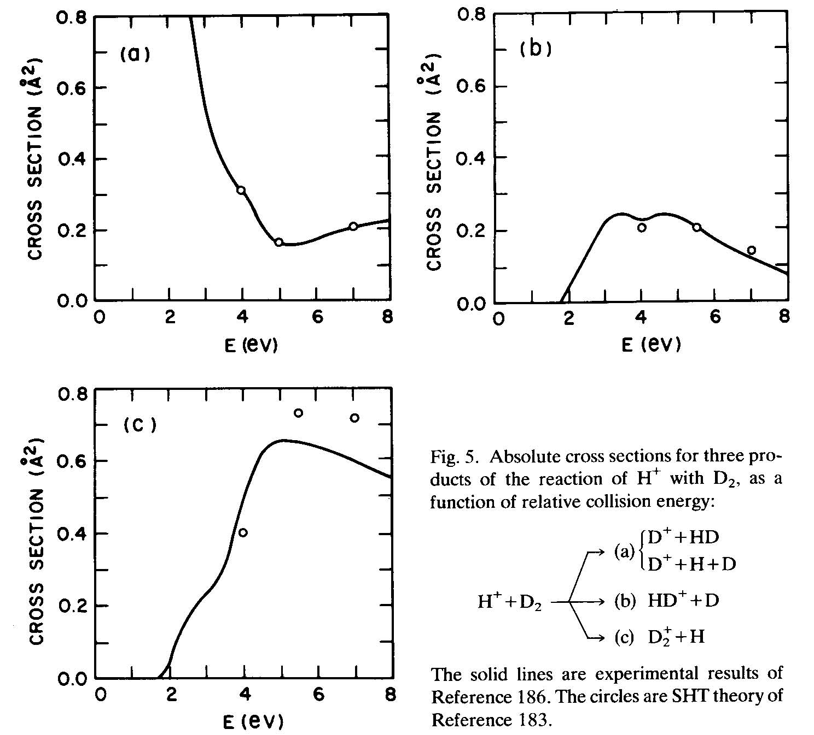
D⁺ + HD
HD⁺ + D
Absolute cross sections for
the reaction of H⁺ with D₂
as a function of incident energy
Points: surface hopping,
Tully - Preston, 1971
Solid curves: experiment,
Ochs -Teloy, 1974
D₂⁺ + H

Slide 17
Fast Forward to 1990, Bell Labs:
Turning points
No distinct crossing points
Nearly parallel surfaces
Many electronic states
Broad coupling region
R₂(a₀)
Need to go beyond
1971 assumption of hopping
only at crossing points
R₁(a₀)
Nonadabatic coupling vector

Slide 18

H _{q} (t)
drives quantum
transitions
Classical subsystem
Quantum subsystem

Slide 19
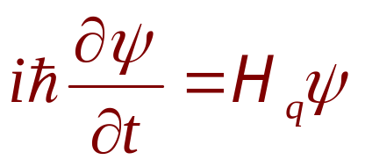
H _{q} (t)
drives quantum
transitions
Classical subsystem
Quantum subsystem

Slide 20
H _{q} (t)
drives quantum
transitions
Classical subsystem
Quantum subsystem
Key: quantum force: “back-reaction”
How do quantum transitions effect classical path?

Slide 21
H _{q} (t)
drives quantum
transitions
Classical subsystem
Quantum subsystem
Key: quantum force: “back-reaction”
How do quantum transitions effect classical path?
How can we treat back-reaction more accurately, and yet retain the feature that trajectories end up in distinct states rather than mixtures?

Slide 22
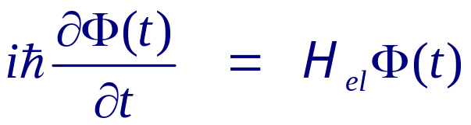
Surface Hopping (1990 Version)
1]
, i.e., motion on a single adiabatic p.e.s.
2] Quantum amplitudes along path:
R(t)

Slide 23
Surface Hopping (1990 Version)
1]
, i.e., motion on a single adiabatic p.e.s.
2] Quantum amplitudes along path:
3] Stochastic “hops” between states so that avg probability = |c_{k}(t)|²
“fewest switches”

Slide 24
Stochastic Fewest Switches algorithm (2-state):
|c₂|² = 0.8 |c₂|² = 0.7
8
?
7
2
3
t_{k} t_{k+1}

Slide 25
Stochastic Fewest Switches algorithm (2-state):
|c₂|² = 0.8 |c₂|² = 0.7
8
7
2
3
t_{k} t_{k+1}

Slide 26
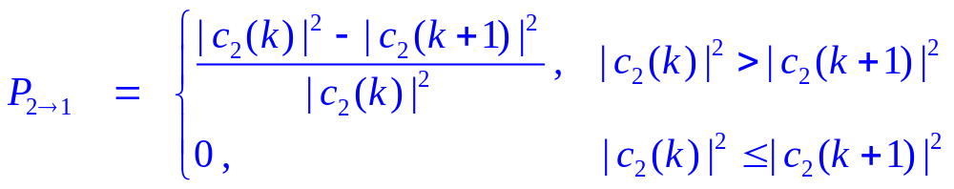
Stochastic Fewest Switches algorithm (2-state):
|c₂|² = 0.8 |c₂|² = 0.7
8
7
2
3
t_{k} t_{k+1}

Slide 27
Surface Hopping (1990 Version)
1]
, i.e., motion on a single adiabatic p.e.s.
2] Quantum amplitudes along path:
3] Stochastic “hops” between states so that avg probability = |c_{k}(t)|²
4] Scale momentum in direction of coupling vector to conserve energy
“Pechukas Force”

Slide 28
Surface Hopping (1990 Version)
1]
, i.e., motion on a single adiabatic p.e.s.
2] Quantum amplitudes along path:
3] Stochastic “hops” between states so that avg probability = |c_{k}(t)|²
4] Scale momentum in direction of coupling vector to conserve energy
5] Include decoherence

Slide 29
Decoherence

Slide 30
Decoherence

Slide 31
Decoherence

Slide 32
Decoherence

Slide 33
Decoherence

Slide 34
Surface Hopping (1990 Version)
1]
, i.e., motion on a single adiabatic p.e.s.
2] Quantum amplitudes along path:
3] Stochastic “hops” between states so that avg probability = |c_{k}(t)|²
4] Scale momentum in direction of coupling vector to conserve energy
5] Include decoherence
6] Frustrated Hops
Algorithm calls for a hop but there is insufficient energy in the degree
of freedom in the direction of the nonadiabatic coupling vector

Slide 35
Frustrated Hops
Algorithm calls for a hop but there is insufficient energy in the degree
of freedom in the direction of the nonadiabatic coupling vector
E*
?
E*
= kinetic energy in direction of the
nonadiabatic coupling vector
probability on state k = |c_{k}|²
Critical element of Surface Hopping: Branching probabilities are
determined not by |c_{k}|², but by the fraction of trajectories on each state.

Slide 36

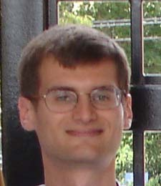
Frustrated Hops and Detailed Balance
Detailed Balance:
N₁ P_{12} = N₂ P_{21}
Priya Parandekar
 Equilibrium
Multiple Transitions
Relaxation Processes
J. R. Schmidt
hν
Infrequent events
Condensed Phases
e.g., nonradiative transition
vs. reaction on excited state
Long Timescales

Slide 37
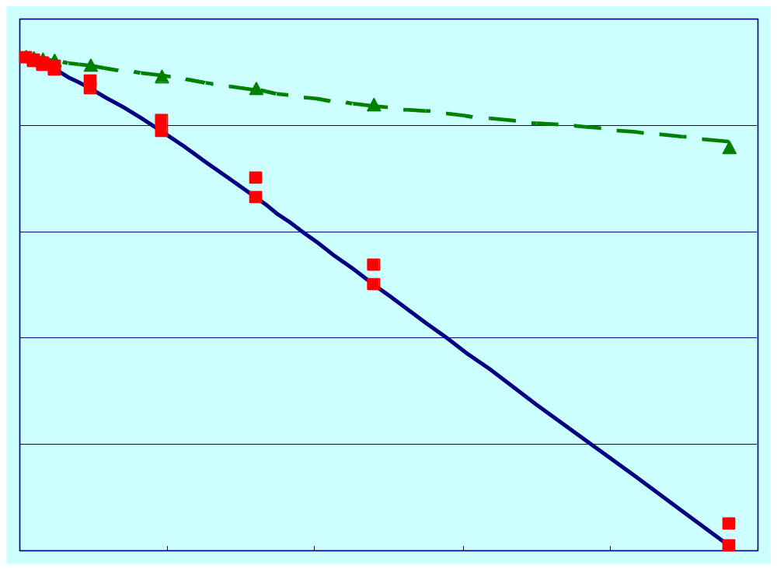
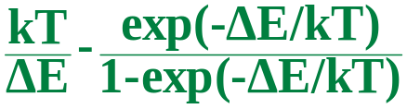
2-Electronic State Model ΔE = 34.6 kJ/mole
Excited State Population vs. Inverse Temperature
0
-2
-4
-6
-8
-10
log_{e}(0.5)
Ehrenfest
Surface Hopping
log_{e}(population)
Boltzmann
0 0.001 0.002
1/T (K)

Slide 38
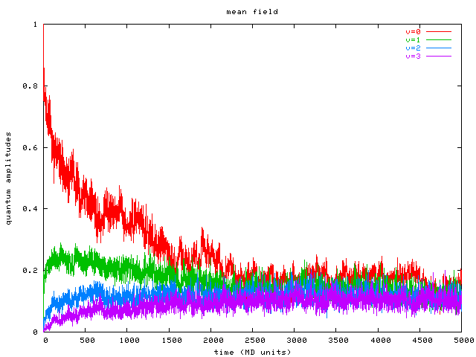
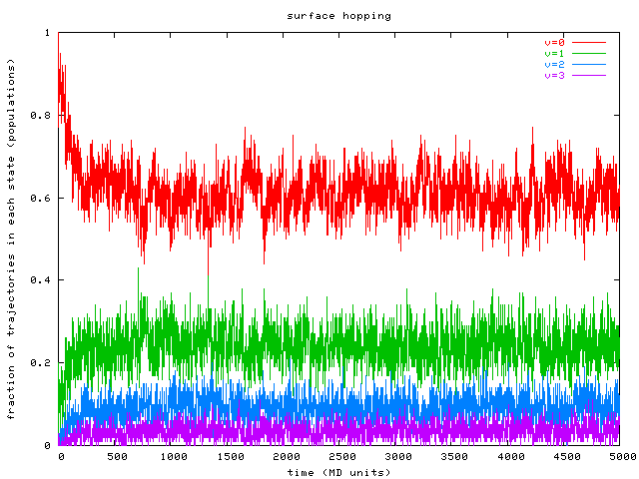
Many Quantum States
2005 Priya Parandekar
[classical bath] --- C --- C --- C --- C --- C --- C --- C --- C --- H
Random force and friction
(5000 ºK)
classical
(Morse)
quantum
(Morse)
Ehrenfest (SCF) Surface Hopping
V=0
V=1
V=2
V=3
time
time

Slide 39
Surface Hopping (1990 Version)
1]
, i.e., motion on a single adiabatic p.e.s.
2] Quantum amplitudes along path:
3] Stochastic “hops” between states so that avg probability = |c_{k}(t)|²
4] Scale momentum in direction of coupling vector to conserve energy
5] Include decoherence
6] Frustrated Hops
Algorithm calls for a hop but there is insufficient energy in the degree
of freedom in the direction of the nonadiabatic coupling vector

Slide 40
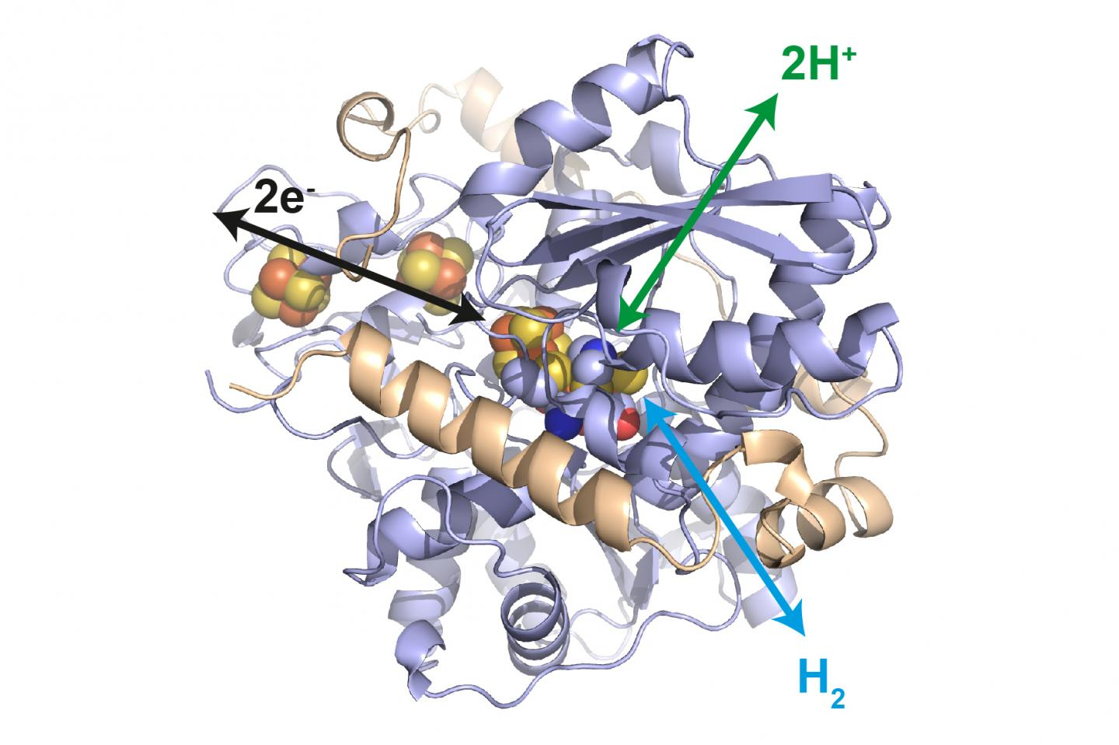
Treat Nuclear Motion by Quantum Mechanics:
tunneling
zero-point motion
quantized energy levels
Prohibitive for large number of nuclei
Compromise strategy: a few quantum nuclei, the rest classical

Slide 41
Treat Nuclear Motion by Quantum Mechanics:
tunneling
zero-point motion
quantized energy levels
Prohibitive for large number of nuclei
Compromise strategy: a few quantum nuclei, the rest classical
However:
justification of the
Born-Oppenheimer
approximation ???

Slide 42
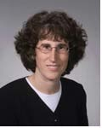
Mixed Quantum-Classical Nuclear Motion
Sharon Hammes-Schiffer and JCT, J. Chem. Phys. 101, 4657 (1994)
Quantum Effects:
Zero-Point Energy
Quantized Energy Levels
Tunneling

Slide 43
Mixed Quantum-Classical Nuclear Motion
Sharon Hammes-Schiffer and JCT, J. Chem. Phys. 101, 4657 (1994)
Quantum Effects:
Zero-Point Energy
Quantized Energy Levels
Tunneling

Slide 44
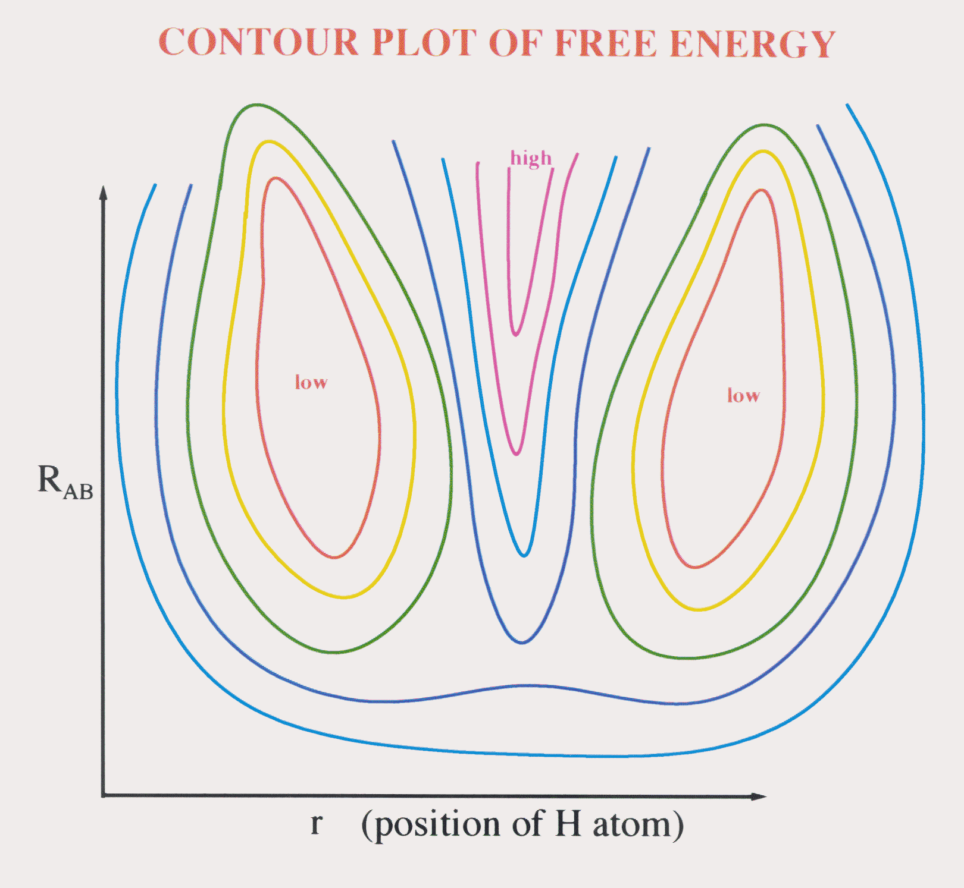

Slide 45
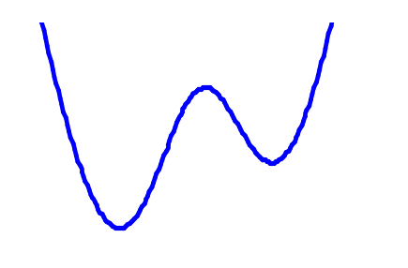
Adiabatic vs. Nonadiabatic (Sharon Hammes-Schiffer, JCT)

Slide 46
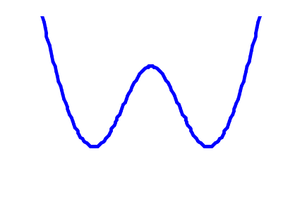
Adiabatic vs. Nonadiabatic (Sharon Hammes-Schiffer, JCT)
Solvent
Fluctuation

Slide 47
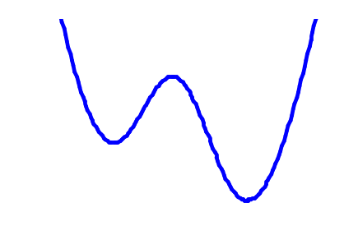
Adiabatic vs. Nonadiabatic (Sharon Hammes-Schiffer, JCT)
Solvent
Fluctuation
Solvent
Fluctuation
Adiabatic  Reaction

Slide 48
Adiabatic vs. Nonadiabatic (Sharon Hammes-Schiffer, JCT)
switch
states
tunneling splitting
Adiabatic  Reaction

Slide 49
Adiabatic vs. Nonadiabatic (Sharon Hammes-Schiffer, JCT)
switch
states
Adiabatic  Reaction
Nonadiabatic  No Reaction

Slide 50
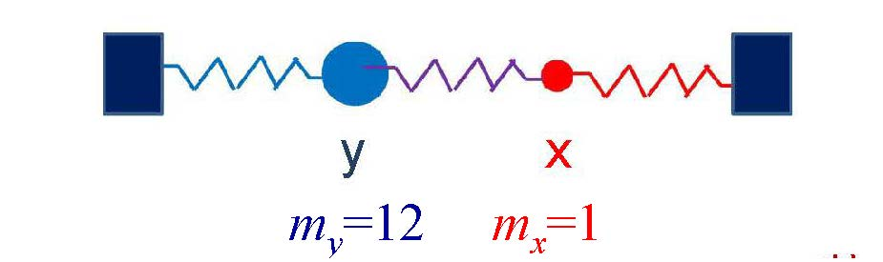
Mixed Quantum-Classical Nuclear Motion
Vibrational Spectra ? JCT, J. Chem. Phys. 2023
Simple 2 atom linear model
Compute spectra by Fourier Transform
of Dipole Moment Correlation Function

Slide 51
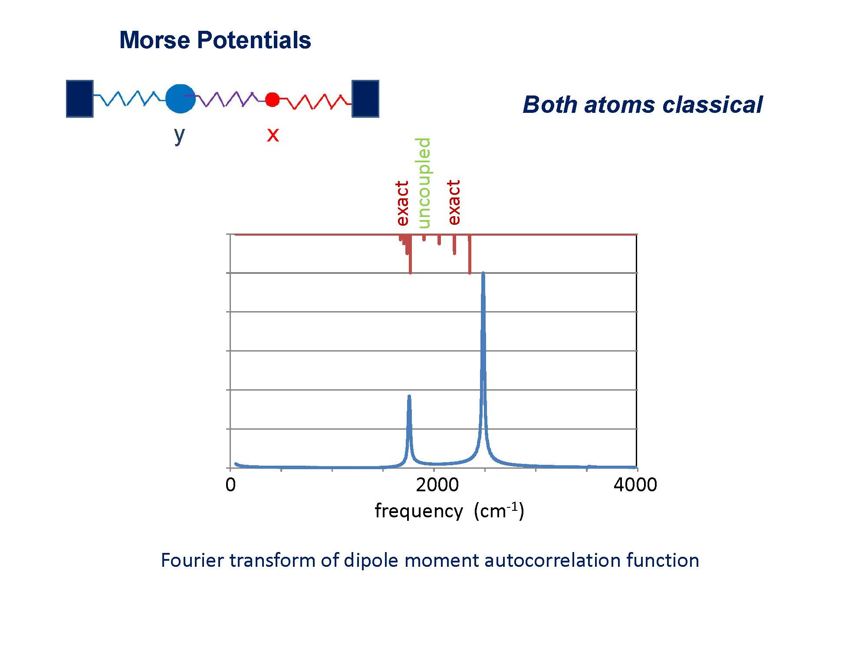
m_{y}=12 m_{x}=1

Slide 52
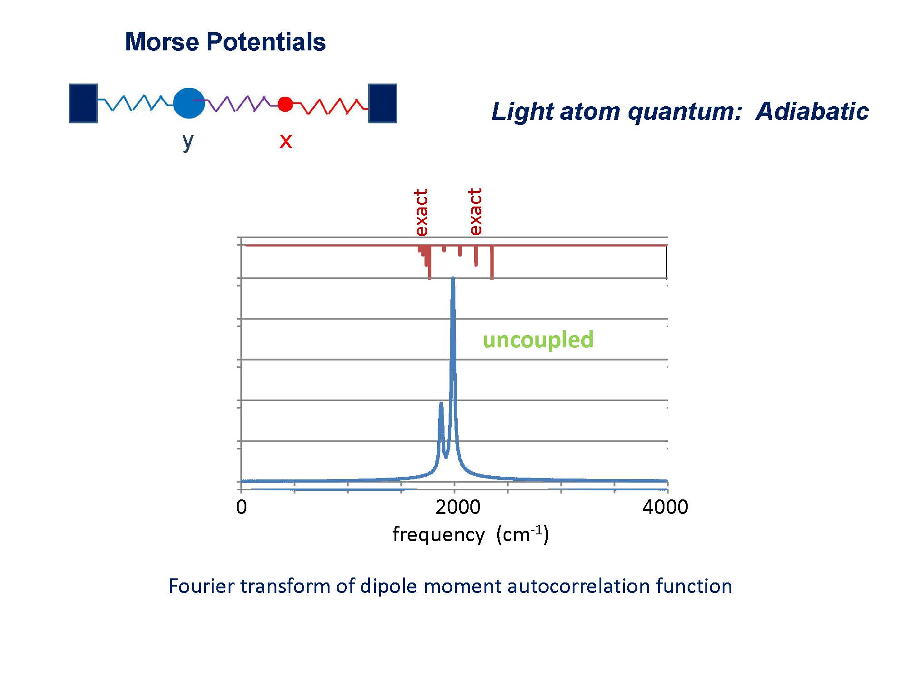
m_{y}=12 m_{x}=1

Slide 53
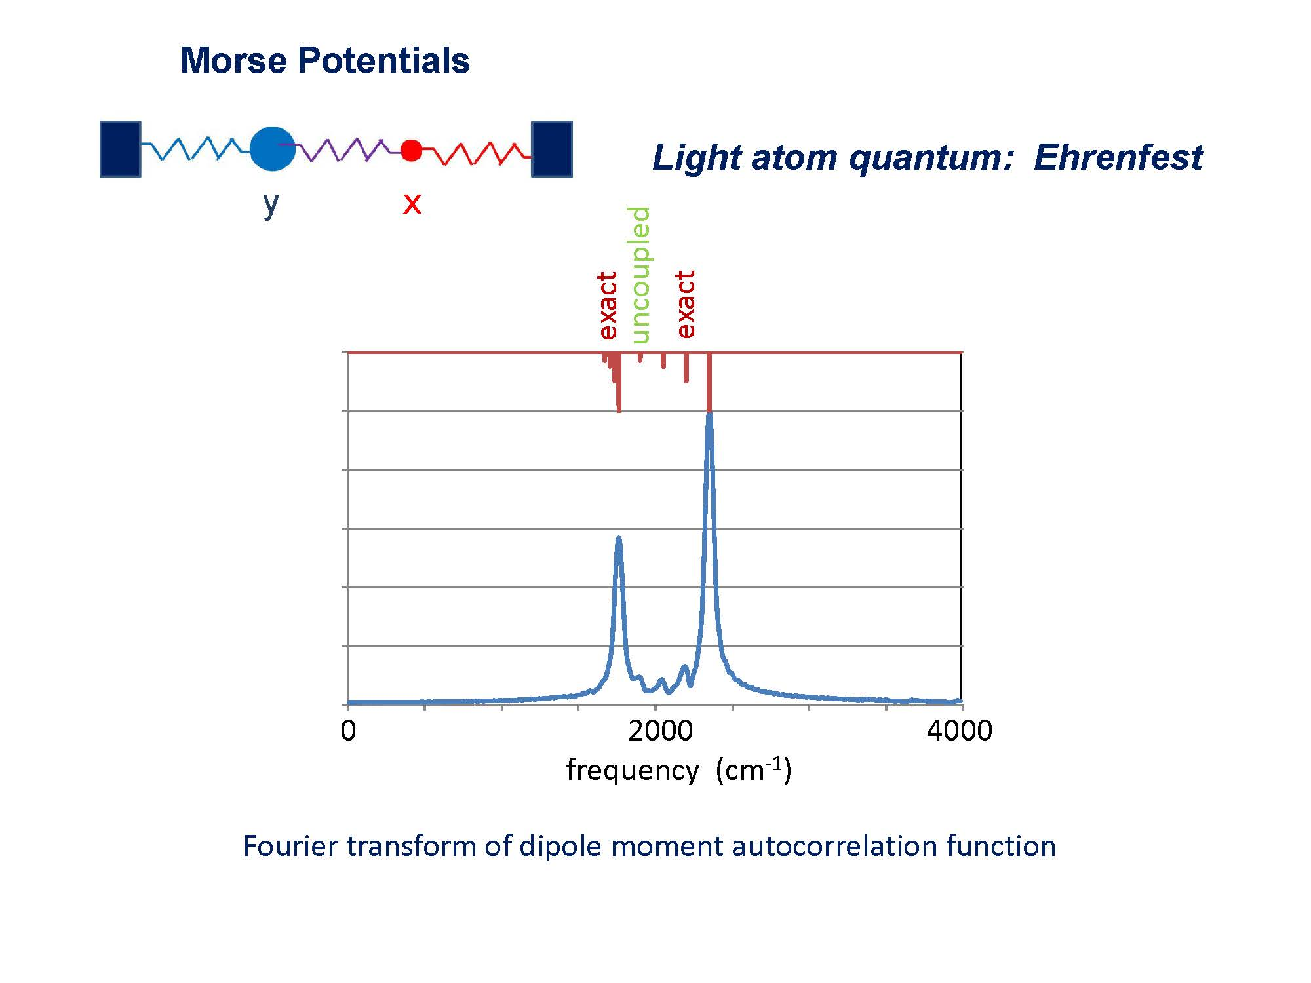
m_{y}=12 m_{x}=1

Slide 54
Conclusions about treating some nuclei quantum, others classical
Requires nonadiabaticity to achieve coupled motions
(e.g., normal modes)
True also for electron-nuclear coupled motion, but less
dramatic because of mass disparities
3. Ehrenfest incorporates coupled motion
4. Surface Hopping is problematical

Slide 55
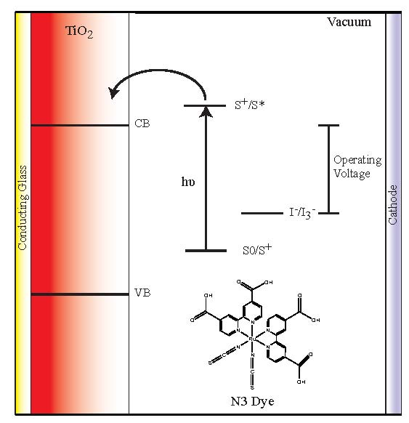
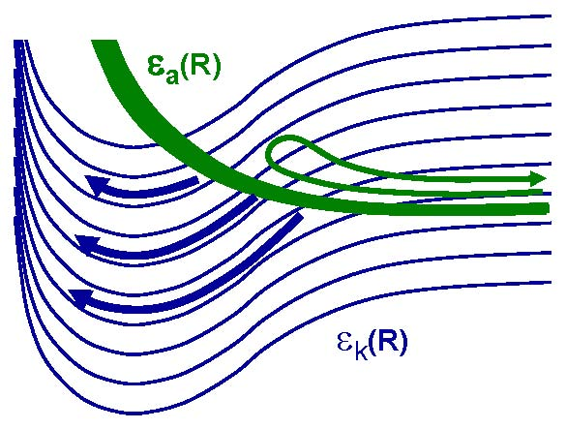
electronic continuum ?
ionization metals semiconductors

Slide 56
electronic continuum ?
ionization metals semiconductors

Slide 57

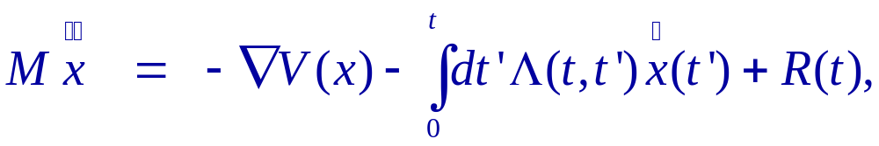
Nonadiabatic dissipation at metal surfaces
Weak Coupling Approx to Ehrenfest:
Molecular Dynamics with Electronic
Friction, Martin Head-Gordon, JCT,
J. Chem. Phys. 103, 10137 (1995)
friction kernal
fluctuating force

Slide 58
VIBRATIONAL LIFETIME: CO on Cu(100) (ps.)
MODE EXPERIMENT CALC (0K) CALC(0K)
(Phonons) (Electrons)
C – O 2.5 +/- 0.5 >100000 3.3 +/- 0.5
stretch (A. Harris et al.)

Slide 59
VIBRATIONAL LIFETIME: CO on Cu(100) (ps.)
MODE EXPERIMENT CALC (0K) CALC(0K)
(Phonons) (Electrons)
C – O 2.5 +/- 0.5 >100000 3.3 +/- 0.5
stretch (A. Harris et al.)
E_{vac}
E_{F}
π*
B. N. J. Persson and M. Persson, (1980)

Slide 60
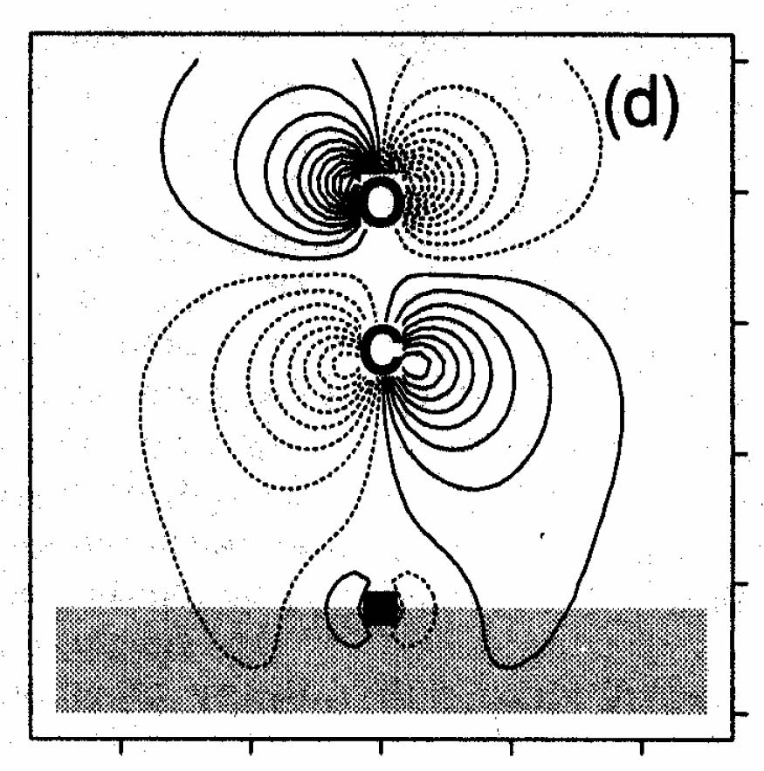
dΨ_{HOMO}/dR
( C -- O Stretch )

Slide 61
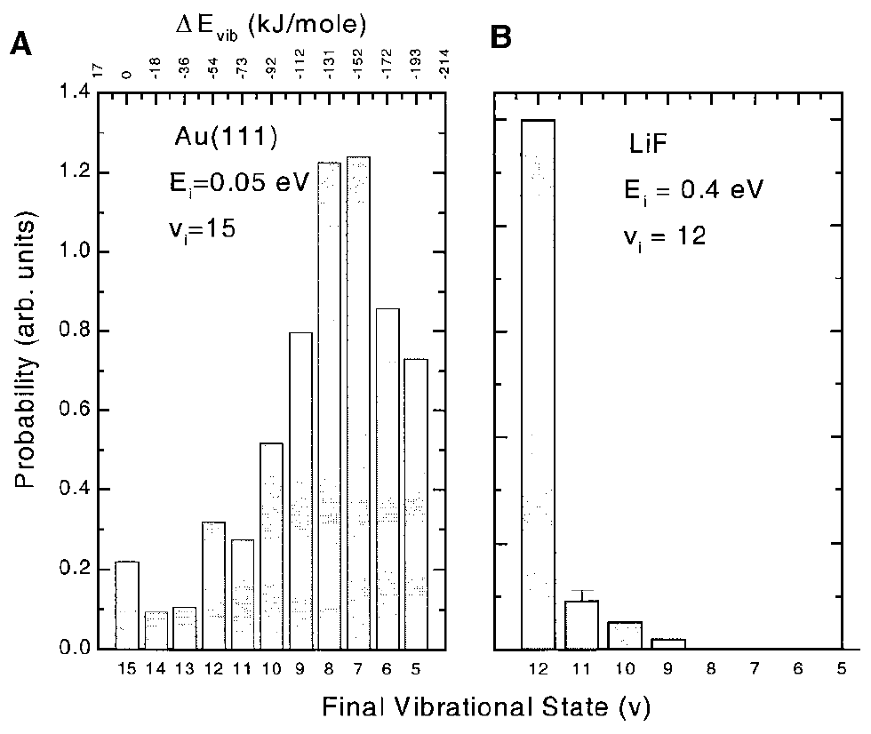
Scattering of vibrationally excited NO from Au(111)
electron transfer: strong coupling
Probability
Final Vibrational State
Huang, Rettner, Auerbach, Wodtke,Science 2000, 290, 111.

Slide 62

Scattering of vibrationally excited NO from Au(111)
electron transfer: strong coupling
Friction:
Weak Coupling:
Electronic Friction
cannot account for
the observed huge
energy transfer
Probability
Final Vibrational State
Friction: from my memory !

Slide 63
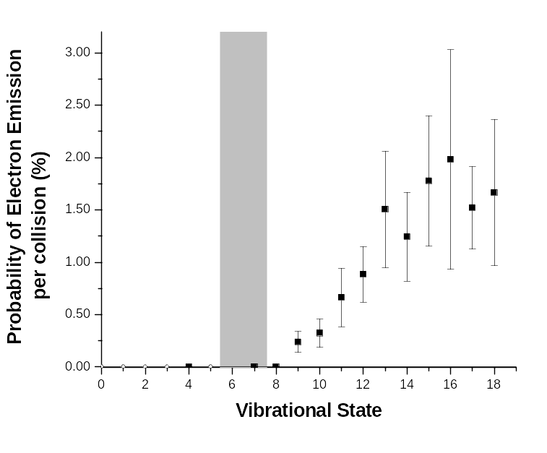
Electron Emission:
 inadequacy of electronic friction model
Φ
Friction:
Weak Coupling:
Electron emission
from Cs covered
Au surface
work
function
White, J. D.; Chen, J.; Auerbach, D. J.; Wodtke, A. M. Nature 2005, 433, 503.

Slide 64
Electronic excitations at metal surfaces?
Inelastic Electron Scattering Picture:
a. Non-Resonant  friction model
e⁻

Slide 65
Electronic excitations at metal surfaces?
Inelastic Electron Scattering Picture:
b. Resonant  transient negative ion
NO⁻
e⁻
NO

Slide 66
Electronic excitations at metal surfaces?
Inelastic Electron Scattering Picture:
b. Resonant  transient negative ion
NO⁻
e⁻
NO
Franck-Condon picture (J. W. Gadzuk)

Slide 67
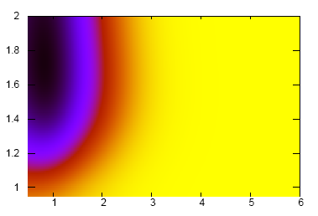

NO approaching a three-fold site on Au(111)
Ground state charge on NO
DFT (VASP, PW91)
ν = 15
r (Å)
ν = 0
z (Å)

Slide 68
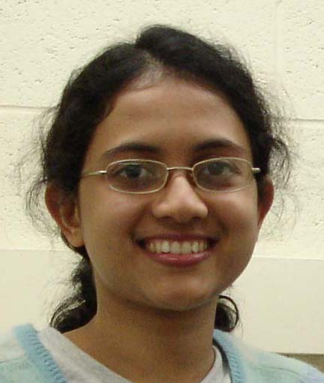
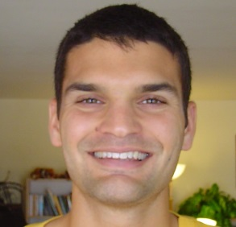
Scattering of Nitric Oxide from a Metal Surface (Gold)
1. Calculations of potential energy surfaces and
nonadiabatic couplings?
2. Propagation of surface hopping trajectories?
Newns-Anderson Hamiltonian
Independent Electron Surface Hopping (IESH)
coupling
NO⁻ + surface⁺
Sharani Roy
NO + surface
ground state
Neil Shenvi

Slide 69
1. Map onto Anderson-Newns (tight binding) picture:
diagonalize
occupy many
orbitals
1-el diabatic orbitals
1-el adiabatic orbitals
many-el product wave fn.
1 + 60
61

Slide 70
1. Map onto Anderson-Newns (tight binding) picture:
diagonalize
occupy many
orbitals
1-el diabatic orbitals
1-el adiabatic orbitals
many-el product wave fn.
1 + 60
61
30 electrons → ~ 10¹⁷ states

Slide 71
1. Map onto Anderson-Newns picture:
diagonalize
occupy many
orbitals
1-el diabatic orbitals
1-el adiabatic orbitals
many-el product wave fn.
2. Evolve many-electron wave function along trajectory:
initial many
-electron wave fn
(eg, ground state)
each orbital evolves into
linear combination of
adiabatic orbitals
many-el wave fn at
any time is a specific
occupation of these
evolving mixed orbitals

Slide 72
1. Map onto Anderson-Newns picture:
diagonalize
occupy many
orbitals
1-el diabatic orbitals
1-el adiabatic orbitals
many-el product wave fn.
2. Evolve many-electron wave function along trajectory:
initial many
-electron wave fn
(eg, ground state)
each orbital evolves into
linear combination of
adiabatic orbitals
many-el wave fn at
any time is a specific
occupation of these
evolving mixed orbitals
3. Fewest Switches Surface Hop among adiabatic orbitals
each electron independently

Slide 73
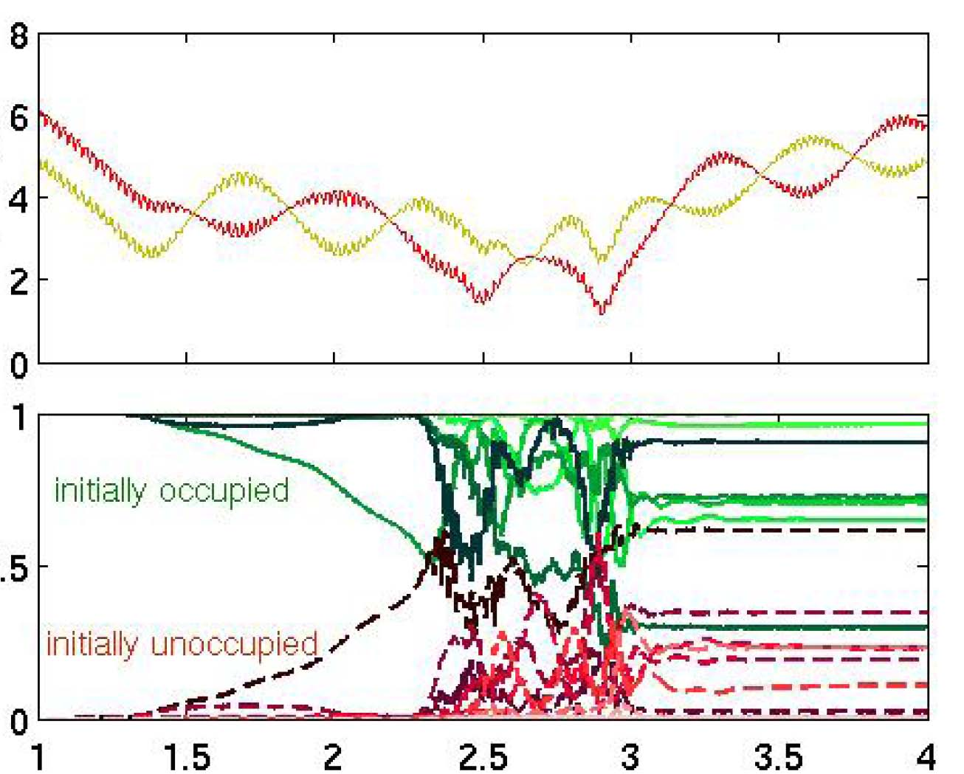
NO(v=15) scattered from Au(111) (surface hopping trajectory)
132 moving Au atoms, accurate phonon
spectrum, periodic boundaries, etc.
z (A)
~ 100 surface
hops typically
encountered
orbital occupation
time (ps)

Slide 74
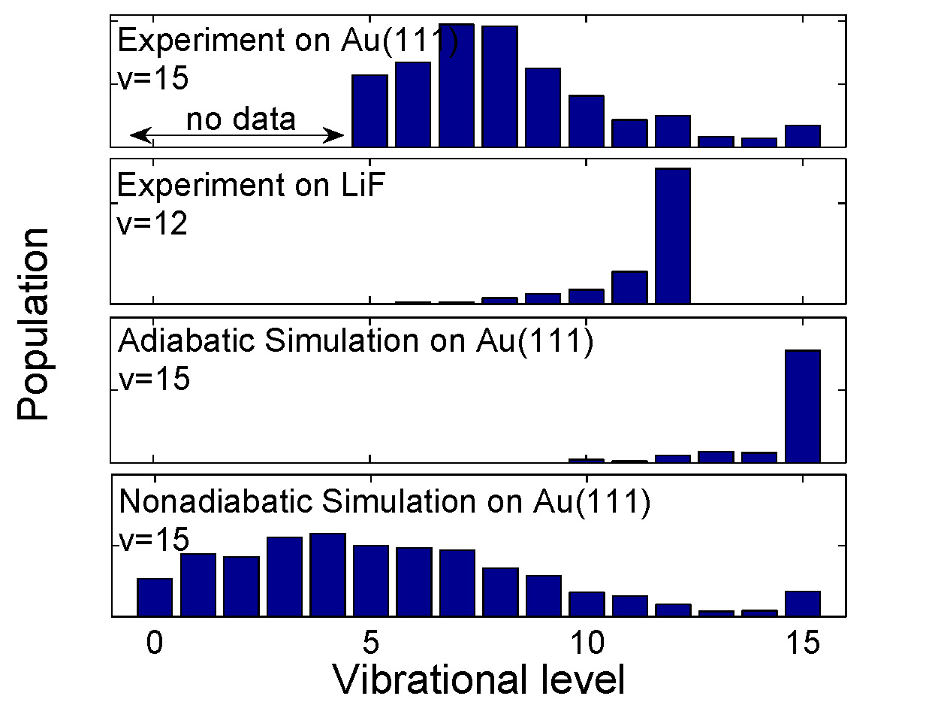
Sharani Roy
Neil Shenvi
Expts: Huang, Rettner, Auerbach, Wodtke, Science 2000, 290, 111.

Slide 75
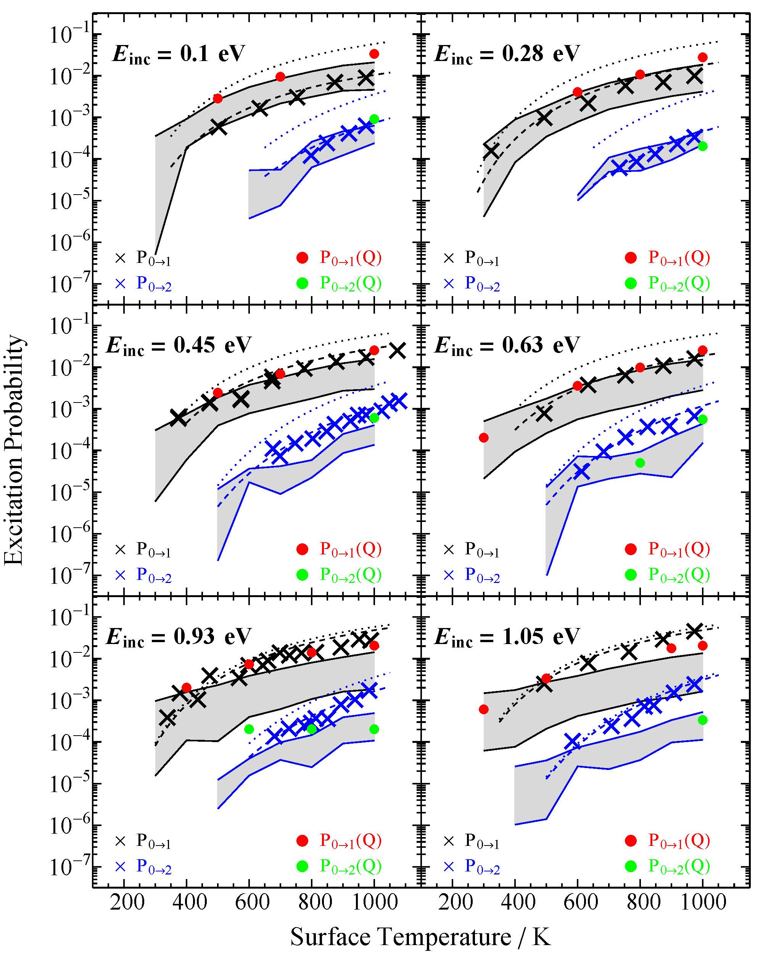
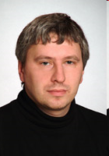
NO(v=0) scattered
from Au(111)
xxxx P₀ ₁
xxxx P₀ ₂
Sascha
Kandratsenka

Slide 76
Translational and Angular Momentum Conservation ?
t₀
φ₁
t₀ + δt
φ₂
- +
φ₁ – φ₂
moving nucleus but
stationary electron
φ (z)
φ
(z) exp( i k_{e} z)

Slide 77
Translational and Angular Momentum Conservation ?
Direct Dynamics in Cartesian coordinates:
E_{trans} and J are not conserved
This is true for all nonadiabatic (Cartesian) direct dynamics methods that are based on separation of “fast” and “slow” particles, where energies and couplings of the fast particles are computed at fixed positions of the slow particles, and motion of the slow coordinates is governed by nonadiabatic coupling.
Examples:
Ehrenfest (mean field)
Surface Hopping
Exact Factorization
Nonadiabatic wave packet evolution

Slide 78
Translational and Angular Momentum Conservation ?
Some Strategies:
Electron translational factors (Subotnik et al. 2023)
Direct Dynamics with approximations to nonadiabatic couplings
that depend only on internal coordinates
Projection Operator to remove overall translation and rotation from
nonadiabatic couplings (Truhlar et al. 2020)
Fitted potentials and nonadiabatic couplings that depend only on
internal coordinates. e.g., machine learning
φ (z)
φ
(z) exp( i k_{e} z)

Slide 79

VISTA: Virtual International Seminar on Theoretical Advancements
Thanks to Alexey Akimov for inaugurating and leading VISTA:
100 Seminars!!

