Slide 1

Factorized Electron Nuclear Dynamics: Theory Development and Implementation
Julian Stetzler
Advisors: Vitaly Rassolov & Sophya Garashchuk

Slide 2
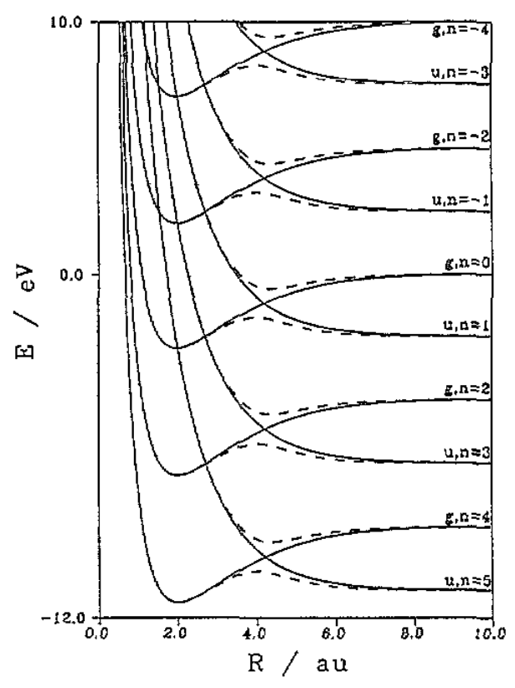
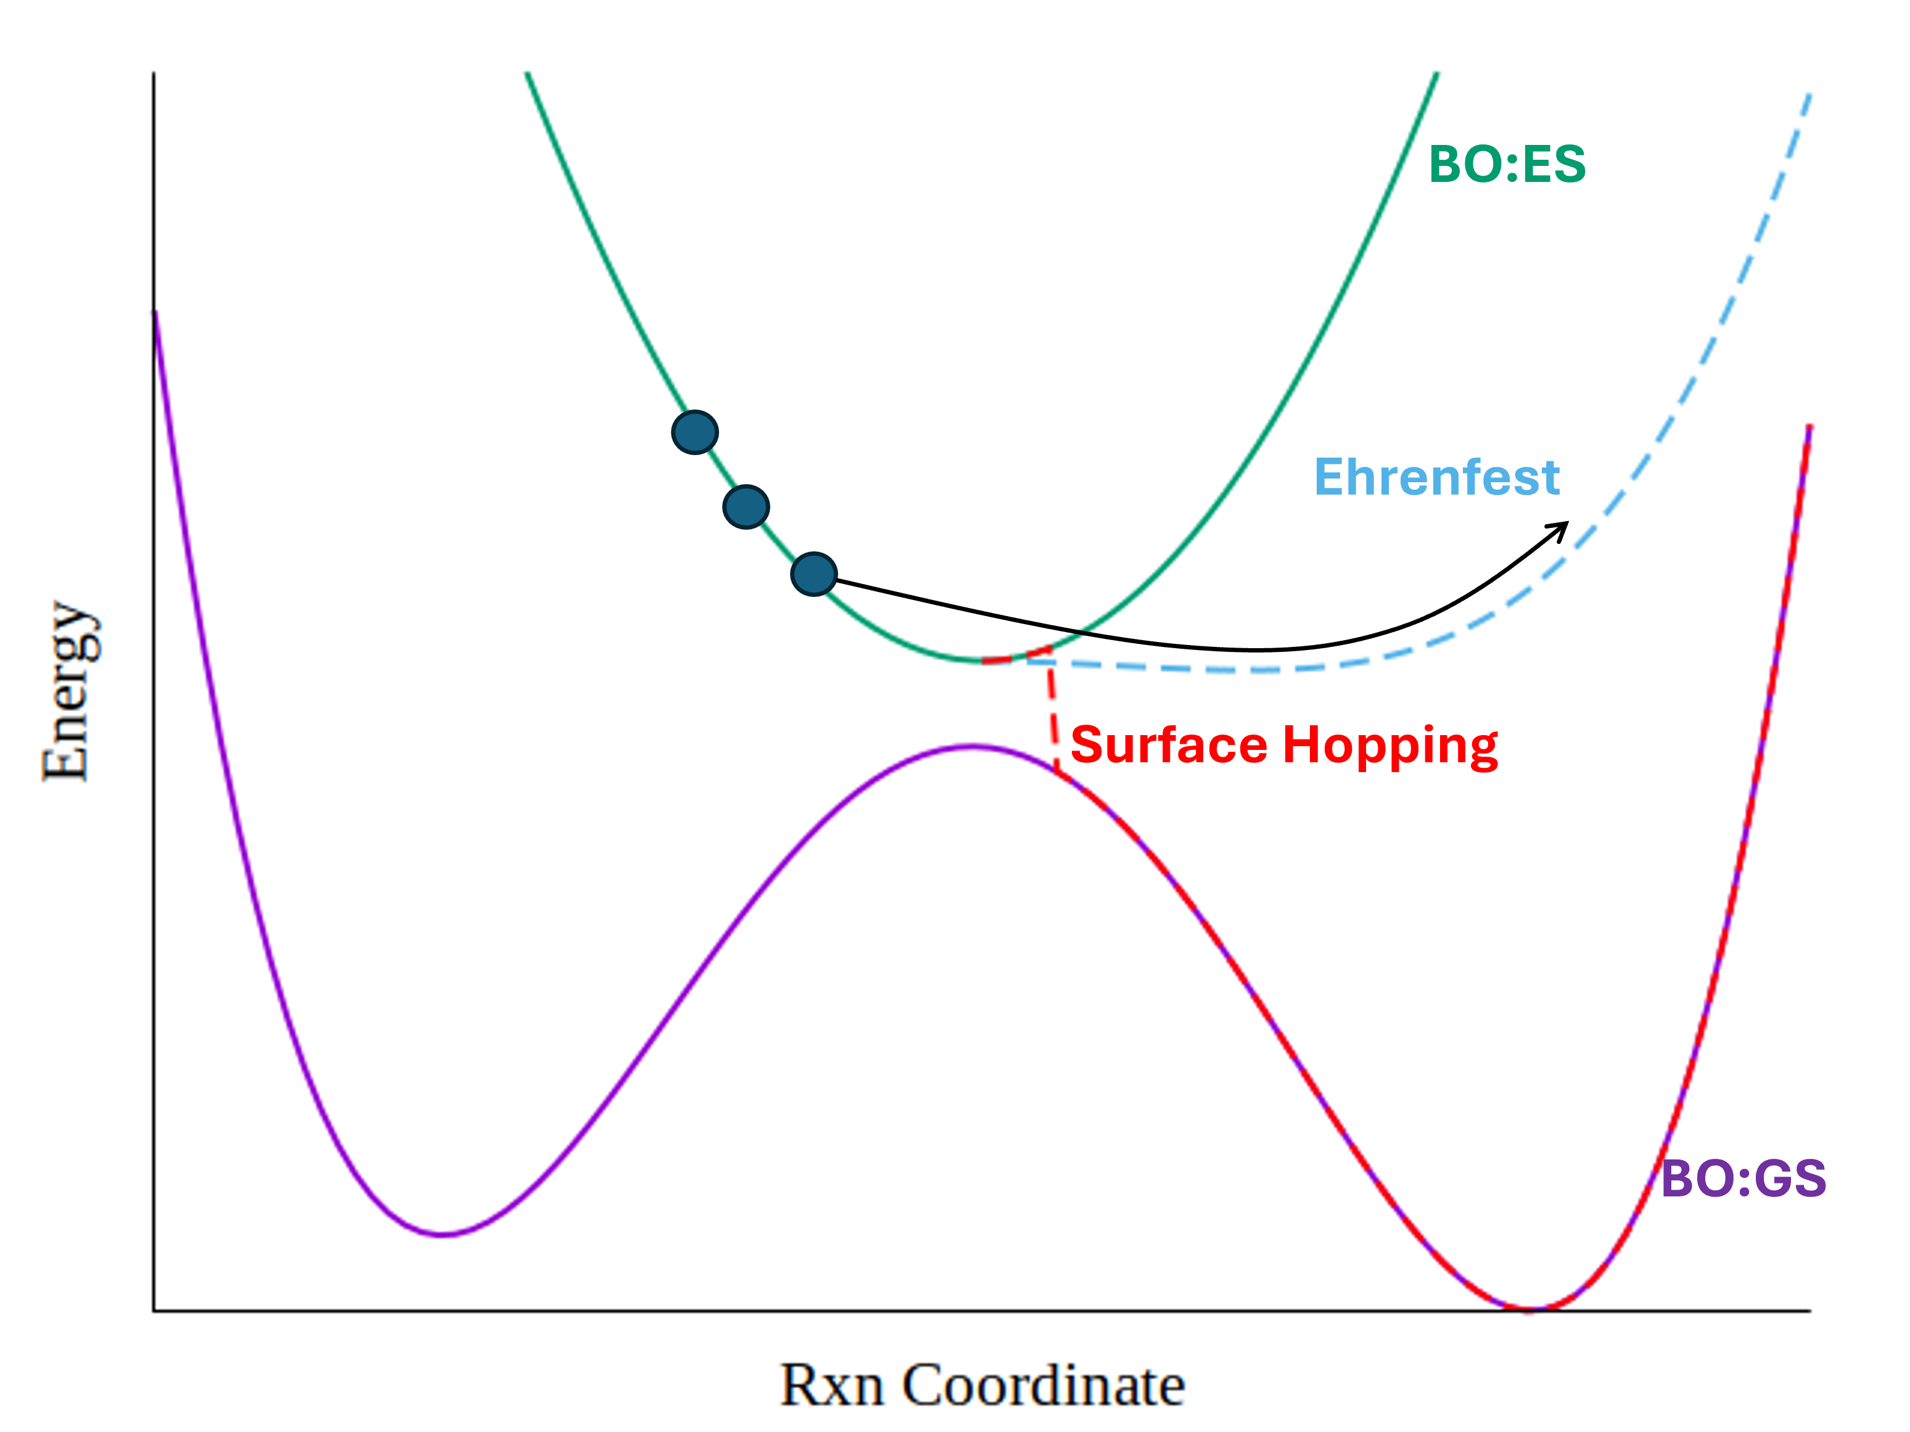
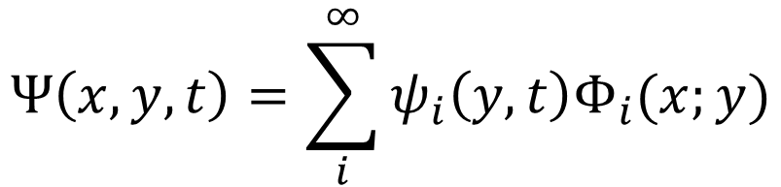
Non-adiabatic dynamics beyond Born-Huang
$$Ψ\left(x,y,t\right)=\sum_{i}^{∞}{ψ_{i}\left(y,t\right)Φ_{i}(x;y)}$$
BH:
Giusti-Suzor, A, et al., B. Dynamics of H2+ in Intense Laser Fields. Journal of Physics B: Atomic, Molecular and Optical Physics 1995, 28, 309

Slide 3
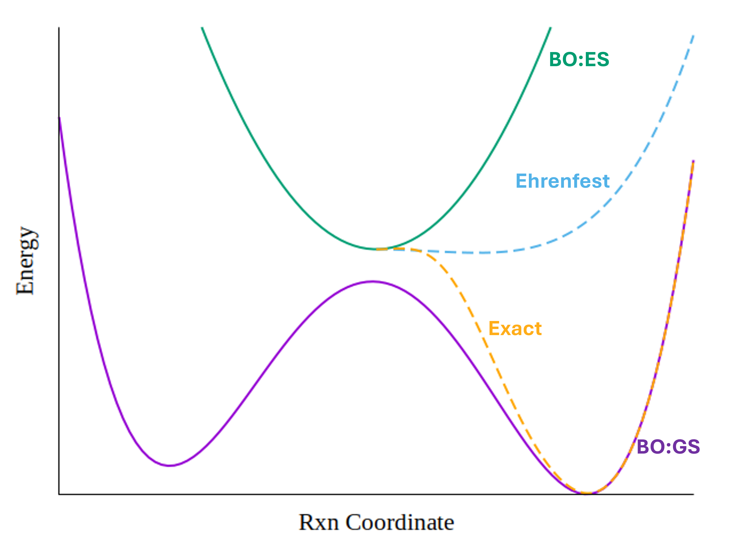

Non-adiabatic dynamics beyond Born-Huang
XF:
$$Ψ\left(x,y,t\right)=ψ\left(y,t\right)Φ(x,y,t)$$
Giusti-Suzor, A, et al., B. Dynamics of H2+ in Intense Laser Fields. Journal of Physics B: Atomic, Molecular and Optical Physics 1995, 28, 309

Slide 4
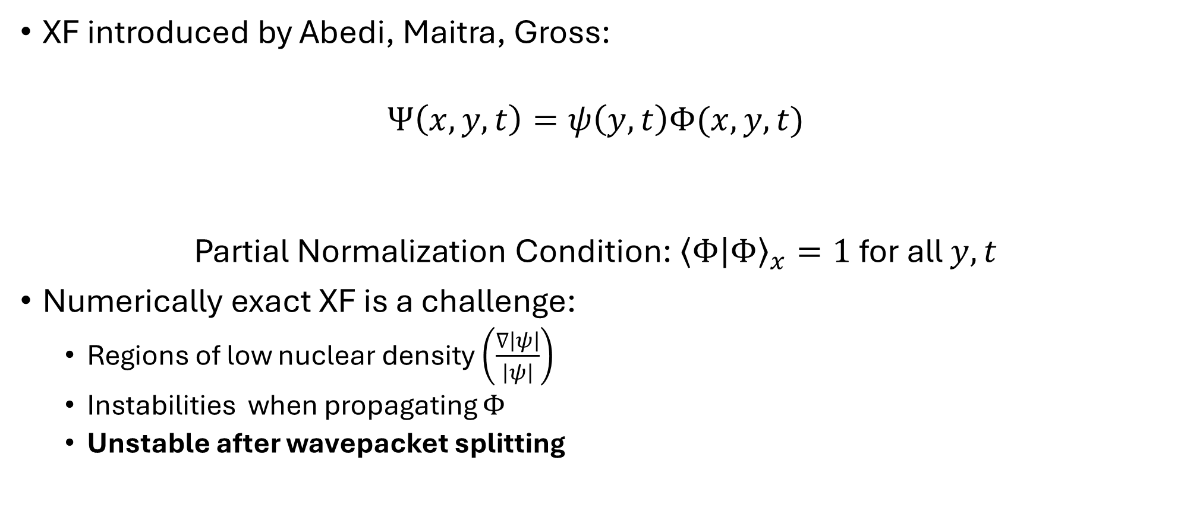

Exact Factorization
XF introduced by Abedi, Maitra, Gross:
$$Ψ\left(x,y,t\right)=ψ\left(y,t\right)Φ(x,y,t)$$
Partial Normalization Condition: ${\left\langle Φ | Φ\right\rangle }_{x}=1$for all $y,t$
Numerically exact XF is a challenge:
Regions of low nuclear density $\left(\frac{∇\left|ψ\right|}{\left|ψ\right|}\right)$
Instabilities when propagating $Φ$
Unstable after wavepacket splitting
Nuclear
Electronic
y
x
Abedi, A, et. al. Phys. Rev. Lett. 2010, 105 (12), 123002.
Gossel, G. H., et. al. J. Chem. Phys. 2019, 150 (15), 154112.

Slide 5


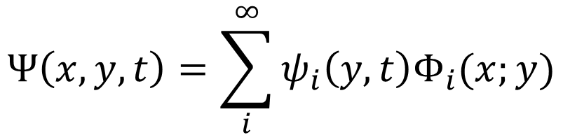


Factorized Electron-Nuclear Dynamics (FENDy): The Vision
Combine quantum trajectory description of nuclei with wave packet description of electrons for scalability to large systems
“optimal grid”
Electronic “wavepackets”
$$ψ\left(y,t\right)=|ψ|e^{iS(y,t)}$$
XF:
$$Ψ\left(x,y,t\right)=ψ\left(y,t\right)Φ(x,y,t)$$
$$p=∇S(y,t)$$
$$Ψ\left(x,y,t\right)=\sum_{i}^{∞}{ψ_{i}\left(y,t\right)Φ_{i}(x;y)}$$
BH:
$$\dot{y}=\frac{p}{M} \dot{p}=−∇(V+U)$$
$$U=−\frac{ℏ^{2}}{2M}\frac{∇^{2}|ψ|}{|ψ|}$$
Electronic functions “riding” nuclear trajectories
S. Garashchuk, J. Stetzler, and V. Rassolov. J. Chem. Theory Comp. 2023 19 (5), 1393-1408

Slide 6
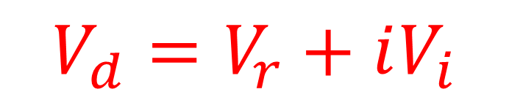



Factorized Electron-Nuclear Dynamics (FENDy) with a Complex Potential
XF ansatz:
Definitions:
$${\hat{D}}_{2}={\hat{K}}_{y}=−\frac{1}{2M }∇_{y}^{2}$$
$$Ψ\left(x,y,t\right)=ψ\left(y,t\right)Φ(x,y,t)$$
FENDy with complex potential:
$${\hat{D}}_{1}=−\frac{1}{M }\frac{∇_{y}ψ}{ψ}∇_{y}$$
$${\hat{K}}_{y}ψ+V_{d}\left(y,t\right)ψ=i∂_{t}ψ$$
$${\hat{H}}_{el}=−\frac{1}{2 }∇_{x}^{2}+V(x,y)$$
$${\hat{H}}_{el}Φ+\left({\hat{D}}_{2}+{\hat{D}}_{1}\right)Φ−V_{d}\left(y,t\right)Φ=i∂_{t}Φ$$
$${\overline{p}}_{Φ}=<Φ|∇_{y}arg⁡(Φ)|Φ>_{x}$$
$V_{d}=V_{r}+iV_{i}$
S. Garashchuk, J. Stetzler, and V. Rassolov. Factorized Electron–Nuclear Dynamics with an Effective Complex Potential , Journal of Chemical Theory and Computation 2023 19 (5), 1393-1408

Slide 7
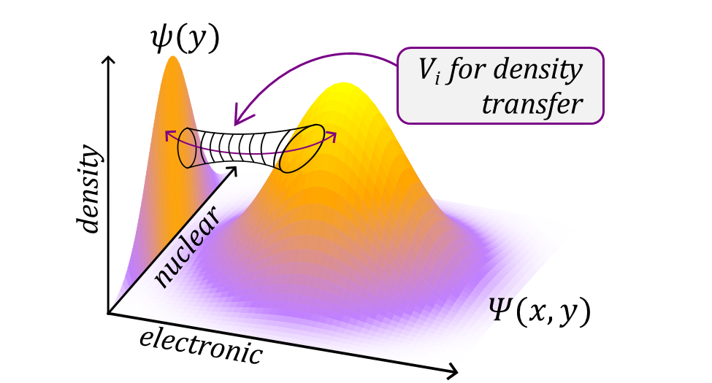
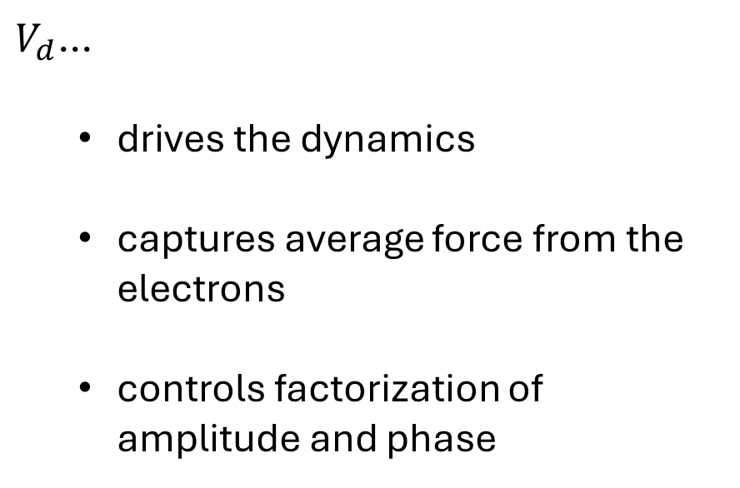
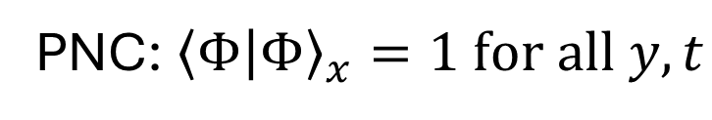
Factorized Electron-Nuclear Dynamics (FENDy) with a Complex Potential
$V_{d}$...
drives the dynamics
captures average force from the electrons
controls factorization of amplitude and phase
PNC: ${\left\langle Φ | Φ\right\rangle }_{x}=1 for all y,t$
S. Garashchuk, J. Stetzler, and V. Rassolov. Factorized Electron–Nuclear Dynamics with an Effective Complex Potential , Journal of Chemical Theory and Computation 2023 19 (5), 1393-1408

Slide 8
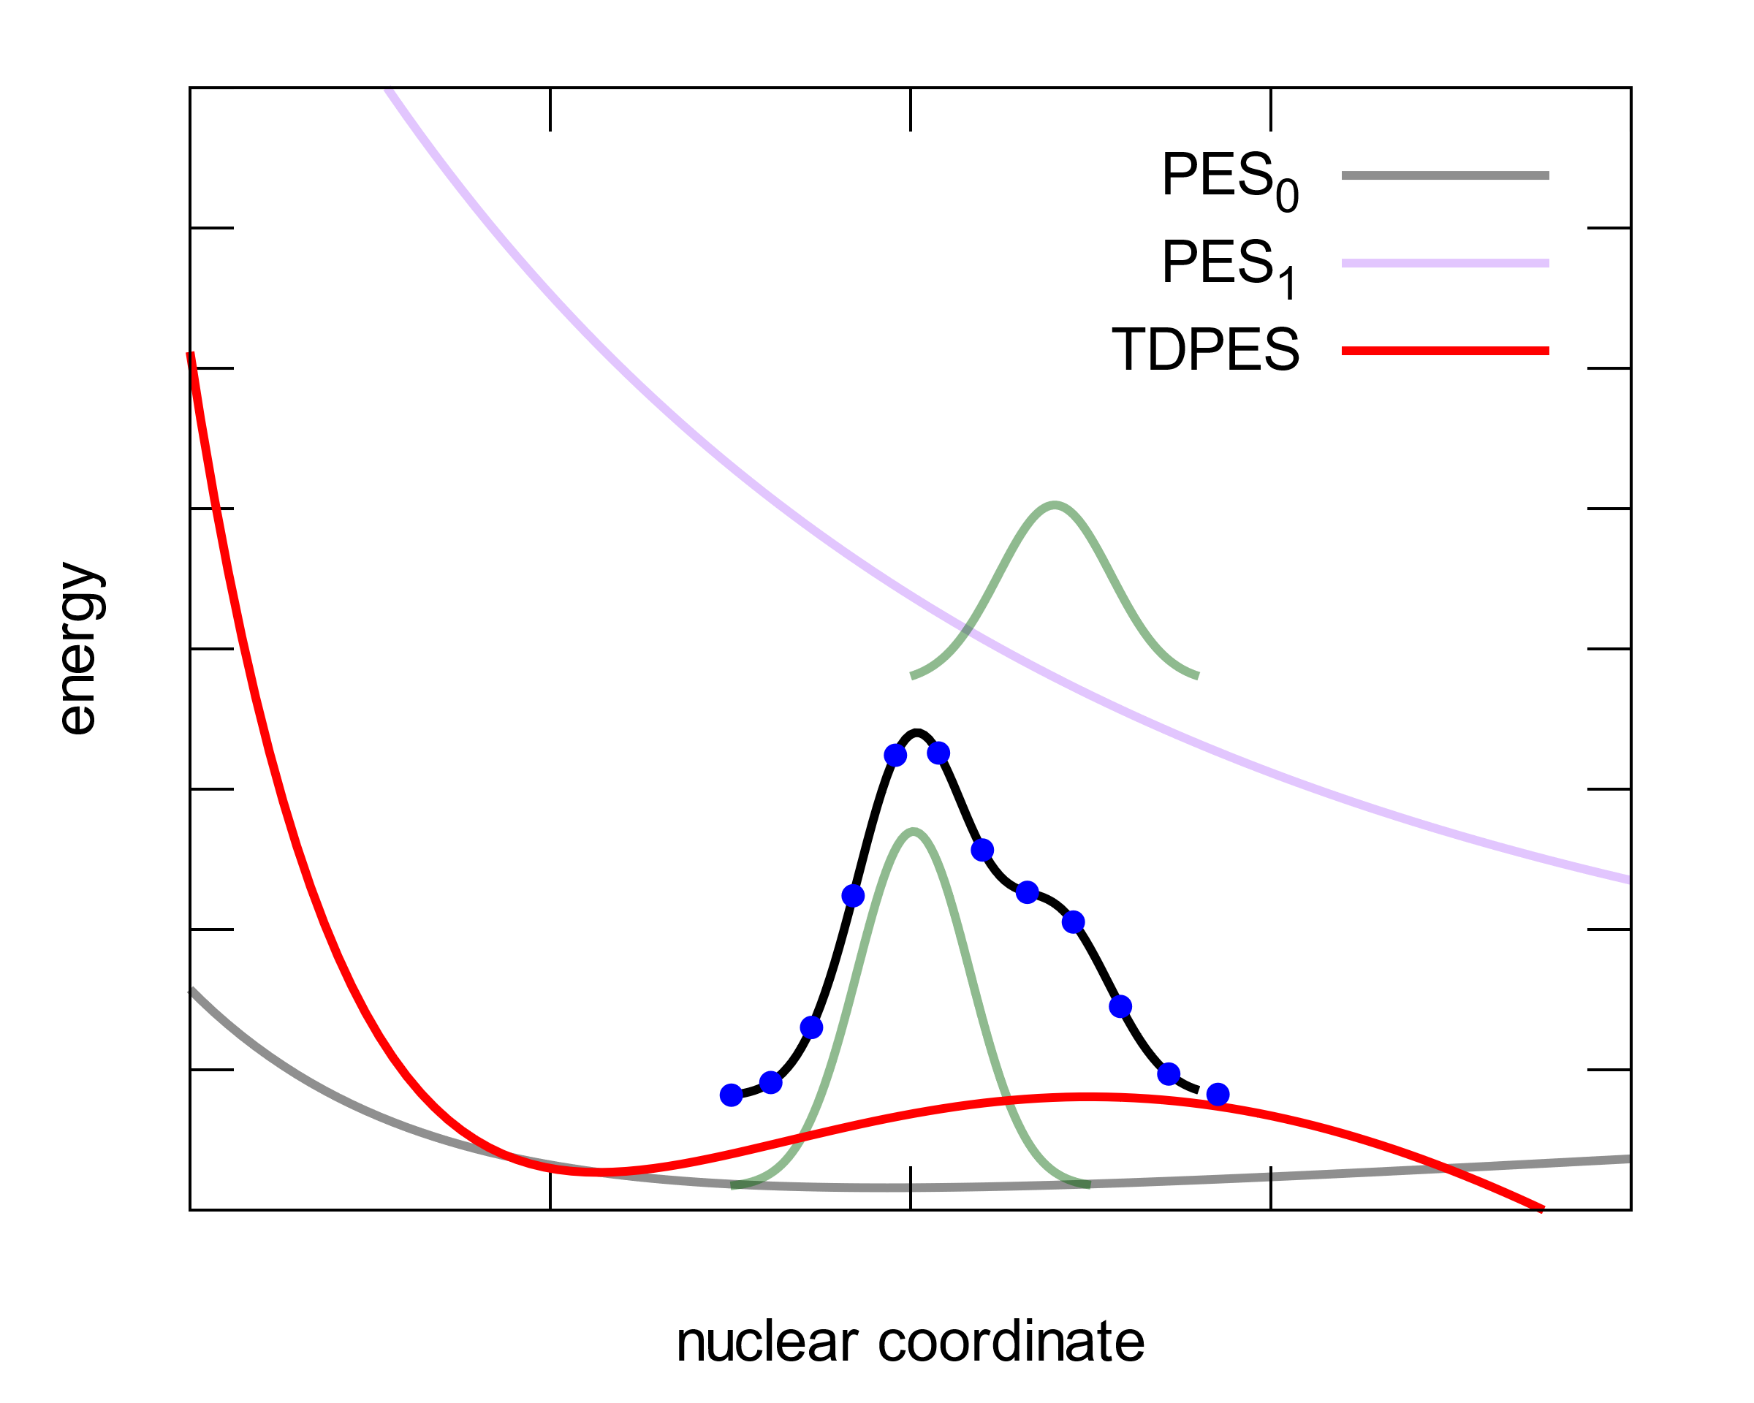



H₂⁺ with FENDy
Let’s put a real electron and simulate photodissociation : H₂⁺ w/ 6-31G basis
Problem: Numerical implementation of FENDy
Several unique conceptual challenges
Derivatives on unstructured grids
PNC
Propagation scheme
$$ψ_{1}$$
quantum trajectories
$$ψ_{FENDy}$$
$$ψ_{0}$$
J. Stetzler, et. al. “Factorized electron-nuclear dynamics with effective complex potential: On-the-fly implementation for H2+ in a laser field” Molecular Physics. doi: 10.1080/00268976.2025.2611404.

Slide 9
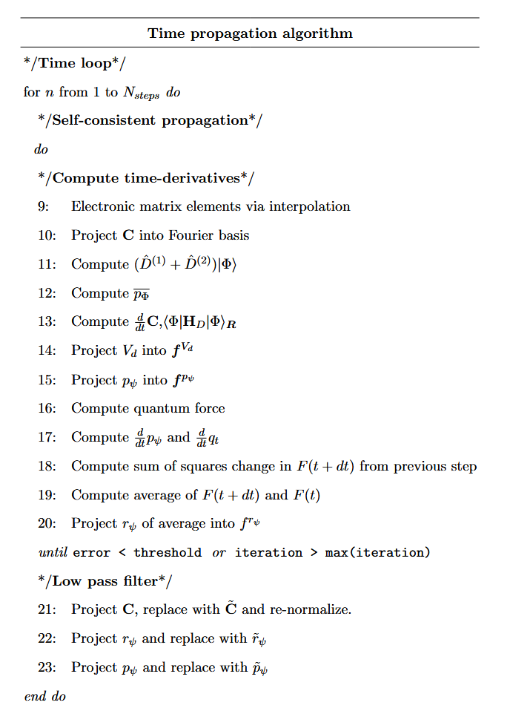
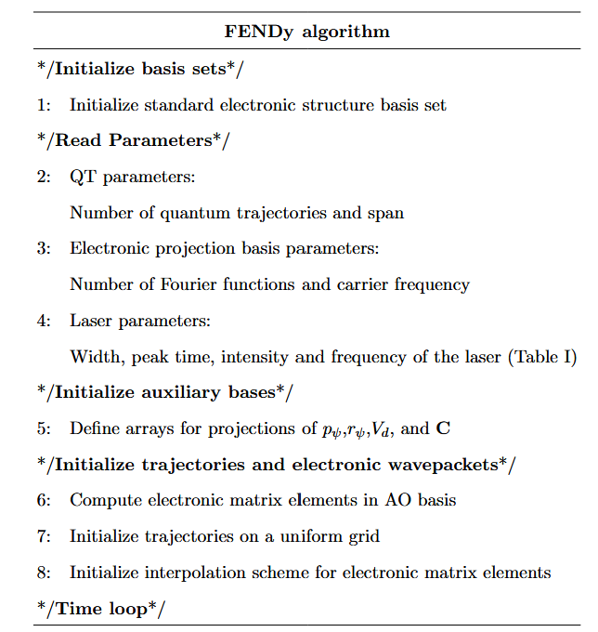
FENDy Algorithm
J. Stetzler, et. al. “Factorized electron-nuclear dynamics with effective complex potential: On-the-fly implementation for H2+ in a laser field” Molecular Physics. doi: 10.1080/00268976.2025.2611404.

Slide 10
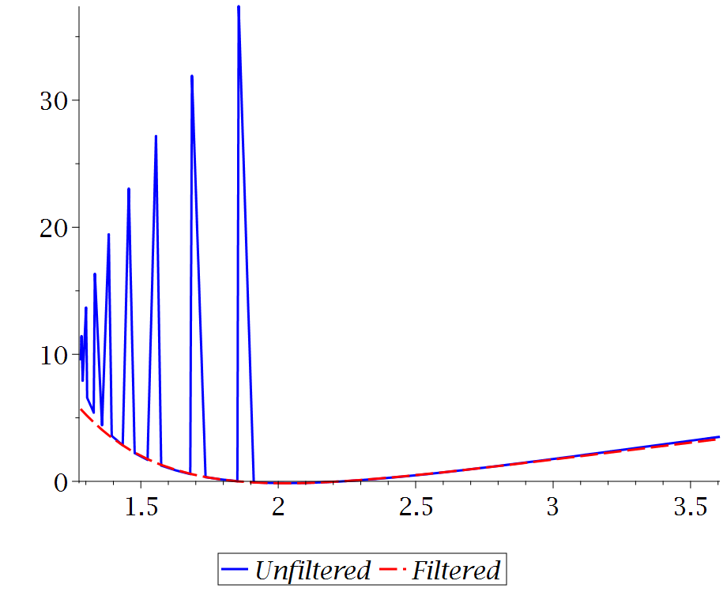
Suppressing noise via Low Pass Filter
Projection into a basis reduces noise from unphysical crossing of trajectories
Convenient way to obtain derivatives
p
J. Stetzler, et. al. Molecular Physics (2026)
y

Slide 11
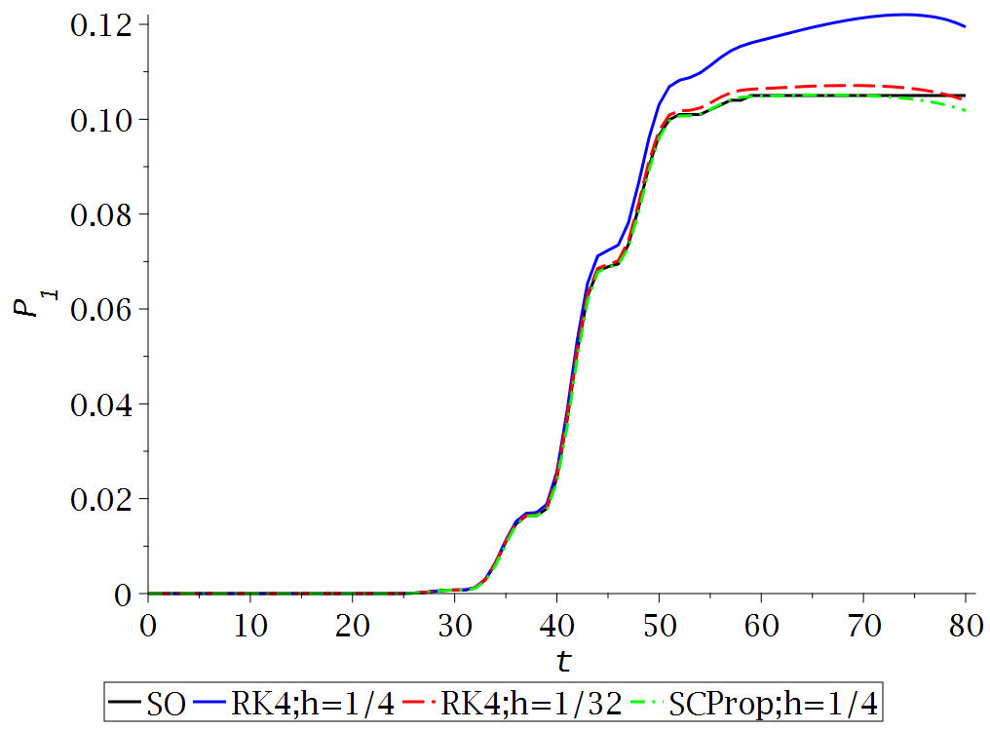
Self-Consistent Prop
-RK4 was very slow to converge for this system
Idea adapted from:
J. Jakowski, et. al. , J. Chem. Theory Comput. 21 (3), 1322–1339 (2025). doi:10.1021/acs.jctc.4c01241.
J. Stetzler, et. al. “Factorized electron-nuclear dynamics with effective complex potential: On-the-fly implementation for H2+ in a laser field” Molecular Physics. doi: 10.1080/00268976.2025.2611404.

Slide 12
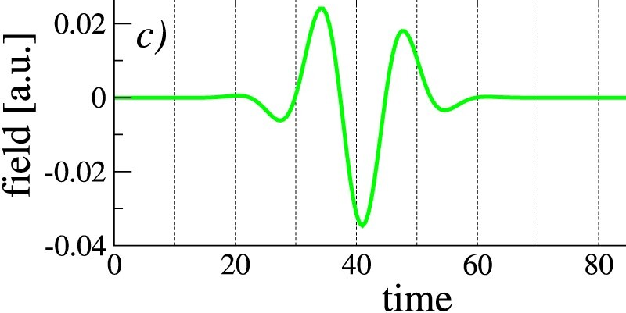
FENDy Applied to H₂⁺
Needed to use “mean-field” TDPES, leading to electronic momentum
Convergence to exact results
J. Stetzler, et. al. “Factorized electron-nuclear dynamics with effective complex potential: On-the-fly implementation for H2+ in a laser field” Molecular Physics. doi: 10.1080/00268976.2025.2611404.

Slide 13

FENDy Success! For short times…
Avoid eigenfunction calculation and success with QT implementation
$$q_{eq}$$
J. Stetzler, et. al. “Factorized electron-nuclear dynamics with effective complex potential: On-the-fly implementation for H2+ in a laser field” Molecular Physics. doi: 10.1080/00268976.2025.2611404.

Slide 14
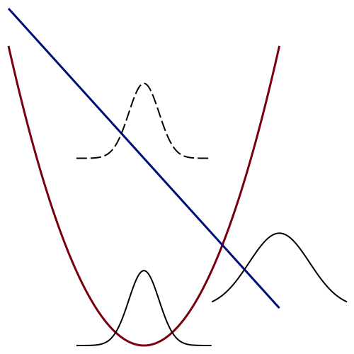
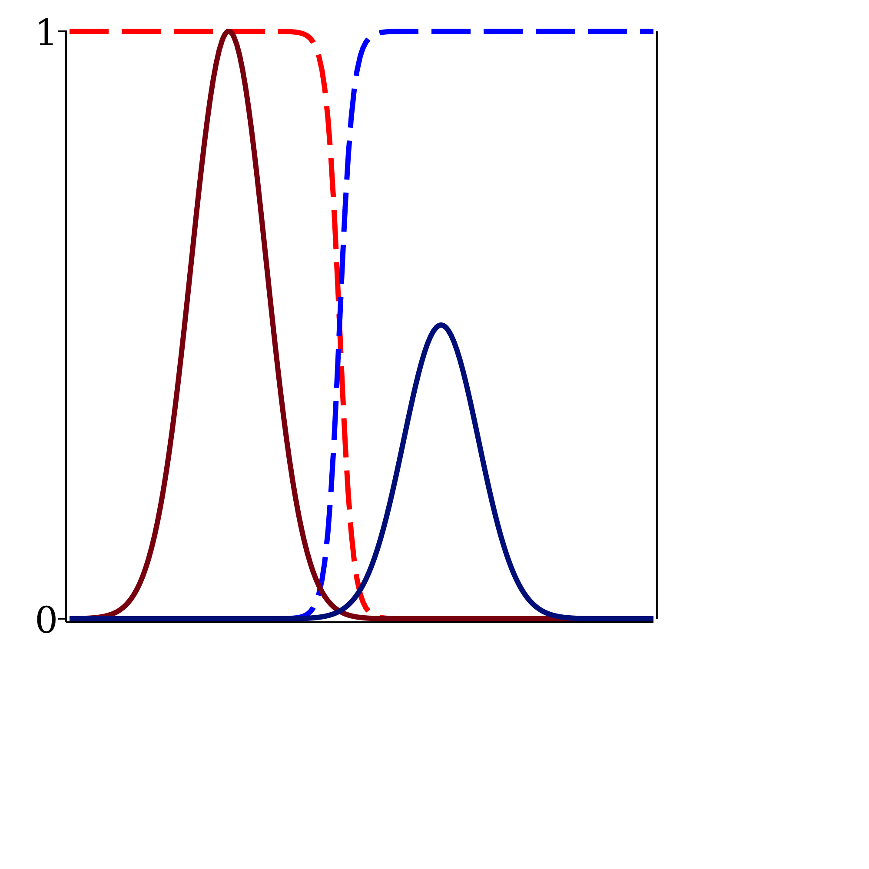
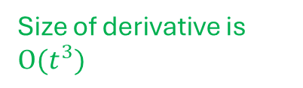
Dynamics of Bifurcating Factorized Wavefunctions
a)
b)
excited state
nuclear coordinate
Ψ₂(0)
|C₁|²
|C₂|²
energy
time-evolution
XF coefficients |C_{i}|²
Size of derivative is $O(t^{3})$
ℏν
Ψ₂(t)
|Ψ₂|²
|Ψ₁|²
Ψ₁(0)
ground state
nuclear coordinate
median point
J. Stetzler, S. Garashchuk, V. A. Rassolov “Analysis of divergent dynamics of exactly factorized electron-nuclear wavefunctions” Philosophical Magazine C: Quantum Matter, Theory and Phenomena (2026), 1–20. doi: 10.1080/14786435.2026.2612828

Slide 15
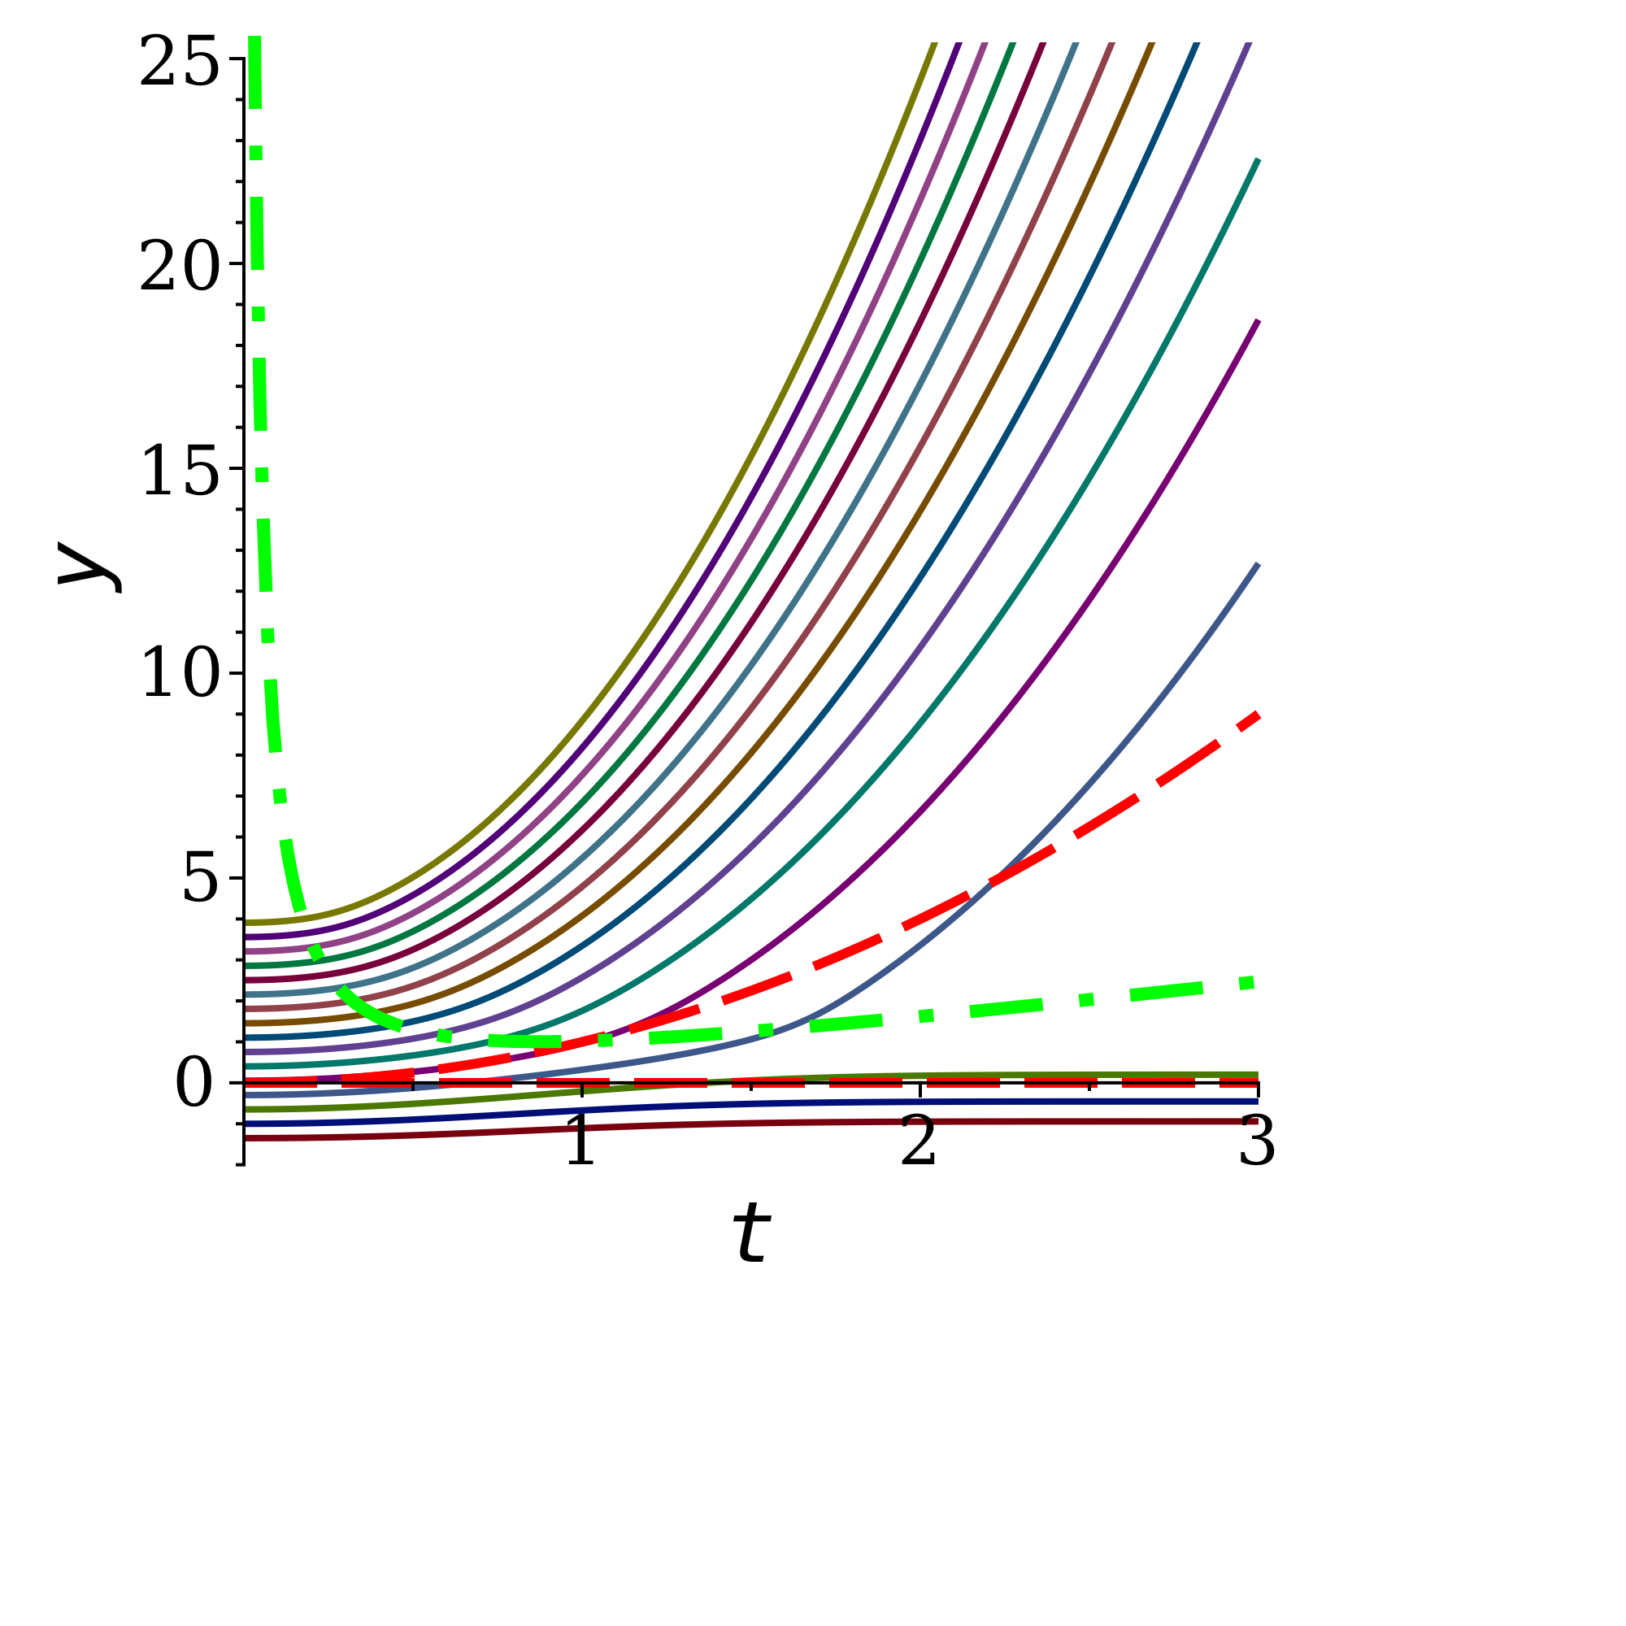
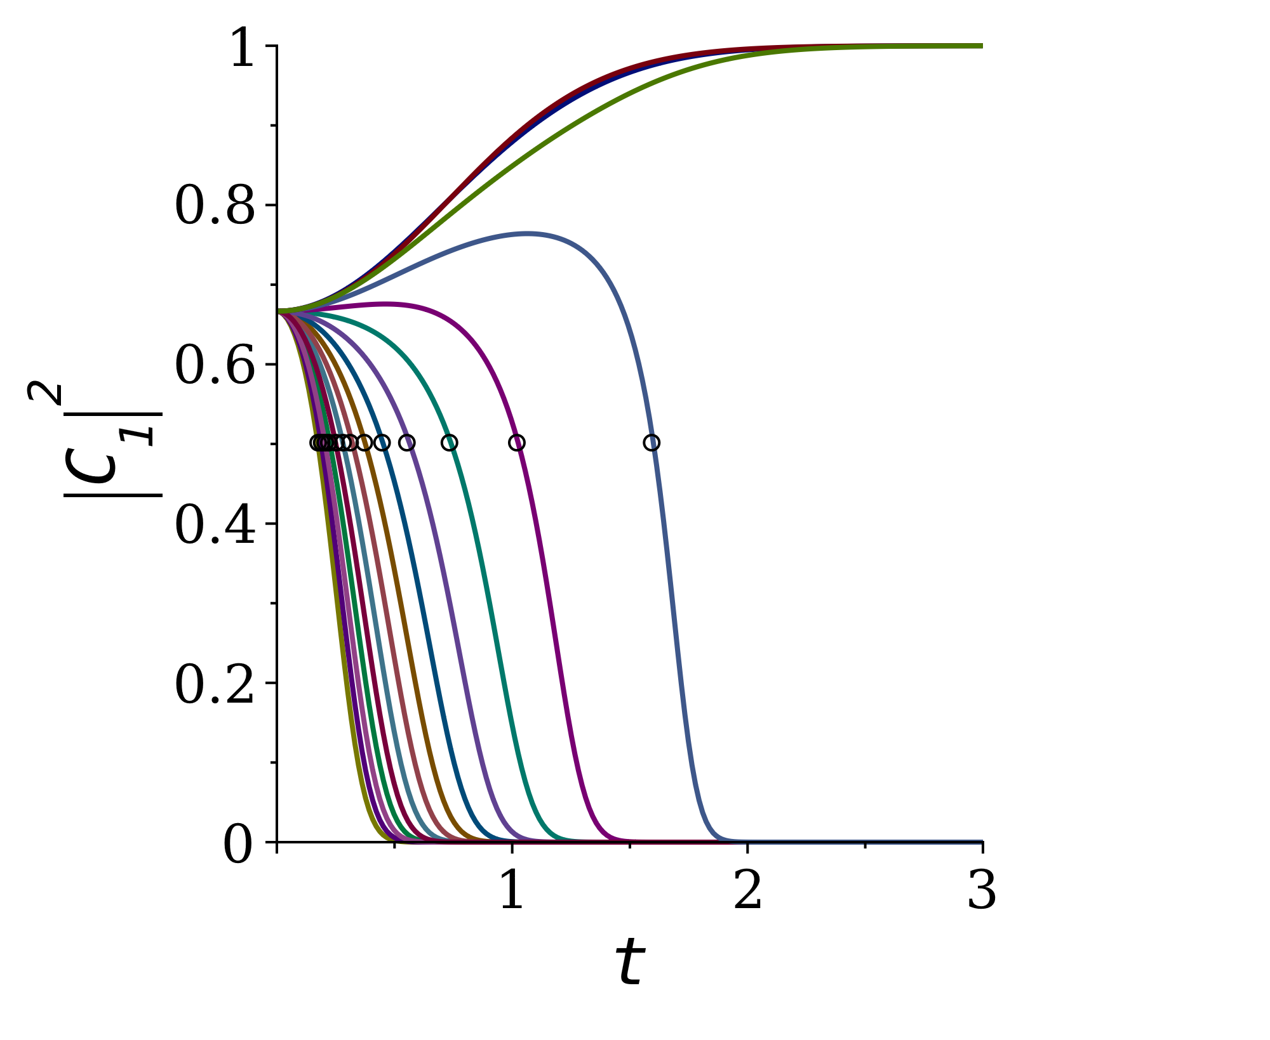
The problem of derivatives
J. Stetzler, S. Garashchuk, V. A. Rassolov “Analysis of divergent dynamics of exactly factorized electron-nuclear wavefunctions” Philosophical Magazine C: Quantum Matter, Theory and Phenomena (2026), 1–20. doi: 10.1080/14786435.2026.2612828

Slide 16
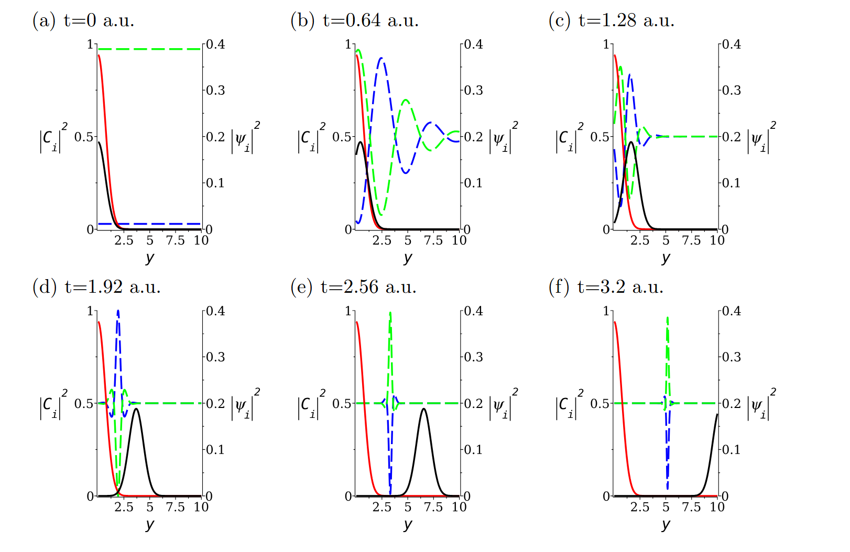
Localized Basis Diverging Wavepackets
J. Stetzler, et. al. Philosophical Magazine C (2026), 1–20

Slide 17
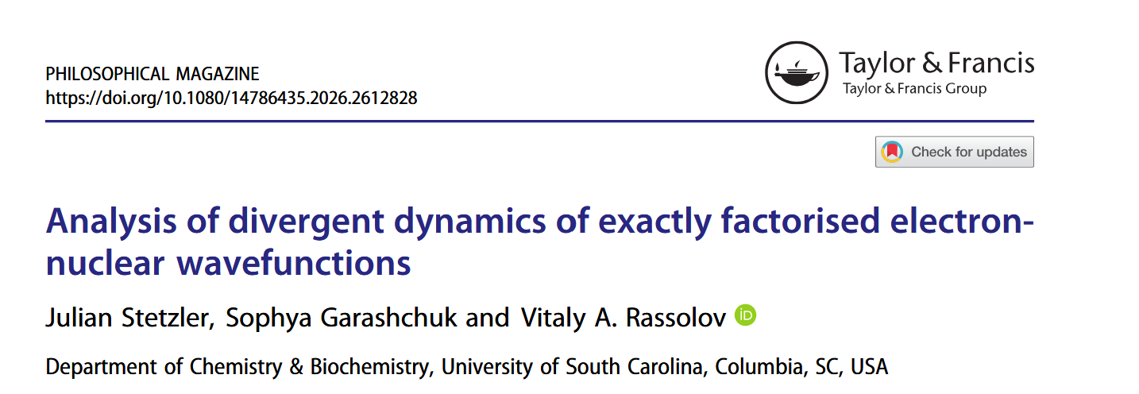

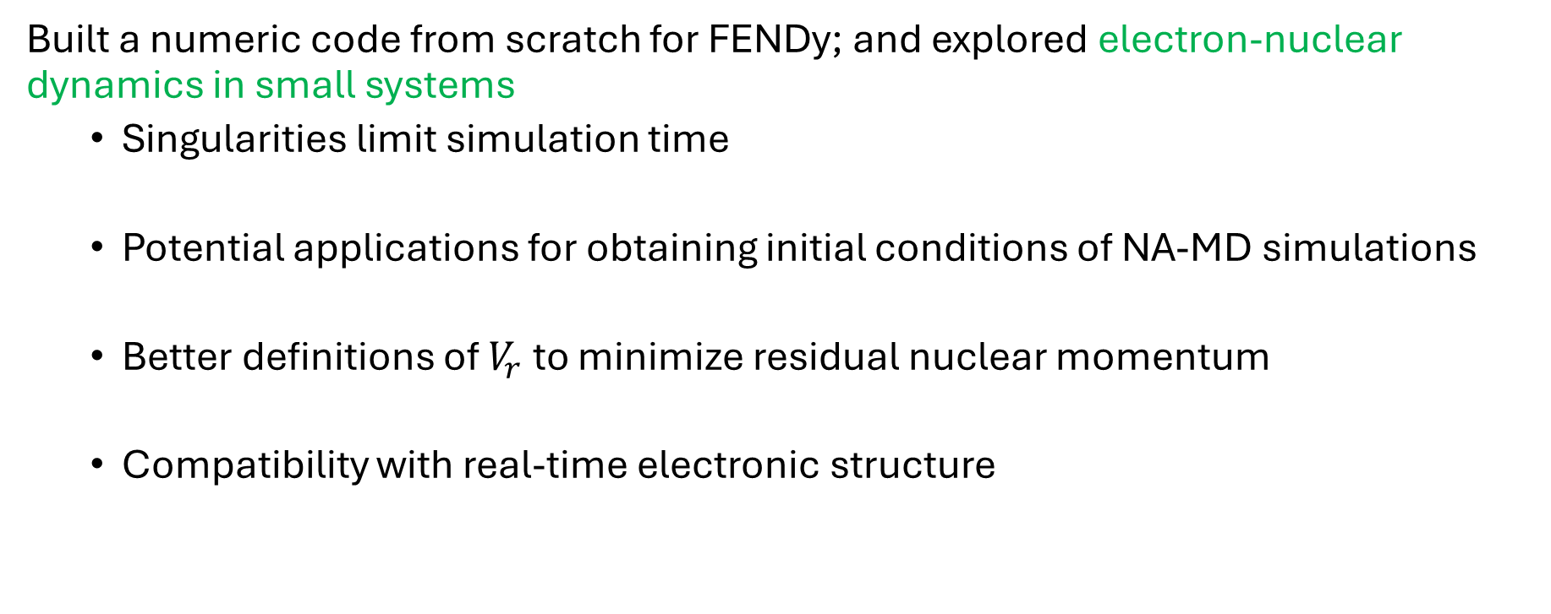
Summary
Built a numeric code from scratch for FENDy; and explored electron-nuclear dynamics in small systems
Singularities limit simulation time
Potential applications for obtaining initial conditions of NA-MD simulations
Better definitions of $V_{r}$ to minimize residual nuclear momentum
Compatibility with real-time electronic structure

Slide 18
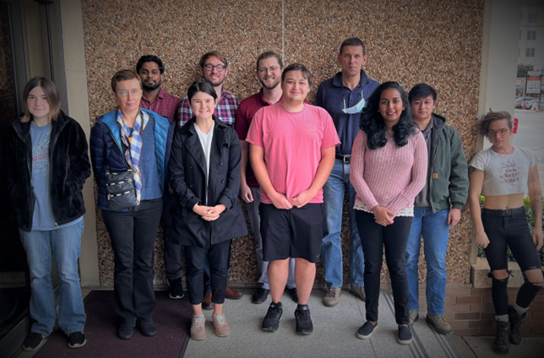
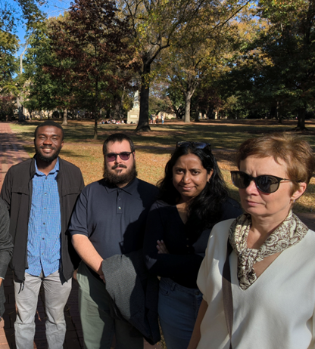

Thank you!
Professor Vitaly Rassolov
Professor Sophya Garashchuk
Dr. Sachith Wickramasinghe
Dr. Shehani Wettasinghe
Dr. Matt Dutra
Dr. Giacomo Botti
Austin Hill
Chanikya Jayawardana
Michael Safo

Slide 19
The Imaginary Potential
Definitions:
$${\hat{D}}_{2}={\hat{K}}_{y}=−\frac{1}{2M }∇_{y}^{2}$$
$${\hat{D}}_{1}=−\frac{1}{M }\frac{∇_{y}ψ}{ψ}∇_{y}$$
$V_{i}$ will maintain normalization
$$\frac{d}{dt}⟨Φ|Φ⟩_{x}=0$$
$${\hat{H}}_{el}=−\frac{1}{2 }∇_{x}^{2}+V(x,y)$$
$${\overline{p}}_{Φ}=<Φ|∇_{y}arg⁡(Φ)|Φ>_{x}$$
$$V_{i}=−\frac{1}{M}\left(\frac{∇_{y}|ψ|}{|ψ|}+∇_{y}\right){\overline{p}}_{Φ}$$
$$V_{i}=ℑ({⟨\hat{D}}_{1}+{\hat{D}}_{2}⟩_{x})$$
Exact in a complete basis
Exact in a finite basis
Both proportional to ${\overline{p}}_{Φ}$
S. Garashchuk, J. Stetzler, and V. Rassolov. J. Chem. Theory Comp. 2023 19 (5), 1393-1408
J. Stetzler, et. al. “Factorized electron-nuclear dynamics with effective complex potential: On-the-fly implementation for H2+ in a laser field” Molecular Physics. doi: 10.1080/00268976.2025.2611404.

Slide 20
The Real Potential
Definitions:
$${\hat{D}}_{2}={\hat{K}}_{y}=−\frac{1}{2M }∇_{y}^{2}$$
$${\hat{D}}_{1}=−\frac{1}{M }\frac{∇_{y}ψ}{ψ}∇_{y}$$
Ideal $V_{r}$defined to satisfy
$${\hat{H}}_{el}=−\frac{1}{2 }∇_{x}^{2}+V(x,y)$$
$$\frac{d}{dt}{\overline{p}}_{Φ}=0$$
$${\overline{p}}_{Φ}=<Φ|∇_{y}arg⁡(Φ)|Φ>_{x}$$
When satisfied $V_{i}=0$
$${∇_{y}V}_{r}={\left\langle ∇_{y}{\hat{H}}_{el}\right\rangle }_{x}+\left(\frac{4∇_{y}|ψ|}{|ψ|}+2∇_{y}\right){\left\langle {\hat{D}}_{2}\right\rangle }_{x}$$
$$V_{r}=ℜ({⟨{\hat{H}}_{el}+\hat{D}}_{1}+{\hat{D}}_{2}⟩_{x})$$
Exact in a complete basis and defined for 1D nucleus
Numerically stable in a finite basis
S. Garashchuk, J. Stetzler, and V. Rassolov. J. Chem. Theory Comp. 2023 19 (5), 1393-1408
J. Stetzler, et. al. “Factorized electron-nuclear dynamics with effective complex potential: On-the-fly implementation for H2+ in a laser field” Molecular Physics. doi: 10.1080/00268976.2025.2611404.

Slide 21
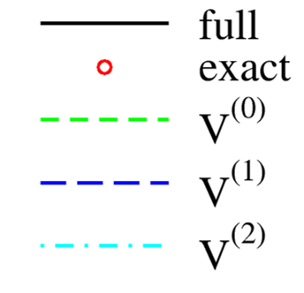
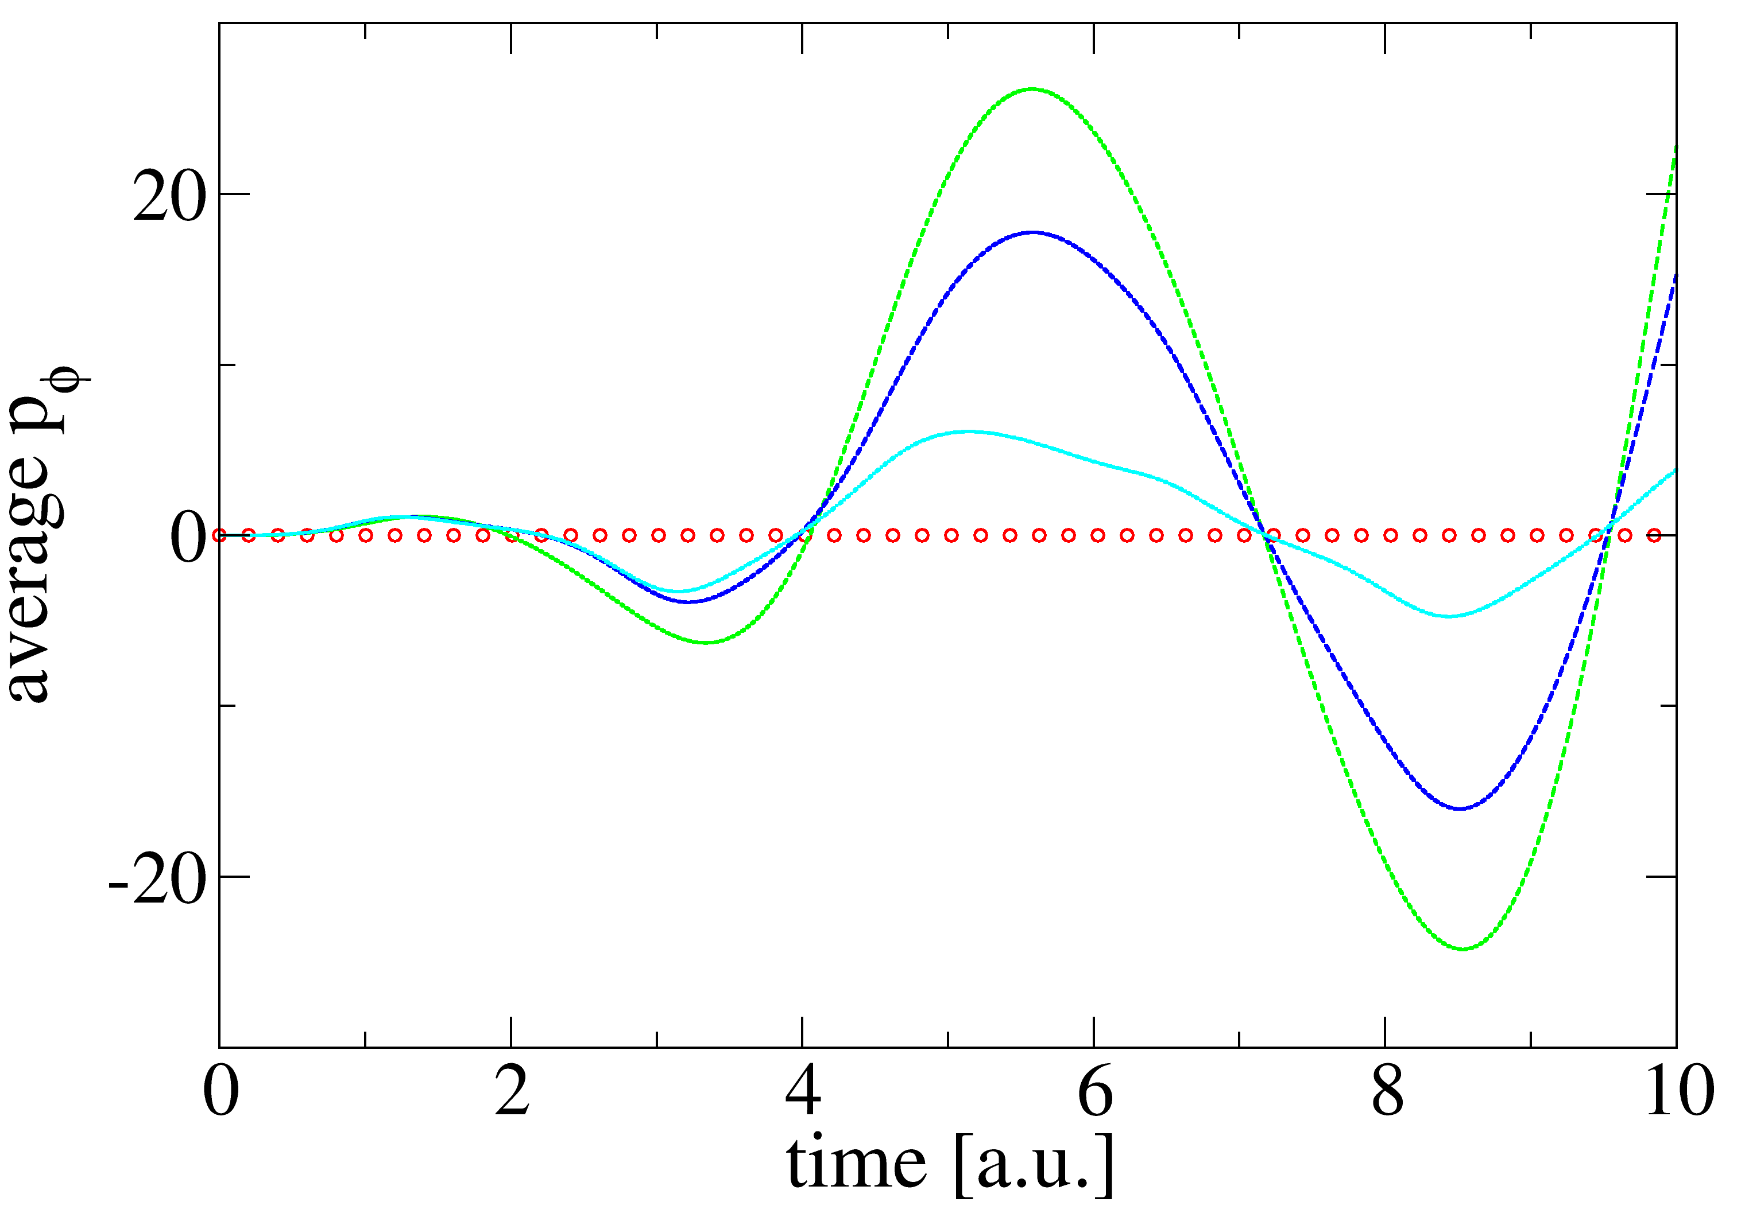
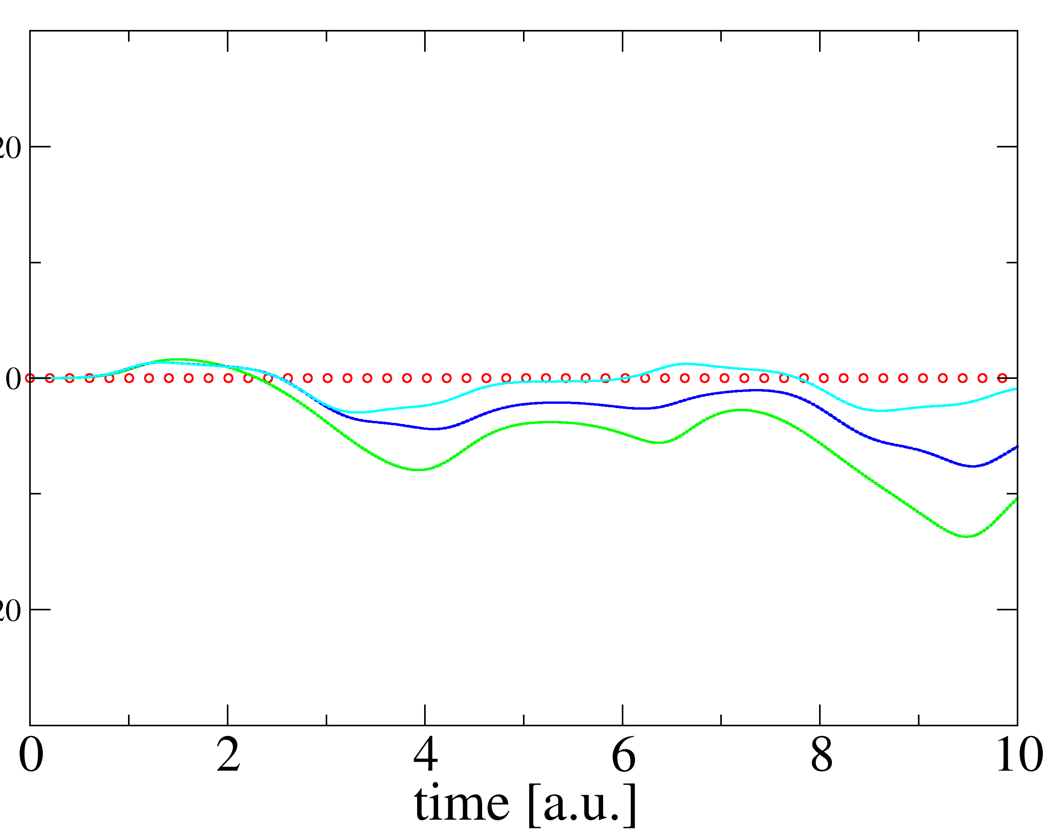
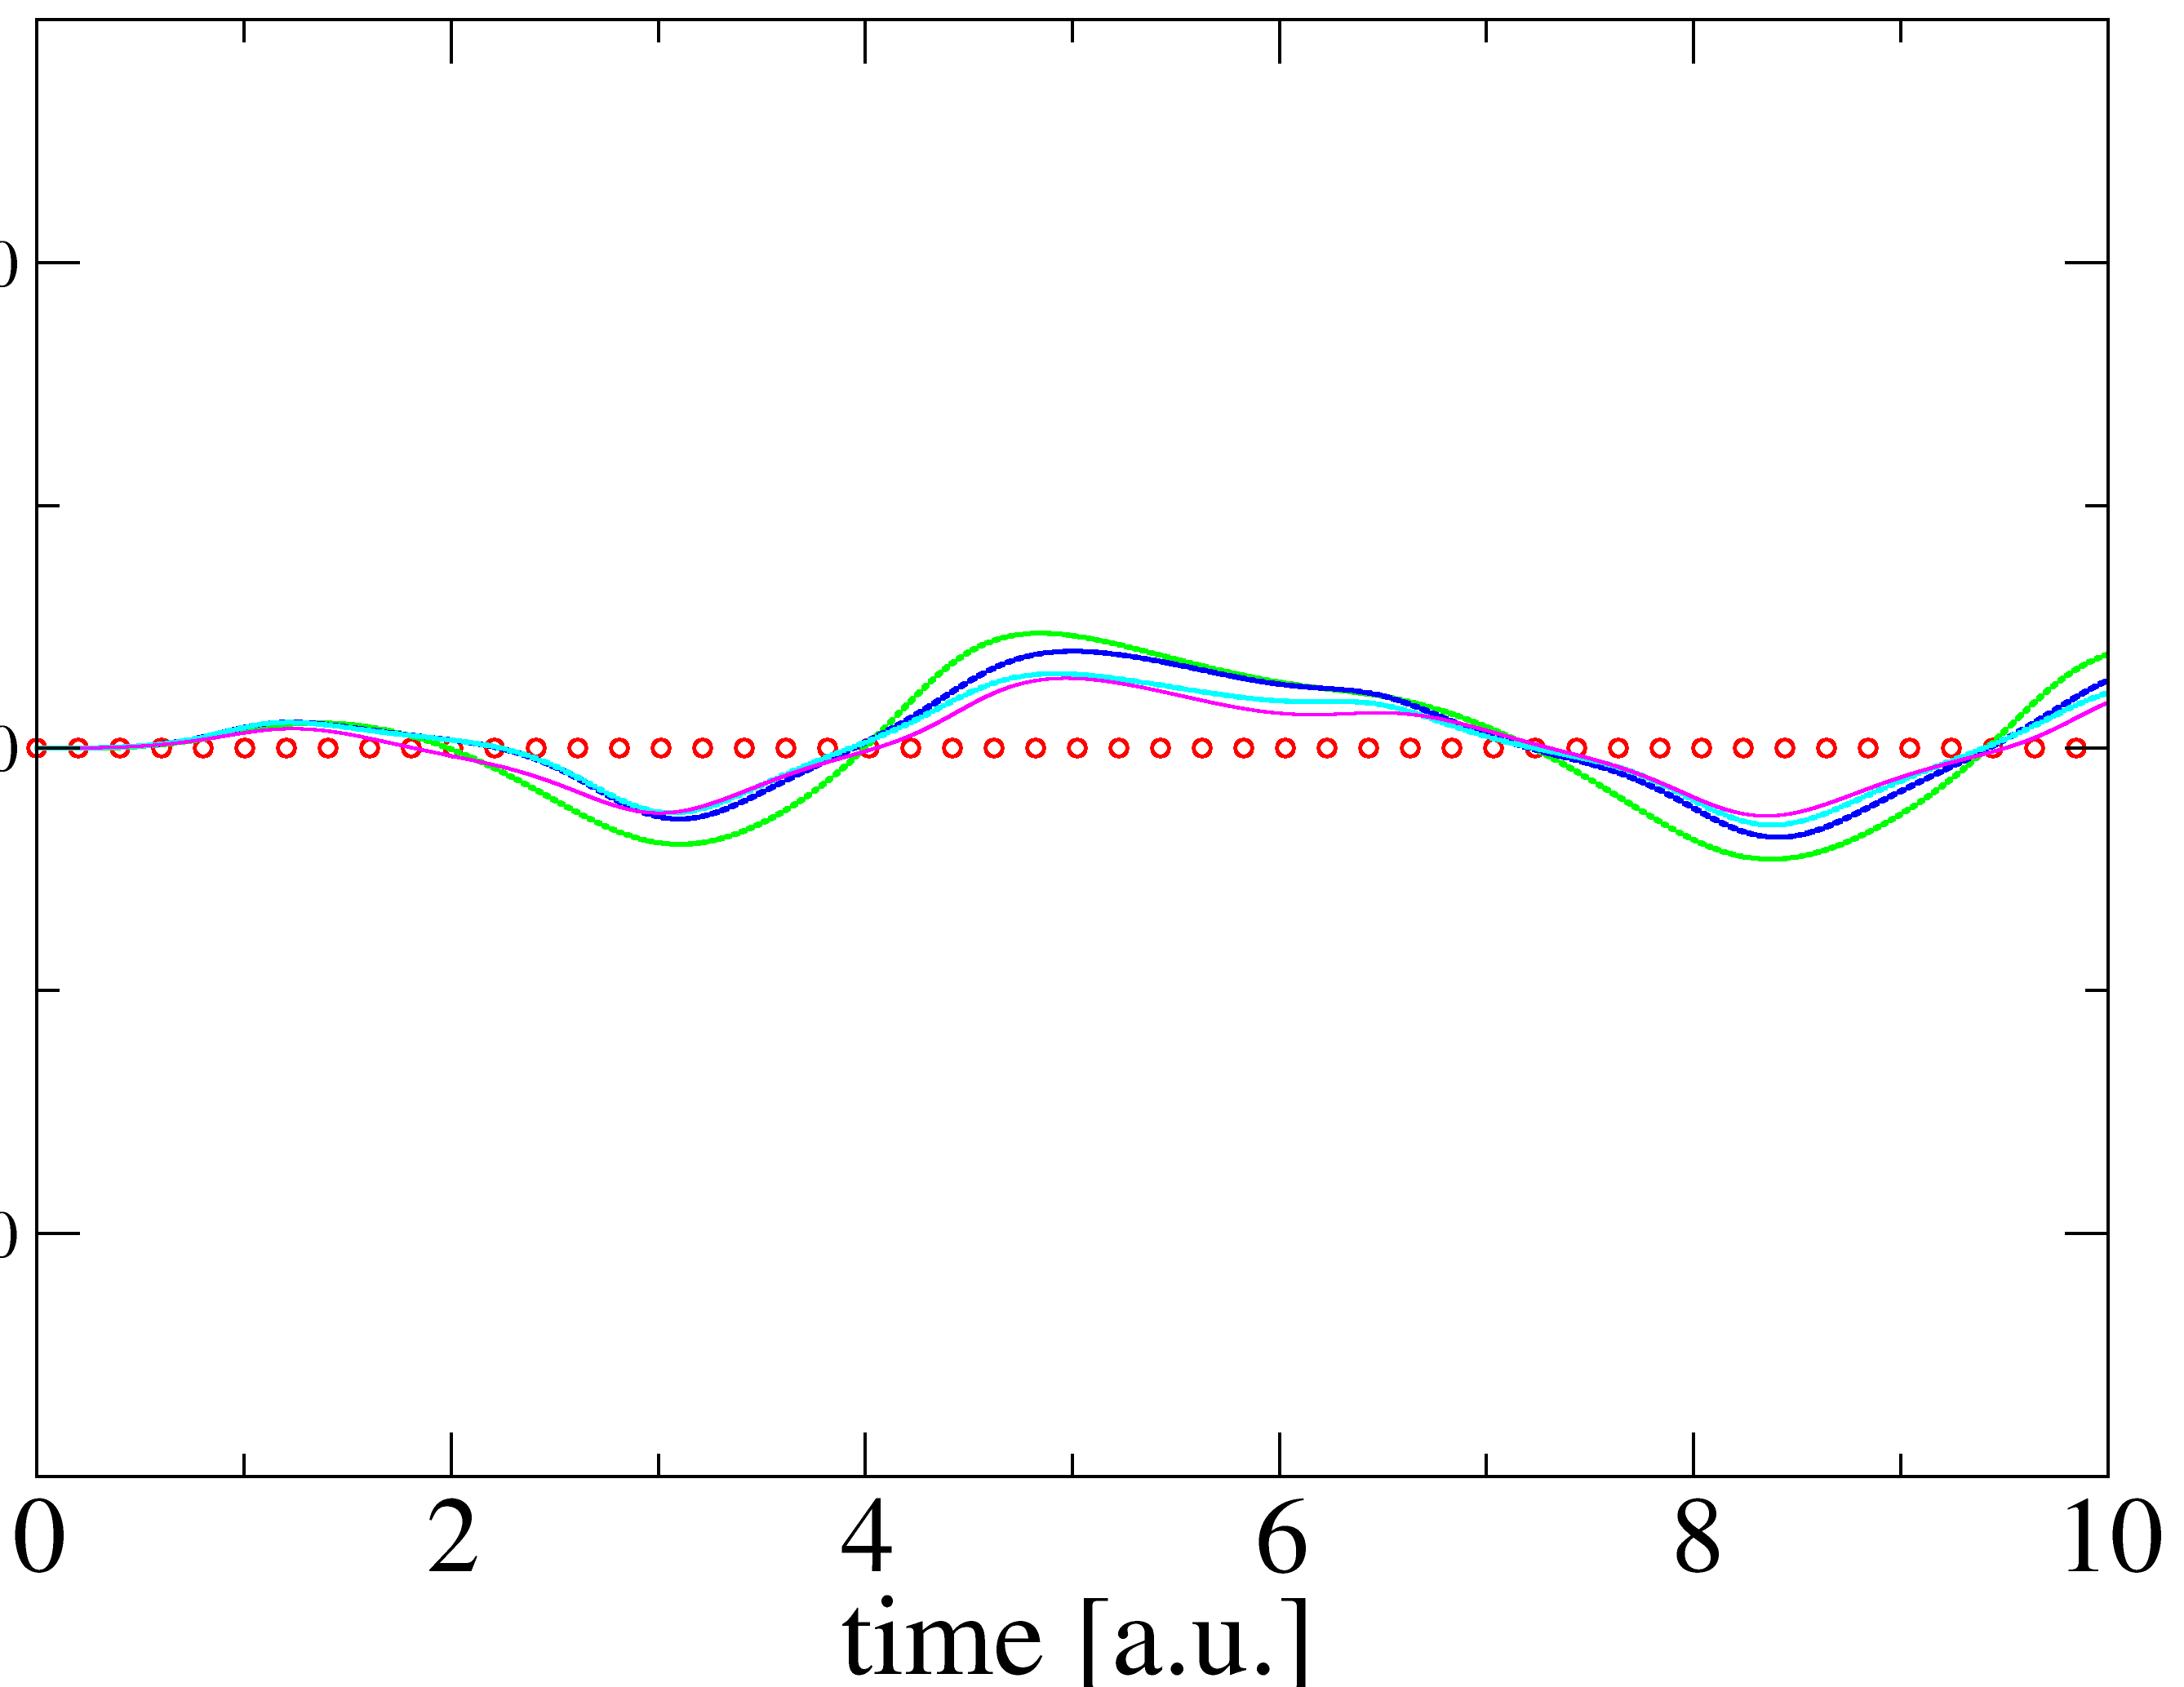
FENDy in a model system
Problem: $V_{i}$ uniquely defined; $V_{r}$ only for 1D nuclei
KST Model:
$$V\left(x,y\right)=\frac{1}{2}k{\left(x−y\right)}^{2}+\frac{1}{2}Ky^{2}$$
ideal
Explore various $V_{r}$:
Eulerian
Lagrangian
Electronic
S. Garashchuk, J. Stetzler, and V. Rassolov. J. Chem. Theory Comp. 2023 19 (5), 1393-1408

Slide 22



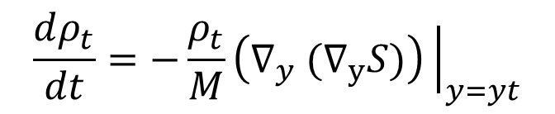
More on Bohmian Dynamics
The quantum trajectory formulation offers some distinct advantages
$$ψ\left(y,t\right)=|ψ|e^{iS(y,t)}$$
Trajectory weight conservation:
$$w_{t}≔w\left(y_{t}\right)={\left|ψ\right|}^{2}dy_{t}$$
$$p=∇_{y}S(y,t)$$
$$w_{t}=w_{0}$$
Continuity euation
$$\frac{dρ_{t}}{dt}=−\frac{ρ_{t}}{M}\left(∇_{y} (∇_{y}S)\right){\left.​\right|}_{y=yt}$$
Expectation values:
$$\left\langle \hat{O}\right\rangle =∫O\left(y\right){\left|ψ\right|}^{2}dy≈\sum_{i}^{NTraj}{O\left(y_{t}\right)w_{t}}$$
S. Garashchuk, J. Stetzler, and V. Rassolov. J. Chem. Theory Comp. 2023 19 (5), 1393-1408

Slide 23
Self-Consistent Propagation
Found to provide better convergence in larger (by number of parameters) systems
$$F\left(t\right)≔y\left(t\right),p\left(t\right),C(t)$$
Compute F(t+dt) self consistently using
$$F_{av}=\frac{F\left(t\right)+F\left(t+dt\right)}{2}$$
Error computed as:
$$\sum_{i}{{\left|Δy_{i}\right|}^{2}+{\left|Δp_{i}\right|}^{2}+\sum_{j}{{\left|ΔC_{ij}\right|}^{2}}}$$
J. Stetzler, et. al. “Factorized electron-nuclear dynamics with effective complex potential: On-the-fly implementation for H2+ in a laser field” Molecular Physics. doi: 10.1080/00268976.2025.2611404.

Slide 24
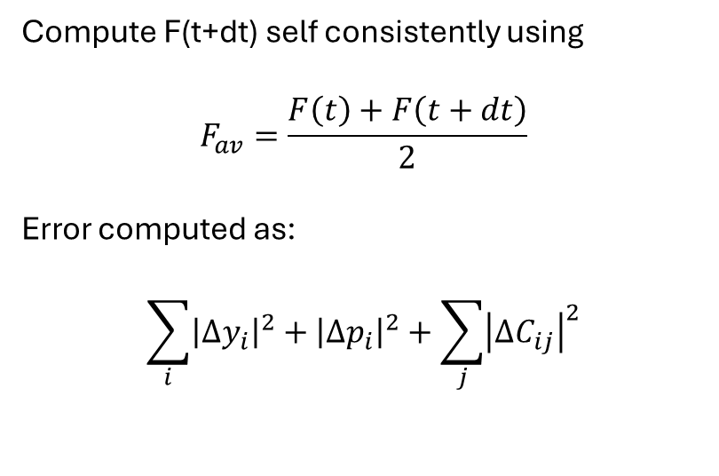
Self-Consistent Propagation
Found to provide better convergence in larger (by number of parameters) systems
$$F\left(t\right)≔y\left(t\right),p\left(t\right),C(t)$$
Compute F(t+dt) self consistently using
$$F_{av}=\frac{F\left(t\right)+F\left(t+dt\right)}{2}$$
Error computed as:
$$\sum_{i}{{\left|Δy_{i}\right|}^{2}+{\left|Δp_{i}\right|}^{2}+\sum_{j}{{\left|ΔC_{ij}\right|}^{2}}}$$
J. Stetzler, et. al. “Factorized electron-nuclear dynamics with effective complex potential: On-the-fly implementation for H2+ in a laser field” Molecular Physics. doi: 10.1080/00268976.2025.2611404.

Slide 25
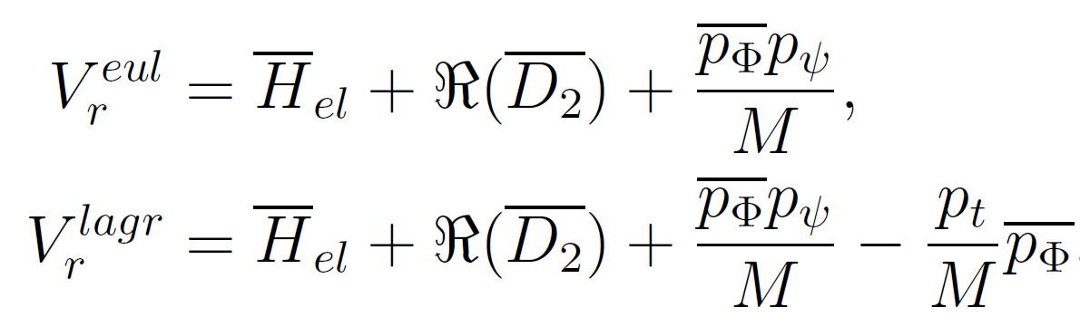
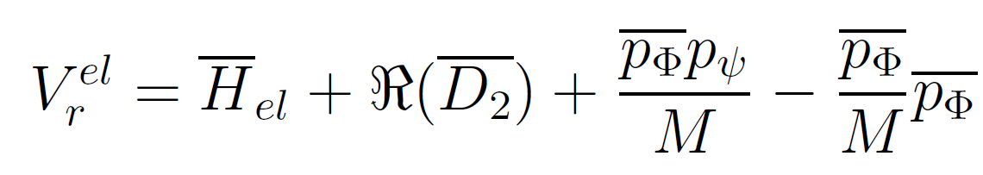
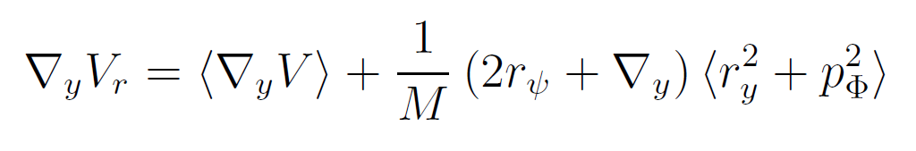

Equations for $V_{r}$

Slide 26
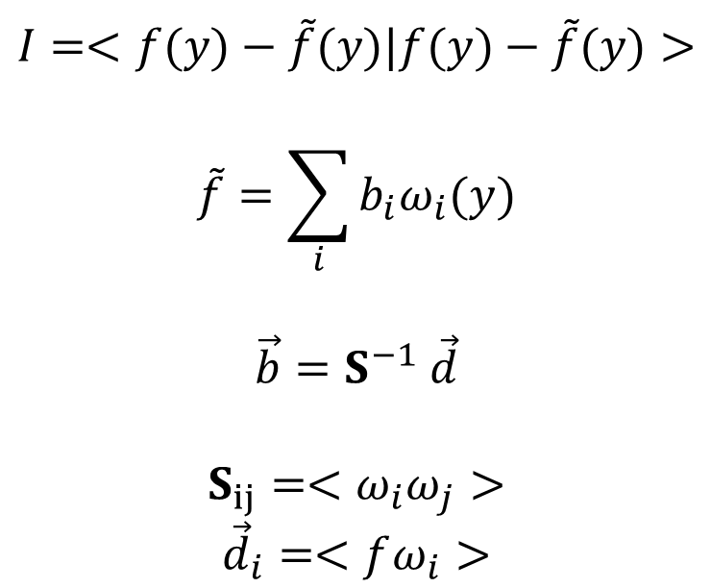
LSF Eqs
$$I=<f(y)−\tilde{f}(y)|f(y)−\tilde{f}(y)>$$
$$\tilde{f}=\sum_{i}{b_{i}ω_{i}(y)}$$
$$\vec{b}=S^{−1} \vec{d}$$
$$S_{ij}=<ω_{i}ω_{j}>$$
$${\vec{d}}_{i}=<fω_{i}>$$

Slide 27
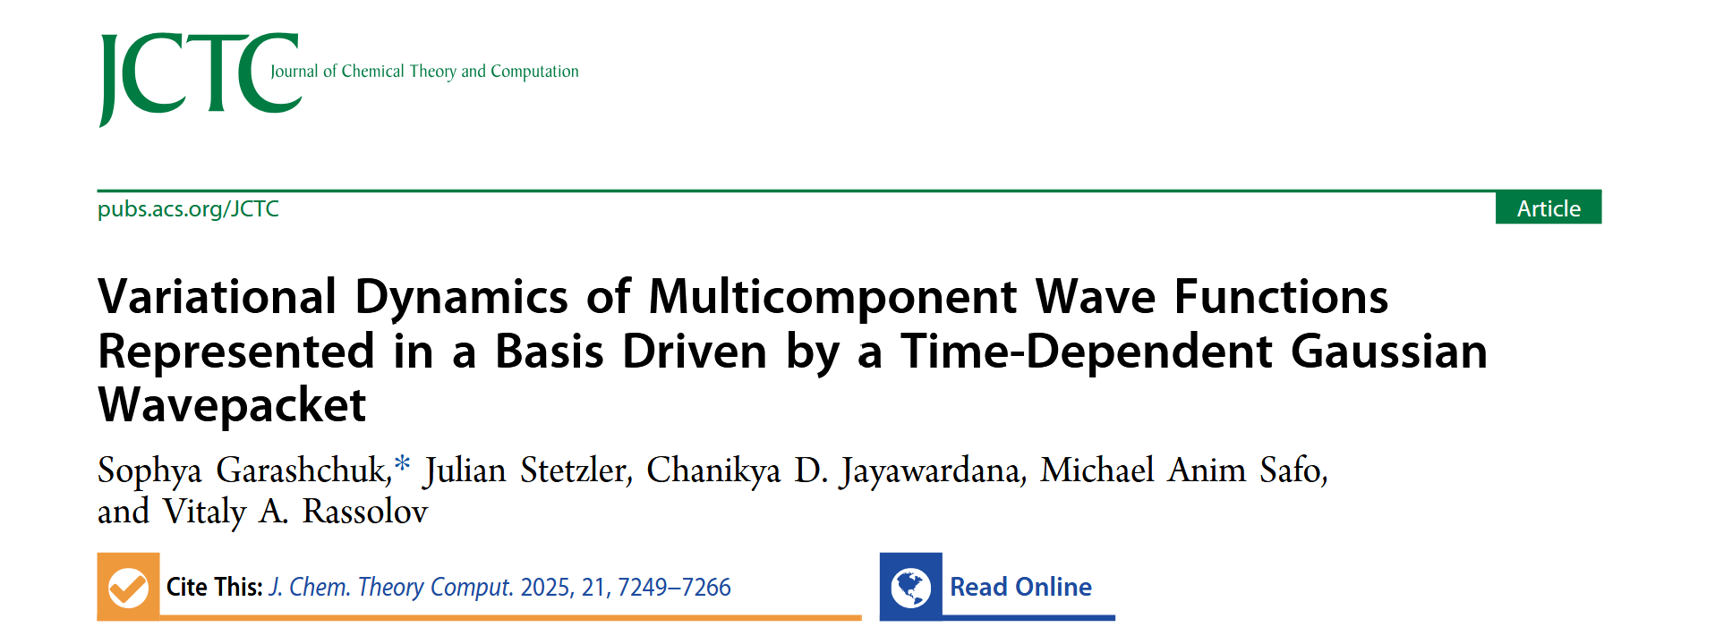
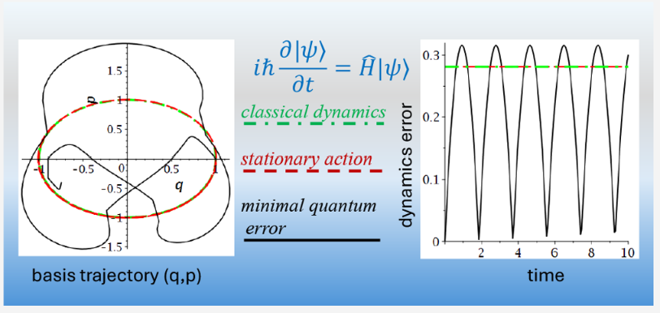
Variational Wavepackets
Motivation of the paper: Modeling effects of molecular environments on a quantum subsystems using the TDSE
My part was coding and analytically evaluating the error functionals for the simplest cases

Slide 28
FIA Outliers
Outliers were species with large negative charges far from the boron center or molecules with large substituents (t-butyl)
Modelled steric by included surface area and volume of each molecule in the fit
Also computed solvated FIA with SM6 (challenge was accuracy of Flouride ion)

