Slide 1
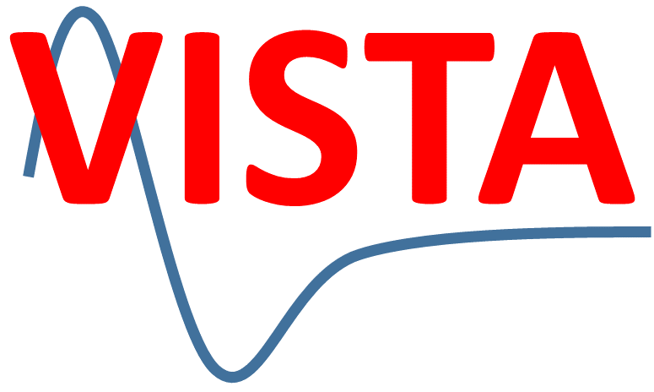

A novel Hessian free method to prevent Zero Point Energy Leak in Classical Trajectory Simulation
Saikat Mukherjee
Prof. Mario Barbatti Group
Institut de Chimie Radicalaire
Aix-Marseille University, France

Slide 2
Introduction
ZPE is an outcome of quantum uncertainty principle. ZPE leak in a vibrational mode is well known in classical reaction dynamics.
During classical trajectory propagation, the energy in some vibrational modes may fall below its quantum ZPE value and this leaked energy eventually accumulates into another mode in an isolated system.
The classical trajectories cross the saddle point and may form products containing less energy than ZPE in the internal vibrational DOFs.
A quantum mechanical wavepacket moves over the saddle point towards products with vibrational mode energies always greater or equal to their ZPE values.

Slide 3
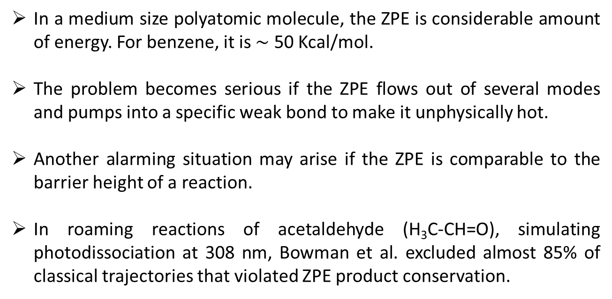
Introduction
In a medium size polyatomic molecule, the ZPE is considerable amount of energy. For benzene, it is $\sim$ 50 Kcal/mol.
The problem becomes serious if the ZPE flows out of several modes and pumps into a specific weak bond to make it unphysically hot.
Another alarming situation may arise if the ZPE is comparable to the barrier height of a reaction.
In roaming reactions of acetaldehyde (H₃C-CH=O), simulating photodissociation at 308 nm, Bowman et al. excluded almost 85% of classical trajectories that violated ZPE product conservation.
“ZPE leaking” problem surely needs attention !

Slide 4
Introduction
Simplest Fix: Ignore ZPE in classical simulation; Discard ZPE violating trajectories that either form products with less than their ZPE (“hard” ZPE constrain) or form products where the sum of the product vibrational energies is less than the total product ZPE (“soft” ZPE constrain).
Active Methods: Apply some constrains during the trajectory propagation; directly intervening the classical propagation of nuclei.
“It is better to include no ZPE in modes, rather than to have it present and allow it to flow in an unrestricted fashion.” (Hase & Miller)

Slide 5
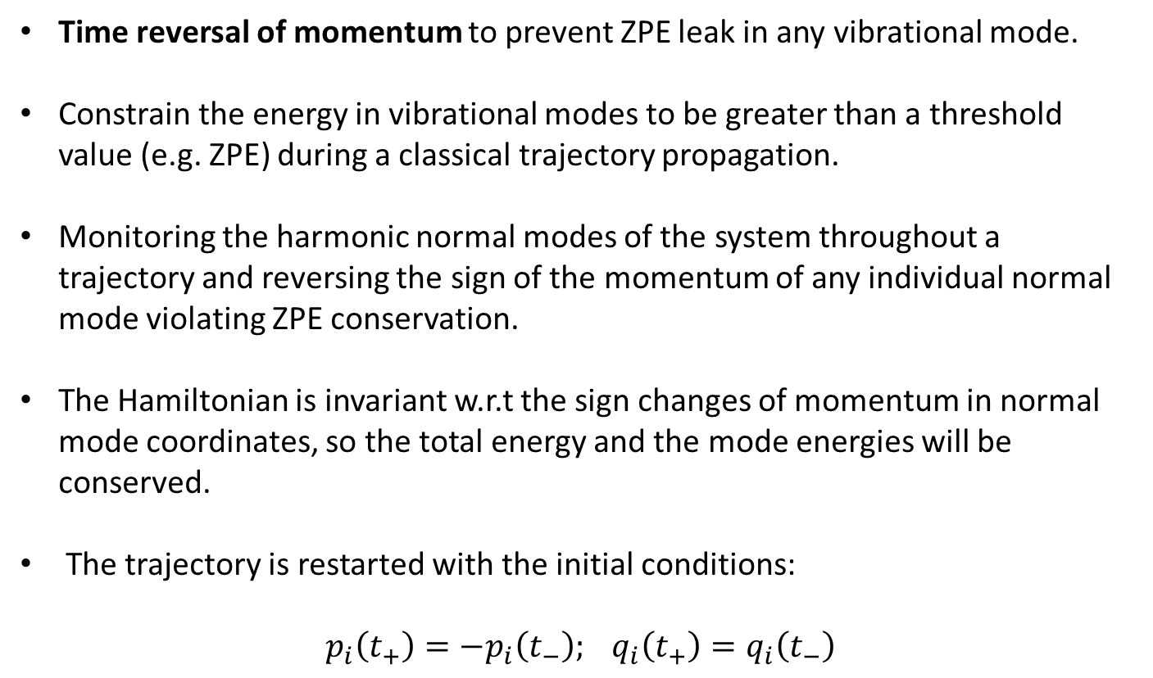
Bowman – Hase & Miller Method: Impulsive Quantum Kicks
Time reversal of momentum to prevent ZPE leak in any vibrational mode.
Constrain the energy in vibrational modes to be greater than a threshold value (e.g. ZPE) during a classical trajectory propagation.
Monitoring the harmonic normal modes of the system throughout a trajectory and reversing the sign of the momentum of any individual normal mode violating ZPE conservation.
The Hamiltonian is invariant w.r.t the sign changes of momentum in normal mode coordinates, so the total energy and the mode energies will be conserved.
The trajectory is restarted with the initial conditions:
$$p_{i}\left(t_{+}\right)=−p_{i}\left(t_{−}\right); q_{i}\left(t_{+}\right)=q_{i}\left(t_{−}\right)$$

Slide 6
Bowman – Hase & Miller Method: Impulsive Quantum Kicks
(Constrained)
Hard Sphere Repulsive Potential:
phase-space plot of a normal mode. The shaded area represents the vibrational energy less than ZPE.
(Unconstrained)
The phase–space plot and the mode energy for the Henon-Heiles Hamiltonian with and without constrained trajectory calculation.
These normal modes corresponds to the equilibrium geometry and not the instantaneous normal modes.
J. M. Bowman, B. Gazdy, Q. Sun, J. Chem. Phys. 91, 2859 (1989)

Slide 7
Bowman – Hase & Miller Method: Impulsive Quantum Kicks
When the molecule moves far away from the equilibrium, an instantaneous normal modes description is required at any arbitrary nuclear configuration.
The basic idea remains the same, requires Hessian calculation at each timestep.
After each timestep, diagonalize the projected force constant matrix at the current position; obtain eigenvalues.
Check ZPE leakage for each mode and correct if necessary.
Since the treatment affects the vibrational mode only when it is below the ZPE level, where the corresponding DOF are reasonably well described harmonically.
Ignored the imaginary frequency modes.
W. H. Miller, W. L. Hase, C. L. Darling, J. Chem. Phys. 91, 2863 (1989)

Slide 8
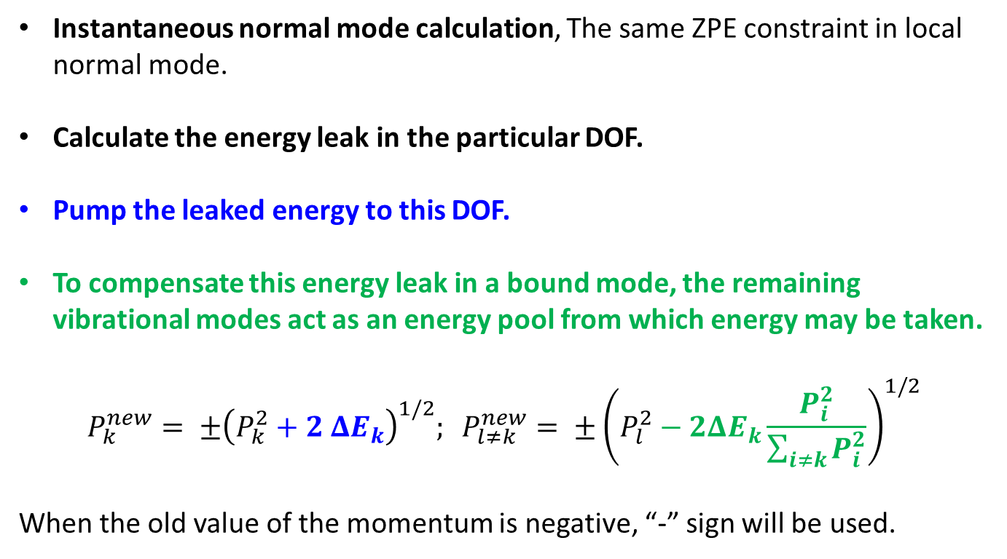
Varandas Proposal
Instantaneous normal mode calculation, The same ZPE constraint in local normal mode.
Calculate the energy leak in the particular DOF.
Pump the leaked energy to this DOF.
To compensate this energy leak in a bound mode, the remaining vibrational modes act as an energy pool from which energy may be taken.
$$P_{k}^{new}= ±{\left(P_{k}^{2}+2 ΔE_{k}\right)}^{1/2}; P_{l≠k}^{new}= ±{\left(P_{l}^{2}−2ΔE_{k}\frac{P_{i}^{2}}{\sum_{i≠k}{P_{i}^{2}}}\right)}^{1/2}$$
When the old value of the momentum is negative, “-” sign will be used.
A. J. C. Varandas, J. M. C. Marques, J. Chem. Phys. 100, 1908 (1994)

Slide 9
New Proposed Scheme to prevent ZPE leak
Expensive Hessian calculation and normal mode analysis are not required.
Conserves total energy, linear momentum and COM angular momentum.
Designed for implementing in the MQC direct dynamics.
Monitor the kinetic energy of a local vibration. When the KE drops below a certain threshold, pump the leaked energy in a particular bond.
The energy is taken from the pool of energy constructed by the other bonds.
All these energy adjustments are occurred in terms of velocity of the corresponding classical nuclei.
In this case, the energy is taken from the other bonds, i.e. from the molecule itself. So, the energy is conserved inherently keeping the system as a microcanonical ensemble.

Slide 10
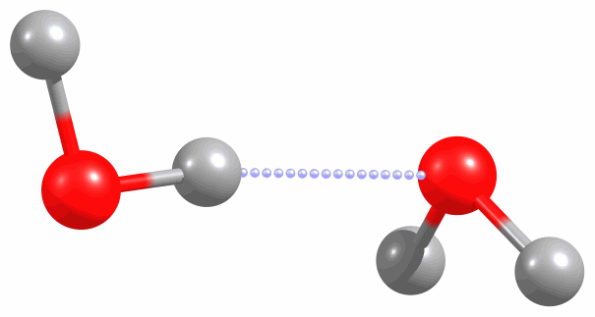
ZPE correction scheme
Split the atom pairs of a molecule into two groups:
Soft atom pairs: prone to ZPE leakage, i.e. O-H, N-H, …
AH atom pairs: (1-2), (1-3), (4-5), (4-6)
All other atom pairs (even not bonded) act as a energy pool
BC atom pairs: (1-4), (1-5), (1-6),
(2-3), (2-4), (2-5), (2-6),
(3-4), (3-5), (3-6), (5-6)
2
3
4
1
5
6

Slide 11
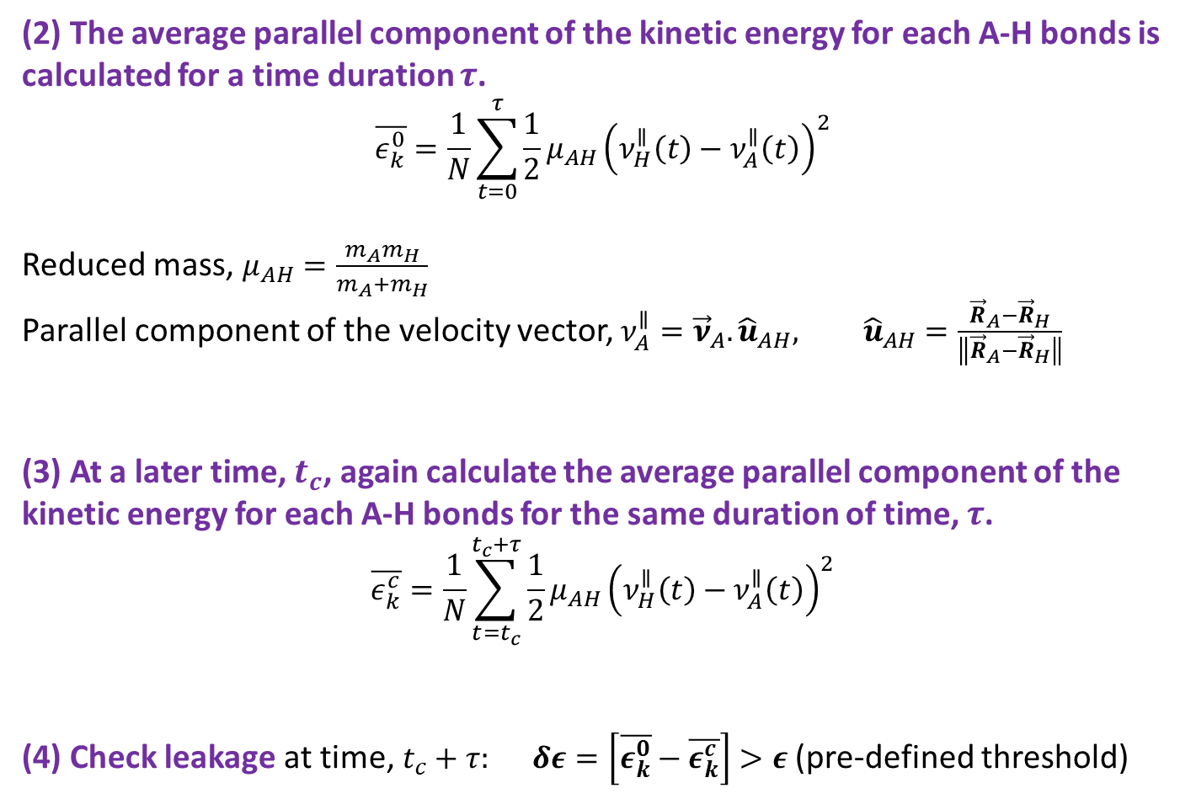
ZPE correction scheme
(2) The average parallel component of the kinetic energy for each A-H bonds is calculated for a time duration $τ$.
$$\overline{ε_{k}^{0}}=\frac{1}{N}\sum_{t=0}^{τ}{\frac{1}{2}μ_{AH}{\left(ν_{H}^{∥}\left(t\right)−ν_{A}^{∥}\left(t\right)\right)}^{2}}$$
Reduced mass, $μ_{AH}=\frac{m_{A}m_{H}}{m_{A}+m_{H}}$
Parallel component of the velocity vector, $ν_{A}^{∥}={\vec{ν}}_{A}.{\hat{u}}_{AH}, {\hat{u}}_{AH}=\frac{{\vec{R}}_{A}−{\vec{R}}_{H}}{\left\|{\vec{R}}_{A}−{\vec{R}}_{H}\right\|}$
(3) At a later time, $t_{c}$, again calculate the average parallel component of the kinetic energy for each A-H bonds for the same duration of time, $τ$.
$$\overline{ε_{k}^{c}}=\frac{1}{N}\sum_{t=t_{c}}^{t_{c}+τ}{\frac{1}{2}μ_{AH}{\left(ν_{H}^{∥}\left(t\right)−ν_{A}^{∥}\left(t\right)\right)}^{2}}$$
(4) Check leakage at time, $t_{c}+τ:$ $δε=\left[\overline{ε_{k}^{0}}−\overline{ε_{k}^{c}}\right]>ε$ (pre-defined threshold)

Slide 12
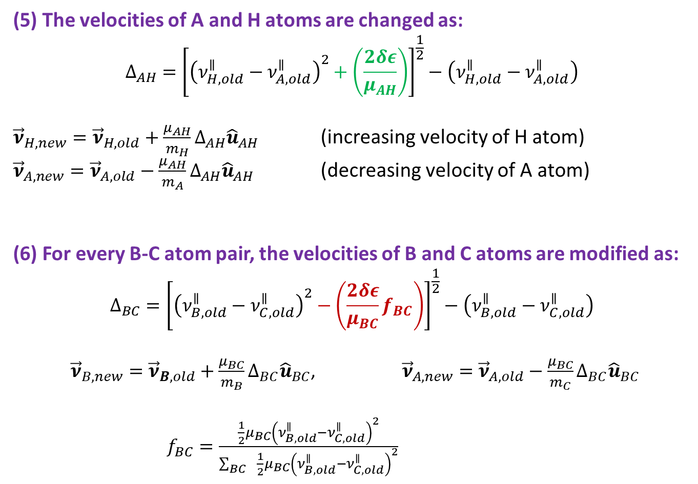
ZPE correction scheme
(5) The velocities of A and H atoms are changed as:
$$Δ_{AH}={\left[{\left(ν_{H,old}^{∥}−ν_{A,old}^{∥}\right)}^{2}+\left(\frac{2δε}{μ_{AH}}\right)\right]}^{\frac{1}{2}}−\left(ν_{H,old}^{∥}−ν_{A,old}^{∥}\right)$$
${\vec{ν}}_{H,new}={\vec{ν}}_{H,old}+\frac{μ_{AH}}{m_{H}}Δ_{AH}{\hat{u}}_{AH}$ (increasing velocity of H atom)
${\vec{ν}}_{A,new}={\vec{ν}}_{A,old}−\frac{μ_{AH}}{m_{A}}Δ_{AH}{\hat{u}}_{AH}$ (decreasing velocity of A atom)
(6) For every B-C atom pair, the velocities of B and C atoms are modified as:
$$Δ_{BC}={\left[{\left(ν_{B,old}^{∥}−ν_{C,old}^{∥}\right)}^{2}−\left(\frac{2δε}{μ_{BC}}f_{BC}\right)\right]}^{\frac{1}{2}}−\left(ν_{B,old}^{∥}−ν_{C,old}^{∥}\right)$$
${\vec{ν}}_{B,new}={\vec{ν}}_{B,old}+\frac{μ_{BC}}{m_{B}}Δ_{BC}{\hat{u}}_{BC}$, ${\vec{ν}}_{A,new}={\vec{ν}}_{A,old}−\frac{μ_{BC}}{m_{C}}Δ_{BC}{\hat{u}}_{BC}$
$f_{BC}=\frac{\frac{1}{2}μ_{BC}{\left(ν_{B,old}^{∥}−ν_{C,old}^{∥}\right)}^{2}}{\sum_{BC }{ \frac{1}{2}μ_{BC}{\left(ν_{B,old}^{∥}−ν_{C,old}^{∥}\right)}^{2}}}$

Slide 13
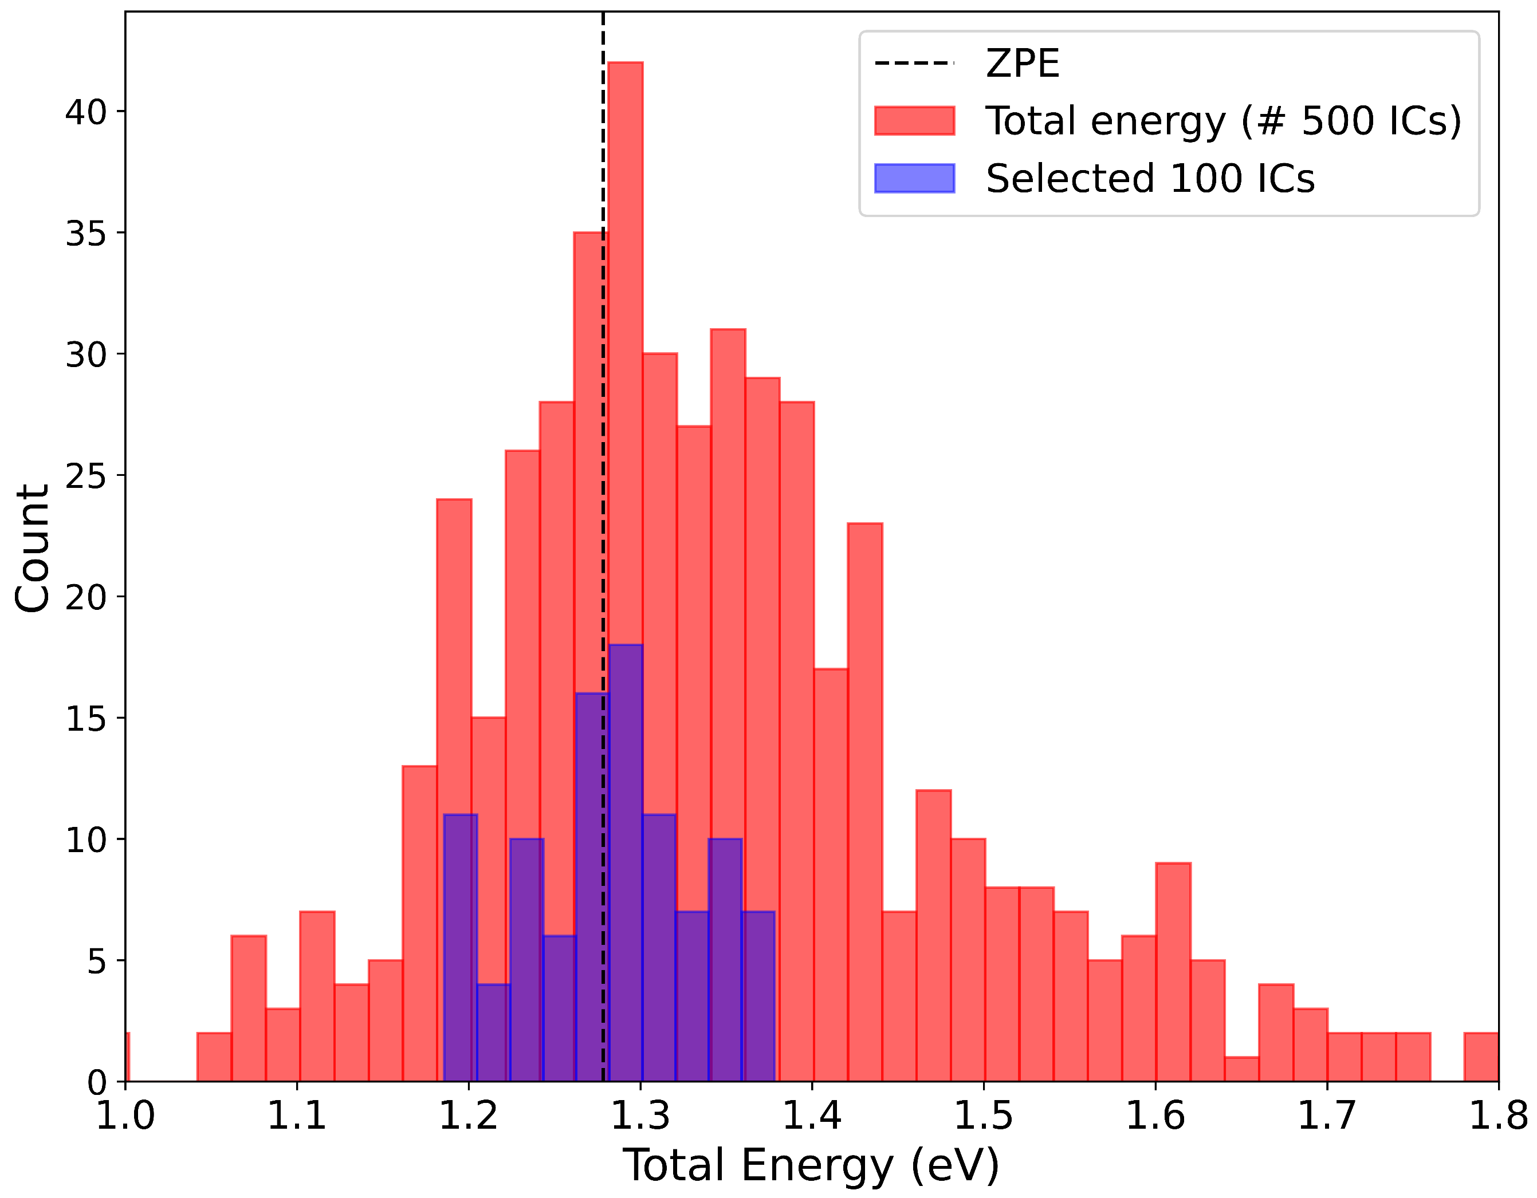
Results: Ground state Dynamics of Water dimer
MP2/aug-cc-pVDZ level of theory; Ground state BO dynamics.
Ab initio calculated ZPE is 1.28 eV.
Stretching mode frequency between the two water monomer is 200 cm⁻¹
ZPE is 0.012 eV.
The dimer dissociation energy (D_{e}) is 0.225 eV;
Bowman HBB2 PES predicts 0.216 eV; CCSD(T)/CBS limit is 0.218 eV.
Initial conditions are generated by correlated quantum HO distribution.
Selected 100 initial conditions
with the total energy ZPE +- 0.1 eV.
Any dissociation of the dimer will occur
only due to the unrealistic ZPE leakage
from other modes.
Bowman et al., J. Chem. Phys. 130, 144314 (2009)
J. R. Lane, J. Chem. Theory Comput. 9, 316 (2013)

Slide 14
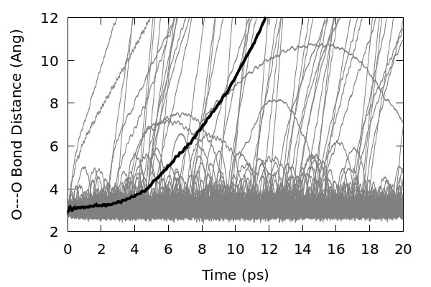
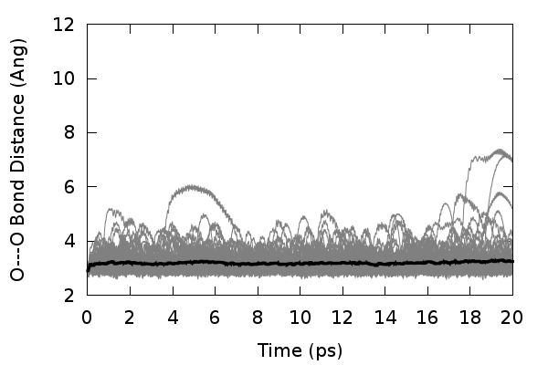
Before ZPE Correction
Bowman Correction
After ZPE Correction
Bowman [JCP, 132, 164103 (2010)]:
averaging over 100 trajectories
dt = 0.0484 fs,
correction took at every 0.24 fs.
Present case:
averaging over 100 trajectories
dt = 0.5 fs,
correction is invoked at every 10 fs.
NO HESSIAN

Slide 15
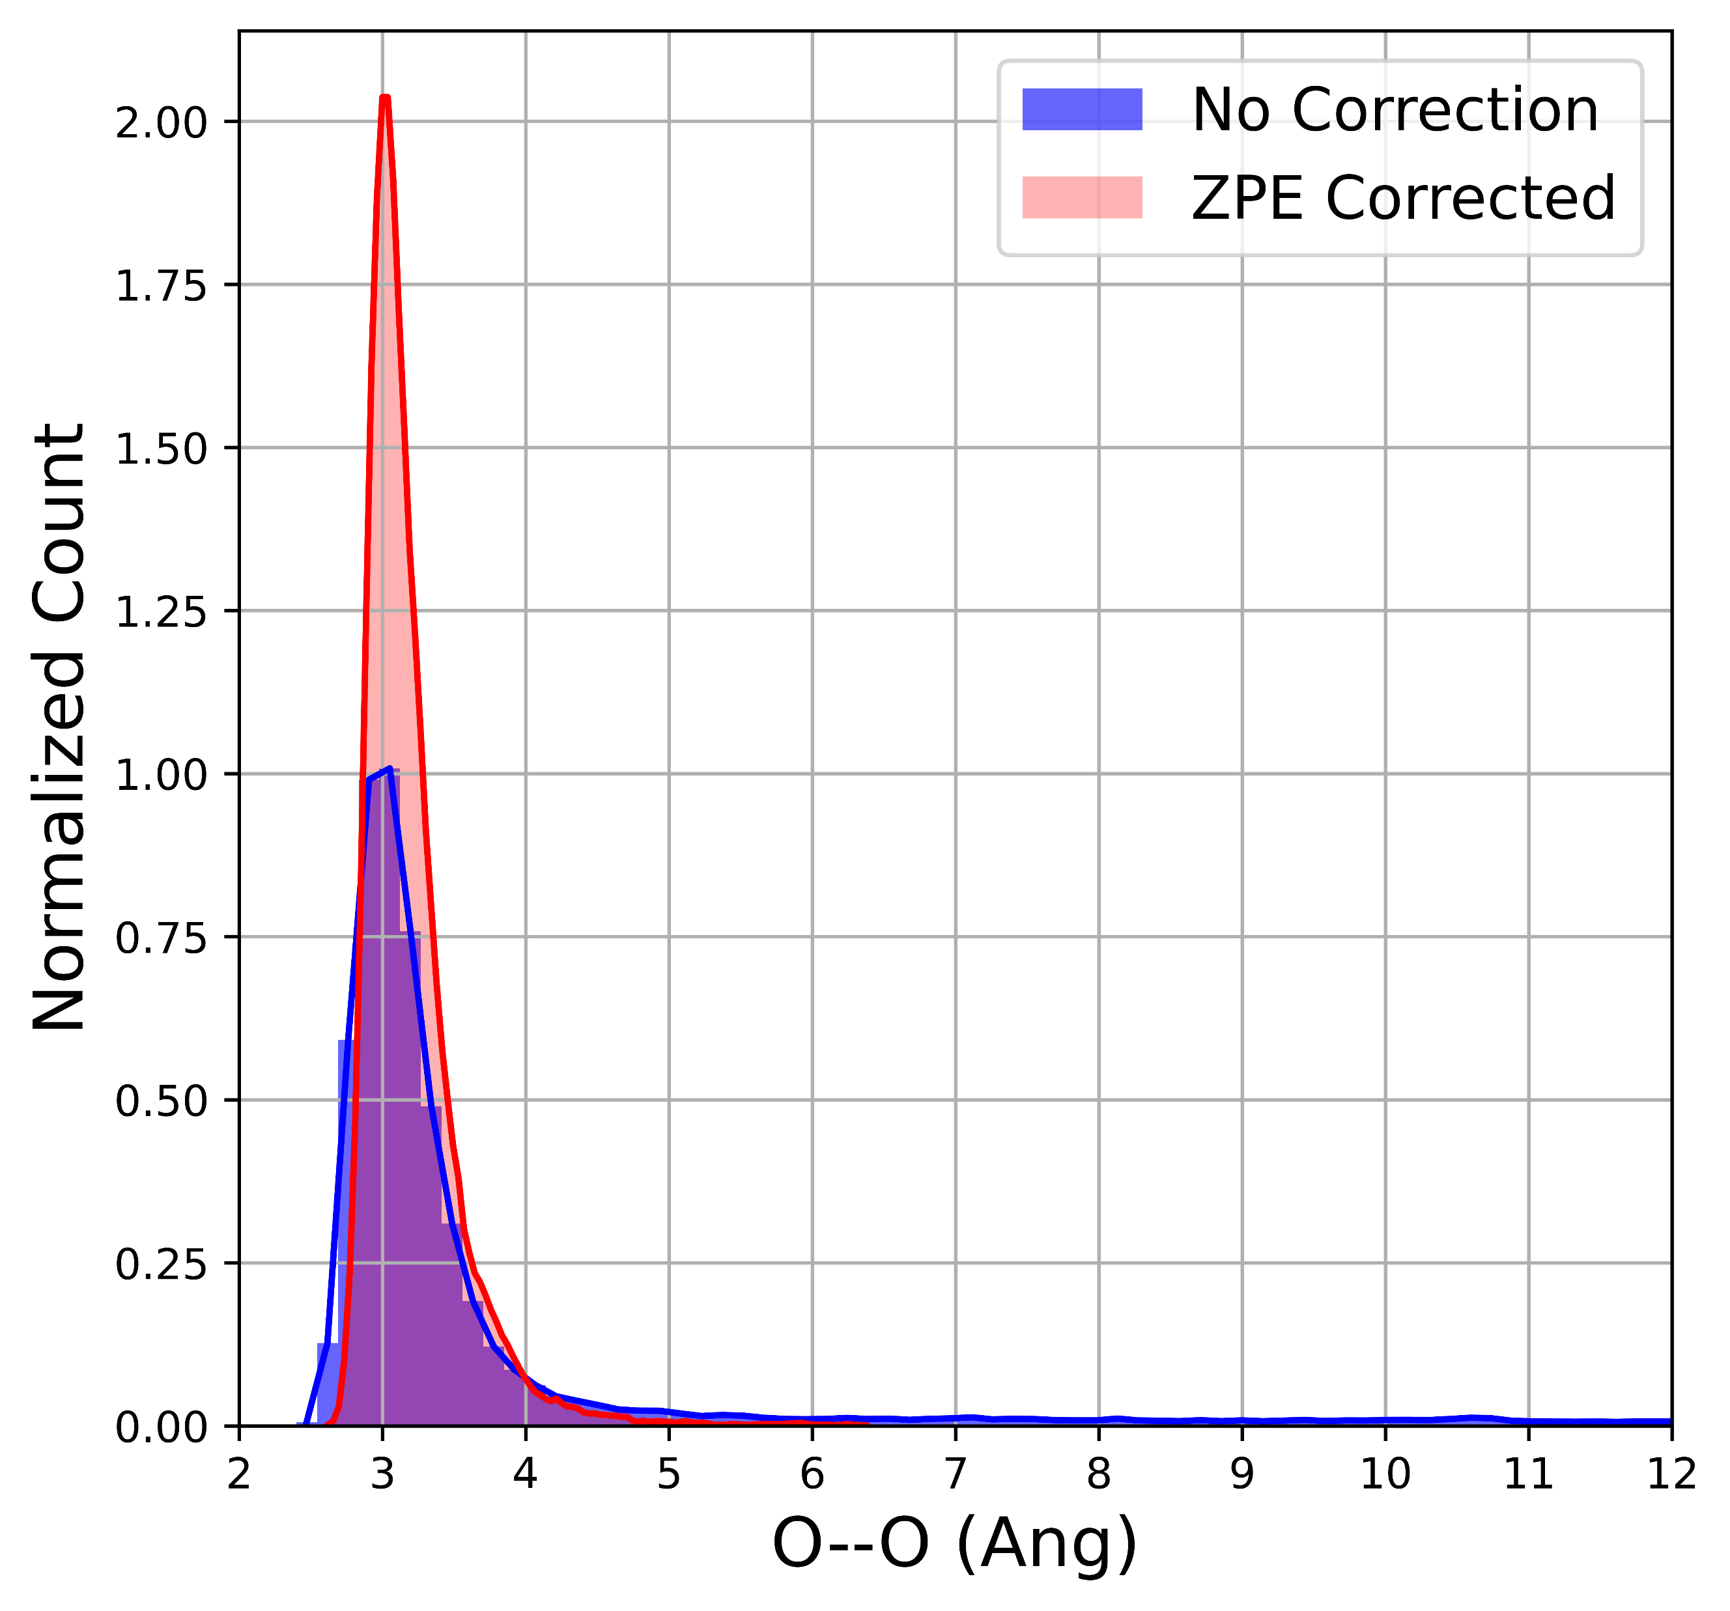
The O—O distances between the two monomer at every timestep up to 20 ps for 100 trajectories are collected and plotted as normalized histogram.

Slide 16
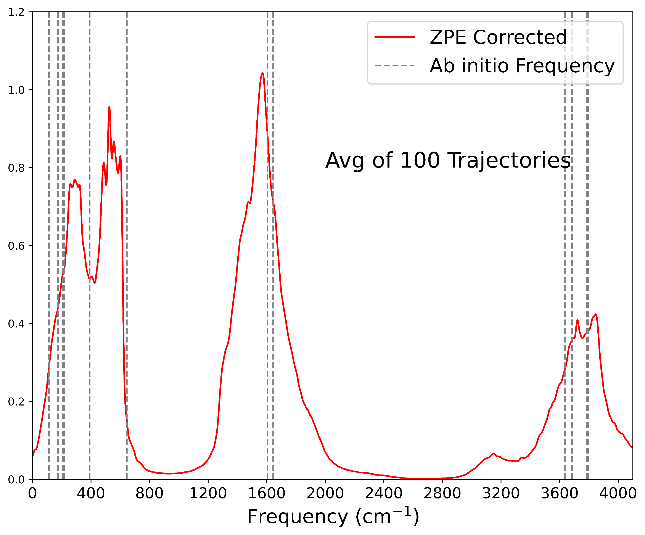
Power Spectra: Fourier transform of the velocity autocorrelation function

Slide 17
Summary
A Hessian free method to prevent ZPE leakage in classical trajectory simulation.
Very general in nature and Easy to implement in MQC dynamics.
In principle, can be readily extended to excited states also.
Conserve the total energy, linear momentum and angular momentum of COM
Dynamics has not been perturbed much, can reproduced the ground state harmonic frequencies.
This scheme is codified in the NX NS, which will be available soon.

Slide 18

Acknowledgements
Prof. Mario Barbatti
Dr. Baptiste Demoulin
&
All my group members
https://www.subnano.org
Thank You

