Slide 1

on impact in plasma Electrophore model for dissociation of molecules after the electron impact in plasma
Ryan Brook,^{1,2} Dmitry Makhov,¹ Alfred Stonelake,¹ Gregory Armstrong,² Anna Nelson,² Jonathan Tennyson,^{2,3} and Dmitrii V. Shalashilin¹* ¹School of Chemistry, University of Leeds, Leeds LS2 9JT, United Kingdom ²Quantemol Ltd., 320 City Road, The Angel, London EC1V 2NZ, United Kingdom ³Department of Physics and Astronomy, University College London, London WC1E 6BT, United Kingdom *Email: d.shalashilin@leeds.ac.uk

Slide 2
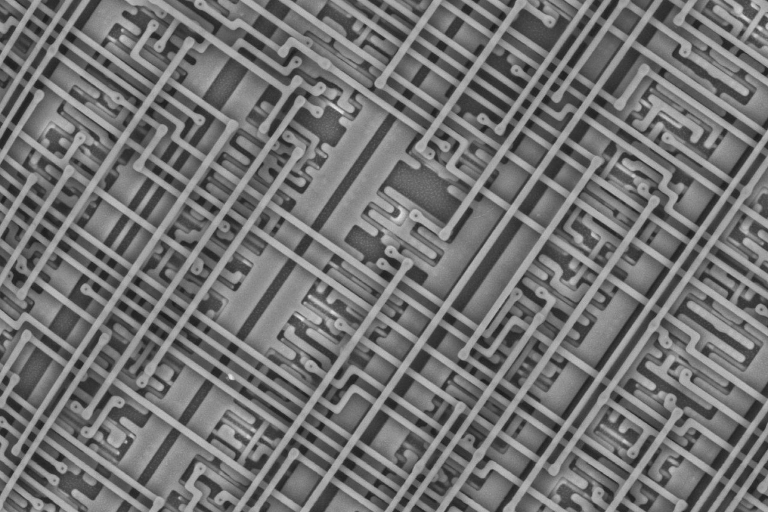
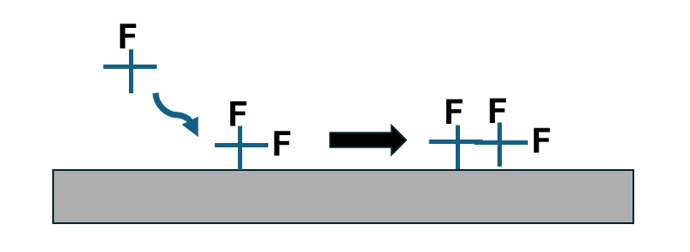
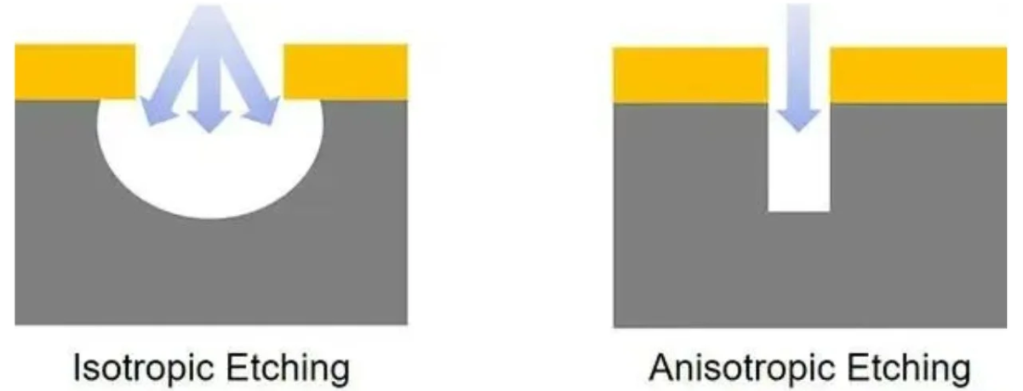
Motivation and vision.
Low temperature plasmas are essential to the manufacture of devices in the semiconductor industry.
Plasma Etching Plasma Deposition
Free radicals Ions Free Radicals
F•, •CF3, :CF2
Inside of a microchip
+

Slide 3
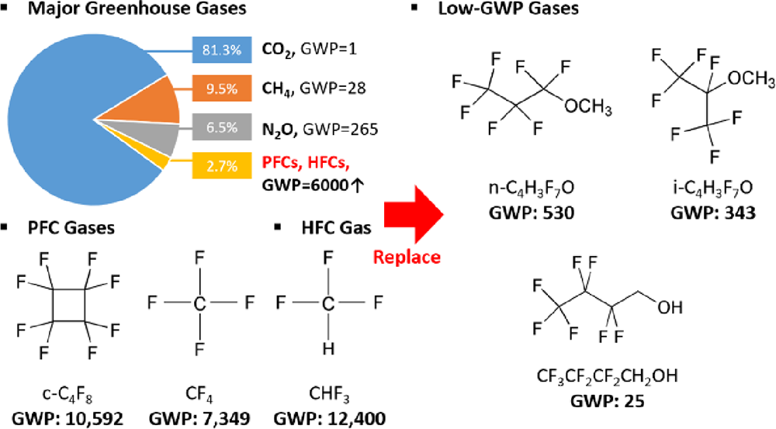
Motivation and vision.
The gases are fluorine-organic molecules which are not environmentally friendly and expected to be phased out of manufacturing.
Developing new plasma sources with new families of gases, which are efficient and environmentally friendly, is a high priority for the industry.

Slide 4
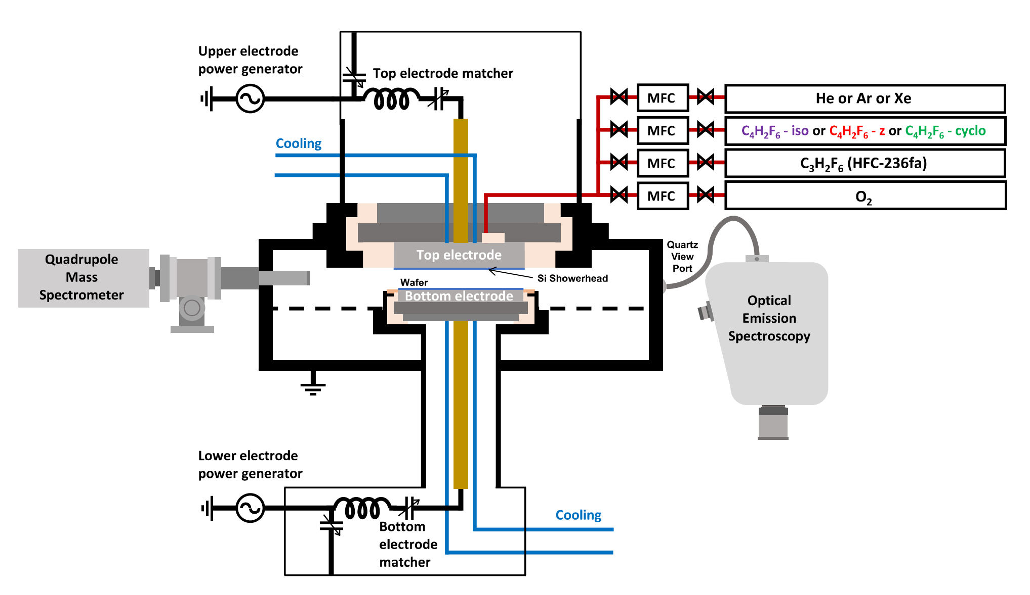
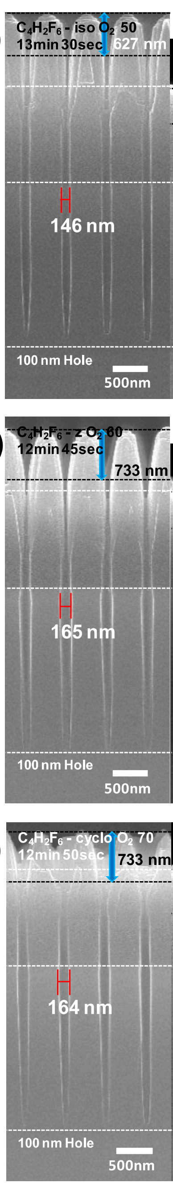
Experiment
Real plasma etching device coupled to quadruple Mass Spec. Etching patterns

Slide 5
Theory
We run ab initio molecular dynamics (AIMC or AIMD) in order to identify:
  The fragments formed
  The kinetics of fragmentation
  Give us a molecule and we tell you how it breaks. In silico design?

Slide 6



Plan of the talk
Molecular Dynamics we use
First simulations of dissociation of molecules after electron impact and Electrophore Model (EM)
https://doi.org/10.1021/acs.jpclett.4c00348
Dmitry Makhov
Development of Electrophore Model and systematic simulations of the dynamics with a new code.
https://doi.org/10.1116/6.0004454
https://etheses.whiterose.ac.uk/id/eprint/38227/
Ryan Brook
More simulations of dissociation of hydrofluorocarbons and electronic structure confirmation of the Electrophore Model
Alfred Stonelake
Future developments and vision. Potential energy surfaces with Machine Learning and simulations at low T. Better comparison with mass spec.
Sourav Roy

Slide 7
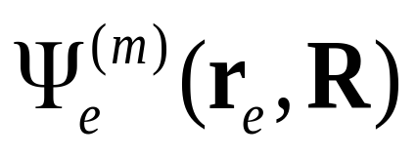
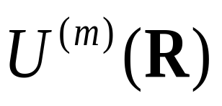
Basics. Born-Oppenheimer Potential Energy Surfaces and Molecular Dynamics.
Born-Oppenheimer electronic wave function of the m^{th} electronic state (Adiabatic states)
m^{th} electronic energy
PES drives the motion of nuclei
But what are the surfaces involved in the dissociation in plasma?

Slide 8
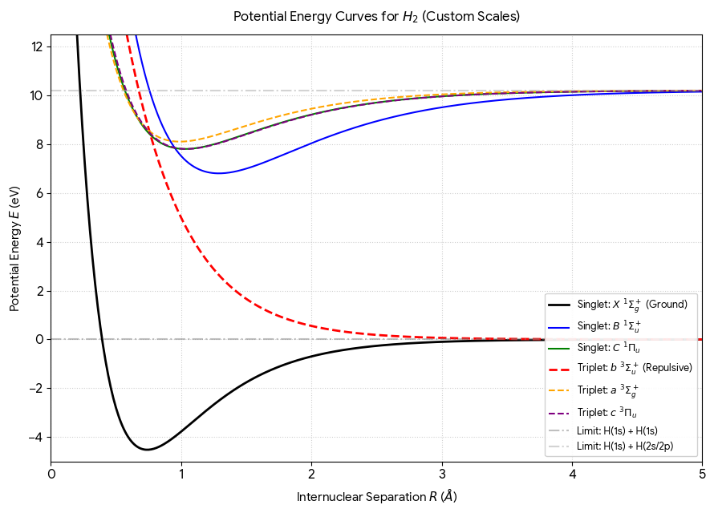


Basics. Born-Oppenheimer Potential Energy Surfaces and Molecular Dynamics.
In plasma molecules are excited to higher electronic states by electron impact.
Triplet state more repulsion
$$U^{(1)}(R)$$
Singlet state
$$U^{(0)}(R)$$
The lowest triplet electronic state plays crucial role in dissociation.

Slide 9
Basics. Born-Oppenheimer Potential Energy Surfaces and Mechanism of dissociation after electron impact
T₂
Several low electronic state both triplet and singlet can be excited by electron impact.
We expect that triplet states are most important as they are in general more repulsive and lower in energy
T₁
A● + ●B
S₀
-

Slide 10
Basics. Born-Oppenheimer Potential Energy Surfaces and Mechanism of photo-dissociation
S₂
In photochemistry only singlet states are excited by photons.
However, all method developed in photochemistry can be applied to chemistry after electron impact
S₁
hν
A● + ●B
S₀

Slide 11
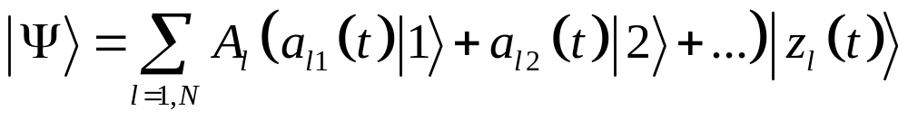
Non-adiabatic quantum dynamics
We apply our own Ab Initio Multiple Cloning (AIMC) method.
Electronic wave function
Nuclear basis of Gaussian CSs
Ehrenfest configuration
is a Gaussian CS dressed with Electronic wave function
Amplitude
Sum of normalised Ehrenfest configurations

Slide 12
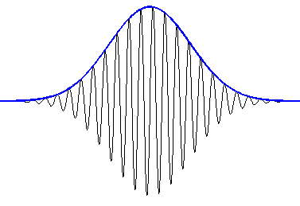
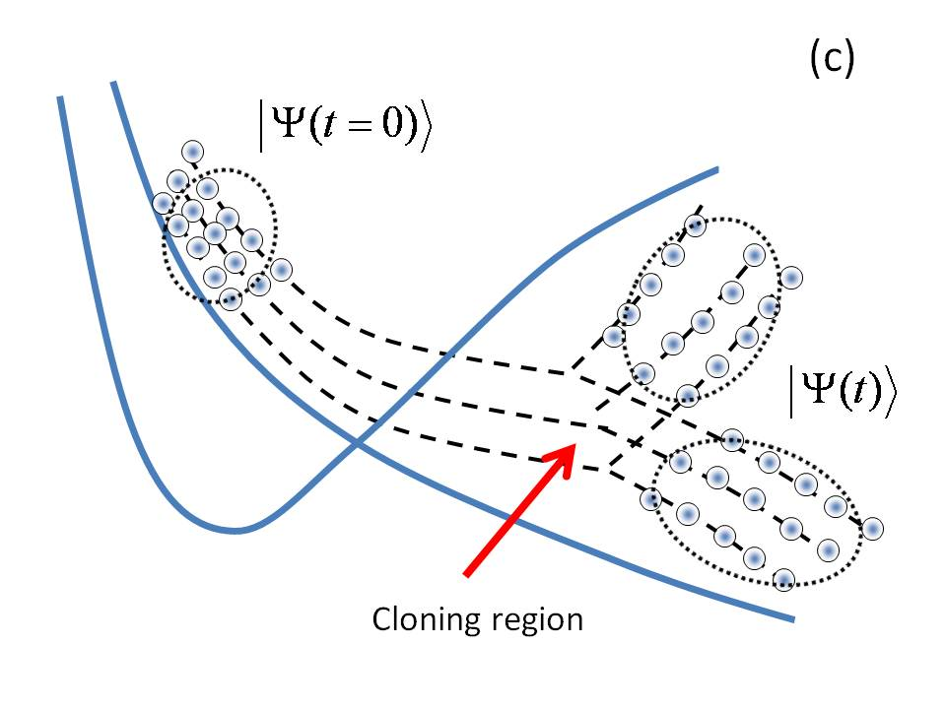
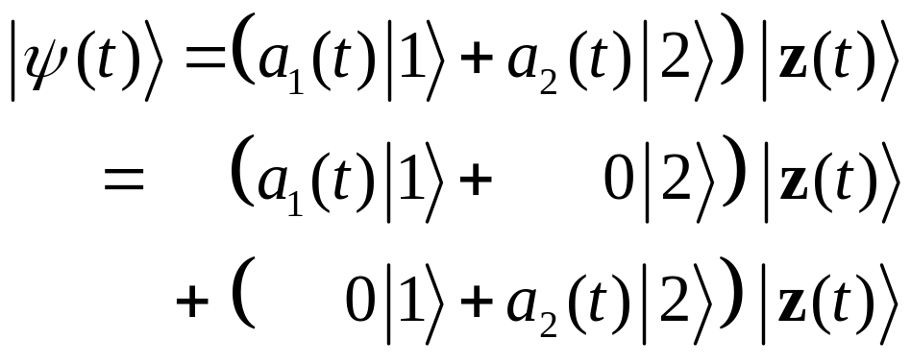
Non-adiabatic quantum dynamics
We apply our own Ab Initio Multiple Cloning (AIMC) method.
Coherent State Samplings:
Cloning
Cloning is a straightforward
way to do spawning (Martinez)
Cloning provides adoptive basis set for nonadiabatic dynamics

Slide 13
Non-adiabatic quantum dynamics
We apply our own Ab Initio Multiple Cloning (AIMC) method.
AIMC describes quantum motion of nuclei in terms of several coupled trajectory guided basis functions.
Cloning provides trajectory branching to account for wave-function bifurcation when there are transitions between electronic states.
Forces are calculated Ab initio
If we use only one trajectory and one PES then AIMC becomes Ab Initio Molecular Dynamics AIMD.

Slide 14
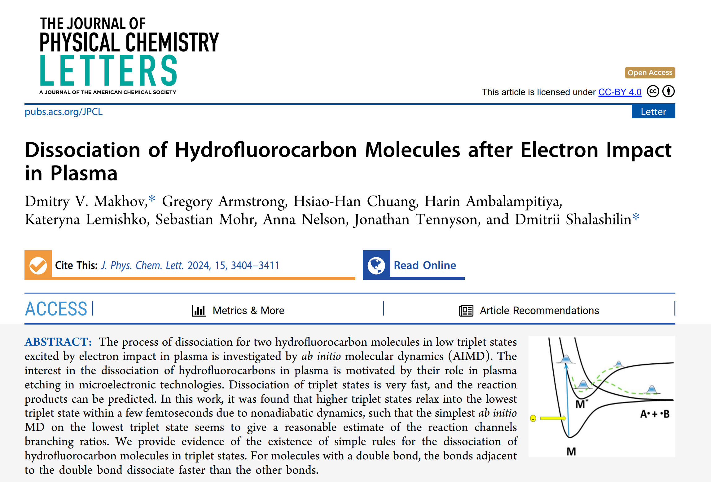
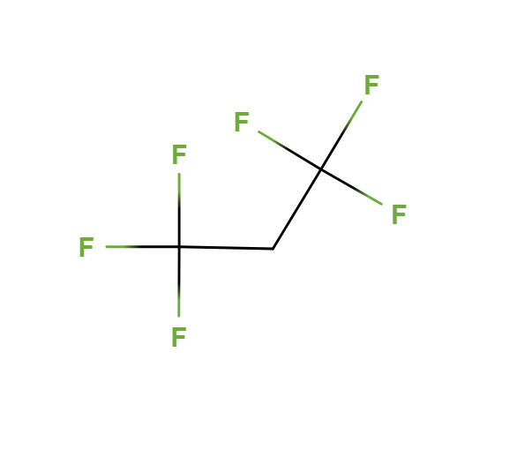
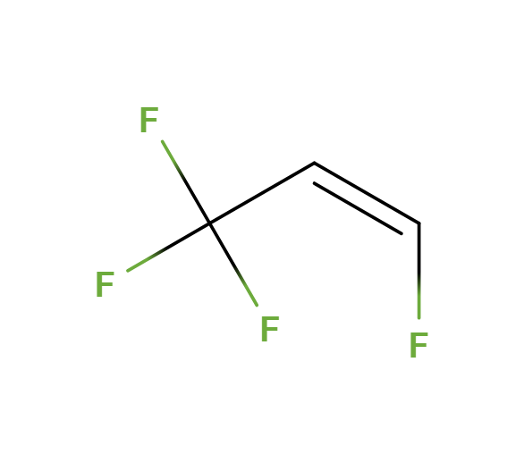
First simulations of dissociation of molecules after electron impact and Electrophore Model (EM)
https://doi.org/10.1021/acs.jpclett.4c00348
Dmitry Makhov
C₃H₂F₆
C₃H₂F₄

Slide 15
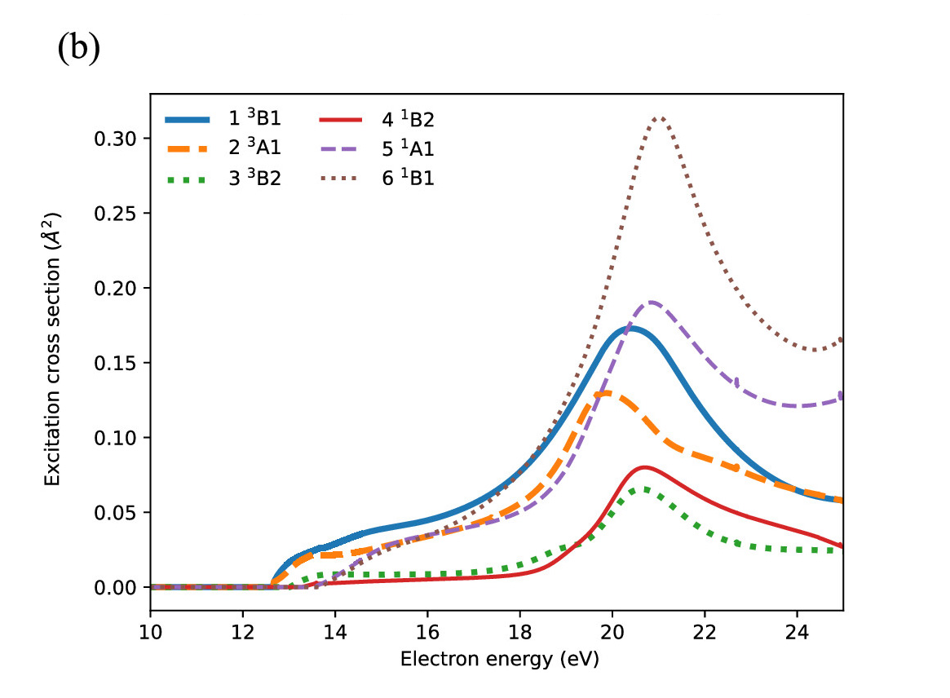
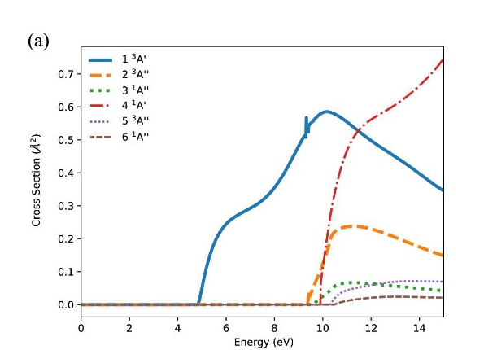
Molecules
Two molecules has been chosen for the start, C₂H₂F₄ and C₃H₂F₆
C₂H₂F₆
C₂H₂F₄
Electron impact excitation cross sections for C₃H₂F₆ and C₃H₂F₄
No separation between two lowest excited states
Non-adiabatic dynamics is needed
One clearly separated lowest triplet state
Can avoid expensive non-adiabatic dynamics

Slide 16
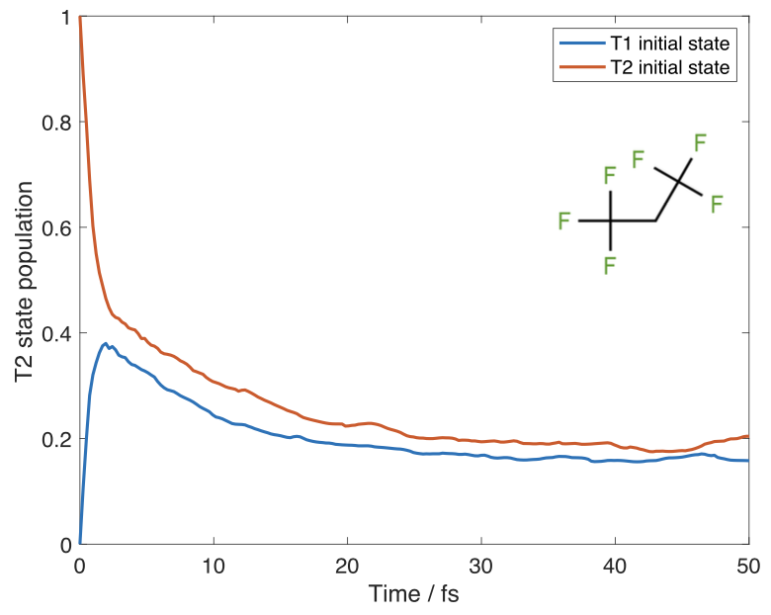
Non-adiabatic dynamics for C₂H₂F₆
Spin-flip TDDFT method implemented in Q-Chem quantum chemistry package (BH&HLYP, 6-31+G*)
500 trajectories with Boltzmann random initial conditions for 5000 K
Average populations of the upper triplet state of C3H2F6 molecule as a function of time given by AIMC nonadiabatic dynamics calculations that use lower (blue) and upper (red) triplet states as the initial state.
Even when several triplet states are initially involved, in many cases higher triplet states quickly relax into the lowest triplet state.

Slide 17
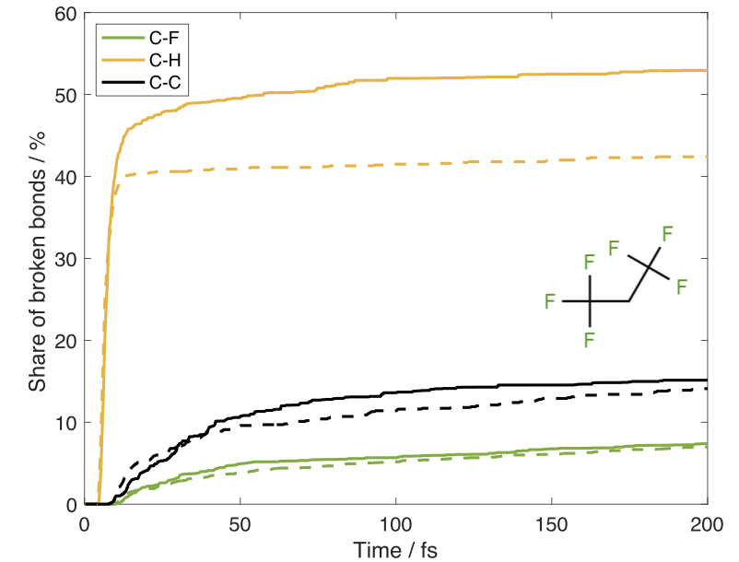
Dissociation kinetics of C₂H₂F₆
T₂
T₁
-
Comparison of dissociation kinetics of a C₃H₂F₆ given by AIMC nonadiabatic dynamics with initial state T₂ (solid) and by the molecular dynamics (AIMD) on T₁ potential energy surface (dashed). The number of broken bonds as a function of time for at 5000 K.
For all other molecules, we run molecular dynamics on a single T₁ potential energy surface.

Slide 18
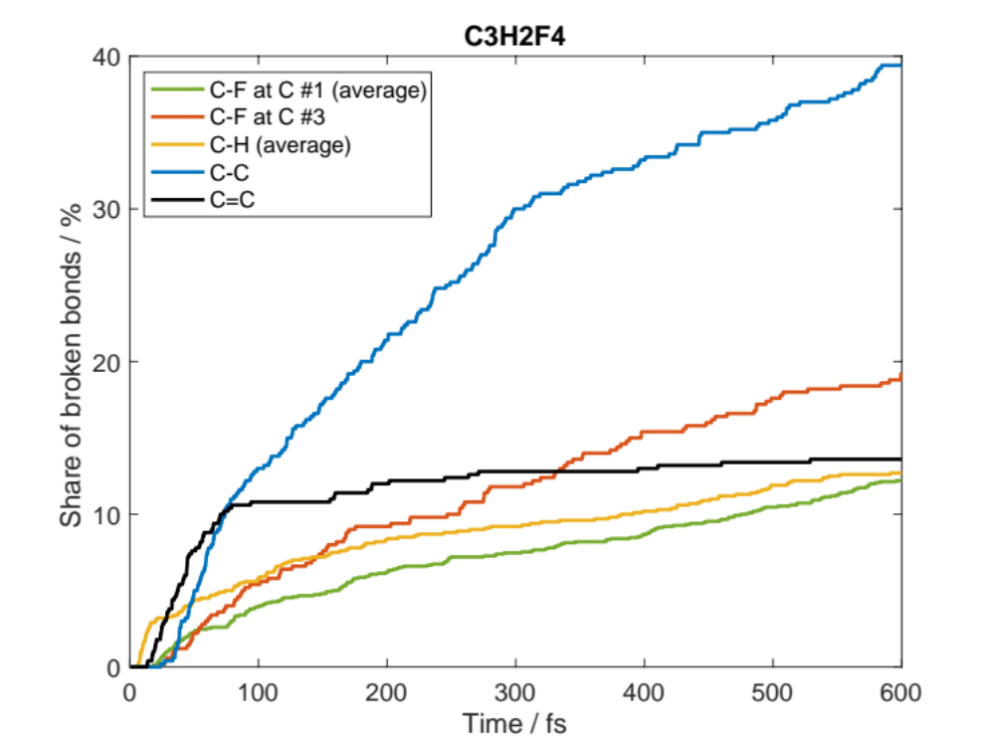
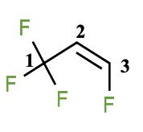
Dissociation kinetics of C₂H₂F₄
C-C bond breaks efficiently
C=C bond breaks very fast initially
C-F bond at double-bonded C atom has significantly higher dissociation rate than other C-F bonds
This can be explained by the localization of the initial T₁ excitation on the double bond.
The double bond here can be called an electrophore, by analogy with the chromophore in photochemistry.
The number of broken bonds as a function of time
for C₃H₂F₄ at 5000 K.
The electrophore model can help to predict the dissociation channels

Slide 19
Electrophores
(a)
_{σ*}
Triplet excitation is localized in the region with a low energy gap between the highest occupied and the lowest unoccupied orbitals
(a) The energy gap between π- and π*-orbital is low, which makes C=C bond an electrophore
(b) The lone pairs of the oxygen atom do not participate in chemical bonding, and their energy is in the middle between those of the bonding andantibonding orbitals.
The energy gap is lower than for promoting an electron from the bonding to the antibonding orbital
This makes oxygen atom a possible electrophore.
_{π*}
p_{z}
p_{z}
_{π}
sp₂
sp₂
_{σ}
(b)
Are there other types of Electrophore?
O sp³
C
C

Slide 20
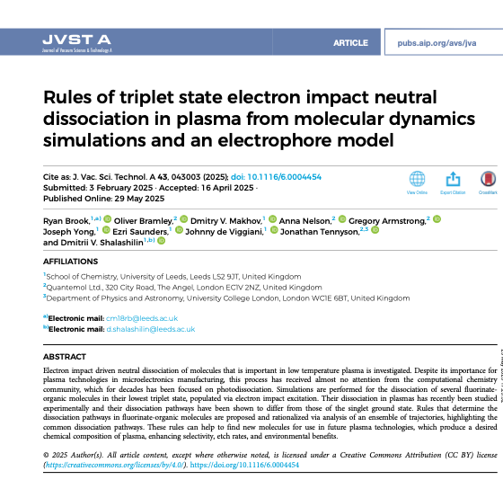
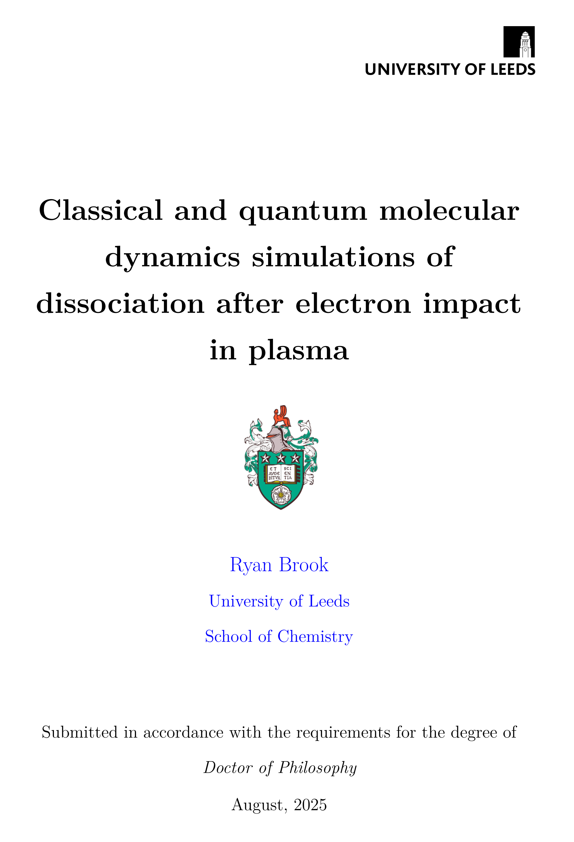
Development of Electrophore Model and systematic simulations of the dynamics with a new code.
https://doi.org/10.1116/6.0004454
https://etheses.whiterose.ac.uk/id/eprint/38227/
Ryan Brook

Slide 21

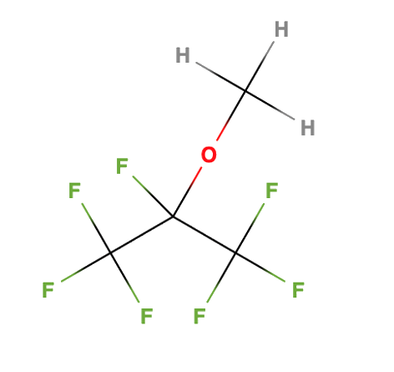
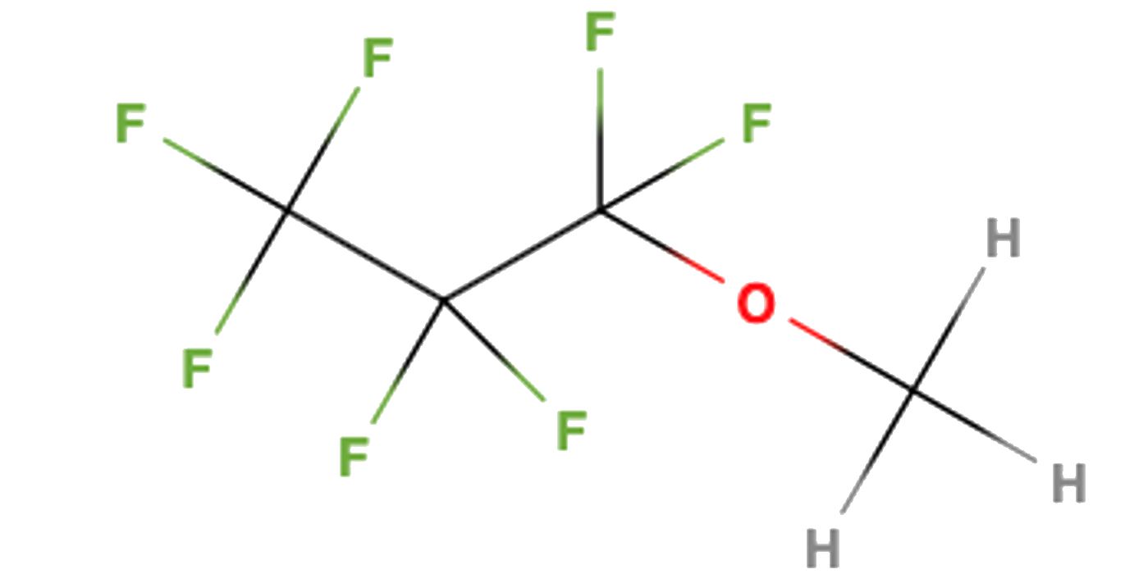
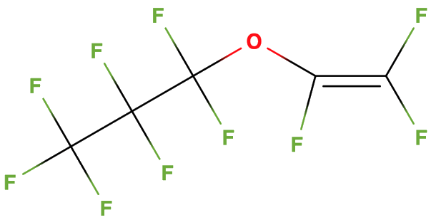
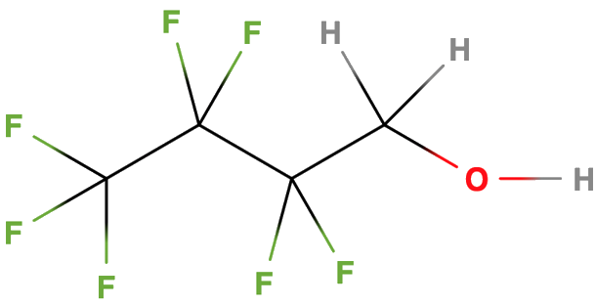
Development of Electrophore Model and systematic simulations of the dynamics with a new code.
https://doi.org/10.1116/6.0004454
https://etheses.whiterose.ac.uk/id/eprint/38227/
Ryan Brook
We have chosen a new selection of fluorinated organic molecules, now with an oxygen atom.
These molecules were investigated experimentally, and several key bonds were identified to be prominent in their neutral dissociation pathways.
i-C₄H₃F₇O
n-C₄H₃F₇O
PPVE
C₄H₂F₇OH

Slide 22
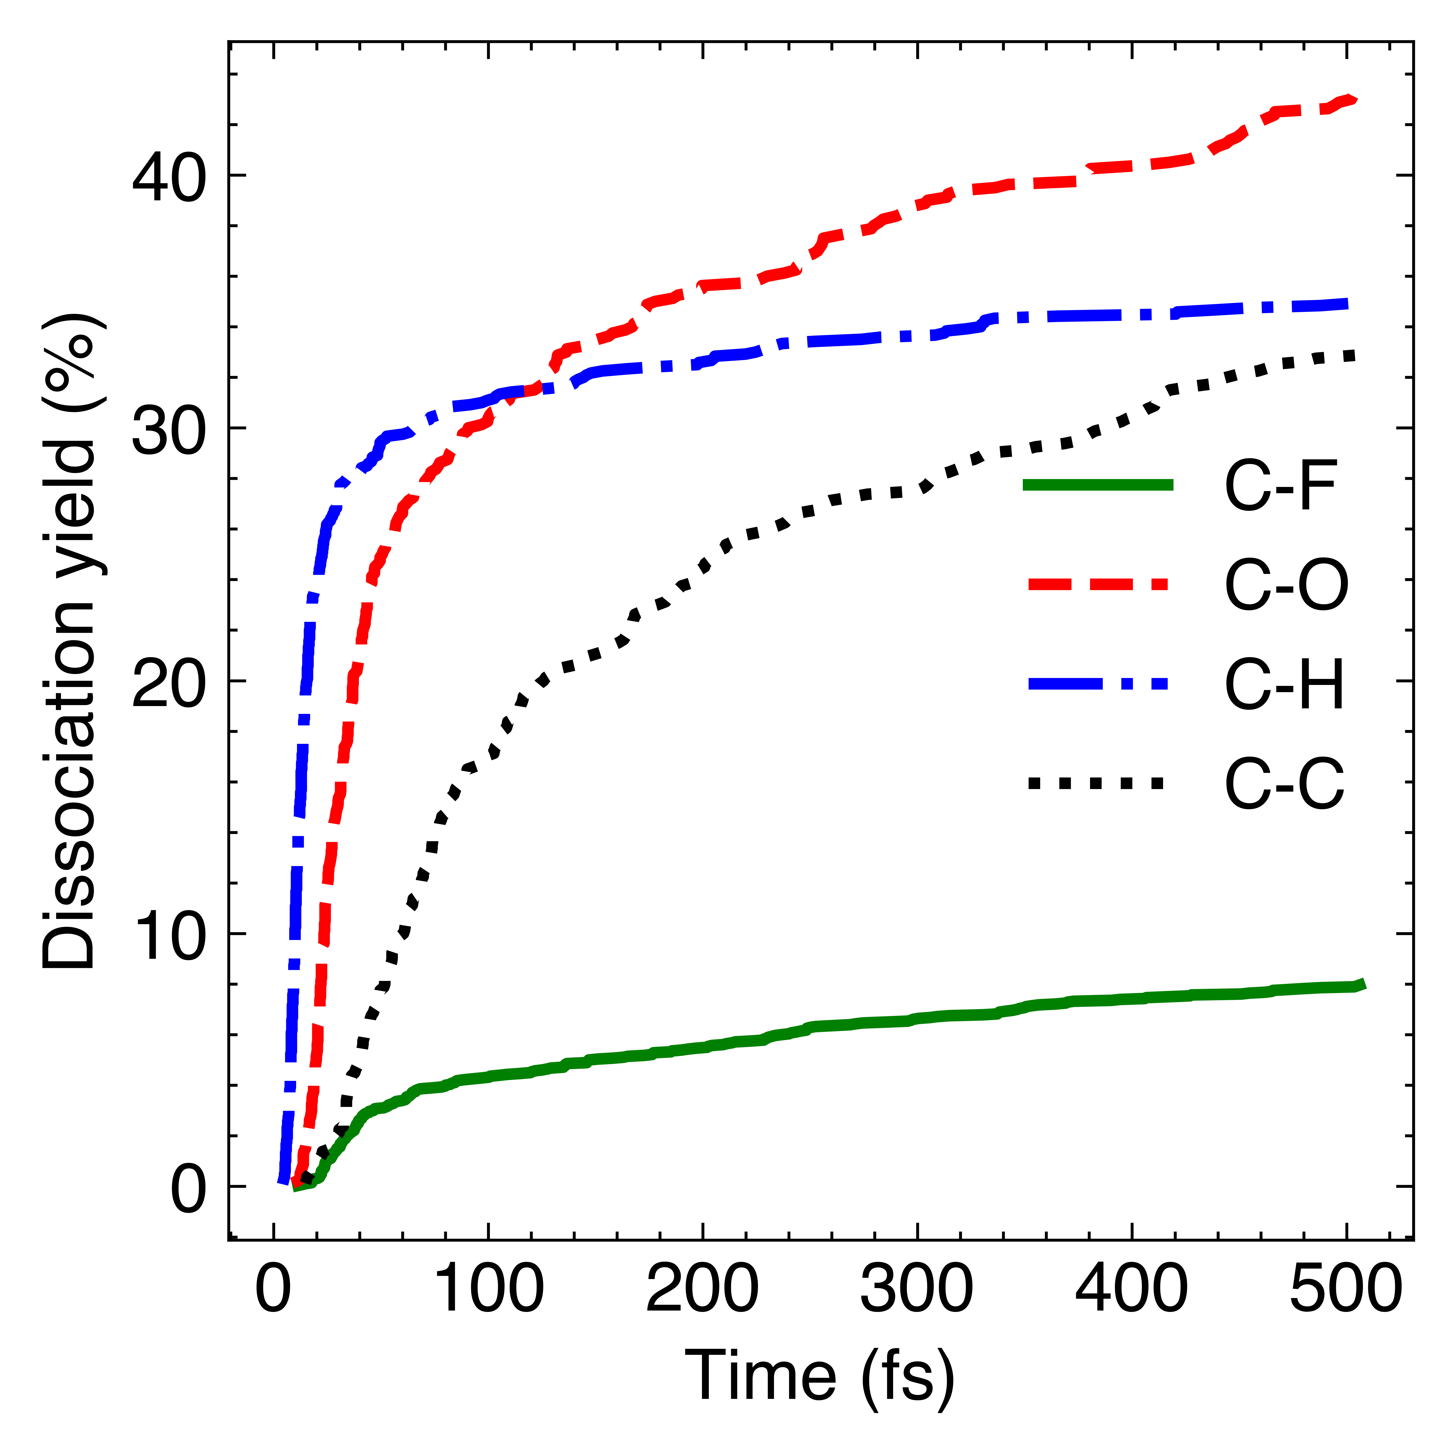
i-C₄H₃F₇O – Overview
4
1
2
3
C-O bonds break most
One C-H bond breaks for every molecule
C-F has the lowest number of bonds broken

Slide 23
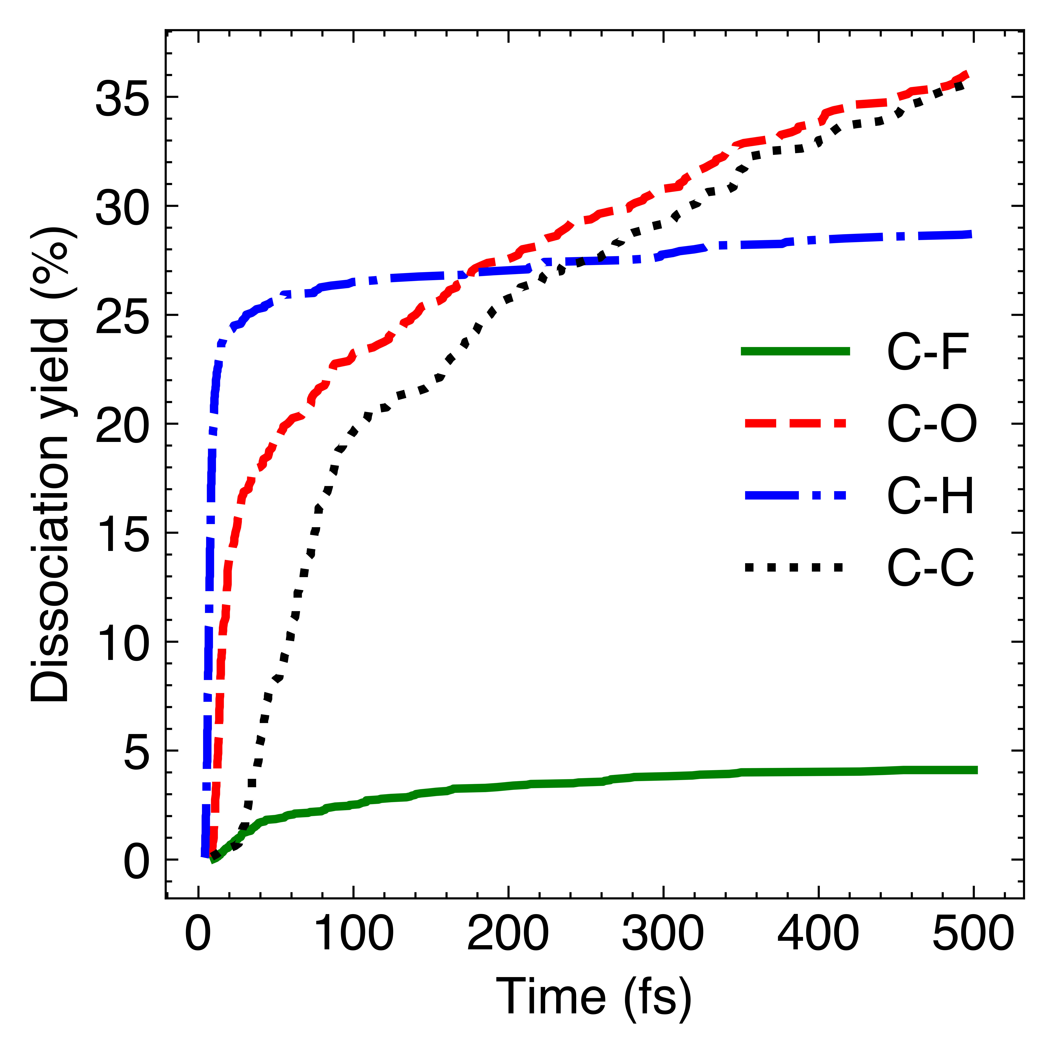
n-C₄H₃F₇O – Overview
2
1
3
4
C-C bonds break similar to the case of i-isomer, but other bonds break less frequently

Slide 24
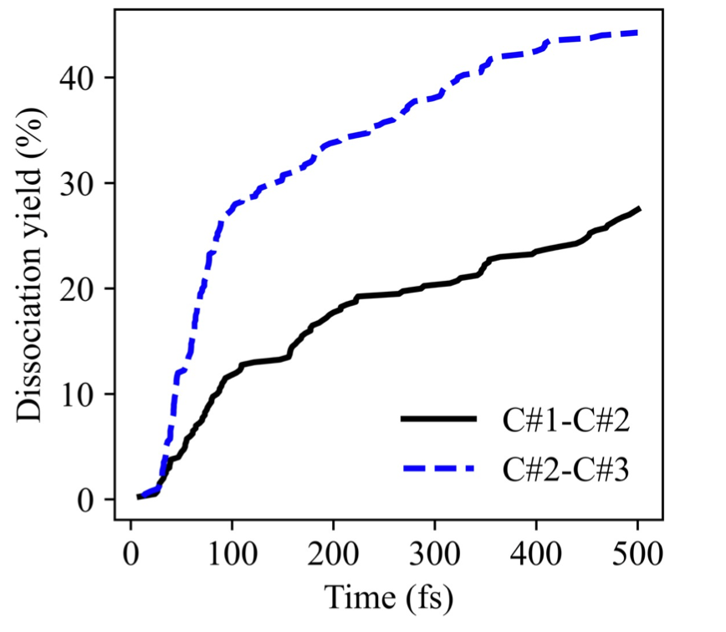
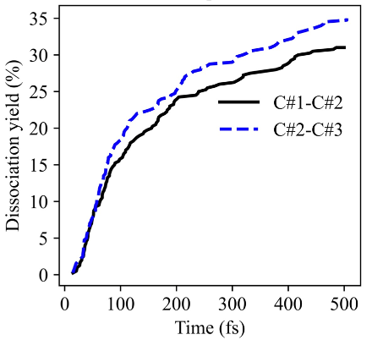
n- vs i-isomer – C-C
1
2
3
The C#2-C#3 bonds in the n-isomer breaks much more often
This can be explained by the proximity to the oxygen atom, which is an electrophore in this molecule
The C-C bonds in the i-isomer breaks with the same rate, as to be expected from a symmetrical molecule.
4
4
1
2
3

Slide 25
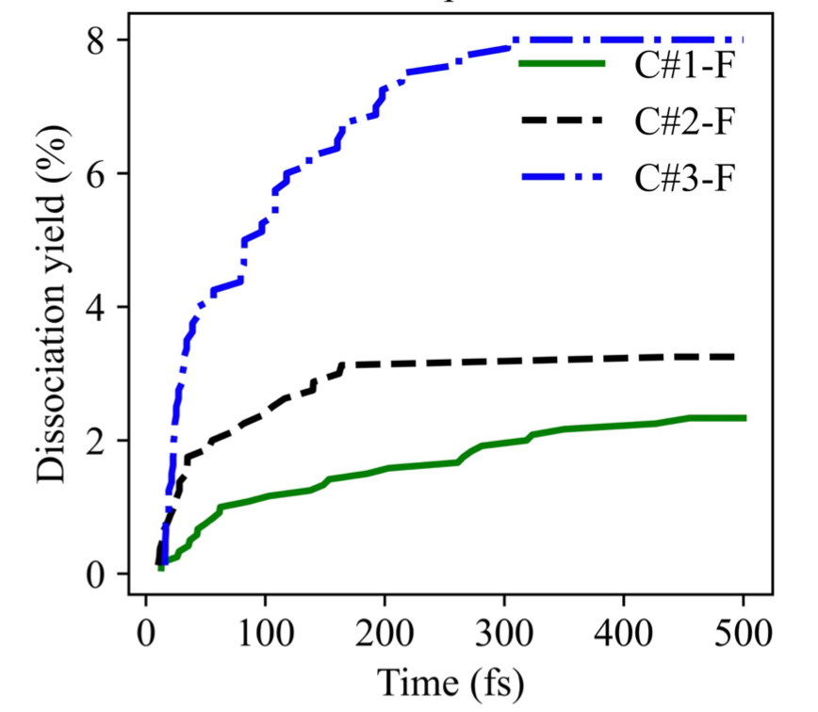
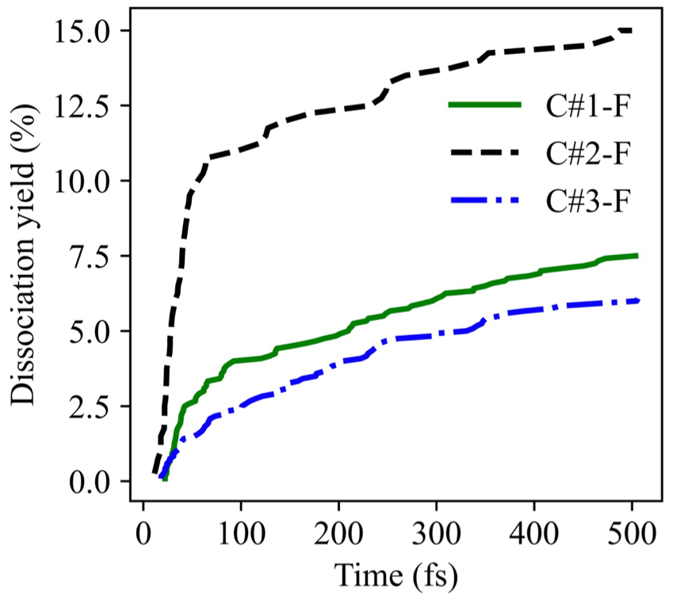
n- vs i-isomer – C-F
1
2
3
The breaking rate of C-F bond in n-isomer greatly dependent on the proximity to the oxygen atom.
For i-isomer, the C#2-F bond breaking rate is the highest.
Oxygen atom is an electrophore
4
4
1
2
3

Slide 26
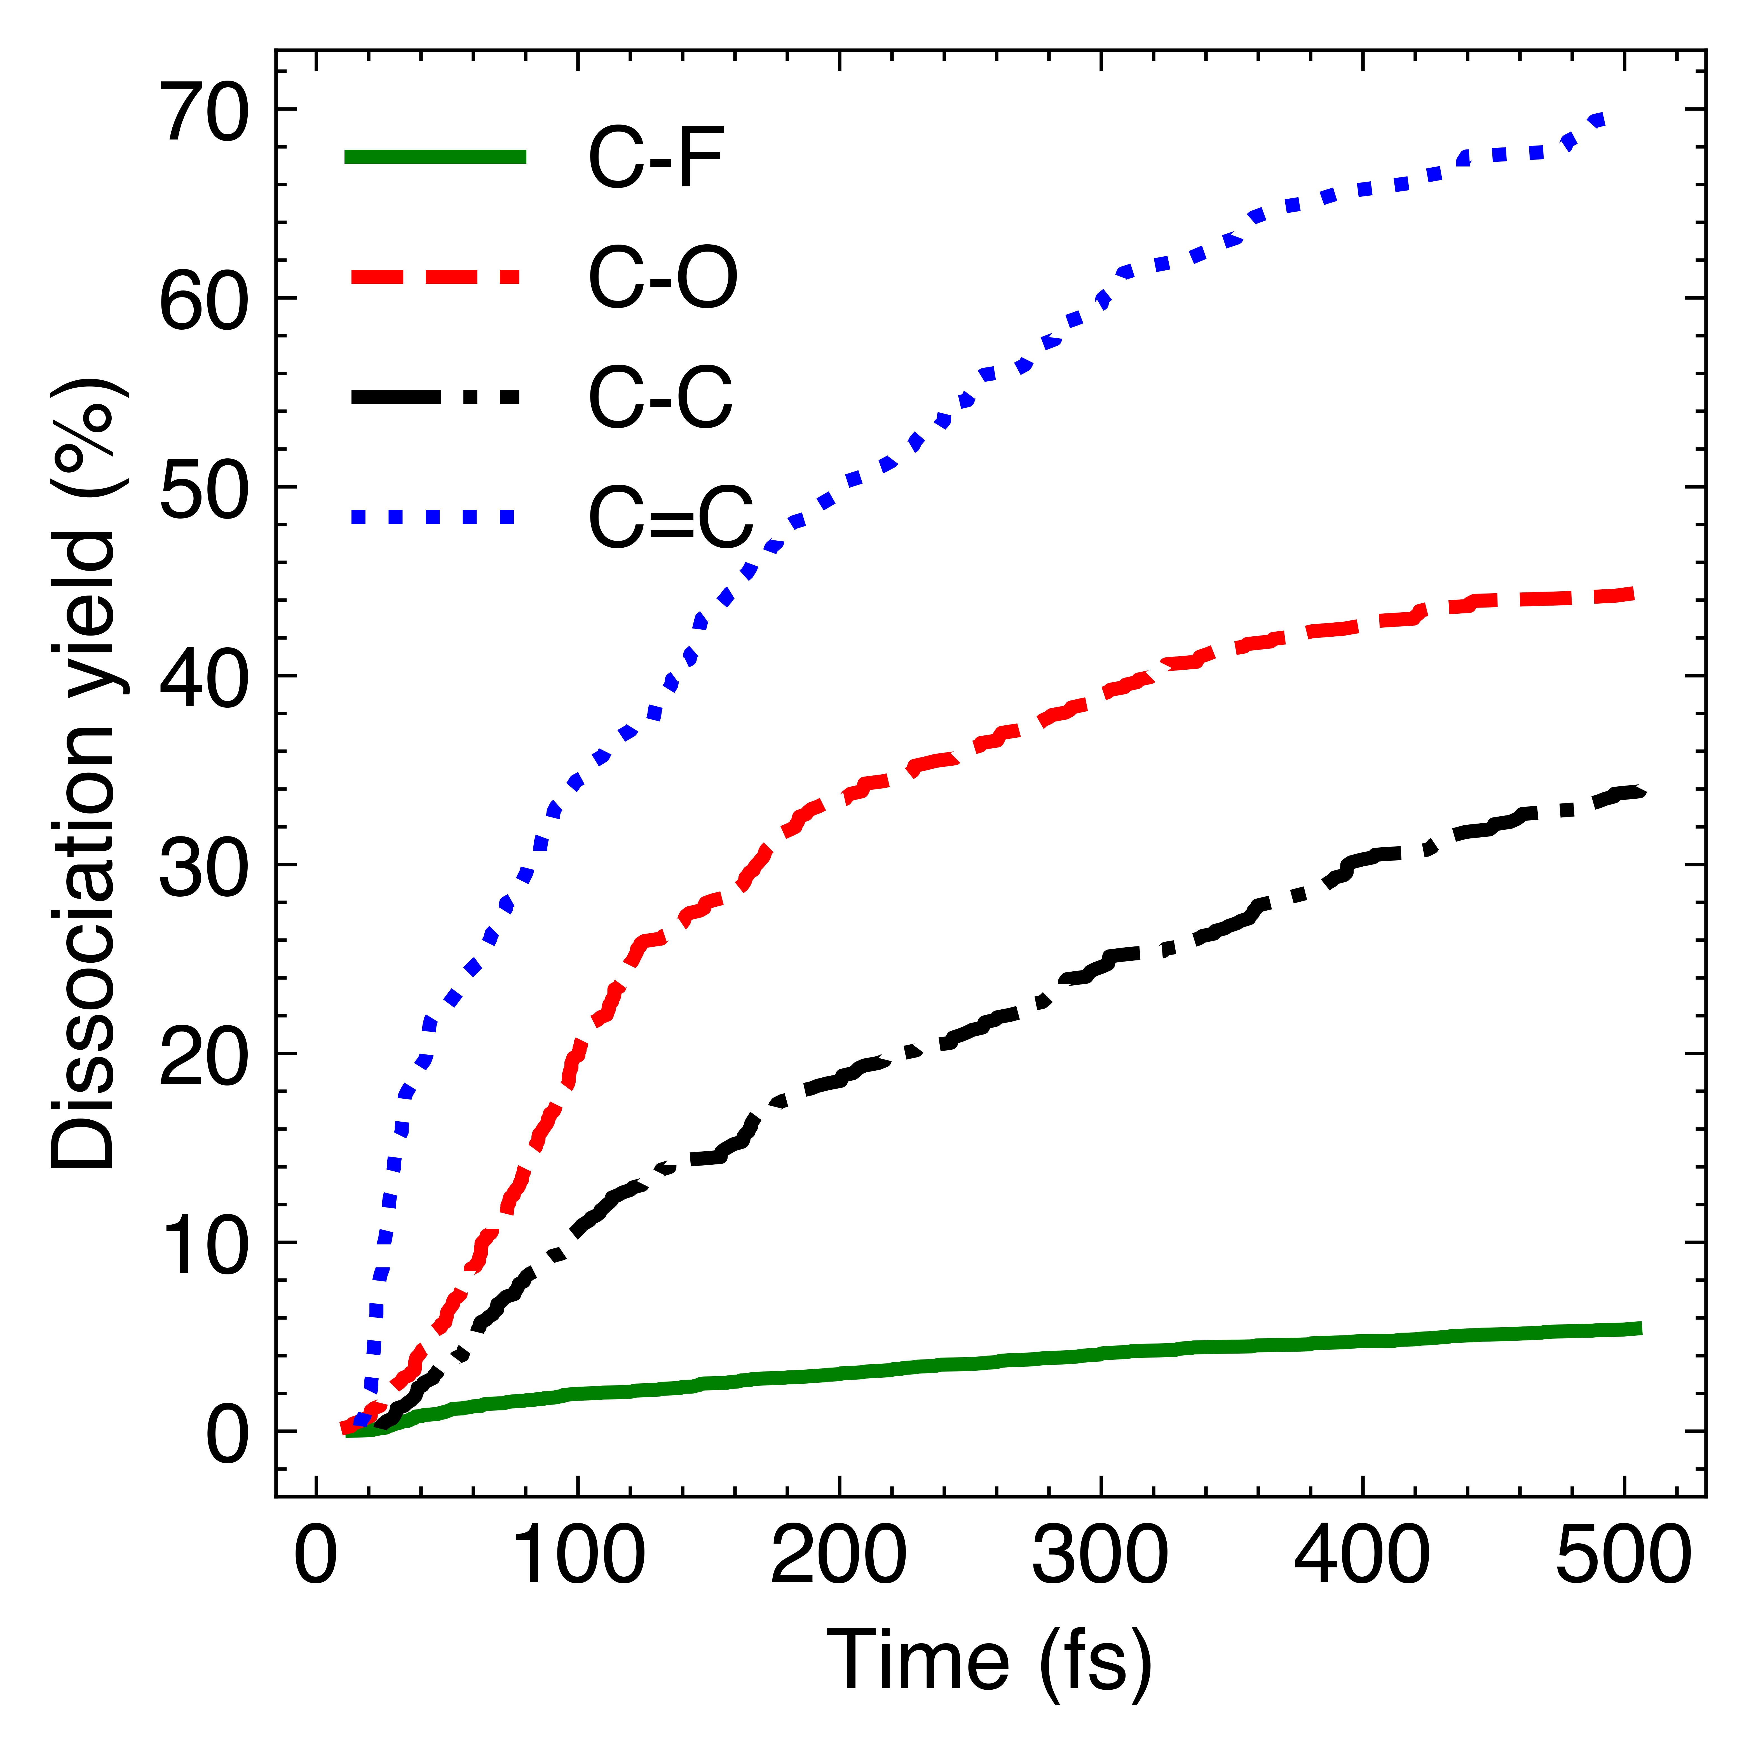
PPVE – Overview
4
5
3
1
2
C=C & C-O bonds break the most, suggesting location of localization

Slide 27
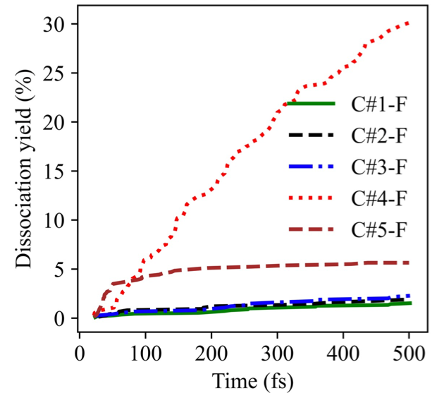
PPVE – C-F Bonds
PPVE molecule has two electrophores – a double bond and an oxygen atom.
4
5
3
1
2
Over 50% of all C-F bonds broken come from just one single C-F bond
The effect of proximity to multiple electrophores is cumulative

Slide 28
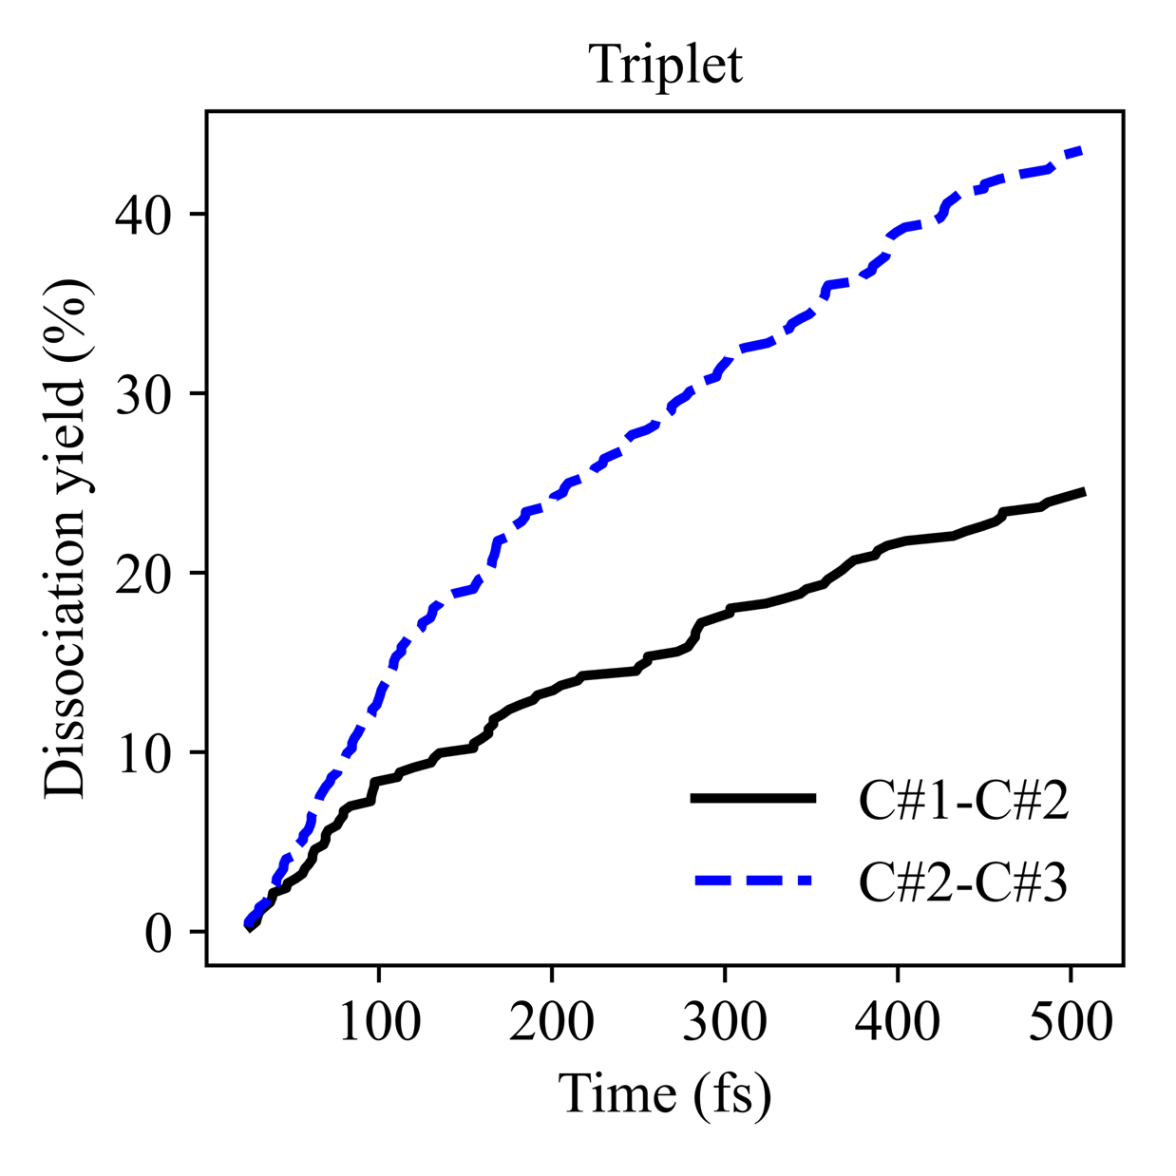
PPVE – Low C#3-F Count
4
5
3
1
2
C#3-O quickly breaks in 66% of the molecules due to the presence of the double bond.
C#2-C#3 breaks in 40.5% of molecules
Both of these factors combined limit the breaking of the C#3-F bonds, despite proximity to the oxygen atom.

Slide 29
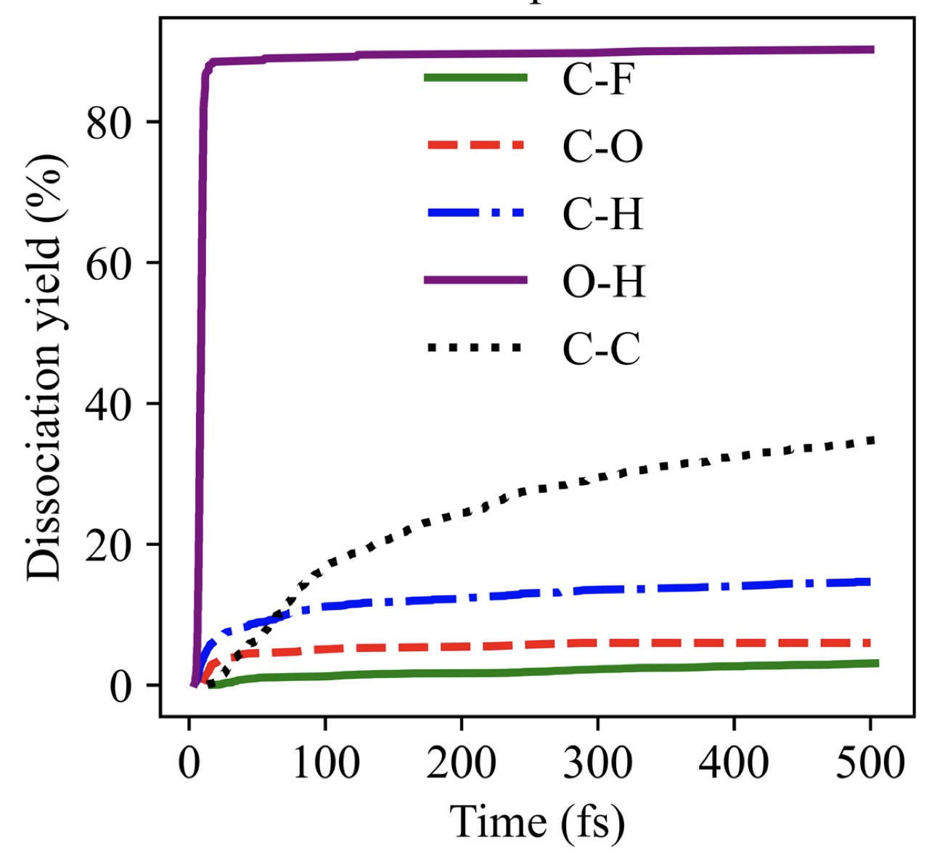
C₄H₂F₇OH – Overview
1
3
4
2
O-H bond breaks almost immediately
Probably this prevents C-O bond breaking

Slide 30
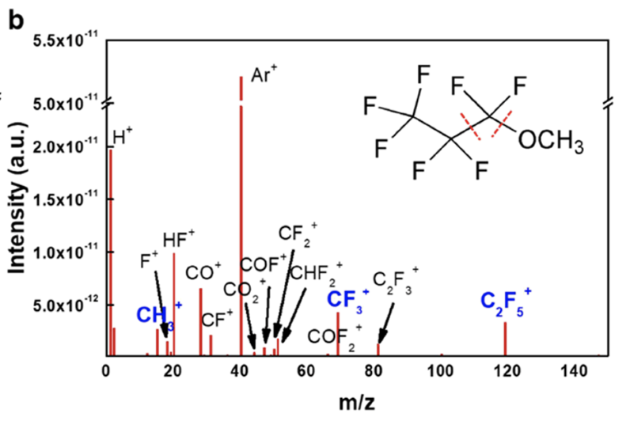
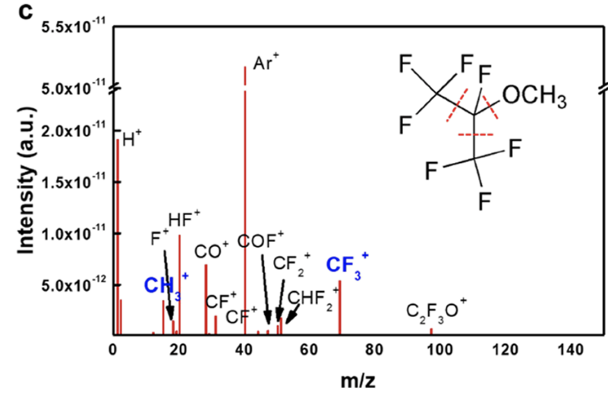
Experimental
The molecules that we simulated were investigated experimentally to test whether they would be viable replacements for the C4F8 plasma precursor
Several key bonds were identified to be prominent in their neutral dissociation pathways.
These bonds correspond to the bonds most often dissociated in our simulations.
Y.Kim et al, ACS Sustainable Chemistry & Engineering, 2022, 10, 32, 10537–10546. https://doi.org/10.1021/acssuschemeng.2c01705

Slide 31
Experimental
Real plasma etching device couple to quadruple Mass Spec. Etching patterns

Slide 32
Dissociation rules
Based on the results for all molecules, we have formulated a preliminary list of rules for triplet state dissociation
Selected rules:
Double C=C bonds and an oxygen atoms are electrophores
Bonds in the proximity of the electrophore dissociate more efficiently
The effect of proximity to multiple electrophores is cumulative
Detailed list of rules is in our paper

Slide 33
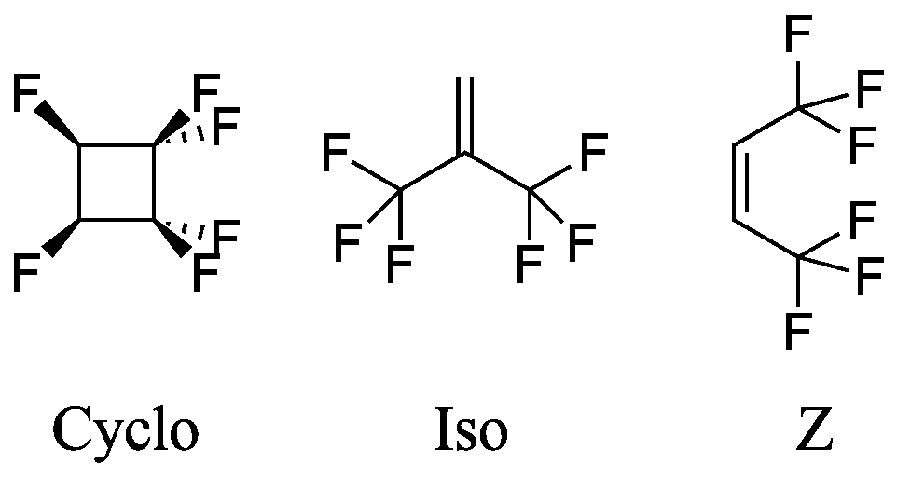
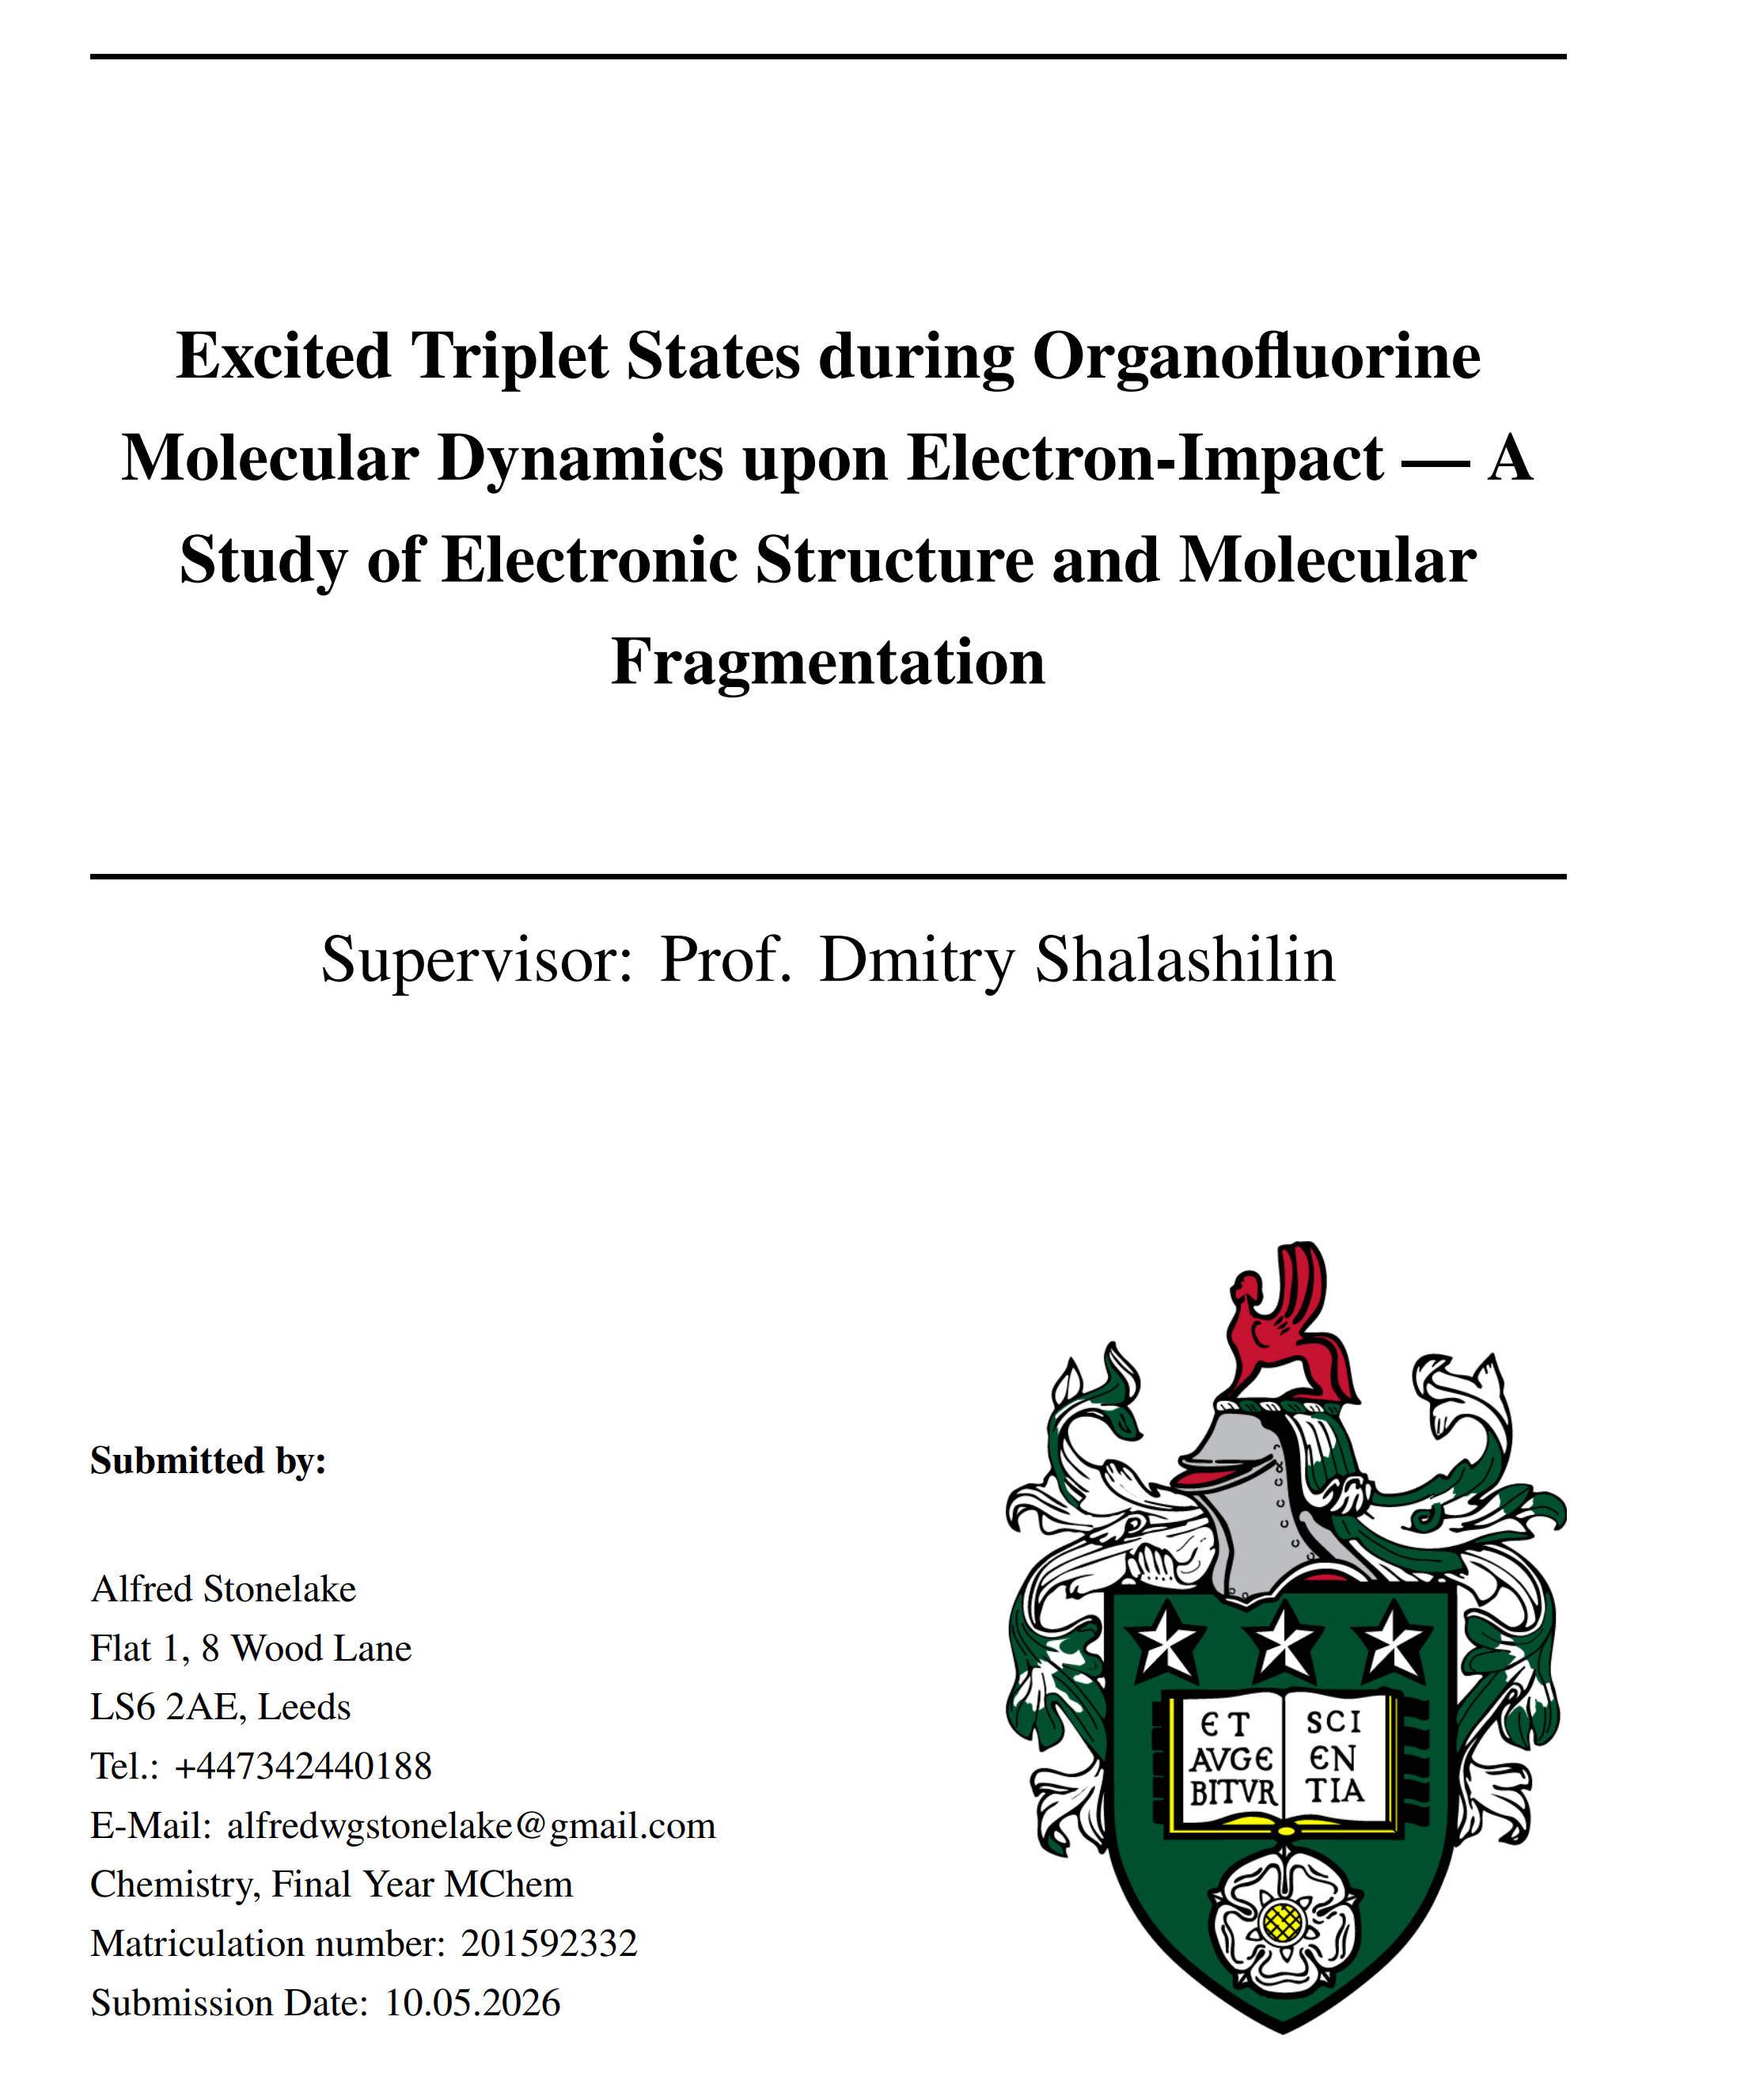
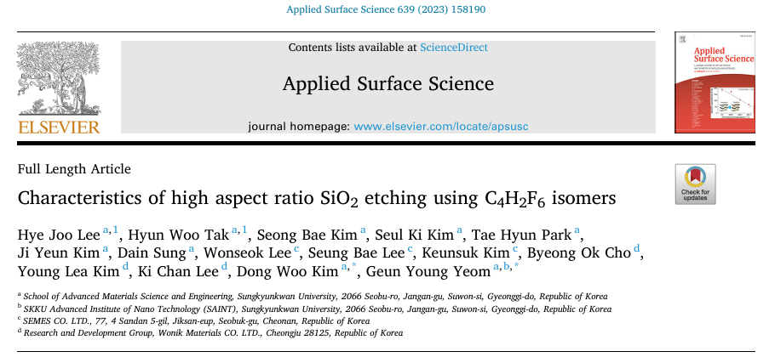
More simulations of dissociation of hydrofluorocarbons and electronic structure confirmation of the Electrophore Model
Alfred Stonelake

Slide 34
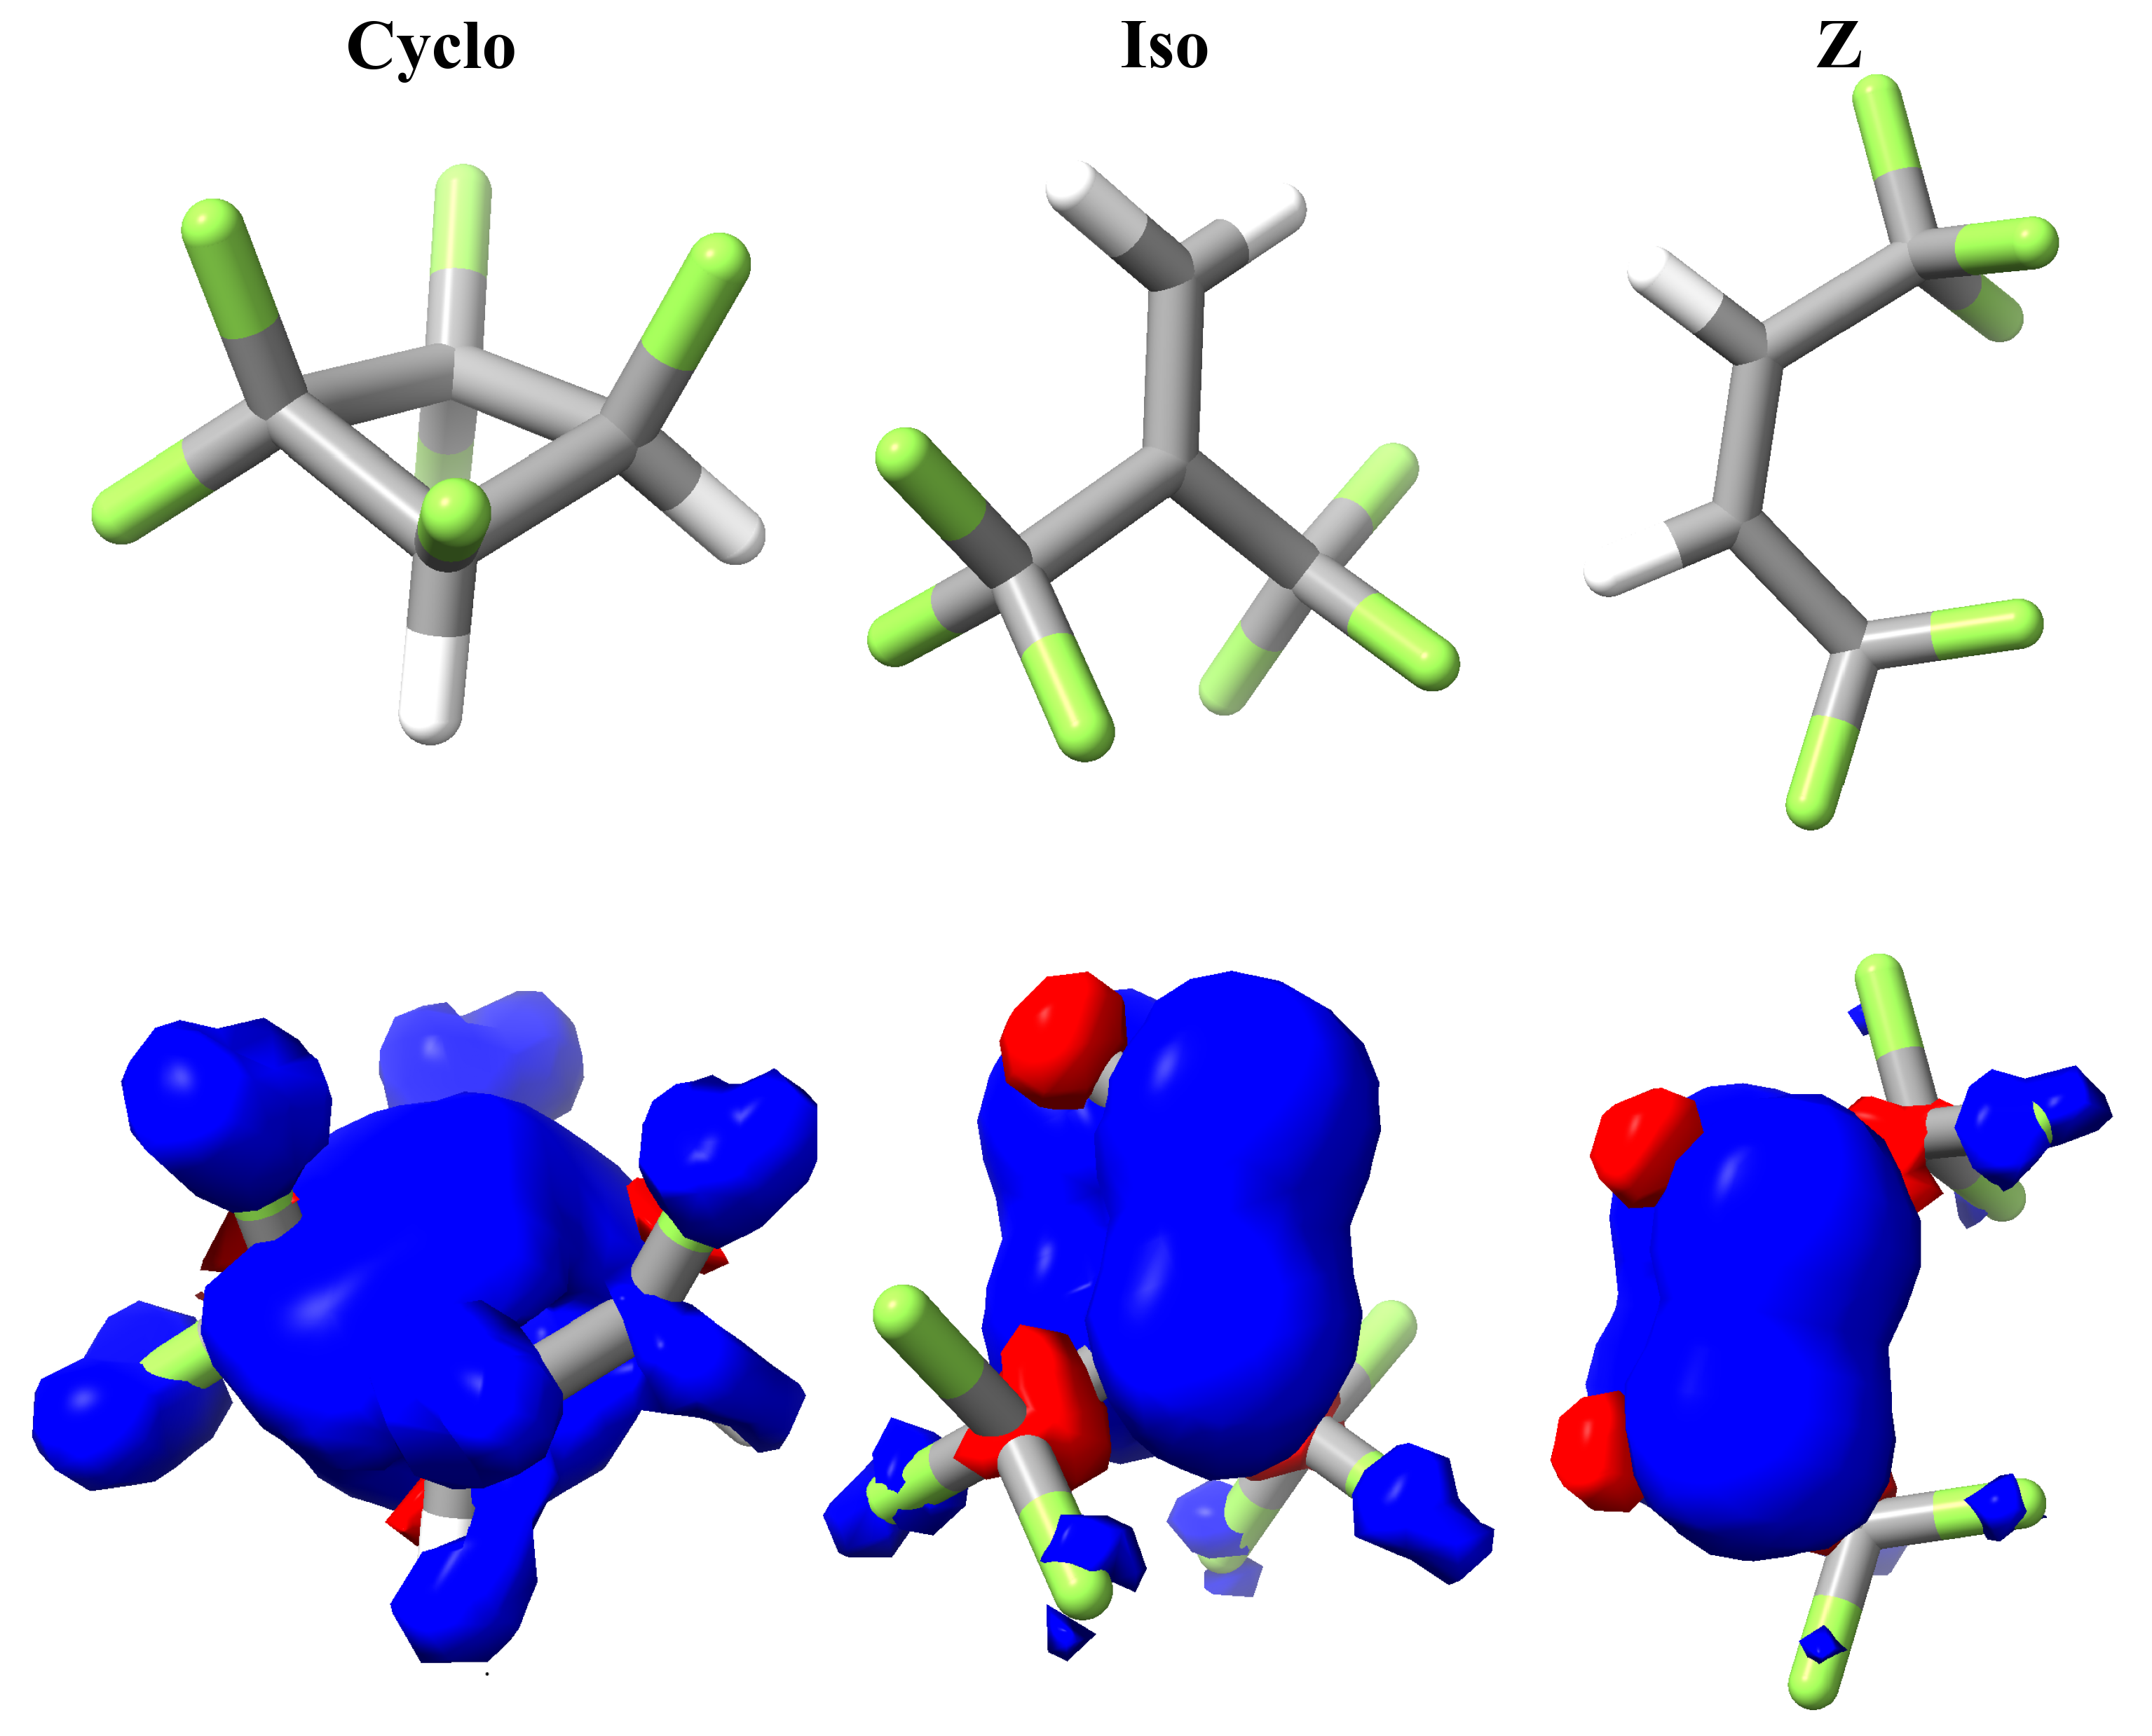

Slide 35
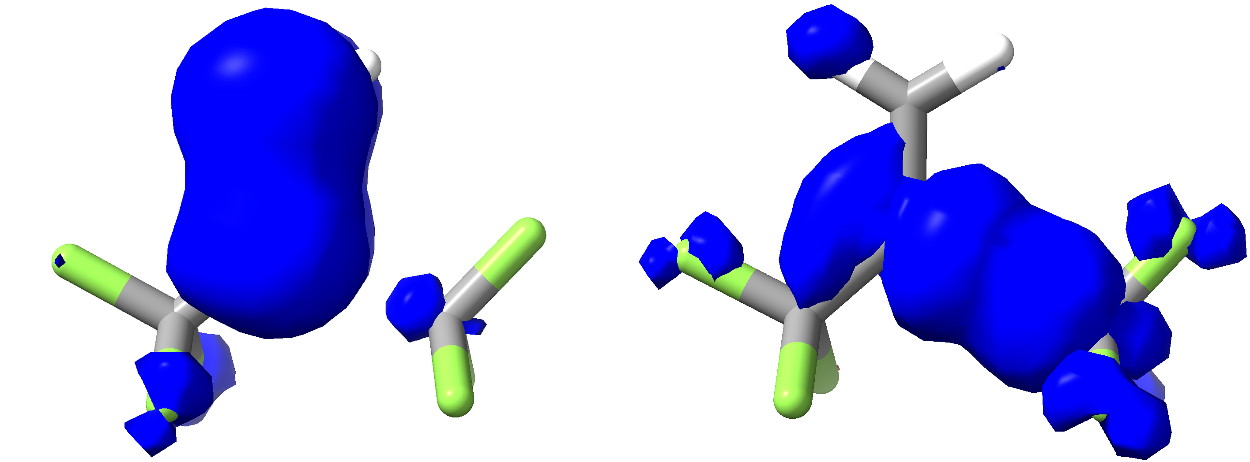

Slide 36
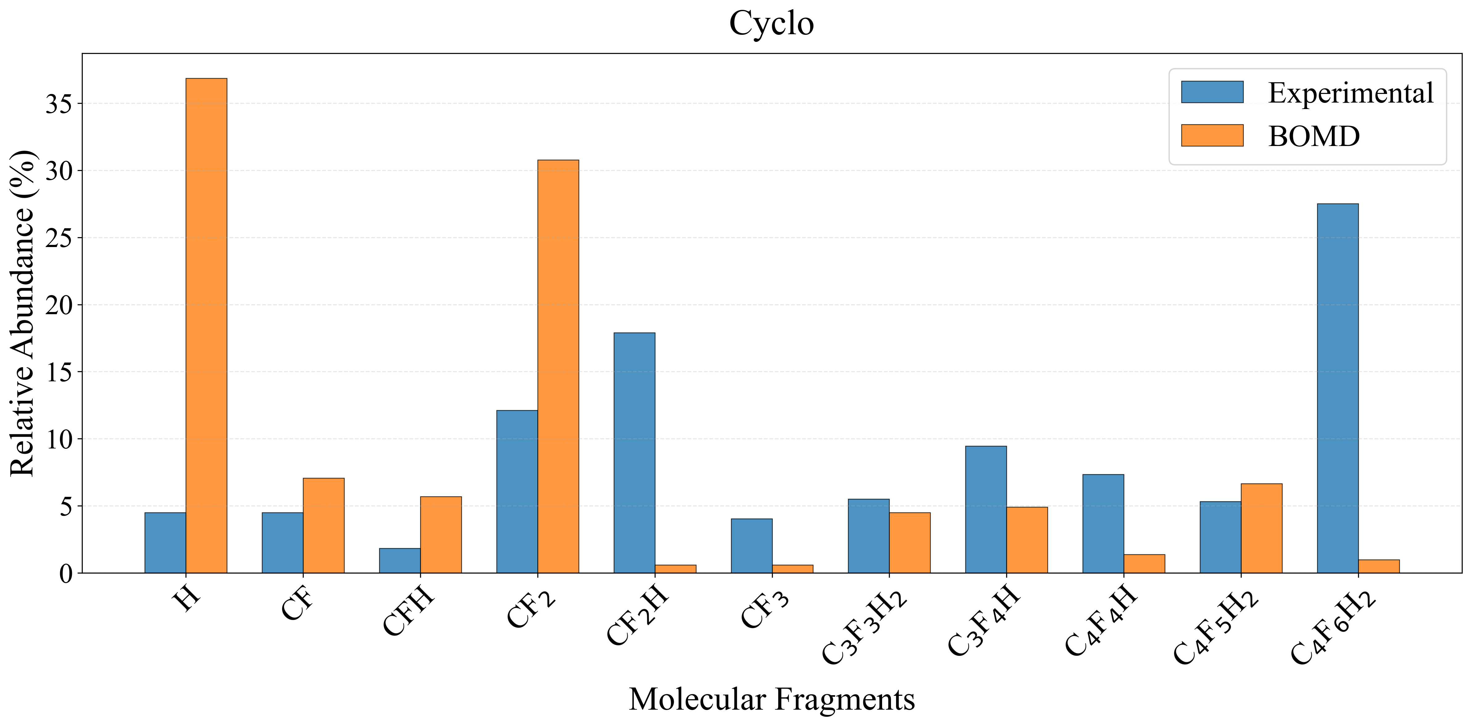
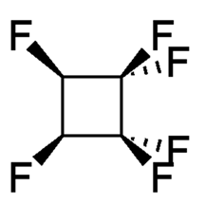
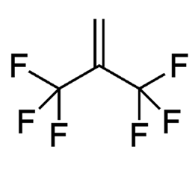
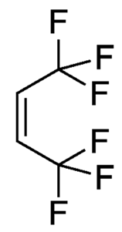
Mass Spec (blue) at 300 K vs MD product distribution (red) at 5000 K
To make quantitative comparison we need :
To take into account dissociation of radicals after ionization
To take into account reactions in plasma
To reduce the temperature of the simulations to hundreds of K !!!

Slide 37
Future developments and vision. Potential energy surfaces with Machine Learning and simulations at low T. Better comparison with mass spec.
Sourav Roy
1) Machine Learning Force Field instead of ab initio dynamics will speed up calculations. Currently we can go down to 2000-3000 K
2) Better ways to compare with mass spec
3) More molecules, more types of electrophores.
4) Vision: Tell us the radicals you want, and we suggest molecules to put into your plasma

Slide 38
Summary
Dissociation of lowest excited triplet state following electron impact excitation is important for industry but has been very little investigated.
Electrophores, i.e., a small parts of the molecule that localize the initial triplet excitation, exist, such as C=C double bond or oxygen atom.
The bonds containing the electrophore dissociate readily, and the proximity to the electrophore also affects the dissociation yield of other chemical bonds.
For more details see the link from our group webpage: https://molecular-dynamics.leeds.ac.uk/neutral-dissociation-in-plasma/
Thank you!

