Slide 1


Enhancing Interlayer Charge Transport of Two-Dimensional Perovskites by Structural Stabilization via Fluorine Substitution
Liz Stippell
PhD Candidate: University of Southern California
Advisor: Prof. Oleg Prezhdo

Slide 2
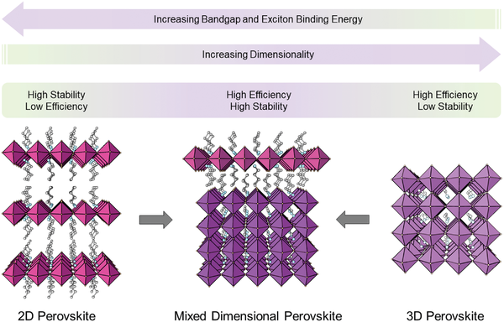
The Search for Better Energy Materials: Two-Dimensional Perovskites
Question:
How can we improve the efficiency of 2D perovskites?
Answer:
Adjust the organic spacers to enhance charge transfer
Wu, G. et al. Advanced Materials 2022, 34 (8), 2105635.
Notes:
Sources:
https://www.researchgate.net/figure/Schematic-illustration-for-2D-perovskites-3D-perovskites-and-mixed-dimensional_fig1_356789331

Slide 3
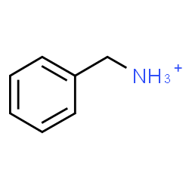
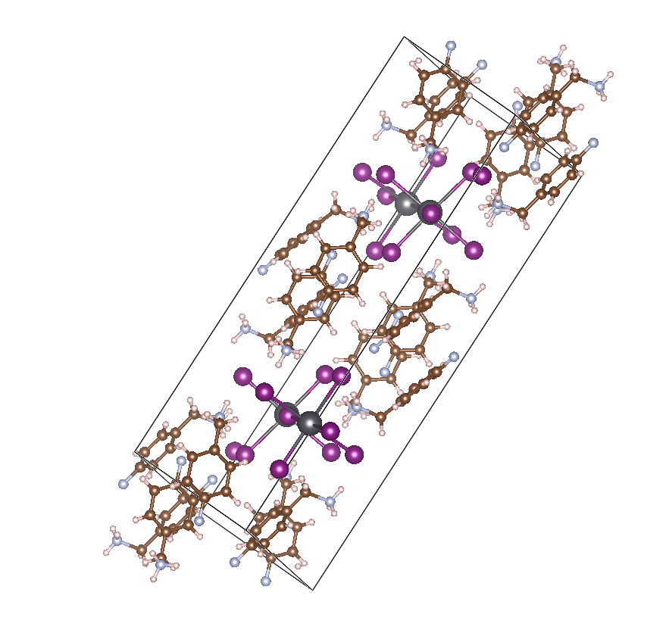
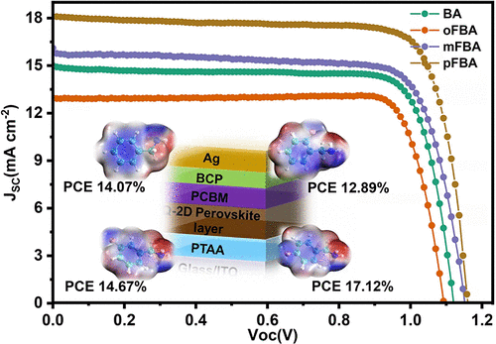
Using Fluorine to Enhance Charge Transfer
Fluorinated-Benzylammonium (F-BZA)
Why the para- position?
PCE
F
Benzylammonium (BZA)
Question:
HOW does fluorine improve charge transfer and efficiencies?
Yan, G. Chemistry of Materials 2022, 34 (7), 3346-3356.
Wang, Z. ACS Applied Materials & Interfaces 2022, 14 (6), 7917-7925.
Notes:
Sources: SHOW EXPERIMENTAL WORK
PARA VS OTHER POSITIONS
https://www.researchgate.net/figure/Schematic-illustration-for-2D-perovskites-3D-perovskites-and-mixed-dimensional_fig1_356789331

Slide 4
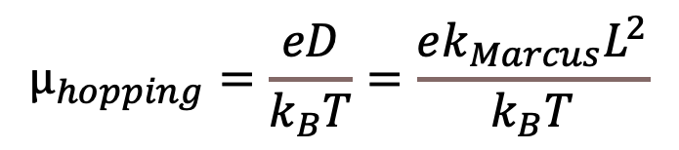
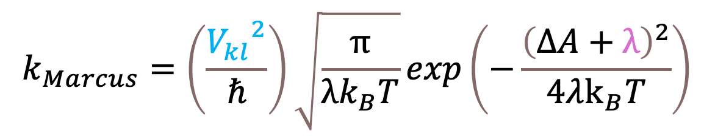


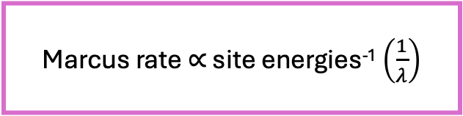
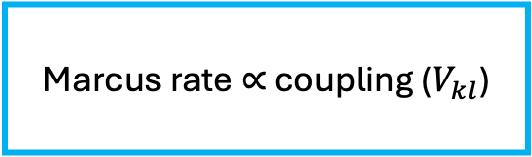
Understanding Charge Transfer: Marcus Theory
Marcus rate $∝$ coupling ($V_{kl}$)
Marcus rate $∝$ site energies⁻¹ $\left(\frac{1}{λ}\right)$
$$k_{Marcus}=\left(\frac{{V_{kl}}^{2}}{ℏ}\right)\sqrt{\frac{π}{λk_{B}T}}exp\left(−\frac{{\left(ΔA+λ\right)}^{2}}{4λk_{B}T}\right)$$
$$μ_{hopping}=\frac{eD}{k_{B}T}=\frac{ek_{Marcus}L^{2}}{k_{B}T}$$
$$λ=\frac{σ^{2}}{2k_{B}T}$$
$$σ=〈{\left(dE−〈dE〉\right)}^{2}〉$$
Charge Carrier Hopping Mobility
Marcus, R. A. The Journal of Chemical Physics 1965, 43 (8), 2654-2657.
Notes:
Sources:
https://www.researchgate.net/figure/Schematic-illustration-for-2D-perovskites-3D-perovskites-and-mixed-dimensional_fig1_356789331

Slide 5
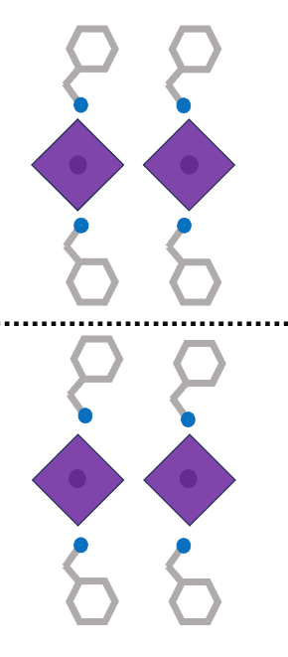

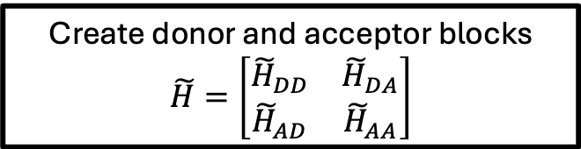
Projection Diabatization Method (POD): Computing Nonadiabatic Couplings
Fragment-based diabatization method
Acceptor
Create donor and acceptor blocks
$\tilde{H}=\left[\begin{matrix}{\tilde{H}}_{DD} & {\tilde{H}}_{DA} \\ {\tilde{H}}_{AD} & {\tilde{H}}_{AA}\end{matrix}\right]$
Diagonalize each block separately
$H^{′}=\left[\begin{matrix}ε_{1,D} & 0 & & & & \\ 0 & ε_{2,D} & & & V_{DA} & \\ ⋮ & & ⋱ & & & \\ & & & ε_{1,A} & 0 & \\ & V_{AD} & & 0 & ε_{2,A} & \\ & & & ⋮ & & ⋱\end{matrix}\right]$
Donor Energies
Donor
Acceptor Energies
Donor-Acceptor Couplings
Kondov, I. The Journal of Physical Chemistry C 2007, 111 (32), 11970-11981.
Notes:
Sources:
https://www.researchgate.net/figure/Schematic-illustration-for-2D-perovskites-3D-perovskites-and-mixed-dimensional_fig1_356789331

Slide 6
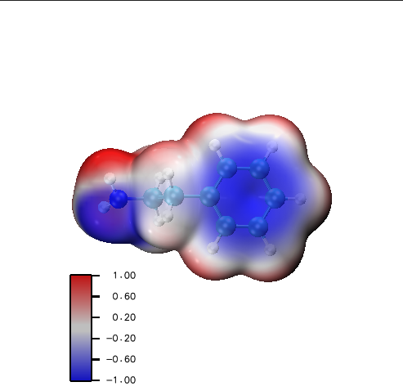
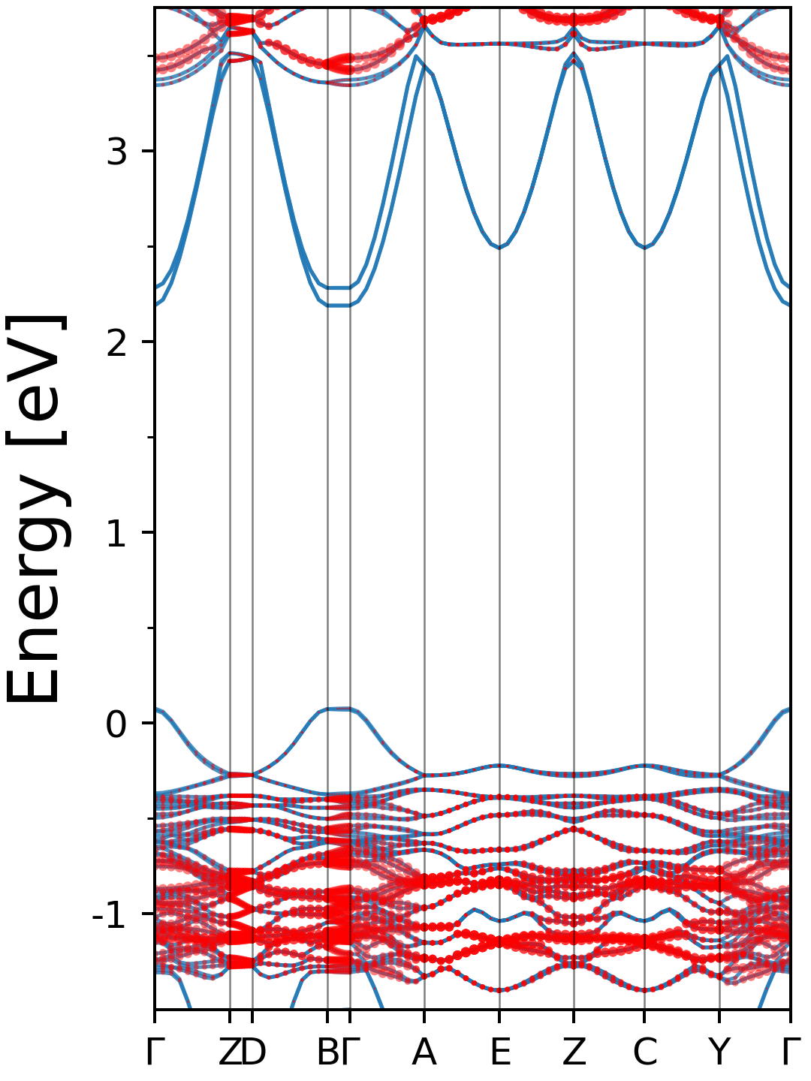
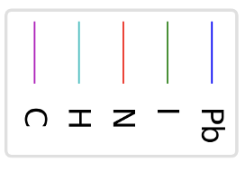
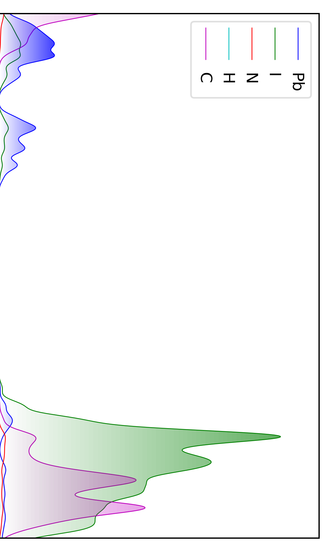
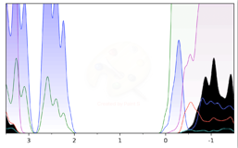
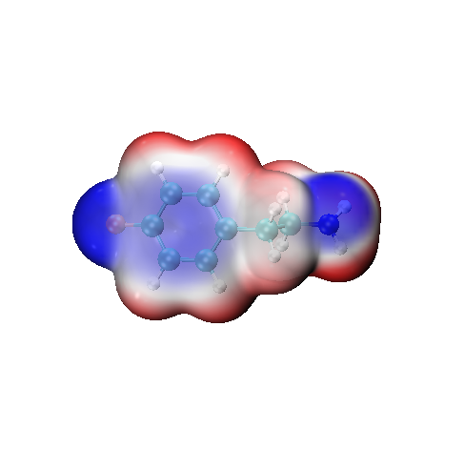
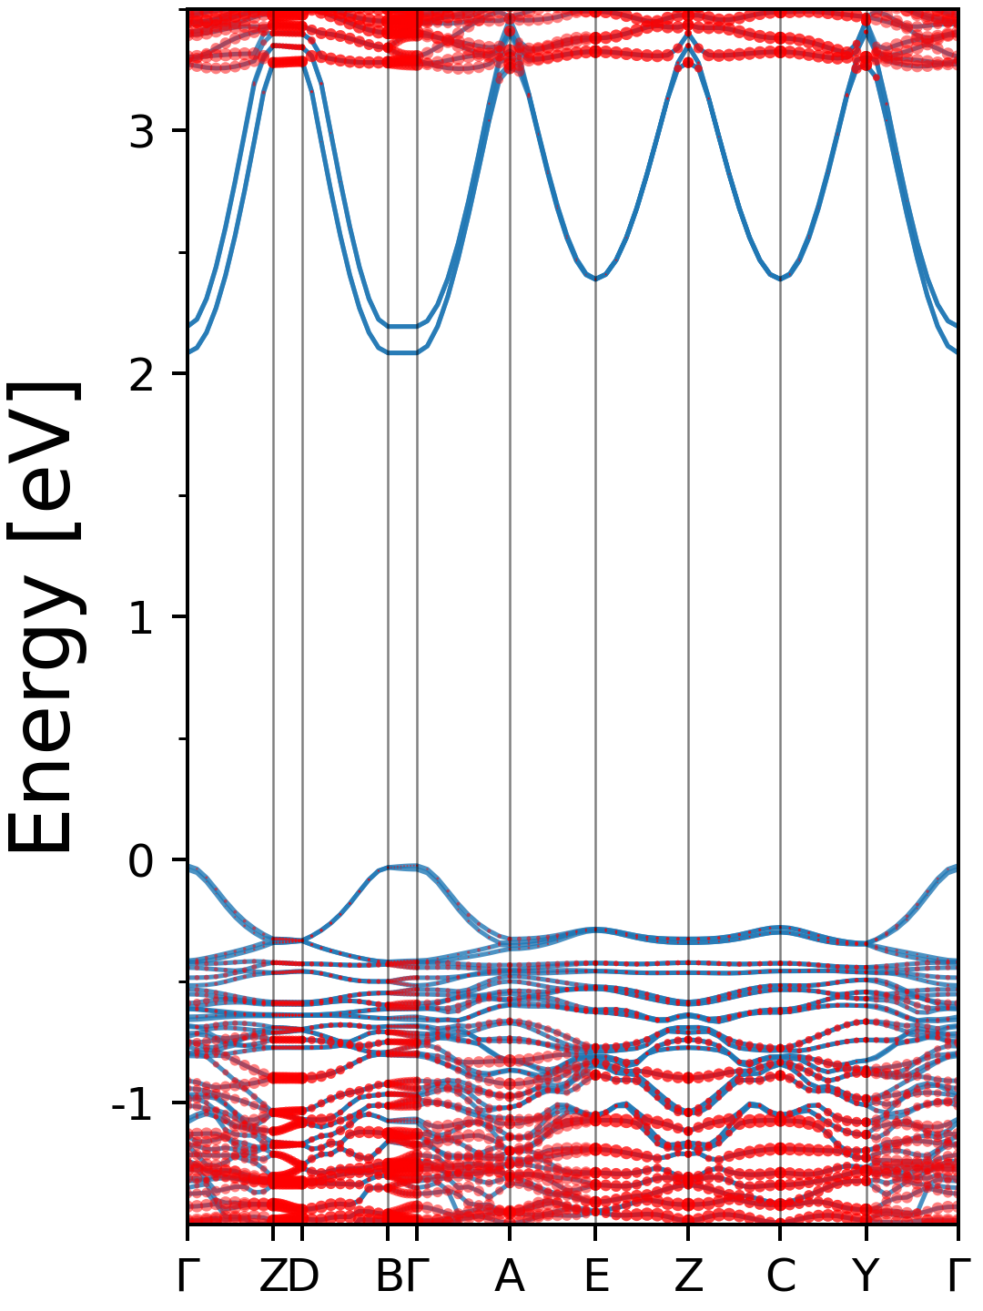
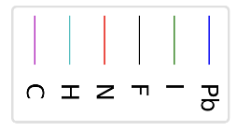
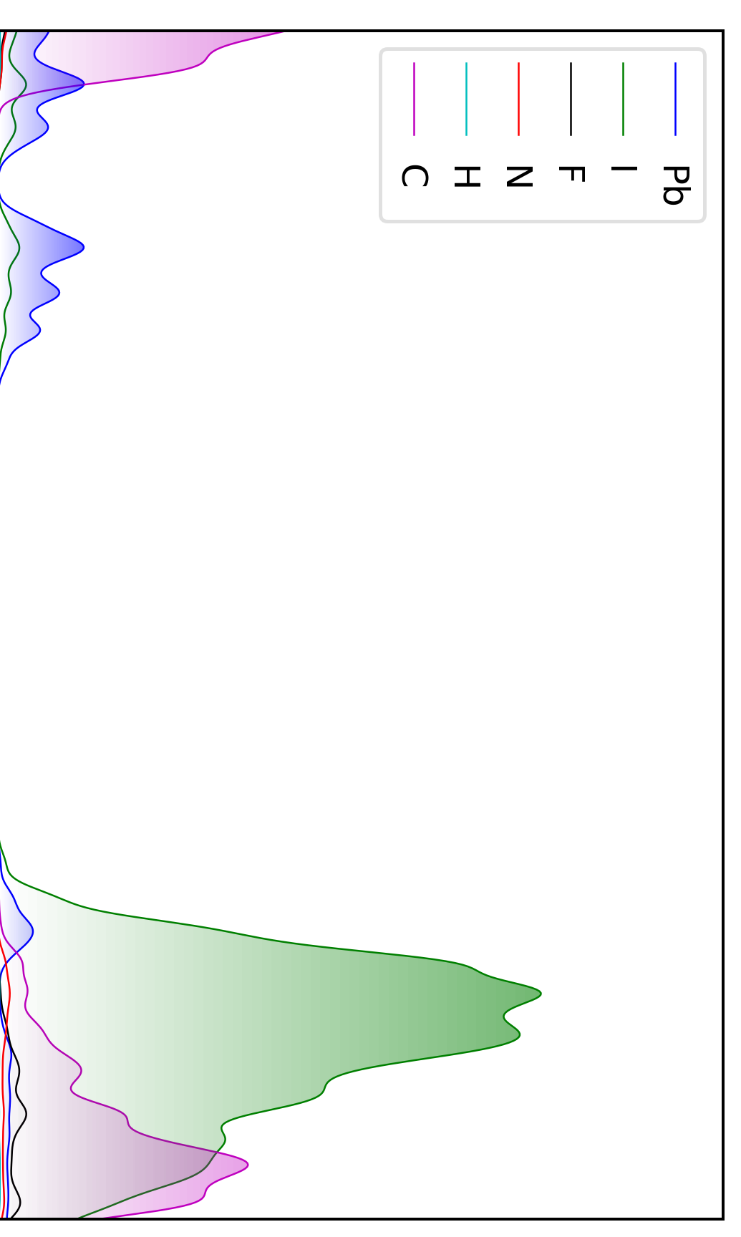
Fluorine’s Effects on Electronic Structure
Fluorine does NOT contribute to band edge states
Non-Fluorinated
LUMO
Fluorinated
HOMO
Fluorine has minimal influence in coupling
Charge density migrates to fluorine
Potential to enhance charge transfer
Notes:
Sources:
https://www.researchgate.net/figure/Schematic-illustration-for-2D-perovskites-3D-perovskites-and-mixed-dimensional_fig1_356789331

Slide 7
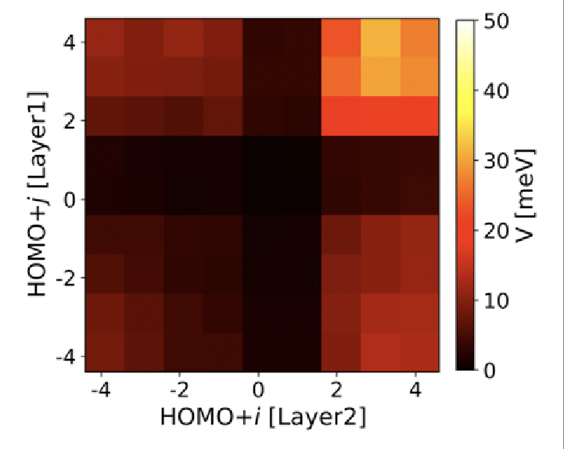
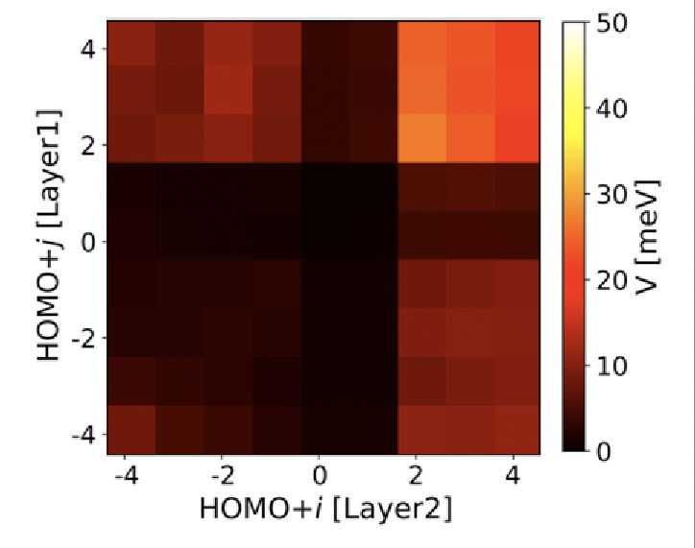
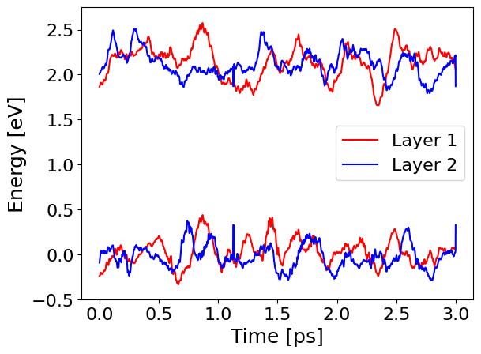
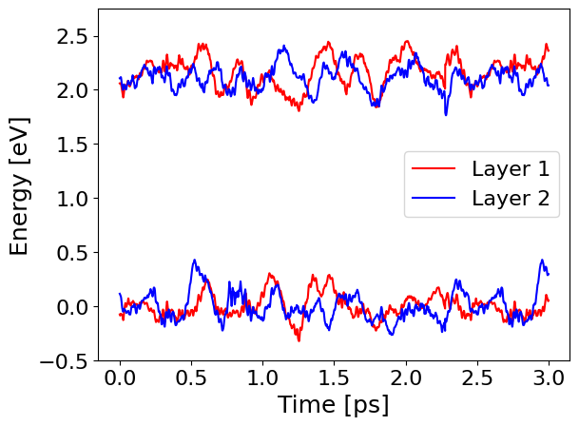

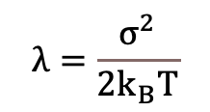
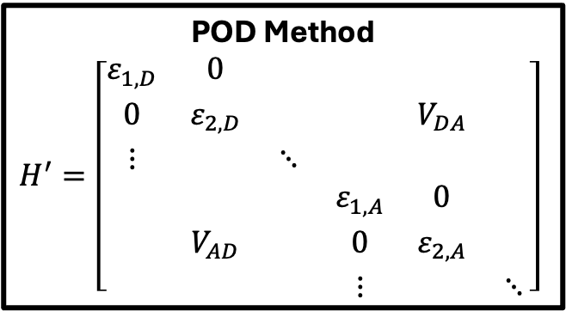
Fluorine’s Effects on Marcus Rate: Nonadiabatic Coupling & Reorganization Energy
POD Method
$H^{′}=\left[\begin{matrix}ε_{1,D} & 0 & & & & \\ 0 & ε_{2,D} & & & V_{DA} & \\ ⋮ & & ⋱ & & & \\ & & & ε_{1,A} & 0 & \\ & V_{AD} & & 0 & ε_{2,A} & \\ & & & ⋮ & & ⋱\end{matrix}\right]$
Non-Fluorinated
Fluorinated
$$λ=\frac{σ^{2}}{2k_{B}T}$$
$$σ=〈{\left(dE−〈dE〉\right)}^{2}〉$$
HOMO ~ -2.5 eV
HOMO ~ -2.75
Notes:
Sources:
https://www.researchgate.net/figure/Schematic-illustration-for-2D-perovskites-3D-perovskites-and-mixed-dimensional_fig1_356789331

Slide 8
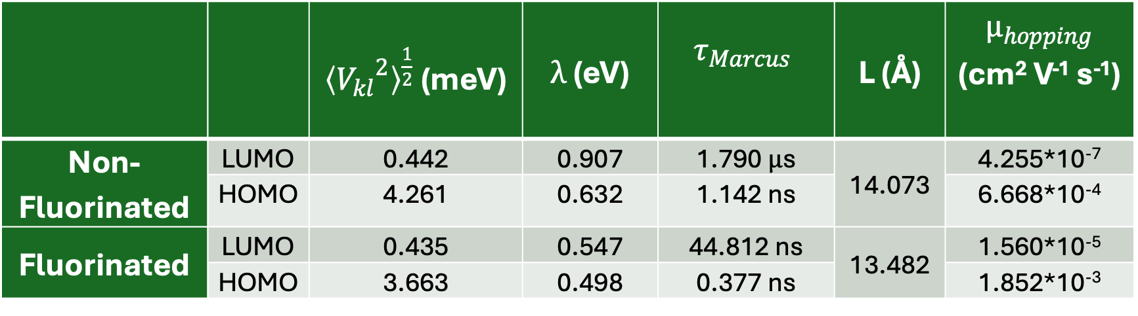
Putting the pieces together: charge transfer rates
 |  | ${〈{V_{kl}}^{2}〉}^{\frac{1}{2}}$ (meV) | $λ$ (eV) | $$τ_{Marcus}$$ | L (Å) | $μ_{hopping}$ (cm² V⁻¹ s⁻¹)
Non-Fluorinated | LUMO | 0.442 | 0.907 | 1.790 $μ$s | 14.073 | 4.255*10⁻⁷
 | HOMO | 4.261 | 0.632 | 1.142 ns |  | 6.668*10⁻⁴
Fluorinated | LUMO | 0.435 | 0.547 | 44.812 ns | 13.482 | 1.560*10⁻⁵
 | HOMO | 3.663 | 0.498 | 0.377 ns |  | 1.852*10⁻³
Marcus Rate
Reorganization Energy
Charge Carrier Hopping
Mobility
RMS Electronic Coupling
Distance Between Layers
Notes:
Sources:
https://www.researchgate.net/figure/Schematic-illustration-for-2D-perovskites-3D-perovskites-and-mixed-dimensional_fig1_356789331

Slide 9
Fluorine as a Structural Stabilizer
 | Average Displacement (Å)
 | Pb | I | N | H | C | F | Organic Spacers | Inorganic Crystals
Non-Fluorinated | 0.71 | 0.83 | 1.04 | 1.46 | 0.91 | - | 1.25 | 0.81
Fluorinated | 0.63 | 0.74 | 0.86 | 1.21 | 0.73 | 1.01 | 1.02 | 0.72
Displacement decreases with addition of fluorine atoms
F
Notes:
Sources:
https://www.researchgate.net/figure/Schematic-illustration-for-2D-perovskites-3D-perovskites-and-mixed-dimensional_fig1_356789331

Slide 10
Conclusions
Fluorine substitution enhances the PCE of the 2D perovskite not through coupling effects but through reorganization energy and structural stabilization.
 | Organic Spacers | Inorganic Crystals
BZA | 1.25 | 0.81
F-BZA | 1.02 | 0.72
HOMO ~ -2.5 eV
HOMO ~ -2.75
Notes:
Sources:
https://www.researchgate.net/figure/Schematic-illustration-for-2D-perovskites-3D-perovskites-and-mixed-dimensional_fig1_356789331

Slide 11
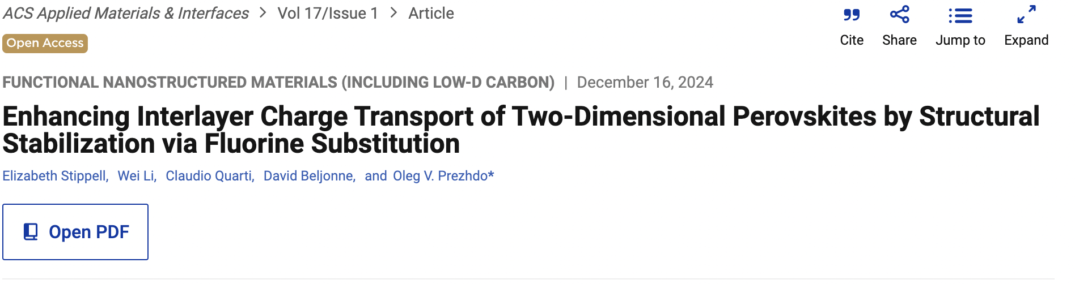
Thank you!
Collaborators
Wei Li
Claudio Quarti
David Beljonne
Advisor
Oleg Prezhdo
Notes:
Sources:
https://www.researchgate.net/figure/Schematic-illustration-for-2D-perovskites-3D-perovskites-and-mixed-dimensional_fig1_356789331

Slide 12
Extra Slides

Slide 13
Notes:
SOURCE: https://pubs.acs.org/doi/10.1021/acs.chemmater.2c00146

