Slide 1



Mechanisms and Methodologies for Modelling Excited-State Dynamics in Bare and Hydrated TiO₂ Nanoclusters
Miguel Recio-Poo
Departament de Ciència de Materials i Química Física
Institut de Química Teòrica i Computacional (IQTCUB)
Universitat de Barcelona
miguelrecio@ub.edu

Slide 2
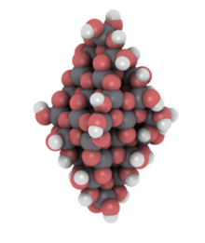
Role of TiO₂ in photocatalysis
Titania (TiO₂) is a widely used metal oxide in both industrial and environmental applications. Water splitting.
H₂ : Clean energy source but against thermodynamics.
H₂
+ O₂
Energy
H₂O
TiO₂
Chemical energy
𝚫G⁰= 237 kJ/mol
Need of external energy. Photocatalytic water splitting. Anatase titania as a potential solution.
Bandgap is too large (3.2 eV). Absorbs only a small fraction of solar spectrum. High recombination rate of electron-hole pairs.

Slide 3
Key steps in photocatalytic water splitting
H₂
1
Light irradiation/harvesting
H⁺
6
2
Electron-hole generation
Conduction band
-
3
Electron-hole separation
CB
e⁻
Surface
recombination
H⁺/H₂
2
Bulk
Recombination
(ps-ns)
-
+
+
Electron-hole transportation to the surface
H₂O/O₂
4
4
VB
h⁺
(fs-ps)
+
5
Oxidation reaction
Valence band
-
+
-
4
Reduction reaction and H₂ generation
6
Photoexcitation
(fs-ps)
1
3
+
4
+
5
O₂ + H⁺
Surface
reaction
(𝜇s-ms)
H₂O

Slide 4
Modelling excited state dynamics
TiO₂ is a stable, abundant photocatalyst—but limited by fast electron–hole recombination
Surface
recombination
Bulk
Recombination
(ps-ns)
-
+
+
+
Can we tune or extend such recombination times?
-
+
Studying excited state: Nonadiabatic molecular dynamics (nanostructuring, hydration,…)

Slide 5
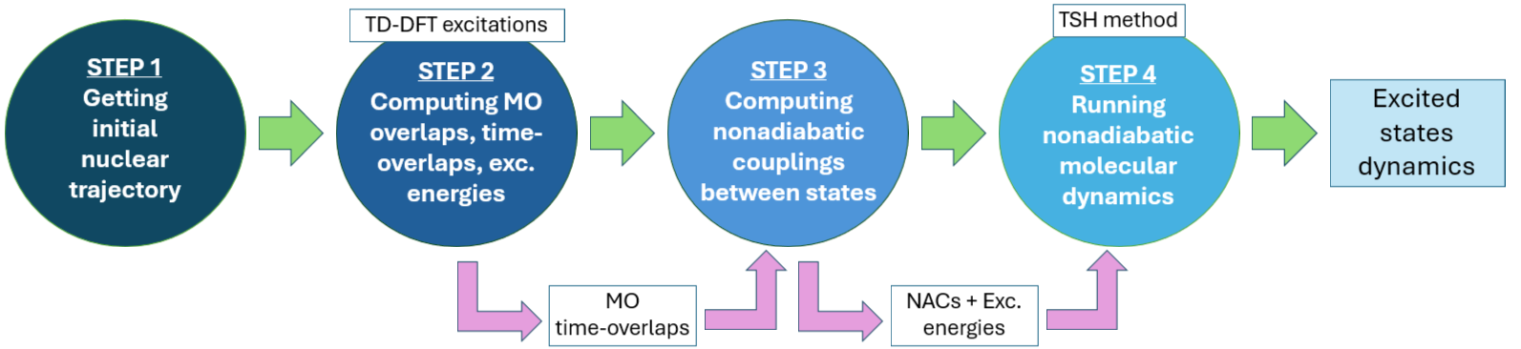


Nonadiabatic Molecular Dynamics workflow
STEP 1
STEP 2
STEP 3
STEP 4
Alexey V. Akimov
CP2K: step 1, step 2 (excitations)
Libra: step 2 (overlaps), step 3, step 4
A. V. Akimov, J. Comput. Chem. 2016, 37, 1626-1649

Slide 6
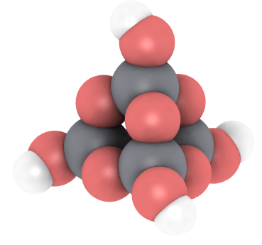
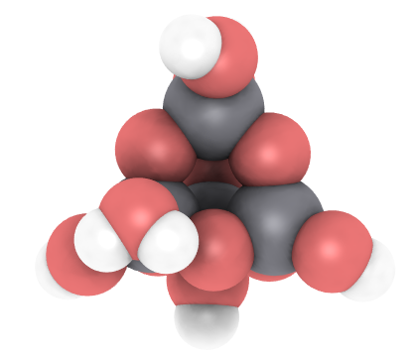
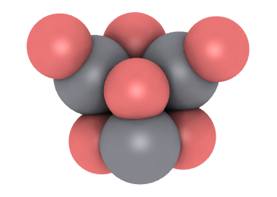
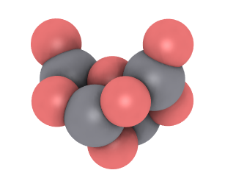
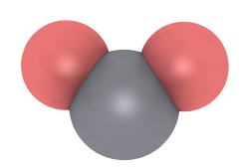
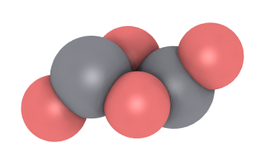
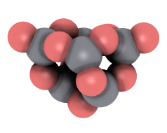
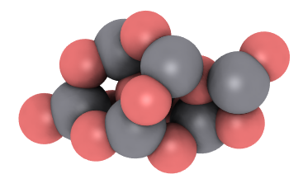
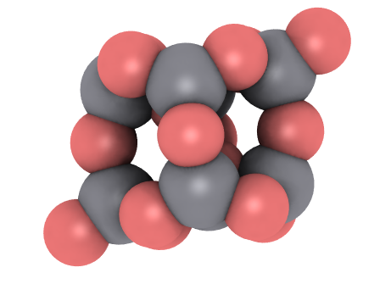
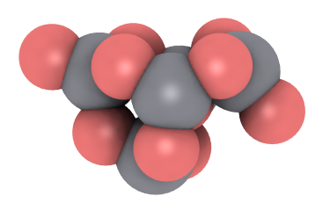
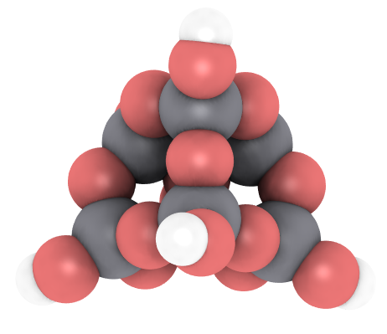
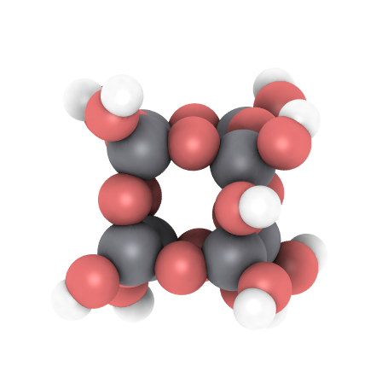
Model Systems: TiO₂ Nanoclusters
(TiO₂)₄(H₂O)₂
(TiO₂)₄(H₂O)₄
(TiO₂)₃
(TiO₂)₄
(TiO₂)₁
(TiO₂)₂
(TiO₂)₅
(TiO₂)₆
(TiO₂)₇
(TiO₂)₈
(TiO₂)₈(H₂O)₂
Part II (JACS)
(TiO₂)₈(H₂O)₅
Part I (JPCC)

Slide 7
Part I – Hydration and Methodology Assessment
(TiO₂)₈
(TiO₂)₄
Dependence of excited state dynamics on the hydration degree
S₁→S₀ (electron-hole recombination)
Benchmark common TD-DFT and NA-MD methodologies
(TiO₂)₄(H₂O)₂
(TiO₂)₈(H₂O)₂
(TiO₂)₄(H₂O)₄
(TiO₂)₈(H₂O)₅
J. Phys. Chem. C 2025, 129 (3), 1806

Slide 8
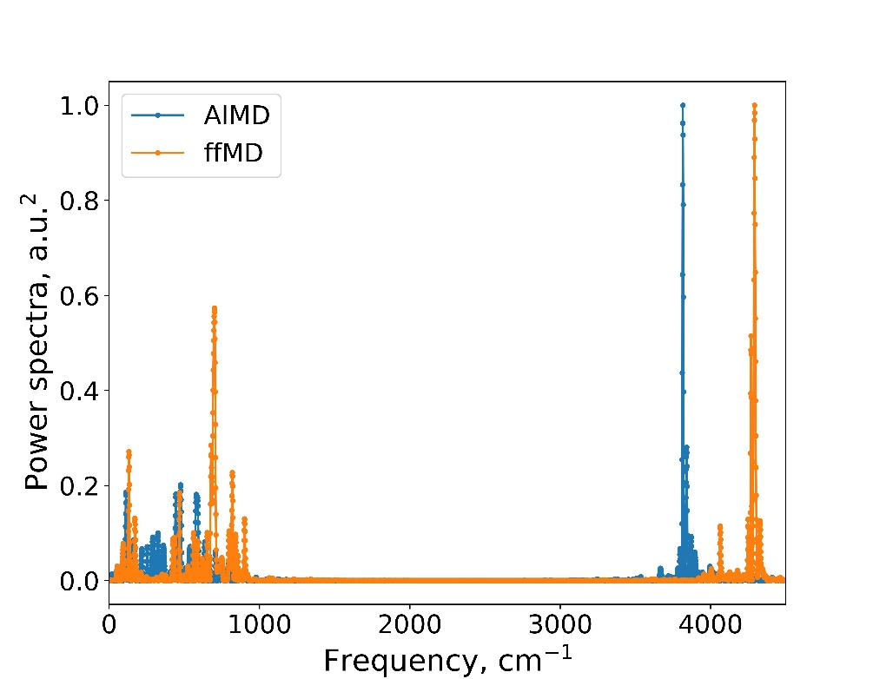
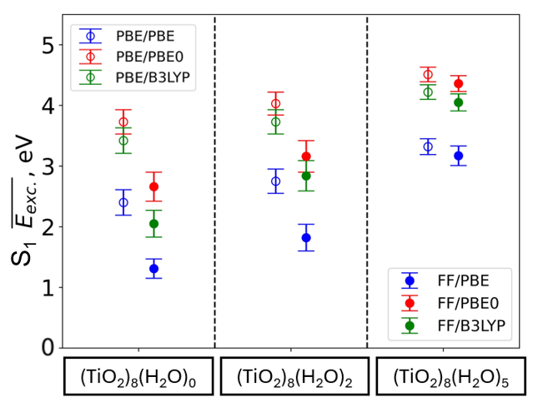
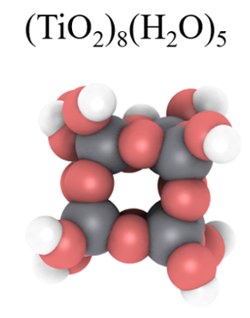
Part I - Vibrational and electronic structure
Classical Dynamics (NanoTiO & FFTiOH)
Ab initio Molecular Dynamics (PBE)
4 ps run (1 ps equilibration + 3 ps production):3000 structures
S₀ to S₁ state transition
PBE, PBE0 and B3LYP functionals
100 to 200 cm⁻¹ -> Ti-O-Ti angle bending
500-1000 cm⁻¹ -> Ti-O stretching
Hydroxyl stretching mode around 4000 cm⁻¹
Hydration increases excitation S₁ energies Hybrid functionals mitigate underestimation
S₁→S₀ transition driven by Ti-O modes
J. Phys. Chem. C 2025, 129 (3), 1806

Slide 9
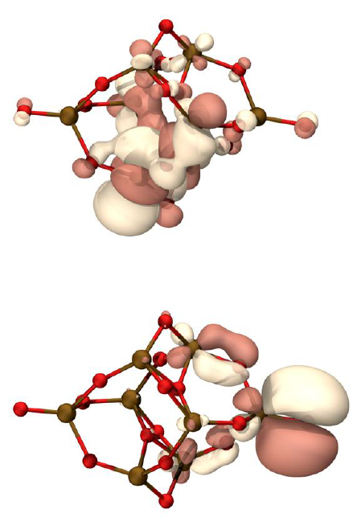
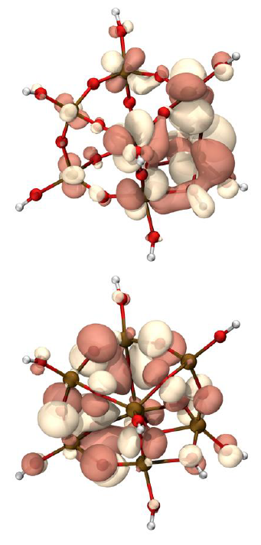
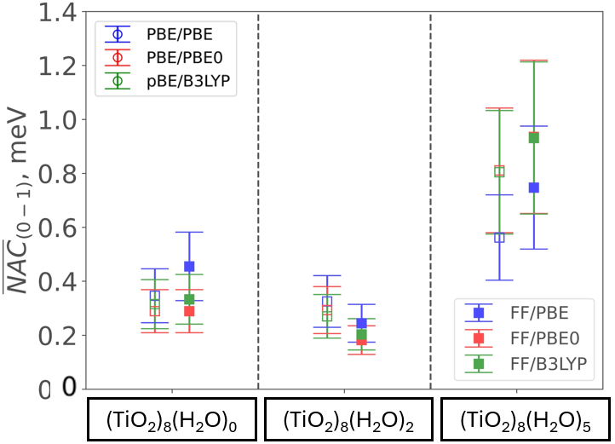

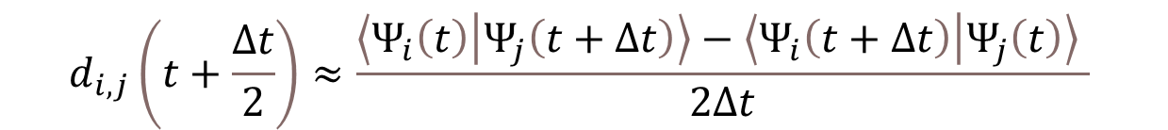
Part I - Nonadiabatic Couplings
Hammes-Schiffer-Tully (HST) approach:
$$d_{i,j}\left(t+\frac{Δt}{2}\right)≈\frac{\left\langle Ψ_{i}\left(t\right) | Ψ_{j}\left(t+Δt\right)\right\rangle −\left\langle Ψ_{i}\left(t+Δt\right) | Ψ_{j}\left(t\right)\right\rangle }{2Δt}$$
LUMO
HOMO
Hydration
Competition between energy difference and isotropy
J. Phys. Chem. C 2025, 129 (3), 1806

Slide 10
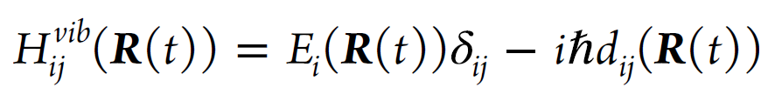
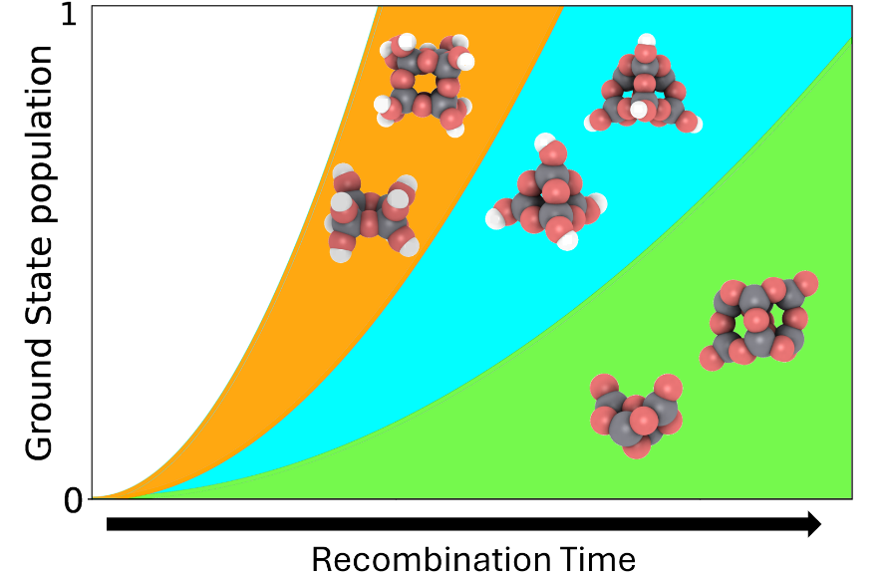
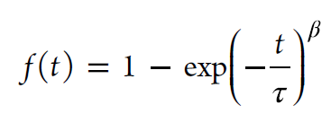

Part I - Nonadiabatic molecular dynamics
TSH methods:
FSSH, DISH, ID-A, mSDM
NA-MD initialized in S₁
15000 trajectories per methodology
Decay evolution fitted to exponential fitting functions
Hydration increases electron-hole recombination rates.
Hybrid functionals and decoherence-corrected methods produce accurate predictions of excited-state dynamics. FFMD vs AIMD agreement.
J. Phys. Chem. C 2025, 129 (3), 1806

Slide 11
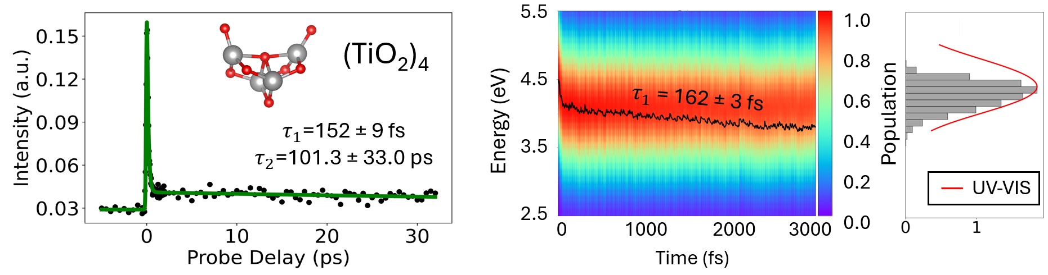
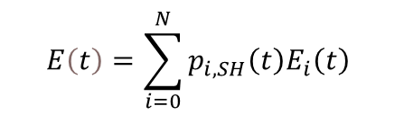
Part II – Relaxation vs recombination
Investigating ultrafast relaxation and recombination in atomically precise (TiO₂)_{n} (n = 1–8) nanoclusters.
Experimentally recorded transient absorption signals
Computations: Time-resolved population-energy spectrograms + DOS
Pump: 266 nm, 4.66 eV; Probe: 800 nm
Two lifetimes: τ₁: ultrafast relaxation to S_{1;} τ₂: slower recombination to S₀.
$$E\left(t\right)=\sum_{i=0}^{N}{p_{i,SH}\left(t\right)E_{i}\left(t\right)}$$
Relaxation:
Recombination well-captured
by population of S₀
J. Am. Chem. Soc. 2025, 147, 40900–40909

Slide 12
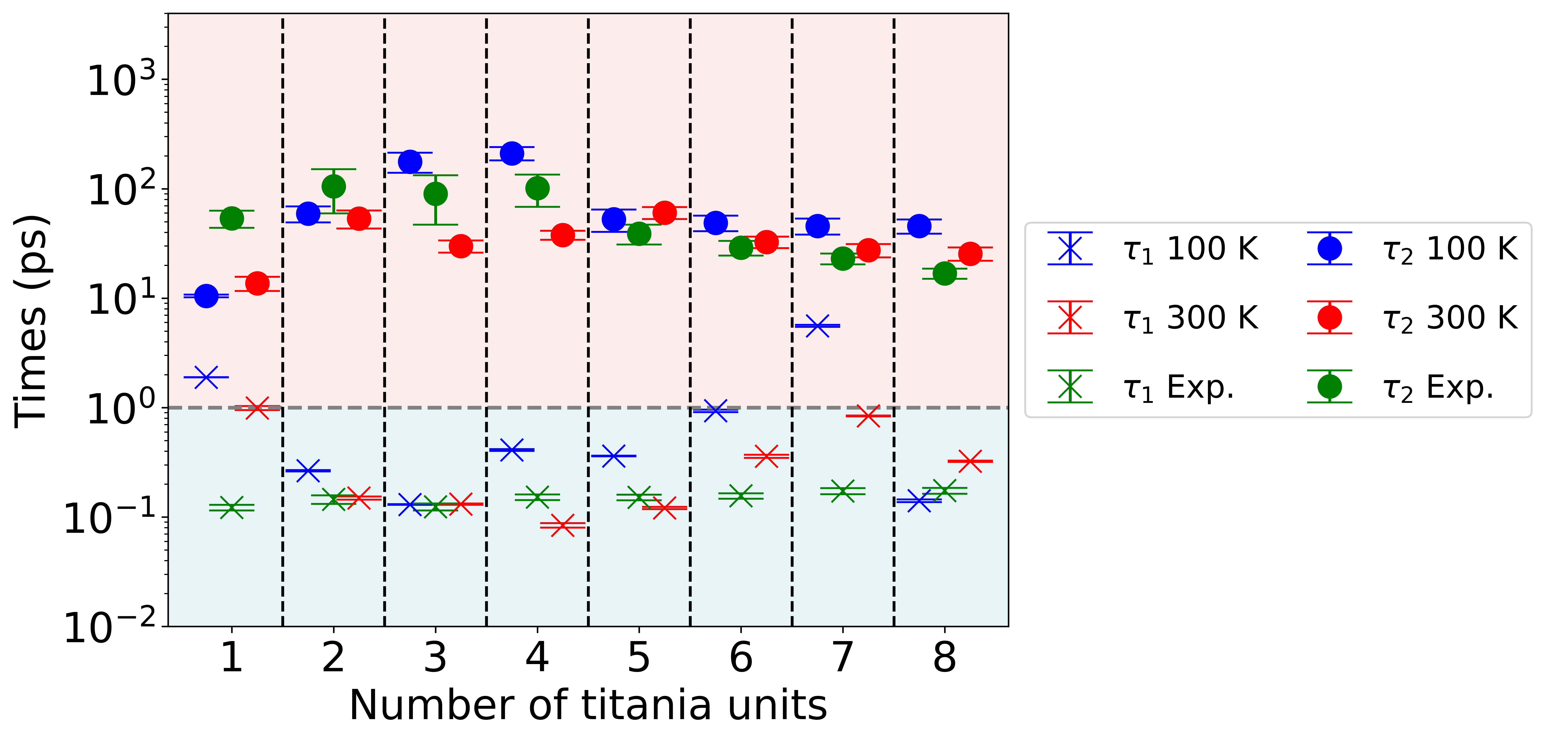
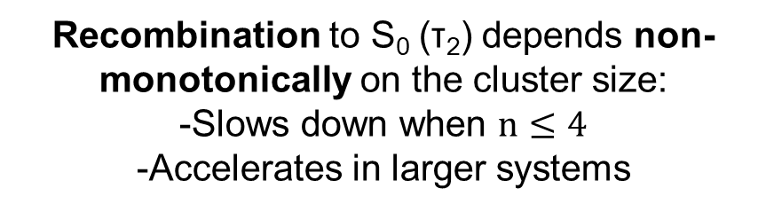
Part II – Agreement and trends
Recombination to S₀ (τ₂) depends non-monotonically on the cluster size:
-Slows down when $n≤4$
-Accelerates in larger systems
Slower relaxation to S₁ (τ₁) in larger clusters
J. Am. Chem. Soc. 2025, 147, 40900–40909

Slide 13
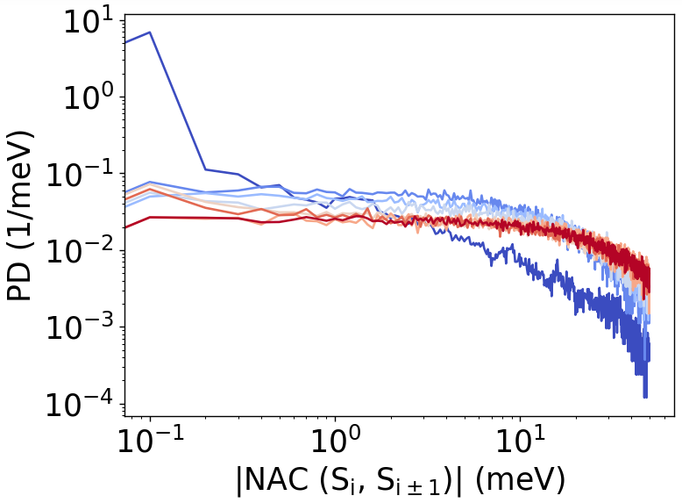
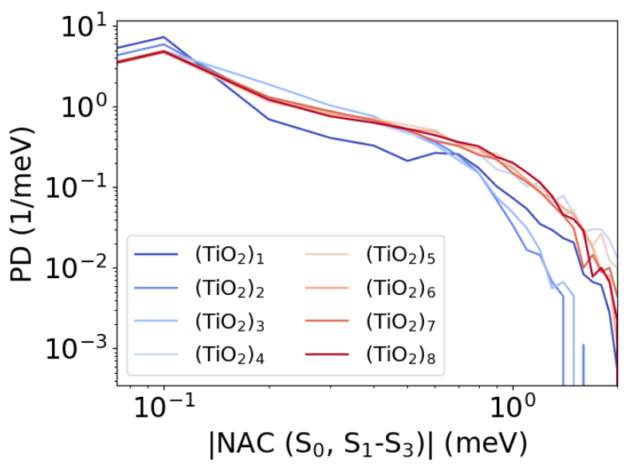
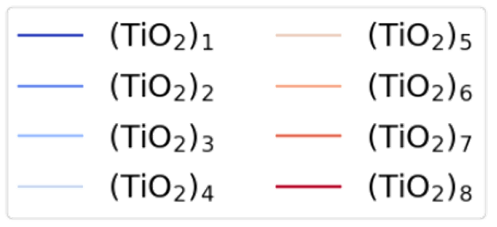
Part II – Mechanistic explanation
Larger NACs between adjacent states are more probable for larger clusters: population spreading among higher-energy states leading to larger τ₁
Larger 0-1:3 NACs also accelerate recombination in larger systems.
Larger clusters → greater atomic fluctuations (higher RMSD).
J. Am. Chem. Soc. 2025, 147, 40900–40909

Slide 14
Conclusions
Influence of water increases excitation energies and generally NACs. Indirect influence: Hydroxyl related modes not coupled to S₀→S₁ transition. Hydration increases electron-hole recombination rates.
Hybrid functionals and decoherence-corrected methods produce accurate predictions of excited-state dynamics. FFMD vs AIMD agreement.
Two universal pathways identified in (TiO₂)_{n} (n = 1–8): Ultrafast relaxation (τ₁ → S₁) and slower recombination (τ₂ → S₀).
Atomic flexibility and multiconfigurational mixing grow with size → boosts NACs couplings and alters lifetimes. Mechanistic explanation for observerd trends.
Strong experiment–theory agreement → validates Libra + CP2K NA-MD workflow as a predictive tool to analyse excited state dynamics in titania systems.

Slide 15














5. Conclusions
ESPA Tarragona 2024
Acknowledgments
Scott Sayres
Stefan T. Bromley
Ángel Morales García
Alexey V. Akimov
Mohammad Shakiba
Chase Rotteger
Francesc Illas
Hannah Rucker
PRE2019-087627
PID2020-115293RJ-I00
PID2021-126076NB-I00
PID2021-127957NB-100
TED2021- 129506B-C22
TED2021-132550B-C22
CEX2021-001202-M
GRANT NSF-2045204
2021-SGR-00079
2021-SGR-00354

Slide 16
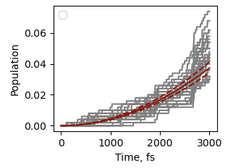
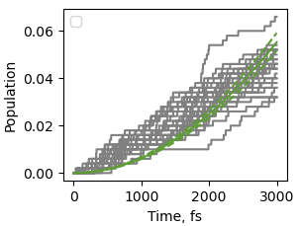
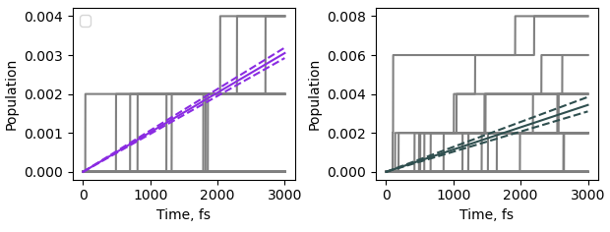
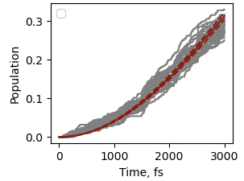
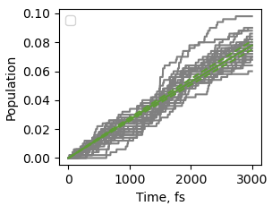
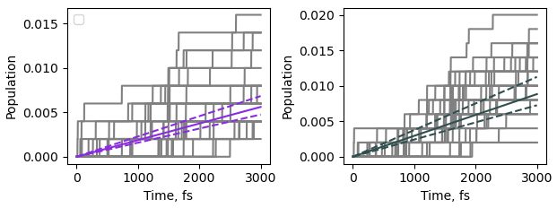
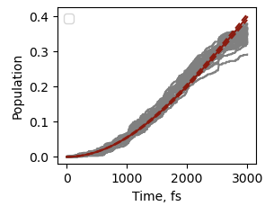
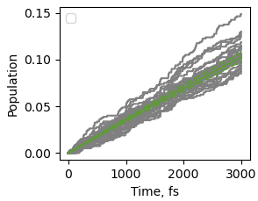
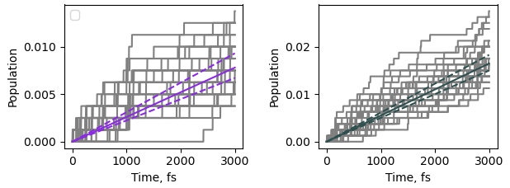
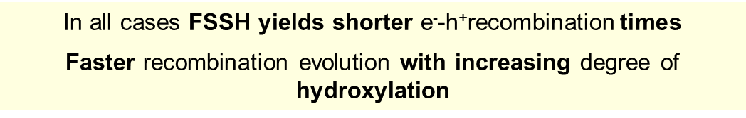
EXTRA
FSSH
DISH
MSDM
ID-A
(TiO₂)₄
AIMD + PBE
(TiO₂)₄(H₂O)₂
(TiO₂)₄(H₂O)₄
In all cases FSSH yields shorter e⁻-h⁺recombination times
Faster recombination evolution with increasing degree of hydroxylation

Slide 17
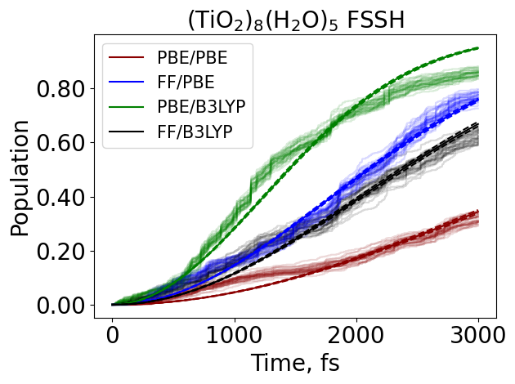
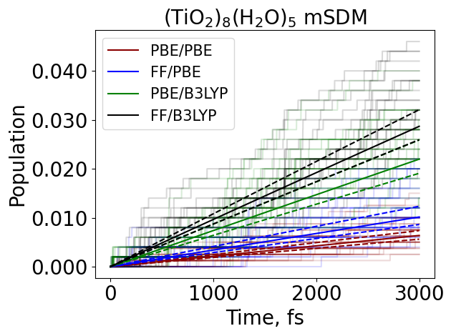
EXTRA
mSDM method involves a complex description leading to the elimination of coherences and thus to larger decay
Hybrid TD-DFT functionals give rise to faster S₁-S₀ recombination
Good agreement in final results between ffMD and AIMD!!
(TiO₂)₈(H₂O)₂ provides longer times – more convenient for photocatalysis

Slide 18
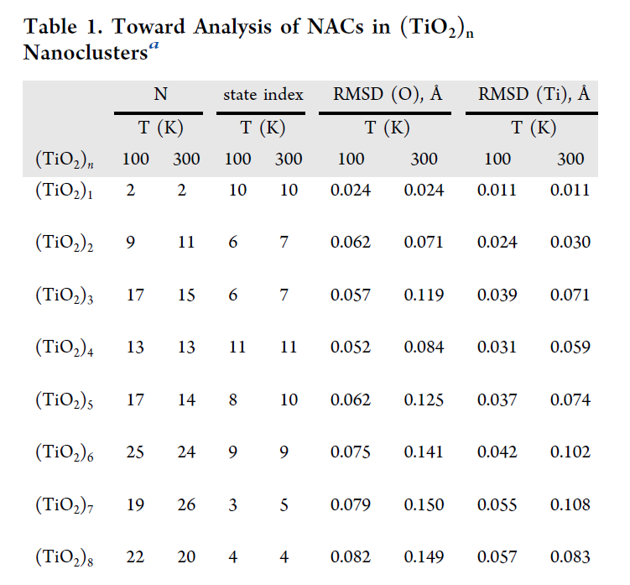
EXTRA
Structure–Dynamics Connection
Larger clusters → greater atomic fluctuations (higher RMSD).
The first four columns quantify the degree of configurational mixing: number of determinants contributing to TD-DFT wf.
Other columns show the RMSD of oxygen and titanium atoms
at 100 and 300 K.
Larger atomic fluctuations
cause stronger perturbations of the electronic density resulting in larger NACs.

