Slide 1
Deep Learning Electron-Phonon Couplings Beyond Mean-Field Level
Chaoqun Zhang
Postdoc @ Yale University, Zhu Group
2026-05-20
Virtual International Seminar on Theoretical Advancements (VISTA)

Slide 2
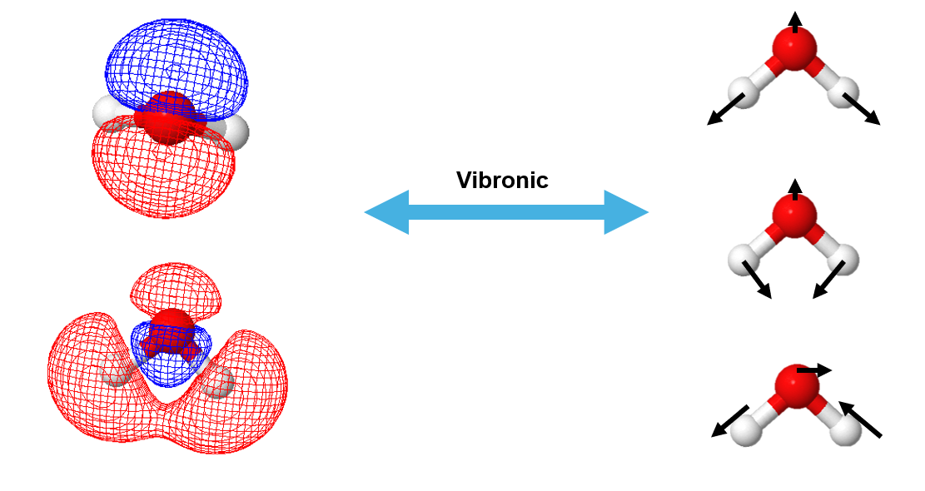
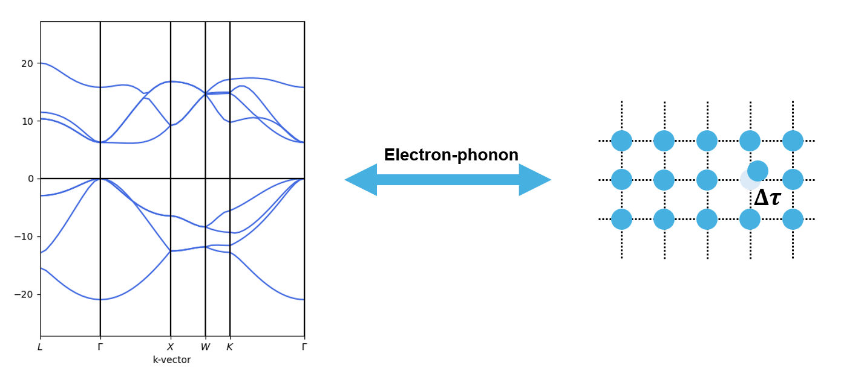
Electron-phonon / vibronic coupling

Slide 3
Electron-phonon / vibronic coupling

Slide 4
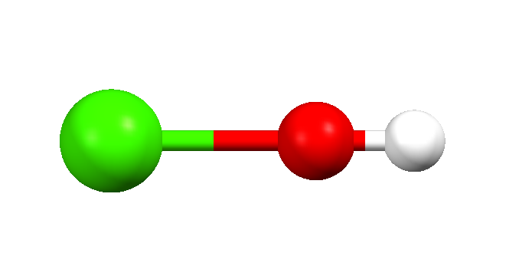








Why electron-phonon coupling?
Application in laser cooling of CaOH
$A^{2}Π_{1/2}$(000)
?
$ν_{1}$: M-O Stretching
$ν_{2}$: Bending
…… ……
$ν_{3}$: H-O Stretching
$$\left(ν_{1}ν_{2}ν_{3}\right)$$
$X^{2}Σ_{1/2}^{+}$(100)
$X^{2}Σ_{1/2}^{+}$(010)
$X^{2}Σ_{1/2}^{+}$(000)
C Zhang, et al, J. Chem. Phys. 155, 091101 (2021)

Slide 5
Why electron-phonon coupling?
Application in laser cooling of CaOH
$A^{2}Π_{1/2}$(000)
$ν_{1}$: M-O Stretching
$ν_{2}$: Bending
…… ……
$ν_{3}$: H-O Stretching
$$\left(ν_{1}ν_{2}ν_{3}\right)$$
$X^{2}Σ_{1/2}^{+}$(100)
$X^{2}Σ_{1/2}^{+}$(010)
$X^{2}Σ_{1/2}^{+}$(000)
C Zhang, et al, J. Chem. Phys. 155, 091101 (2021)

Slide 6
Why electron-phonon coupling?
Application in laser cooling of CaOH
$A^{2}Π_{1/2}$(000)
$ν_{1}$: M-O Stretching
$ν_{2}$: Bending
…… ……
$ν_{3}$: H-O Stretching
$$\left(ν_{1}ν_{2}ν_{3}\right)$$
$X^{2}Σ_{1/2}^{+}$(100)
$X^{2}Σ_{1/2}^{+}$(010)
$X^{2}Σ_{1/2}^{+}$(000)
Exp. 0.099(6)%
Calc. 0.063%
w/o vibronic 0.0%
C Zhang, et al, J. Chem. Phys. 155, 091101 (2021)

Slide 7
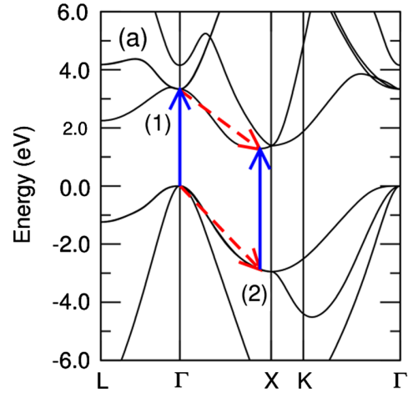
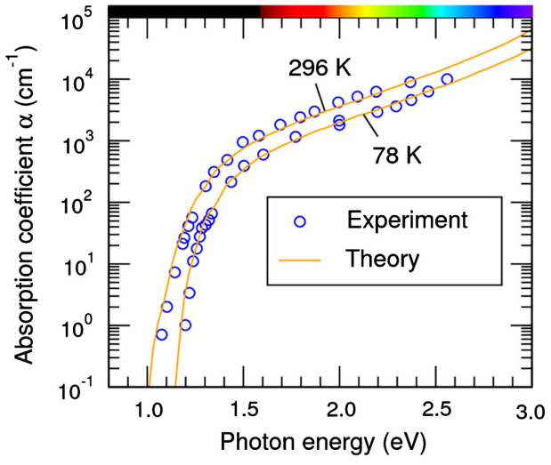
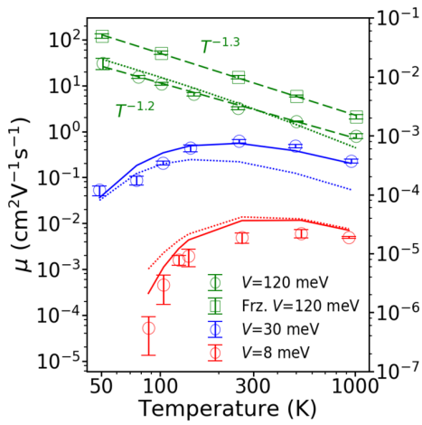
Why electron-phonon coupling?
Phonon-assisted optical transition in silicon
Charge transportation
Band
Hopping
J Noffsinger, et al, Phys. Rev. Lett. 108, 167402 (2012)
S Giannini, A Carof, J Blumberger, J. Phys. Chem. Lett. 9, 3116 (2018)

Slide 8
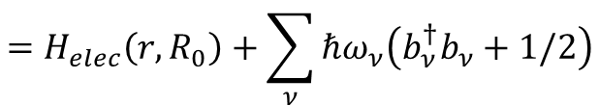


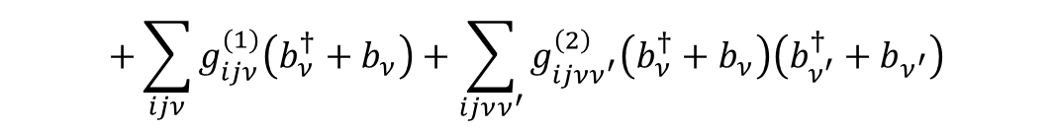
How to calculate electron-phonon couplings
Molecular wave function: direct-product basis
$$|Ψ_{i}\left(r,R_{0}\right)χ_{m}\left(R\right)⟩$$
$$H\left(r,R\right)=H_{elec}\left(r,R_{0}\right)+H_{nuc}^{(2)}\left(R\right)+V_{e−ph}^{(1+2)}\left(r,R\right)$$
$$=H_{elec}\left(r,R_{0}\right)+\sum_{ν}{ℏω_{ν}\left(b_{ν}^{†}b_{ν}+1/2\right)}$$
$$+\sum_{ijν}{g_{ijν}^{(1)}\left(b_{ν}^{†}+b_{ν}\right)}+\sum_{ijνν^{′}}{g_{ijνν^{′}}^{\left(2\right)}\left(b_{ν}^{†}+b_{ν}\right)\left(b_{ν^{′}}^{†}+b_{ν^{′}}\right)}$$
$$g_{ijν}^{(1)}≡\left\langle Ψ_{i}\left(r,R_{0}\right) | {\left(\frac{∂H_{elec}}{∂R_{ν}}\right)}_{0} | Ψ_{j}\left(r,R_{0}\right)\right\rangle$$
$$g_{ijνν^{′}}^{(2)}≡\left\langle Ψ_{i}\left(r,R_{0}\right) | {\left(\frac{∂^{2}H_{elec}}{∂R_{ν^{′}}∂R_{ν}}\right)}_{0} | Ψ_{j}\left(r,R_{0}\right)\right\rangle$$

Slide 9
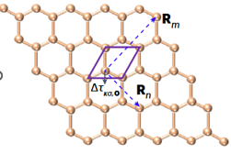


DFT electron-phonon couplings workflow
Density functional perturbation theory (DFPT)
$$\frac{∂V}{∂Δτ}$$
Optimized geometry
$$g_{ijν}$$
Phonon

Slide 10
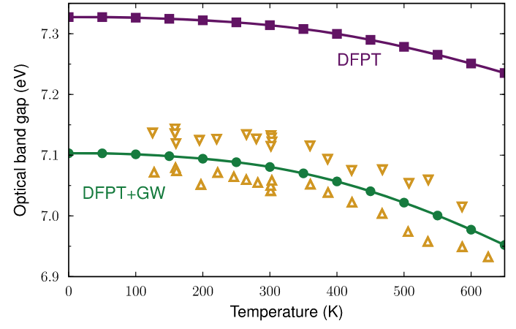
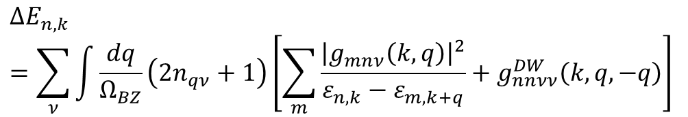
DFT code validation
Diamond band gap renormalization
$$ΔE_{n,k}=\sum_{ν}{\int{\frac{dq}{Ω_{BZ}}\left(2n_{qν}+1\right)\left[\sum_{m}{\frac{{\left|g_{mnν}\left(k,q\right)\right|}^{2}}{ε_{n,k}−ε_{m,k+q}}}+g_{nnνν}^{DW}\left(k,q,−q\right)\right]}}$$
Basis | Zero-point renormalization (ZPR, in meV)
Planewave [1] | -437
Gaussian [2] | -407
Gaussian [This work] | -446
Exp.
[1] G Antonius, et al, Phys. Rev. Lett. 112, 215501 (2014)
[2] G Mann, M Rohlfing, T Deilmann, Phys. Rev. B. 110, 075145 (2024)

Slide 11
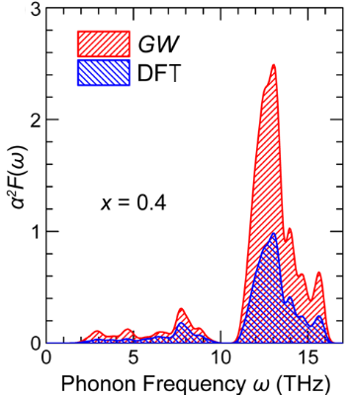
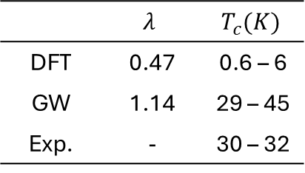
Is DFT enough for all systems?
Diamond band gap renormalization
Superconductivity
 | $$λ$$ | $$T_{c}(K)$$
DFT | 0.47 | 0.6 – 6
GW | 1.14 | 29 – 45
Exp. | - | 30 – 32
Exp.
G Antonius, et al, Phys. Rev. Lett. 112, 215501 (2014)
Z Li, et al, Phys. Rev. Lett. 122, 186402 (2019)

Slide 12

Workflow is the same for quasi-particle picture
GW
$$\frac{∂V}{∂Δτ}$$
$$\frac{∂Σ}{∂Δτ}$$
DFT
Optimized geometry
$$g_{ijν}$$
DFT
Phonon

Slide 13
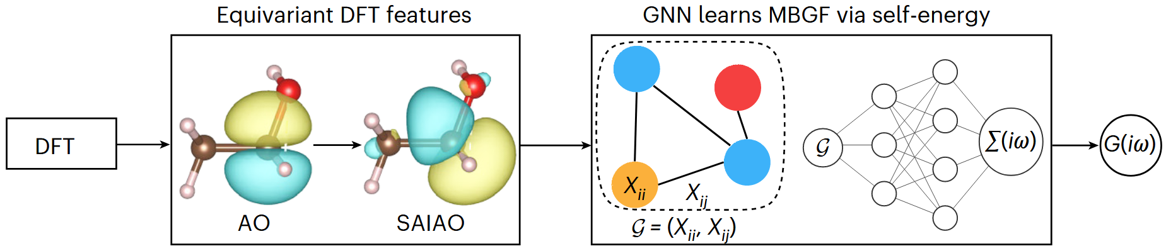
Accurate machine learning Green’s function
C. Venturella, et al, J. Chem. Theory Comput. 20, 143 (2024) C. Venturella, J. Li, T. Zhu, Nat. Comput. Sci. 5, 502 (2025)

Slide 14
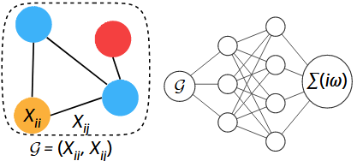



Machine learning workflow
$$Δτ$$
DFT
∑(ω)
Phonon
$$g_{ij,ν}^{GW}$$
$$\frac{∂Σ(ω)}{∂Δτ}$$
C. Zhang, in preparation

Slide 15
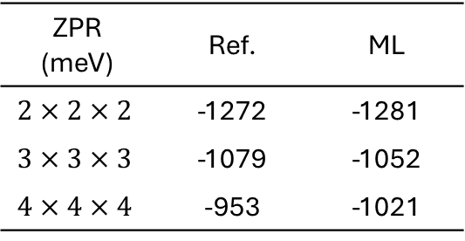
Preliminary results: band gap correction
Diamond band gap renormalization
$$ΔE_{n,k}=\sum_{ν}{\int{\frac{dq}{Ω_{BZ}}\left(2n_{qν}+1\right)\left[\sum_{m}{\frac{{\left|g_{mnν}\left(k,q\right)\right|}^{2}}{ε_{n,k}−ε_{m,k+q}}}+g_{nnνν}^{DW}\left(k,q,−q\right)\right]}}$$
ZPR (meV) | Ref. | ML
$$2×2×2$$ | -1272 | -1281
$$3×3×3$$ | -1079 | -1052
$$4×4×4$$ | -953 | -1021
Exp.
G Antonius, et al, Phys. Rev. Lett. 112, 215501 (2014)
C. Zhang, in preparation

Slide 16
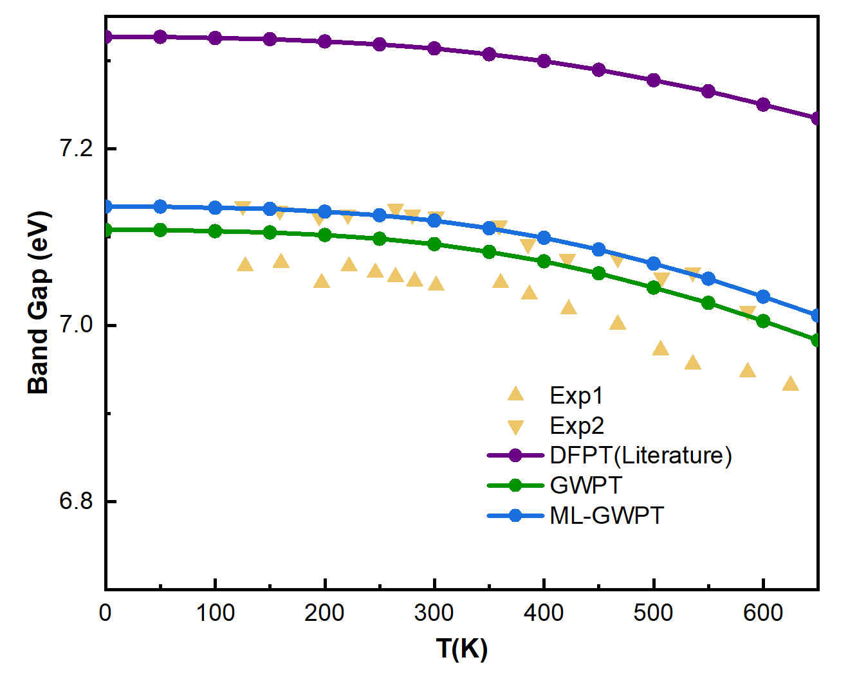
Preliminary results: temperature dependence
G Antonius, et al, Phys. Rev. Lett. 112, 215501 (2014)
C. Zhang, in preparation

Slide 17
Summary
What we have:
We implemented finite difference e-ph couplings in PySCF for DFT and GW.
Machine learning Green’s function workflow was extended to GW e-ph couplings.
More work to be done:
More physical observables from e-ph couplings
Better k-points extrapolation

Slide 18
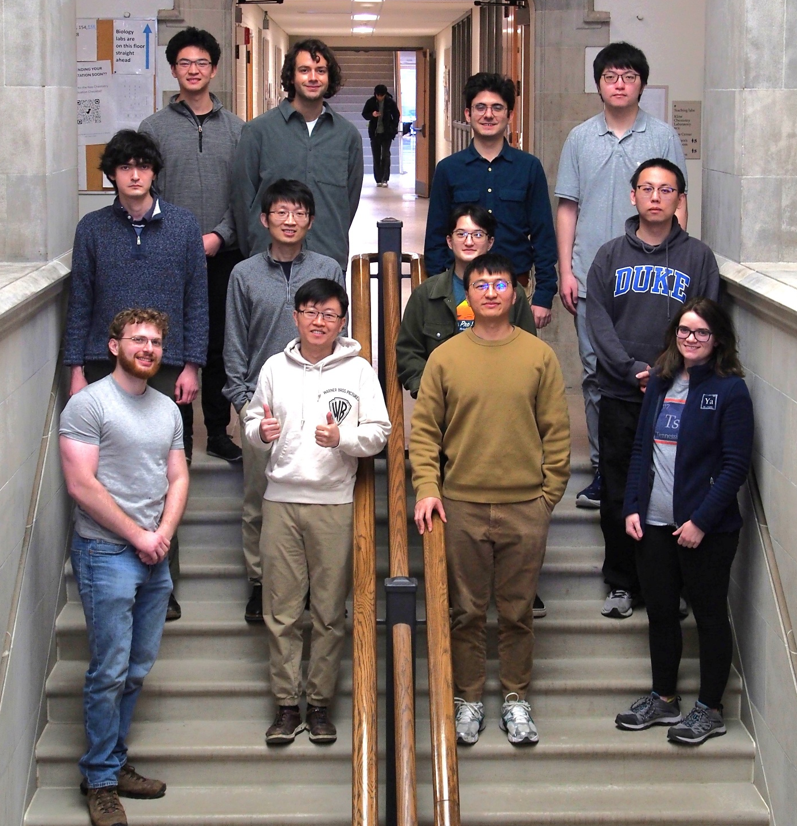


Acknowledgment
Dr. Junjie Yang
Zhu Lab

