Slide 1


Incorporating Geometric Phase Effects by Local Diabatic Representation
Dr. Yujuan Xie (Bing Gu’s Group)
Date: 2025.03.26

Slide 2
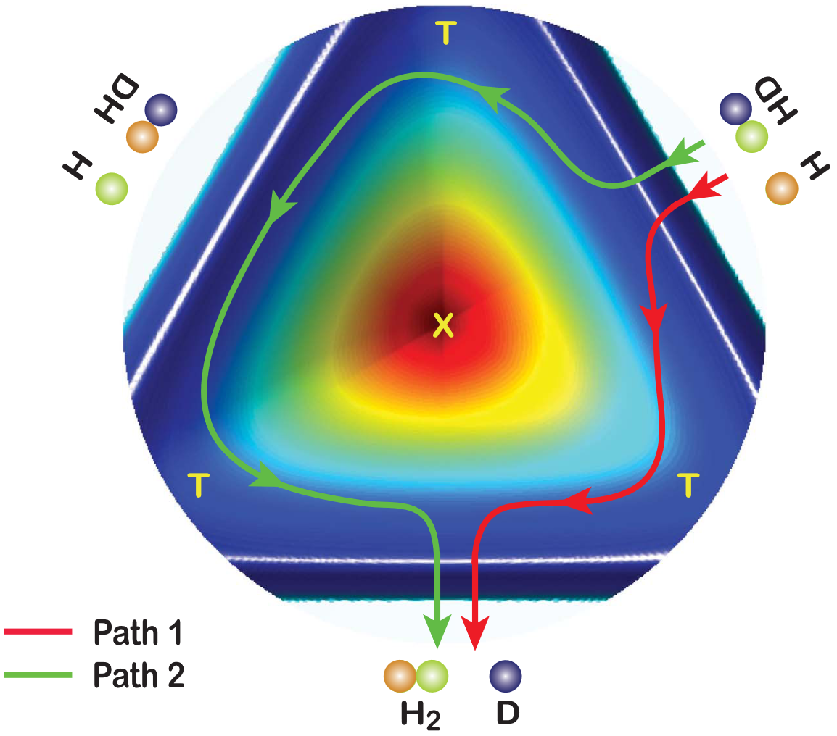
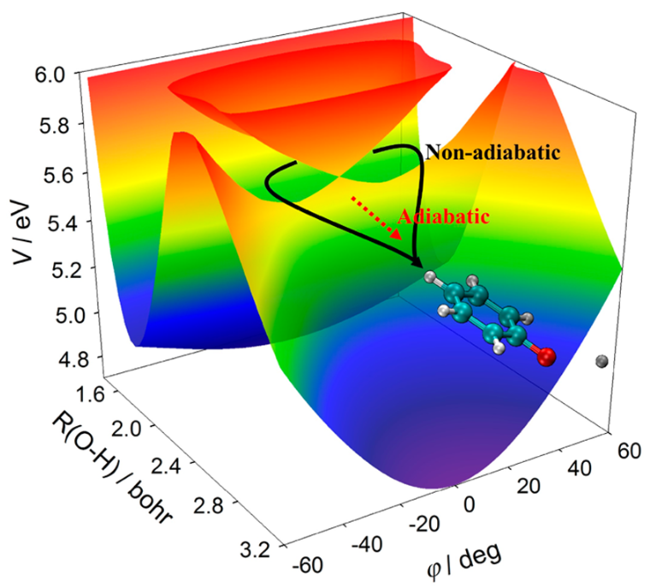
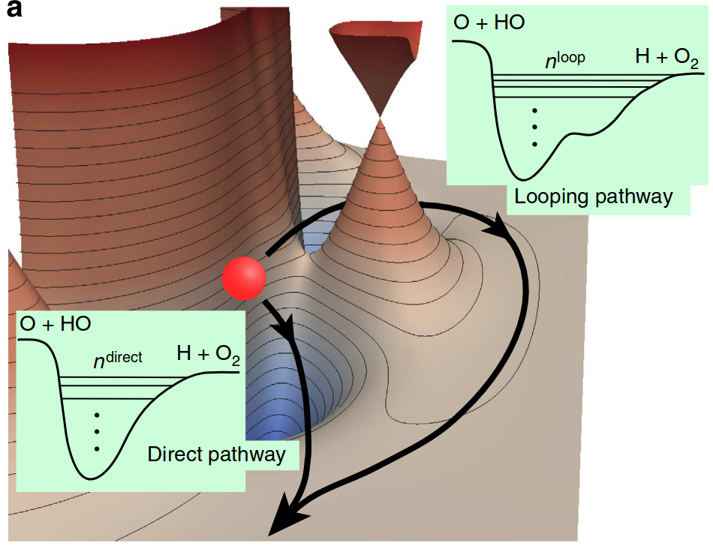
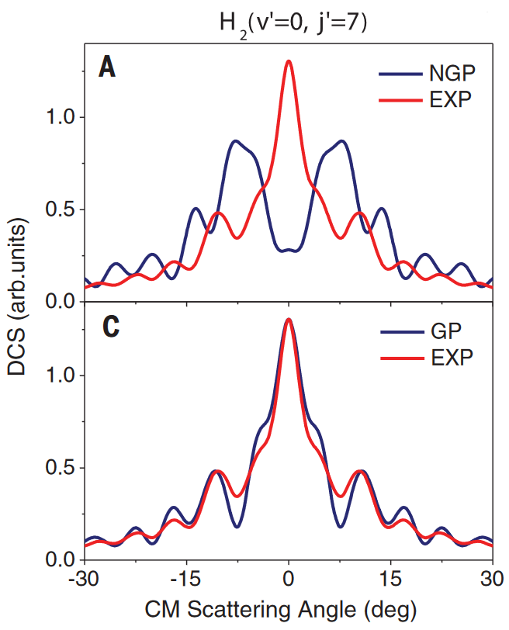
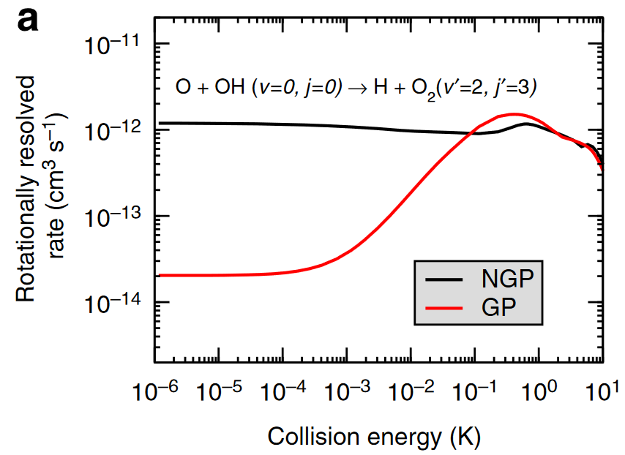
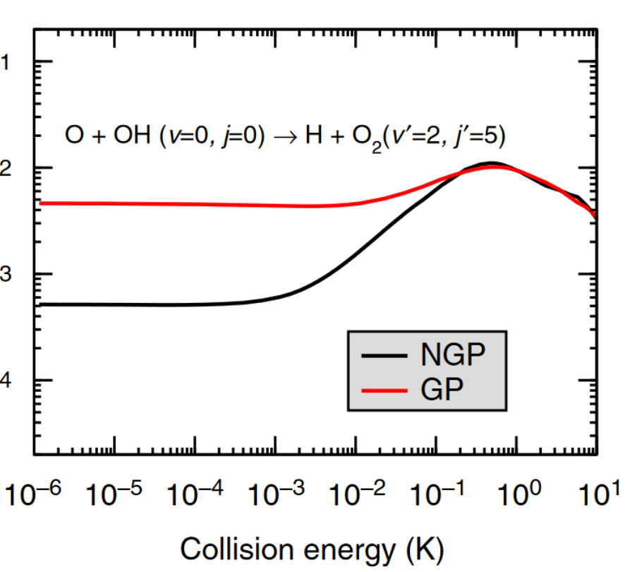
Geometric phase effects profoundly impact reactive dynamics.
1
Enhancing the forward scattering
Suppressing or enhancing the reaction rates by nearly two orders of magnitude.
100 times shorter
Xie et al. Acc. Chem. Res. 2019, 52, 501−509
Yuan et al., Nat. Commun. 2020, 11, 3640
Kendrick et al., Nat. Commun., 2015, 6, 7918

Slide 3
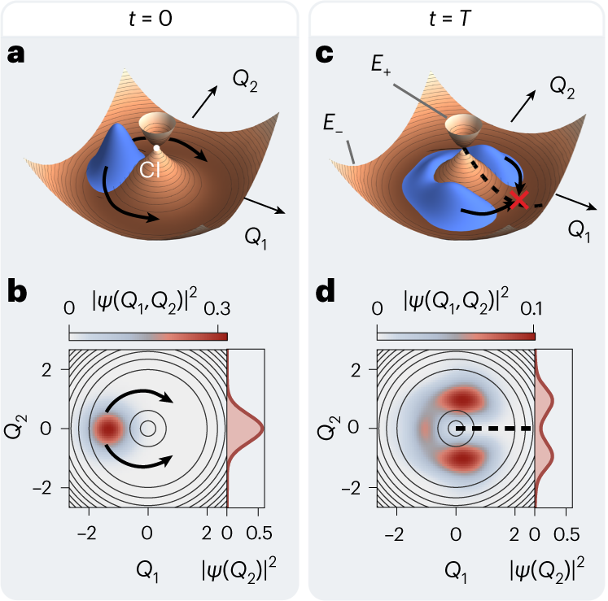

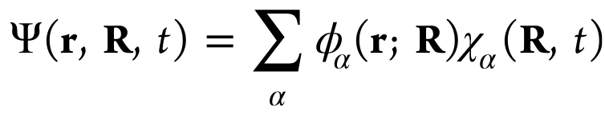
The geometric phase effect arises from the sign change of the adiabatic electronic wave function along a closed loop around a conical intersection.
2
single
valued
change
sign
Destructive interference of nuclear wave packet.
C. H. Valahu, et al. Nat. Chem. 2023, 15, 1503–1508

Slide 4
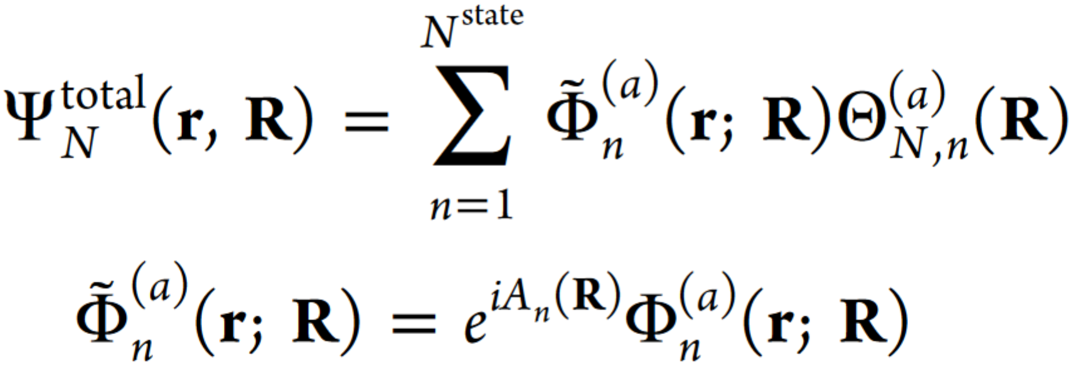
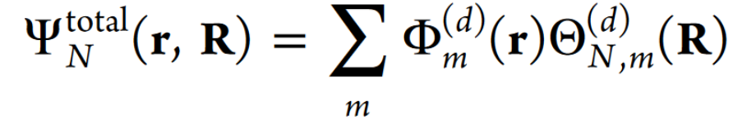
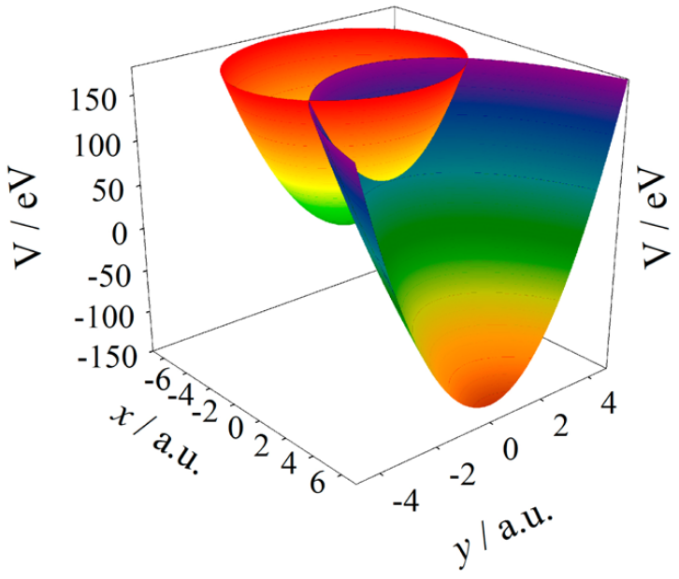
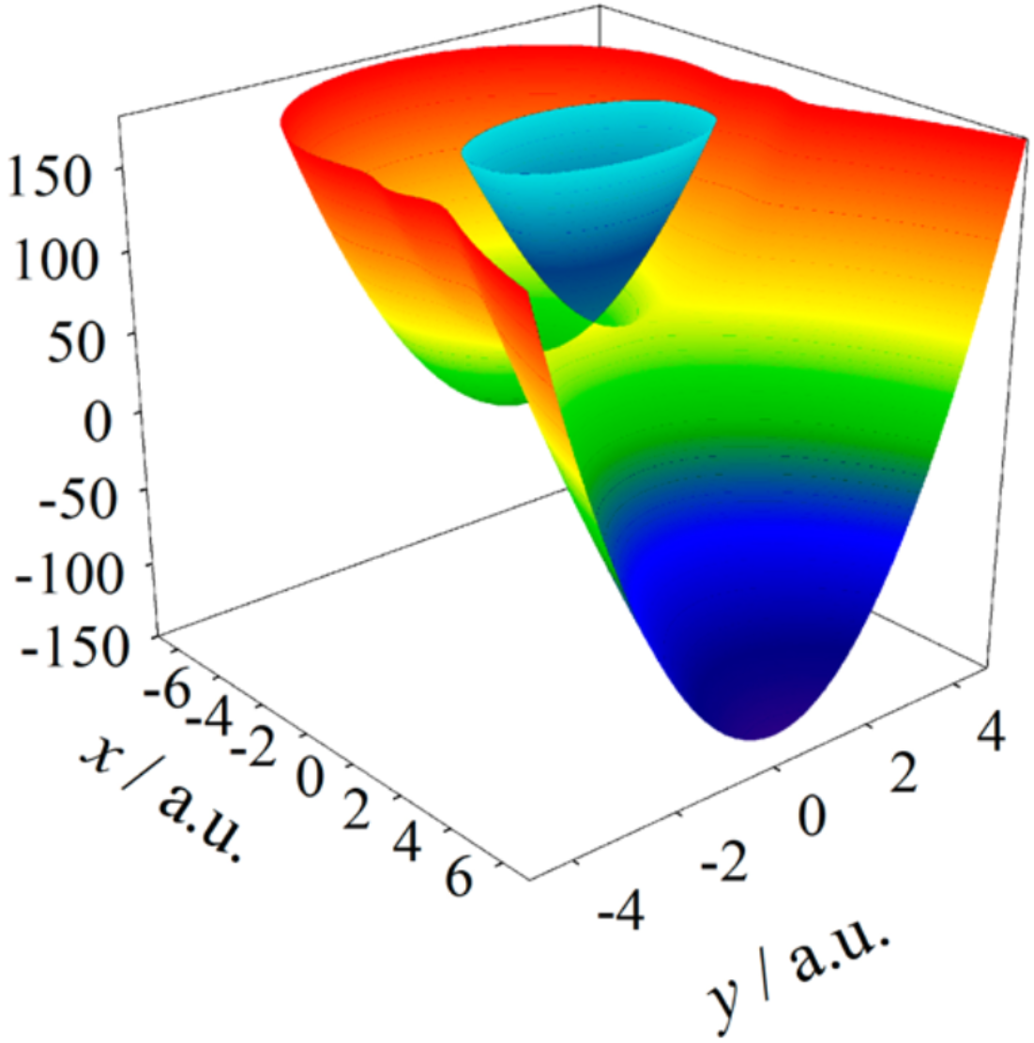
Challenges of conventional approaches to capture geometric phase effect.
3
adiabatic representation:
Diabatic representation:
Vector potential: A_{n}(R)
Numerically infeasible for multi-atomic systems
Divergence of vector potential and derivative coupling
Locate conical intersection seam
Xie et al., J. Chem. Theory Comput. 2017, 13, 1902−1910
Mead et al., J. Chem. Phys. 1979, 70, 2284−2296

Slide 5
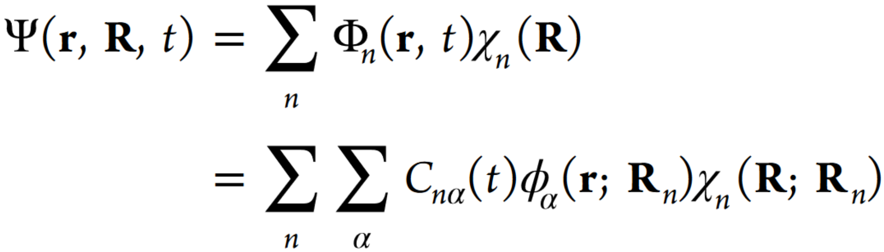
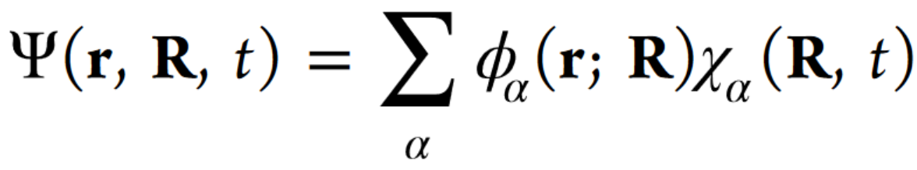
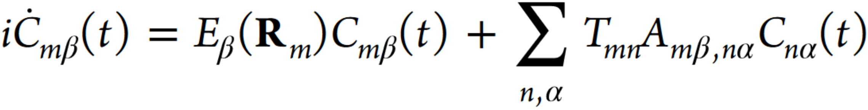
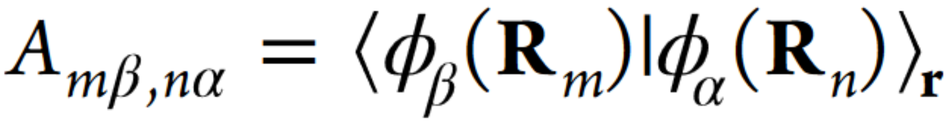
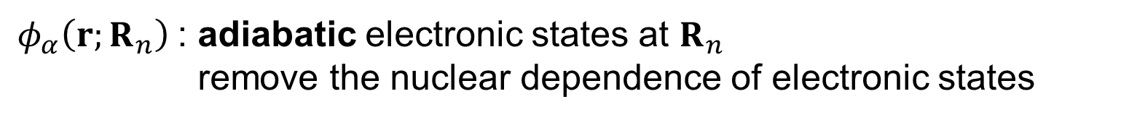
The local diabatic representation (LDR) provides a divergence-free framework for capturing geometric phase effect.
4
LDR
Born-Huang expansion
$φ_{α}\left(r;R_{n}\right)$: adiabatic electronic states at $R_{n}$
remove the nuclear dependence of electronic states
equation of motion: full quantum
: Divergence free. Always bounded [-1,1] , even at intersections

Slide 6
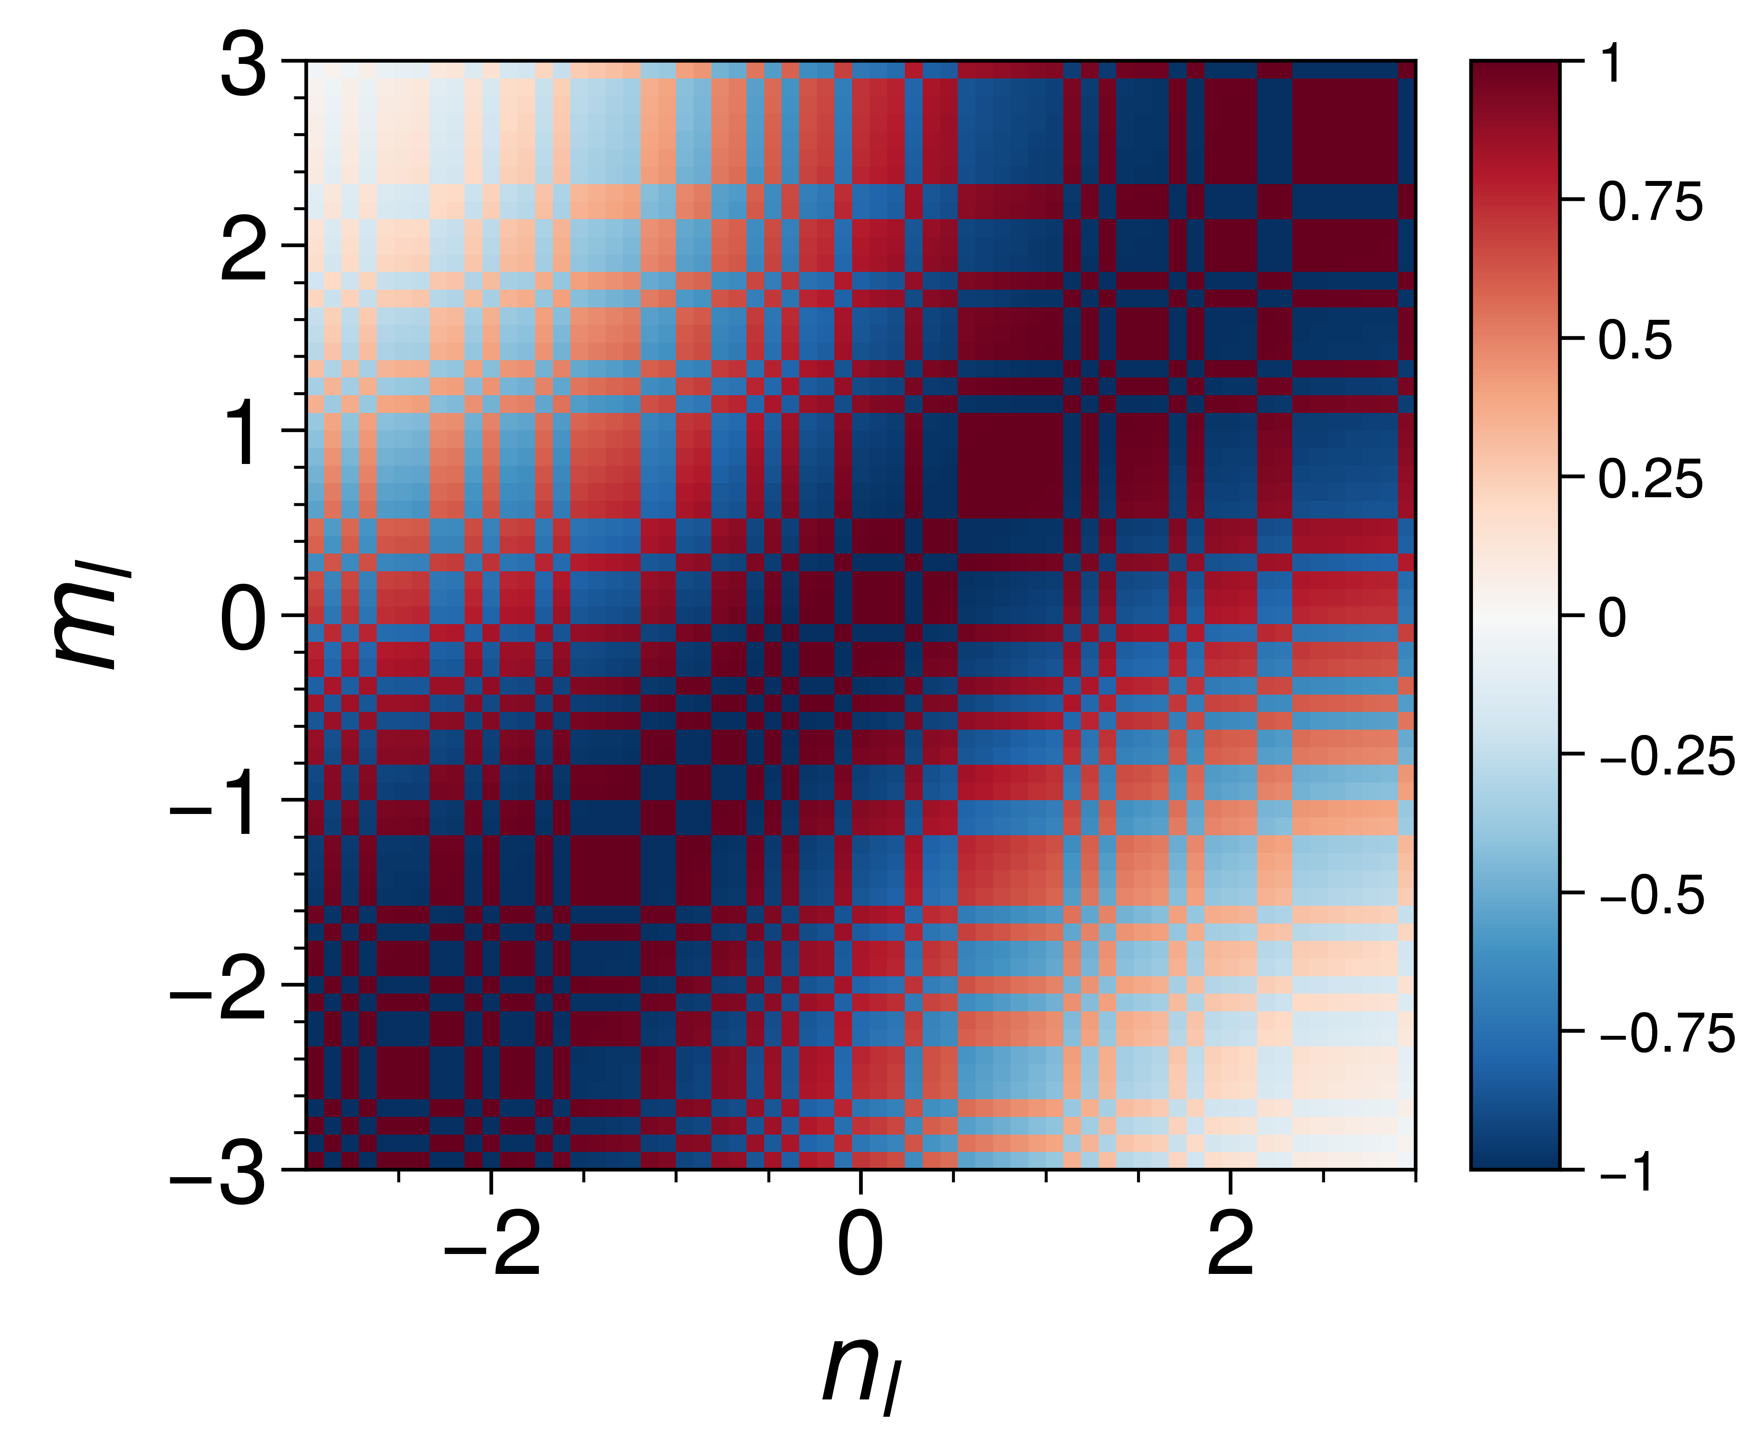
Geometric phase effect is encoded in the electronic overlap matrix.
5
α = β = 1
Phase of intrastate overlap matrix A_{mα,nα}
Geometric phase
R_{m}
LDR and BO dynamics
R_{n}
1
Topology of electronic states
Born-Oppenheimer dynamics
Yujuan Xie, Bing Gu, arXiv:2501.05003

Slide 7
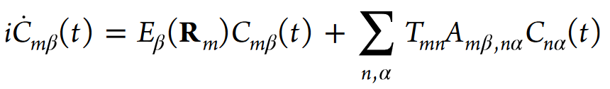



Workflow of ab initio LDR
6
Set primitive nuclear basis set {$ζ_{μ}$(R)}
discrete variable representation (DVR)
$$\left\langle ζ_{ν}|\hat{R}|ζ_{μ}\right\rangle$$
Reference geometries
Eletronic Structure Calculation
DVR nuclear basis set
{$R_{n}$}
{$|χ_{n}⟩$}
Adiabatic Potential Energy Surfaces
Eletronic Wavefunction
Electronic Overlap Matrix
Time-propagation
Observables
Zhu et al. J.Phys. Chem. Lett. 2024, 15, 8487−8493

Slide 8
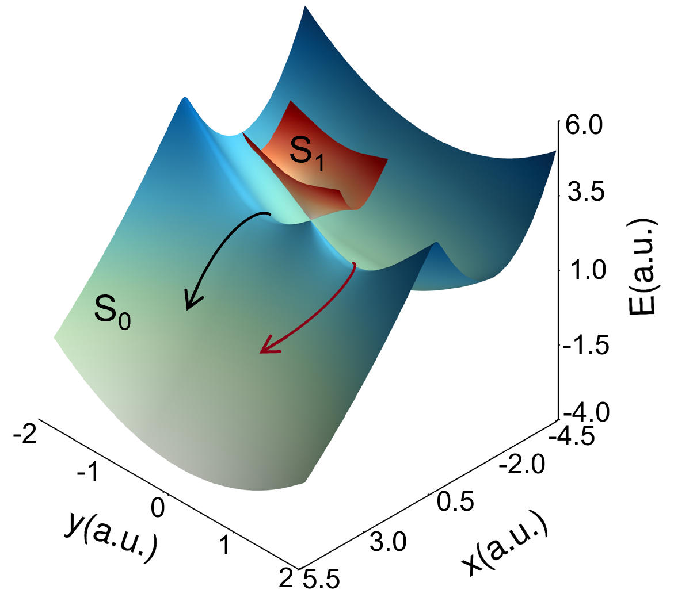
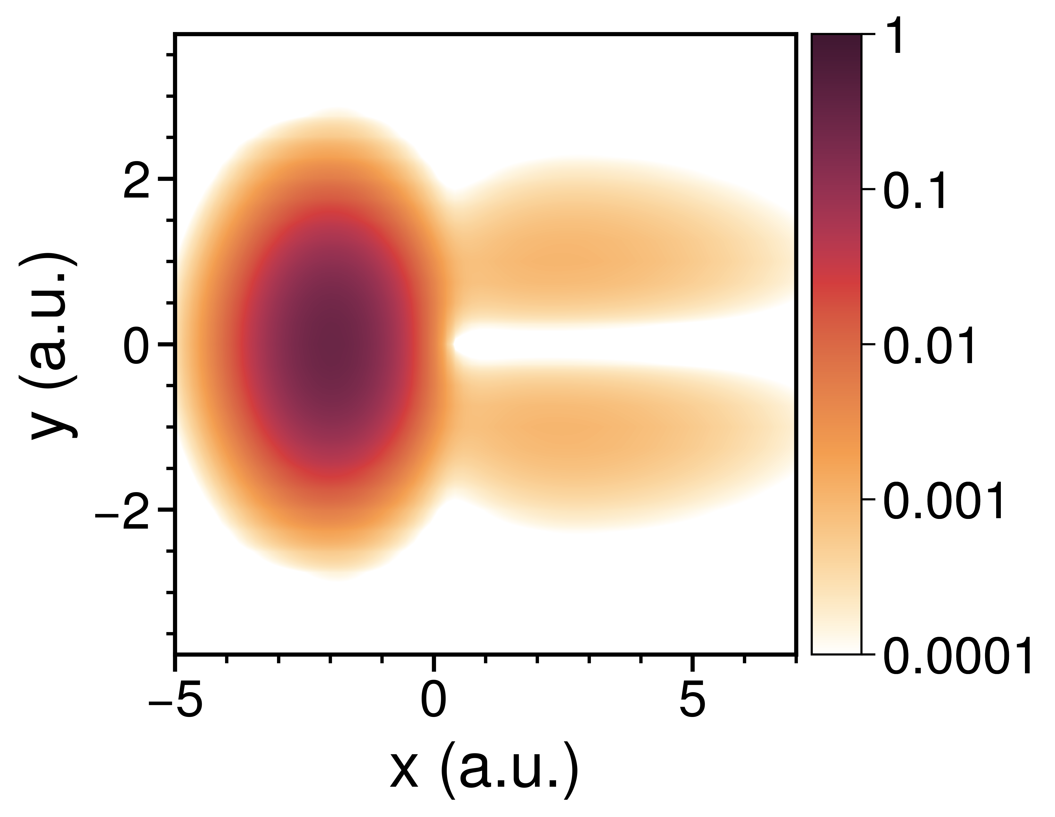
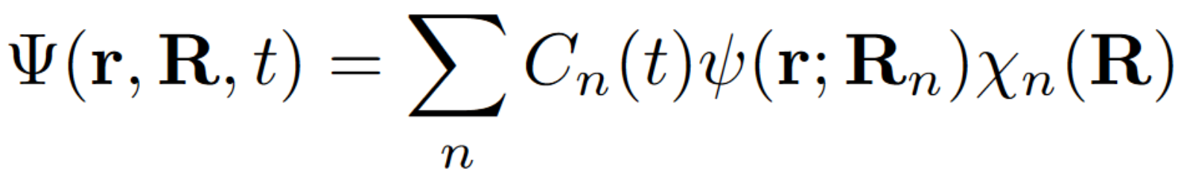
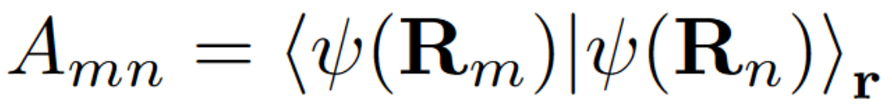
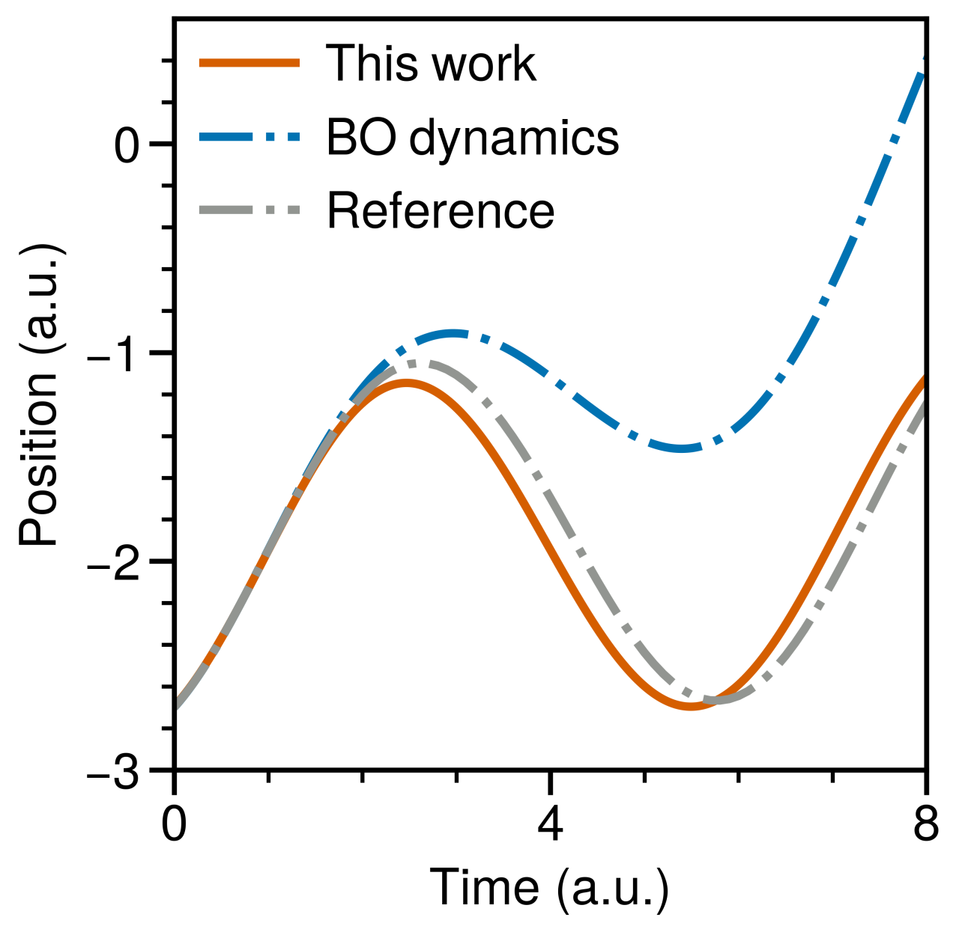
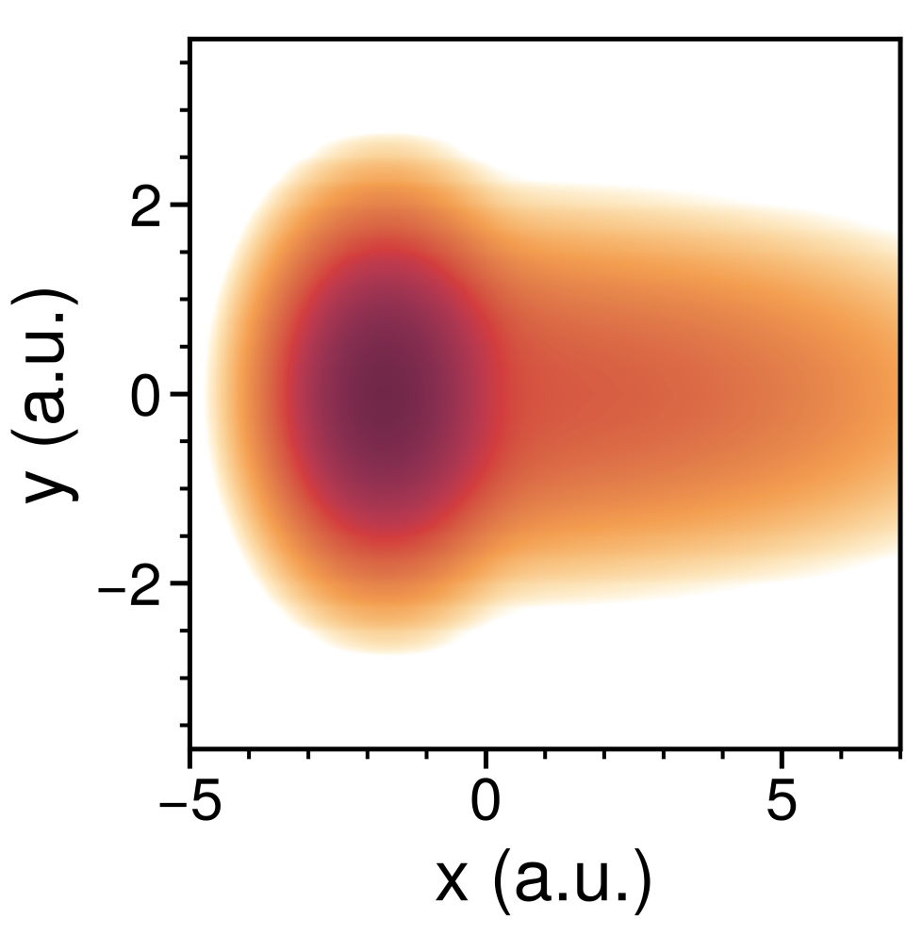
Geometric phase captured with only a single state.
7
Ground state only
Single-state LDR
Two-state vibronic model
Single-state LDR
geometric phase manifested as a nodal line along the y = 0.
The reaction rate increases in the absence of the geometric phase effect.
Destructive
interference
BO dynamics
Xie et al., Phys. Rev. A, 95, 022104 (2017)
In preparation

Slide 9
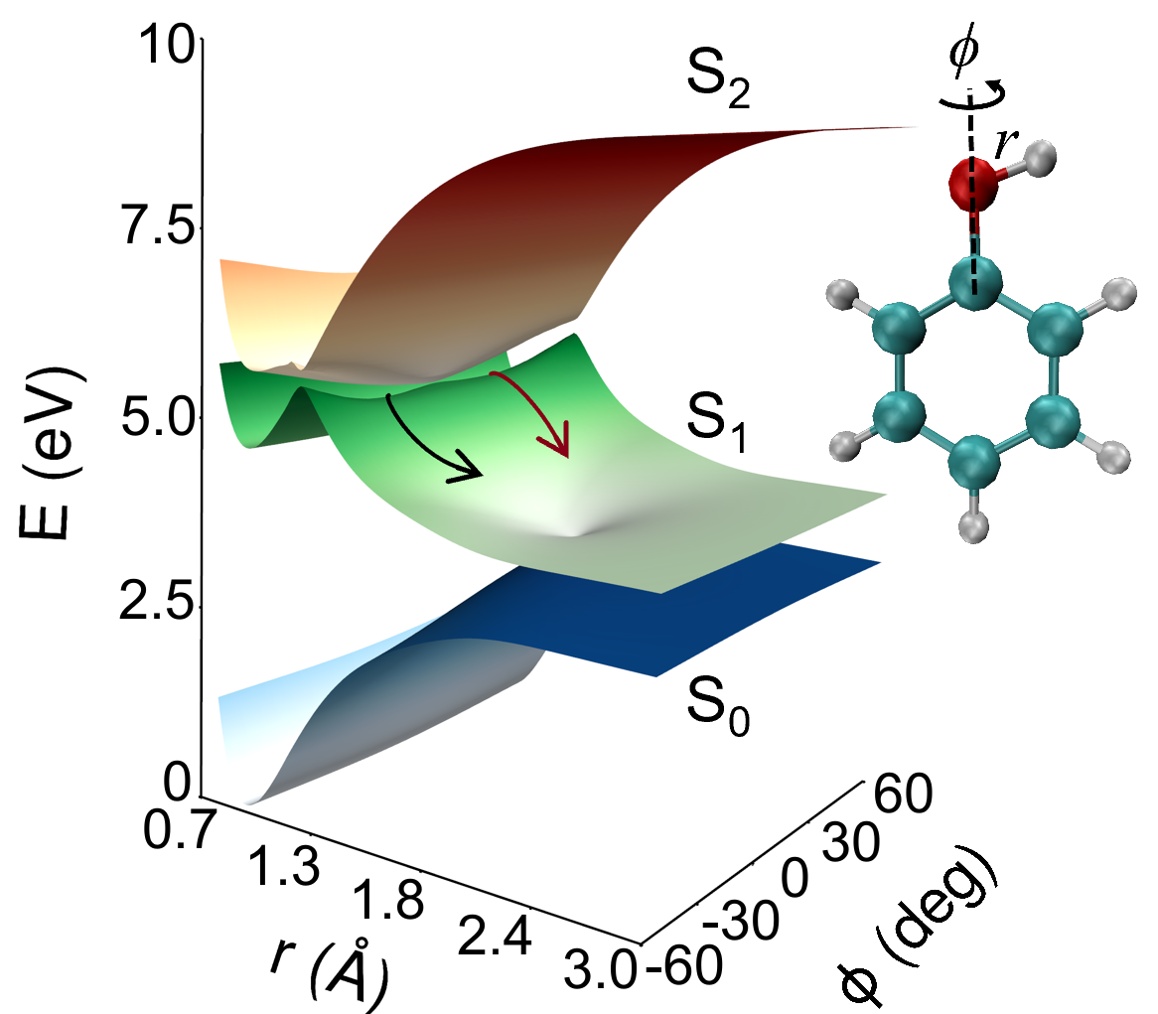
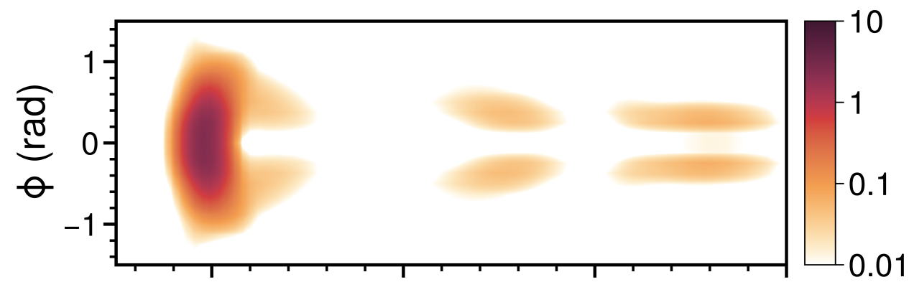
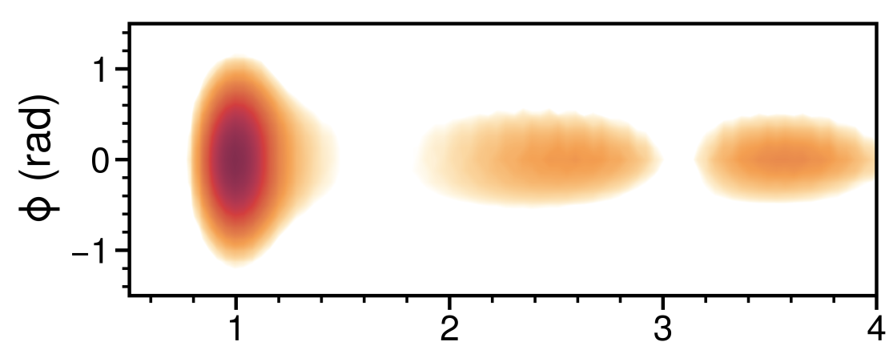
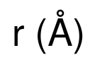
Geometric phase captured with only a single state.
8
Single-state LDR
geometric phase manifested as a nodal line along the ϕ = 0
S₁ state only
Destructive interference
Single-state LDR
BO dynamics
Lan et al., J. Chem. Phys. 122, 224315 (2005)
In preparation

Slide 10
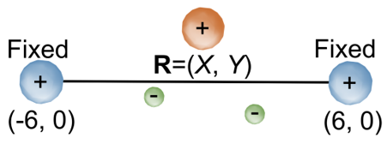
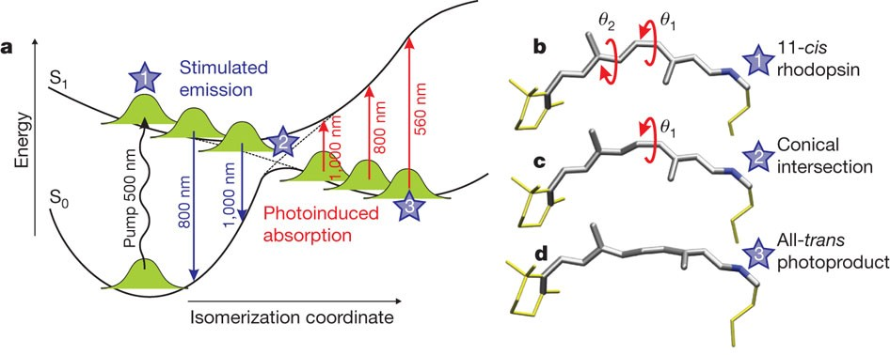
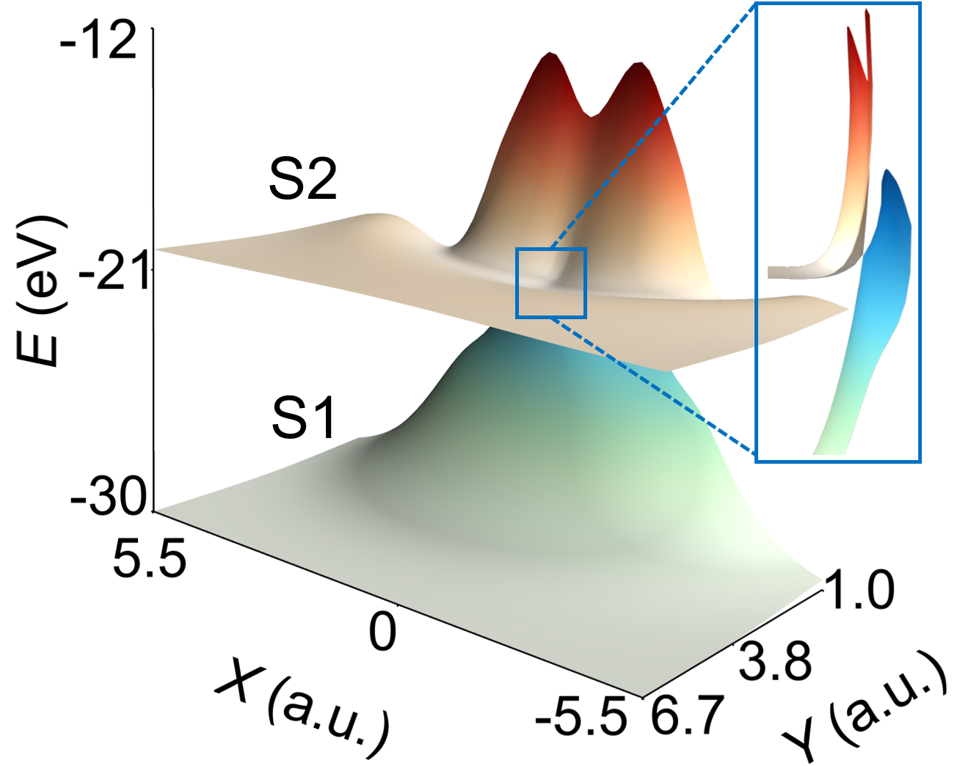
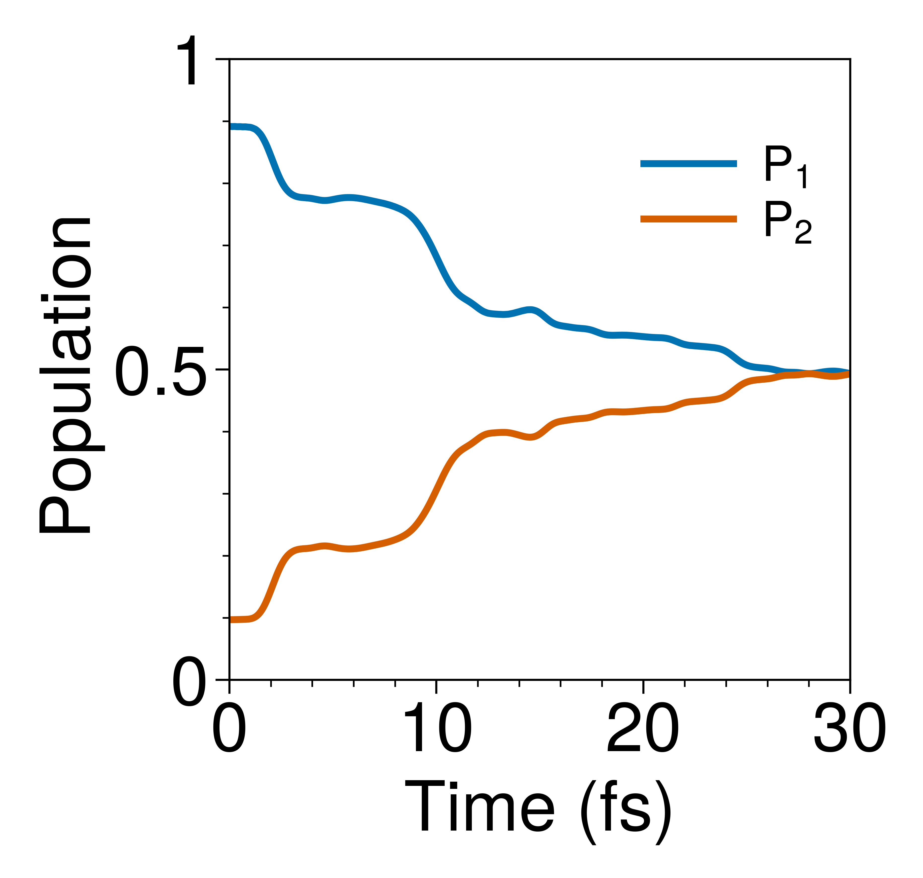
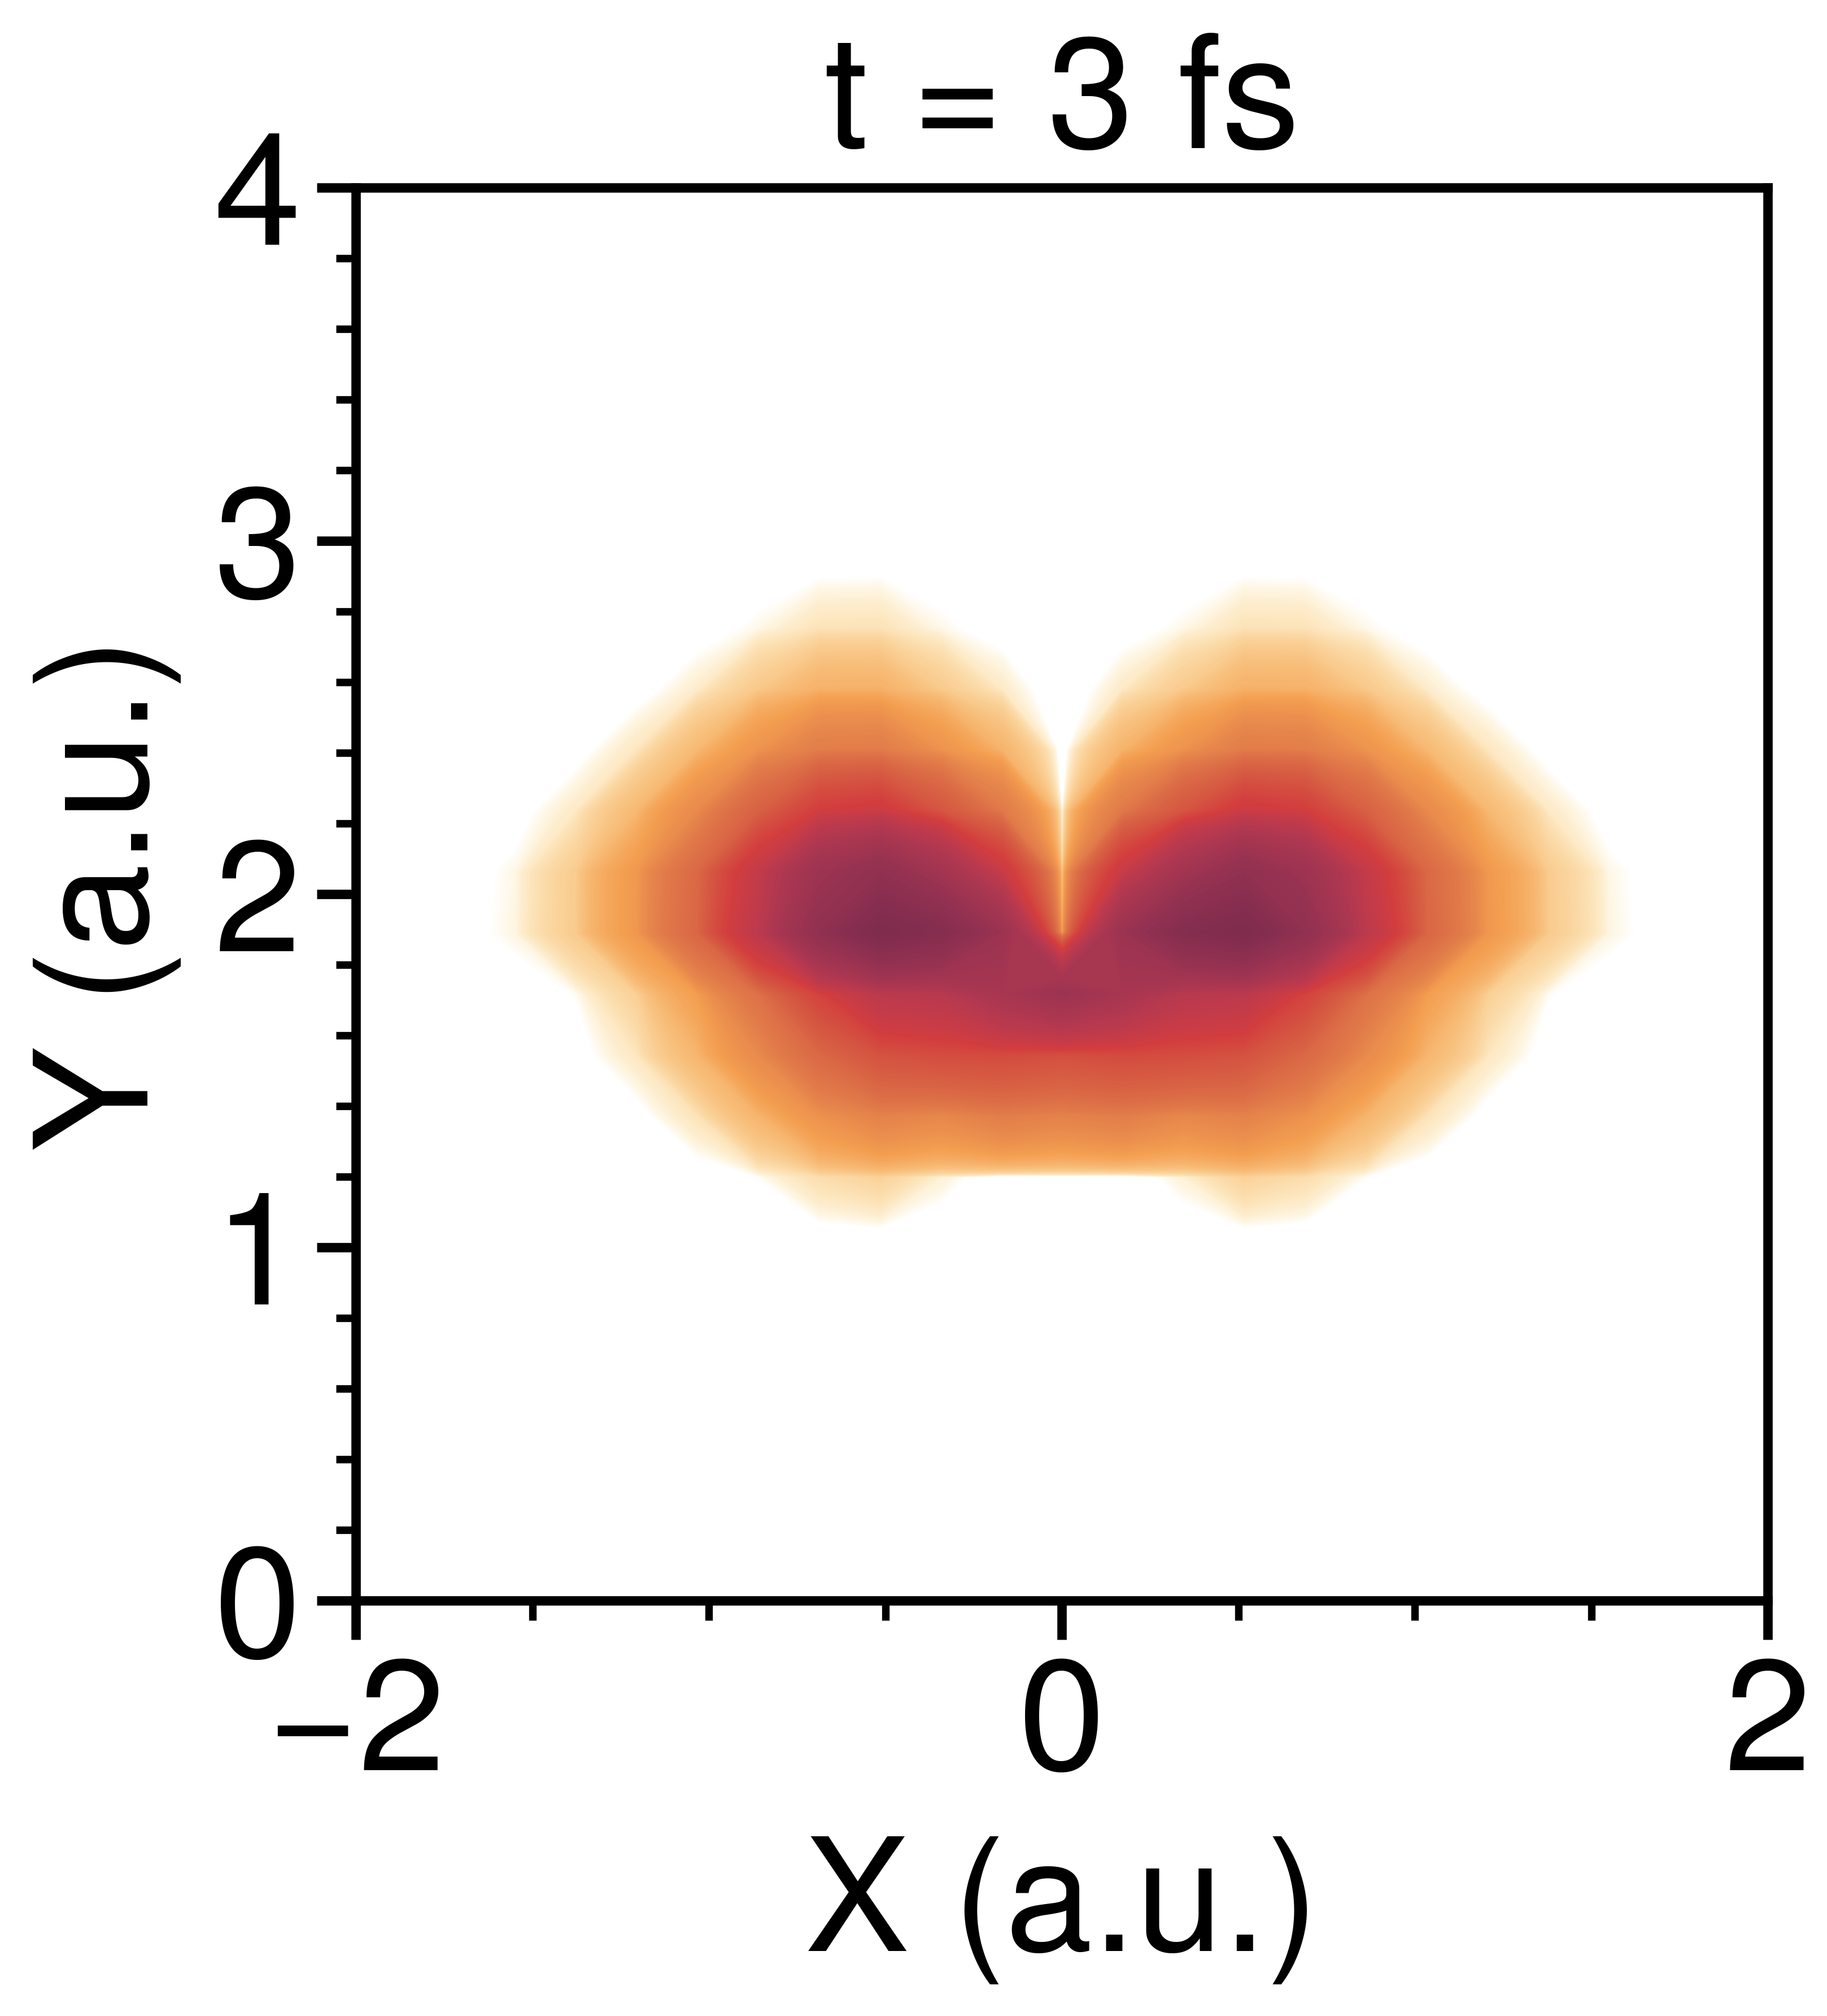
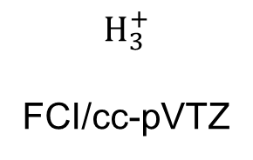
The geometric phase in nonadiabatic dynamics is incorporated by LDR.
9
$$H_{3}^{+}$$
FCI/cc-pVTZ
Polli et al. Nature 2010, 467 (7314), 440–443
S1
Electronic nonadiabatic transition
destructive interference
Geometric phase effect
In preparation

Slide 11
Conclusions
10
The local diabatic representation provides a numerically exact approach for exact quantum dynamic simulation without singularities.
The single-state local diabatic representation enables the incorporation of the geometric phase effect using only a single potential energy surface.
The local diabatic representation captures the geometric phase effect in nonadiabatic reactions.

Slide 12

Acknowledgments
11
Advisor:
Prof. Bing Gu
Group Members:
Dr. Xiang Li
Xiaotong Zhu
Ruoxi Liu
Mo Sha
Junzhe Zhang
Shuoyi Hu
Li Huang

Slide 13
Thanks for your attention.

Slide 14
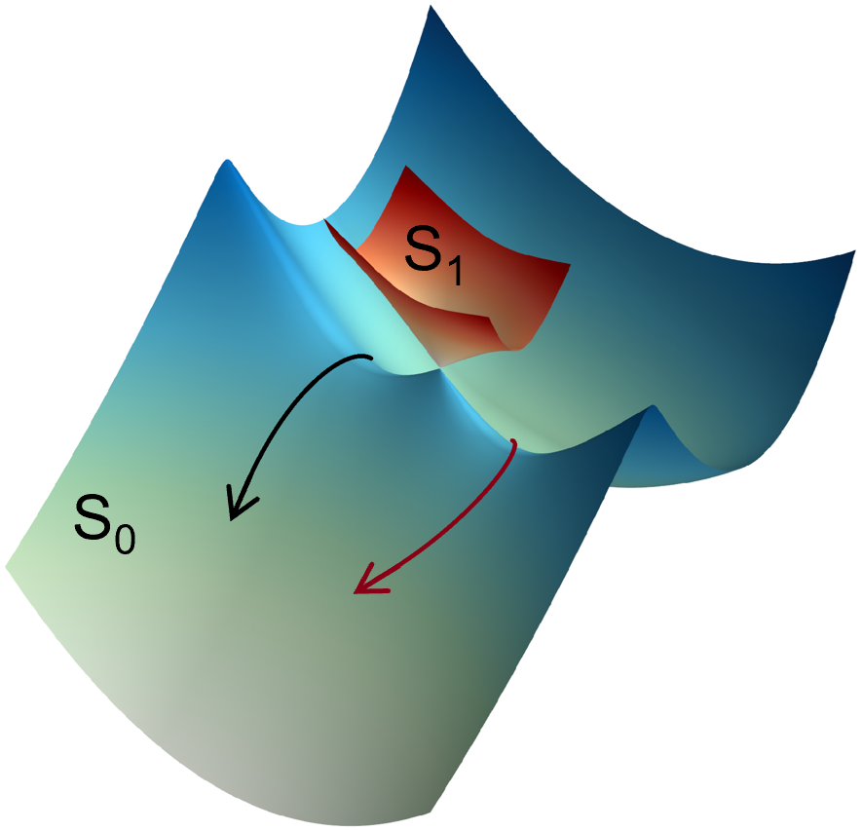
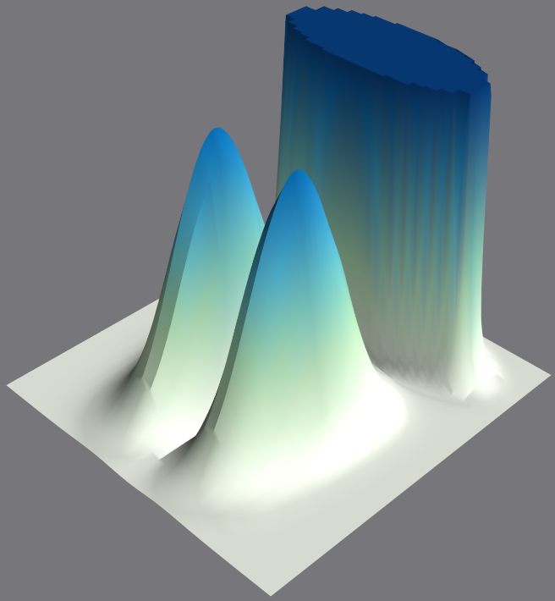
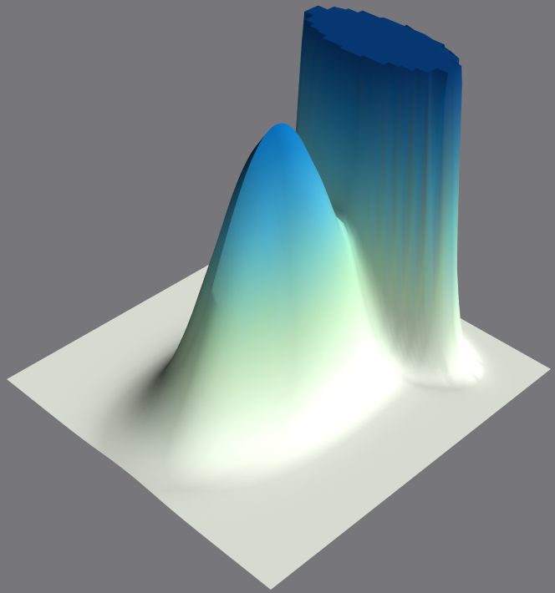
Local diabatic representation
Born−Oppenheimer dynamics
vs.
With geometric phase effect
Without geometric phase effect

