Slide 1

Interacting Quantum Trajectories and Dwell Times for Particles with Spin ½
Richard Lombardini¹ and Bill Poirier²
¹St. Mary’s University (San Antonio, TX)
²University of Vermont (Burlington, VT)
R. Lombardini and B. Poirier. Interacting quantum trajectories for particles with spin 1/2. [Molecular Physics 122, e2334805 (2024)].
B. Poirier and R. Lombardini. Dwell times, wavepacket dynamics, and quantum trajectories with spin 1/2. [Entropy 26, 336 (2024)].
Notes:
1. Completed work during sabbatical in B. Poirier’s theoretical and computational lab.
2. Work was recently published by Molecular Physics; other work in a special issue of Entropy journal called “Quantum Mechanics and the Challenge of Time”
3. Quantum trajectory methods (QTMs) have been embraced by the chemical physics community and also community in nuclear physics as effective computational approaches to quantum problems with many degrees of freedom (DOFs). Their defining feature is that particles have definite position and momenta (like classical mechanics), but the results are fully quantum.
3. They stem from the De Broglie-Bohm or pilot wave interpretation of quantum mechanics (aka Bohmian Mechanics).
4. QTMs defeat the exponential growth of computational effort as DOFs are added to quantum system as plagued by other methods (e.g., grid or basis set methods)
5. One variation of QTMs that I will present is called Interacting Quantum Trajectories (IQT) where no wavefunction is needed.
6. IQT could offer benefits due to its simplicity (no wavefunction) and numerical stability.
7. This IQT method has been developed for both relativistic and non-relativistic spinless particle cases.
8. I will present the recent development of this new method applied to the Pauli Equation which handles nonrelativistic systems with spin ½. First time (to our knowledge) that this IQT method is applied to spin ½ systems.
9. I will look at two iconic quantum problems involving spin: quantum spin flipper and the Stern-Gerlach Experiment.
10. Last, I will talk about different possible theoretical candidates for quantum dwell times using QTMs.

Slide 2
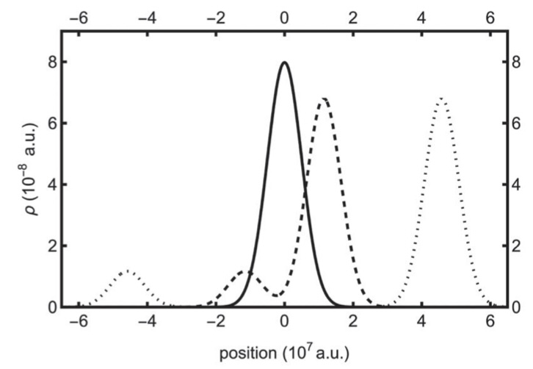
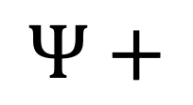


Introduction
X
$$Ψ$$
$$Ψ$$
$$Ψ+$$
Traditional Quantum
Mechanics
De Broglie-Bohm (dBB)
Interacting Quantum Trajectories (IQT)
In IQT, B. Poirier [Chem. Phys. 370, 4-14 (2010)] found a way to treat “…the trajectory ensemble itself as the fundamental quantum entity” (pg. 5).
Quantum effects manifest as interactions among trajectories.
Notes:
Traditional quantum mechanics has a wavefunction that provides all of the information of system.
In dBB theory, the wavefunction is retained and used to guide a single quantum trajectory, which provides physical insight beyond wavefunction alone. Although it is a hidden variable theory, it is not local (nonlocal quantum forces).
B. Poirier, in the spirit of possibly uncovering both ontological insights and computational advantages, found a way to treat ‘the trajectory ensemble itself as the fundamental quantum entity’, thereby doing away with the wavefunction entirely.
Quantum effects manifest as interactions among trajectories. One could construct wavefunction, if you wanted, but there is no need.
Again, I will be presenting the novel extension of IQT to handle non-relativistic particles with spin ½ traditionally treated with Pauli equation.
COULD END HERE!!!!!
We will start with Pauli equation and move to dBB formalism developed by Holland et al. which results in 4 coupled real-valued PDEs (time evolution equations dependent on wavefunction) that describe quantum dynamics.
Next, we will demonstrate extension from dBB to IQT resulting in three coupled PDEs (time evolution equations not dependent on wavefunction) and a new trajectory-labelling coordinate.
1D equations will be addressed.
Computational techniques will also be explored.

Slide 3
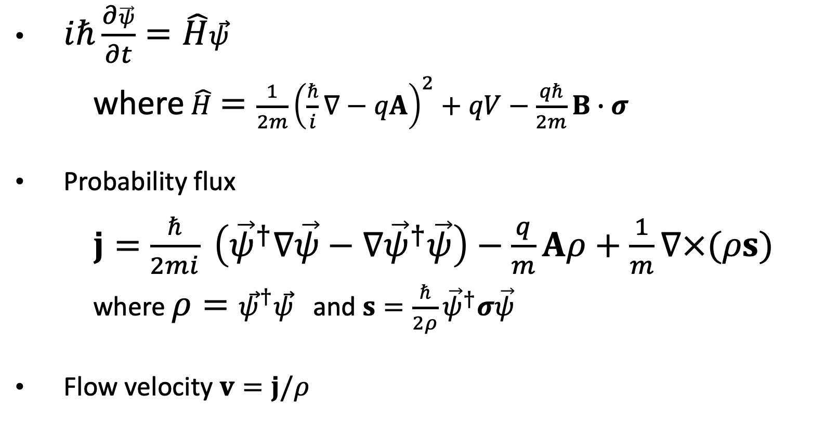
Pauli Equation
$iℏ\frac{∂\vec{ψ}}{∂t}=\hat{H}\vec{ψ}$
where$\hat{H}=\frac{1}{2m}{\left(\frac{ℏ}{i}∇−qA\right)}^{2}+qV−\frac{qℏ}{2m}B∙σ$
Probability flux
$j=$ $\frac{ℏ}{2mi} \left({\vec{ψ}}^{†}∇\vec{ψ}−{∇\vec{ψ}}^{†}\vec{ψ}\right)−\frac{q}{m}Aρ+\frac{1}{m}∇×(ρs)$
where $ρ={\vec{ψ}}^{†}\vec{ψ}$ and $s=\frac{ℏ}{2ρ}{\vec{ψ}}^{†}σ\vec{ψ}$
Flow velocity $v=j/ρ$
Notes:
Time dependent Schrodinger equation where psi is a spinor wavefunction.
Hamiltonian operator in SI units: q charge, m mass, A vector potential, B magnetic field, V scalar electric potential, sigma Pauli spin matrix vector
For the QTM theories, we need the probability flux for Pauli equation, which is related to velocity field integrated for trajectories.
Rho is the probability density and s is the spin vector which serves as a local expectation value of spin operator sigma
Flux is related to flow velocity of probability fluid in both dBB and IQT theories

Slide 4
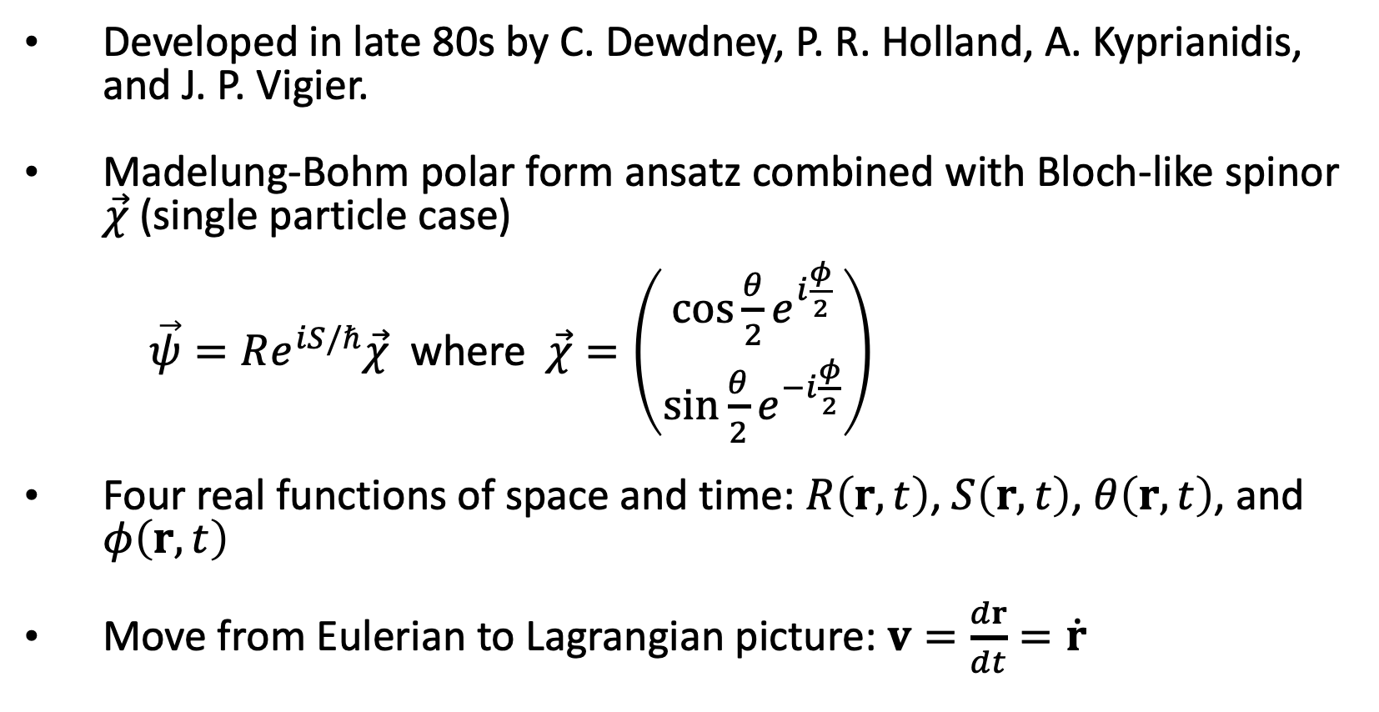
dBB Approach
Developed in late 80s by C. Dewdney, P. R. Holland, A. Kyprianidis, and J. P. Vigier.
Madelung-Bohm polar form ansatz combined with Bloch-like spinor $\vec{χ}$ (single particle case)
$\vec{ψ}=Re^{iS/ℏ}\vec{χ}$ where $\vec{χ}=\left(\begin{matrix}\cos{\frac{θ}{2}e^{i\frac{φ}{2}}} \\ \sin{\frac{θ}{2}e^{−i\frac{φ}{2}}}\end{matrix}\right)$
Four real functions of space and time: $R\left(r,t\right)$, $S\left(r,t\right)$, $θ\left(r,t\right)$, and $φ\left(r,t\right)$
Move from Eulerian to Lagrangian picture: $v=\frac{dr}{dt}=\dot{r}$
Notes:
1. R and S provide information on spatial part of wavefunction; chi is the Bloch-like spinor
2. Theta and phi act like polar and azimuthal spherical coordinate angles, respectively, giving us a spin orientation of the particle
3. It is advantageous to move from Eulerian picture where computational grid points of position are stationary over time to Lagrangian picture where grid points move along trajectories over time obtained by integrating flow velocity.

Slide 5
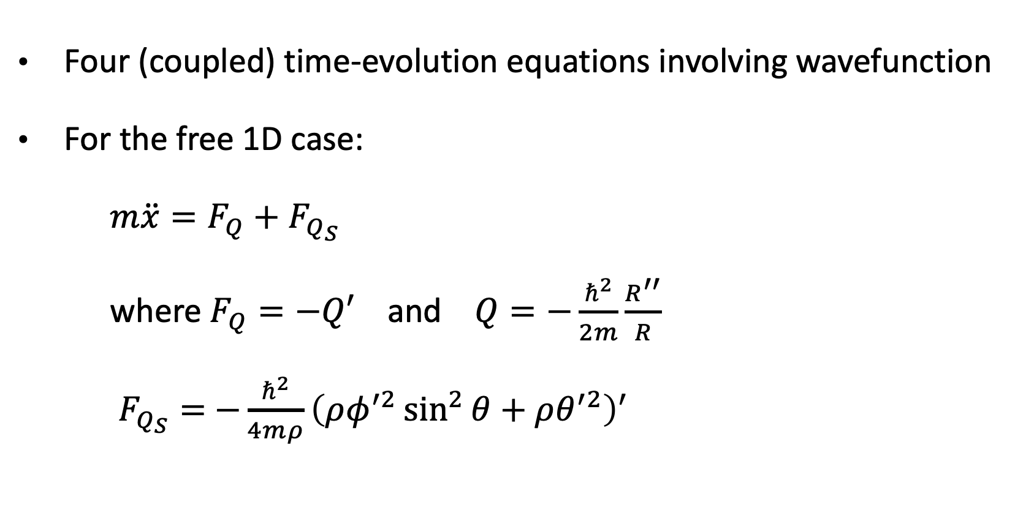
dBB Approach
Four (coupled) time-evolution equations involving wavefunction
For the free 1D case:
$m\ddot{x}=F_{Q}+F_{Q_{S}}$
where $F_{Q}=−Q′$ and $Q=−\frac{ℏ^{2}}{2m}\frac{R^{′′}}{R}$
$F_{Q_{S}}=$ $−\frac{ℏ^{2}}{4mρ}{\left(ρφ^{′2}\sin^{2}{θ+ρθ^{′2}}\right)}^{′}$
Notes:
”free” means no forces and no electromagnetic fields—gotta start somewhere
One of the equations has a Newtonian-like form, which should equal to 0 in the ”free” case, but there are non-local quantum forces that provide quantum effects
Prime means derivative with respect to x
Q is the well-known quantum potential in dBB communities.
Quantum spin force is a purely spin-based force from spinor portion

Slide 6

IQT Approach
Replace wavefunction $\vec{ψ}$ with ensemble of trajectories by introducing a new independent trajectory-labelling variable C.
$x\left(t\right)→x\left(C,t\right)$, $θ\left(x,t\right)→θ\left(C,t\right)$, and $φ\left(x,t\right)→φ\left(C,t\right)$
$ρ\left(x,t\right)=\frac{1}{x^{(1)}\left(C,t\right)}$ where $x^{(1)}={\left.\frac{∂x\left(C,t\right)}{∂C}\right|}_{t},$ or in general, $x^{(n)}={\left.\frac{∂^{n}x\left(C,t\right)}{{∂C}^{n}}\right|}_{t}$
Three (coupled) time-evolution equations not involving wavefunction
For the free 1D case:
$$m\ddot{x}=F_{Q}+F_{Q_{S}}$$
$$F_{Q}=−\frac{ℏ^{2}}{4m}\left(\frac{x^{(4)}}{{\left[x^{(1)}\right]}^{4}}−8\frac{x^{(3)}x^{(2)}}{{\left[x^{(1)}\right]}^{5}}+10\frac{{\left[x^{(2)}\right]}^{3}}{{\left[x^{(1)}\right]}^{6}}\right)$$
$F_{Q_{S}}=$ $−\frac{ℏ^{2}}{4m}{\left(\frac{{\left[φ^{(1)}\right]}^{2}\sin^{2}{θ} + {\left[θ^{(1)}\right]}^{2}}{{\left[x^{(1)}\right]}^{3}}\right)}^{(1)}$
Notes:
This IQT approach for the non-relativistic spin ½ system is completely new work (to our knowledge).
We want to replace wavefunction with ensemble of trajectories.
We need to introduce a new independent variable C, or trajectory-labeling variable. Past work, has chosen C to be trajectory starting point at initial time t = 0.
Now, all trajectory-based field quantities depend on independent field variables C and t.
Since there is flexibility in choosing C, we pick C such that resulting PDEs are in a simpler form and the resulting probability density in C has been uniformized.
Now, the force terms are derivatives with respect to C, instead of x in the dBB approach. Also, all remnants of wavefunction are gone (no rho or probability density), except for orientation angles of spin which are now functions of C and t. So, we have three sets of trajectory ensembles to propagate: x, theta, and phi.
The force terms can be numerically handled using central finite difference approximations.
The free particle is a bit complicated, but I would like to point out that adding external fields, and more degrees of freedom, does not add much more complexity. For example, let’s look at the Stern-Gerlach experiment.

Slide 7
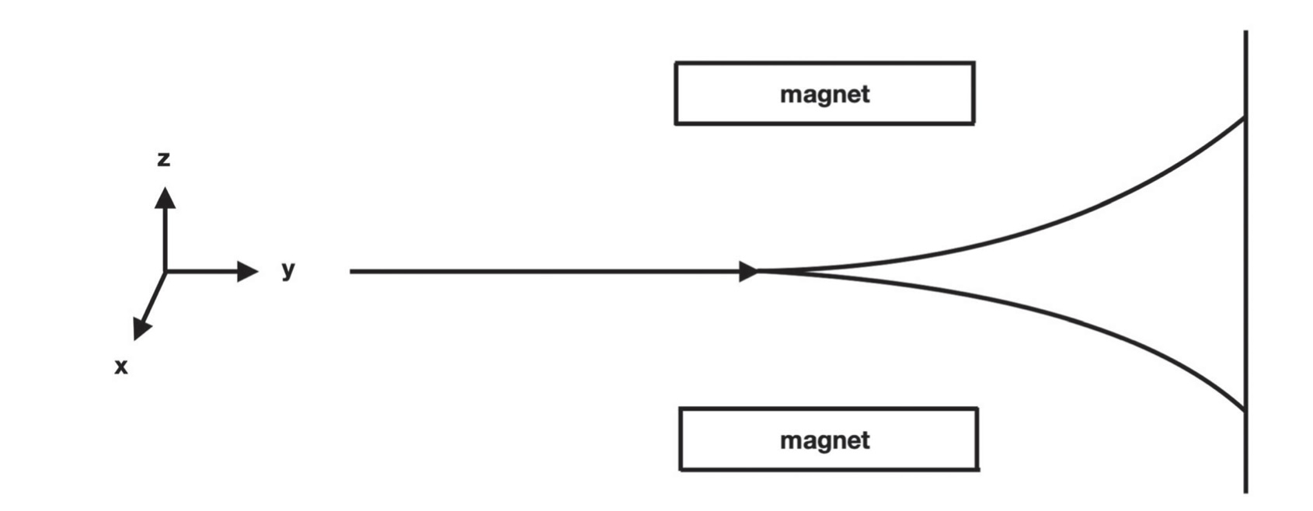

IQT Approach
Stern-Gerlach experiment
$$m\ddot{z}=F_{Q}+F_{Q_{S}}+μ_{B}B_{0}^{′}\cos{θ}$$
Notes:
Stern-Gerlach experiment where neutral silver atoms moving in y direction in the presence of a nonuniform magnetic field with magnetic field gradient B0’ along z direction.
The atoms have unpaired valence electrons whose spin interacts with magnetic field causing a binary split of atom streams due to spin orientation.
It is a 3D problem, but we can impose approximations in order to uncouple degrees of freedom and focus just on z motion (Basically, a 1D problem)
Newton-like IQT equation carries an extra term where muB is the Bohr magneton or magnetic moment of electron due to its spin.

Slide 8
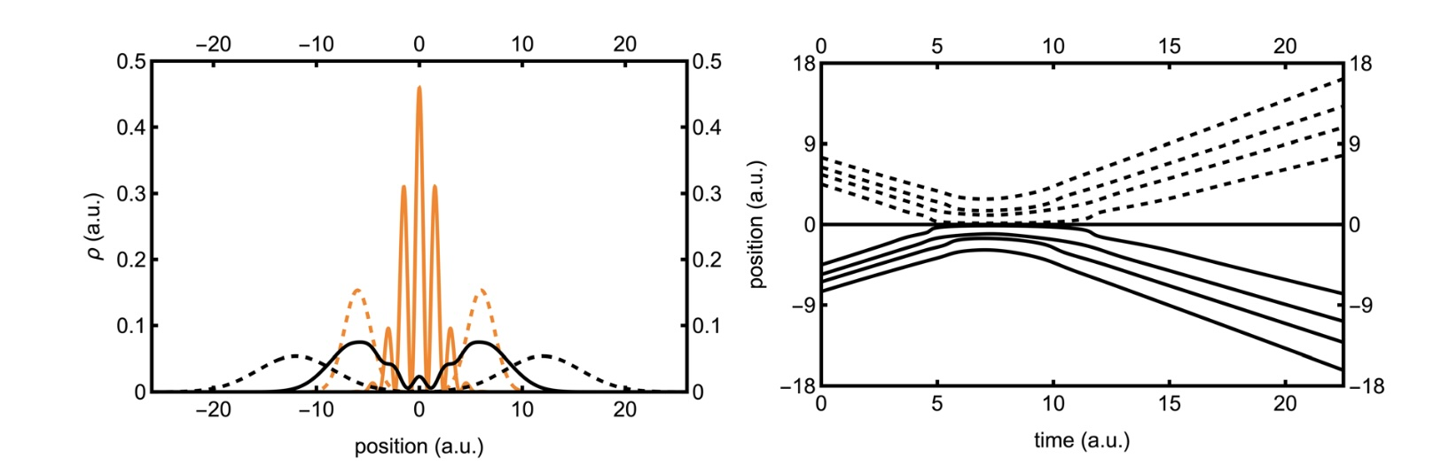
Quantum Spin Flipper (Free Spinor)
With spatial interference
Two spin-up coherent Gaussian waves approach each other and overlap.
Notes:
Example in Holland’s book: The Quantum Theory of Motion
Left: probability density versus position at different times: light dashed (start), light solid (overlap and interference), dark solid (moving away), dark dashed (last)
Right: Position versus time of ensemble of trajectories: C, or trajectory-labeling coordinate, ranges from 0 to 1, C = 1/2 is dark horizontal line, below C = ½ is solid and above ½ is dashed.
Note the region of turbulence in trajectories reflecting interference.

Slide 9
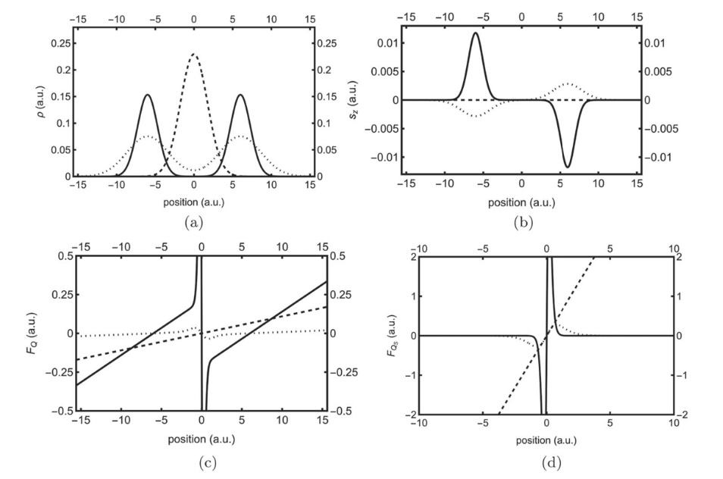
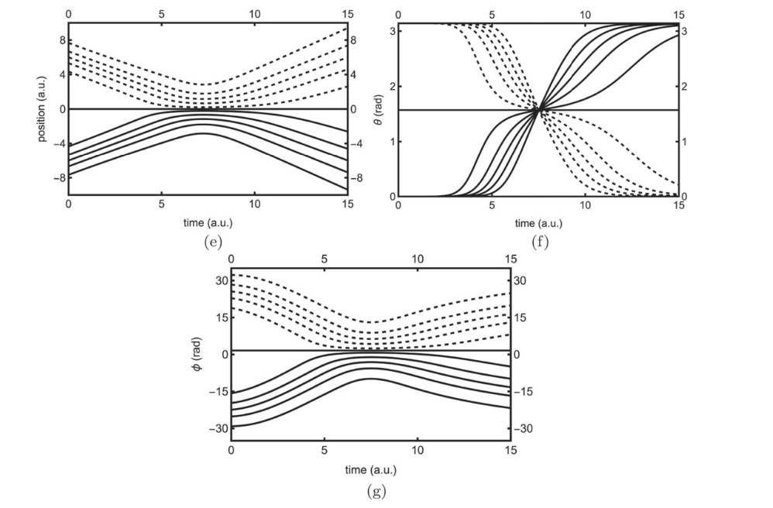
Quantum Spin Flipper (Free Spinor)
Without spatial interference
Spin-up wave interacts with spin-down wave [spin flips—see (b)].
Notes:
(a)-(d) dark line is initial time shot, dashed is next, and last time shot is dotted.
(a) probability density versus position (no interference)
(b) spin in z-direction versus position
(c) FQ versus position and (d) FQS versus position—note the nonlocal behavior
(e)-(g) C ranges from 0 to 1, C=1/2 is straight solid line, <1/2 are solid lines, >1/2 are dashed lines
(e) trajectories must reflect in the overlap region and change direction—implies a spin flip
(f) polar angle flips between 0 and pi
(g) azimuthal angle has similar behavior as trajectories

Slide 10
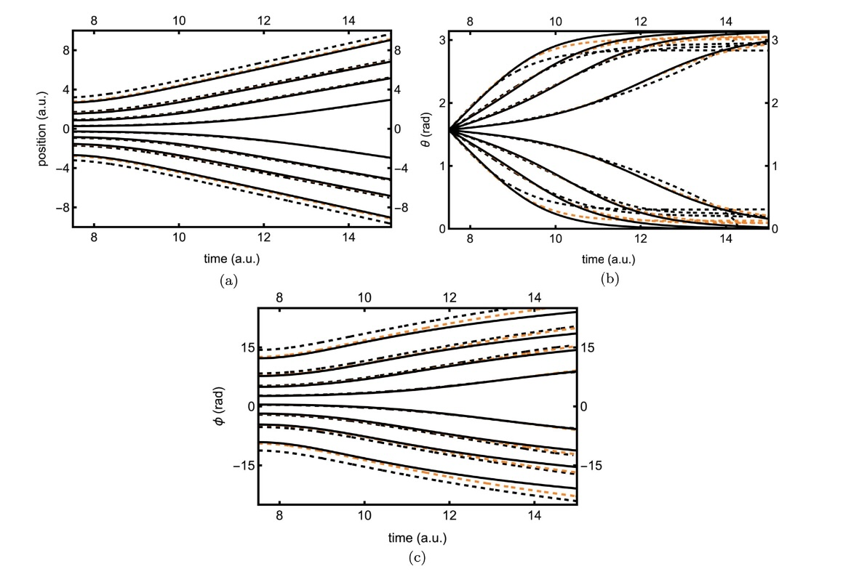

Quantum Spin Flipper (Free Spinor)
IQT numerical calculations of free spinor with no interference
Used central finite difference approximation for derivatives in C.
Used St$\ddot{o}$rmer-Verlet and Midpoint methods for time propagation.
NO WAVEFUNCTION NEEDED!!!
Notes:
Dark lines are exact trajectories.
(a) trajectories, (b) polar angle, (c) azimuthal angle
Dark dashed are numerical calculations using 17 trajectories
Light dashed are numerical calculations using 81 trajectories—approaching exact solution

Slide 11
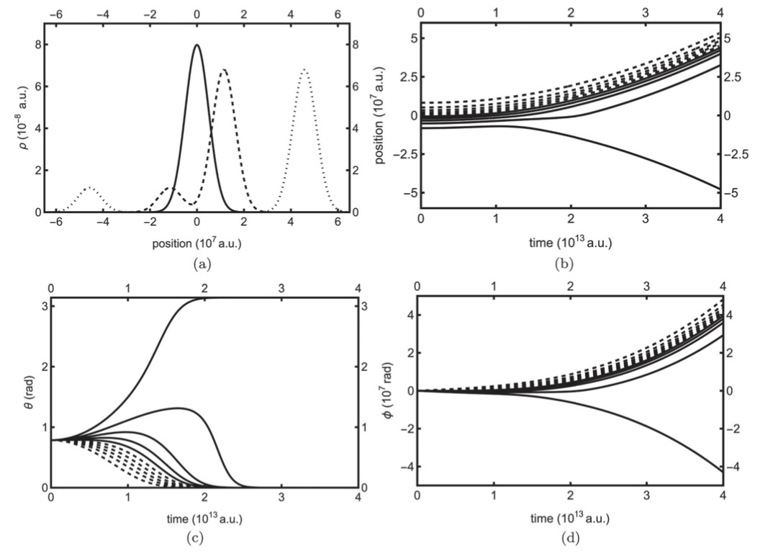

Stern-Gerlach Experiment
Initial conditions: $θ_{0}=\frac{π}{4} rad$ and $φ_{0}=0$
$\cos^{2}\frac{π}{8}≈85.36\%$ of silver atoms should measure spin-up.
9/10 or 90% trajectories end up in positive z region.
Notes:
With initial conditions, most trajectories propagate in the positive z-direction.
Most polar angle trajectories rotate to 0, or spin up, azimuthal has similar behavior as trajectories
9 out of 10 measure spin-up or 90%--this approaches the 85.36% value as number of trajectories is increased

Slide 12
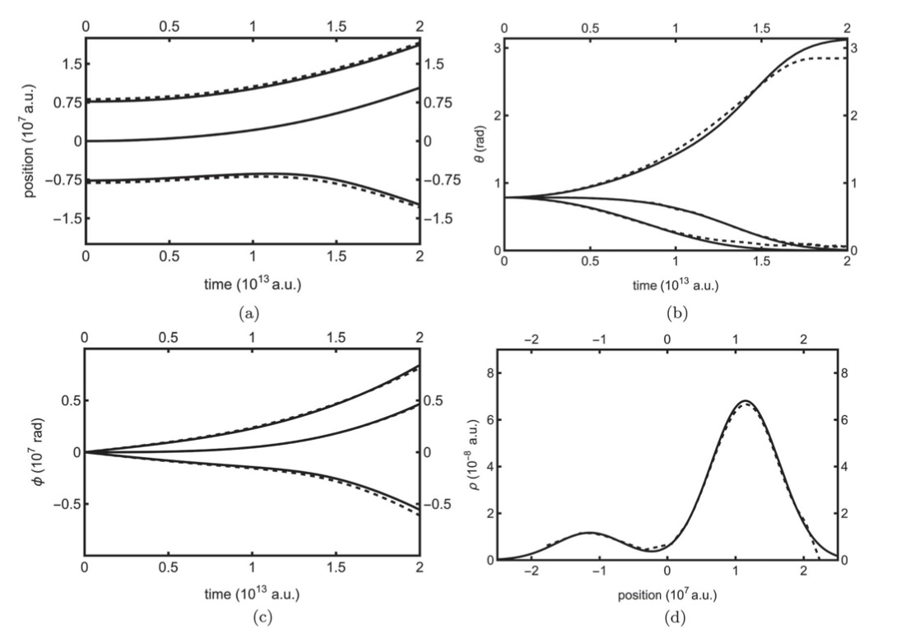

Stern-Gerlach Experiment
IQT numerical calculations of Stern-Gerlach Experiment
Used central finite difference approximation for derivatives in C.
Used St$\ddot{o}$rmer-Verlet and Midpoint methods for time propagation.
NO WAVEFUNCTION NEEDED!!!
Although, wavefunction can be recovered [see (d)].
Notes:
Dark lines is exact solution and dashed are numerical with 49 trajectories (not all shown)
(d) actually took trajectories and recreated probability density

Slide 13
Future Plans
Improve upon numerical algorithms.
Implement IQT on systems with multiple particles and spatial dimensions.
Examine particles with higher spin.
Develop IQT version of relativistic quantum mechanics for spin-1/2 particles.
Notes:
Nonlinear equations are very sensitive to time step and number of trajectories; time integrators implemented need a lot of time steps--maybe adopt implicit integration schemes such as adaptive time-step Bulirsch-Stoer method—other works have done so
Do numerical calculations for higher dimensionality—see how number of trajectories increase with dimensionality. It should be less than exponential.
Relativistic IQT has been developed for spinless particles—not dynamically equivalent to Klein-Gordon equation. Perhaps, relativistic IQT for spin-1/2 will not be equivalent to Dirac Equation.

Slide 14
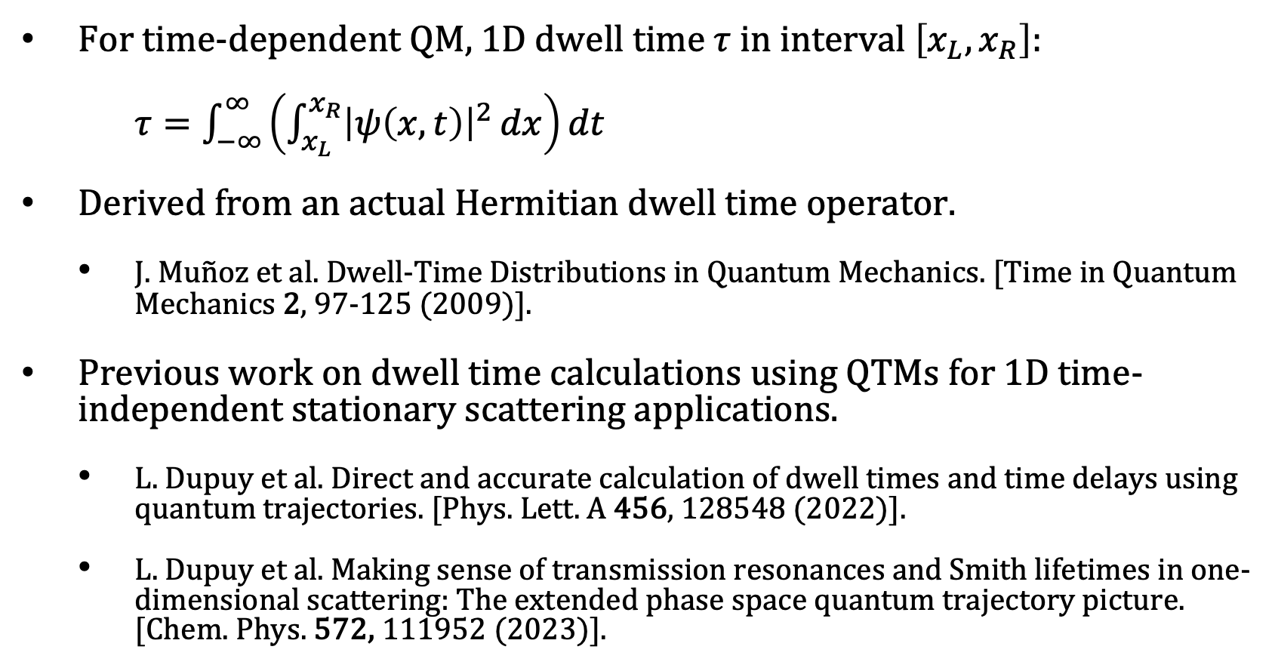
Why Dwell Time?
For time-dependent QM, 1D dwell time $τ$ in interval $\left[x_{L},x_{R}\right]$:
$τ=\int_{−∞}^{∞}{\left(\int_{x_{L}}^{x_{R}}{{\left|ψ\left(x,t\right)\right|}^{2}}dx\right)dt}$
Derived from an actual Hermitian dwell time operator.
J. Mu$\tilde{n}$oz et al. Dwell-Time Distributions in Quantum Mechanics. [Time in Quantum Mechanics 2, 97-125 (2009)].
Previous work on dwell time calculations using QTMs for 1D time-independent stationary scattering applications.
L. Dupuy et al. Direct and accurate calculation of dwell times and time delays using quantum trajectories. [Phys. Lett. A 456, 128548 (2022)].
L. Dupuy et al. Making sense of transmission resonances and Smith lifetimes in one-dimensional scattering: The extended phase space quantum trajectory picture. [Chem. Phys. 572, 111952 (2023)].
Notes:
In conventional QM theory, time is not usually endowed with Hermitian operator like other observables.
Represents amount of time particle spends within interval.

Slide 15
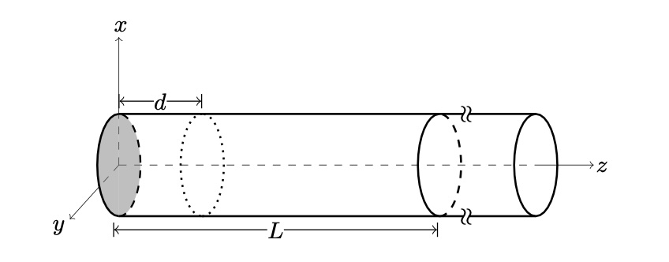

Experimental Setup
Inspired by dBB arrival time calculations for spin-1/2 particles
S. Das, M. N$\ddot{o}$th, and D. D$\ddot{u}$rr. Exotic Bohmian arrival times of spin-1/2 particles: an analytical treatment. [Phys. Rev. A 99, 052124 (2019)].
Spin state influences the quantum trajectory dynamics in dBB theory.
Notes:
Work was inspired by work by Das where particles in 3D of different spin states (starting as first excited state of harmonic oscillator confined to z>0; i.e., infinite barrier at z=0, which is turned off right at t=0) were sent through a cylindrical waveguide (modelled by harmonic potential; like a quadrupole ion trap). Using dBB theory, arrival time distributions depend on spin state since spin state influences velocity field.
You will get different arrival time distributions dependent on spin state. This same problem being treated using conventional QM is argued, in paper, to be ambiguous.
Suggests that experiment could validate whether dBB is correct theory.

Slide 16
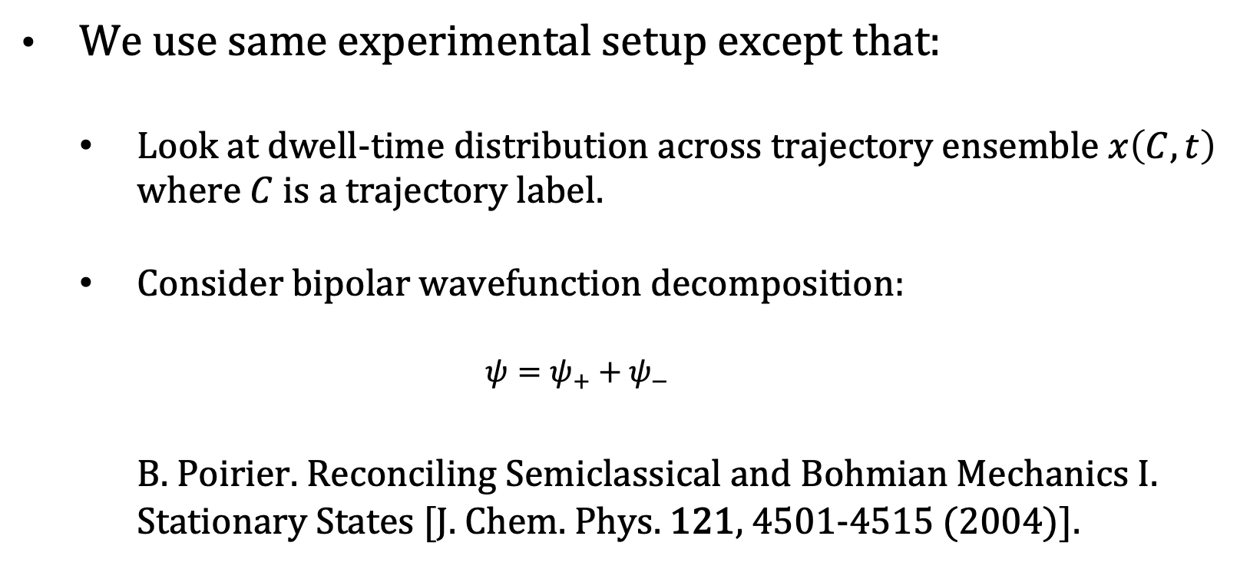
Experimental Setup
We use same experimental setup except that:
Look at dwell-time distribution across trajectory ensemble $x\left(C,t\right)$ where $C$ is a trajectory label.
Consider bipolar wavefunction decomposition:
$$ψ=ψ_{+}+ψ_{−}$$
B. Poirier. Reconciling Semiclassical and Bohmian Mechanics I. Stationary States [J. Chem. Phys. 121, 4501-4515 (2004)].
Notes:
Discretize C uniformly from 0 to 1 where resulting probability density in C has been uniformized.. Each of the N trajectories in ensemble carries same probability 1/N. Using this we were able to recreate Das’s arrival time distributions.
Hamiltonian is time-independent (cylindrical waveguide) over all time. Use the same wavefunction at t = 0 and only consider region z>0
Psi+ is wavefunction with only positive momentum components (or positive Fourier contributions) and Psi- has negative momentum components (or negative Fourier contributions).
Using bipolar decomposition, one can avoid oscillatory dwell time behavior as one changes interval due to interference of these + and – components. Can calculate an average dwell time. Also, interference-free bipolar components are classical-like and approach classical counterparts in the classical limit of large action.

Slide 17
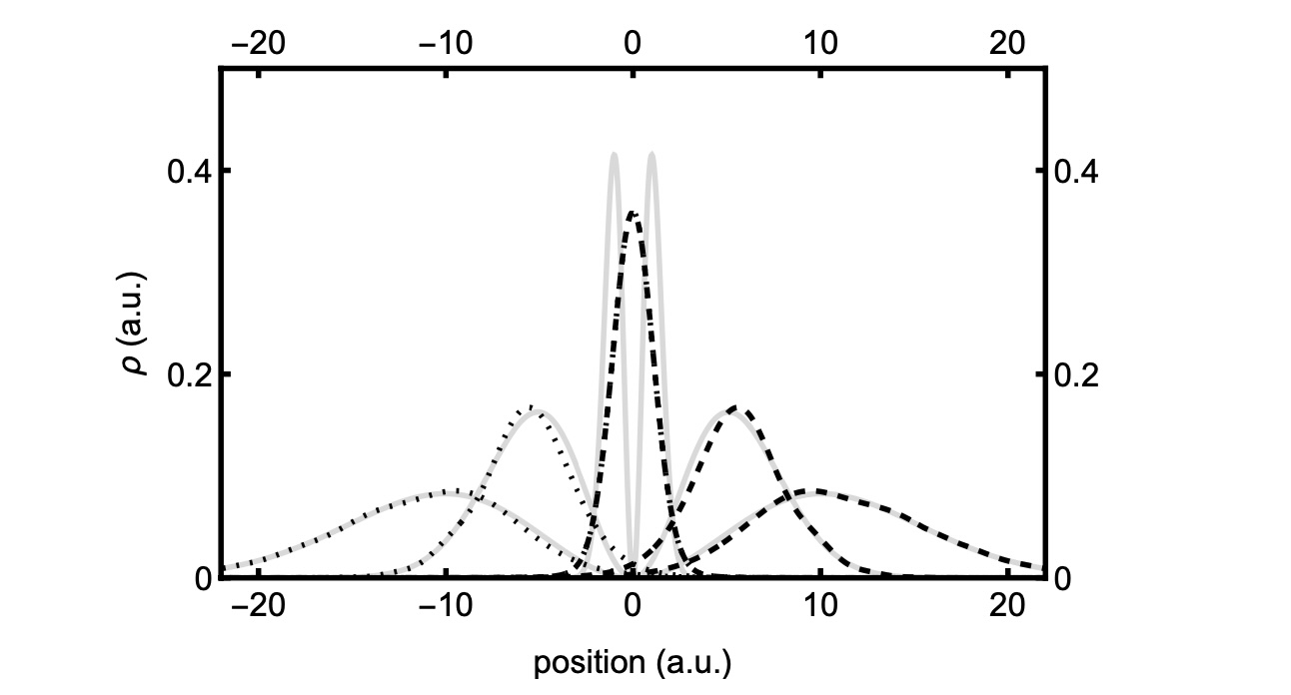
Probability Density Propagation
Notes:
Grey line represent unipolar probability density at t=0, 5, and 10. Actually show virtual part, i.e., z<0. Note: at t=0 plot is halved so that we can fit in one contained plot.
Dashed is Psi+
Dotted is Psi-
You can think of unipolar trajectory from t = -infinity to t = infinity as combination of two waves: psi – coming from right moving left (negative z) and psi+ coming from left moving right (positive z). At t=0, they interfere in z=0 region. Note that as time is further away from t=0, you can see that the bipolar contributions match the unipolar.

Slide 18
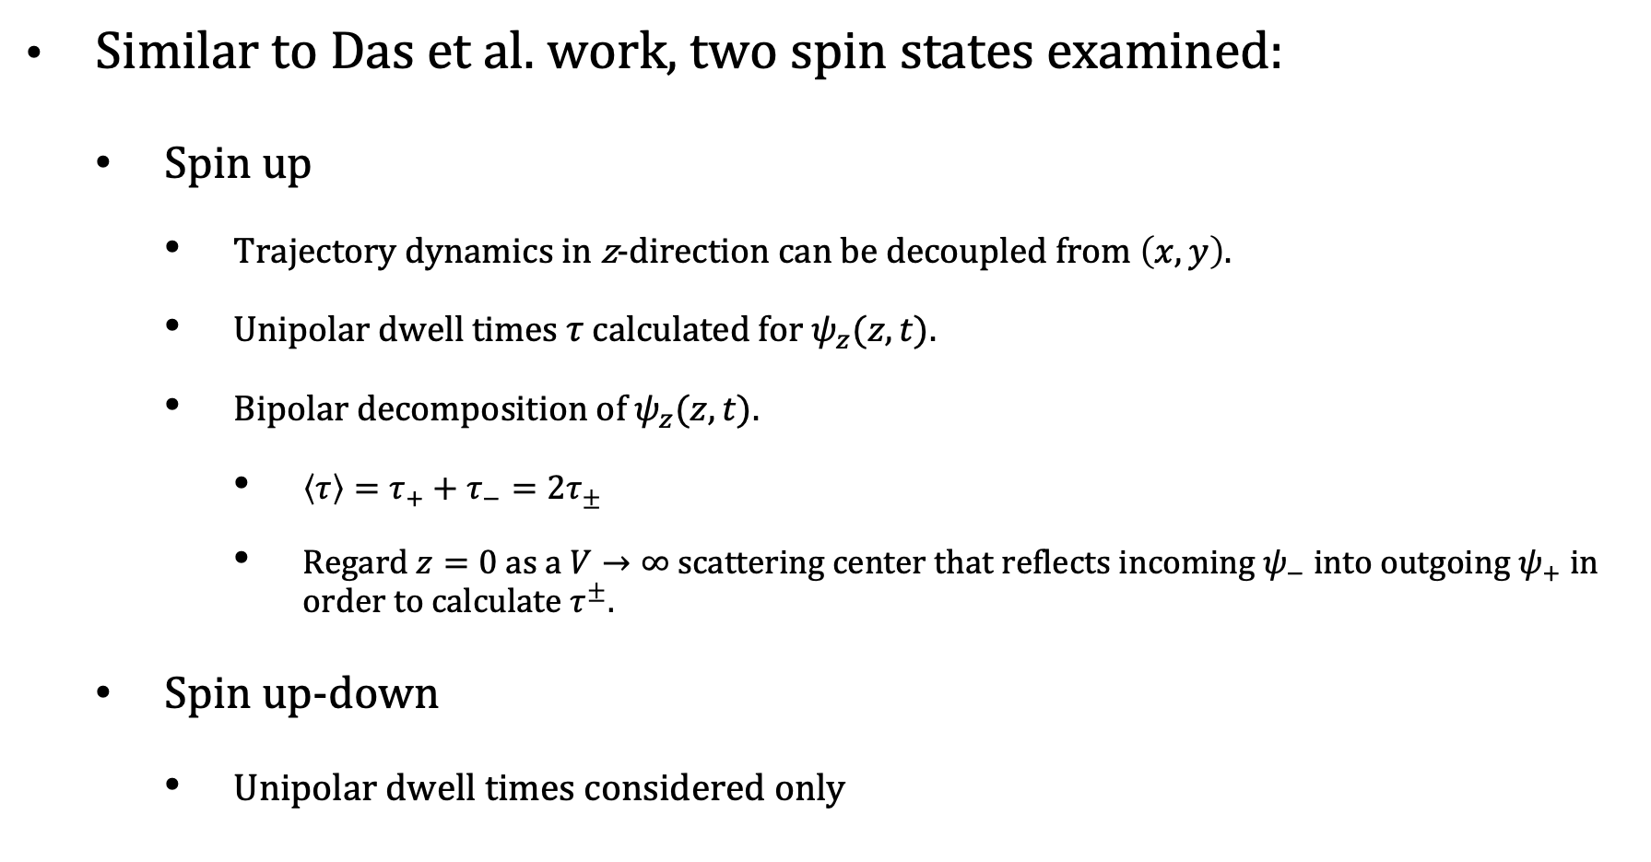
Spin States Examined
Similar to Das et al. work, two spin states examined:
Spin up
Trajectory dynamics in z-direction can be decoupled from $\left(x,y\right)$.
Unipolar dwell times $τ$ calculated for $ψ_{z}(z,t)$.
Bipolar decomposition of $ψ_{z}(z,t)$.
$\left\langle τ\right\rangle =τ_{+}+τ_{−}=2τ_{±}$
Regard $z=0$ as a $V→∞$ scattering center that reflects incoming $ψ_{−}$ into outgoing $ψ_{+}$ in order to calculate $τ^{±}.$
Spin up-down
Unipolar dwell times considered only
Notes:
For spin up, x,y trajectory dynamics can be decoupled from z, so we just looked at propagation of trajectories along z direction. Turns into 1D problem. Can easily do bipolar decomposition
Average dwell time <tau> does not contain oscillations with respect to interval boundaries that unipolar dwell time would have due to interference between bipolar wavepacket interference…may be better suited to represent average dwell time experimentally.
Reflection scenario: consider the scattering center at origin where psi+ and psi- meet as, instead, where psi- comes in from left and is reflected as psi+ going out to the right

Slide 19
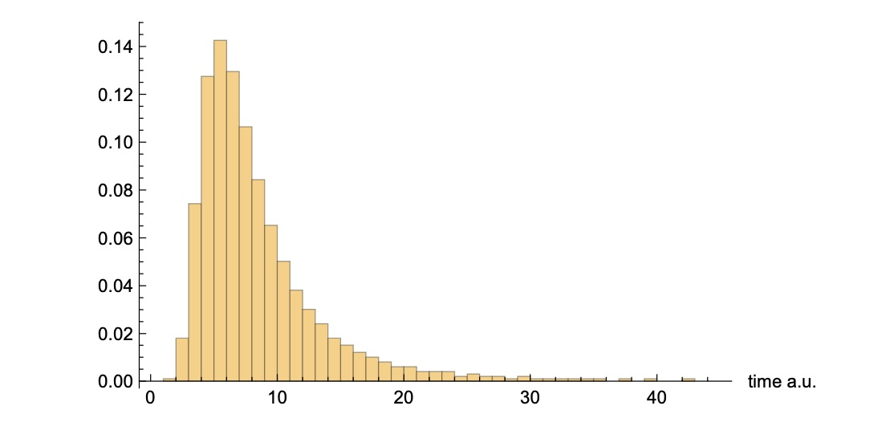
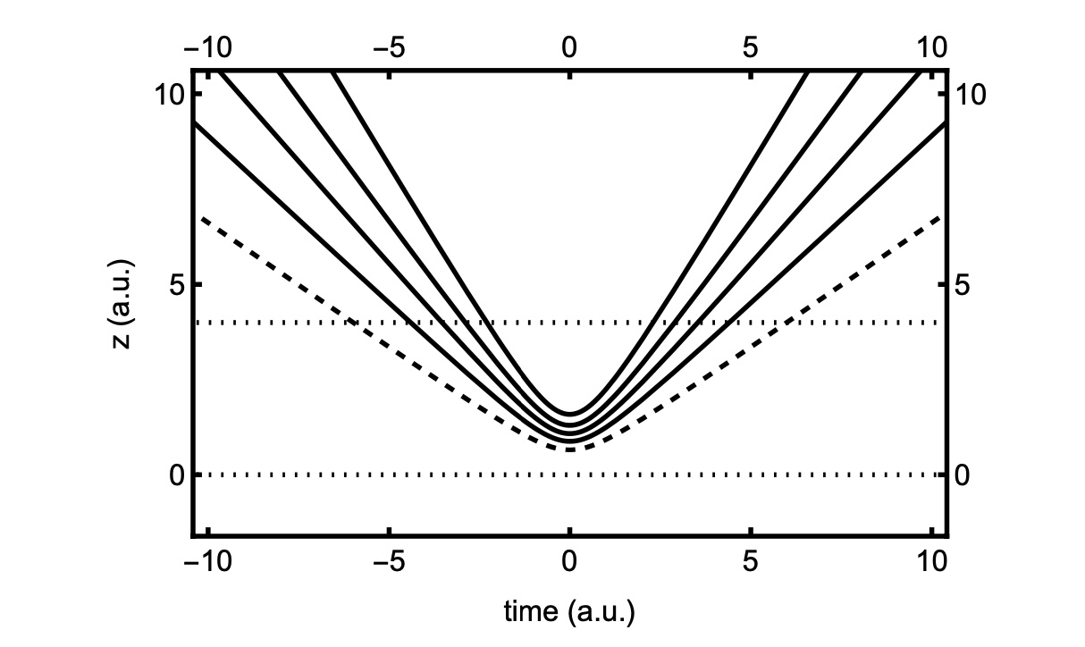
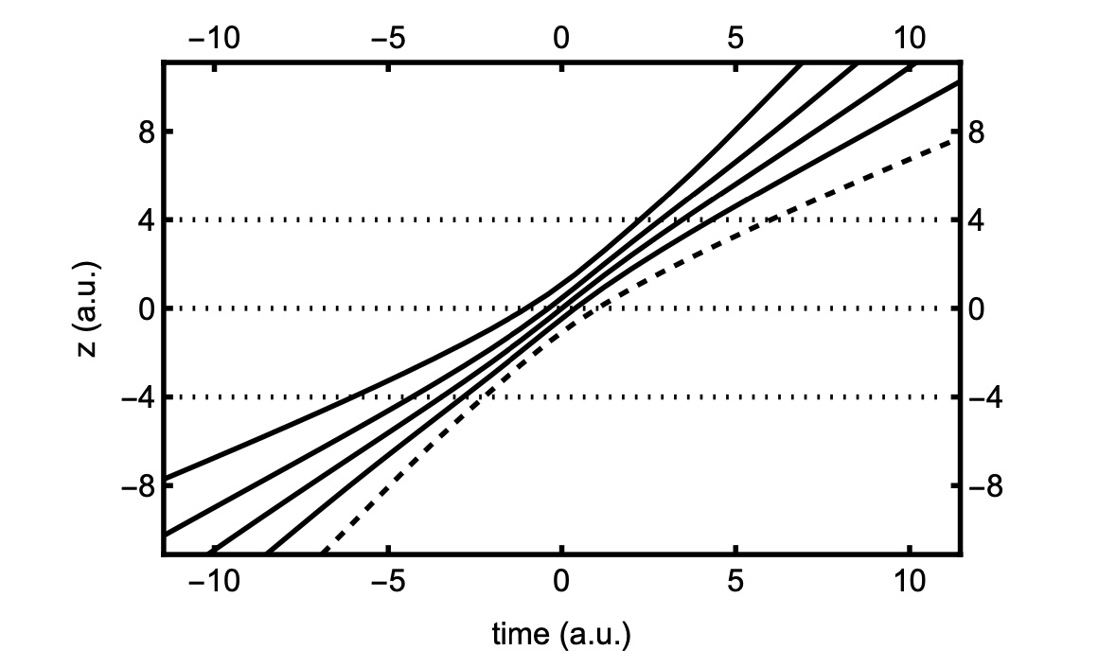
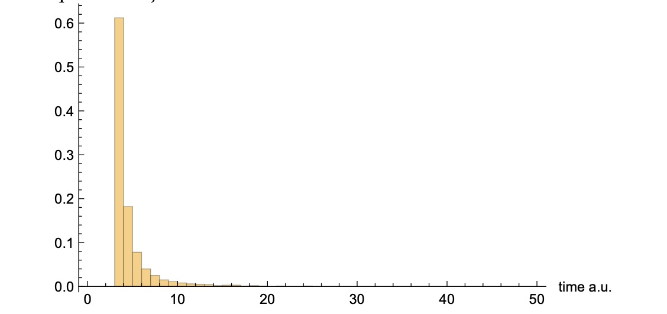
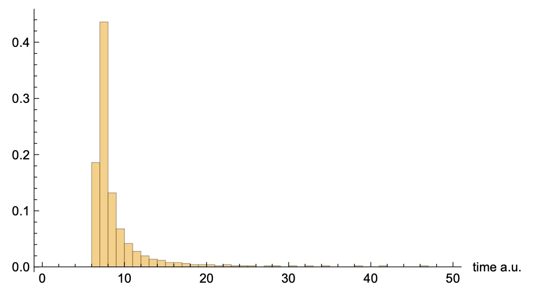
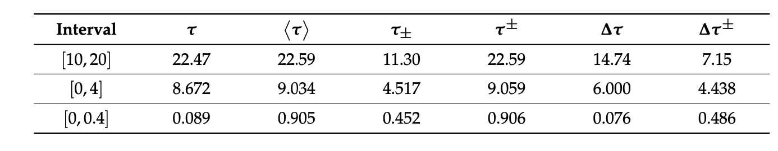



Spin Up Dwell Time Results
$$τ$$
3 intervals considered: [10,20], [0,4], and [0,0.4]
$$τ_{±}$$
$$τ^{±}$$
Notes:
[0,4] trajectory, which contains scattering center, and distributions are shown.
Unipolar trajectories on left with only real trajectories (z>0) for t from –infinity to infinity. Dashed line is C = 1/6 closest to 0
Top distribution is unipolar dwell time distribution (N=1000)
Tau on chart is average from distribution with standard standard deviation of 6.0 (N=1000)
Middle is bipolar psi+. Virtual window [-4,0] included
Middle distribution reflects psi+
On table we see tau+. By symmetry it is same as tau-, and by previous arguments, the sum represents average dwell time <tau> = tau+ + tau-
Small but significant difference between tau and <tau> due to oscillation of tau with interval boundary.
Last, by including virtual region [-4,0], we can mimic reflection scenario with bipolar components. We see that it gives value also similar but slightly different than <tau> and tau. Definitely provides a much smaller standard deviation.

Slide 20
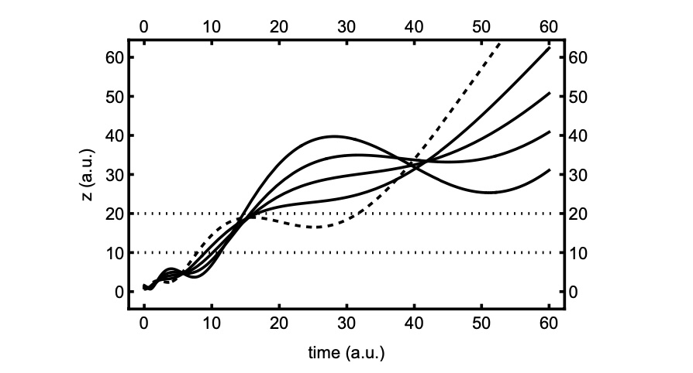
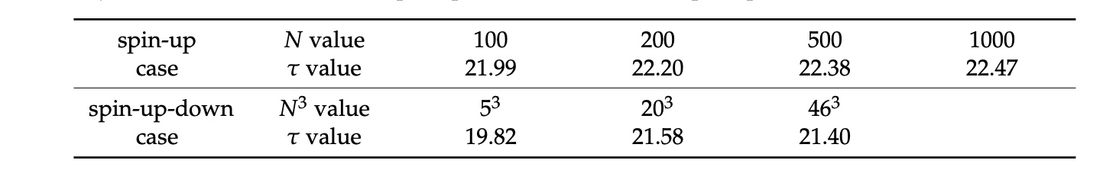
Spin Up-Down Dwell Time Results
Asymptotic interval considered: [10,20]
Notes:
Trajectories do not cross: we are only showing trajectory progressing along z-coordinate. x=0 always for trajectories (i.e., trajectories always occupy a y-z plane) but y changes with z. These depend on trapping frequency used for cylindrical waveguide which models a quadrupole ion trap.
Only unipolar trajectories are considered.
Convergence of tau is considered as a function of N or N^3.
There is a difference in tau which may be discernible with experiment.

