Slide 1
Intermolecular Coulombic Decay in Water Dimers: A Computational Study
Victor Suarez
Georgia Institute of Technology
Kretchmer Group

Slide 2
Background & Motivation
Following inner-shell ionization within molecular systems, electrons can undergo competing ultrafast relaxation pathways:
Auger-Meitner Decay
$${H_{2}O}^{+∗}\underset{→}{Auger}{H_{2}O}^{2+}+e^{−}$$

Slide 3
Background & Motivation
Following inner-shell ionization within molecular systems, electrons can undergo competing ultrafast relaxation pathways:
Auger-Meitner Decay
Intermolecular Coulomb Decay
$${H_{2}O}^{+∗}\underset{→}{Auger}{H_{2}O}^{2+}+e^{−}$$
$$H_{2}O+{H_{2}O}^{+∗}\underset{→}{ ICD }{H_{2}O}^{+}+{H_{2}O}^{+}+e^{−}$$

Slide 4
Background & Motivation
Following inner-shell ionization within molecular systems, electrons can undergo competing ultrafast relaxation pathways:
Auger-Meitner Decay
Intermolecular Coulomb Decay
Electron-Transfer Mediated Decay
$${H_{2}O}^{+∗}\underset{→}{Auger}{H_{2}O}^{2+}+e^{−}$$
$$H_{2}O+{H_{2}O}^{+∗}\underset{→}{ ICD }{H_{2}O}^{+}+{H_{2}O}^{+}+e^{−}$$
$$H_{2}O+{H_{2}O}^{+∗}\underset{→}{ ETMD }{H_{2}O}^{2+}+H_{2}O+e^{−}$$

Slide 5
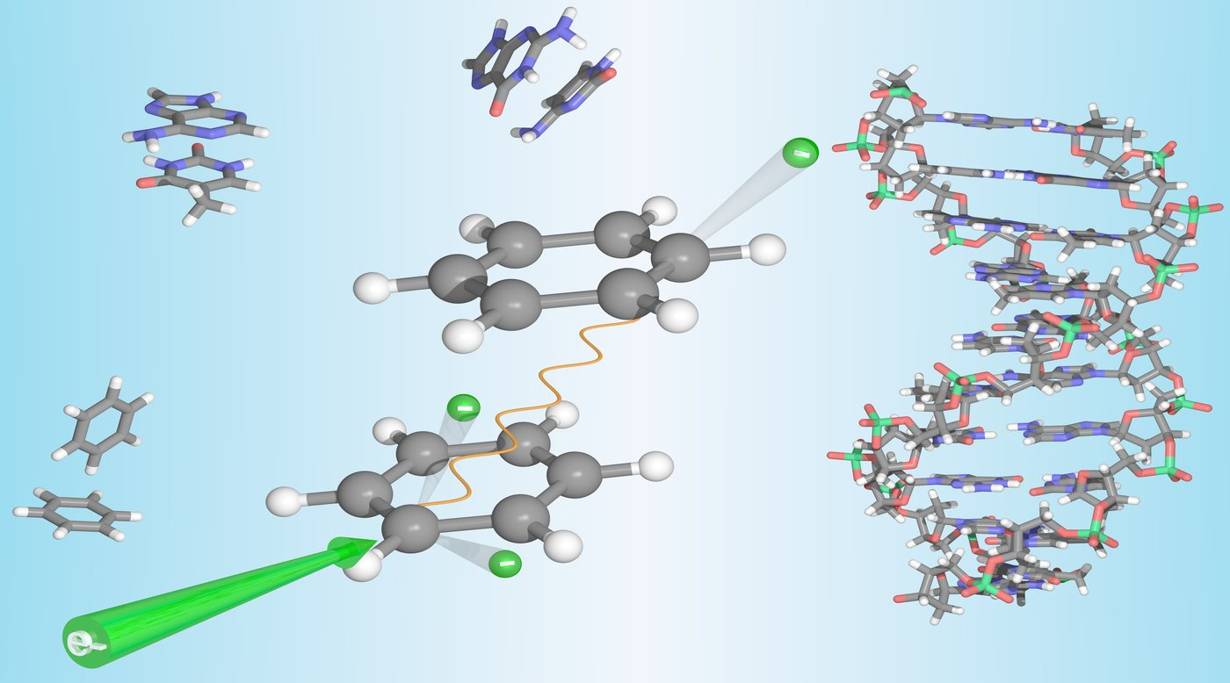
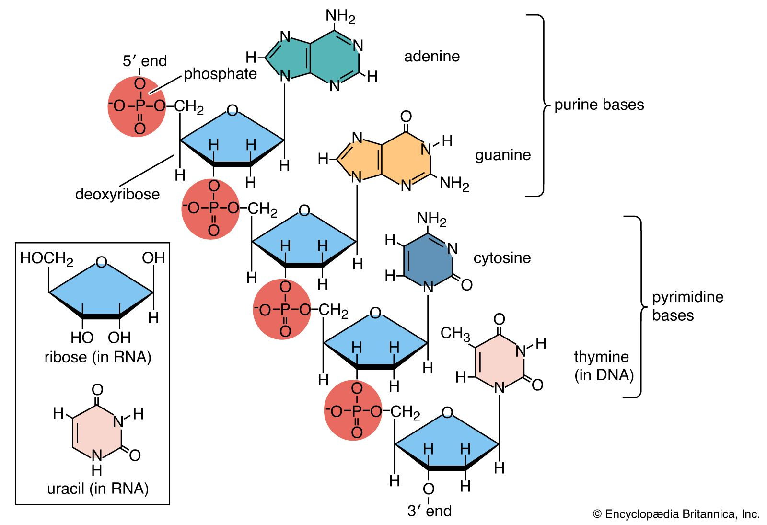
Background & Motivation
These relaxation pathways generate secondary ionized low-energy electrons (LEEs), which can perform highly reactive downstream chemistry
Understanding these ultrafast mechanisms could lead to new technologies for cancer prevention and targeted destruction of biomolecules
Ren, X., Zhou, J., Wang, E. et al. Ultrafast energy transfer between π-stacked aromatic rings upon inner-valence ionization. Nat. Chem. 14, 232–238 (2022).

Slide 6

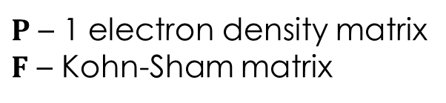

Methods: RT-TDDFT + CAP
Real-Time Time Dependent Density Functional Theory (RT-TDDFT) solves for the time evolution of the 1 electron reduced density matrix
$$P_{ij}=\left\langle ψ | {\hat{a}}_{j}^{†}{\hat{a}}_{i} | ψ\right\rangle$$
$$i\frac{∂P}{∂t}=\left[F,P\right]$$
$P$ – 1 electron density matrix
$F$ – Kohn-Sham matrix

Slide 7
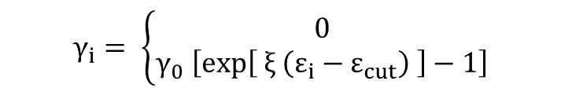




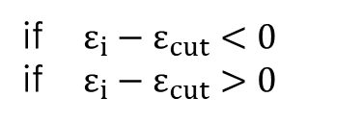
Methods: RT-TDDFT + CAP
Real-Time Time Dependent Density Functional Theory (RT-TDDFT) solves for the time evolution of the 1 electron reduced density matrix
Ionization of an electron to the free particle continuum is approximately treated using a complex absorbing potential (CAP)
$$P_{ij}=\left\langle ψ | {\hat{a}}_{j}^{†}{\hat{a}}_{i} | ψ\right\rangle$$
$$i\frac{∂P}{∂t}=\left[F,P\right]$$
$P$ – 1 electron density matrix
$F$ – Kohn-Sham matrix
$$ε_{cut}$$
$$F^{′}=F+iΓ$$
$$Γ=\left[\begin{aligned}\begin{matrix}γ_{1} & 0 \\ 0 & γ_{2}\end{matrix} \begin{matrix}… & 0 \\ … & 0\end{matrix} \\ \begin{matrix}⋮ & ⋮ \\ 0 & 0\end{matrix} \begin{matrix}⋱ & ⋮ \\ … & γ_{i}\end{matrix}\end{aligned}\right]$$
$$i\frac{∂P}{∂t}=\left[F^{′}P−PF^{′†}\right]$$
$$γ_{i}= \left\{\begin{matrix}0 \\ γ_{0} \left[exp\left[ ξ \left(ε_{i}−ε_{cut}\right) \right]−1\right]\end{matrix}\right.$$
if $ε_{i}−ε_{cut}<0$
if $ε_{i}−ε_{cut}>0$

Slide 8
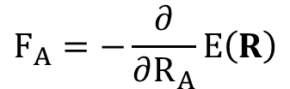

Methods: RT-TDDFT + Ehrenfest
Ehrenfest dynamics assumes nuclear motion follows the expectation value of the electronic energy
The mean-field nuclear gradients are:
$$E\left(R\right)=\left\langle ψ | \hat{H}\left(R\right) | ψ\right\rangle$$
$$F_{A}=−\frac{∂}{∂R_{A}}E\left(R\right)$$

Slide 9
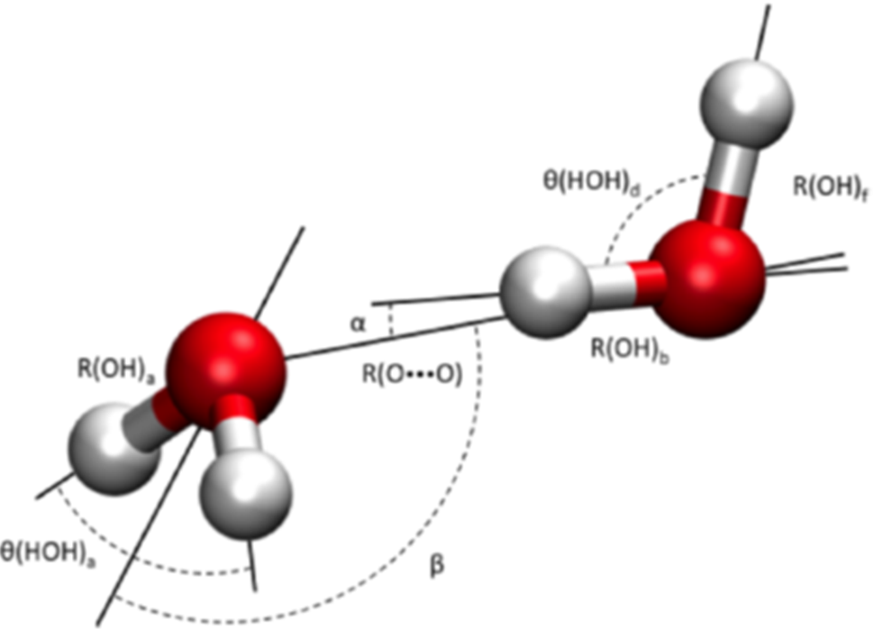
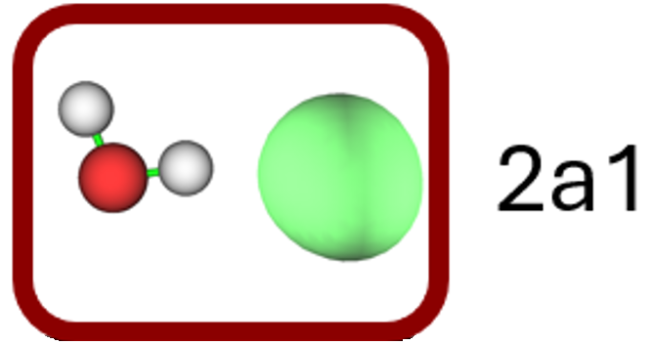
Collaboration: Water Dimer Project
Our experimental collaborators are looking at the fragmentation products of water dimers following ionization of the 2a1 inner-valence orbital on the oxygen atom
Following excitation, water is expected to undergo ICD followed by coulomb explosion of the dimer
Experimental data includes kinetic energy releases of the ionized electrons as well as the nuclear fragments following coulomb explosion

Slide 10
Collaboration: Water Dimer Project
Our goal is to predict the non-radiative pathways and downstream fragmentation products along with kinetic energy release through our RT-TDDFT + CAP + Ehrenfest methodology

Slide 11
Methods: Computational Workflow
Motivated by our experimental collaborators looking at ICD within water dimers, the full calculation can be separated into three distinct parts:
NVT thermostated ab-initio molecular dynamics at 30 K

Slide 12
Methods: Computational Workflow
Motivated by our experimental collaborators looking at ICD within water dimers, the full calculation can be separated into three distinct parts:
NVT thermostated ab-initio molecular dynamics at 30 K
Remove inner-valence 2a1 electron, run RT-TDDFT + CAP + Ehrenfest

Slide 13
Methods: Computational Workflow
Motivated by our experimental collaborators looking at ICD within water dimers, the full calculation can be separated into three distinct parts:
NVT thermostated ab-initio molecular dynamics at 30 K
Remove inner-valence 2a1 electron, run RT-TDDFT + CAP + Ehrenfest
After ultrafast mechanism switch over to Born-Oppenheimer Molecular Dynamics (BOMD) for bifurcation and fragmentation

Slide 14
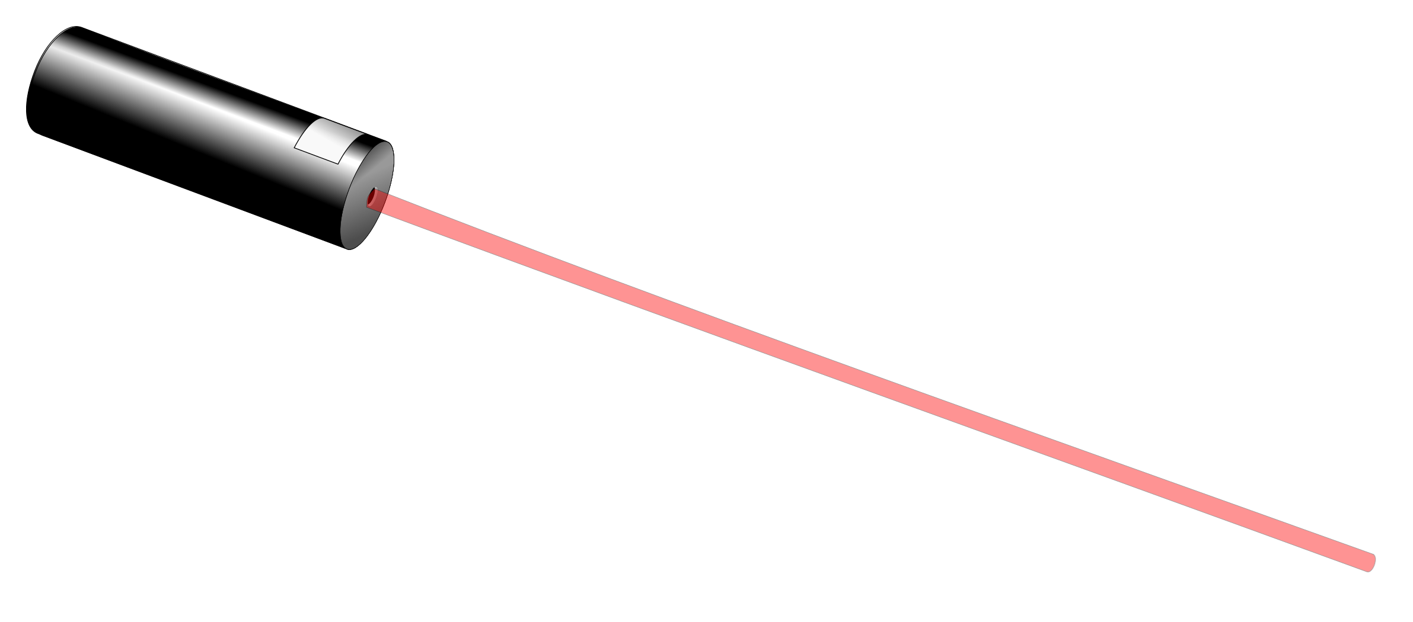
Results: Proton Acceptor Ionization

Slide 15
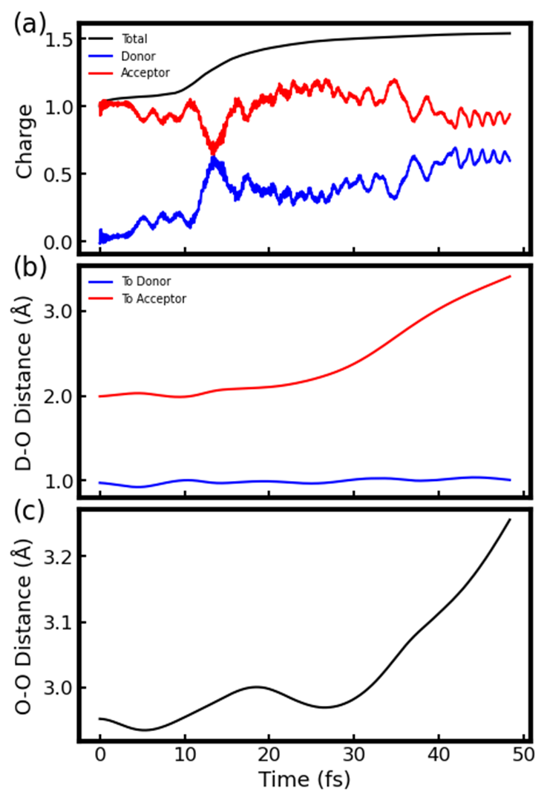

Results: Proton Acceptor Ionization

Slide 16
Results: Proton Acceptor Ionization
Intermolecular Coulomb Decay
$$D_{2}O^{+∗}+D_{2}O\underset{→}{ ICD }D_{2}O^{+}+D_{2}O^{+}$$

Slide 17
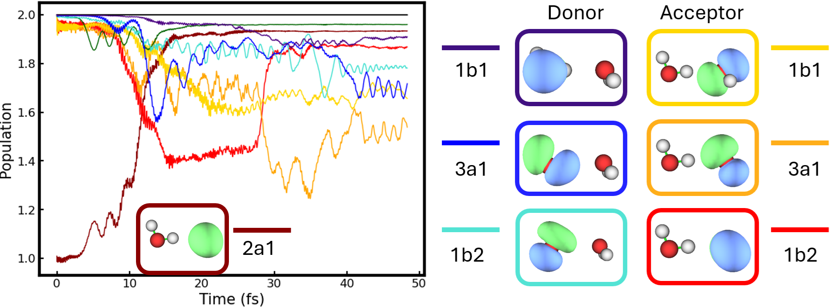
Results: Proton Acceptor Ionization

Slide 18
Results: Proton Acceptor Ionization

Slide 19
Results: Proton Acceptor Ionization

Slide 20
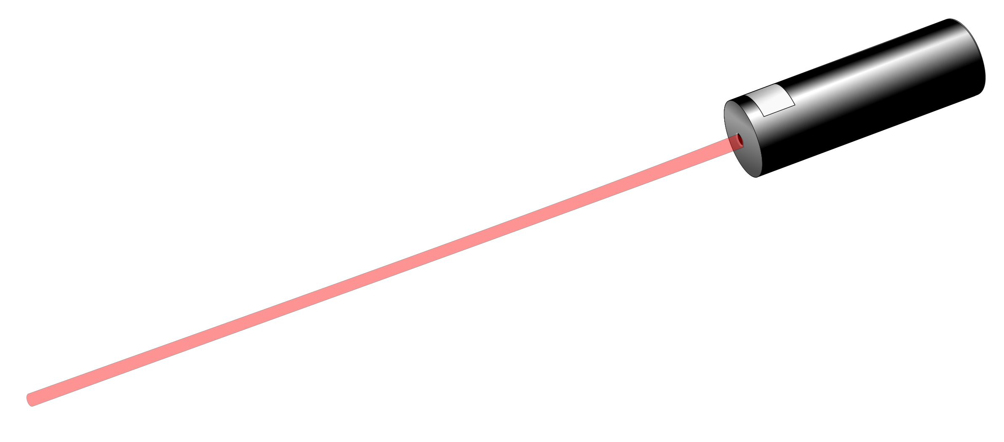
Results: Proton Donor Ionization

Slide 21
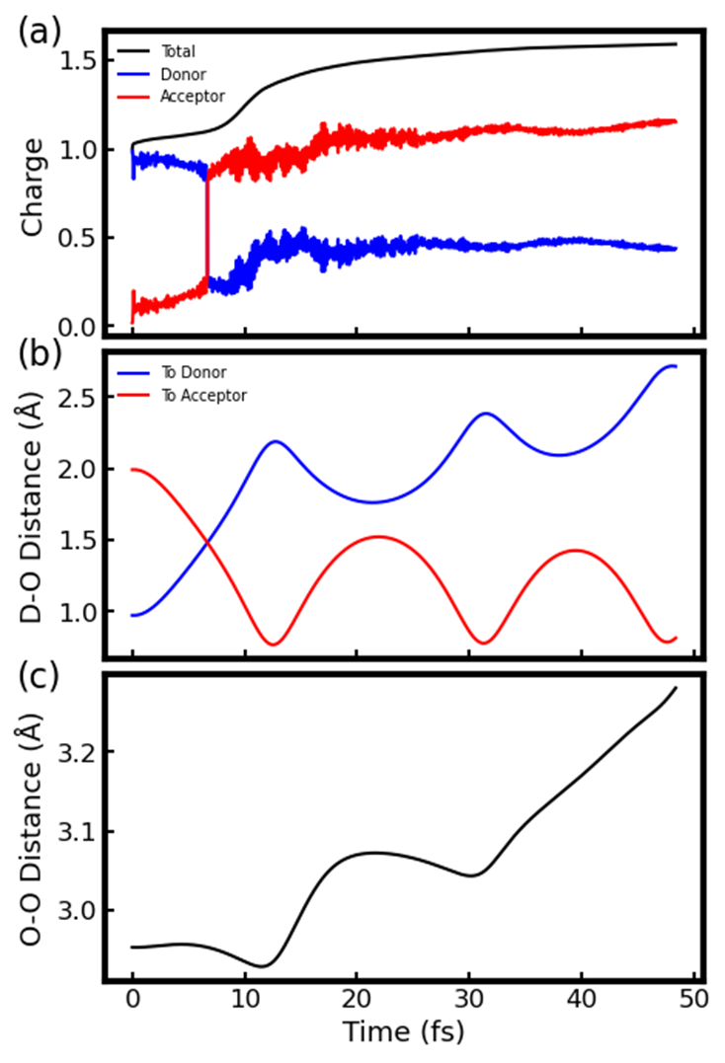
Results: Proton Donor Ionization

Slide 22
Results: Proton Donor Ionization
Auger-Meitner Decay
$$D_{2}O+{DOD}^{+∗}\underset{→}{ PT }{D_{3}O}^{+}+{OD}^{∗}\underset{→}{Auger}{D_{3}O}^{+}+{OD}^{+}$$

Slide 23
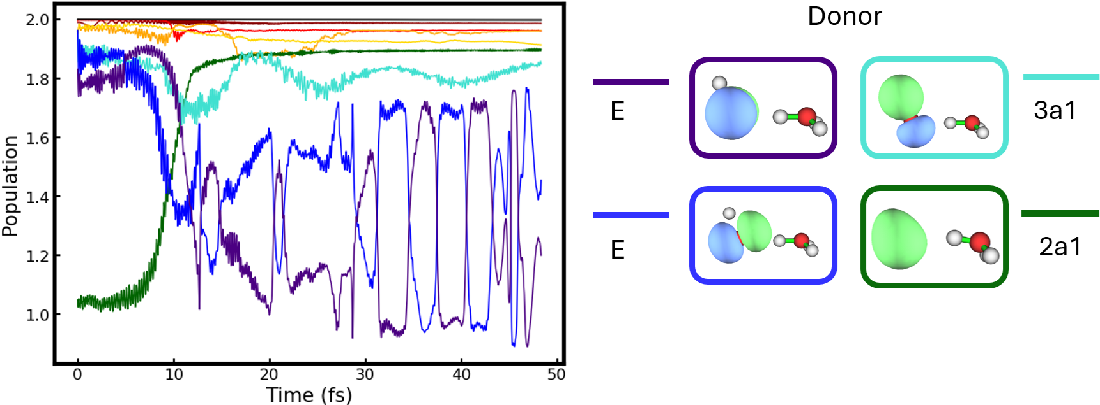
Results: Proton Donor Ionization

Slide 24
Results: Proton Donor Ionization

Slide 25
Results: Decoherence & Fragmentation
After ultrafast mechanism, we switch over to BOMD to account for lack of decoherence and bifurcation within Ehrenfest

Slide 26
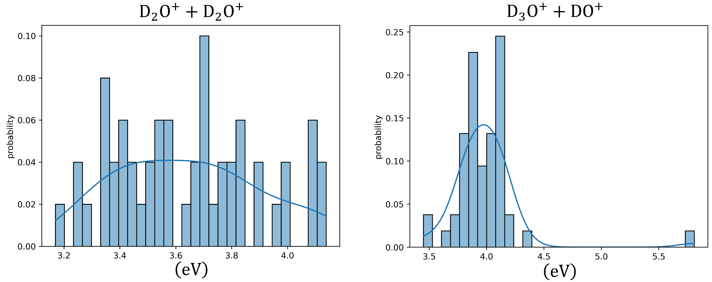
Results: Decoherence & Fragmentation
After ultrafast mechanism, we switch over to BOMD to account for lack of decoherence and bifurcation within Ehrenfest
From BOMD we predict final fragmentation products and kinetic energy release (KER) of the fragments
Credit to Dr. Yi-Siang Wang

Slide 27
Conclusions
Through RT-TDDFT + CAP + Ehrenfest we were able to predict two distinct pathways depending on which water molecule is excited:

Slide 28
Conclusions
Through RT-TDDFT + CAP + Ehrenfest we were able to predict two distinct pathways depending on which water molecule is excited:
Acceptor:
$$D_{2}O^{+∗}+D_{2}O\underset{→}{ ICD }D_{2}O^{+}+D_{2}O^{+}$$

Slide 29
Conclusions
Through RT-TDDFT + CAP + Ehrenfest we were able to predict two distinct pathways depending on which water molecule is excited:
Acceptor:
Donor:
$$D_{2}O^{+∗}+D_{2}O\underset{→}{ ICD }D_{2}O^{+}+D_{2}O^{+}$$
$$D_{2}O+{DOD}^{+∗}\underset{→}{ PT }{D_{3}O}^{+}+{OD}^{∗}\underset{→}{Auger}{D_{3}O}^{+}+{OD}^{+}$$

Slide 30
Conclusions
Through RT-TDDFT + CAP + Ehrenfest we were able to predict two distinct pathways depending on which water molecule is excited:
Acceptor:
Donor:
We predict a new plausible mechanism for ICD within water dimers in the case of proton donor excitation consistent with our experimental collaborators and the literature
$$D_{2}O^{+∗}+D_{2}O\underset{→}{ ICD }D_{2}O^{+}+D_{2}O^{+}$$
$$D_{2}O+{DOD}^{+∗}\underset{→}{ PT }{D_{3}O}^{+}+{OD}^{∗}\underset{→}{Auger}{D_{3}O}^{+}+{OD}^{+}$$

Slide 31
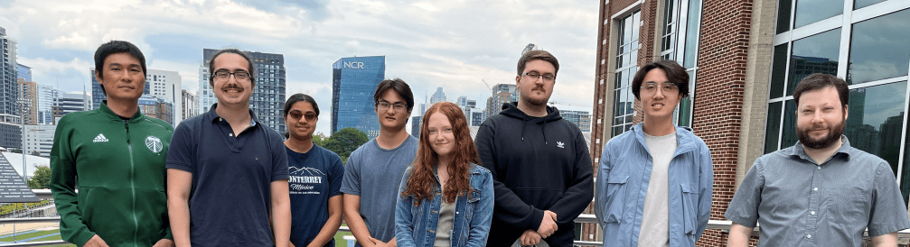
Acknowledgements
Project members: Yi-Siang Wang, Matthew Rohan
Code developers: Matthew Rohan, Mikhayla Clothier
Our code called TIDES is currently available on github, plans to implement our methodology directly into PSI4 are underway.

