Slide 1



Photoinduced dynamics in organic chromophores: vibronic couplings, efficiency and transient absorption
Sebastian Fernandez-Alberti
Notes:
The fundamental principles of the efficient energy funneling bserved in light-harvesting photosynthetic systems can be
unraveled by studying the built-in energy gradients in welldefined, artificial light-harvesting macromolecules called dendrimers.

Slide 2
Photoinduced dynamics
in
multichromophoric conjugated molecules
Non-adiabatic EXcited-state molecular dynamics (NEXMD)
Electronic relaxation pathways
Vibronic coherences
Transient absorption
"Non-adiabatic Excited State Molecular Dynamics: theory and applications for modeling photophysics in extended molecular materials" T. Nelson, et al., Chem. Rev., 120, 4, 2215-2287 (2020).

Slide 3
Non-adiabatic EXcited-State Molecular Dynamics
Energies, gradients, and vibronic couplings between multiple electronic excited states calculated “on the fly” .
Configuration interaction singles (CIS) using the Collective Electronic Oscillator (CEO ) at AM1 level.
Ground state conformational sampling at constant temperature
→ Photoexcitation and ultrafast dynamics in the excited states
Surface Hopping,
Ehrenfest (Mean Field)
Multiconfigurational Ehrenfest
Cloning
“NEXMD v2.0 Software Package for Nonadiabatic Excited State Molecular Dynamics Simulations” V. M. Freixas, et al, J. Chem. Theory Comput. 19, 5356−5368 (2023).
LANL Github: https://github.com/lanl/NEXMD
Notes:
Within the NA-ESMD framework^{1,,}, direct nonadiabatic molecular dynamics simulations can be applied to describe photoinduced dynamics in large organic conjugated molecules involving multiple coupled electronic excited states.
Herein we briefly summarize the NA-ESMD theoretical framework.
The electronic energies, gradients, and nonadiabatic coupling vectors were calculated on the fly during the molecular dynamics simulations.
Configuration interaction singles (CIS) level using the collective electronic oscillator (CEO) code22 combined with the Austin model 1 (AM1) Hamiltonian.46

Slide 4
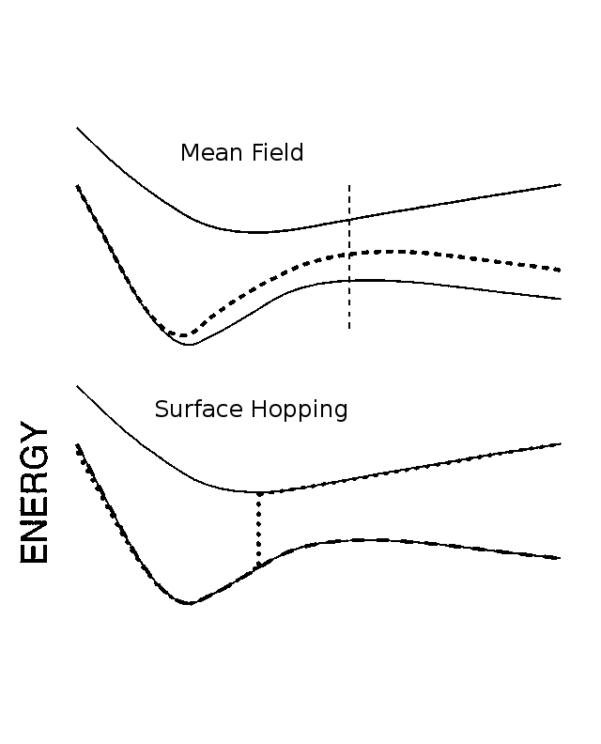
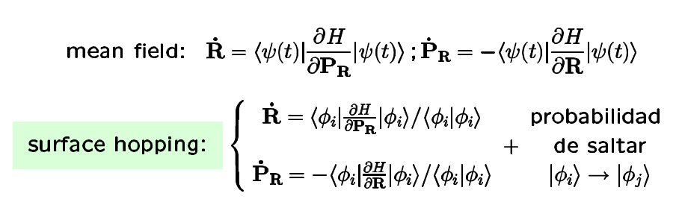
Nonadiabatic Molecular Dynamics Mixed quantum/classical methods
Nonadiabatic couplings:
Mean field :
Probability to hop
Notes:
Our MDQT implementation considers the simultaneous propagation of an electronic wavepacket quantum mechanically while the nuclei move classically on a potential energy surface which is defined by a single AM1/CIS electronic state at a given time. Transitions from one electronic surface to another are allowed depending on the strength of their non-adiabatic couplings.

Slide 5
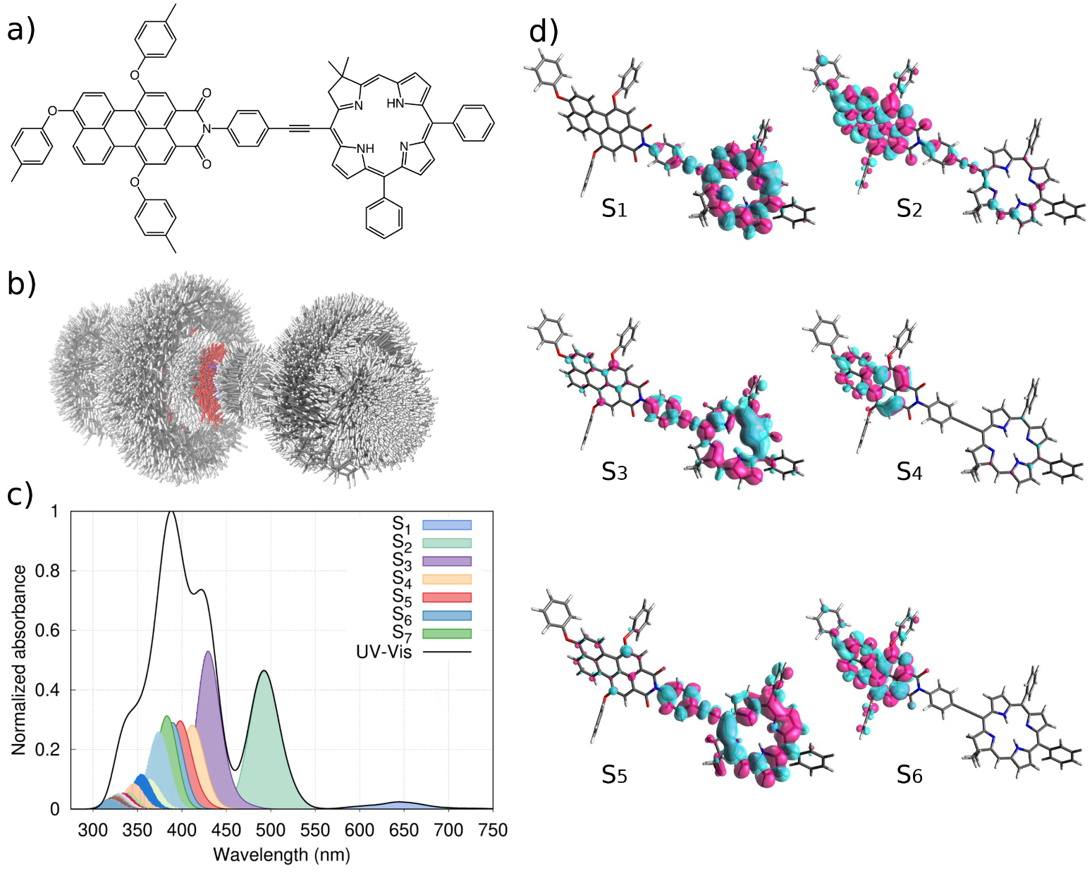
Back-and-forth energy transfer during electronic relaxation
in
a chlorin-perylene dyad

Slide 6
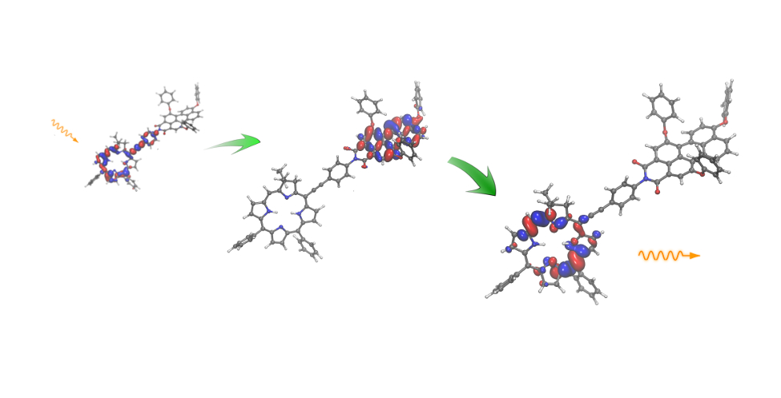
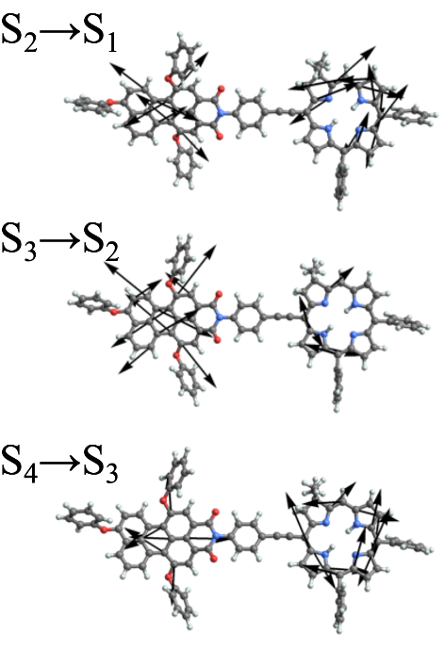
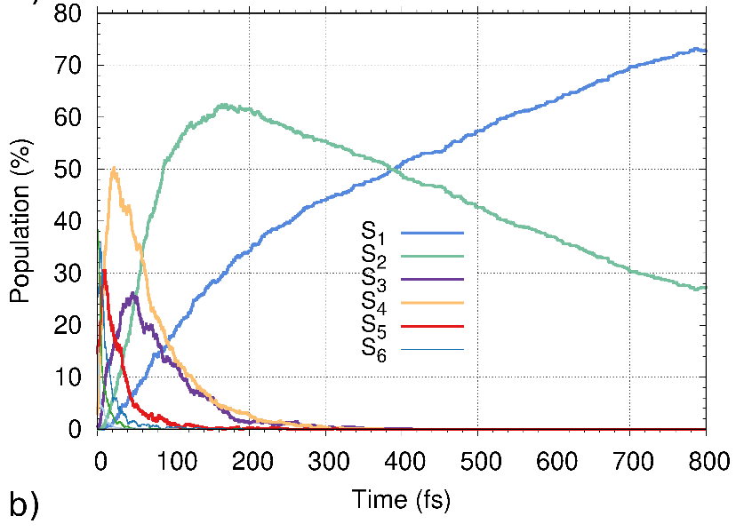
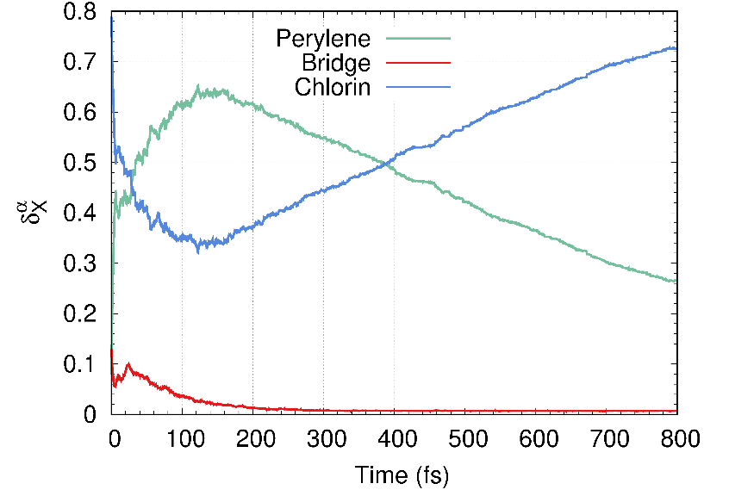
Back-and-forth energy transfer during electronic relaxation
in
a chlorin-perylene dyad

Slide 7
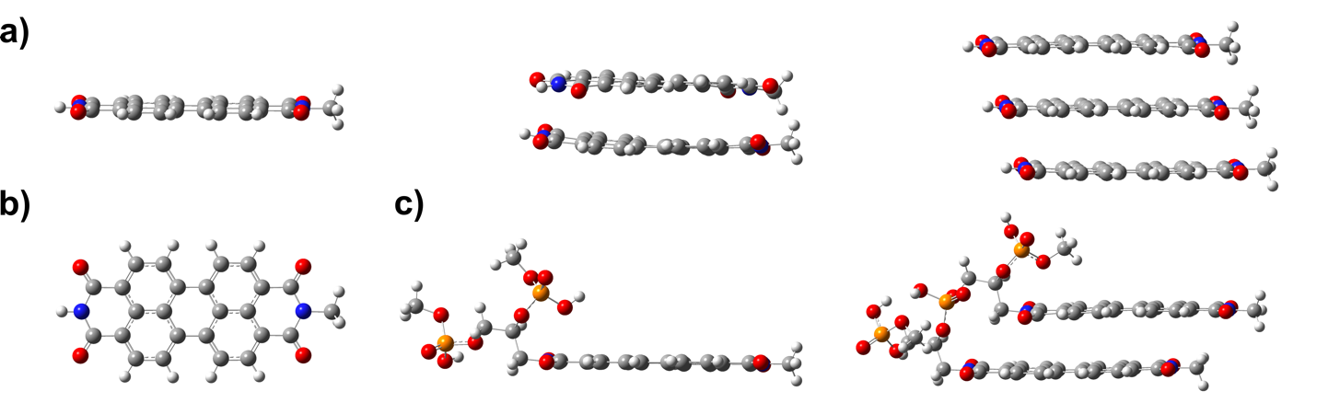
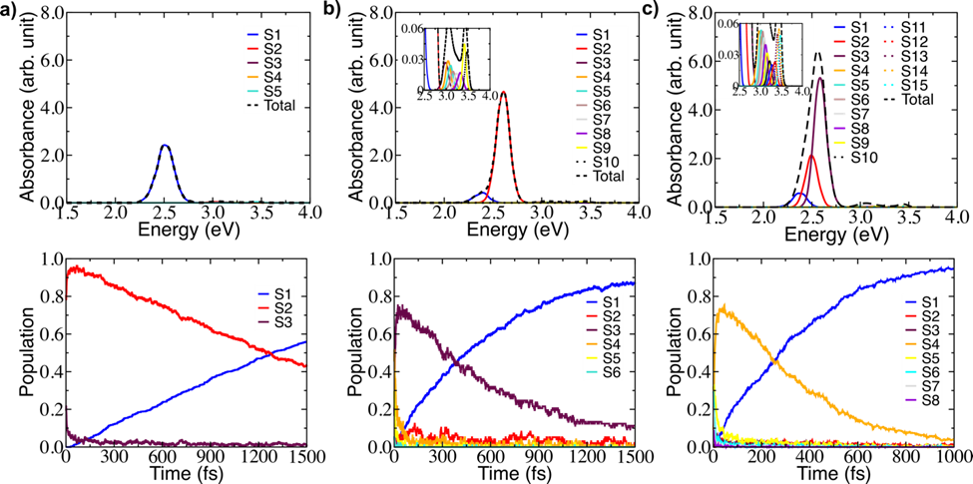
Electronic and vibrational relaxations within molecular assemblies
of
Perylene diimide

Slide 8
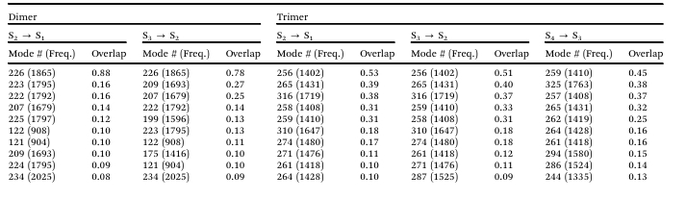
Electronic and vibrational relaxations within molecular assemblies
of
Perylene diimide
Only a few normal modes significantly overlap with the nonadiabatic coupling vectors. The set of these active modes are equivalent for S₄→ S_{3 ,} S₃→ S₂ and S₂→ S₁ transitions.
The overall sequential S₄→ S₁ relaxation pathway involves a common bundle of states that leads to no transient accumulation of electronic populations in the intermediate S₃ and S₂ states.
This process activates a positive feedback mechanism involving a common set of vibrational normal modes that accelerate the process by increasing the efficiency of its vibronic dynamics.

Slide 9
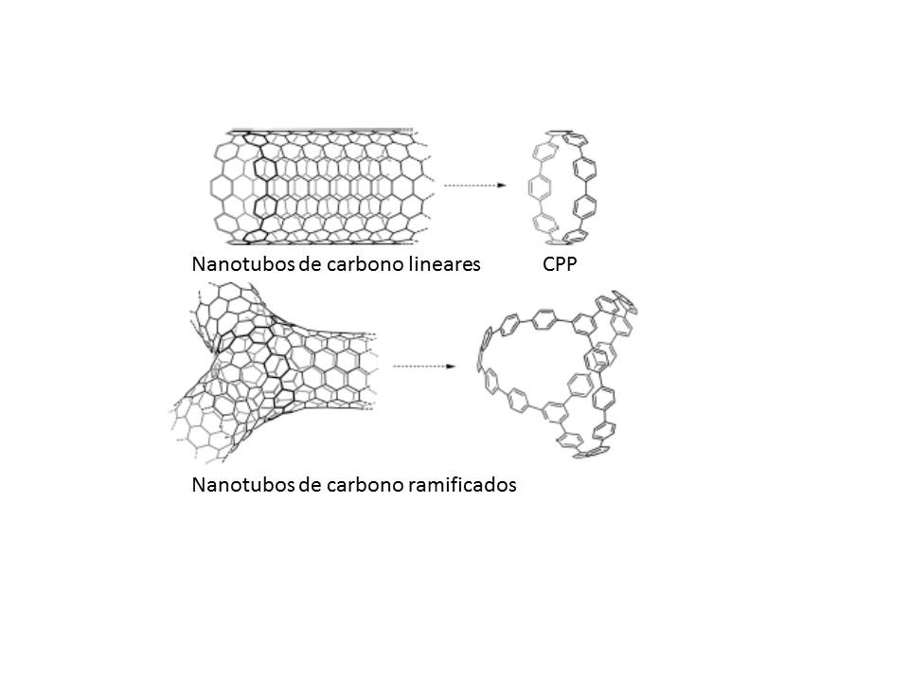
Carbon nanorings
(Cycloparaphenylenes (CPPn)
the smallest possible fragments of armchair carbon nanotubes
radially cyclic conjugated systems
unique photophysical properties
promising materials for implementation as organic semiconductors and sensors.
Notes:
The first kind of nanoring that have been synthetized were…
CPPs possess non-planar conjugated systems in which the efficiency in π-orbital overlaps competes with bending strains introduced by the cyclic nanostructure⁴⁰
relationship between the molecular conformation and exciton delocalization in the excited states of cyclic π-conjugated molecules^{42,44}. On one hand, excited-state dynamics can induce ultrafast torsional reorganization that planarizes the structure of the excited state, resulting in an extension of the excitonic wave function. On the other hand, an increase in ring size induces ring deformations and, hence, the localization of the exciton on only a few phenyl rings of the nanoring. This effect is expected to increase with temperature since conformational disorder, due to thermal fluctuations, reduces the extent of exciton localization.

Slide 10
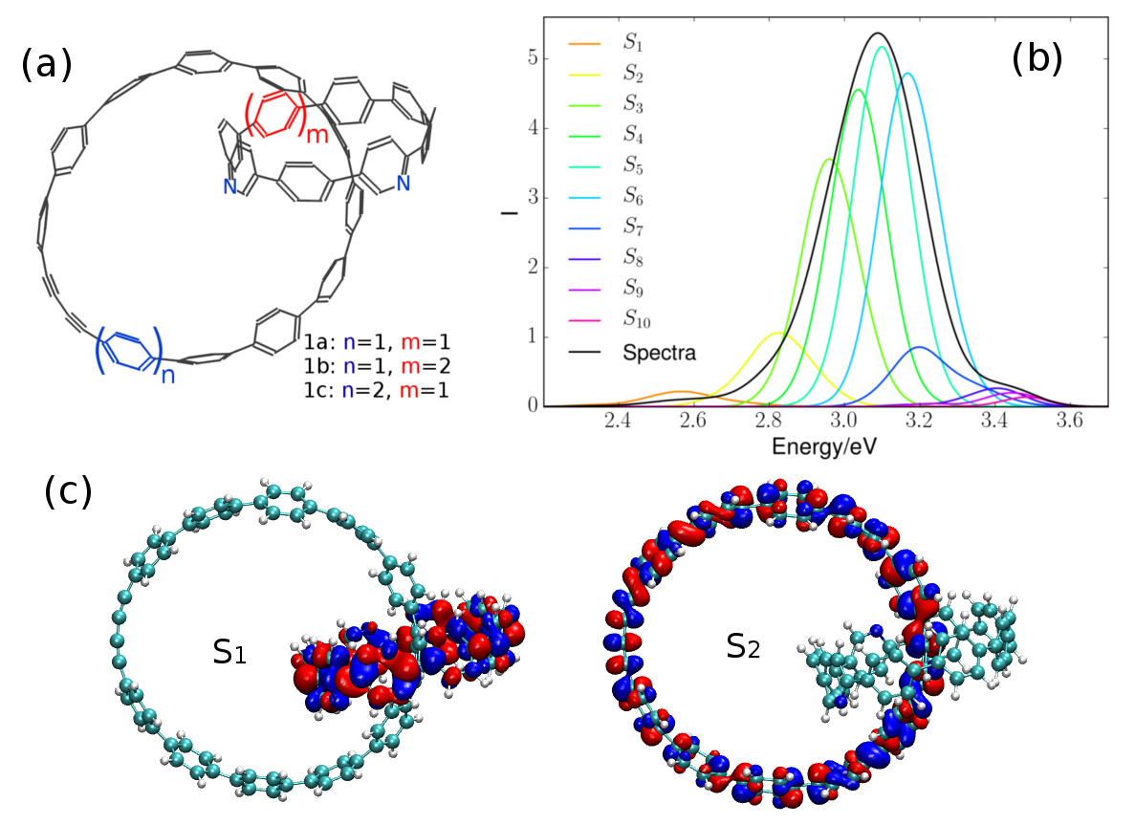
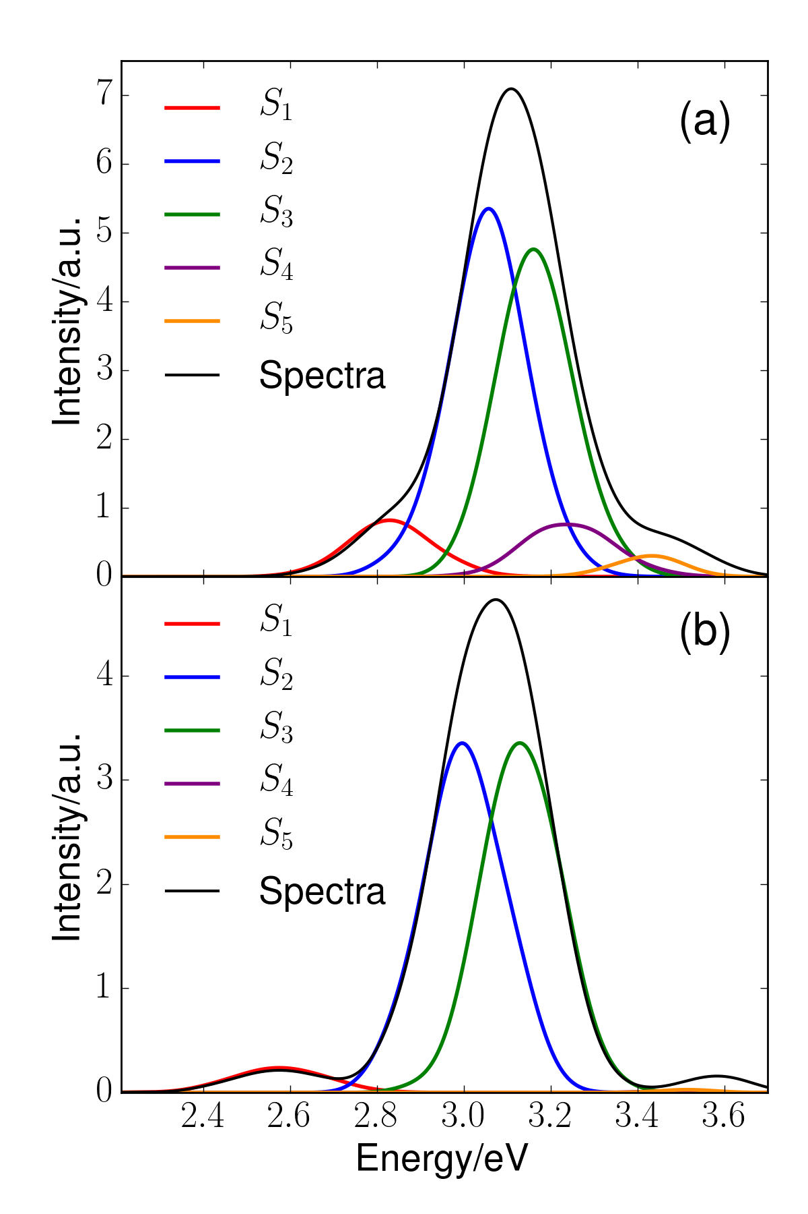
Tuning electronic relaxation of nanorings through their interlocking.

Slide 11
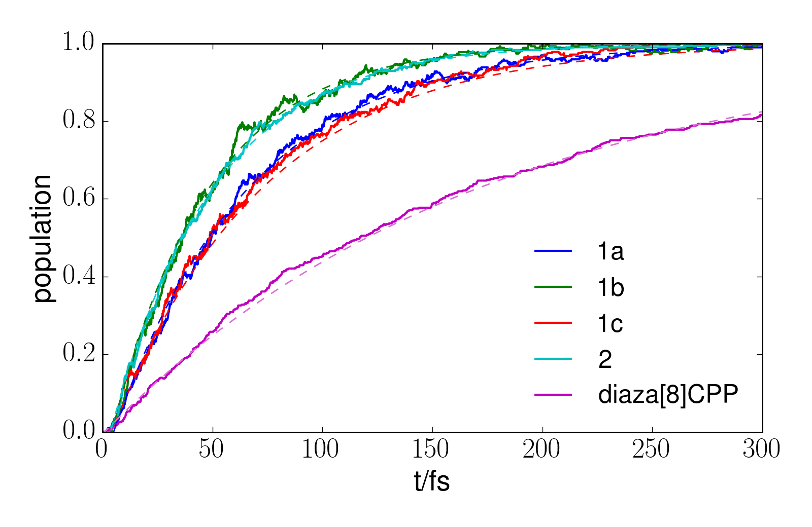
Tuning electronic relaxation of nanorings through their interlocking.

Slide 12
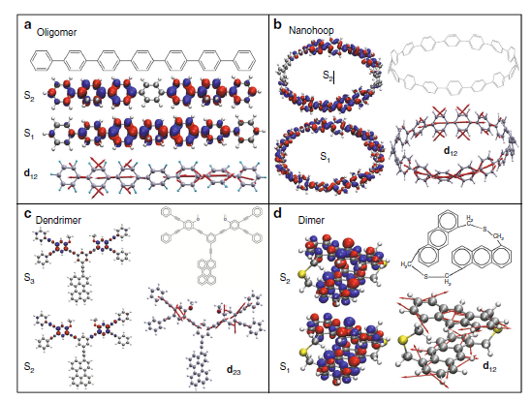
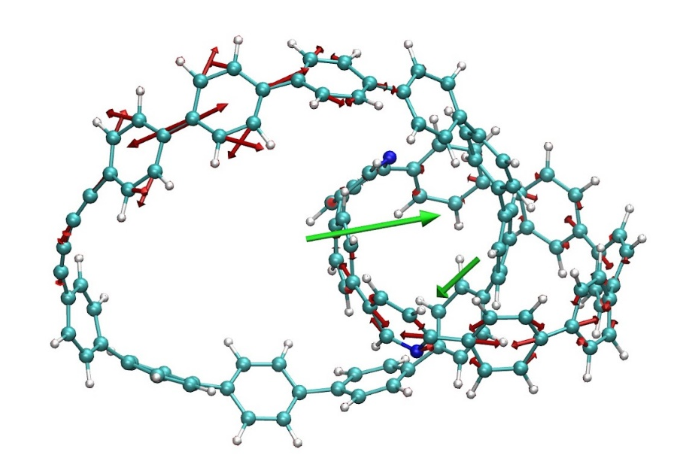
Antisymetric-to-symetric S₂->S₁ transition
T R. Nelson et al., Nature Comm. Vol. 9, Article number: 2316 (2018).

Slide 13
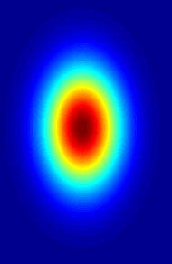
Ultrafast vibronic coherences
Multiconfigurational Ehrenfest approach (MCE)
Trajectory guided basis
Ψ(t=0)
Ψ(t)
Ψ(t=0)
Ψ(t)
Regular static grid
Trajectory guided grid
Trajectory guided basis allows to run on the fly dynamics
“Ab initio quantum direct dynamics simulations of ultrafast photochemistry with Multiconfigurational Ehrenfest approach”, D. Makhov, C. Symonds, S. Fernandez-Alberti, and D. Shalashilin, Chem. Phys. 493, 200–218 (2017).

Slide 14



MCE
we represent the wavefunction on a trajectory-guided basis
with
nuclear part:
Gaussian wave-packet moving along an Ehrenfest trajectory
electronic part:
superposition of several electronic eigenstates
D. Shalashilin, Faraday Disc. 153, 105 (2011).

Slide 15
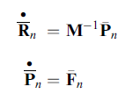

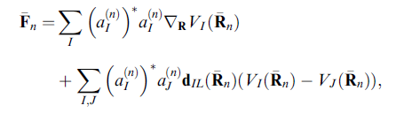
MCE: Evolution of nuclear basis function
the motion of the centers of Gaussians is determined by the usual set of Hamilton’s equations
with Ehrenfest forces

Slide 16

MCE: Evolution of electronic basis function
the evolution of the Ehrenfest amplitudes is determined by
In the original MCE method are adiabatic states

Slide 17
Ehrenfest trajectories
Nonadiabatic molecular dynamics (Ehrenfest)
Electronic energies, gradients, and nonadiabatic coupling vectors calculated “on the fly” .
Configuration interaction singles (CIS) using the Collective Electronic Oscillator (CEO) at AM1 level.
Equilibration on the ground state at 300K
→ Fotoexcitation and ultrafast dynamics in the excited states
An Ab Initio Multiple Cloning approach for the simulation of photoinduced dynamics in conjugated molecules” V. M. Freixas et al, Phys. Chem. Chem. Phys. 20, 17762 - 17772 (2018).
“NEXMD Software Package for Non-adiabatic Excited State Molecular Dynamics Simulations” W. Malone et al., J. Chem. Theory Comput.,16, 9, 5771–5783 (2020).
Notes:
Within the NA-ESMD framework^{1,,}, direct nonadiabatic molecular dynamics simulations can be applied to describe photoinduced dynamics in large organic conjugated molecules involving multiple coupled electronic excited states.
Herein we briefly summarize the NA-ESMD theoretical framework.
The electronic energies, gradients, and nonadiabatic coupling vectors were calculated on the fly during the molecular dynamics simulations.
Configuration interaction singles (CIS) level using the collective electronic oscillator (CEO) code22 combined with the Austin model 1 (AM1) Hamiltonian.46

Slide 18



MCE: Evolution of the whole wave-function
with
where
Note that overlaps include both nuclear part and electronic parts

Slide 19
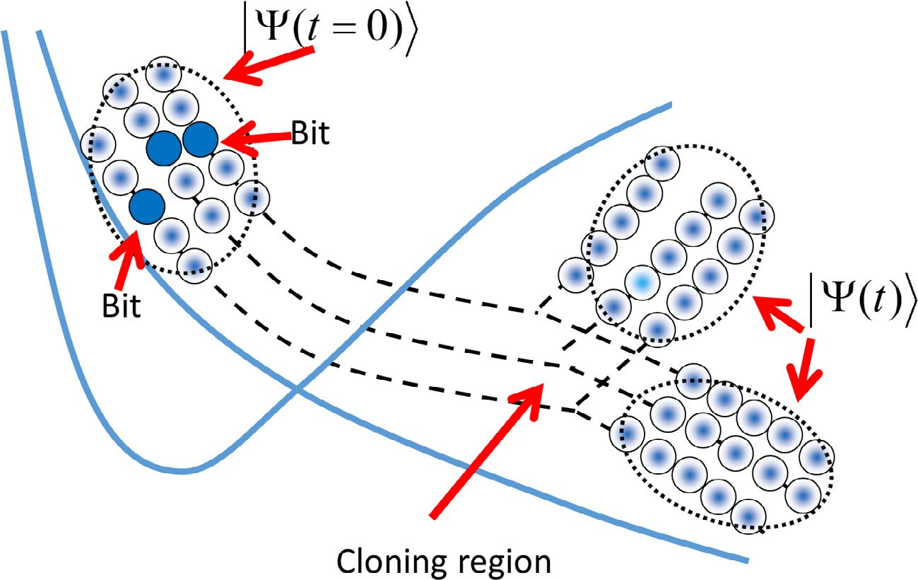
AIMC-TDDB: Ab initio multiple cloning
the difference between the shapes of the potential energy surfaces for different electronic states should lead
to branching of the wave packet
Notes:
The Ehrenfest basis set is guided by an average potential, which can be advantageous when quantum transitions are frequent. However,
it becomes unphysical in regions of low non-adiabatic coupling when two or more electronic states have significant contributions to
the Ehrenfest configuration (1.2): in this case, the difference between the shapes of the potential energy surfaces for different
electronic states should lead to branching of the wave packet. In order to reproduce bifurcations of the wave-function after
leaving the non-adiabatic coupling region, we introduced the so called Ab Initio Multiple Cloning (AIMC-MCE) [6] algorithm, which
was very much inspired by the well-established Ab Initio Multiple Spawning (AIMS) [1,30,31]. Cloning addresses the problem of basis
misguiding by way of the cloning procedure illustrated in Fig. 1.

Slide 20
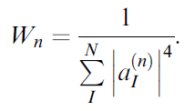


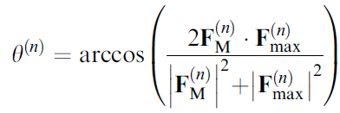

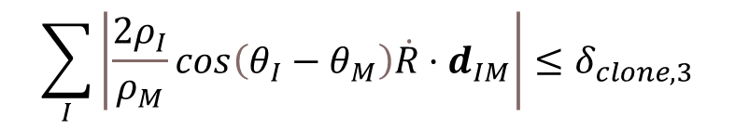
AIMC-TDDB: cloning criteria
Criterion #1
Criterion #2
Cloning events should take place only when at least two adiabatic electronic states are sufficiently populated
Cloning events should prevent situations in which the nuclear motion guided by the average Ehrenfest force lacks physical significance
Criterion #3
We limit the cloning to regions of phase space where the electronic states are not strongly coupled
$$\sum_{I}{\left|\frac{2ρ_{I}}{ρ_{M}}cos\left(θ_{I}−θ_{M}\right)\dot{R}·d_{IM}\right|≤δ_{clone,3}}$$
Notes:
Cloning events should take place only when at least two adiabatic electronic states are sufficiently populated. Otherwise, the amplitude of one of the clones will be too small and will not further improve sampling. Clonning events should prevent situations in which the nuclear motion guided by the average Ehrenfest force lacks physical significance. In such cases, the Ehrenfest TBF could fail to explore dynamically important regions of the configurational space.
This definition of y(n) takes into account not only the difference in the directions of F(n) M and F(n) max but also the difference in their magnitudes. In the case when both magnitudes are equivalent, eqn (40), y(n) is reduced to a standard definition of the angle between two vectors.
We limit the cloning to regions of phase space where the electronic states are not strongly coupled, limiting the rate of basis set growth: without this criterion, a TBF would clone multiple times while passing through a conical intersection. These regions are defined by the ratio of two terms in
eqn (8): a second term associated with nonadiabatic population exchange and a first term representing the gradient of the Ehrenfest PES

Slide 21
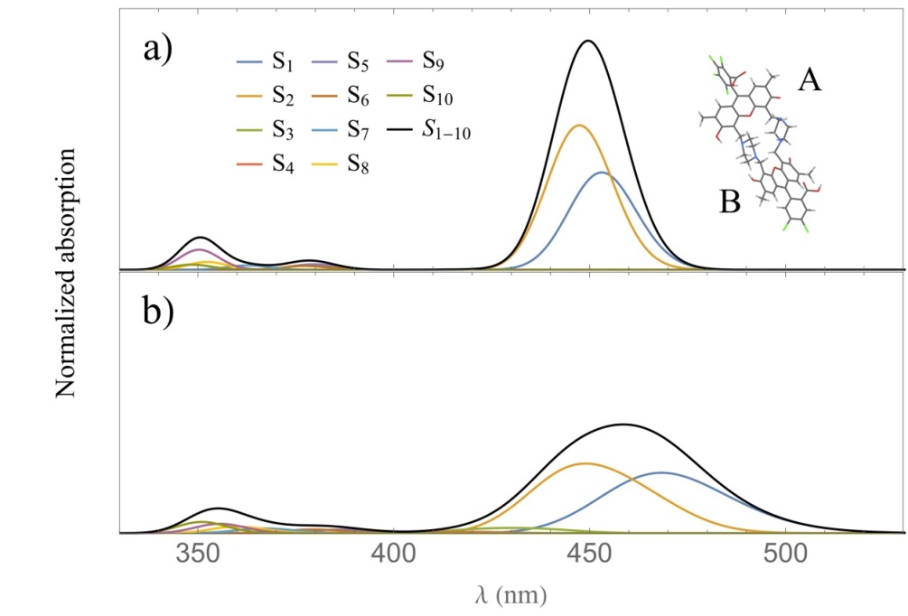
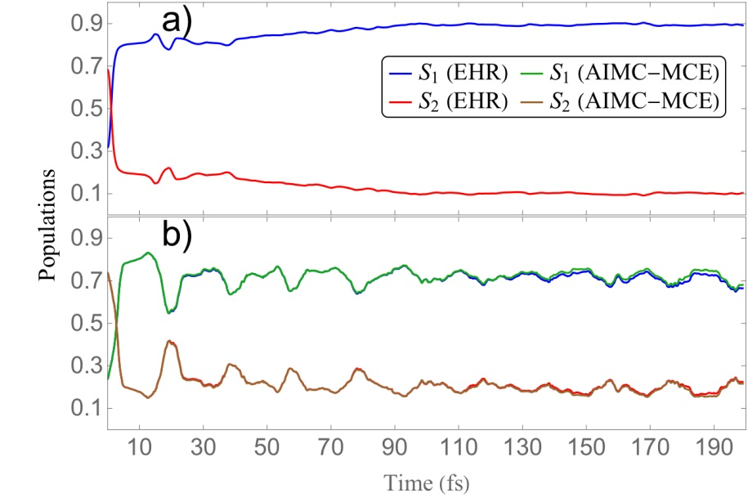
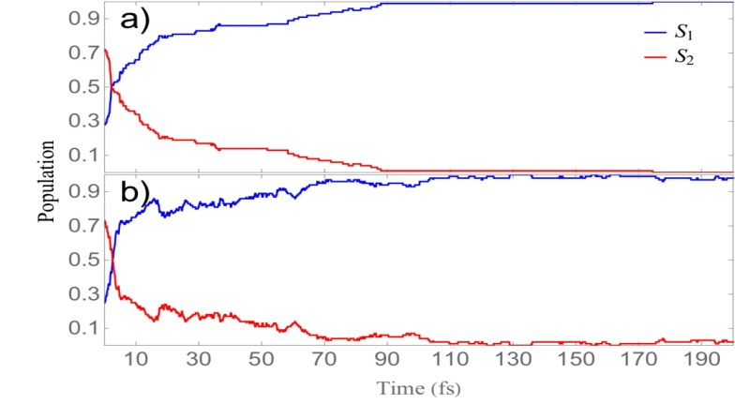
Vibronic quantum beating
between
electronic excited states
in a
heterodimer
Surface hopping
Notes:
fundamental insights into the coherence creation
and destruction mechanisms, as a general property of relatively
rigid and densely packed multichromophore molecular
systems.

Slide 22
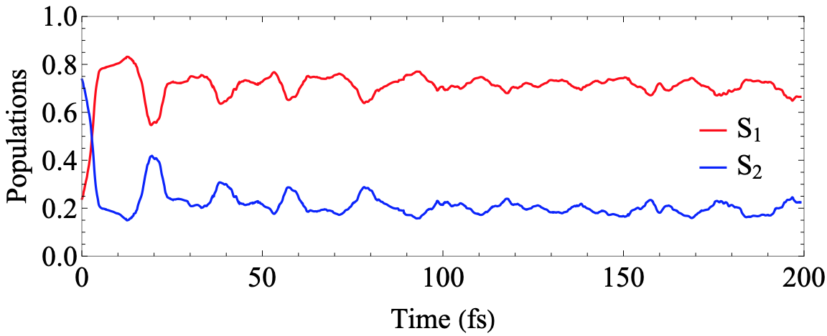
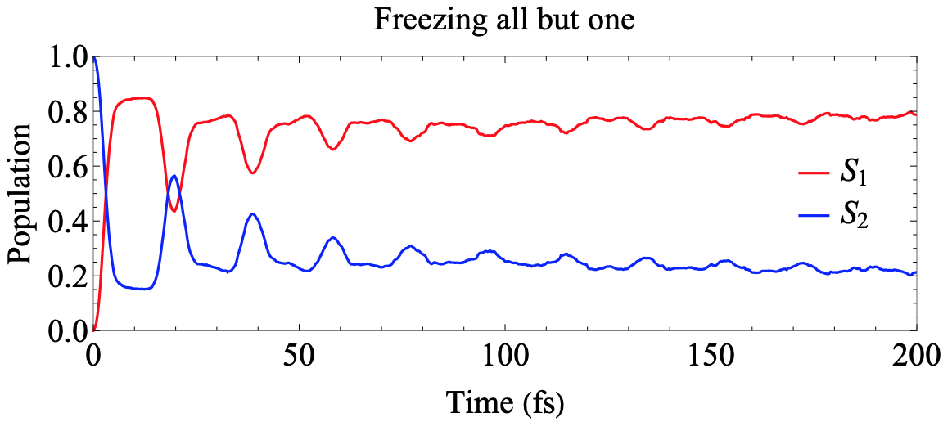
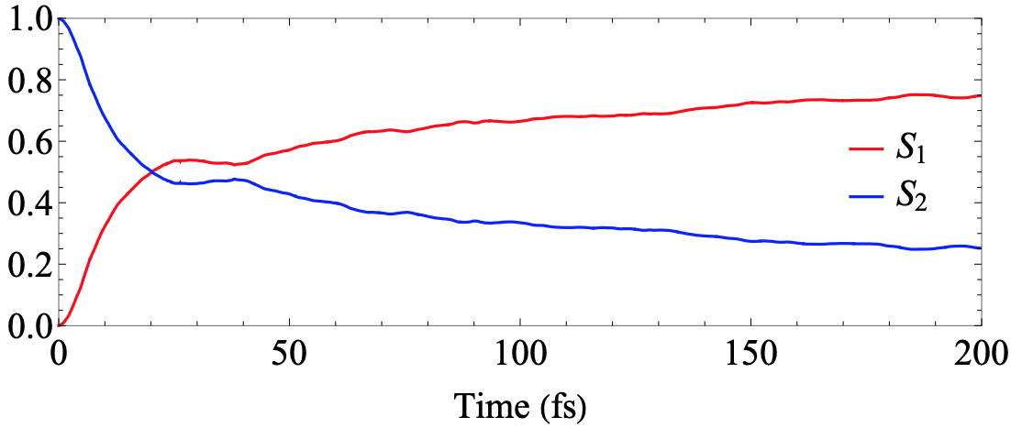
without freezing
Freezing nuclear motions
Freezing all vibration except
in the direction of d₁₂
Freezing the direction of d₁₂
Notes:
Cloning events should take place only when at least two adiabatic electronic states are sufficiently populated. Otherwise, the amplitude of one of the clones will be too small and will not further improve sampling. Clonning events should prevent situations in which the nuclear motion guided by the average Ehrenfest force lacks physical significance. In such cases, the Ehrenfest TBF could fail to explore dynamically important regions of the configurational space.
This definition of y(n) takes into account not only the difference in the directions of F(n) M and F(n) max but also the difference in their magnitudes. In the case when both magnitudes are equivalent, eqn (40), y(n) is reduced to a standard definition of the angle between two vectors.
We limit the cloning to regions of phase space where the electronic states are not strongly coupled, limiting the rate of basis set growth: without this criterion, a TBF would clone multiple times while passing through a conical intersection. These regions are defined by the ratio of two terms in
eqn (8): a second term associated with nonadiabatic population exchange and a first term representing the gradient of the Ehrenfest PES

Slide 23
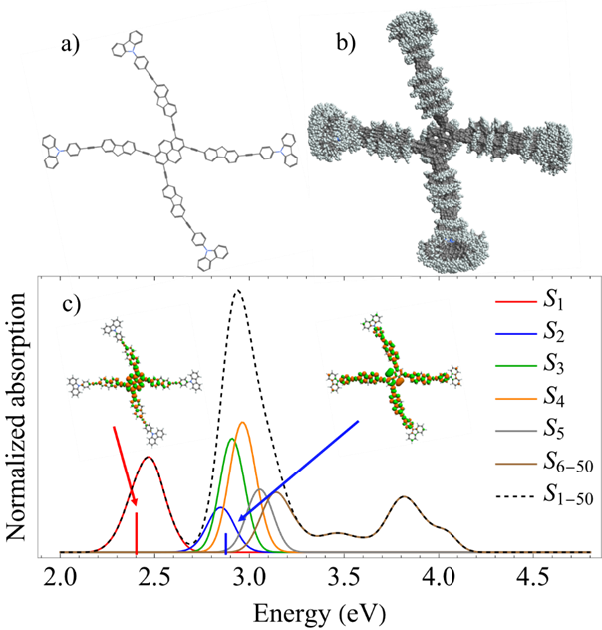
Transient Absorption pump-probe signals in dendrimers
Notes:
The nonlinear polarization 7(,) T t governing the TA PP signal is expressed through the third-order response functions

Slide 24
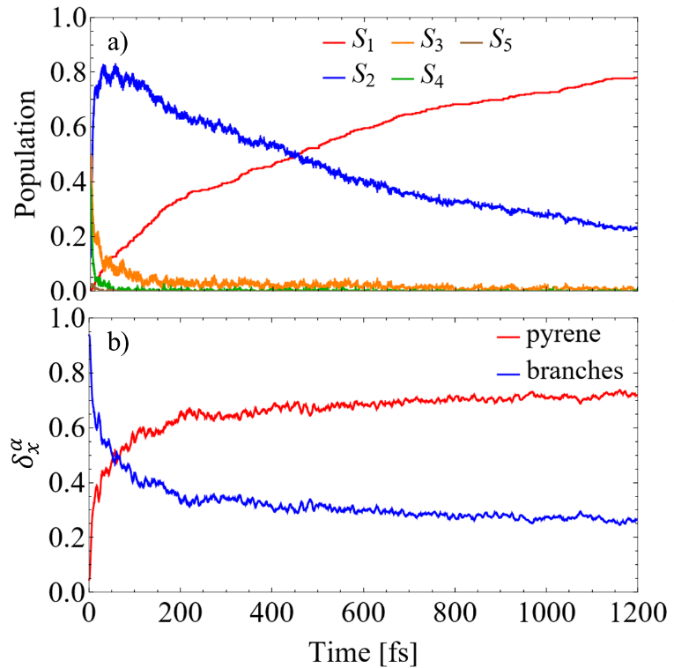
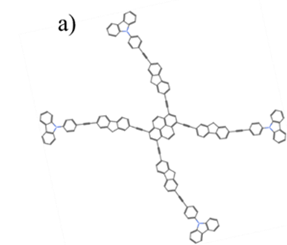
Transient Absorption pump-probe signals in dendrimers

Slide 25
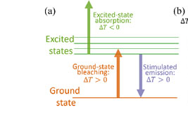
Transient Absorption pump-probe signals in dendrimers

Slide 26
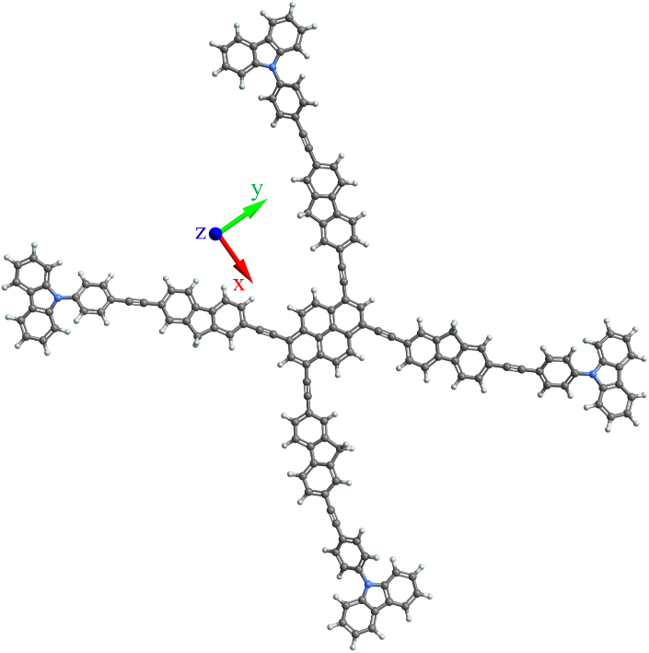
Transient Absorption pump-probe signals in dendrimers

Slide 27
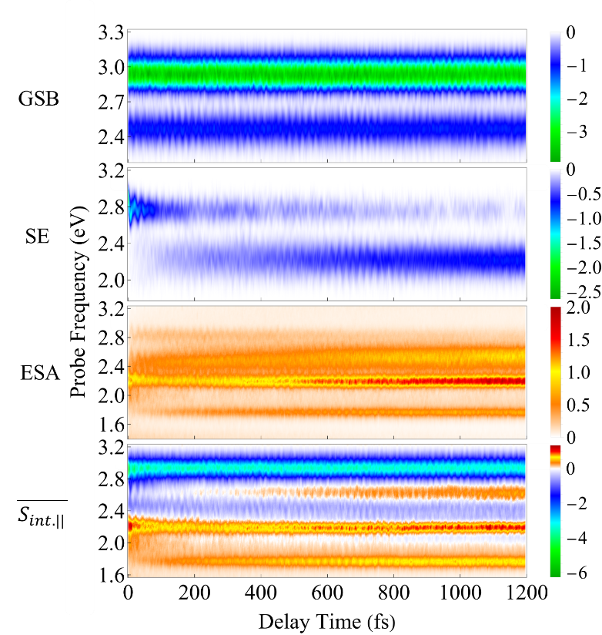
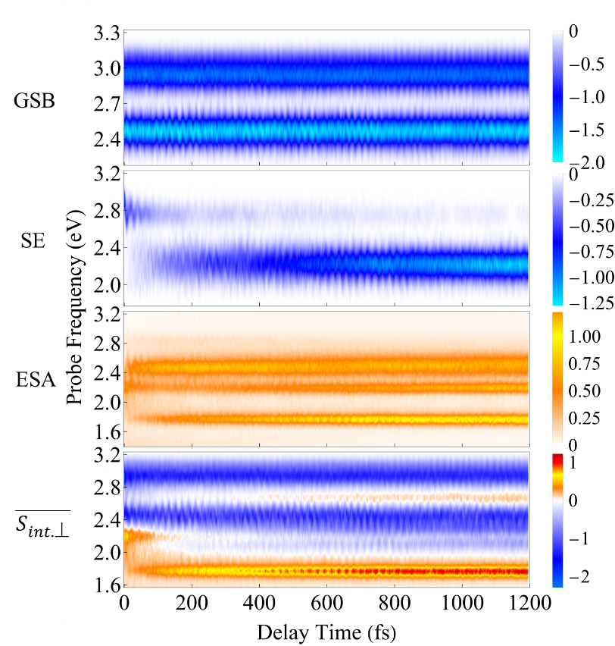
Transient Absorption pump-probe signals in dendrimers
Notes:
The GSB signal probes transitions from the ground state S₀ to the states of manifold {I}. For $\overline{S_{int,‖}}$ (Figure 5) the main contribution corresponds to $E_{pr}≈2.9$ eV, that corresponds to electronic transitions between the states S₀ and S₃, S₄. For $\overline{S_{int,⊥}}$, on the contrary, the main contribution corresponds to $E_{pr}≈2.5$ eV (Figure 6), which reveals transitions between the S₀ and S₁ states.
The SE signal reflects the projection of the nuclear motion in the current excited state to the ground state and gives a more detailed information on the nonadiabatic transitions than the population dynamics in Figure 2(a). The ultrafast Sn → S2 internal conversion is manifested as a redshift of the SE signal in the frequency domain. Hence the SE spectrum which was initially localized at E_pr≈2.9 eV, moves to the red in less than 50 fs after the photoexcitation. Further on, the S2 → S1 transition causes depopulation of these contribution from the S2 state which is centered at E_pr≈2.8 eV, and the signal shifts to E_pr≈2.3 eV, revealing the S1 state. After ~500 fs, the S1 state receives half of the population and the maximum of the SE intensity corresponds to this state. As was already mentioned, the intramolecular fluorene→pyrene transfer takes place during the photoinduced dynamics in manifold {I} (see Figure 3). This process has a similar manifestation in the GSB and SE signals. Namely, the initial SE intensity at E_pr≈2.8 eV is higher for the (S_(int,‖) ) ̅ signals than for the (S_(int,⊥) ) ̅ signal, but the situation changes to the opposite for E_pr≈2.3 eV at longer times. Nevertheless, the SE contribution at E_pr≈2.8 eV persists longer times for the (S_(int,‖) ) ̅ signal than for the (S_(int,⊥) ) ̅ signal. This is a consequence of the orthogonal orientations of μ03 and μ04 with respect to μ01.
As it can be observed particularly in Figure 6, the final (S_(int,⊥) ) ̅ signal is centered at ~2.3eV, while the GSB signal is centered at ~2.5eV. This difference is due to the effect of nuclear wavepacket evolution on the S1 that cause a red shift also observed in the steady-state fluorescence spectra.32 This red shift is commonly observed as a result of excited state dynamics of multichromophoric conjugated molecular systems and it is associated with certain planarization that promotes the extent of the π-conjugation throughout the chromophore units.91 No oscillations are observed during the S2 → S1 transition, due to the time-delocalized character of this transfer.

Slide 28
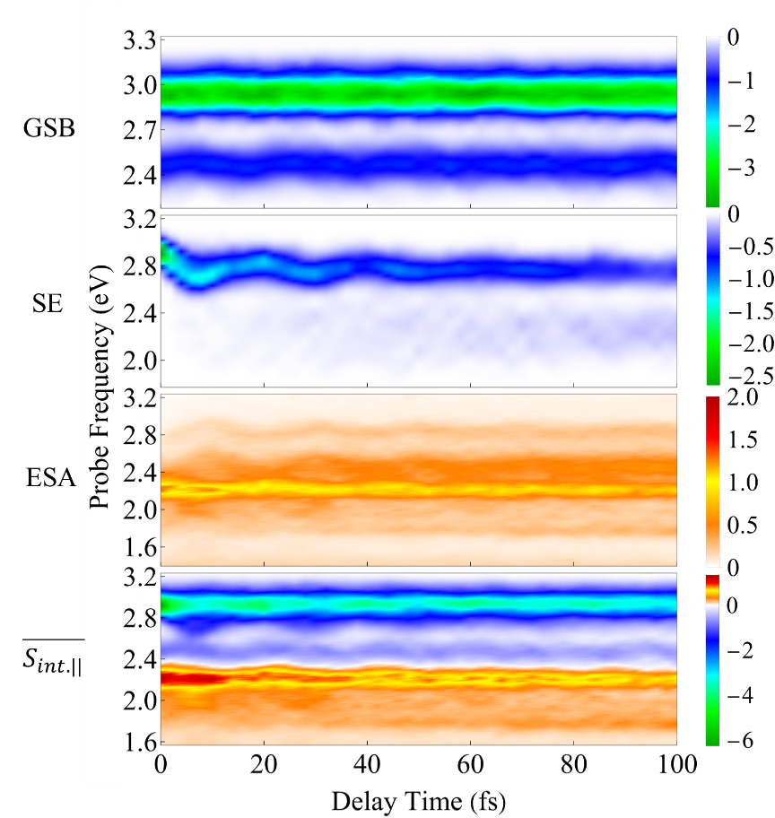
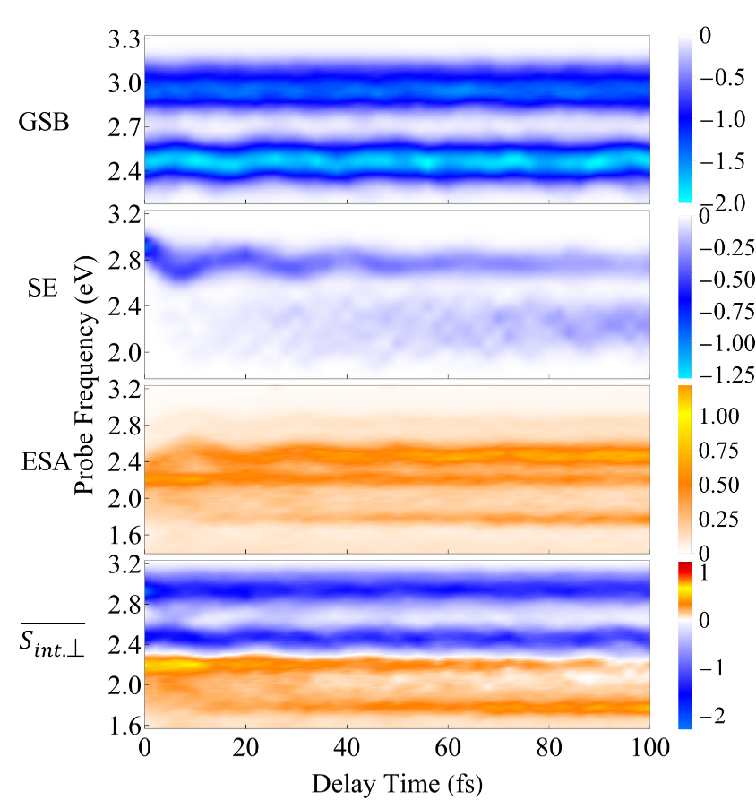
Transient Absorption pump-probe signals in dendrimers
Notes:
A detailed short-time dynamics of the TA PP signals is displayed in Supplemental Figures S4 and S5 for $\overline{S_{int,‖}}$ and $\overline{S_{int,⊥}}$, respectively. During the first ~ 50 fs, the SE signal exhibits oscillations around $E_{pr}≈2.8$ eV due to the evolution of the molecular system on S₂. These oscillations are not so pronounced in the GSB signal since it depends on the nuclear propagation in the electronic ground state. Therefore, these results point out the difference of the nuclear dynamics in the excited states with respect to the nuclear dynamic in the ground state even at short times, which is mostly caused by the reorganization energy, that is the displacement of the equilibrium position of the nuclear modes in the excited electronic states relative to the ground state. Due to the huge number of the (in general, anharmonic) nuclear degrees of freedom involved, the oscillations do not reveal a well-defined period, but the distance between the first two SE maxima corresponds roughly to 15 fs, which corroborates the observation of Ref.²⁷ made for short dendrimers that the main contributor to these oscillations is the triple CC bond stretch.

Slide 29
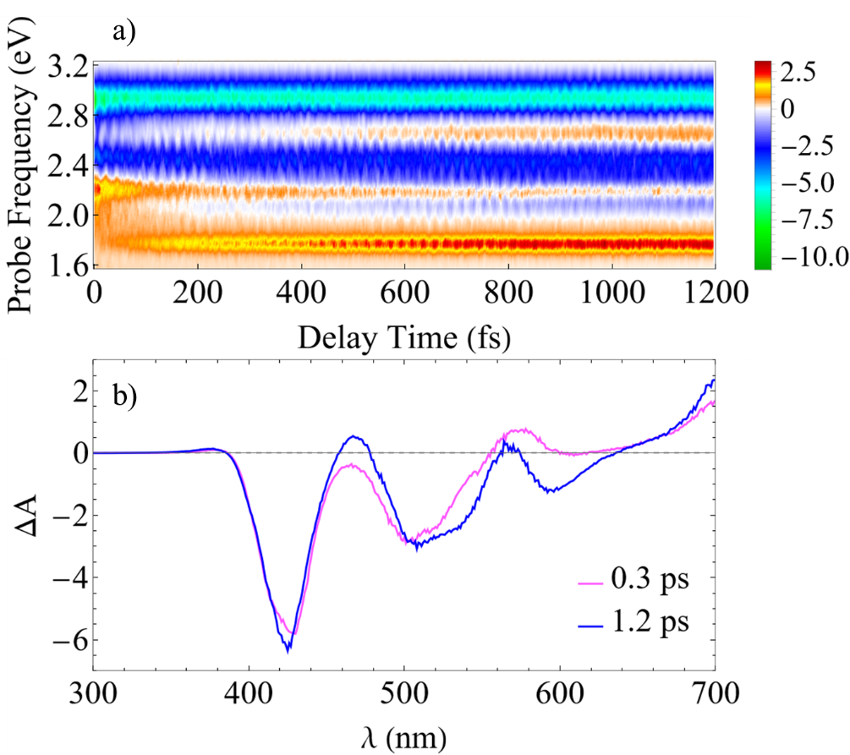
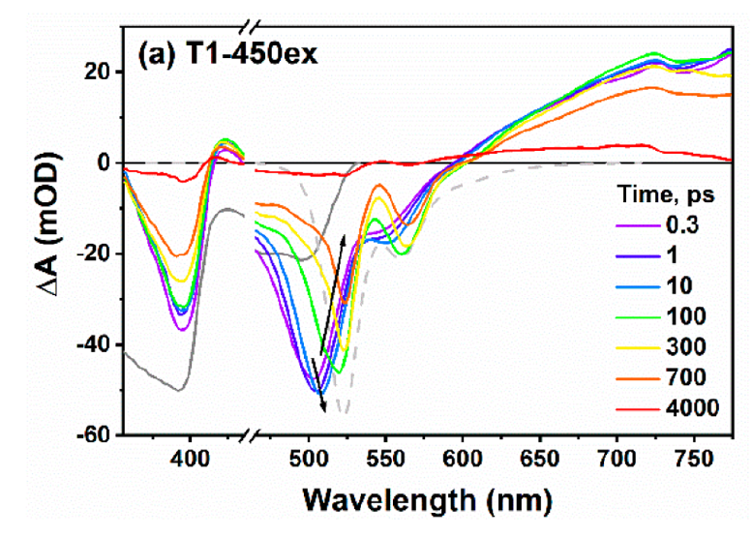
Transient Absorption pump-probe signals in dendrimers
Notes:
The TA PP spectra of Ref.³² reveal three negative bands in the region of ~420-640 nm (~1.9-2.9 eV), which are the superposition of GSB and SE signals. Wavelengths higher than 640 nm are merely caused by the ESA signals.

Slide 30
Main conclusions
The efficiency of electronic energy relaxation can be speeded up by adding a chromophore, oligomerization, interlinking
AIMC naturally account for decoherence of vibronic wavepackets.
Atomistic simulations of pump-probe experiments in dendrimers can be achieved.

Slide 31


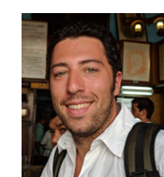



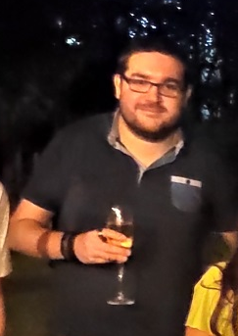
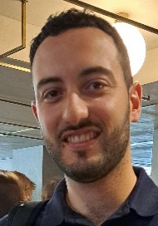

Molecular physics and Biophysics group
Dianelys Ondarse Alvarez
Nicolas Oldani Royle Perez Castillo
Hassiel Negrin Yuvero
Laura Alfonso Hernandez
Galo Balatti
Tadeo E. Saldaño
Matias Chiappinelli
http://ufq.unq.edu.ar/mpbg/

Slide 32


Collaborators
Sergei Tretiak & Tammie Nelson
Dmitrii Shalashilin & Dmitry Makhov
Maxim F. Gelin
Sahar Sharifzadeh

