Slide 1
Trajectory-based nonadiabatic dynamics with a surface-hopping motif: Recent progress in Libra
Daeho Han
Ulsan National Institute of Science & Technology, S. Korea
VISTA seminar 92
Sep 3, 2025

Slide 2

Outline
New trajectory-based nonadiabatic dynamics methods with a surface hopping (SH) motif!
SH based on exact factorization (SHXF)
Quantum-trajectory SH (QTSH)
Fully-integrated SH (FISH)

Slide 3


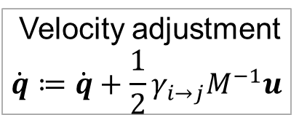

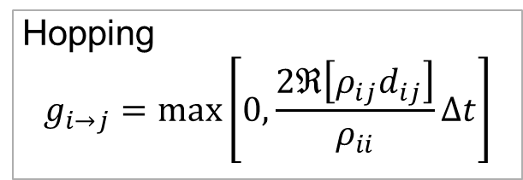

The TSH protocol
electrons
Effective potential in TSH
$$iℏ\dot{ψ}\left(r,t;q\right)={\hat{H}}_{BO}\left(q\right)ψ\left(r,t;q\right)$$
Tully, J. C. JCP. 1990, 93 (2), 1061–1071.
Hopping
$$g_{i→j}=\max\left[0,\frac{2ℜ\left[ρ_{ij}d_{ij}\right]}{ρ_{ii}}Δt\right]$$
$$\{q,p\}$$
TSH
Hopping probability
$$g_{i→j}$$
Velocity adjustment
$$\dot{q}≔\dot{q}+\frac{1}{2}γ_{i→j}M^{−1}u$$
$$q$$
Barbatti, M. JCTC. 2021, 17 (5), 3010–3018.
The force is stochastically set to one of adiabatic forces.
$$\dot{p}=−∇E_{a}$$
nuclei

Slide 4
SH based on exact factorization (SHXF)

Slide 5

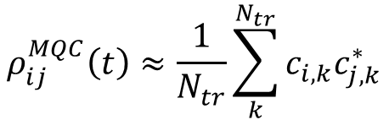
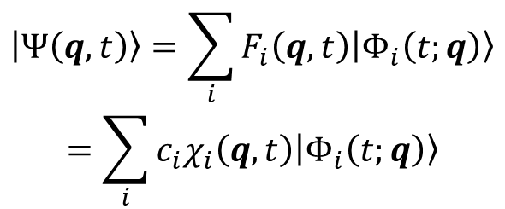

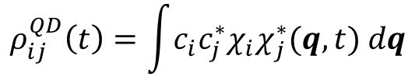
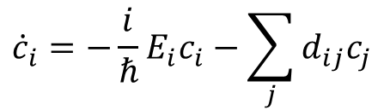
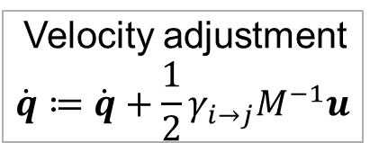
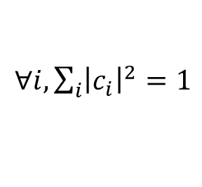
Overcoherence in TSH
electrons
Off-diagonal elements in the density matrix remain constant, after the dynamics leaves away the nonadiabatic coupling region.
$$iℏ\dot{ψ}\left(r,t;q\right)={\hat{H}}_{BO}\left(q\right)ψ\left(r,t;q\right)$$
BH expansion for an electron-nuclear state
$$\left|Ψ\left(q,t\right)\right\rangle =\sum_{i}{F_{i}\left(q,t\right)\left|Φ_{i}\left(t;q\right)\right\rangle }$$
$$=\sum_{i}{c_{i}χ_{i}\left(q,t\right)\left|Φ_{i}\left(t;q\right)\right\rangle }$$
Hopping
$$g_{i→j}=\max\left[0,\frac{2ℜ\left[ρ_{ij}d_{ij}\right]}{ρ_{ii}}Δt\right]$$
$∀i, \sum_{i}{{\left|c_{i}\right|}^{2}}=1$
TSH
Coherence
$$ρ_{ij}^{QD}\left(t\right)=\int{c_{i}c_{j}^{∗}χ_{i}χ_{j}^{∗}(q,t) dq}$$
Velocity adjustment
$$\dot{q}≔\dot{q}+\frac{1}{2}γ_{i→j}M^{−1}u$$
$$ρ_{ij}^{MQC}\left(t\right)≈\frac{1}{N_{tr}}\sum_{k}^{N_{tr}}{c_{i,k}c_{j,k}^{∗}}$$
Xu, J.; Shi, Z.; Wang, L. JCTC. 2024, 20 (6), 2349–2361.
$$\dot{p}=−∇E_{a}$$
Electronic propagation in the conventional TSH
$${\dot{c}}_{i}=−\frac{i}{ℏ}E_{i}c_{i}−\sum_{j}{d_{ij}c_{j}}$$
Zero away from the NAC region
nuclei

Slide 6



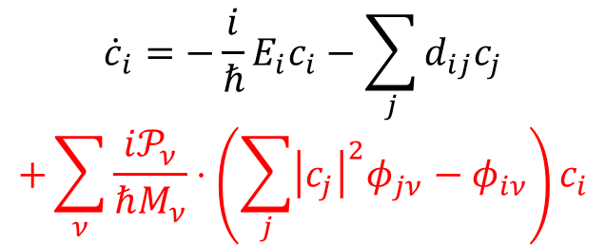

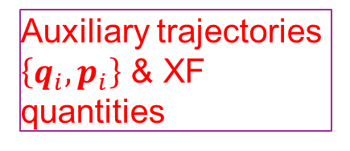


SHXF tackles overcoherence
Han, D.; Akimov, A. V. JCTC. 2024, 20 (12), 5022–5042.
electrons
Exact factorization (XF) ansatz
$$\left|Ψ\left(q,t\right)\right\rangle =χ\left(q,t\right)|ψ\left(t;q\right)⟩$$
$$iℏ\dot{ψ}\left(r,t;q\right)=\left[{\hat{H}}_{BO}+{\hat{H}}_{XF}\right]ψ\left(r,t;q\right)$$
under $∀q∀t, ⟨ψ(t;q)\left|ψ\left(t;q\right)\right\rangle =1$
Abedi, A.; Maitra, N. T.; Gross, E. K. U. PRL. 2010, 105 (12), 123002.
Agostini, F.; Min, S. K.; Abedi, A.; Gross, E. K. U. JCTC. 2016, 12 (5), 2127–2143.
Hopping
$$g_{i→j}=\max\left[0,\frac{2ℜ\left[ρ_{ij}d_{ij}\right]}{ρ_{ii}}Δt\right]$$
Electronic propagation in SHXF
$${\dot{c}}_{i}=−\frac{i}{ℏ}E_{i}c_{i}−\sum_{j}{d_{ij}c_{j}}$$
$$+\sum_{ν}{\frac{i𝒫_{ν}}{ℏM_{ν}}⋅\left(\sum_{j}{{\left|c_{j}\right|}^{2}φ_{jν}}−φ_{iν}\right)}c_{i}$$
Auxiliary trajectories $\left\{q_{i},p_{i}\right\}$ & XF quantities
SHXF
Velocity adjustment
$$\dot{q}≔\dot{q}+\frac{1}{2}γ_{i→j}M^{−1}u$$
Ha, J.-K.; Lee, I. S.; Min, S. K. JPCL. 2018, 9 (5), 1097–1104.
Auxiliary trajectory propagation $\left\{q_{i},p_{i}\right\}$ & XF quantities
Quantum momentum
$$𝒫_{ν}=−iℏ\frac{∇_{ν}|χ|}{|χ|}≈\frac{iℏ}{2σ_{ν}^{2}}\left(q_{ν}−⟨q_{ν}⟩\right)$$
$$\dot{p}=−∇E_{a}$$
Phase gradient
$$φ_{i,ν}\left(t\right)=∇_{ν}\arg{c_{i}}≈p_{i}\left(t\right)−p_{i}(t_{i})$$
nuclei

Slide 7
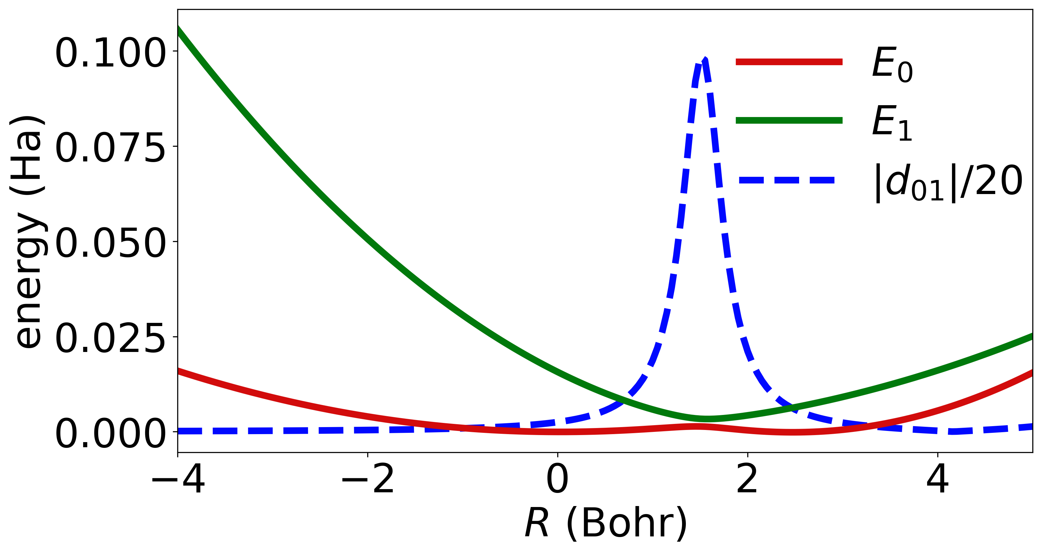
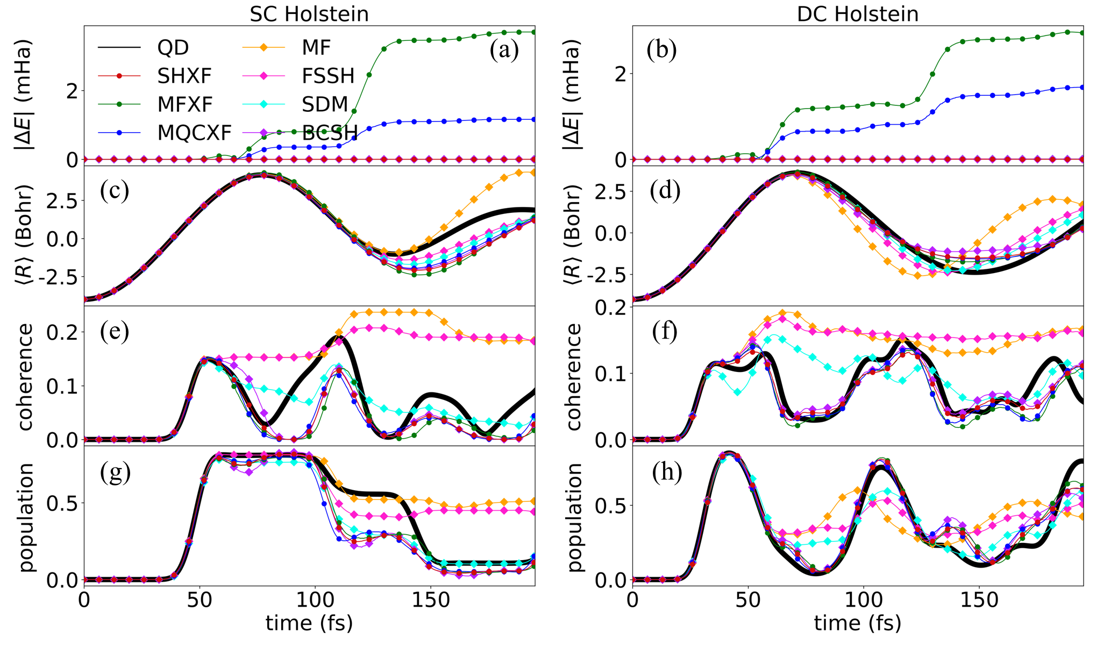
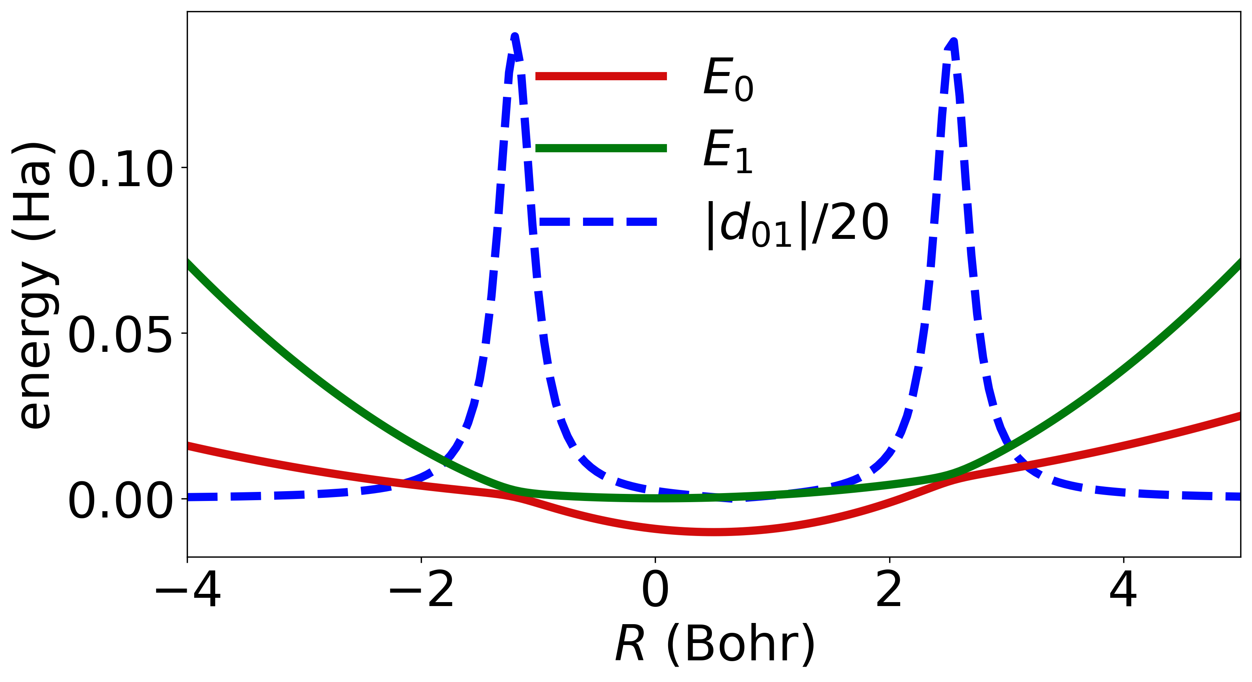
SHXF tackles overcoherence
Han, D.; Akimov, A. V. JCTC. 2024, 20 (12), 5022–5042.
PES
Population & coherence in Holstein models
Single-Crossing (SC) Holstein
Double-Crossing (DC) Holstein
While FSSH suffers from the overcoherence, SHXF and other decoherence-corrected methods such as BCSH and SDM shows a clear damping in coherence.

Slide 8
SHXF tackles overcoherence
Han, D.; Akimov, A. V. JCTC. 2024, 20 (12), 5022–5042.
A schematics for the single-crossing (SC) Holstein dynamics
“Spatial overlap”
$$q$$
There is missing coherence due to spatial overlap in the off-coupling region after the first crossing.

Slide 9
Quantum-Trajectory SH (QTSH)

Slide 10

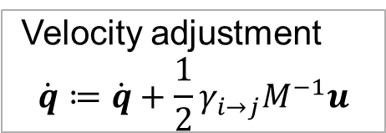


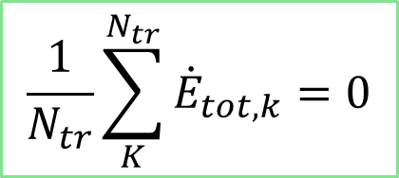

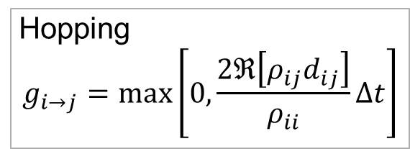
Too “strict” energy conservation in TSH
electrons
$$iℏ\dot{ψ}\left(r,t;q\right)={\hat{H}}_{BO}\left(q\right)ψ\left(r,t;q\right)$$
In TSH, the velocity adjustment procedure enforces energy conservation at the level of individual trajectories.
Hopping
$$g_{i→j}=\max\left[0,\frac{2ℜ\left[ρ_{ij}d_{ij}\right]}{ρ_{ii}}Δt\right]$$
What TSH does
What is supposed to be done
TSH
$$⇒$$
$$\frac{1}{N_{tr}}\sum_{K}^{N_{tr}}{{\dot{E}}_{tot,k}}=0$$
$∀ k, {\dot{E}}_{tot,k}=0$
$$⇐$$
Velocity adjustment
$$\dot{q}≔\dot{q}+\frac{1}{2}γ_{i→j}M^{−1}u$$
$$\dot{p}=−∇E_{a}$$
nuclei

Slide 11





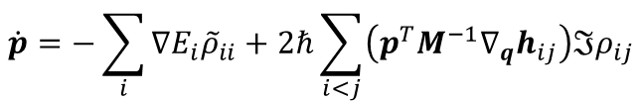

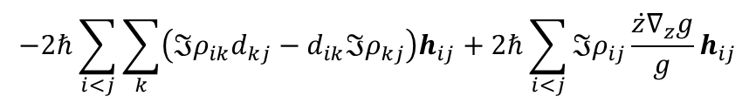
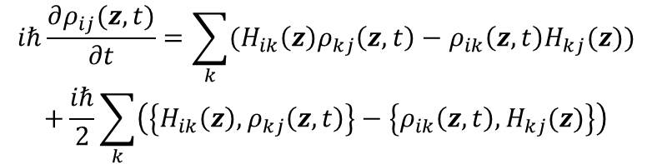
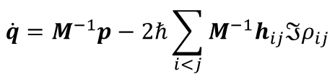

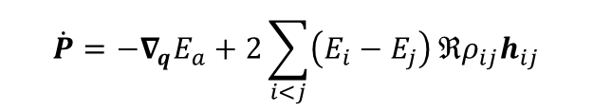

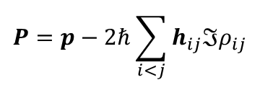
QTSH achieves ensemble-level energy conservation
Han, D.; Martens, C. C.; Akimov, A. V. JCTC. 2025, 21 (6), 2839–2853.
electrons
An optional decoherence correction can be added.
Quantum-Classical Liouville Equation
$$iℏ\frac{∂ρ_{ij}(z,t)}{∂t}=\sum_{k}{(H_{ik}\left(z\right)ρ_{kj}\left(z,t\right)−ρ_{ik}\left(z,t\right)H_{kj}(z))}$$
$$+\frac{iℏ}{2}\sum_{k}{\left(\left\{H_{ik}\left(z\right), ρ_{kj}\left(z,t\right)\right\}−\left\{ρ_{ik}\left(z,t\right), H_{kj}(z)\right\}\right)}$$
$$iℏ\dot{ψ}\left(r,t;q\right)={\hat{H}}_{BO}\left(q\right)ψ\left(r,t;q\right)$$
With the electronic basis $\{|i⟩\}$ and phase-space variables, $z=(q,p)$
Hopping
$$g_{i→j}=\max\left[0,\frac{2ℜ\left[ρ_{ij}d_{ij}\right]}{ρ_{ii}}Δt\right]$$
Equations of motion & kinematic momentum
$$ρ_{ij}\left(z,t\right):={\tilde{ρ}}_{ij}\left(t\right)g(z)$$
Phase-space density
~ proxy density matrix $×$ Gaussian basis
$$iℏ\frac{d{\tilde{ρ}}_{ij}}{dt}=\sum_{k}{\left(H_{ik}{\tilde{ρ}}_{jk}−{\tilde{ρ}}_{ik}H_{kj}\right)}−iℏ\frac{\dot{z}∇_{z}g}{g}{\tilde{ρ}}_{ij}$$
QTSH
$$\dot{q}=M^{−1}p−2ℏ\sum_{i<j}{M^{−1}h_{ij}ℑρ_{ij}}$$
decoherence
Inconvenient!
Martens, C. C. JPCA 2019, 123 (5), 1110–1128.
Velocity adjustment
$$\dot{q}≔\dot{q}+\frac{1}{2}γ_{i→j}M^{−1}u$$
$$\dot{p}=−\sum_{i}{∇E_{i}{\tilde{ρ}}_{ii}}+2ℏ\sum_{i<j}{\left(p^{T}M^{−1}∇_{q}h_{ij}\right)ℑρ_{ij}}$$
$$h_{ij}=⟨i|∇j⟩$$
Huang, D. M.; Green, A. T.; Martens, C. C. JCP. 2023, 159 (21), 214108.
$$d_{ij}=p^{T}M^{−1}h_{ij}$$
Kinematic
momentum
$$P=p−2ℏ\sum_{i<j}{h_{ij}ℑρ_{ij}}$$
Dupuy, L.; Rikus, A.; Maitra, N. T. JPCL. 2024, 2643–2649.
$$\dot{q}=M^{−1}P$$
$$\dot{P}=−∇E_{a}+F_{quant}$$
$$\dot{P}=−∇_{q}E_{a}+2\sum_{i<j}{\left(E_{i}−E_{j}\right)}ℜρ_{ij}h_{ij}$$
Cotton, S. J.; Liang, R.; Miller, W. H. JCP. 2017, 147 (6), 064112.
$$−2ℏ\sum_{i<j}{\sum_{k}{\left(ℑρ_{ik}d_{kj}−d_{ik}ℑρ_{kj}\right)h_{ij}}}+2ℏ\sum_{i<j}{ℑρ_{ij}\frac{\dot{z}∇_{z}g}{g}h_{ij}}$$
Nuclear propagation is governed by kinematic momentum and quantum force
nuclei

Slide 12
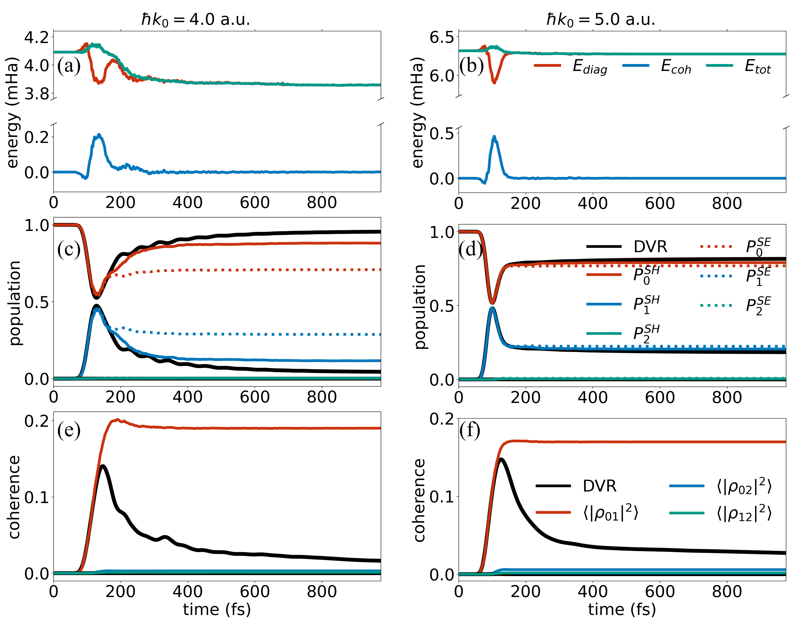
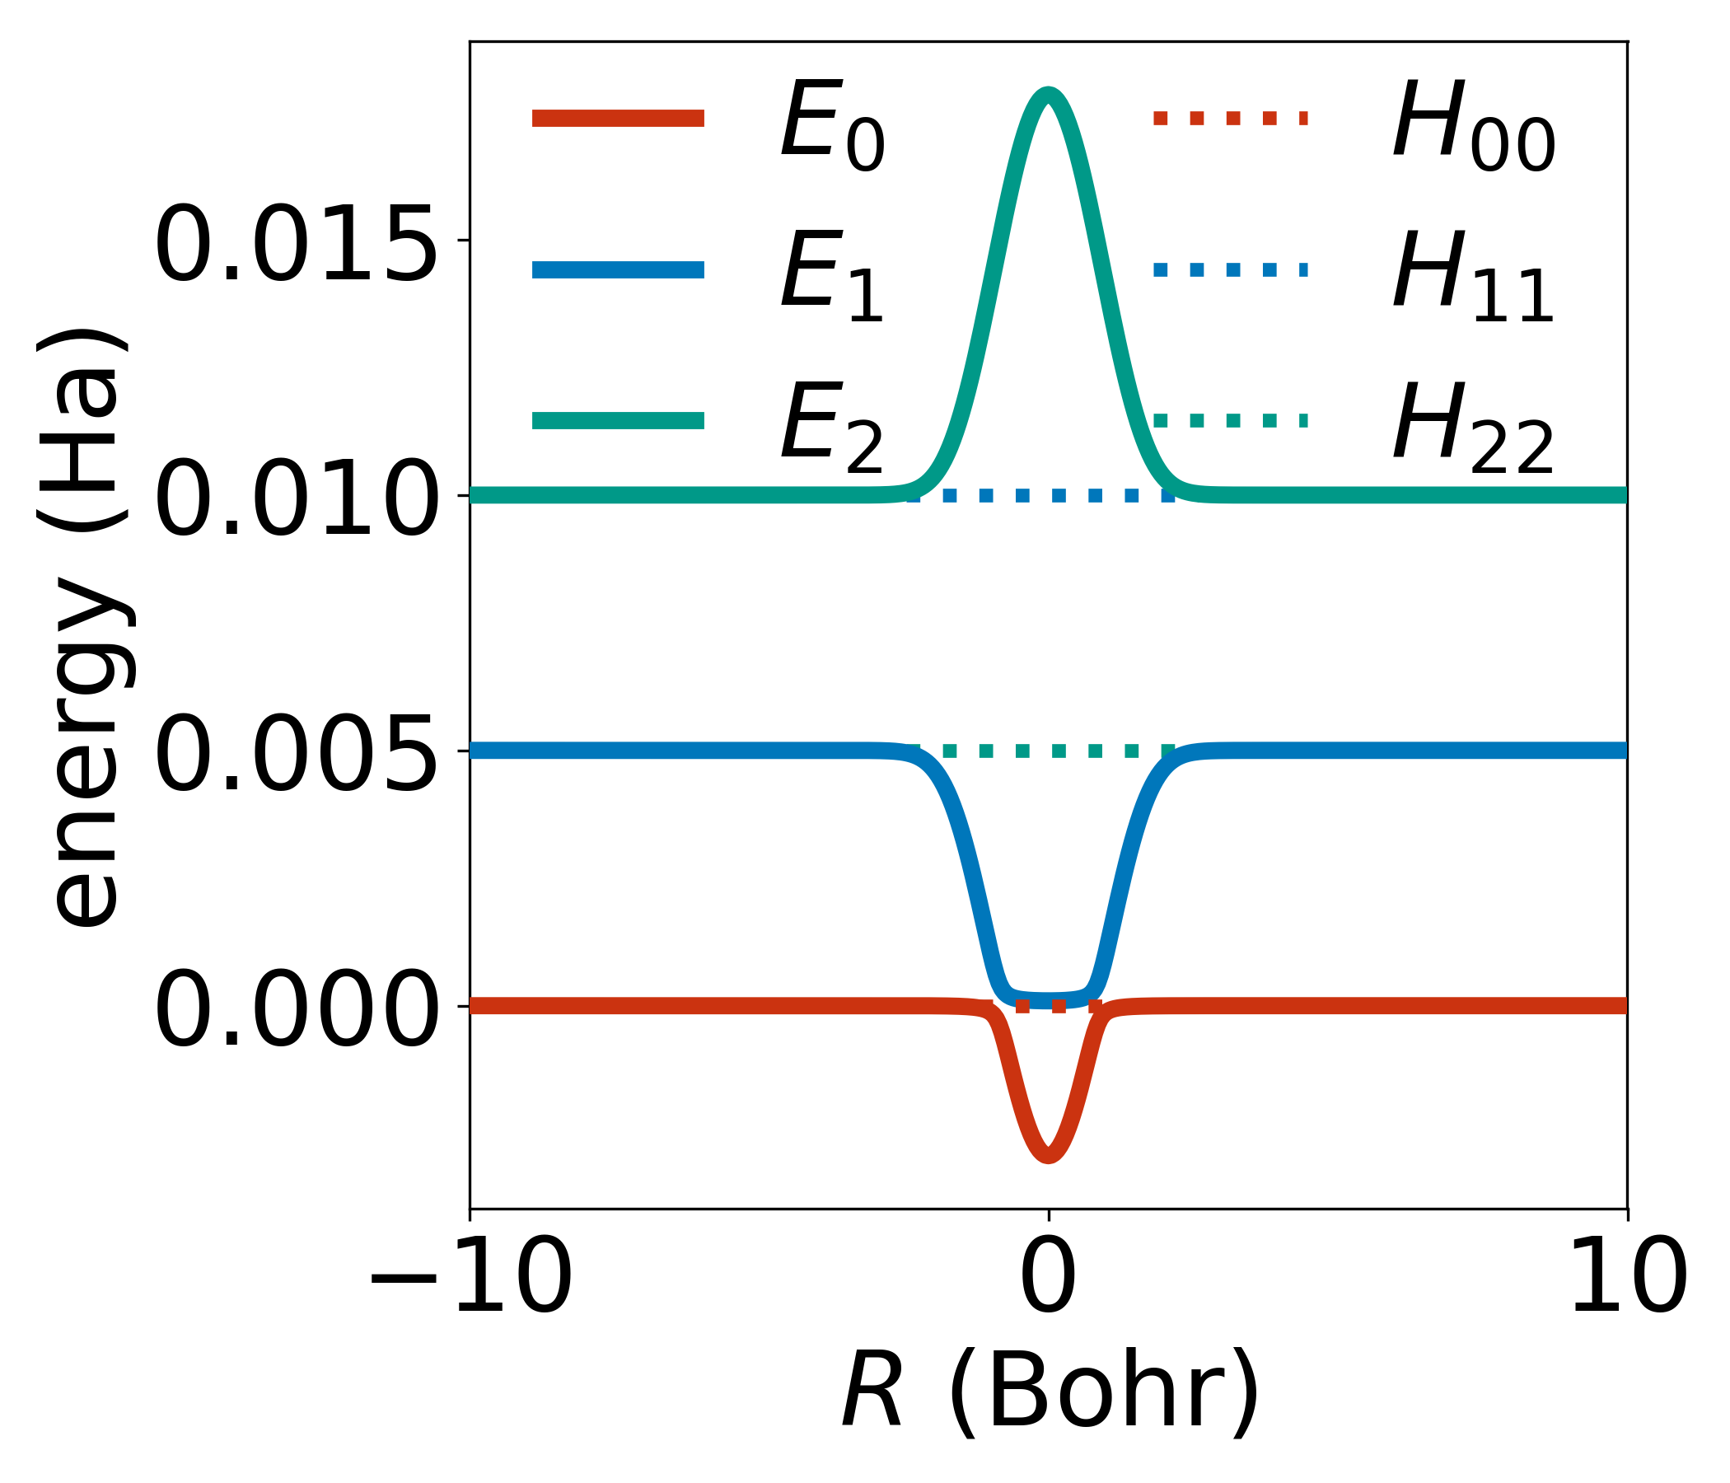

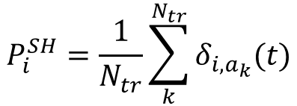


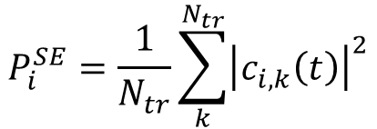
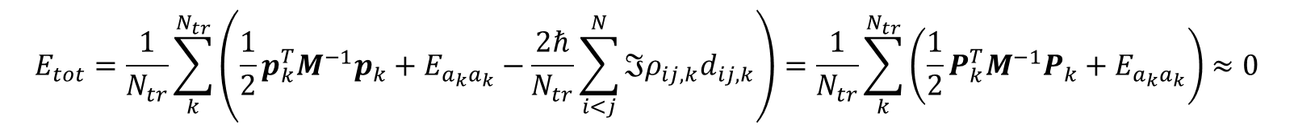



QTSH achieves ensemble-level energy conservation
Han, D.; Martens, C. C.; Akimov, A. V. JCTC. 2025, 21 (6), 2839–2853.
Energy conservation & internal consistency
$a_{k}(t)$ = the active-state index of $k$th trajectory at $t$
$$E_{tot}=\frac{1}{N_{tr}}\sum_{k}^{N_{tr}}{\left(\frac{1}{2}p_{k}^{T}M^{−1}p_{k}+E_{a_{k}a_{k}}−\frac{2ℏ}{N_{tr}}\sum_{i<j}^{N}{ℑρ_{ij,k}d_{ij,k}}\right)}=\frac{1}{N_{tr}}\sum_{k}^{N_{tr}}{\left(\frac{1}{2}P_{k}^{T}M^{−1}P_{k}+E_{a_{k}a_{k}}\right)}≈0$$
$$⇐$$
$${\dot{δ}}_{i,a_{k}}≈{\dot{ρ}}_{ii,k},∀k$$
E_{diag}
E_{coh}
QTSH on the superexchange model
Superexchange model
Notably worse E conservation
$$H_{00}=0;H_{11}=0.005;H_{22}=0.01$$
$$V_{01}=V_{10}=0$$
$$V_{02}=V_{20}=0.001\exp{(−R^{2}/2)}$$
$$V_{12}=V_{21}=0.01\exp{(−R^{2}/2)}$$
$$P_{i}^{SE}=\frac{1}{N_{tr}}\sum_{k}^{N_{tr}}{{\left|c_{i,k}\left(t\right)\right|}^{2}}$$
Population from the density matrix
$$P_{i}^{SH}=\frac{1}{N_{tr}}\sum_{k}^{N_{tr}}{δ_{i,a_{k}}(t)}$$
Population from the active-state occurrence

Slide 13
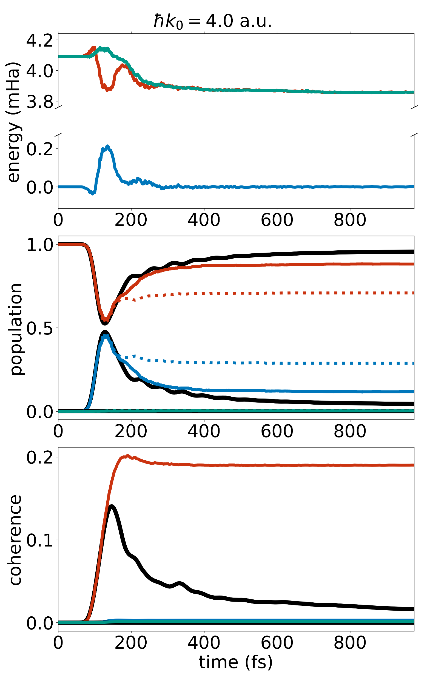
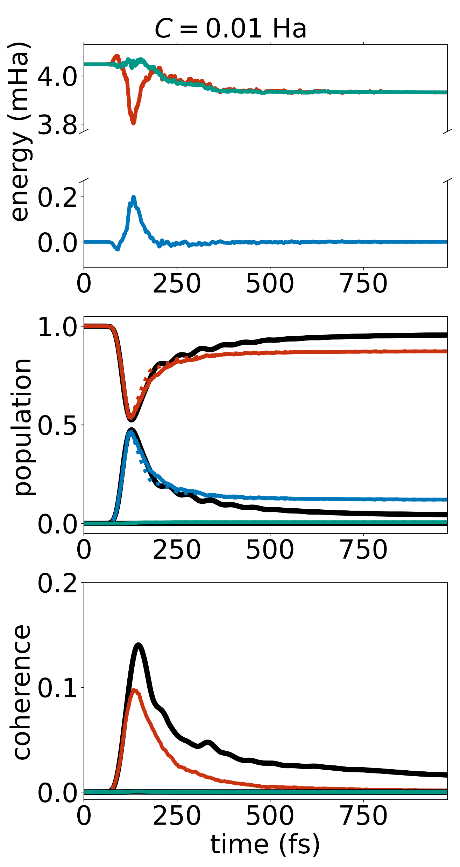
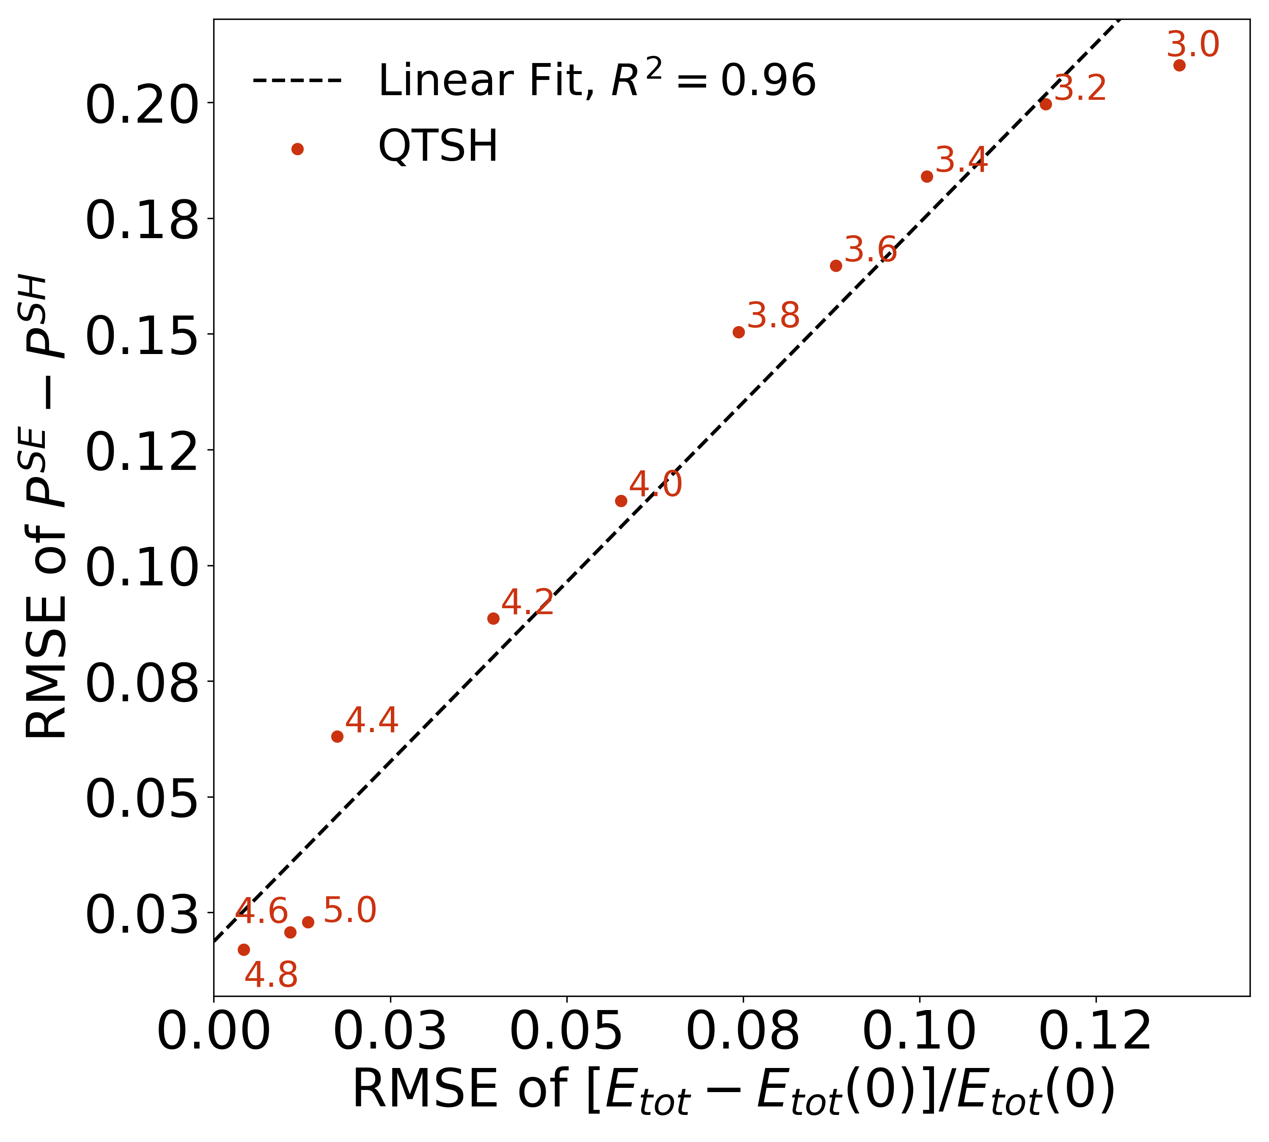
QTSH achieves ensemble-level energy conservation
Han, D.; Martens, C. C.; Akimov, A. V. JCTC. 2025, 21 (6), 2839–2853.
Energy conservation & internal consistency
Improved energy conservation by combining QTSH with decoherence
QTSH
QTSH-SDM

Slide 14
Fully-Integrated SH (FISH)

Slide 15
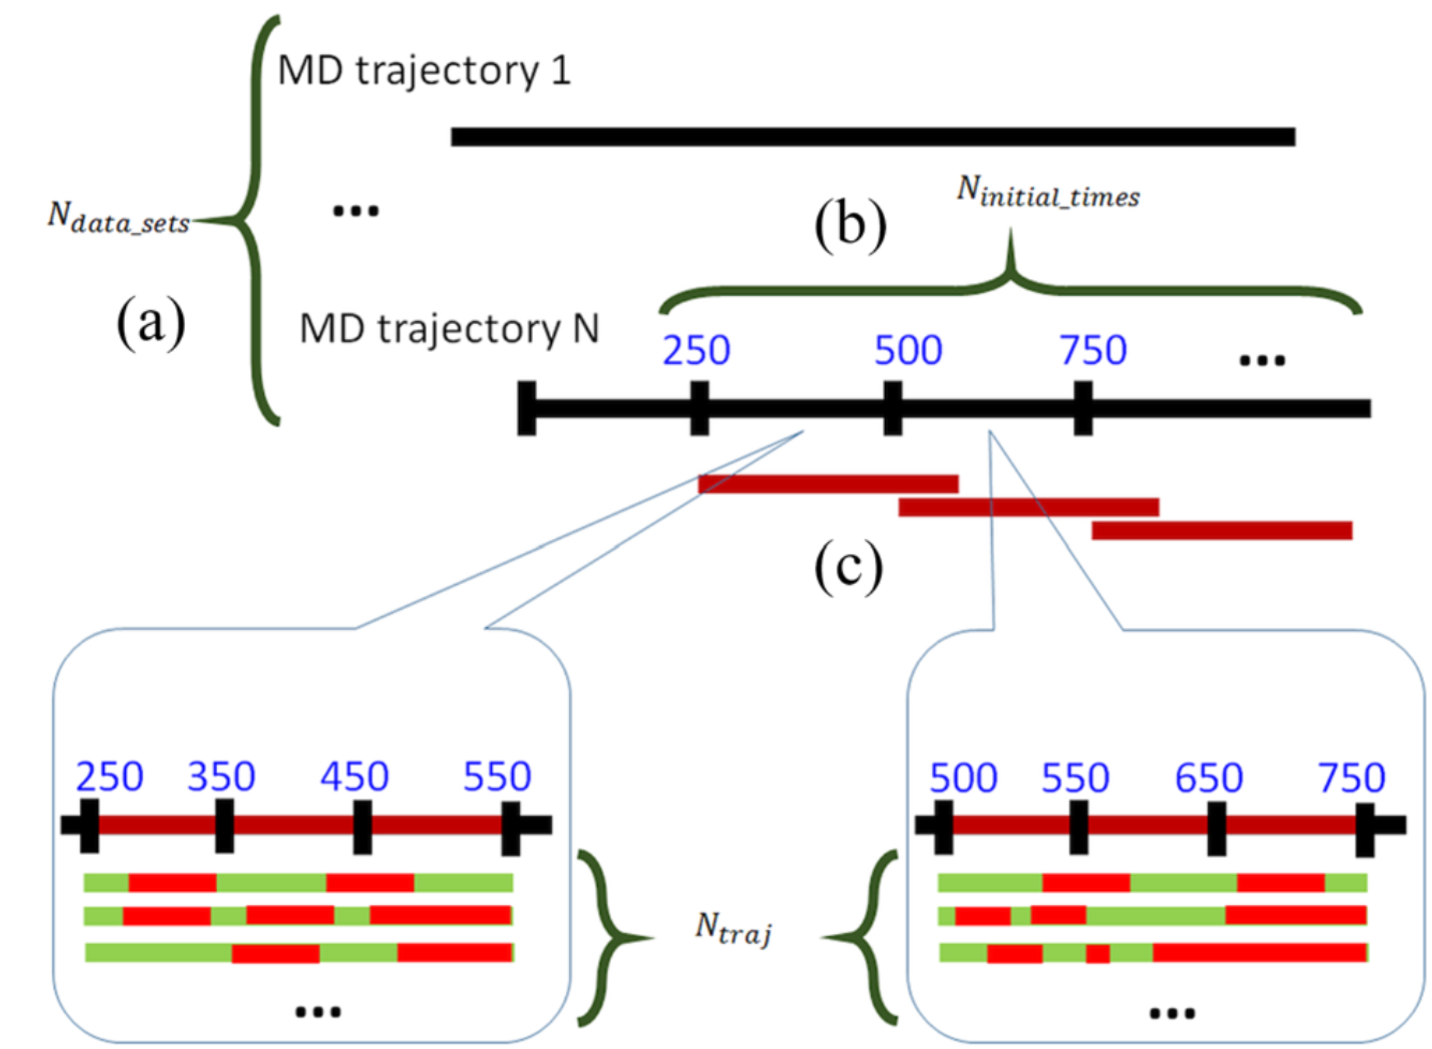


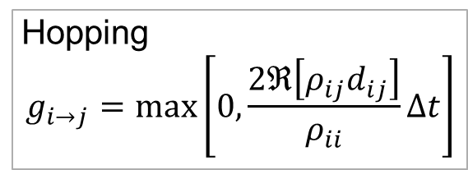

Conventional NBRA-TSH
electrons
No on-the-fly electronic computation and propagation!
NBRA = Neglect of Back-Reaction Approximation
Obtain a “guiding” trajectory first and run multiple stochastic SH calculations to achieve statistical convergence.
$$iℏ\dot{ψ}\left(r,t;q\right)={\hat{H}}_{BO}\left(q\right)ψ\left(r,t;q\right)$$
Hopping
$$g_{i→j}=\max\left[0,\frac{2ℜ\left[ρ_{ij}d_{ij}\right]}{ρ_{ii}}Δt\right]$$
TSH
NBRA-TSH
Smith, B.; Akimov, A. V. JCP. 2019, 151 (12), 124107.
Velocity adjustment
$$\dot{q}≔\dot{q}+\frac{1}{2}γ_{i→j}M^{−1}u$$
Akimov, A. V. JPCL. 2023, 14 (51), 11673–11683.
No electronic backreaction to nuclei
$$\dot{p}=−∇E_{a}$$
$a=$Usually just set to the ground state
nuclei

Slide 16
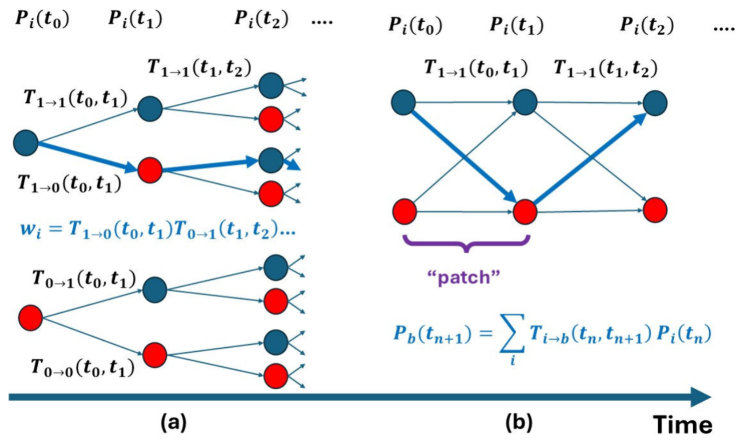
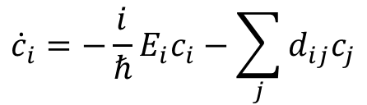

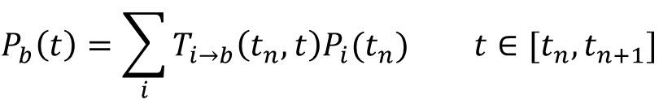
FISH cuts out multiple SH calculations in NBRA-TSH
Han, D.; Shakiba, M.; Akimov, A. V. JPCL. 2025, 16 (28), 7168–7176.
Following the NBRA-based approach, we prepare a guiding trajectory and multiple batches as in NBRA-TSH.
Each batch is divided into coherent histories called “patches.”
batch
Population is propagated recursively up to the transition probability $T_{i→b}$. The transition probability $T_{i→b}$ from a branching point, shown as a node, is determined by a coherent evolution with the corresponding initial state $i$.
$$P_{b}\left(t\right)=\sum_{i}{T_{i→b}\left(t_{n},t\right)P_{i}(t_{n})} t∈[t_{n},t_{n+1}]$$
Coherence from the previous patch is not considered. → The time duration for each patch can be considered as a characteristic decoherence time.
$${\dot{c}}_{i}=−\frac{i}{ℏ}E_{i}c_{i}−\sum_{j}{d_{ij}c_{j}}$$
$T_{i→b}\left(t_{n},t\right)≔{\left|c_{b}\left(t\right)\right|}^{2}$ with ${\left|c_{i}\left(t_{n}\right)\right|}^{2}=1$

Slide 17
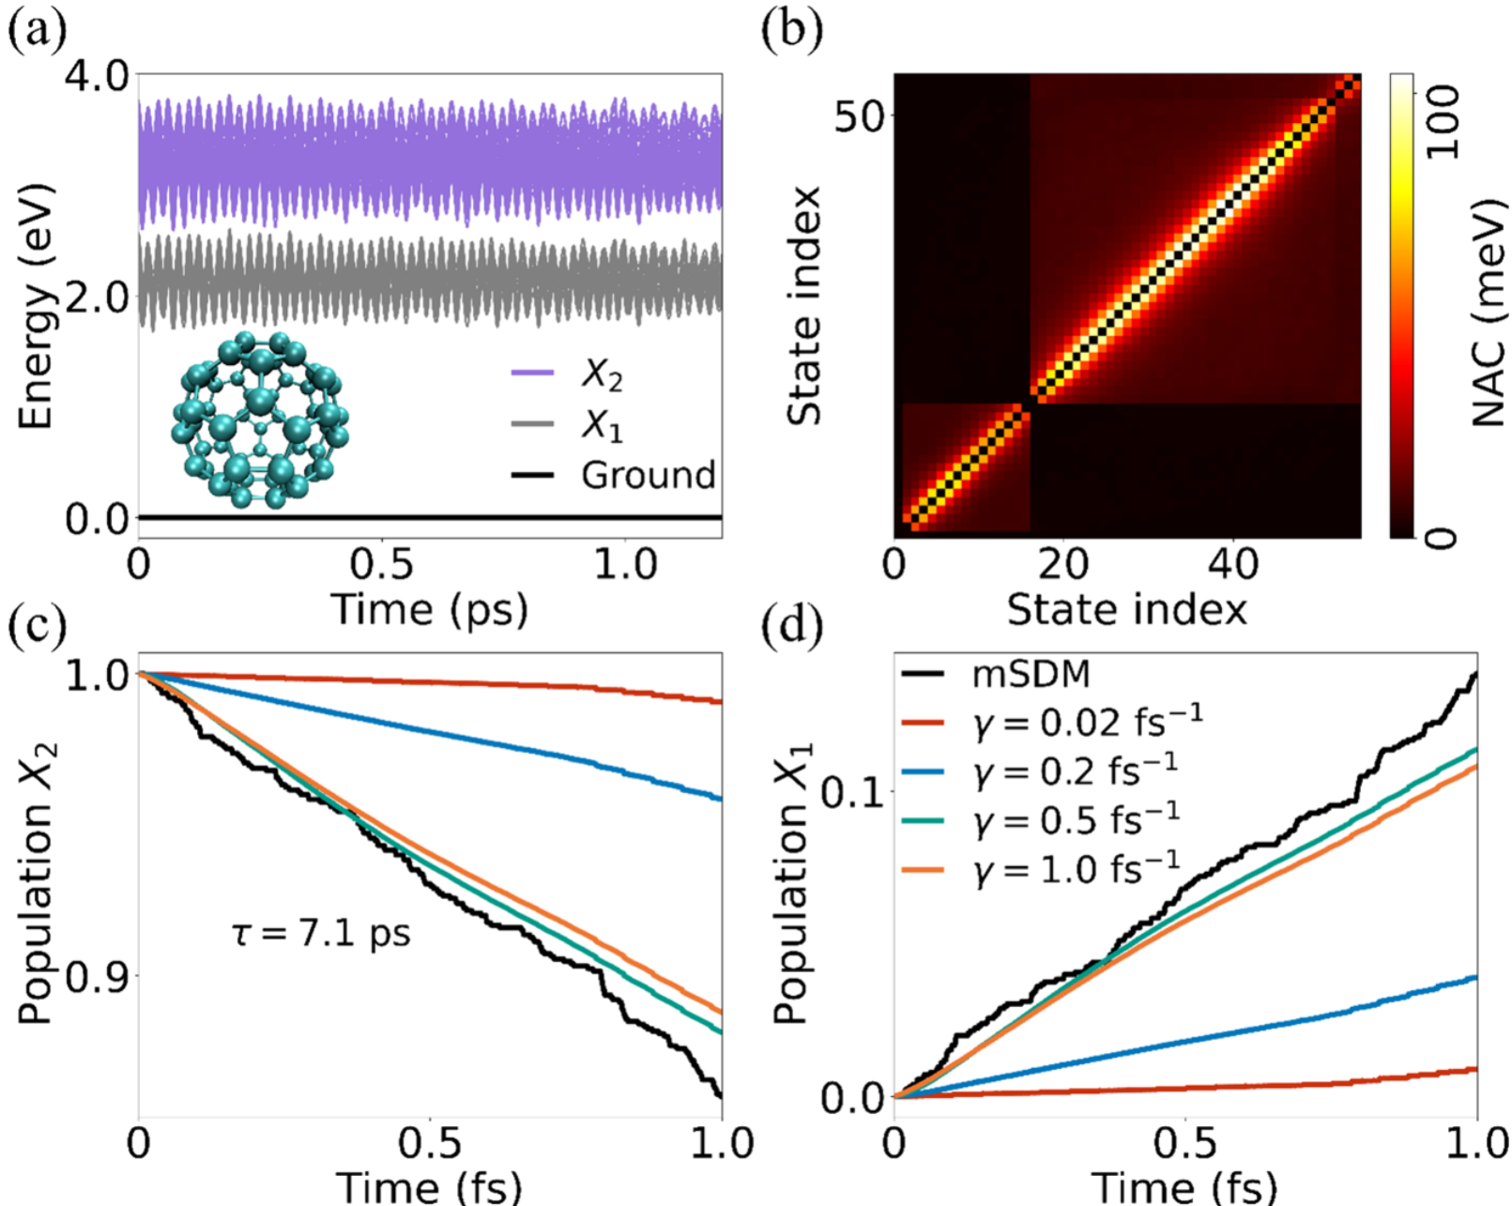



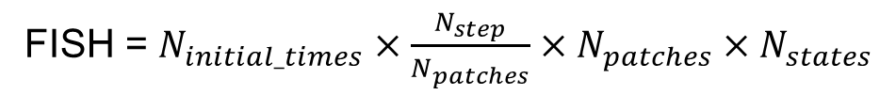
FISH cuts out multiple SH calculations in NBRA-TSH
Han, D.; Shakiba, M.; Akimov, A. V. JPCL. 2025, 16 (28), 7168–7176.
Total number of electronic integrations
NBRA-TSH = $N_{initial_times}×N_{traj}×N_{step}$
FISH = $N_{initial_times}×\frac{N_{step}}{N_{patches}}×N_{patches}×N_{states}$
FISH is beneficial when $N_{state}≪N_{traj}$.
Fullerene NBRA simulations
Decoherence frequency $γ$ is given by the reciprocal of patch time duration.
For the fullerene system, FISH can agree with the conventional NBRA-mSDM.

Slide 18
Conclusion
SHXF (SH based on eXact Factorization) tackles with the overcoherence problem with a decoherence term beyond the BO Hamiltonian, emerging from the electronic equation from XF.
QTSH (Quantum-Trajectory Surface Hopping) eliminates the need for the velocity adjustment with the quantum force from the quantum-classical Liouville formalism and achives the ensemble-level energy conservation.
FISH (Fully-Integrated Surface Hopping) serves as a further reduction of the conventional NBRA-TSH, considering all possible branching that would be usually expressed as multiple SH trajectories in the recursive summation of coherent histories.

Slide 19
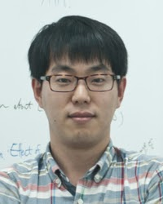



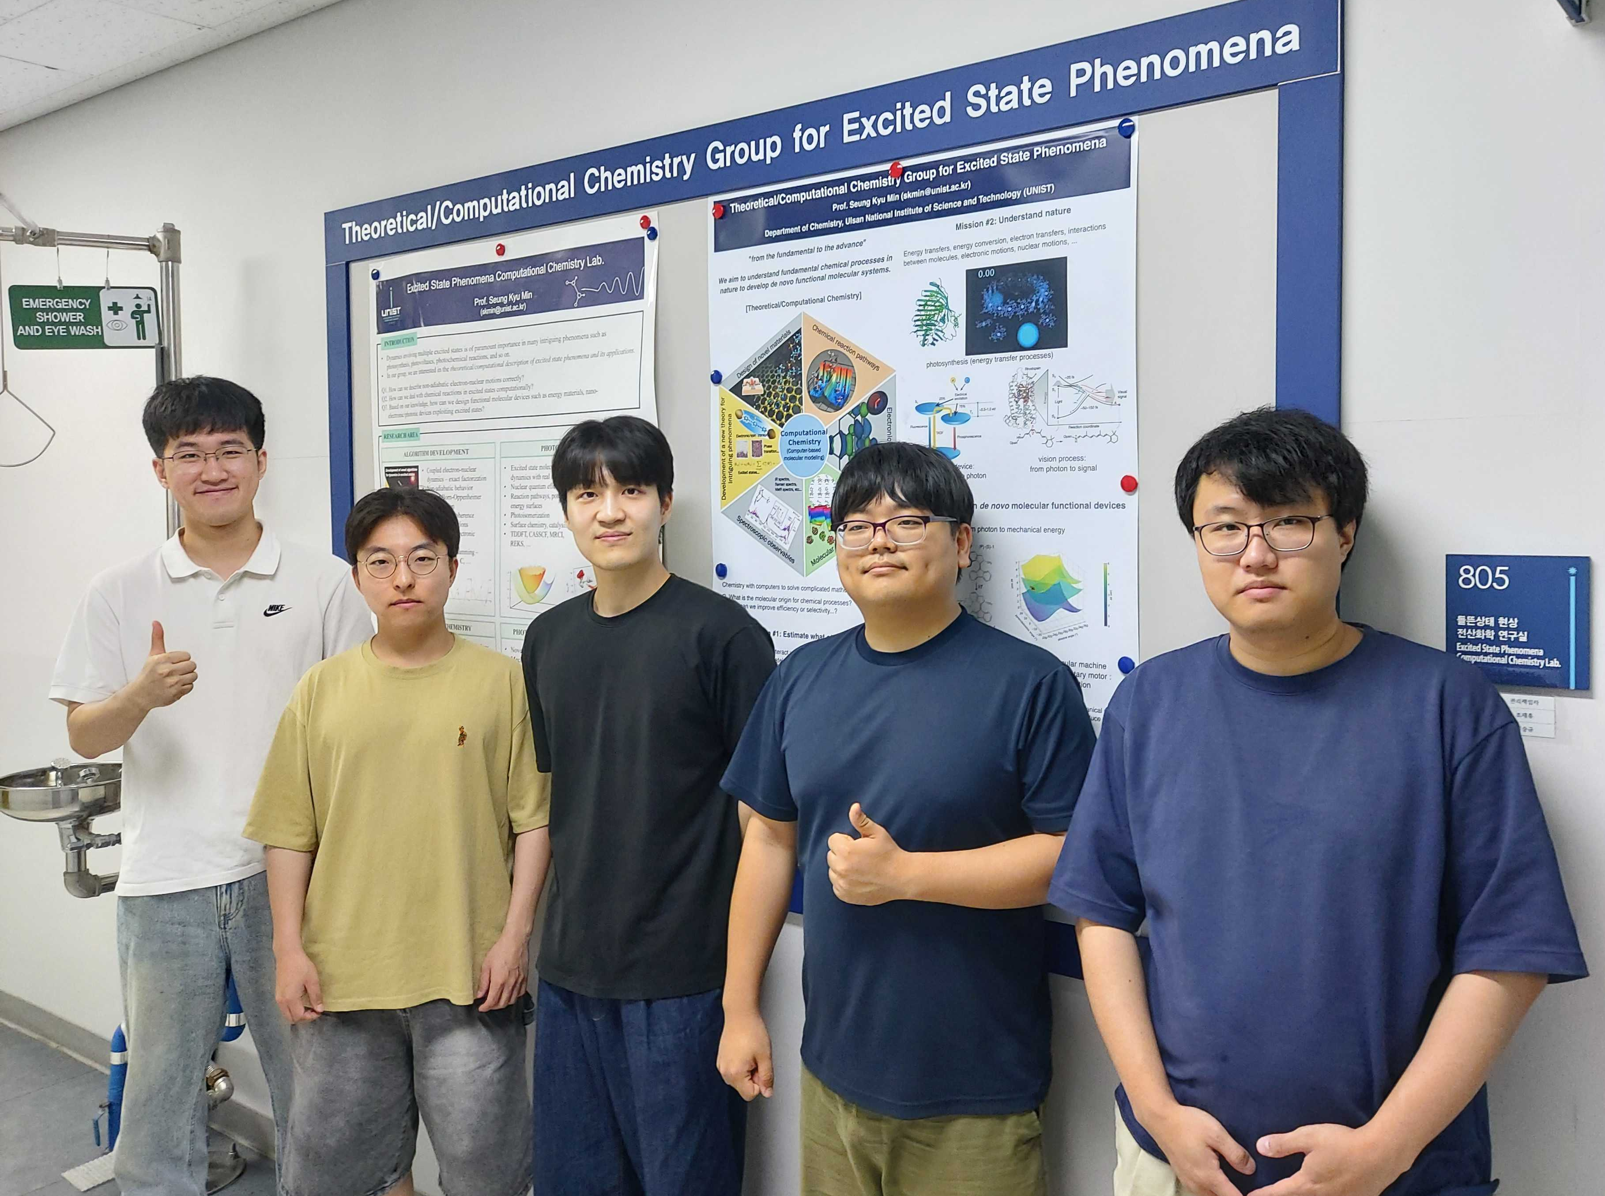

Current Group Members
PI
Prof. Min, Seung Kyu
Senior Researcher
Dr. Filatov, Michael
Post-doc
Dr. Lee, In Seong
Graduate students (from left to right):
Mr. Lee, Jae Hyeok
Mr. Kim, Seong Ho
Mr. Lee, Jonghwan
Mr. Kim, Dokyun
Mr. Kim, Seok Jin
Associated with

Slide 21

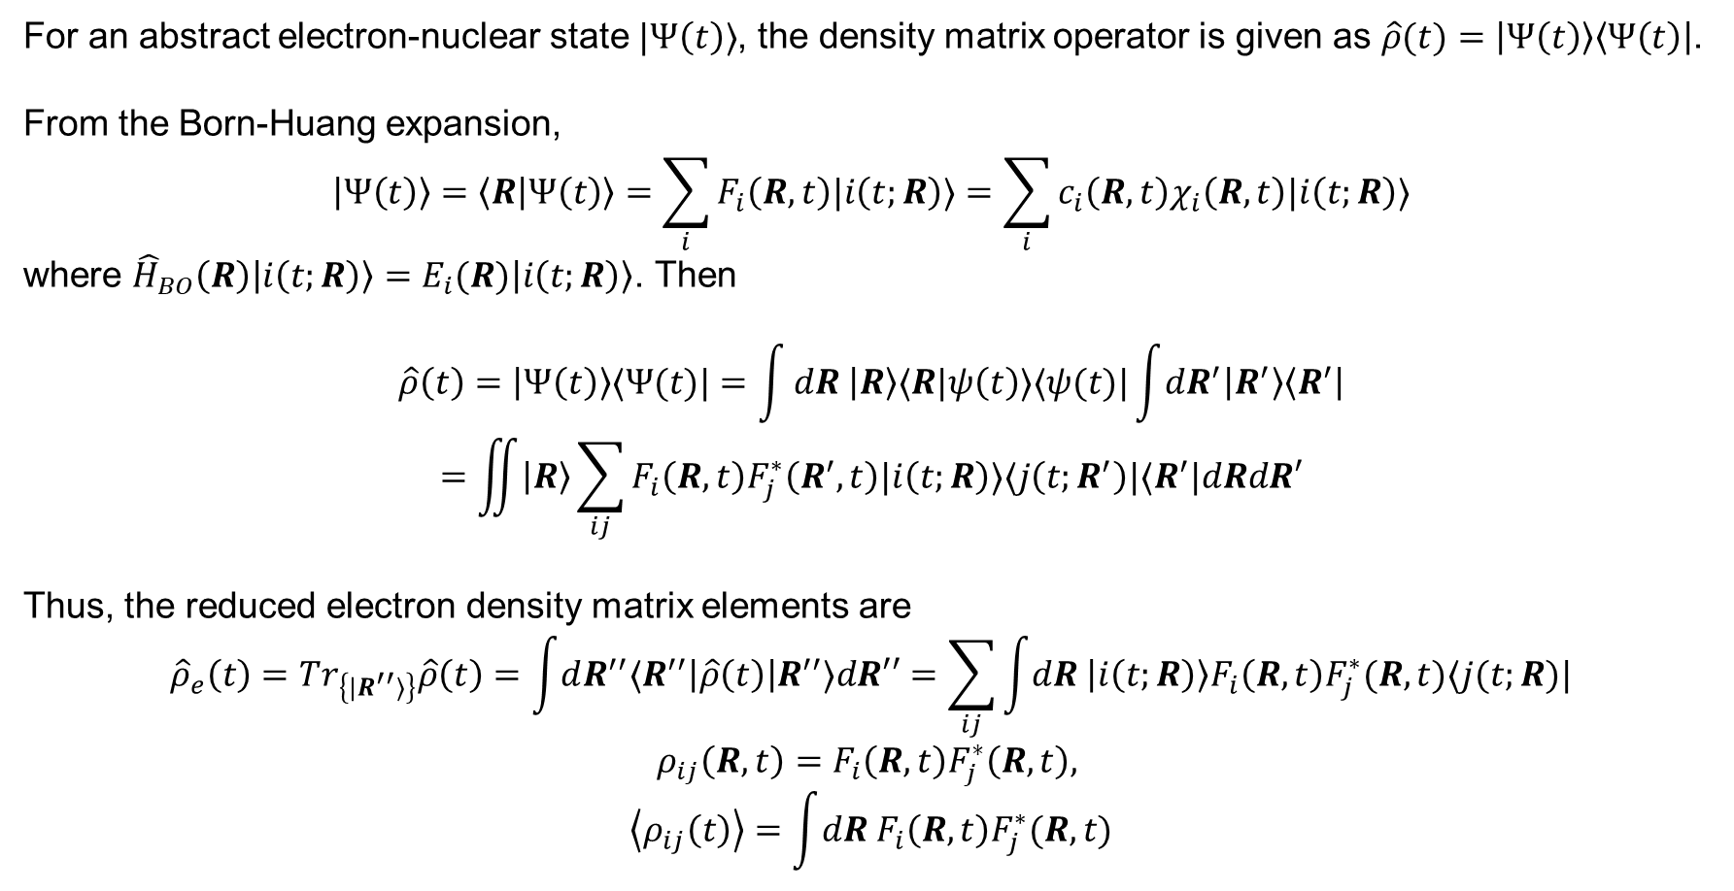



Suppl. Exact coherence
For an abstract electron-nuclear state $|Ψ\left(t\right)⟩$, the density matrix operator is given as $\hat{ρ}(t)=\left|Ψ\left(t\right)\right\rangle \left\langle Ψ\left(t\right)\right|$.
From the Born-Huang expansion,
$$\left|Ψ\left(t\right)\right\rangle =\left\langle R | Ψ\left(t\right)\right\rangle =\sum_{i}{F_{i}\left(R,t\right)|i\left(t;R\right)⟩}=\sum_{i}{c_{i}\left(R,t\right)χ_{i}\left(R,t\right)|i\left(t;R\right)⟩}$$
where ${\hat{H}}_{BO}\left(R\right)\left|i\left(t;R\right)\right\rangle =E_{i}(R)\left|i\left(t;R\right)\right\rangle$. Then
$$\hat{ρ}\left(t\right)=\left|Ψ\left(t\right)\right\rangle ⟨Ψ(t)|=\int{dR \left|R\right\rangle ⟨R|ψ\left(t\right)⟩⟨ψ(t)|\int{dR^{′}\left|R^{′}\right\rangle \left\langle R^{′}\right|}}$$
$$=\iint{\left|R\right\rangle \sum_{ij}{F_{i}\left(R,t\right)F_{j}^{∗}\left(R^{′},t\right)|i\left(t;R\right)⟩⟨j\left(t;R^{′}\right)|⟨R^{′}|dRdR′}}$$
Thus, the reduced electron density matrix elements are
$${\hat{ρ}}_{e}\left(t\right)=Tr_{\left\{{|R}^{′′}⟩\right\}}\hat{ρ}\left(t\right)=\int{dR^{′′}⟨R^{′′}\left|\hat{ρ}\left(t\right)\right|R^{′′}⟩dR′′}=\sum_{ij}{\int{dR \left|i\left(t;R\right)\right\rangle F_{i}\left(R,t\right)F_{j}^{∗}(R,t)⟨j(t;R)|}}$$
$$ρ_{ij}\left(R,t\right)=F_{i}\left(R,t\right)F_{j}^{∗}\left(R,t\right),$$
$$\left\langle ρ_{ij}\left(t\right)\right\rangle =\int{dR F_{i}\left(R,t\right)F_{j}^{∗}(R,t)}$$
$$\sum_{i}{{\left|c_{i}\right|}^{2}}=1$$
$${\left\langle Ψ | Ψ\right\rangle }_{e}={\left|F_{1}\left(R,t\right)\right|}^{2}+{\left|F_{2}\left(R,t\right)\right|}^{2}$$
$${\left|F_{1}\left(R,t\right)\right|}^{2}$$
$${\left|F_{2}\left(R,t\right)\right|}^{2}$$
$$R$$

Slide 22
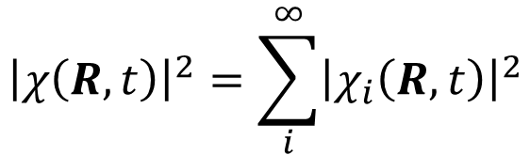




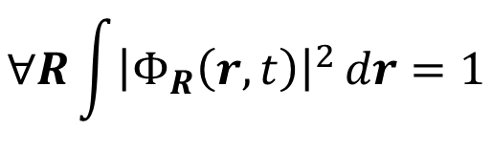
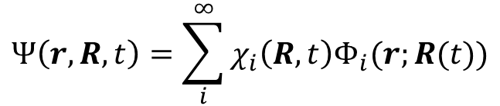
Suppl. Towards the MQC equations from XF
Molecular wave function is factored into the nuclear and electronic wave functions (WFCs).
The probability amplitude ${\left|χ\right|}^{2}$ stands for the exact time-dependent nuclear density.
$$∀R\int{{\left|Φ_{R}\left(r,t\right)\right|}^{2}}dr=1$$
$$Ψ\left(r,R,t\right)=χ\left(R,t\right)Φ_{R}(r,t)$$
Partial Normalization Condition
$${\left|Ψ\left(r,R,t\right)\right|}^{2}drdR={\left|χ\left(R,t\right)\right|}^{2}dR ×{ \left|Φ_{R}\left(r,t\right)\right|}^{2}dr$$
Total probability
Marginal probability for $R$
Conditional probability for $r$ under $R$
cf. Born-Huang expansion
$${\left|χ\left(R,t\right)\right|}^{2}=\sum_{i}^{∞}{{\left|χ_{i}\left(R,t\right)\right|}^{2}}$$
$$Ψ\left(r,R,t\right)=\sum_{i}^{∞}{χ_{i}\left(R,t\right)Φ_{i}(r;R(t))}$$
Abedi, A.; Maitra, N. T.; Gross, E. K. U. PRL 2010, 105 (12), 123002.
Abedi, A.; Maitra, N. T.; Gross, E. K. U. JCP 2012, 137 (22), 22A530.

Slide 23

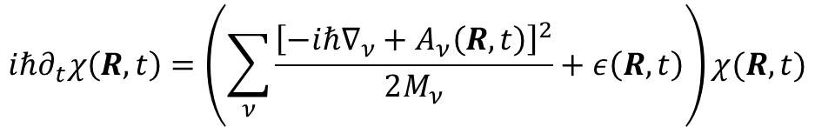

Suppl. Towards the MQC equations from XF
Coupled XF equations
$$iℏ∂_{t}χ\left(R,t\right)=\left(\sum_{ν}{\frac{{\left[−iℏ∇_{ν}+A_{ν}\left(R,t\right)\right]}^{2}}{2M_{ν}}}+ε\left(R,t\right)\right)χ(R,t)$$
$$\{$$
$$iℏ∂_{t}Φ_{R}\left(r,t\right)=\left(H_{BO}\left(r,R\right)+U_{en}^{coup}\left[Φ_{R},χ\right]−ε(R,t)\right)Φ_{R}(R,t)$$
Time-dependent (TD) PES
$$ε\left(R,t\right)={\left\langle Φ_{R}\left(t\right)\left|H_{BO}+U_{en}^{coup}−iℏ∂_{t}\right|Φ_{R}\left(t\right)\right\rangle }_{r}$$
TD vector potential
$$A_{ν}\left(R,t\right)={\left\langle Φ_{R}\left(t\right)|−iℏ∇_{ν}Φ_{R}\left(t\right)\right\rangle }_{r}$$
Electron-nuclear correlation operator
$$U_{en}^{coup}\left[Φ_{R},χ\right]=\sum_{ν}{\frac{1}{M_{ν}}\left[\frac{{\left[−iℏ∇_{ν}−A_{ν}\left(R,t\right)\right]}^{2}}{2}+\left(\frac{−iℏ∇_{ν}χ}{χ}+A_{ν}(R,t)\right)⋅\left(−iℏ∇_{ν}−A_{ν}(R,t)\right)\right]}$$
Leading to Diagonal BO correction
Major electron-nuclear correlation
Abedi, A.; Maitra, N. T.; Gross, E. K. U. PRL. 2010, 105 (12), 123002.
Abedi, A.; Maitra, N. T.; Gross, E. K. U. JCP. 2012, 137 (22), 22A530.

Slide 24


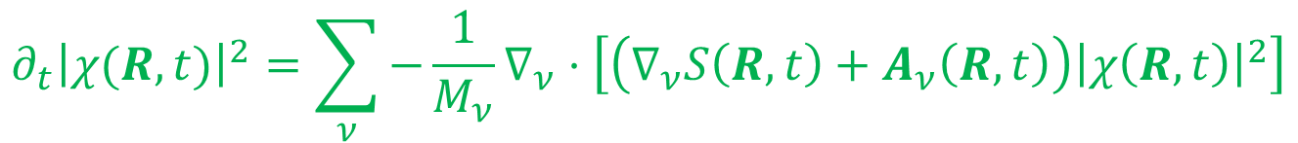
Suppl. Towards the MQC equations from XF
Inserting the polar form of nuclear WFC, $χ\left(R,t\right)=\left|χ\left(R,t\right)\right|\exp\left(\frac{i}{ℏ}S\left(R,t\right)\right)$, into the nuclear TDSE:
$$∂_{t}S\left(R,t\right)=−\sum_{ν}{\frac{{\left[∇_{ν}S\left(R,t\right)+A_{ν}\left(R,t\right)\right]}^{2}}{2M_{ν}}}−ε\left(R,t\right)+ℏ^{2}\sum_{ν}{\frac{1}{2M_{ν}}\frac{∇_{ν}^{2}|χ(R,t)|}{|χ(R,t)|}}$$
Real part
Quantum Hamilton-Jacobi equation
$$∂_{t}{\left|χ(R,t)\right|}^{2}=\sum_{ν}{−\frac{1}{M_{ν}}∇_{ν}⋅\left[\left(∇_{ν}S\left(R,t\right)+A_{ν}\left(R,t\right)\right){\left|χ\left(R,t\right)\right|}^{2}\right]}$$
Imaginary part
Continuity equation
→ Throw away
(Within MQC, we assume its solution, i.e., a delta function).
cf. Hamilton-Jacobi equation
$$∂_{t}S+H\left(R,∇_{R}S,t\right)=0$$
Min, S. K.; Agostini, F.; Gross, E. K. U. PRL. 2015, 115 (7), 073001.
Agostini, F.; Min, S. K.; Abedi, A.; Gross, E. K. U. JCTC. 2016, 12 (5), 2127–2143.

Slide 25







Suppl. Towards the MQC equations from XF
Identifying the classical momentum: $P_{ν}=∇_{ν}S+A_{ν}$ by neglecting the quantum potential.
$$∂_{t}S\left(R,t\right)≈−\sum_{ν}{\frac{{\left[∇_{ν}S\left(R,t\right)+A_{ν}\left(R,t\right)\right]}^{2}}{2M_{ν}}}−ε\left(R,t\right)$$
$$\dot{S}\left(R,t\right)=−\sum_{ν}{\left[\frac{{\left[∇_{ν}S\left(R,t\right)+A_{ν}\left(R,t\right)\right]}^{2}}{2M_{ν}}−\frac{P_{ν}}{M_{ν}}⋅∇_{ν}S(R,t)\right]}−ε\left(R,t\right)$$
In the Lagrangian frame
$$=−\sum_{ν}{\left[\frac{P_{ν}^{2}}{2M_{ν}}−\frac{P_{ν}}{M_{ν}}⋅\left(P_{ν}−A_{ν}\right)\right]}−ε\left(R,t\right)=−\left(ε\left(R,t\right)+\sum_{ν}{A_{ν}⋅\frac{P_{ν}}{M_{ν}}}\right)$$
Applying $∇_{μ}$
${\dot{P}}_{μ}−{\dot{A}}_{μ}=−∇_{μ}\left(ε\left(R,t\right)+\sum_{ν}{A_{ν}⋅\frac{P_{ν}}{M_{ν}}}\right)≔0$ (by setting the Gauge condition)
$$∴{\dot{P}}_{μ}={\dot{A}}_{μ}$$
under $ε\left(R,t\right)+\sum_{ν}{A_{ν}⋅\frac{P_{ν}}{M_{ν}}}=0$
Min, S. K.; Agostini, F.; Gross, E. K. U. PRL 2015, 115 (7), 073001.
Agostini, F.; Min, S. K.; Abedi, A.; Gross, E. K. U. JCTC 2016, 12 (5), 2127–2143.

Slide 26


Suppl. Towards the MQC equations from XF
Approximation to the electronic TDSE
$$iℏ∂_{t}Φ_{R}\left(r,t\right)=\left(H_{BO}\left(r,R\right)+U_{en}^{coup}\left[Φ_{R},χ\right]−ε(R,t)\right)χ(R,t)$$
Neglecting the 2nd order terms generating the DBOC contribution
$$U_{en}^{coup}\left[Φ_{R},χ\right]≈\sum_{ν}{\frac{1}{M_{ν}}\left(\frac{−iℏ∇_{ν}χ}{χ}+A_{ν}(R,t)\right)⋅\left(−iℏ∇_{ν}−A_{ν}(R,t)\right)}$$
$$iℏ{\dot{Φ}}_{R}\left(r,t\right)−iℏ\sum_{ν}{\frac{P_{ν}}{M_{ν}}⋅∇_{ν}Φ_{R}\left(r,t\right)}=\left(H_{BO}\left(r,R\right)+\sum_{ν}{\frac{1}{M_{ν}}\left(\frac{−iℏ∇_{ν}χ}{χ}+A_{ν}\left(R,t\right)\right)⋅\left(−iℏ∇_{ν}−A_{ν}\left(R,t\right)\right)}−ε\left(R,t\right)\right)Φ_{R}(r,t)$$
Min, S. K.; Agostini, F.; Gross, E. K. U. PRL 2015, 115 (7), 073001.
Agostini, F.; Min, S. K.; Abedi, A.; Gross, E. K. U. JCTC 2016, 12 (5), 2127–2143.

Slide 27





Suppl. Towards the MQC equations from XF
Approximation to the electronic TDSE
$$iℏ{\dot{Φ}}_{R}\left(r,t\right)=\left(H_{BO}\left(r,R\right)+\sum_{ν}{\frac{1}{M_{ν}}\left(\frac{−iℏ∇_{ν}χ}{χ}+A_{ν}\left(R,t\right)−P_{ν}\right)⋅\left(−iℏ∇_{ν}\right)}\right)Φ_{R}\left(r,t\right)$$
$$−\left[\sum_{ν}{\frac{1}{M_{ν}}\left(\frac{−iℏ∇_{ν}χ}{χ}+A_{ν}\left(R,t\right)\right)}⋅A_{ν}\left(R,t\right)+ε(R,t)\right]Φ_{R}\left(r,t\right)$$
Utilizing the polar form
Quantum momentum
$$\frac{−iℏ∇_{ν}χ}{χ}+A_{ν}\left(R,t\right)=∇_{ν}S+A_{ν}\left(R,t\right)−iℏ\frac{∇_{ν}\left|χ\left(R,t\right)\right|}{\left|χ\left(R,t\right)\right|}=P_{ν}+𝒫_{ν}$$
$$𝒫_{ν}=−iℏ\frac{∇_{ν}\left|χ\left(R,t\right)\right|}{\left|χ\left(R,t\right)\right|}$$
$$iℏ{\dot{Φ}}_{R}\left(r,t\right)=\left(H_{BO}\left(r,R\right)+\sum_{ν}{\frac{𝒫_{ν}}{M_{ν}}⋅\left(−iℏ∇_{ν}\right)}\right)Φ_{R}\left(r,t\right)$$
$$−\left[\sum_{ν}{\frac{𝒫_{ν}}{M_{ν}}}⋅A_{ν}\left(R,t\right)+\left(\sum_{ν}{\frac{P_{ν}}{M_{ν}}}⋅A_{ν}\left(R,t\right)+ε(R,t)\right)\right]Φ_{R}\left(r,t\right)$$
$≡0$ (The Gauge condition)
$$iℏ{\dot{Φ}}_{R}\left(r,t\right)=\left(H_{BO}\left(r,R\right)−\sum_{ν}{\frac{𝒫_{ν}}{M_{ν}}⋅\left(A_{ν}\left(R,t\right)+iℏ∇_{ν}\right)}\right)Φ_{R}\left(r,t\right)$$
Min, S. K.; Agostini, F.; Gross, E. K. U. PRL 2015, 115 (7), 073001.
Agostini, F.; Min, S. K.; Abedi, A.; Gross, E. K. U. JCTC 2016, 12 (5), 2127–2143.

Slide 28

Suppl. Towards the MQC equations from XF
The XFMQC equations
$$iℏ{\dot{Φ}}_{R}\left(r,t\right)=\left(H_{BO}\left(r,R\right)−\sum_{ν}{\frac{𝒫_{ν}}{M_{ν}}⋅\left(A_{ν}\left(R,t\right)+iℏ∇_{ν}\right)}\right)Φ_{R}\left(r,t\right)$$
$$F_{ν}=−{\left\langle Φ_{R}\left(t\right)\left|∇_{ν}H_{BO}\right|Φ_{R}\left(t\right)\right\rangle }_{r}+\sum_{μ}{\frac{2i𝒫_{μ}}{ℏM_{μ}}⋅\left(A_{μ}\left(R,t\right)A_{ν}\left(R,t\right)−ℏ^{2}{\left\langle ∇_{μ}Φ_{R}\left(t\right) | ∇_{ν}Φ_{R}\left(t\right)\right\rangle }_{r}\right)}$$
Beyond the conventional Ehrenfest terms, the resulting coupled TDSEs explicitly contain the electron-nuclear correlation terms arising from the XF formalism, without adding any ad hoc decoherence correction.
Min, S. K.; Agostini, F.; Gross, E. K. U. PRL 2015, 115 (7), 073001.
Agostini, F.; Min, S. K.; Abedi, A.; Gross, E. K. U. JCTC 2016, 12 (5), 2127–2143.

Slide 29


Suppl. Auxiliary-trajectory Propagation in SHXF
Auxiliary trajectory propagation
When the coherence criterion, that is, $ε<{\left|C_{i}\right|}^{2}<1−ε$, are satisfied for a state, the auxiliary trajectory is spawned for that state.
The initial aux. position $R_{i}$ is set to the real position at the spawning time $t_{i}$.
$$R_{i}\left(t_{i}\right)=R(t_{i})$$
The aux. momentum $P_{i}$ is set by rescaling $P_{i}=α_{i}P$ based on
the energy conservation.
$$\frac{1}{2}P_{i}^{T}M^{−1}P_{i}+E_{i}=\frac{1}{2}P^{T}M^{−1}P+E$$
The aux. position is propagated by the current aux. momentum.
$$R_{i}\left(t+Δt\right)=R_{i}\left(t\right)+M^{−1}P_{i}\left(t\right)Δt$$
When the coherence criterion is no longer satisfied,
or a hop occurs, aux. trajectories are initialized.
Real trajectory
Aux. trajectory
$$R$$
Ha, J.-K.; Lee, I. S.; Min, S. K. JPCL. 2018, 9 (5), 1097–1104.

Slide 30


Suppl. Auxiliary-trajectory Propagation in SHXF
Quantum momentum
The nuclear density is assumed to be combination of Gaussian functions having each aux. position as its center.
Eventually, the sign of quantum momentum is determined by the displacement between the real position and average position. By this procedure, each trajectory possesses its own quantum momentum constructed by its auxiliary trajectories.
$${\left|χ\right|}^{2}=\sum_{i}{{\left|χ_{i}\right|}^{2}}=\sum_{i}{N_{i}}\prod_{ν}{\exp\left(−\frac{{\left(R_{ν}−R_{i,ν}\right)}^{2}}{2σ_{i,ν}^{2}}\right)}$$
$$𝒫_{ν}≈\frac{iℏ}{2σ_{ν}^{2}}\left(R−\left\langle R_{ν}\right\rangle \right)≈\frac{iℏ}{2σ_{ν}^{2}}\left(R_{a,ν}−\sum_{i}{ρ_{ii}R_{i,ν}}\right)$$
Ha, J.-K.; Lee, I. S.; Min, S. K. JPCL. 2018, 9 (5), 1097–1104.

Slide 31


Suppl. Auxiliary-trajectory Propagation in SHXF
Phase gradient
The phase gradient is computed by the momentum difference during the coherence.
Thus, quantum momentum and phase gradient become physical quantities in terms of the relative position and momentum.
$$φ_{i,ν}=−\int_{t_{i}}^{t}{dt^{′}}∇_{ν}E_{i}=\int_{t_{i}}^{t}{dt^{′}}F_{i}=\int_{t_{i}}^{t}{dP_{i}}$$
$$φ_{i,ν}(t)=P_{i}\left(t\right)−P_{i}(t_{i})$$
Ha, J.-K.; Lee, I. S.; Min, S. K. JPCL. 2018, 9 (5), 1097–1104.

Slide 32


Suppl. Auxiliary-trajectory Propagation in SHXF
Decoherence correction through the electron-nuclear correlation term
The newly deduced electron-nuclear correlation contribution to the density is the following.
The direction of the decoherence is determined by the interplay between the relative position and momentum.
$${\dot{ρ}}_{ii}^{XF}=\sum_{ν}{\frac{2i𝒫_{ν}}{M_{ν}}⋅\sum_{j}{\left(φ_{j,ν}−φ_{i,ν}\right)ρ_{jj}ρ_{ii}}}$$
$${\dot{ρ}}_{ii}^{XF}=−\sum_{ν}{\frac{ℏ}{M_{ν}σ_{ν}}\left(R_{ν}−{⟨R}_{ν}⟩\right)⋅\sum_{j}{\left(φ_{j,ν}−φ_{i,ν}\right)ρ_{jj}ρ_{ii}}}$$
Ha, J.-K.; Lee, I. S.; Min, S. K. JPCL. 2018, 9 (5), 1097–1104.

Slide 33




Suppl. Auxiliary-trajectory Propagation in SHXF
Auxiliary trajectory propagation & decoherence correction
< 0
$${\dot{ρ}}_{00}^{XF}=−\frac{ℏ}{Mσ}\left(R−⟨R⟩\right)⋅\left(φ_{1}−φ_{0}\right)ρ_{11}ρ_{00}$$
$${\dot{ρ}}_{11}^{XF}=−\frac{ℏ}{Mσ}\left(R−⟨R⟩\right)⋅\left(φ_{0}−φ_{1}\right)ρ_{00}ρ_{11}$$
Real trajectory
< 0
> 0
The electron-nuclear correlation acts as the decoherence correction, increasing $ρ_{11}$ and decreasing $ρ_{00}$.
Aux. trajectory
$$R$$
Ha, J.-K.; Lee, I. S.; Min, S. K. JPCL. 2018, 9 (5), 1097–1104.

Slide 34



Suppl. Auxiliary-trajectory Propagation in SHXF
Auxiliary trajectory propagation & decoherence correction
< 0
$${\dot{ρ}}_{00}^{XF}=−\frac{ℏ}{Mσ}\left(R−⟨R⟩\right)⋅\left(φ_{1}−φ_{0}\right)ρ_{11}ρ_{00}$$
$${\dot{ρ}}_{11}^{XF}=−\frac{ℏ}{Mσ}\left(R−⟨R⟩\right)⋅\left(φ_{0}−φ_{1}\right)ρ_{00}ρ_{11}$$
> 0
> 0
Aux. trajectory
The electron-nuclear correlation acts as the decoherence correction, increasing $ρ_{00}$ and decreasing $ρ_{11}$.
Real trajectory
Decoherence facilitates the population transfer to the active state → The active state serves as the pointer state!
$$R$$
Ha, J.-K.; Lee, I. S.; Min, S. K. JPCL. 2018, 9 (5), 1097–1104.
Shu, Y.; Truhlar, D. G. JCTC. 2023, 19 (2), 380–395.

Slide 35



Suppl. Auxiliary-trajectory Propagation in SHXF
Branching correction on the auxiliary trajectory propagation
When the dynamics encounters the classical turning point, there are some difficulties for defining the auxiliary momenta
Case I. An auxiliary trajectory encounters the turning point.
In this case, the auxiliary trajectory needs to reflect. However, the aux. momentum is computed by the positive scaling of the real momentum. Thus, a special treatment is necessary.
$$E_{tot}$$
$$P_{i}=α_{i}\left(>0\right)P$$
Aux. trajectory
Inspired by the BCSH method, one can the density of the auxiliary state and initialize the auxiliary project out trajectory.
Real trajectory
$$R$$
Arribas, E. V.; Vindel-Zandbergen, P.; Roy, S.; Maitra, N. T. PCCP. 2023, 25 (38), 26380–26395.
Xu, J.; Wang, L. JCP. 2019, 150 (16), 164101.

Slide 36
Suppl. Auxiliary-trajectory Propagation in SHXF
Branching correction on the auxiliary trajectory propagation
When the dynamics encounters the classical turning point, there are some difficulties for defining the auxiliary momenta
Case II. The real trajectory encounters the turning point.
In this case, the auxiliary trajectory would experience abrupt momentum reversal, which could cause a wrong decoherence correction.
$$E_{tot}$$
Here, one can collapse the state to the active state. The criterion for the turning point is based on the BCSH turning point descriptor.
Real trajectory
$F^{T}\left(t+Δt\right)P_{i}\left(t+Δt\right)⋅F^{T}\left(t+Δt\right)P_{i}\left(t\right)<0$ $⇒$ turning point
Aux. trajectory
$$R$$
Ha, J.-K.; Min, S. K. JCP. 2022, 156 (17), 174109.
Xu, J.; Wang, L. JCP. 2019, 150 (16), 164101.

Slide 37

Suppl. The Wigner-Moyal approach to quantum Liouville
For the full system’s Hamiltonian $\hat{H}=\hat{T}+\hat{V}$, the quantum Liouville equation is
$$iℏ\frac{d\hat{ρ}}{dt}=\left[\hat{H},\hat{ρ}\right].$$
With a complete orthonormal electronic basis, $\{|i⟩\}$, applying the resolution of identity, $\hat{I}=\sum_{i}{|i⟩⟨i|},$
$$iℏ\frac{d{\hat{ρ}}_{ij}}{dt}=\sum_{k}{\left({\hat{H}}_{ik}{\hat{ρ}}_{kj}−{\hat{ρ}}_{ik}{\hat{H}}_{kj}\right)}$$
In the Wigner-Moyal representation, the nuclear operators becomes functions of the nuclear phase space coordinates, $z=(q,p)$. Products of operators are represented by the star (or Moyal) product:
$$\hat{A}\hat{B}→A\left(q,p\right)\text{★}B\left(q,p\right)=A\left(q,p\right)e^{\frac{iℏ}{2}\overset{↔}{Λ}}B(q,p)$$
where $\overset{↔}{Λ}={\overset{←}{∇}}_{q}{\overset{→}{∇}}_{p}−{\overset{←}{∇}}_{q}{\overset{→}{∇}}_{p}$and the arrows indicate the direction that differential operators act.

Slide 38

Suppl. The Wigner-Moyal approach to quantum Liouville
The quantum-classical Liouville equation (QCLE) is then obtained if one keeps only the lowest order nonclassical term in the expansion of the Moyal product:
$$\hat{A}\hat{B}→AB+\frac{iℏ}{2}\left\{\hat{A},\hat{B}\right\}$$
where $\left\{A,B\right\}=∇_{q}A∇_{p}B−∇_{p}A∇_{q}B$ is the Poisson bracket of the phase-space functions. Applying the Wigner-Moyal transformation to the quantum Liouville equation yields
$$iℏ\frac{∂ρ_{ij}(z,t)}{∂t}=\sum_{k}{(H_{ik}\left(z\right)ρ_{kj}\left(z,t\right)−ρ_{ik}\left(z,t\right)H_{kj}(z))}$$
$$+\frac{iℏ}{2}\sum_{k}{\left(\left\{H_{ik}\left(z\right), ρ_{kj}\left(z,t\right)\right\}−\left\{ρ_{ik}\left(z,t\right), H_{kj}(z)\right\}\right)}.$$

Slide 39

Suppl. Derivation of QTSH equations
Starting from the QCLE equation,
$$iℏ\frac{∂ρ_{ij}}{∂t}=\sum_{k=0}^{N−1}{\left(H_{ik}ρ_{kj}−ρ_{ik}H_{kj}\right)}+\frac{iℏ}{2}\sum_{k=0}^{N−1}{\left(\left\{H_{ik},ρ_{kj}\right\}−\left\{ρ_{ik}, H_{kj}\right\}\right)},$$
We have
$$\begin{aligned}iℏ\left[\frac{dρ_{ij}}{dt}\left(z,t\right)−∇_{q}ρ_{ij}\left(z,t\right)\dot{q}−∇_{p}ρ_{ij}\left(z,t\right)\dot{p}\right]=\sum_{k=0}^{N−1}{\left(H_{ik}\left(z\right)ρ_{kj}\left(z,t\right)−ρ_{ik}\left(z,t\right)H_{kj}\right)} \\ +\frac{iℏ}{2}\sum_{k=0}^{N−1}{\left(∇_{q}H_{ik}∇_{p}ρ_{kj}−∇_{p}H_{ik}∇_{q}ρ_{kj}−∇_{q}ρ_{ik}∇_{p}H_{kj}+∇_{p}ρ_{ik}∇_{q}H_{kj}\right)}. \end{aligned}$$
We classify terms in equations according to phase-space derivatives. First, consider the equation involving only the density matrix functions themselves (black equations):
$$iℏ\frac{dρ_{ij}\left(z,t\right)}{dt}=\sum_{k=0}^{N−1}{\left(H_{ik}\left(z\right)ρ_{kj}\left(z,t\right)−ρ_{ik}\left(z,t\right)H_{kj}\right)}$$

Slide 40

Suppl. Derivation of QTSH equations
Applying our phase-density ansatz, $ρ_{ij}\left(z,t\right)={\tilde{ρ}}_{ij}\left(t\right)g\left(z\right)$, yields
$$iℏ\frac{∂{\tilde{ρ}}_{ij}\left(t\right)}{∂t}g\left(z\right)+iℏ{\tilde{ρ}}_{ij}\left(t\right)\dot{z}∇_{z}g=\sum_{k=0}^{N−1}{\left(H_{ik}\left(z\right){\tilde{ρ}}_{kj}\left(t\right)−{\tilde{ρ}}_{ik}\left(t\right)H_{kj}\left(z\right)\right)g\left(z\right)},$$
or
$$iℏ\frac{∂{\tilde{ρ}}_{ij}\left(t\right)}{∂t}=\sum_{k=0}^{N−1}{\left(H_{ik}\left(z\right){\tilde{ρ}}_{kj}\left(t\right)−{\tilde{ρ}}_{ik}\left(t\right)H_{kj}\left(z\right)\right)−iℏ\frac{\dot{z}∇_{z}g}{g\left(z\right)}{\tilde{ρ}}_{ij}\left(t\right). }$$
We work out blue and red equations as well, with the full Hamiltonian matrix definition,
$$H_{ij}≈\left(\frac{1}{2}p^{T}M^{−1}p+V_{ii}\right)δ_{ij}−iℏp^{T}M^{−1}h_{ij}.$$

Slide 41

Suppl. Derivation of QTSH equations
The blue and red equations:
$$−iℏ∇_{q}ρ_{ij}\left(z,t\right)\dot{q}=\frac{iℏ}{2}\sum_{k=0}^{N−1}{\left(−∇_{p}H_{ik}∇_{q}ρ_{kj}−∇_{q}ρ_{ik}∇_{p}H_{kj}\right)}$$
$$\dot{q}∇_{q}ρ_{ij}\left(z,t\right)=\dot{q}{\tilde{ρ}}_{ij}=−iℏM^{−1}p∇_{q}ρ_{ij}+\left(iℏ\right)\frac{iℏ}{2}M^{−1}\sum_{k=0}^{N−1}{\left(h_{ik}∇_{q}ρ_{kj}+∇_{q}ρ_{ik}h_{kj}\right)} \\ \begin{aligned} \end{aligned}−iℏ∇_{p}ρ_{ij}\left(z,t\right)\dot{p}=\frac{iℏ}{2}\sum_{k=0}^{N−1}{\left(∇_{q}H_{ik}∇_{p}ρ_{kj}+∇_{p}ρ_{ik}∇_{q}H_{kj}\right)}$$
$$∇_{p}ρ_{ij}\left(z,t\right)\dot{p}=\frac{1}{2}\left(F_{i}+F_{j}\right)∇_{p}ρ_{ij}+\frac{iℏ}{2}\sum_{k=0}^{N−1}{\left(\left(p^{T}M^{−1}∇_{q}h_{ik}\right)∇_{p}ρ_{kj}+∇_{p}ρ_{ik}\left(p^{T}M^{−1}∇_{q}h_{kj}\right)\right)}$$

Slide 42

Suppl. Derivation of QTSH equations
Applying $ρ_{ij}\left(z,t\right)={\tilde{ρ}}_{ij}\left(t\right)g\left(z\right)$ to both equations and normalization conditions, $\sum_{i}{{\tilde{ρ}}_{ii}=1}$,
$$\dot{q}{\tilde{ρ}}_{ij}=M^{−1}p{\tilde{ρ}}_{ij}− \frac{iℏ}{2}M^{−1}\sum_{k=0}^{N−1}{\left(h_{ik}{\tilde{ρ}}_{kj}+{\tilde{ρ}}_{ik}h_{kj}\right)}⇒\dot{q}=M^{−1}p− \frac{iℏ}{2}M^{−1}\sum_{k,i}{\left(h_{ik}{\tilde{ρ}}_{ki}+{\tilde{ρ}}_{ik}h_{ki}\right)}.$$
$${\tilde{ρ}}_{ij}\dot{p}=\frac{1}{2}\left(F_{i}+F_{j}\right){\tilde{ρ}}_{ij}+\frac{iℏ}{2}\sum_{k=0}^{N−1}{\left(\left(p^{T}M^{−1}∇_{q}h_{ik}\right){\tilde{ρ}}_{kj}+{\tilde{ρ}}_{ik}\left(p^{T}M^{−1}∇_{q}h_{kj}\right)\right)}$$
$$⇒\dot{p}=\sum_{i=0}^{N−1}{F_{i}{\tilde{ρ}}_{ii}}+\frac{iℏ}{2}\sum_{k,i}{\left(\left(p^{T}M^{−1}∇_{q}h_{ik}\right){\tilde{ρ}}_{ki}+{\tilde{ρ}}_{ik}\left(p^{T}M^{−1}∇_{q}h_{ki}\right)\right)}$$
Thus,
$$\dot{q}=M^{−1}p− \frac{iℏ}{2}M^{−1}\sum_{k,i}{\left(h_{ik}{\tilde{ρ}}_{ki}+{\tilde{ρ}}_{ik}h_{ki}\right)},$$
$$\dot{p}=\sum_{i=0}^{N−1}{F_{i}{\tilde{ρ}}_{ii}}+\frac{iℏ}{2}\sum_{k,i}{\left(\left(p^{T}M^{−1}∇_{q}h_{ik}\right){\tilde{ρ}}_{ki}+{\tilde{ρ}}_{ik}\left(p^{T}M^{−1}∇_{q}h_{ki}\right)\right)}.$$

Slide 43

Suppl. Derivation of QTSH equations
The differential equation for $q$ is simplified by
$$−\frac{iℏ}{2}M^{−1}\sum_{k,i}{\left(h_{ik}{\tilde{ρ}}_{ki}+{\tilde{ρ}}_{ik}h_{ki}\right)}=−\frac{iℏ}{2}M^{−1}\sum_{k,i}{\left(h_{ik}\left(α_{ki}+iβ_{ki}\right)+\left(α_{ik}+iβ_{ik}\right)h_{ki}\right)} \\ =−\frac{iℏ}{2}M^{−1}\sum_{k,i}{h_{ik}\left(\left(α_{ki}+iβ_{ki}\right)−\left(α_{ki}−iβ_{ki}\right)\right)}=−\frac{iℏ}{2}M^{−1}\sum_{k,i}{2iβ_{ki}h_{ik}}=ℏM^{−1}\sum_{k,i}{β_{ki}h_{ik}} \\ \begin{aligned}=−ℏM^{−1}\sum_{k,i}{β_{ik}h_{ik}}=−2ℏ\sum_{i,k:i<k}{β_{ik}h_{ik}}. \end{aligned}$$
Thus,
$$\dot{q}=M^{−1}p−2ℏ\sum_{i,k:i<k}{β_{ik}h_{ik}}.$$

Slide 44

Suppl. Derivation of QTSH equations
The differential equation for $p$ is simplified by
$$\frac{iℏ}{2}\sum_{k,i}{\left(\left(p^{T}M^{−1}∇_{q}h_{ik}\right){\tilde{ρ}}_{ki}+{\tilde{ρ}}_{ik}\left(p^{T}M^{−1}∇_{q}h_{ki}\right)\right)} \\ =\frac{iℏ}{2}\sum_{k,i}{\left(\left(p^{T}M^{−1}∇_{q}h_{ik}\right)\left(α_{ki}+iβ_{ki}\right)+\left(α_{ik}+iβ_{ik}\right)\left(p^{T}M^{−1}∇_{q}h_{ki}\right)\right)} \\ =\frac{iℏ}{2}\sum_{k,i}{\left(p^{T}M^{−1}∇_{q}h_{ik}\right)\left(\left(α_{ki}+iβ_{ki}\right)−\left(α_{ki}−iβ_{ki}\right)\right)}=\frac{iℏ}{2}\sum_{k,i}{2iβ_{ki}\left(p^{T}M^{−1}∇_{q}h_{ik}\right)} \\ \begin{aligned}=−ℏ\sum_{k,i}{\left(p^{T}M^{−1}∇_{q}h_{ik}\right)β_{ki}}=ℏ\sum_{k,i}{\left(p^{T}M^{−1}∇_{q}h_{ik}\right)β_{ik}}=2ℏ\sum_{k,i:i<k}{\left(p^{T}M^{−1}∇_{q}h_{ik}\right)β_{ik}}. \end{aligned}$$
Thus,
$$\dot{p}=\sum_{i=0}^{N−1}{F_{i}{\tilde{ρ}}_{ii}}+2ℏ\sum_{i,k:i<k}{\left(p^{T}M^{−1}∇_{q}h_{ik}\right)β_{ik}}.$$

Slide 45



Suppl. The superexchange model dynamics in QTSH
Energy conservation & internal consistency
$$E_{tot}=\frac{1}{N_{tr}}\sum_{k}^{N_{tr}}{\left(\frac{1}{2}p_{k}^{T}M^{−1}p_{k}+E_{a_{k}a_{k}}−\frac{2ℏ}{N_{tr}}\sum_{i<j}^{N}{ℑρ_{ij,k}d_{ij,k}}\right)}$$
E_{diag}
E_{coh}
The superexchange model
$a_{k}(t)$ = the active-state index of $k$th trajectory at $t$
QTSH on the superexchange model
The low-momentum case, multiple crossing due to a temporary trap on the 1st excited state.
After passing the coupling region once, transmission goes on, i.e., just the adiabatic dynamics on the ground-state PES.

Slide 46

Suppl. Individual-state population in NBRA-TSH and FISH
FISH

