Slide 1



How to Estimate the Number of Bonds in 2nd row Diatomic Molecules from Excited State Potential Energy Curves: A Theoretical Treatise
Indian Association for the Cultivation of Science
Kolkata, India
Ishita Bhattacharjee
School of Chemical Sciences
1

Slide 2
Introduction
Methodology and Working Principle
Electronic States, Bonding and PECs
Concluding Remarks
Acknowledgement
Bonding Nature of Dicarbon: C₂
Multiple Bonding in C₂
VB Picture
sp hybridization
Molecular Orbital Diagram
Lewis Pairing
::
C
::
C
Outwardly pointing electrons results in the fourth bond
Bond order=2.0
Two π bonds, no σ bonds
Four Bonds
Shaik, S. et al. Nat. Chem. 2012, 4, 195; Angew. Chem. Int. Ed. 2013, 52, 3020;
2

Slide 3
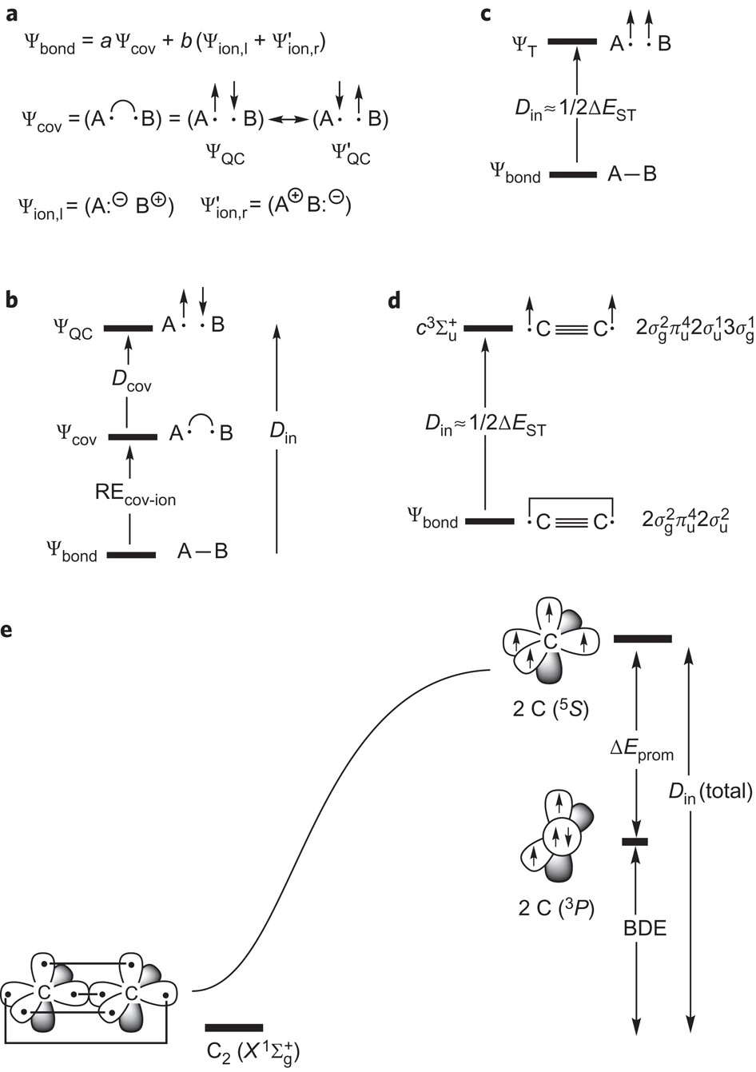
Introduction
Methodology and Working Principle
Electronic States, Bonding and PECs
Concluding Remarks
Acknowledgement
Bonding Nature of Dicarbon: C₂
The Case of Quadruple Bonding in C₂
Values of in situ bond energies for the fourth bond in kcal/mol
Method | C₂
VBSCF/6-31G* | 14.30
VBSCF/6-31G* (1/2ΔE_{ST}) | 11.64
FCI/6-31G* | 14.80
BN and CN⁺ isoelectronic to C₂ were predicted to have the Q Bond
Shaik, S. et al. Nat. Chem. 2012, 4, 195; Angew. Chem. Int. Ed. 2013, 52, 3020

Slide 4

Introduction
Methodology and Working Principle
Electronic States, Bonding and PECs
Concluding Remarks
Acknowledgement
The Quadruple Bonding Conundrum of C₂
An Ongoing Debate
“This seems unlikely to be the last word. It makes one wonder about the current understanding of chemical bonding that there is not even a consensus about this apparently simple molecule. That is not to say that the tools are inadequate; rather, they merely have different virtues.”
four lines ?
4

Slide 5
Introduction
Methodology and Working Principle
Electronic States, Bonding and PECs
Concluding Remarks
Acknowledgement
Bonding Nature of Dicarbon: C₂
Why “Quadruple Bonding in C₂ ” is Counterintuitive
 | Quadratic force constant (mdyn Å⁻¹) | Vibrational frequency of C-C stretching mode (cm⁻¹)
C₂ (ground state) | 12.18 | 1855
Acetylene | 15.80 | 1974
The values indicate bonding in C₂ is weaker compared to acetylene
Frenking, G. et al. Angew. Chem. Int. Ed. 2013, 52, 5922; Piris, M. et al. Chem. Eur. J. 2016, 22, 4109
https://www.chemistryviews.org/details/ezine/9017541/Why_Does_C2_Cause_so_Many_Problems.html

Slide 6
Introduction
Methodology and Working Principle
Electronic States, Bonding and PECs
Concluding Remarks
Acknowledgement
Bonding Nature of Dicarbon: C₂
Why “Quadruple Bonding in C₂ ” is Counterintuitive
Molecule | Effective Bond Order (EBO)
Acetylene | 2.86
C₂ | 2.16
Ethylene | 1.93
Frenking, G. et al. Angew. Chem. Int. Ed. 2013, 52, 5922; Grunenberg Chem. Eur. J. 2016, 21, 17126
https://www.chemistryviews.org/details/ezine/9017541/Why_Does_C2_Cause_so_Many_Problems.html

Slide 7
Introduction
Methodology and Working Principle
Electronic States, Bonding and PECs
Concluding Remarks
Acknowledgement
Bonding from Excited State Perspective
“The Return to Innocence”: Potential Energy Curves
H
H
H
H
1σ*
Potential energy
H
H
H
H
D_{e}
1σ
¹Σ_{g}⁺
r_{eq}
³Σ_{u}⁺
Interatomic distance (r)
How does this apply to Two Multiply Bonded Atoms

Slide 8
Introduction
Methodology and Working Principle
Electronic States, Bonding and PECs
Concluding Remarks
Acknowledgement
Bonding from Excited State Perspective
Multiple Bonding in Molecules
σ*
σ*
H
H
H
H
C
π*
C
C
π*
C
H
π
H
H
π
H
¹A_{g}
³B_{3u}
σ
σ
How does this apply to Two Multiply Bonded Atoms

Slide 9
Introduction
Methodology and Working Principle
Electronic States, Bonding and PECs
Concluding Remarks
Acknowledgement
Bonding from Excited State Perspective
Multiple Bonding in Molecules
σ*
σ*
H
H
H
H
C
C
C
H
C
H
π*
π*
C
C
H
H
H
H
⁵B_{2g}
π
⁵B_{2g}
π
H
H
³B_{3u}
σ
σ
Higher Bond Order Means One has to reach higher Spin State to decimate Bonding

Slide 10
Introduction
Methodology and Working Principle
Electronic States, Bonding and PECs
Concluding Remarks
Acknowledgement
Bonding Nature of Homodiatomic Species
Understanding Multiple Bonding from an Excited State Perspective
High spin states can be created by breaking bond pairs through excitation of electrons from bonding to respective antibonding orbitals. It will lead to high spin sigma states within the valence space.
Lowest Energy High Spin Σ States will have lesser number of bonds compared to that of the ground state
⁷Σ_{u}⁺
⁵Σ_{g}⁺
³Σ_{u}⁺
¹Σ_{g}⁺

Slide 11






Introduction
Methodology and Working Principle
Electronic States, Bonding and PECs
Concluding Remarks
Acknowledgement
Bonding from Excited State Perspective
Excited States: An avenue to inspect multiple bonding
3σ_{u}
3σ_{u}
π*_{g}
π*_{g}
3σ_{g}
One e⁻ excitation
3σ_{g}
One e⁻ excitation
π_{u}
π_{u}
2σ_{u}
2σ_{u}
3σ_{u}
2σ_{g}
2σ_{g}
3σ_{u}
π*_{g}
³Σ_{u}⁺
¹Σ_{g}⁺
π*_{g}
3σ_{g}
3σ_{g}
π_{u}
π_{u}
2σ_{u}
One e
excitation
2σ_{u}
2σ_{g}
⁷Σ_{u}⁺
2σ_{g}
⁵Σ_{g}⁺
⁷Σ_{u}⁺
⁵Σ_{g}⁺

Slide 12
Introduction
Methodology and Working Principle
Electronic States, Bonding and PECs
Concluding Remarks
Acknowledgement
Methodology
Computational Details
All computations were conducted at the CASSCF level, using cc-pvqz basis set.
For the diatomic N₂/C₂ molecule, we used [10,8]/[8, 8] CAS.
For acetylene, we used [10,10] CAS.
All the values we had taken correspond to state averaged calculations.

Slide 13
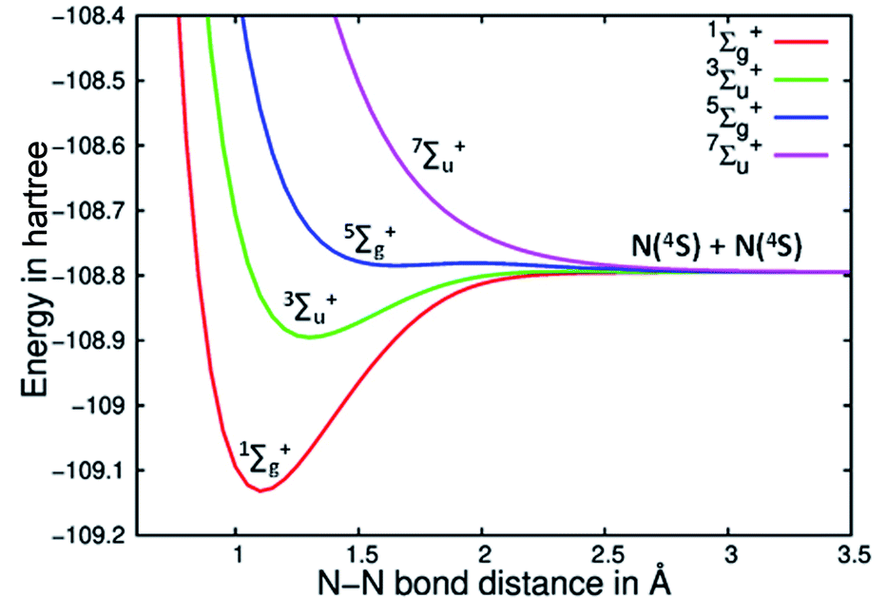
Introduction
Methodology and Working Principle
Electronic States, Bonding and PECs
Concluding Remarks
Acknowledgement
Analysis of Bonding
Potential Energy Curves (PECs) of N₂ and Acetylene
N₂
Acetylene
Bhattacharjee, I. ; Ghosh, D. ; Paul , A. Chem. Sci. 2020, 11, 7009

Slide 14
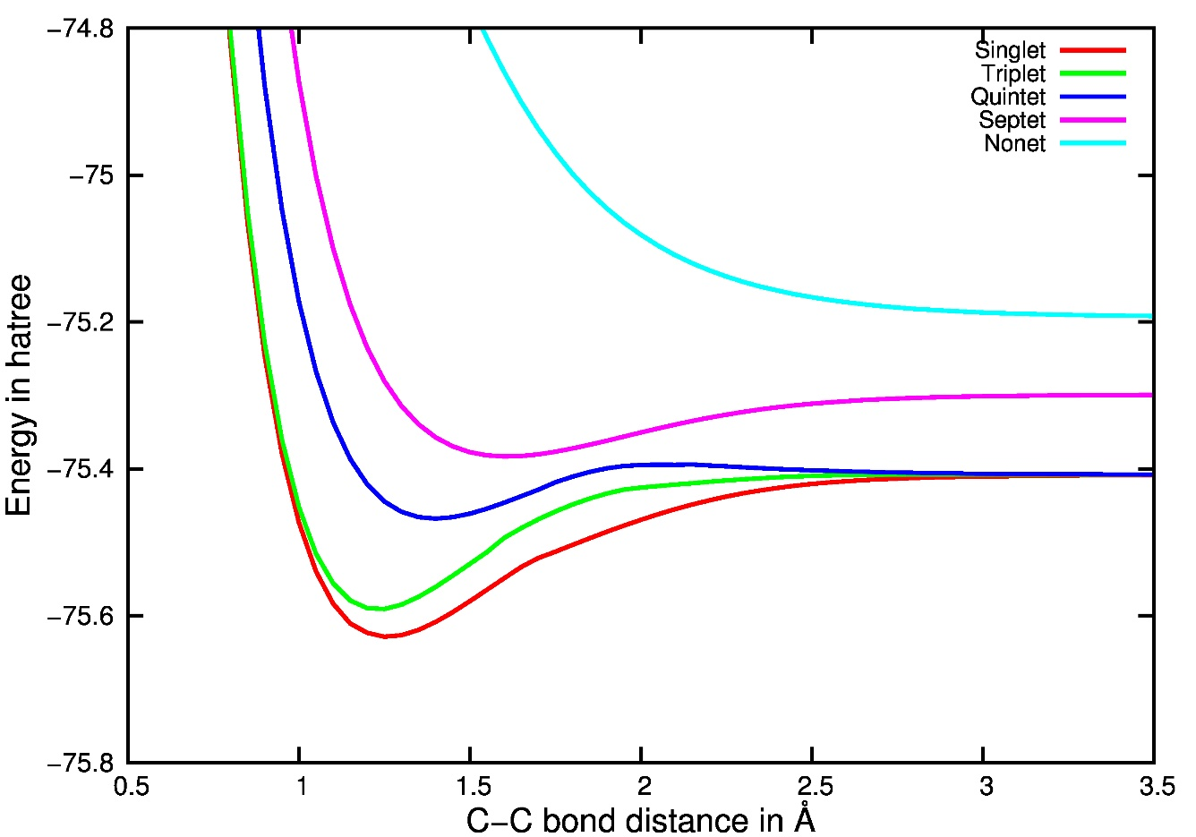
Introduction
Methodology and Working Principle
Electronic States, Bonding and PECs
Concluding Remarks
Acknowledgement
Analysis of Bonding in C₂
Potential Energy Curves (PECs) of the Five Spin States of C₂
⁹∑_{g}⁺
⁷∑_{u}⁺
⁵∑_{g}⁺
³∑_{u}⁺
¹∑_{g}⁺
Bhattacharjee, I. ; Ghosh, D. ; Paul , A. Chem. Sci. 2020, 11, 7009.

Slide 15
Introduction
Methodology and Working Principle
Electronic States, Bonding and PECs
Concluding Remarks
Acknowledgement
Comparison:C₂ with Be₂ (RASSCF)
Why 4σ Electrons Can lead to 2 bonds in C₂ but not in Be₂
3σ_{u}
π*_{g}
3σ_{g}
π_{u}
2σ_{u}
2σ_{g}
¹Σ_{g}⁺
⁵Σ_{g}⁺
C₂
⁷Σ_{u}⁺
Be₂
Accidental Quasi-Degeneracy of 2σ_{u} and 3σ_{g} in C₂ assists in forming 2 Bonds
15

Slide 16
Introduction
Methodology and Working Principle
Electronic States, Bonding and PECs
Concluding Remarks
Acknowledgement
Bonding in C₂

Slide 17
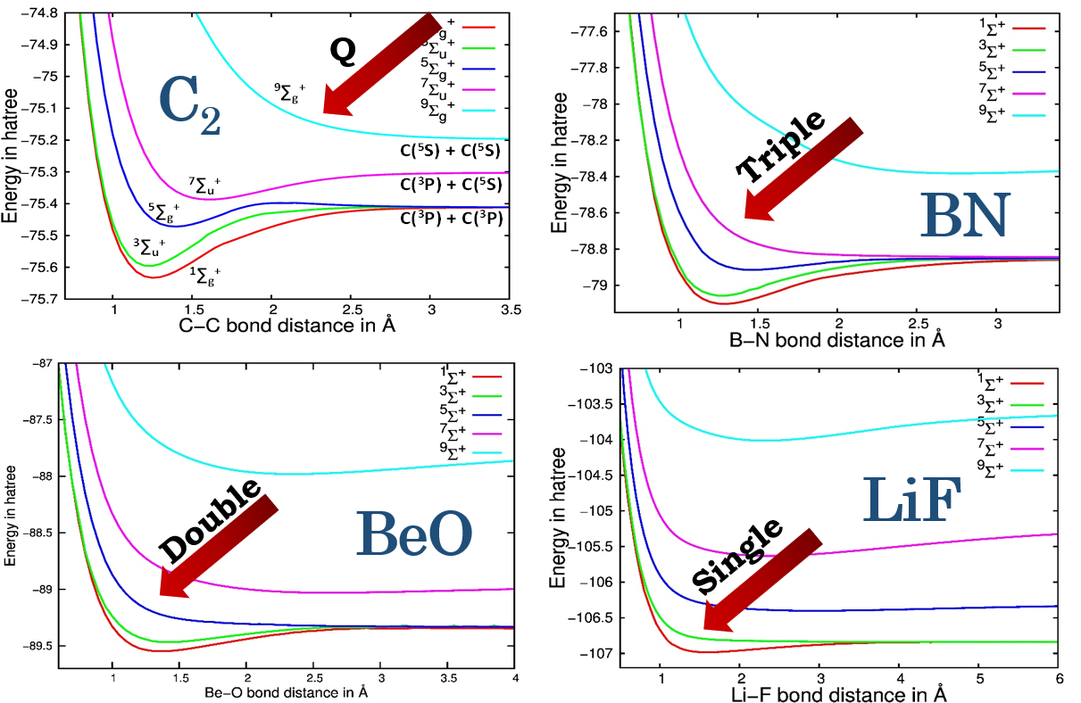
Introduction
Methodology and Working Principle
Electronic States, Bonding and PECs
Concluding Remarks
Acknowledgement
Isoelectronic species of C₂
Lowest Lying Dissociative Spin State : Determiner of No. of Bonds ?
Bhattacharjee, I.; Ghosh, D.; Paul, A. Phys. Chem. Chem. Phys. 2023, 25, 26060-26064.

Slide 18
Introduction
Methodology and Working Principle
Electronic States, Bonding and PECs
Concluding Remarks
Acknowledgement
Isoelectronic species of C₂
Examining Bonding in the Isoelectronic Species
Bonding reappears after the dissociative state
⁹Σ⁺
⁹Σ⁺ state is achieved by simple unpairing of electrons
C
C
C
C
Atomic ground states for carbon
⁹Σ⁺
Complete transfer of an electron from nitrogen to boron is mandatory to reach a state with all unpaired electrons
B
N
B
N
Atomic ground states for boron and nitrogen
18

Slide 19
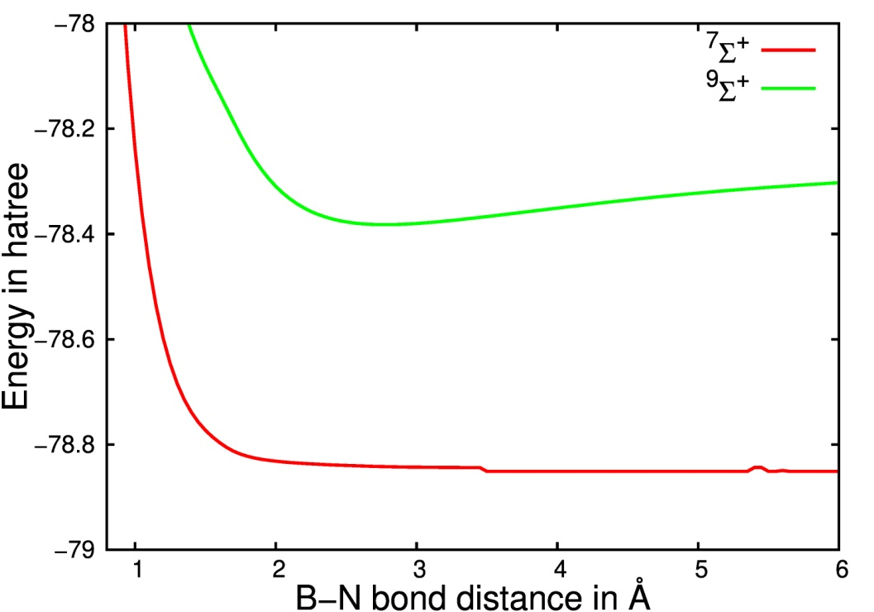
Introduction
Methodology and Working Principle
Electronic States, Bonding and PECs
Concluding Remarks
Acknowledgement
Isoelectronic species of C₂
Examining Bonding in the Isoelectronic Species
Bonding reappears after the dissociative state
B-N distance | 2.75 Å | 7.00 Å
Spin Multiplicity | (Boron, Nitrogen) | (Boron, Nitrogen)
¹Σ⁺ | (+0.1, -0.1) | (0.0, 0.0)
³Σ⁺ | (0.0, 0.0) | (0.0, 0.0)
⁵Σ⁺ | (0.0, 0.0) | (0.0, 0.0)
⁷Σ⁺ | (0.0, 0.0) | (0.0, 0.0)
⁹Σ⁺ | (-1.0, +1.0) | (-1.0, +1.0)
Bhattacharjee, I.; Ghosh, D.; Paul, A. Phys. Chem. Chem. Phys. 2023, 25, 26060-26064.
19

Slide 20
Introduction
Methodology and Working Principle
Electronic States, Bonding and PECs
Concluding Remarks
Acknowledgement
Summary
Our analysis supports the fact that Bond Order of C₂ > Bond Oder of N₂
From Purely Dissociative PECs bond order of 2nd row Diatomic Systems
can be predicted and they have integral values
The diatomic isoelectronic species of C₂ exactly follows Lewis concept of bonding and bond order.
As we go to higher spin states, after complete cleavage of all bonds, a complete transfer of electron takes place resulting in formation of ionic bonds. The PECs indicate that Coulomb attraction are the only stabilising forces present.

Slide 21

21

