Slide 1
Quantum Dose
PK/PD Modeling Utilizing Transformers, QIHMC, Quantum Kernels
Byoungwoo Kang, Thando Khumalo

Slide 2



Motivation
Why add “Quantumness” to the PK/PD problem?
?
Choice of PDE
Poor Exploration of Parameter Space
Small Dataset

Slide 3
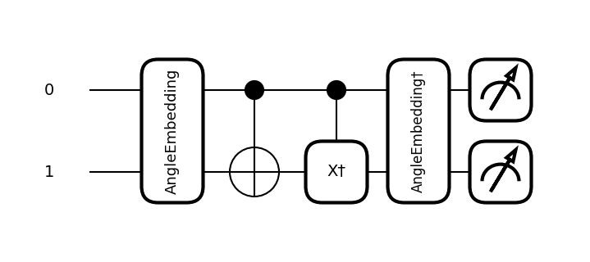

Quantum Dose Method
Stage 1
Transformer Encoder for PK/PD Model Identification
Stage 2
Quantum Inspired Hamiltonian Monte Carlo
Stage 3
Quantum Kernel Method for Support Vector Regression
T E
PK/PD 1
V
k_{a}
CL
time

Slide 4
Advantages
Stage 1: Narrowing down the PK/PD model for improved efficiency in Stage 2/3
Stage 2: A stochastic exploration of parameter space: Tunable weight parameter to overcome large potentials
Stage 3: Quantum correlations that can’t be captured by classical relationships, which potentially provide fundamental understanding from small datasets.

Slide 5
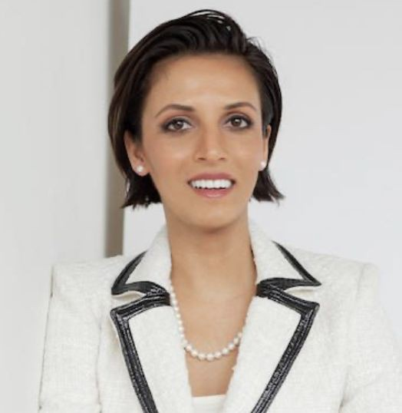


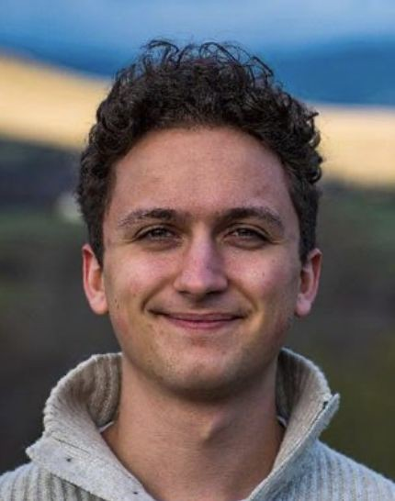

Acknowledgements
Prineha Narang
William Munizzi
Aman Mehta
Jack Diab
Scott Nie
Quantum Innovation Challenge Organizing Committee

