Slide 1



Quantum ESPRESSO in Python: QEpy
Team Embedding
Department of Chemistry & Department of Physics
Rutgers, the State University of New Jersey, Newark, NJ
Wednesday, October 13th 2021

Slide 2


Why Quantum ESPRESSO in Python?
#$@%@#$%@
Make an input file
Run it… collect data
Can I add an external potential of my choice to QE?
Can I run AIMD with the latest-gen thermostat?
or functional?
or do something not among the keywords?
or have access to density and wavefunctions during an SCF?
Yes
With basic programming skills, any workflow is accessible with QEpy

Slide 3

Installation of QEpy
Requirements
Python >= 3.6
Numpy >= 1.18
Compiler (GNU or Intel)
f90wrap >= 0.2.5
Quantum ESPRESSO == 6.5
Installation
QE
Only support version 6.5 (https://gitlab.com/QEF/q-e/-/releases/qe-6.5)
Need add compiler option '-fPIC'to all the FLAGS
./configure -enable-parallel=yes \
CFLAGS=-fPIC FFLAGS=-fPIC try_foxflags=-fPIC
make pw
QEpy
$QE is the installation directory of QE.
git clone --recurse-submodules https://gitlab.com/shaoxc/qepy.git
qedir=${QE} python3 -m pip install ./qepy

Slide 4
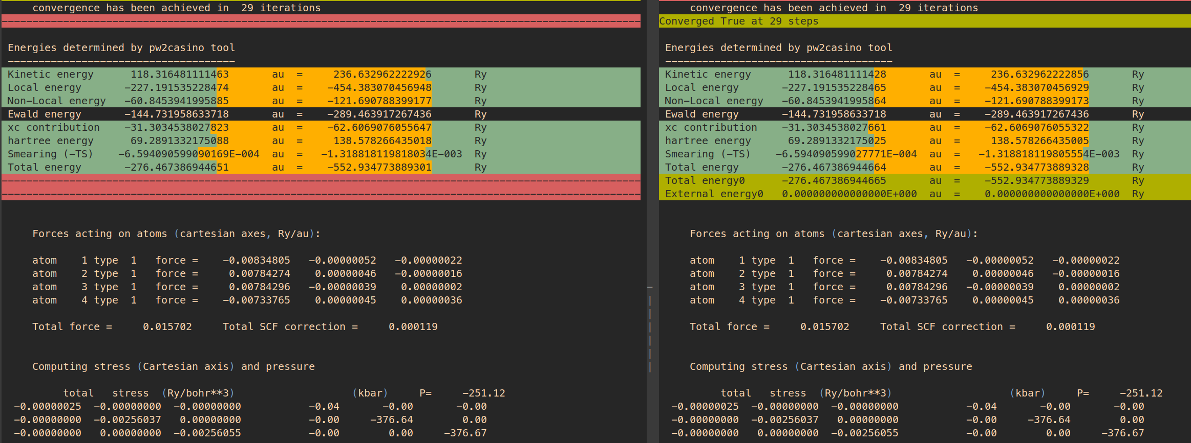
Let’s give QEpy a try…
Original QE
mpirun -n 2 pw.x -pw2casino -in qe_in.in
QEpy
mpirun -n 2 python test_pwscf.py
Same results, about same timing!

Slide 5
High-level run of QEpy: QEpyDriver
import numpy as np
import qepy
class QEpyDriver :
def __init__(self, inputfile, comm = None, ldescf = False, **kwargs):
qepy.qepy_pwscf(inputfile, comm)
embed = qepy.qepy_common.embed_base()
embed.ldescf = ldescf
qepy.control_flags.set_niter(1)
self.embed = embed
self.iter = 0
def diagonalize(self, print_level = 2, **kwargs):
if self.iter > 0 :
self.embed.initial = False
else :
self.embed.initial = True
self.iter += 1
self.embed.mix_coef = -1.0
qepy.qepy_electrons_scf(print_level, 0, self.embed)
def mix(self, mix_coef = 0.7, print_level = 2):
self.embed.mix_coef = mix_coef
qepy.qepy_electrons_scf(print_level, 0, self.embed)
def check_convergence(self, **kwargs):
return qepy.control_flags.get_conv_elec()
def get_energy(self, **kwargs):
return self.embed.etotal
def get_forces(self, icalc = 0, **kwargs):
qepy.qepy_forces(icalc)
forces = qepy.force_mod.get_array_force().T
return forces
def get_stress(self, **kwargs):
stress = np.ones((3, 3), order='F’)
qepy.stress(stress)
return stress
def stop(self, **kwargs):
qepy.punch('all’)
qepy.qepy_stop_run(0, what = 'no')
How to use the QEpyDriver class
import qepy
from qepy.driver import QEpyDriver
try:
from mpi4py import MPI
comm = MPI.COMM_WORLD
comm = comm.py2f()
except Exception:
comm = None
fname = 'qe_in.in'
driver = QEpyDriver(fname, comm)
for i in range(60):
driver.diagonalize()
driver.mix(mix_coef = 0.7)
if driver.check_convergence(): break
energy = driver.get_energy()
forces = driver.get_forces()
stress = driver.get_stress()
driver.stop()

Slide 6
QEpy under the hood: test_pwscf.py
import numpy as np
import qepy
from mpi4py import MPI
comm = MPI.COMM_WORLD
comm = comm.py2f()
fname = 'qe_in.in'
qepy.qepy_pwscf(fname, comm)
embed = qepy.qepy_common.embed_base()
qepy.qepy_electrons_scf(0, 0, embed)
# qepy.electrons()
nscf = qepy.control_flags.get_n_scf_steps()
conv_flag = bool(qepy.control_flags.get_conv_elec())
print('Converged {} at {} steps'.format(conv_flag, nscf), flush = True)
qepy.qepy_calc_energies(embed)
qepy.qepy_forces(0)
forces = qepy.force_mod.get_array_force().T
stress = np.ones((3, 3), order='F')
qepy.stress(stress)
1) we import numpy and qepy
2) we set up the MPI communicators**
3) we initialize QEpy from file and we
Initialize the “embedding” class
4) Check convergence and # of SCF steps
5) Evaluate energy
6) We get and print forces
7) We get and print stresses

Slide 7
We can do it in a different way:
test_pwscf.py
test_pwscf_scf.py
import numpy as np
import qepy
from mpi4py import MPI
comm = MPI.COMM_WORLD
comm = comm.py2f()
fname = 'qe_in.in'
qepy.qepy_pwscf(fname, comm)
embed = qepy.qepy_common.embed_base()
qepy.qepy_electrons_scf(0, 0, embed)
# qepy.electrons()
nscf = qepy.control_flags.get_n_scf_steps()
conv_flag = bool(qepy.control_flags.get_conv_elec())
print('Converged {} at {} steps'.format(conv_flag, nscf), flush = True)
qepy.qepy_calc_energies(embed)
qepy.qepy_forces(0)
forces = qepy.force_mod.get_array_force().T
stress = np.ones((3, 3), order='F')
qepy.stress(stress)
import numpy as np
import qepy
from mpi4py import MPI
comm = MPI.COMM_WORLD
comm = comm.py2f()
fname = 'qe_in.in'
qepy.qepy_pwscf(fname, comm)
embed = qepy.qepy_common.embed_base()
qepy.control_flags.set_niter(1)
for i in range(60):
if i>0 : embed.initial = False
embed.mix_coef = -1.0
qepy.qepy_electrons_scf(0, 0, embed)
embed.mix_coef = 0.7
qepy.qepy_electrons_scf(0, 0, embed)
if qepy.control_flags.get_conv_elec() : break
qepy.qepy_calc_energies(embed)
Same result, one SCF step at a time

Slide 8
Use your own potential. With QEpy, the ball is in your court!
embed.exttype
0 | external | 000
1 | pseudo | 001
2 | hartree | 010
3 | hartree + pseudo | 011
4 | xc | 100
5 | pseudo + xc | 101
6 | hartree + xc | 110
7 | pseudo + hartree + xc | 111
nr = np.zeros(3, dtype = 'int32')
qepy.qepy_mod.qepy_get_grid(nr)
extpot = np.zeros(np.prod(nr), order = 'F')
qepy.qepy_mod.qepy_set_extpot(embed, extpot)
embed.exttype = 0
Energies determined by pw2casino tool
-------------------------------------
……
Total energy -276.467386944339 au = -552.934773888678 Ry
Total energy0 -276.467386944338 au = -552.934773888675 Ry
External energy0 0.000000000000000E+000 au = 0.000000000000000E+000 Ry

Slide 9
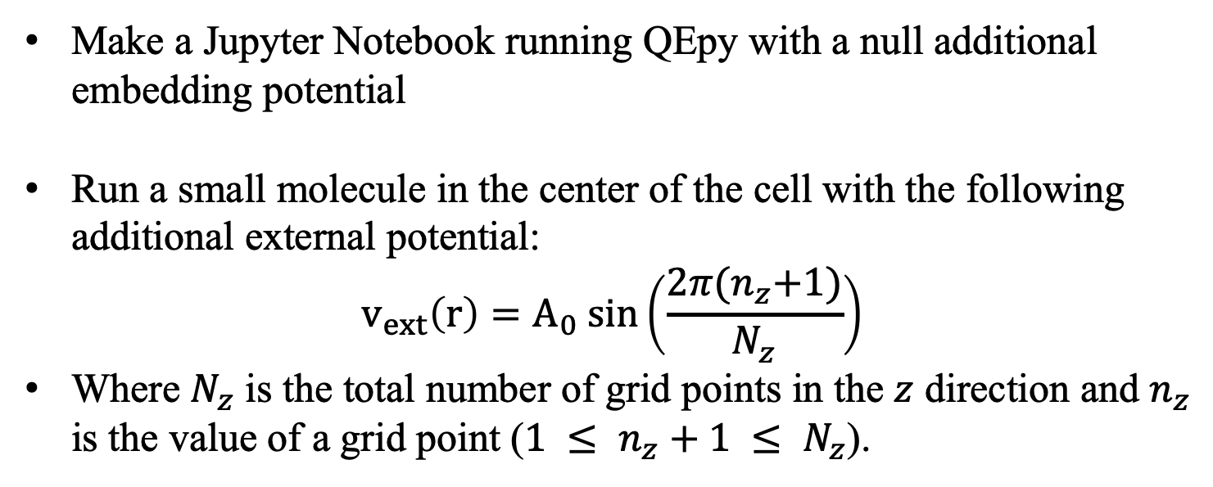
Challenge: QEpy with Jupyter Notebooks!
Make a Jupyter Notebook running QEpy with a null additional embedding potential
Run a small molecule in the center of the cell with the following additional external potential:
$${v_{ext}\left(r\right)=A}_{0} sin\left(\frac{2π{(n}_{z}+1)}{N_{z}}\right)$$
Where $N_{z}$ is the total number of grid points in the $z$ direction and $n_{z}$ is the value of a grid point ($1 ≤ n_{z}+1 ≤ N_{z}$).
5 minutes in, feel free to check out: Materials/jupyter-scf/

Slide 10
Advanced
get forces
icalc
0 | all | 000
1 | no ewald | 001
2 | no local | 010
3 | no ewald and local | 011
icalc = 0
qepy.qepy_force(icalc)
force = qepy.force_mod.get_array_force()
get density
inone = True
nr = np.zeros(3, dtype = 'int32')
qepy.qepy_mod.qepy_get_grid(nr, inone = inone)
nspin = qepy.lsda_mod.get_nspin()
density = np.empty((np.prod(nr), nspin), order = 'F')
qepy.qepy_mod.qepy_get_rho(density, inone = inone)
If inone=True, only root processor returns a gathered density. Otherwise, processors return a distributed density.

Slide 11
Using Qepy with ASE
Anything = ASE( )

Slide 12
QEpyCalculator in ASE
QEpyCalculator :
+get_bz_k_points
+get_density
+get_effective_potential
+get_eigenvalues
+get_fermi_level
+get_forces
+get_ibz_k_points
+get_k_point_weights
+get_magnetic_moment
+get_number_of_bands
+get_number_of_grid_points
+get_number_of_k_points
+get_number_of_spins
+get_occupation_numbers
+get_potential_energy
+get_pseudo_density
+get_pseudo_wave_function
+get_spin_polarized
+get_stress
+get_wave_function
+get_xc_functional
+rank
Run it with ASE (https://wiki.fysik.dtu.dk/ase/)
import qepy
import time
try:
from mpi4py import MPI
comm = MPI.COMM_WORLD
except Exception:
comm = None
from qepy.calculator import QEpyCalculator
calc = QEpyCalculator(comm = comm, inputfile = 'qe_in.in')
energy = calc.get_potential_energy()
forces = calc.get_forces()

Slide 13
AIMD with ASE
import qepy
try:
from mpi4py import MPI
comm = MPI.COMM_WORLD
except Exception:
comm = None
from qepy.calculator import QEpyCalculator
import ase.io
from ase.io.trajectory import Trajectory
from ase import units
from ase.md.andersen import Andersen
from ase.md.velocitydistribution import MaxwellBoltzmannDistribution
inputfile = 'qe_in.in'
calc = QEpyCalculator(comm = comm, inputfile = inputfile)
atoms = ase.io.read(inputfile, format='espresso-in')
atoms.set_calculator(calc)
T = 340
MaxwellBoltzmannDistribution(atoms, temperature_K = T, force_temp=True)
dyn = Andersen(atoms, 1.5 * units.fs, temperature_K = T, andersen_prob=0.02)
traj = Trajectory("md.traj", "w", atoms)
dyn.attach(traj.write, interval=1)
dyn.run(5)

Slide 14
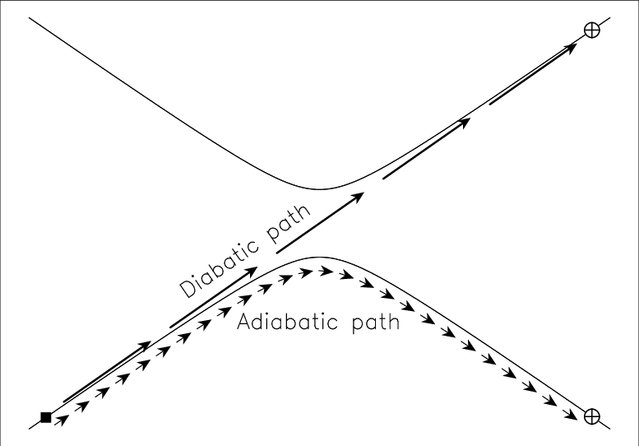
Advanced applications with QEpy: nonadiabatic dynamics
QEpy is designed to help you run nonstandard workflows: NAMD!
Some versions of nonadiabatic dynamics require the computation of overlaps between KS orbitals at consecutive time steps. QEpy can provide the needed quantities easily with just a few lines of code.
Let’s look at a Jupyter Notebook: Materials/jupyter-nvt

Slide 15
Advanced compilation of QEpy
QEDIR = $(or ${qedir}, ../../../)
include ${QEDIR}/make.inc
MODULES_SOURCES = constants.f90 cell_base.f90 ions_base.f90 \ wavefunctions.f90 funct.f90 recvec.f90 control_flags.f90
MODULES_FILES = $(addprefix ${QEDIR}/Modules/,${MODULES_SOURCES})
PW_SOURCES = pwcom.f90 scf_mod.f90 read_file_new.f90 punch.f90 \
atomic_wfc_mod.f90 close_files.f90 stress.f90 electrons.f90
PW_FILES = $(addprefix ${QEDIR}/PW/src/,${PW_SOURCES})
# QE_FILES is the final list to wrap
QE_FILES = ${MODULES_FILES} ${PW_FILES}
make.qe.inc
+= *.f90
QEpy can easily include additional QE routines/quantities as Python methods/quantities
You can put any files you want to wrap to MODULES_SOURCES or PW_SOURCES without any modification.

Slide 16

Hope you enjoyed it, thank you!
@MikPavanello
@XuechengShao
@alesgeno

