Slide 1
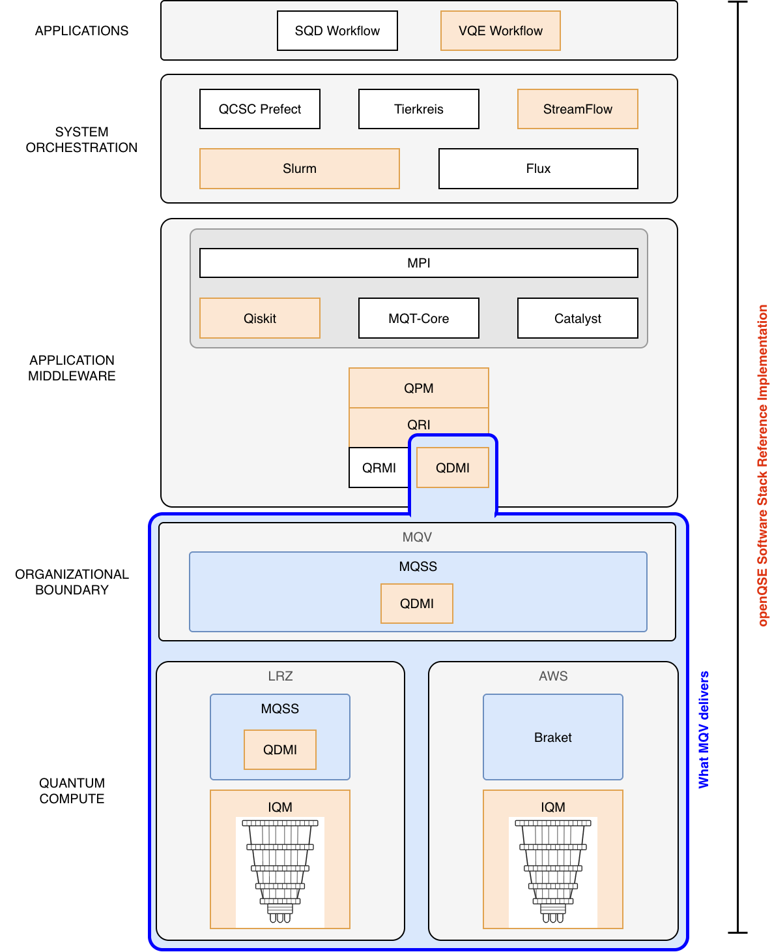
MQV: one QDMI device, several quantum computers
Standard
QDMI, loaded through MQT Core. openQSE only needs configuration.
Installable
pip install mqss-qdmi-mqv
Published on PyPI.
Federated
Behind one device, MQSS reaches IQM at LRZ and IQM on AWS. Each machine is one QPU name; no new code for users.
Munich Quantum Valley · openQSE DOE booth dry run · 2026-11-11
Notes:
About 60 seconds. ORNL just showed the openQSE stack; this is the same diagram, with MQV's part framed in blue. Everything above the blue frame is the openQSE reference implementation: VQE through StreamFlow and Slurm, Qiskit, QPM and QRI. At the QDMI line, openQSE loads one device: ours, mqss-qdmi-mqv, through MQT Core's QDMI driver. Behind that one device sits MQSS, the Munich Quantum Software Stack, which federates several machines: IQM at LRZ, and IQM on AWS through Braket. Three points: it is a standard interface, it installs with pip, and a new machine behind MQSS is just a new QPU name for users.

Slide 2
How a user runs it, and what works today
The job script: pick the machine by its QPU name
Through MQV, as of [2026-11-10]
#SBATCH --qpu=sc26-mqv-eqe1
Machine | Status
planqc MAQCS (simulator) | Works (testbed, 2026-11-04)
LRZ IQM (EQE1) | [Works / in progress]
AWS Braket IQM | In progress
The code: plain Qiskit plus the openQSE backend
qc = QuantumCircuit(3)
qc.h(0); qc.cx(0, 1); qc.cx(1, 2)
qc.measure_all()
eqe1 = QFwBackend(provider="shim",
service_id="shim-sc26-mqv-eqe1")
job = eqe1.run(qc, shots=100)
print(job.result().get_counts())
[QR code]
The device on PyPI:
pypi.org/project/
mqss-qdmi-mqv
EQE1 counts: {'000': [__], '111': [__]}
Munich Quantum Valley · openQSE DOE booth dry run · 2026-11-11
Notes:
About 90 seconds, then 30 seconds of outlook. This is all a user writes. In the job script, one line picks the machine: the QPU name sc26-mqv-eqe1. In the code, plain Qiskit, and one openQSE backend whose service is shim- plus the QPU name. Nothing here says MQV or MQSS: change the QPU name and the same job goes to another machine. [Show the video here if we have one: sbatch, squeue, the counts.] On the right, what works through MQV today, stated honestly: MAQCS works from the testbed; LRZ's IQM [works / is being connected in MQSS]; AWS is in progress. The QR code leads to the device on PyPI. Outlook: each new machine behind MQSS becomes one more QPU name.

