Slide 1
Deploying AI inference services at ALCF
AI4Science series
November 4th, 2025
Benoit CÔtÉ
Aditya Tanikanti
TOM URAM
Venkatram vishwanath
Data Services
Software Developer
ALCF
bcote@anl.gov
Data Services
Architect
ALCF
atanikanti@anl.gov
Data Services and Workflows Team Lead
ALCF
turam@anl.gov
AI / ML
Team Lead
ALCF venkat@anl.gov

Slide 2
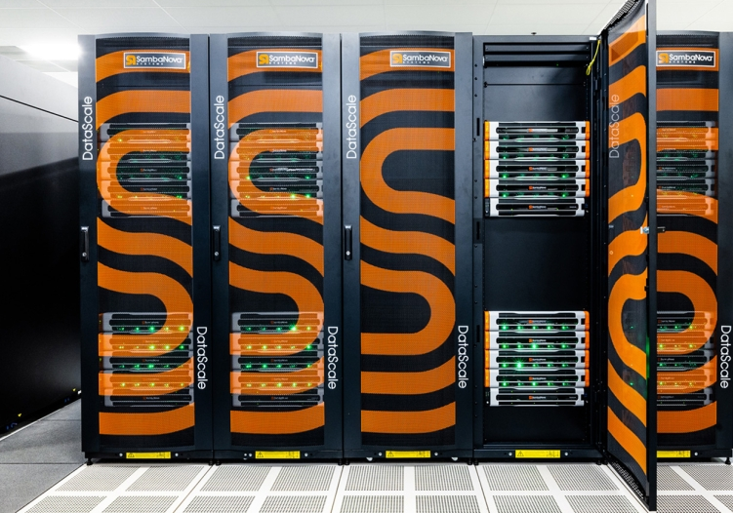
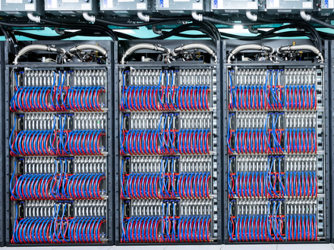
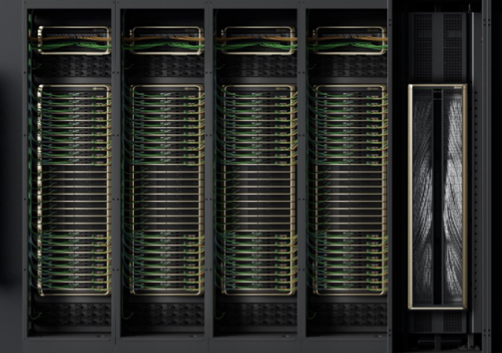
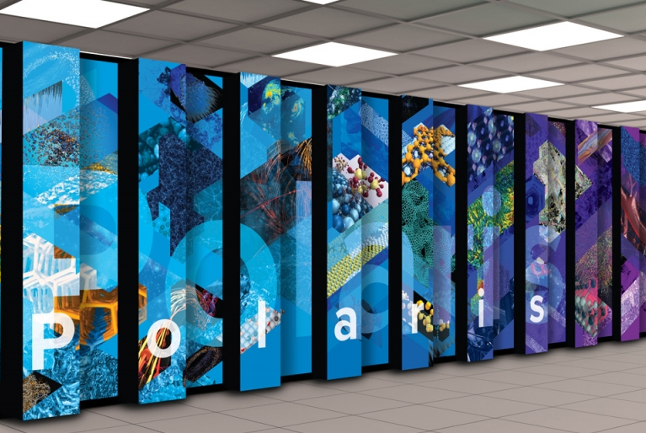
ALCF is Deploying diverse inference systems for science
Metis (SambaNova SN40L)
Tara NVIDIA GH200
Minerva NVIDIA B200
Sophia A100

Slide 3
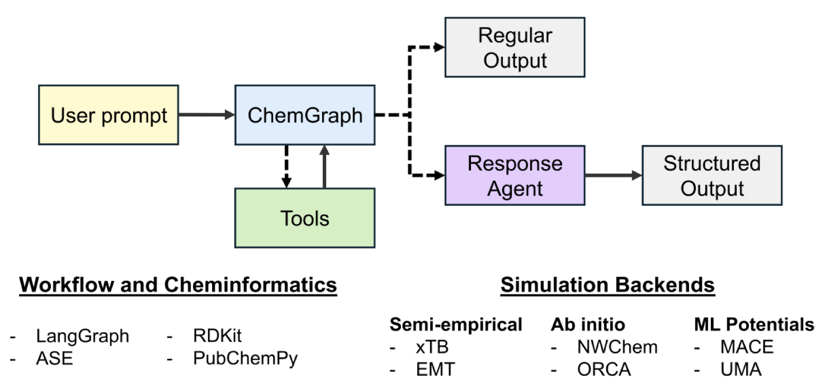
Some inference service use-cases
ChemGraph – Thang et al. https://www.arxiv.org/pdf/2506.06363
Largest usage is currently for generating synthetic data for science

Slide 4
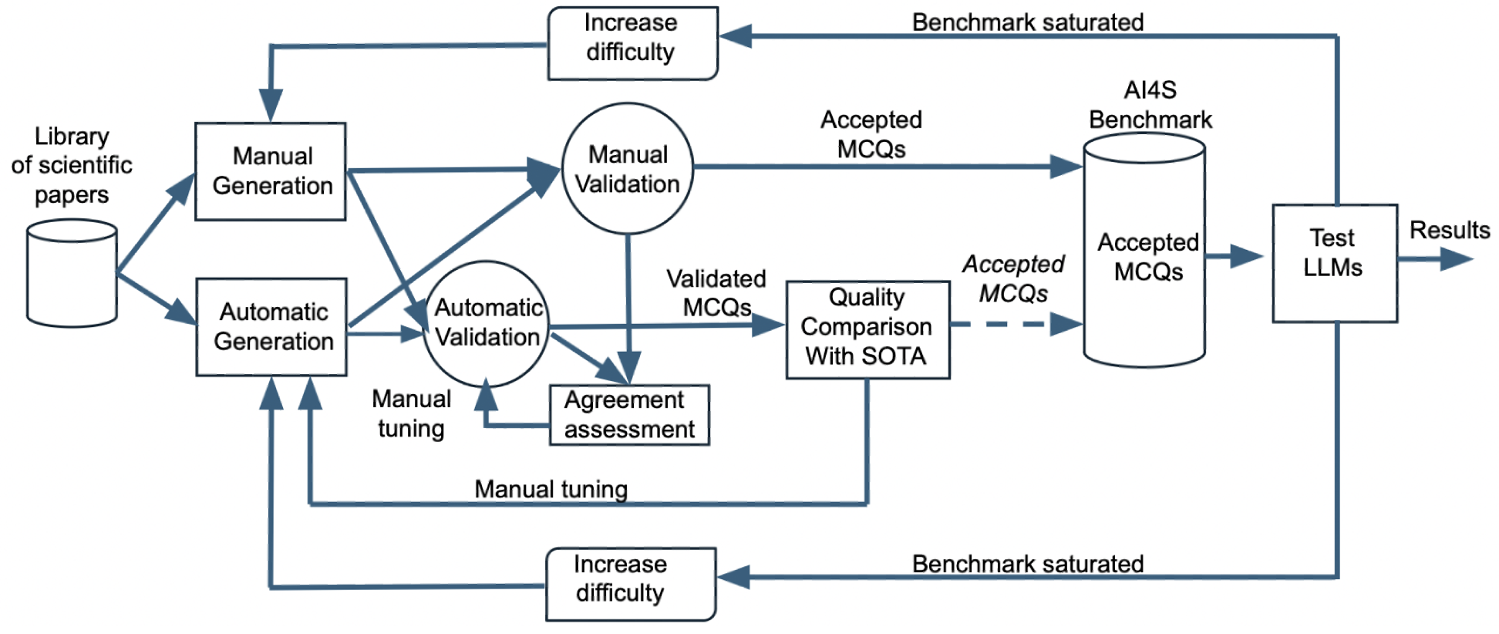
Some inference service use-cases
ChemGraph – Thang et al. https://www.arxiv.org/pdf/2506.06363
AuroraGPT-EAIRA – Capello et al. https://arxiv.org/pdf/2502.20309
Largest usage is currently for generating synthetic data for science

Slide 5
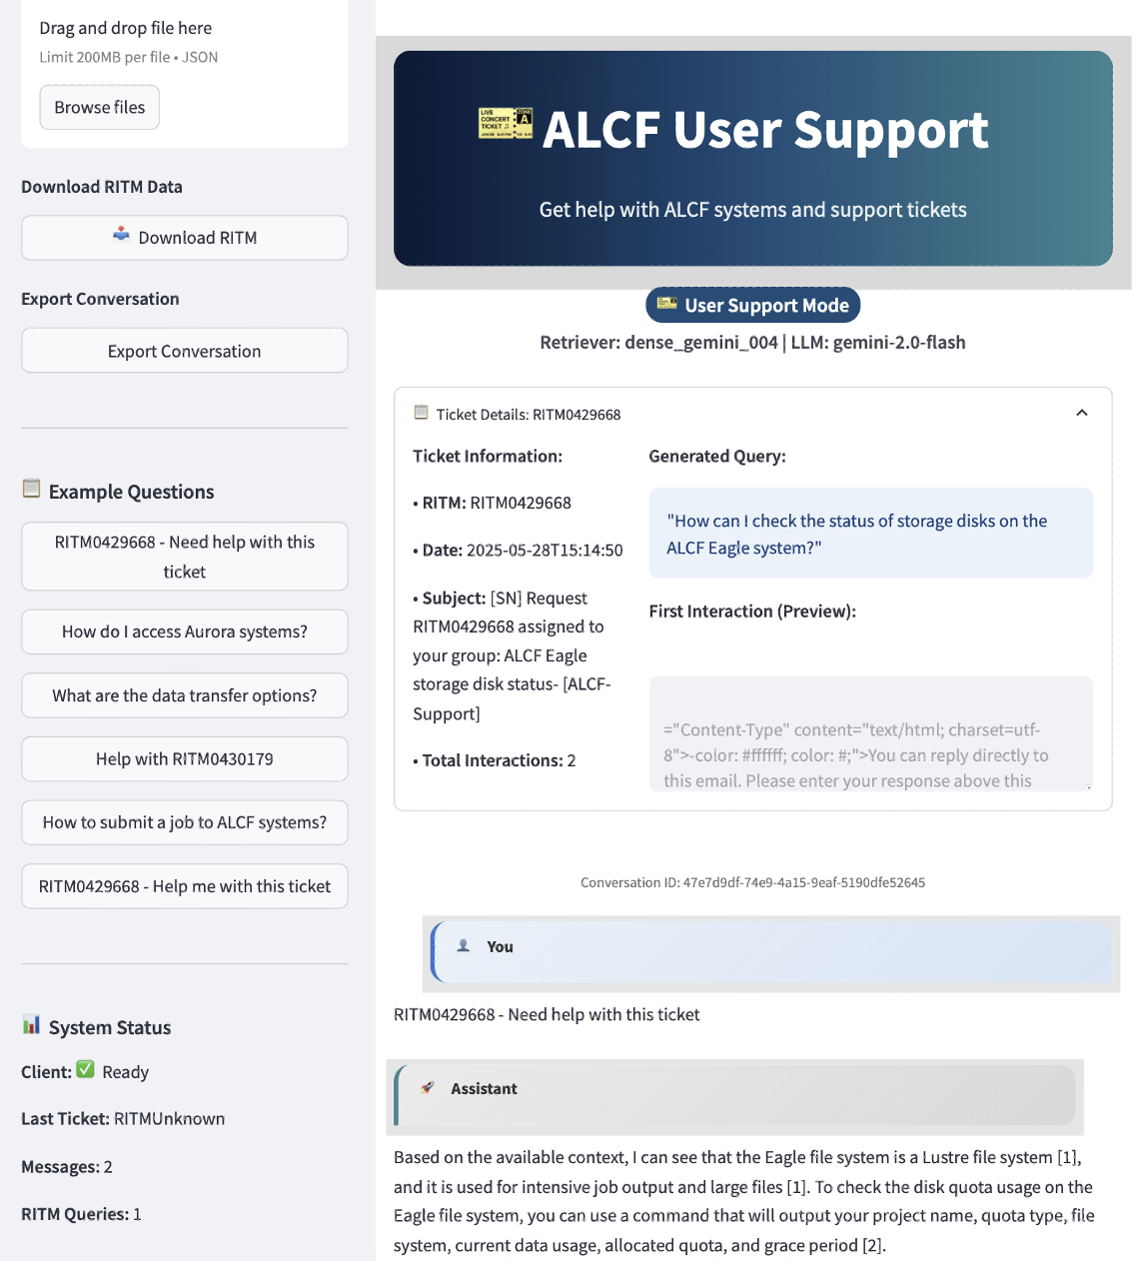
Some inference service use-cases
ChemGraph – Thang et al. https://www.arxiv.org/pdf/2506.06363
AuroraGPT-EAIRA – Capello et al. https://arxiv.org/pdf/2502.20309
Largest usage is currently for generating synthetic data for science

Slide 6
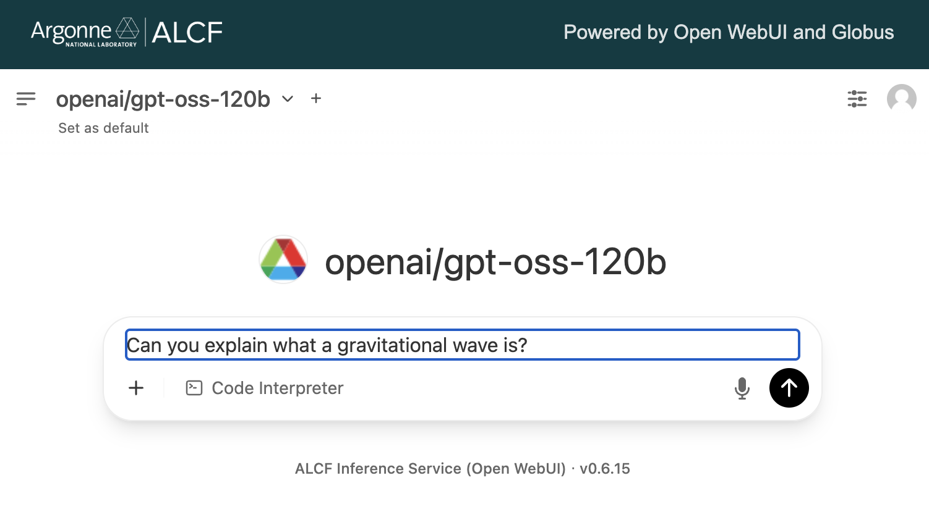
Interfacing with the inference service
Open WebUI interface
https://inference.alcf.anl.gov

Slide 7
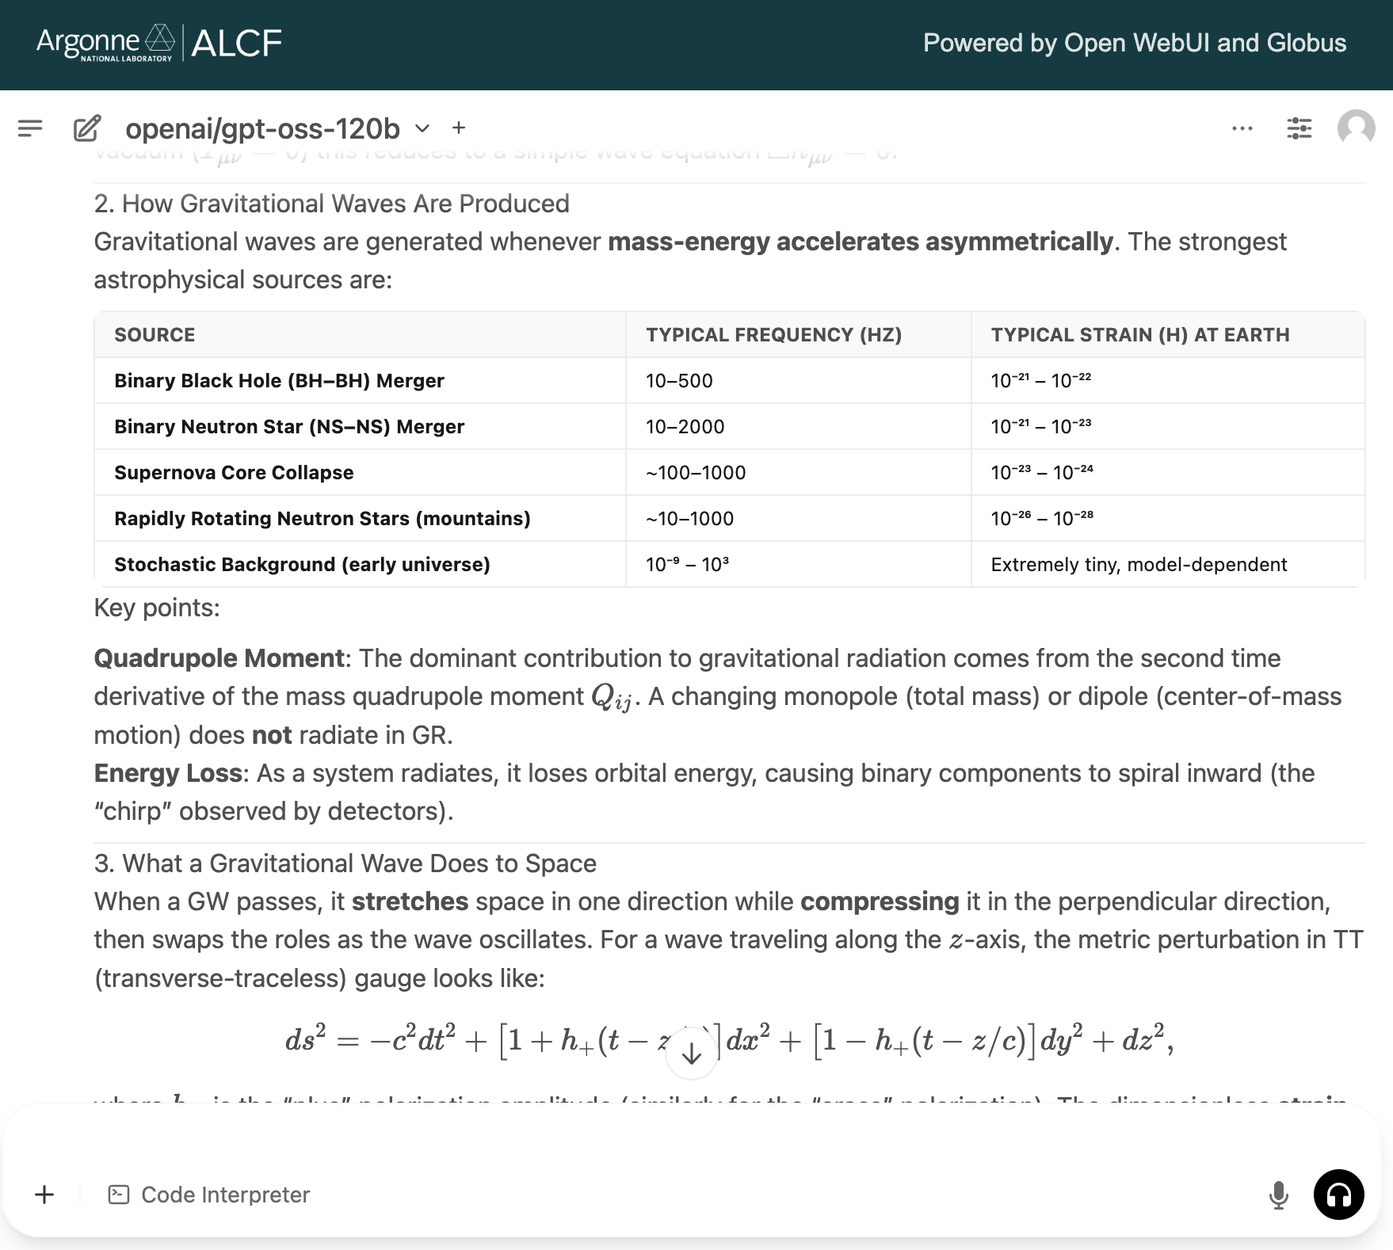
Interfacing with the inference service
Open WebUI interface
https://inference.alcf.anl.gov

Slide 8
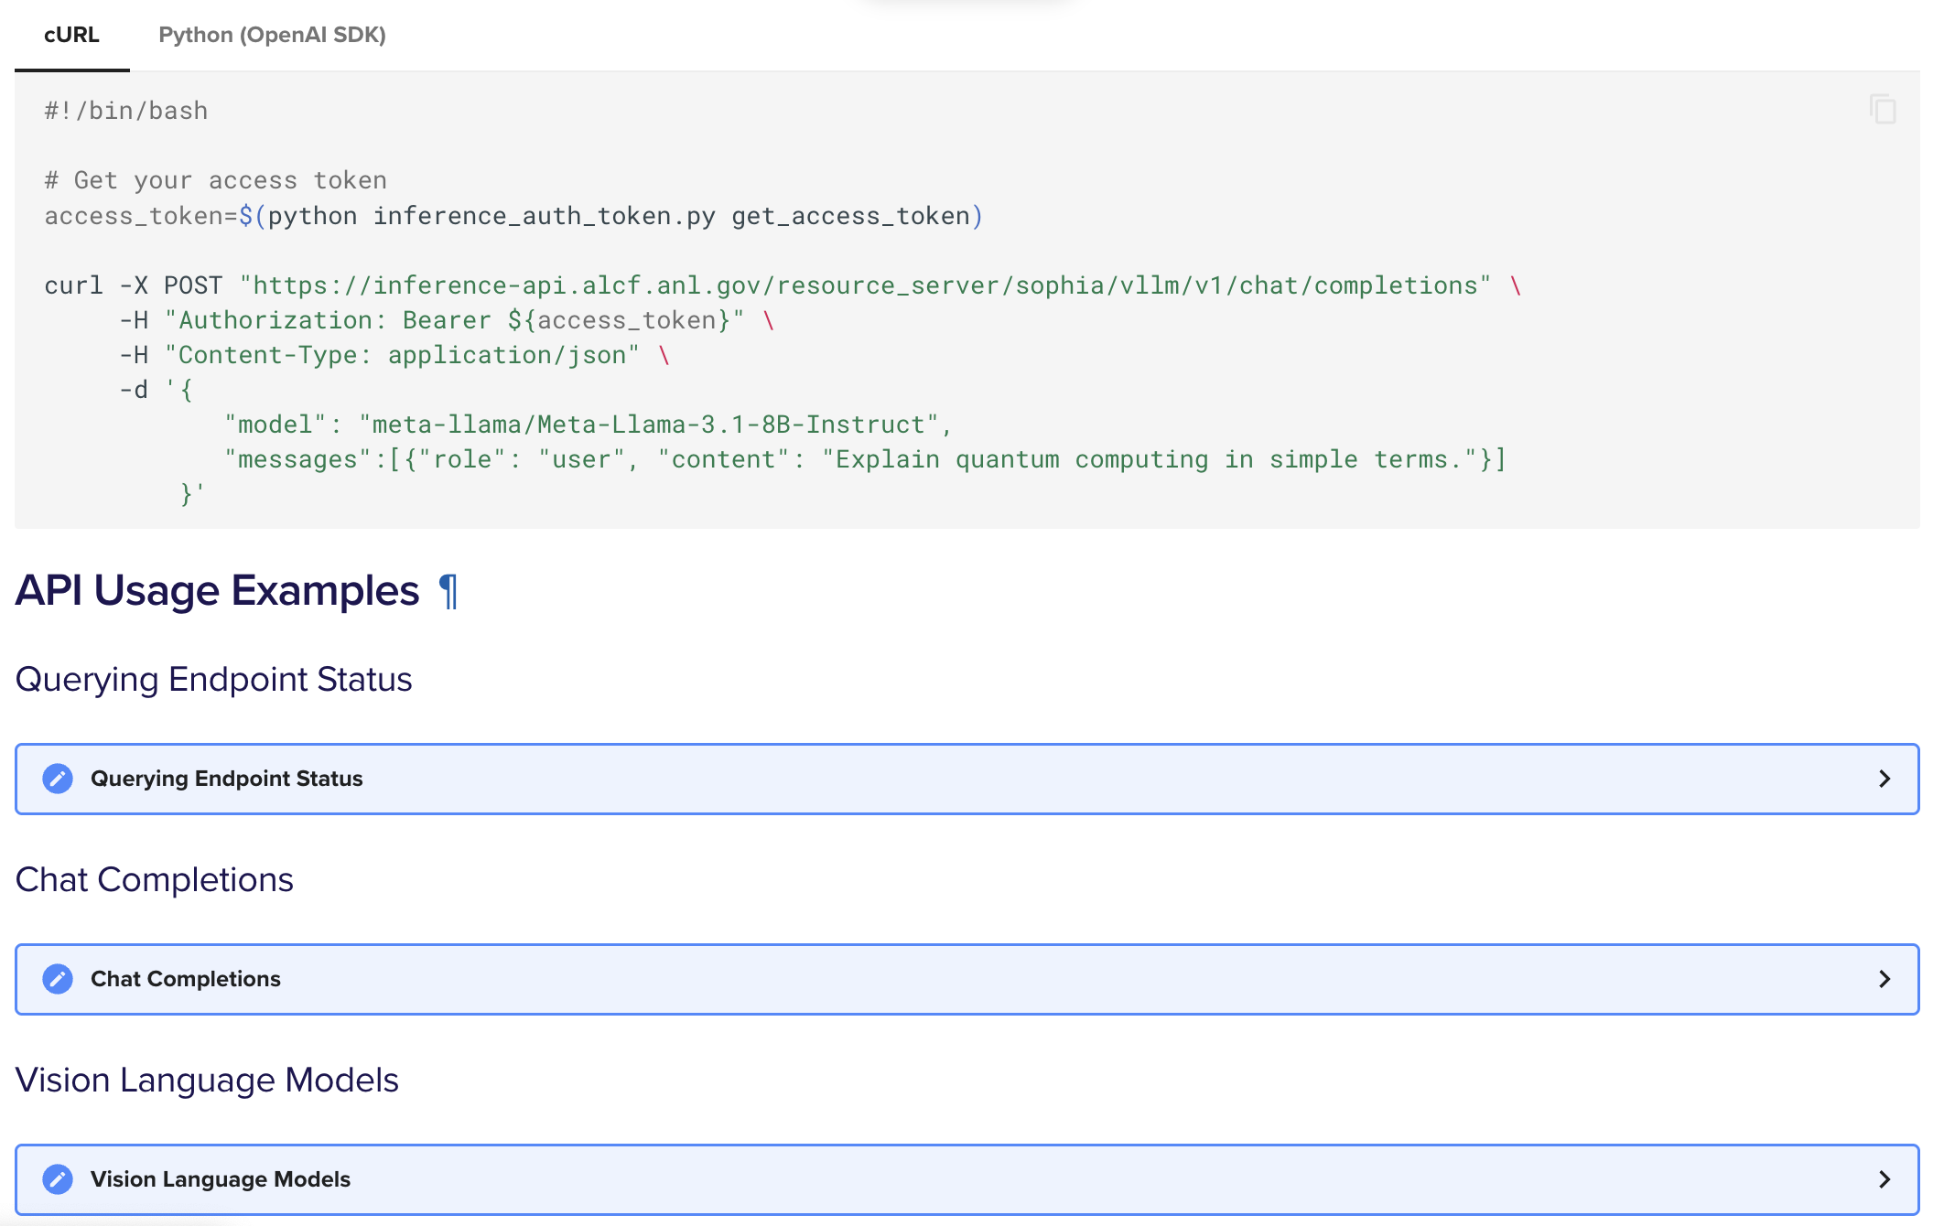
Interfacing with the inference service
OpenAI API (including batch)
https://docs.alcf.anl.gov/services/inference-endpoints

Slide 9
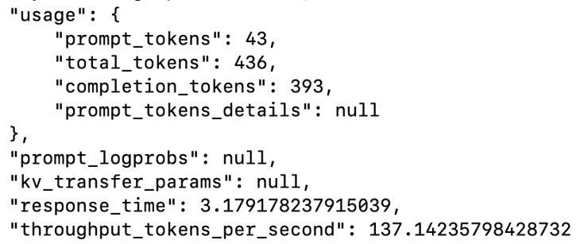
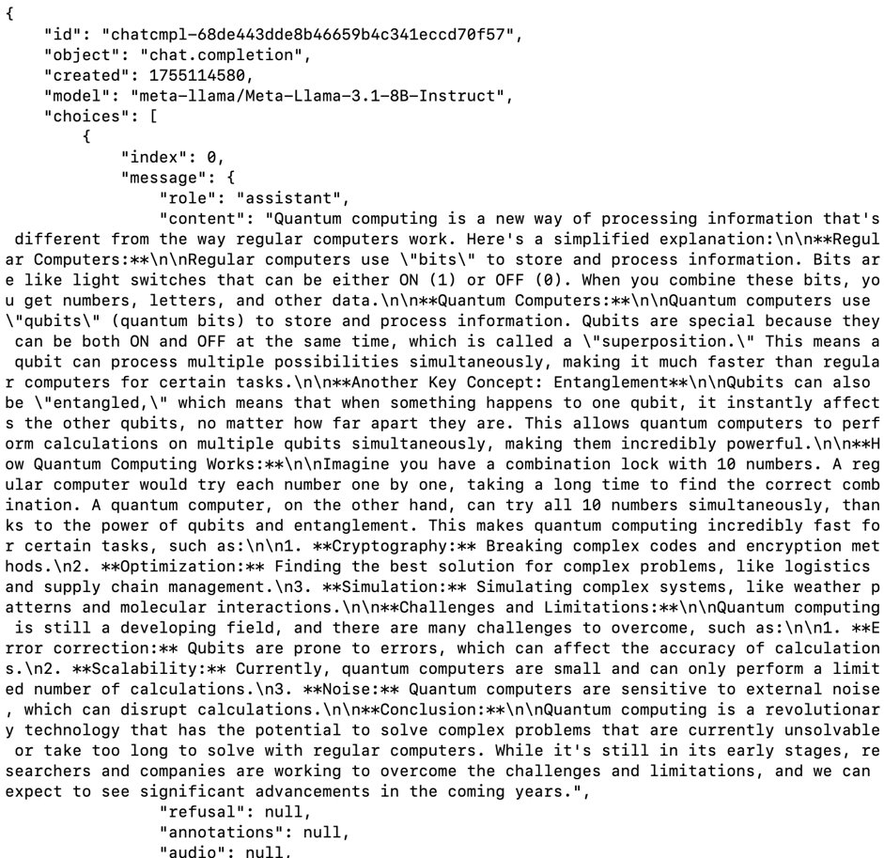
Interfacing with the inference service
OpenAI API (including batch)
https://docs.alcf.anl.gov/services/inference-endpoints

Slide 10
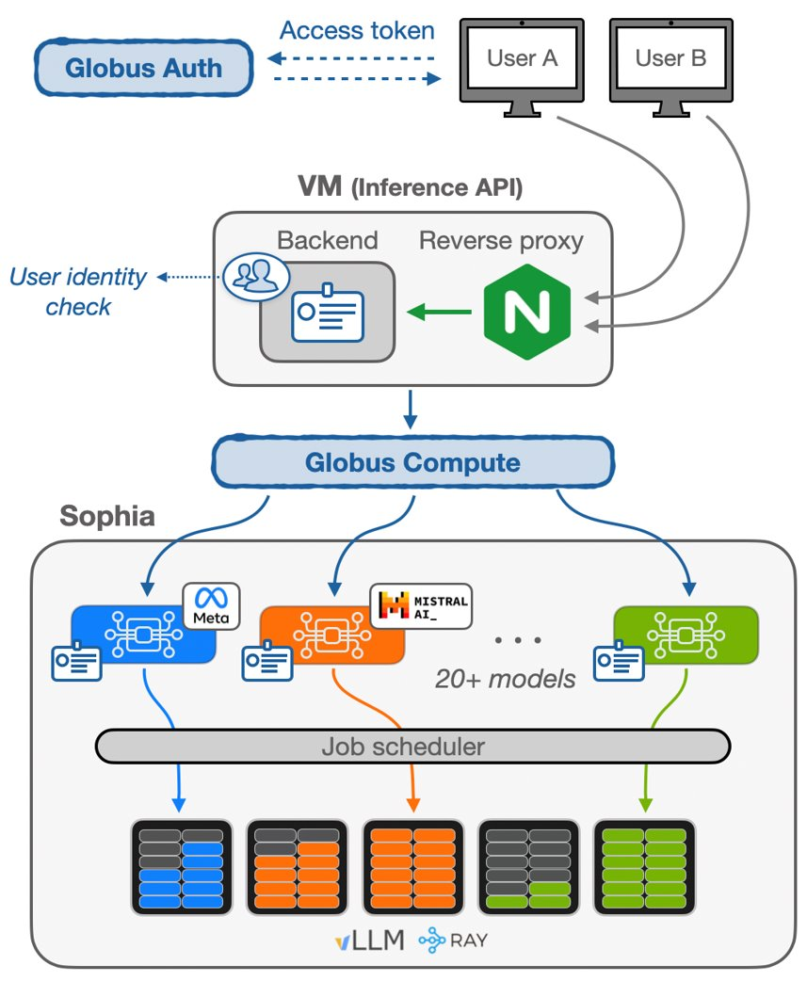

System overview
Inference Service leverages ALCF computing resources to serve requests to a growing set of models
Authentication via Globus Auth and orchestration using Globus Compute
Combination of “in-memory/active” models and on-demand schedulable models
Usage metrics are curated to understand and improve the service
...
Minerva (NVIDIA B200)
Metis (SambaNova SN40L)
https://arxiv.org/abs/2510.13724

Slide 11
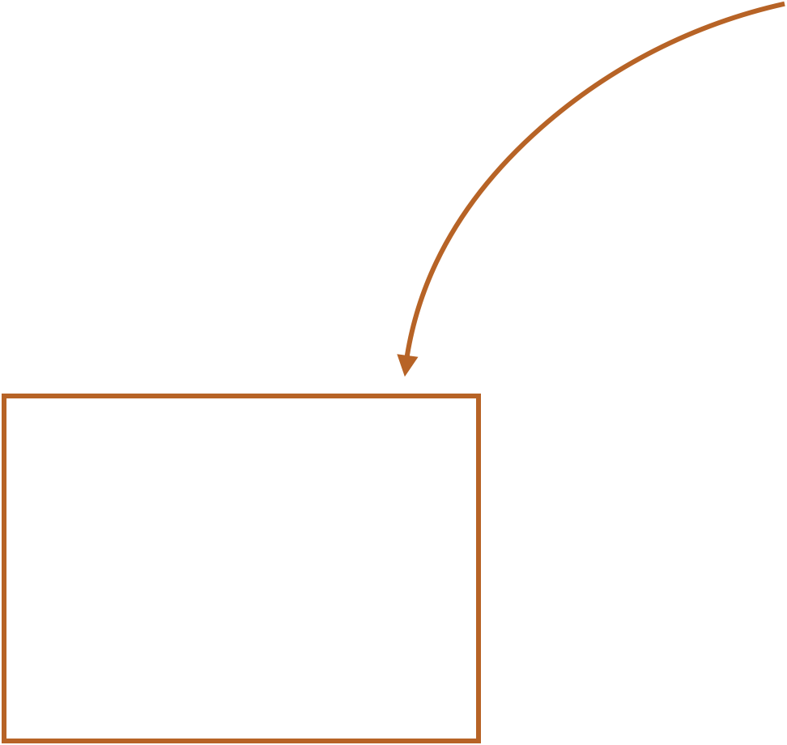
System overview
Inference Service leverages ALCF computing resources to serve requests to a growing set of models
Authentication via Globus Auth and orchestration using Globus Compute
Combination of “in-memory/active” models and on-demand schedulable models
Usage metrics are curated to understand and improve the service
...
Minerva (NVIDIA B200)
Metis (SambaNova SN40L)
https://arxiv.org/abs/2510.13724

Slide 12
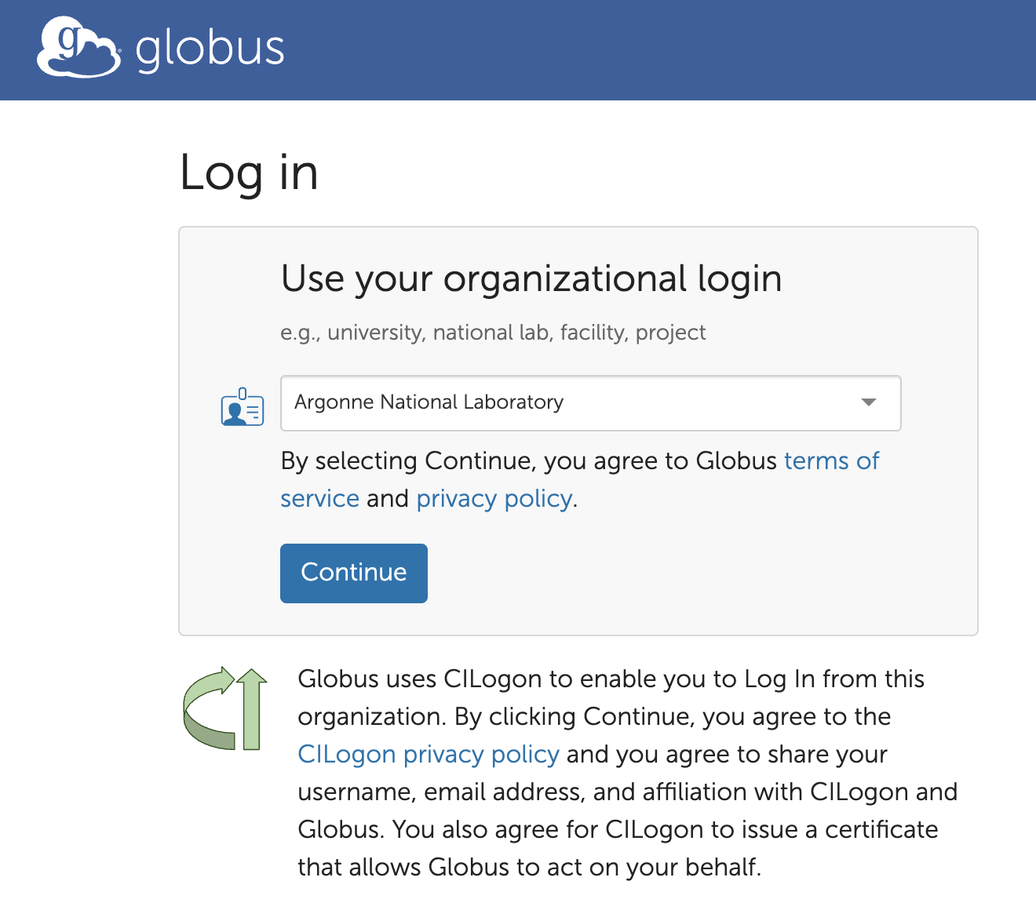
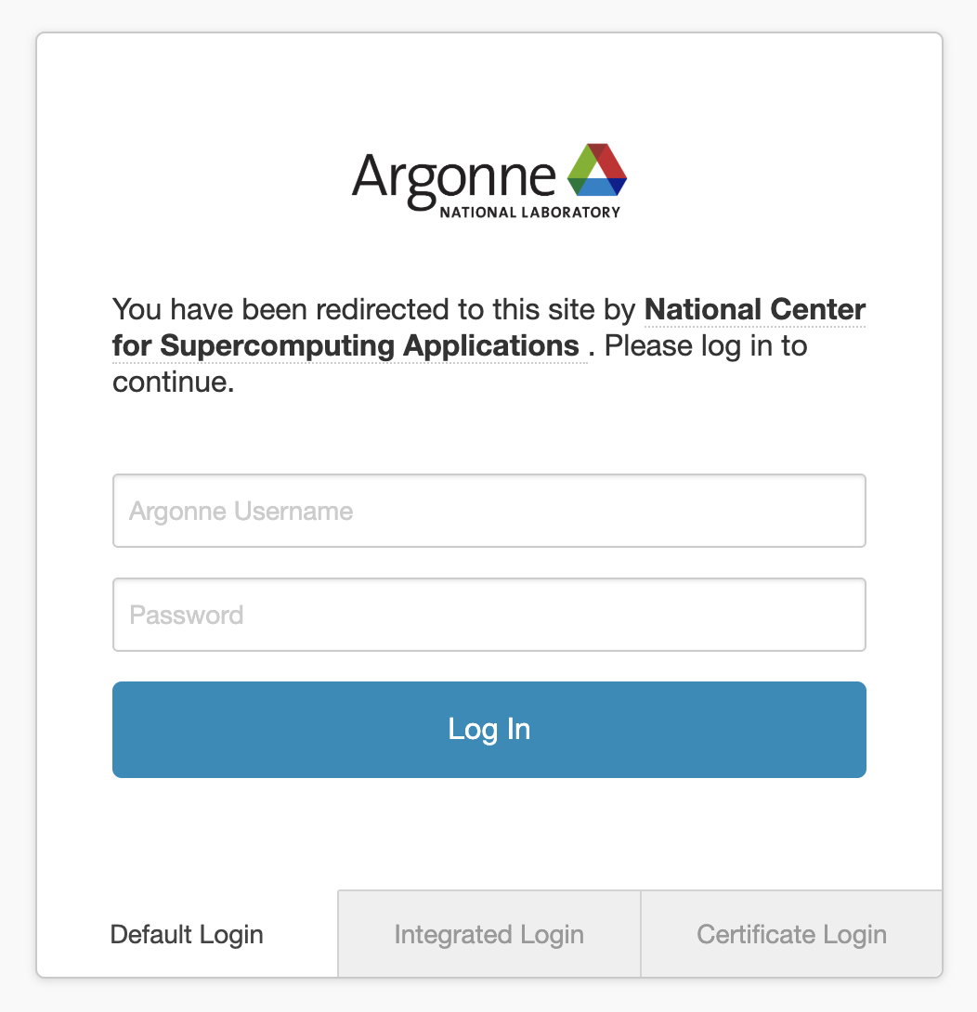
Globus Auth
1100+ identity providers
Inference service currently only opened
to ANL and ALCF
Authentication and authorization platform (OAuth2/OpenID compliant)
Federated identity provider integrating with different institutions worldwide
Redirect to the selected identity provider’s login page

Slide 13
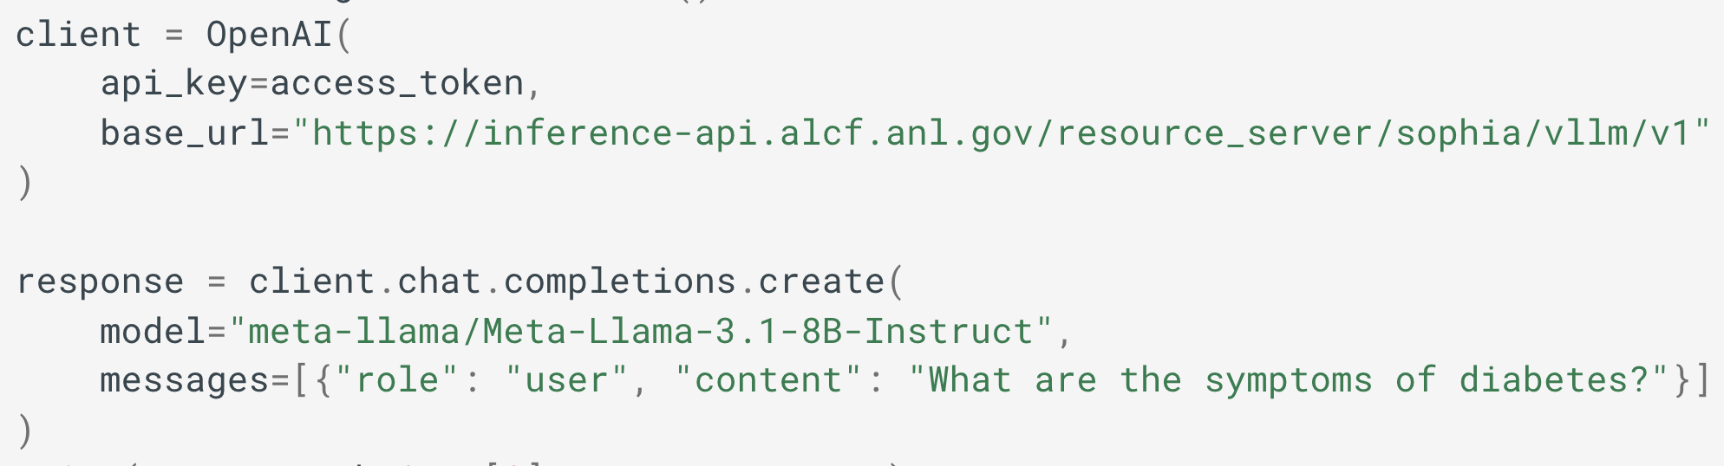
Globus Auth
1100+ identity providers
Inference service currently only opened
to ANL and ALCF
Authentication and authorization platform (OAuth2/OpenID compliant)
Federated identity provider integrating with different institutions worldwide
From a user’s perspective:
Globus Auth generates a token
The token is passed to our inference service as an API key
Redirect to the selected identity provider’s login page

Slide 14
Available models ON SOPHIA (31 total)
B - Batch enabled
T - Tool calling enabled
R - Reasoning enabled
H - Always hot
Family | Models
Meta Llama | Meta-Llama-3.1-70B-Instruct^{BTH}, Meta-Llama-3.1-8B-Instruct^{BTH}, Meta-Llama-3.1-405B-Instruct^{BT}, Llama-3.3-70B-Instruct^{BT}, Llama-4-Scout-17B-16E-Instruct^{BTH}, Llama-4-Maverick-17B-128E-Instruct^{T}
OpenAI | gpt-oss-20b^{BRTH}, gpt-oss-120b^{BRTH}
Mistral | Mistral-Large-Instruct-2407, Mixtral-8x22B-Instruct-v0.1
Aurora GPT | AuroraGPT-IT-v4-0125^{B}, AuroraGPT-Tulu3-SFT-0125^{B}, AuroraGPT-DPO-UFB-0225^{B}, AuroraGPT-7B-OI^{B}
Other Models | Allenai/Llama-3.1-Tulu-3-405B, google/gemma-3-27b-it^{BTH}, mgoin/Nemotron-4-340B-Instruct-hf
Vision (VLM) | meta-llama/Llama-3.2-90B-Vision-Instruct
Embedding | Salesforce/SFR-Embedding-Mistral, mistralai/Mistral-7B-Instruct-v0.3-embed

Slide 15
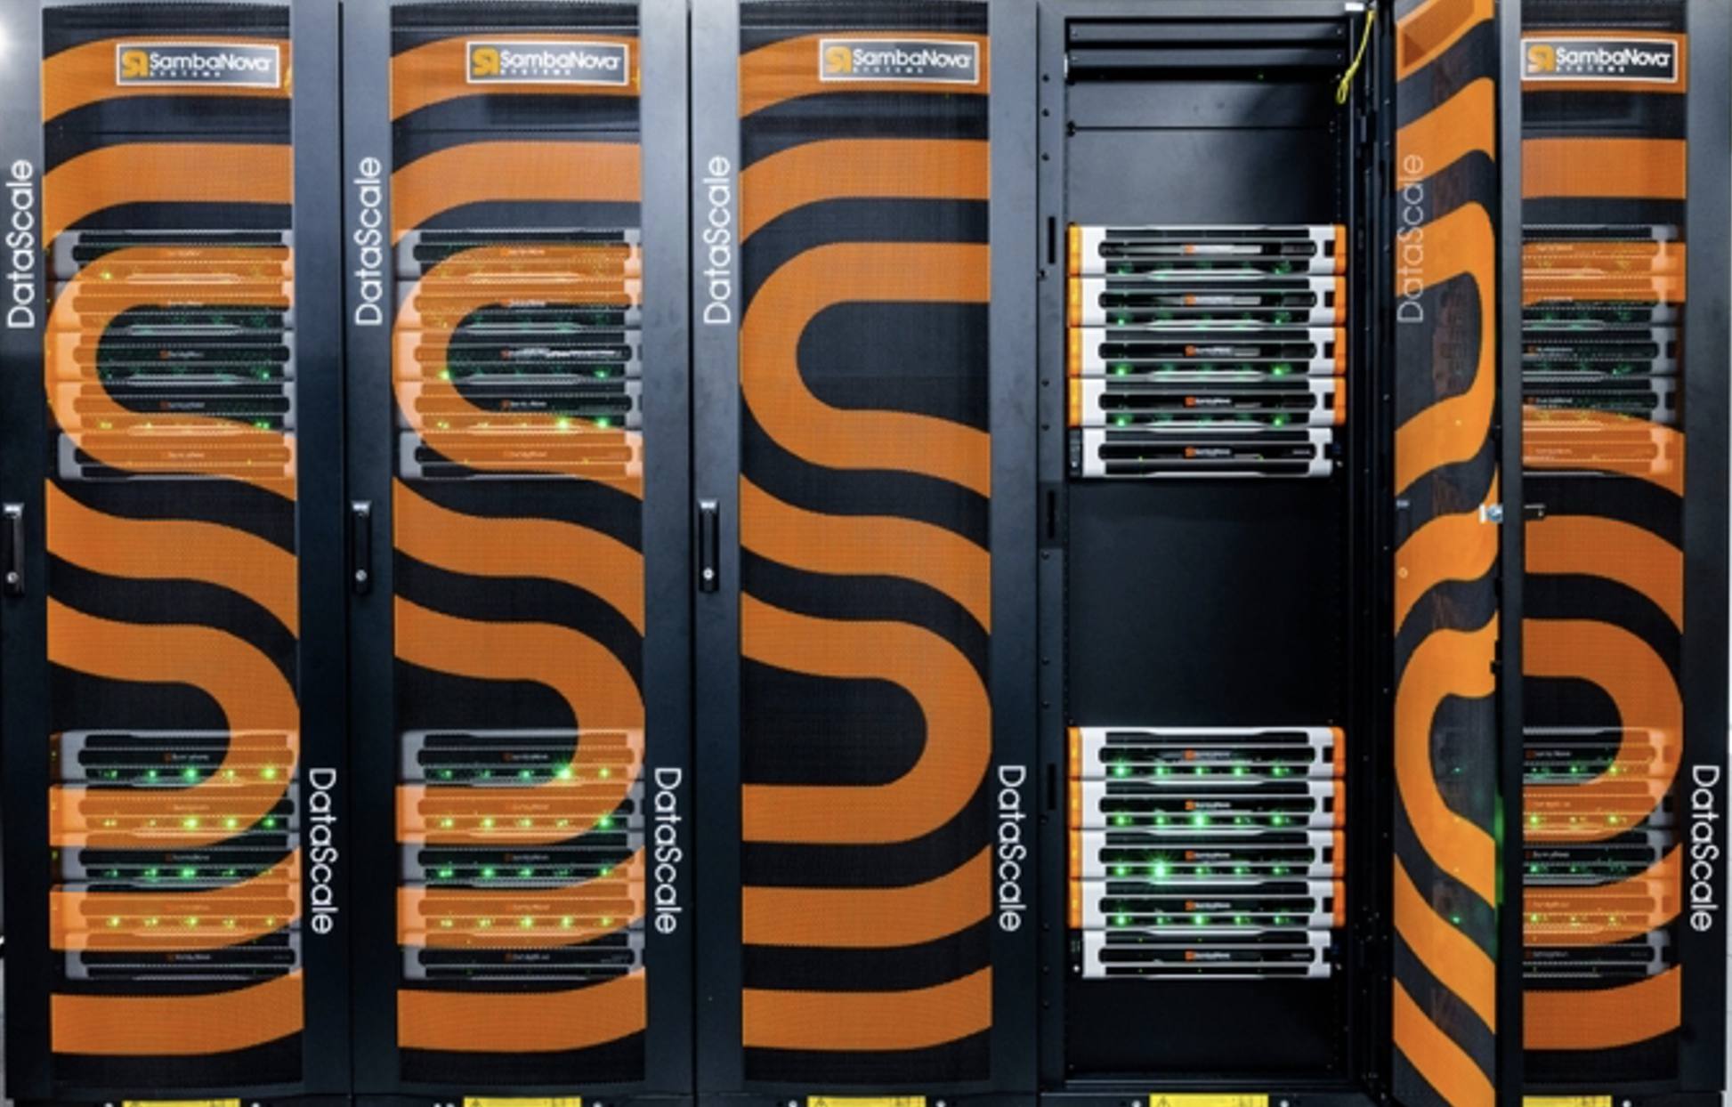
Metis – sn40L inference cluster
SambaNova SN40L
2x SN40L nodes each with 16x SN40 RDU (32 SN40L Accelerators)
1.5TB per RDU – 48TB in aggregate
Highly optimized for inference

Slide 16
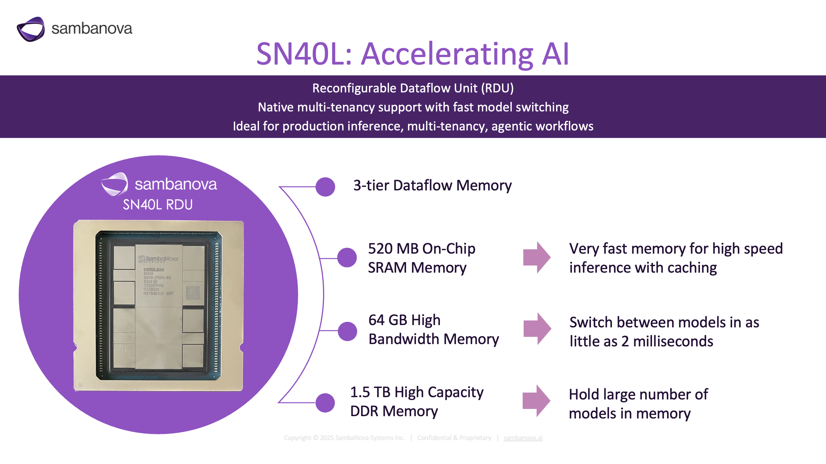
Notes:
The SambaNova SN40L Reconfigurable Dataflow Unit (RDU) is the chip that powers the SambaNova platform. It has two key innovations that make it the best chip for AI inference. First is the dataflow architecture, which makes it more efficient than GPUs for inference. The extreme efficiency of the dataflow architecture is what makes it possible for the SambaNova system to deliver exceptional performance with very low power consumption.
The second is the three-tier memory design that enables our ability to support both very large models and multiple models on a single node. The DDR DRAM is very large memory and can hold both large models and large numbers of models. The HBM, or high bandwidth memory, moves the models from DRAM to SRAM for processing very quickly. The SRAM is very fast memory that runs the models with lightning speed.

Slide 17
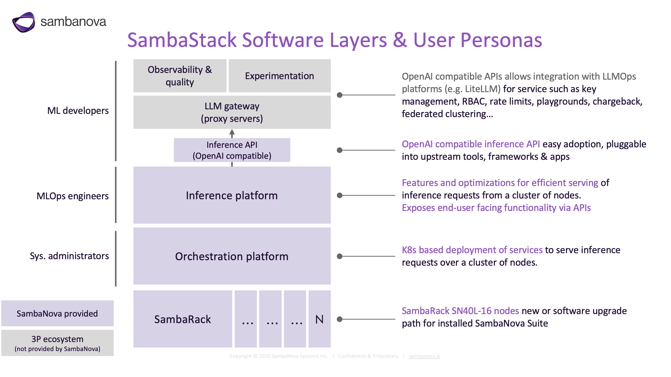

Slide 18
Available models ON Metis (2 total)
B - Batch enabled
T - Tool calling enabled
R - Reasoning enabled
H - Always hot
Chat Language Models
gpt-oss-120b-131072^{RH}
Llama-4-Maverick-17B-128E-Instruct^{H}
While Metis currently host less models than Sophia, our Gateway API has a direct connection to its models (i.e. does not rely on Globus Compute). This significantly reduces latency and improves the user experience on our web chat interface.

Slide 19
Future work
Tool calling integration
Working towards centralized logs and monitoring
Host Gateway API on Kubernetes
Implement model failure resiliency
Integrate with local scheduler API to query job status and delete jobs
Improve federated routing to offload requests to multiple clusters
More dedicated resources (including Tara and Minerva from NVIDIA)
Implement Globus-Flow base batch system for users outside of ALCF

Slide 20
Large collaboration
Ryan Chard, Nick Saint, Tom Uram, Thang Pham, Murat Keceli, Rajeev Thakur, Ken Raffenetti, Le Chen, Yanfei Guo, Krishna Chetty, Murali Emani, Khalid Hossain, Nathan Nichols, Rachana Ananthakrishnan, Anthony Avarca, Bill Allcock, Tommie Jackson, Ian Foster, Mike Papka, Rick Stevens, ALCF and CELS Operations, Globus Labs, and many more.
Joint collaboration with Globus

Slide 21
conclusion
ALCF Inference Endpoints democratize LLM access for scientific research by:
Providing seamless access to 30+ cutting-edge models
Supporting diverse use cases: chat, vision, embeddings, agents, and batch processing
Integrating with multiple HPC backends for optimal performance
Auto scaling based on request workload
Web Interface: https://inference.alcf.anl.gov/
Documentation (usage examples): https://docs.alcf.anl.gov/services/inference-endpoints/
Contact: support@alcf.anl.gov
See our paper: https://arxiv.org/abs/2510.13724

Slide 22
THANK YOU

