Slide 1
PQC Key Identification and Serialization
Dieter Bong (Utimaco), Joppe Bos (NXP), Christine Cloostermans (NXP), Silvio Dragone (IBM), Basil Hess (IBM), Christopher Meyer (Utimaco), Mike Osborne (IBM), Karen Willbrand (Utimaco)

Slide 2
PQC Key serialization and identification
NIST PQC submissions have single serialized structure for keys
Each algorithm variant has an implicit key format
Nice in theory for removing parsing vulnerabilities
Nice in theory to tie an algorithm identifier to an implicit key format
In practice :
Many possible algorithm variants for a single scheme (E.g. Dilithium)
Many submissions mention compression options
An explosion in variants for hybrid schemes
PQC Keys simply do not fit many legacy solutions
Schemes already being deployed in production
PQC Algorithms will continue to evolve together with the need to migrate keys for different versions
Interop testing already hampered

Slide 3
PQC Key serialization and identification
Goal: Make sure that PQC algorithms can be used by the largest number of applications – safely
Learning from past mistakes with ECC in reducing multiple standards
Allowing as much interoperability and experience building ahead of NISTs final standard
Approach
To ensure correct communication key formats are serialized.
To recognize the need for key compression and deal with it early in a safe way
To identify the best identification algorithm/key identification approach
Higher level (than crypto API) considerations:
How to store / load the key from key formats (ordering)
Optional choices (for performance / size considerations)
Perhaps look at Hybrid modes?
Solving this now will avoid larger problems in the future

Slide 4
Solution direction
We cannot solve the world, but we can take first step in the right direction
An RFC specifying key formats will help
Help manage algorithm versions and compatibility in key formats
Help interoperability of both testing and integration
Help make choices in future standards clear
Help prevent delays in integration and adoption
Draft RFC “PQC Key Identification and Serialization” is shared with the cryptographic community

Slide 5
Industry-wide observations
Even at a limited deployment, challenges are arising
Interoperability between crypto-libraries
A libOQS issue was flagged*, where OQS and Circl were running different Kyber versions and confusion ensued
Interoperability between test set-ups
With each round/compression change, all devices need to be updated
Underspecification of algorithms
Reducing interoperability; different implementation choices
Can even make wrong choices..
Overspecification of algorithms
Reduces adoption cross-industry; e.g. cloud versus embedded setting
* https://github.com/open-quantum-safe/liboqs/issues/909

Slide 6
Solution direction
We cannot solve the world, but we can take first step in the right direction
An RFC specifying key formats will help
Help manage algorithm versions and compatibility in key formats
Help interoperability of both testing and integration
Help make choices in future standards clear
Help prevent delays in integration and adoption
Draft RFC “PQC Key Identification and Serialization” is shared with the cryptographic community

Slide 7
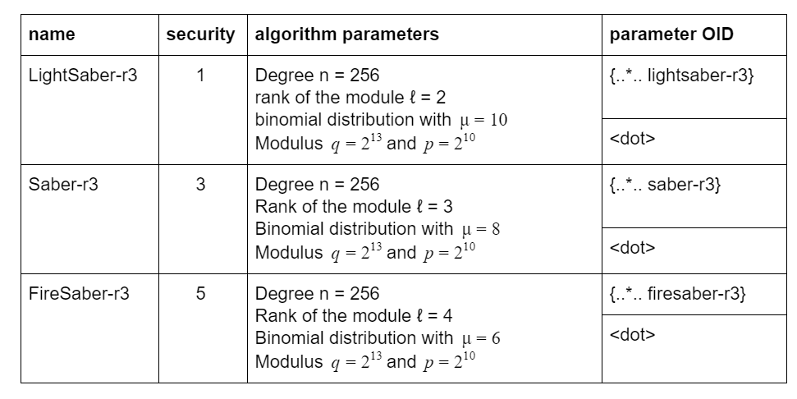
In the RFC: parameter identifiers
Describe parameter choices of parameter sets
For now, includes Round 3 finalist sets
OIDs to be filled in

Slide 8
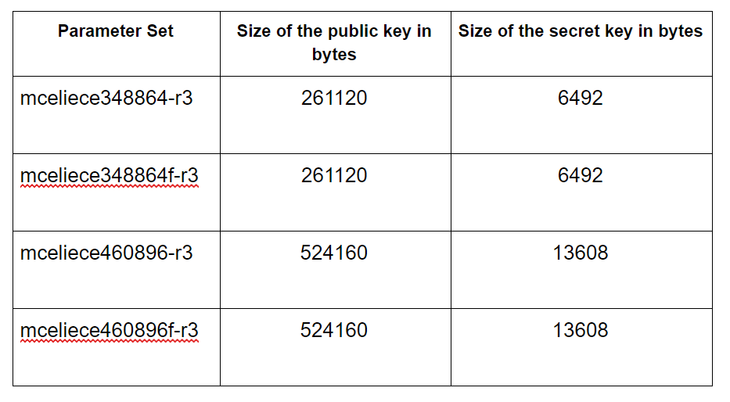
In the RFC: key descriptions and sizes
For each parameters sets, descriptions of the various components key and their sizes
Byte sizes of the full keys
Different compression options, like e.g. Rainbow has, are also included

Slide 9
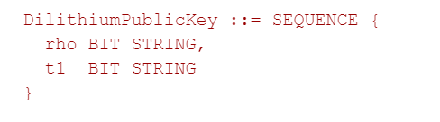
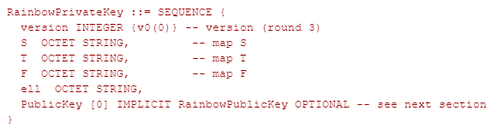
In the RFC: ASN.1 formats
Indicates the version and order of the parameters
Optional fields for public keys / optional algorithm parameters
BIT/OCTET choice currently on what seemed logical from the specs

Slide 10

What’s next?
Align with NIST on algorithm OIDs
Align with ETSI / OASIS SAM / PKCS11 / KMIP TC / more
Resolve issues around hybrid modes (IP, key serialization)
Encouraged format for migration
Path is uncertain
Alternate Round 3 candidates

