Slide 1
PQC Key Identification and Serialization
Dieter Bong (Utimaco), Joppe Bos (NXP), Christine Cloostermans (NXP), Silvio Dragone (IBM), Basil Hess (IBM), Christopher Meyer (Utimaco), Mike Osborne (IBM), Karen Willbrand (Utimaco)

Slide 2
PQC Key serialization and identification
To ensure correct communication key formats are serialized.
PQC key formats are unspecified, yet
Different versions: Round 1, 2, 3, standardized
Different compression choices
Higher level (than crypto API) considerations:
How to store / load the key from key formats (ordering)
Optional choices (for performance / size considerations)
Hybrid modes?
Popular submissions are being deployed in practice NOW (positive!) →interoperability gets challenging
Solving this now will avoid larger problems in the future

Slide 3
Solution direction
We cannot solve the world, but we can take first step in the right direction
An RFC specifying key formats will help
Help manage algorithm versions and compatibility in key formats
Help interoperability of both testing and integration
Help make choices in future standards clear
Help prevent delays in integration and adoption
Draft RFC “PQC Key Identification and Serialization” is shared with the cryptographic community

Slide 4
Industry-wide observations
Even at a limited deployment, challenges are arising
Interoperability between crypto-libraries
A libOQS issue was flagged*, where OQS and Circl were running different Kyber versions and confusion ensued
Interoperability between test set-ups
With each round/compression change, all devices need to be updated
Underspecification of algorithms
Reducing interoperability; different implementation choices
Can even make wrong choices..
Overspecification of algorithms
Reduces adoption cross-industry; e.g. cloud versus embedded setting
* https://github.com/open-quantum-safe/liboqs/issues/909

Slide 5
Solution direction
We cannot solve the world, but we can take first step in the right direction
An RFC specifying key formats will help
Help manage algorithm versions and compatibility in key formats
Help interoperability of both testing and integration
Help make choices in future standards clear
Help prevent delays in integration and adoption
Draft RFC “PQC Key Identification and Serialization” is shared with the cryptographic community

Slide 6
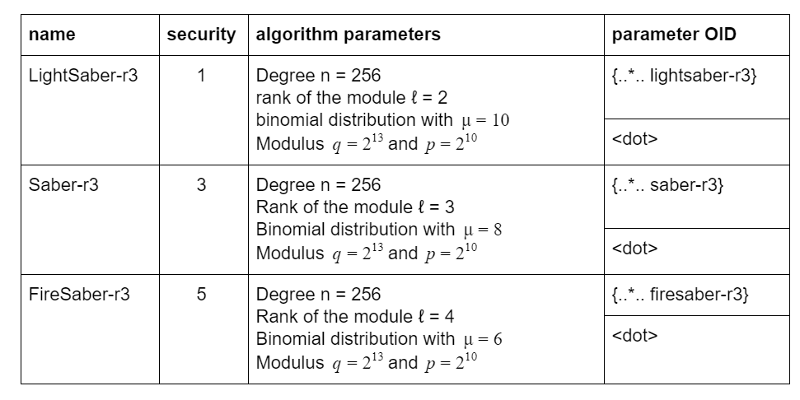
In the RFC: parameter identifiers
Describe parameter choices of parameter sets
For now, includes Round 3 finalist sets
OIDs to be filled in

Slide 7
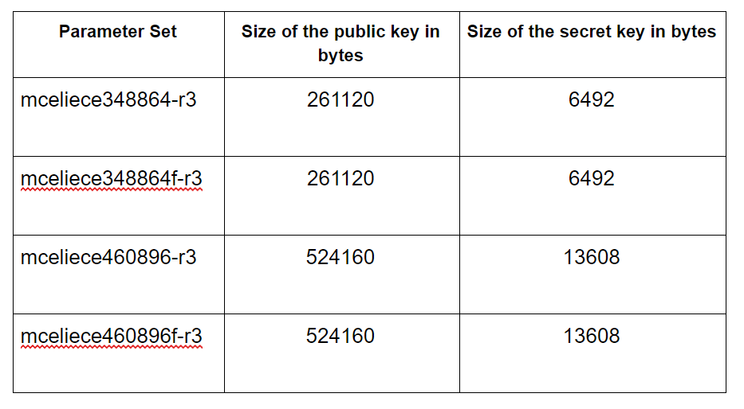
In the RFC: key descriptions and sizes
For each parameters sets, descriptions of the various components key and their sizes
Byte sizes of the full keys
Different compression options, like e.g. Rainbow has, are also included

Slide 8
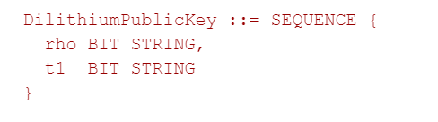
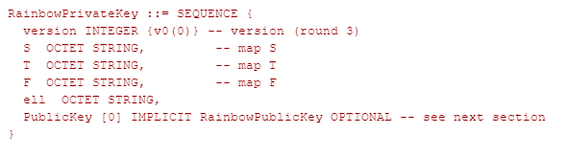
In the RFC: ASN.1 formats
Indicates the version and order of the parameters
Optional fields for public keys / optional algorithm parameters
BIT/OCTET choice currently on what seemed logical from the specs

Slide 9

What’s next?
Align with NIST on algorithm OIDs
Align with ETSI / OASIS SAM / PKCS11 / KMIP TC / more
Resolve issues around hybrid modes (IP, key serialization)
Encouraged format for migration
Path is uncertain
Alternate Round 3 candidates

