Slide 1
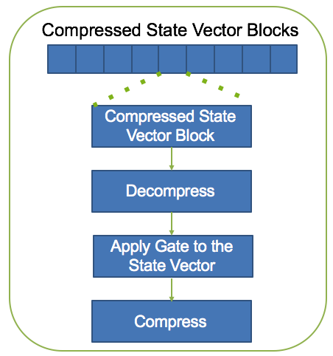
Full State Quantum Circuit Simulation by Using Lossy Data Compression
Xin-Chuan Wu¹, Sheng Di³, Franck Cappello^{2,3}, Hal Finkel³, Yuri Alexeev³, Frederic T. Chong^{1,3}
¹University of Chicago (USA); ²University of Illinois Urbana-Champaign (USA); ³Argonne National Laboratory (USA)
Abstract
To evaluate, validate, and refine the design of a new quantum algorithm or a quantum computer, researchers and developers need methods to assess their correctness and fidelity. This requires the capability of simulation for full quantum state amplitudes. However, the number of quantum state amplitudes increases exponentially with the number of qubits, leading the memory requirement growing exponentially. In this work, we present our technique to simulate more qubits than previously reported by using lossy data compression. Our empirical data suggests that we can simulate full state quantum circuits up to 63 qubits with 0.8 petabytes memory.
Objective
Introduction
Quantum State:
Given n qubits, the size of the state vector is 2^{n} complex amplitudes.
|Ѱ〉 = a₀ |000…000〉 + a₁ |000…001〉 + … + a₂^{n} |111…111〉
Quantum Gates:
Each quantum gate is expressed by a corresponding matrix.
Applying a quantum gate to the quantum state is equivalent to multiplying the state vector by the corresponding matrix.
Quantum Circuits Simulation
Intel-QS: Distributed High Performance Quantum Computing Simulator
Using MPI (message-passing-interface) protocols to store and manipulate the quantum state for both intra- and inter-node operations.
Full state amplitude-vector update
Capable of high depth quantum circuits simulation
Data Compression in Quantum Circuits Simulation
SZ: Error-bounded Lossy Compressor for HPC Data
Support parallel in-situ compression
MPI/openMP
Results
Conclusion
We present a full state quantum circuits simulation technique to simulate more qubits than previously reported by using lossy data compression.
Our approach compress the state vector to reduce the memory requirement, so the we can simulate a larger quantum system with the same memory capacity.
Future Work
Analyzing effect of compression errors and relationship to real physical noise
Integration with other approximate simulation techniques
Evaluating different compression algorithms for quantum state
References
[1] Di, Sheng, and Franck Cappello. "Fast error-bounded lossy HPC data compression with SZ." 2016 IEEE International Parallel and Distributed Processing Symposium (IPDPS). IEEE, 2016.
[2] Smelyanskiy, Mikhail, Nicolas PD Sawaya, and Alán Aspuru-Guzik. "qHiPSTER: the quantum high performance software testing environment." arXiv preprint arXiv:1601.07195 (2016).
[3] Dingwen Tao, Sheng Di, Franck Cappello, "A Novel Algorithm for Significantly Improving Lossy Compression of Scientific Data Sets, " in International Parallel and Distributed Processing Symposium (IEEE/ACM IPDPS 2017), Orlando, Florida, 2017.
[4] Xin Liang, Sheng Di, Dingwen Tao, Zizhong Chen, Franck Cappello, "Efficient Transformation Scheme for Lossy Data Compression with Point-wise Relative Error Bound", in IEEE CLUSTER 2018.
Acknowledgments
This research used resources of the Argonne Leadership Computing Facility, which is a DOE Office of Science User Facility supported under Contract DE-AC02-06CH11357.This research was supported by the Exascale Computing Project (ECP), Project Number: 17-SC-20-SC, a collaborative effort of two DOE organizations – the Office of Science and the National Nuclear Security Administration, responsible for the planning and preparation of a capable exascale ecosystem, including software, applications, hardware, advanced system engineering and early testbed platforms, to support the nation’s exascale computing imperative. The material was supported by the U.S. Department of Energy, Office of Science, and supported by the National Science Foundation under Grant No. 1619253. This work is funded in part by EPiQC, an NSF Expedition in Computing, under grant CCF-1730449. This work is also funded in part by NSF PHY-1818914 and a research gift from Intel.
Benchmark 1: QAOA - 17 Qubits and 260 Gates
Benchmark 2: QFT - 26 Qubits and 1710 Gates
N+3 Qubits
N+4 Qubits
Fidelity: 92.5%
Fidelity: 99.9%
q₀
U
q₀
Performance Overhead: 64%
Performance Overhead: 15x
q₁
q₁
a₀₀
u₁₁
u₁₂
a₀₀
=
a’₀₀
a’₀₀
System | Memory (PB) | Max Qubits
TACC Stampede | 0.192 | 43
Titan | 0.71 | 45
Theta | 0.8 | 45
K computer | 1.4 | 46
Exascale | 4-10 | 48-49
|Ѱ〉 =
a₀₁
u₂₁
u₂₂
a₀₁
a’₀₁
|Ѱ’〉 =
a'₀₁
a₁₀
a'₁₀
Benchmark 3: Grover’s Search - 17 Qubits and 120 Gates
Benchmark 4: Grover’s Search - 30 Qubits and 199 Gates
a₁₁
u₁₁
u₁₂
a₁₀
=
a’₁₀
a'₁₁
N+13 Qubits
N+18 Qubits
u₂₁
u₂₂
a₁₁
a’₁₁
Fidelity: 99.9%
Fidelity: 99.9%
q₀
q₀
Performance Overhead: 90%
Performance Overhead: 19x
q₁
U
q₁
N Qubits
N+K Qubits
a₀₀
u₁₁
u₁₂
a₀₀
=
a’₀₀
a’₀₀
Quantum
State
Compressed
Quantum
State
|Ѱ〉 =
a₀₁
u₂₁
u₂₂
a₁₀
a’₁₀
|Ѱ’〉 =
a'₀₁
a₁₀
a'₁₀
Data Compression
Compressed
Quantum
State
a₁₁
u₁₁
u₁₂
a₀₁
=
a’₀₁
a'₁₁
u₂₁
u₂₂
a₁₁
a’₁₁
…
Compressed
Quantum
State
With the same memory capacity, we simulate more number of qubits by using data compression techniques.
Simulation:
The full quantum state vector is divided into several state vector blocks.
All state vector blocks are compressed and stored in memory.
Each block is decompressed to perform the computation.
The block is compressed again after the computation.
Each state vector block is decompressed and compressed for each gate operation.
H
X
Y
Z
S
T
+
The International Conference for High Performance Computing, Networking, Storage and Analysis (SC)’18 | November 11-16, 2018

