Slide 1
QAOA Parameter-Setting Strategies using the Stochastic Benchmark Framework
Anurag Ramesh
David E. Bernal Neira
11/25/2025
Purdue University

Slide 2
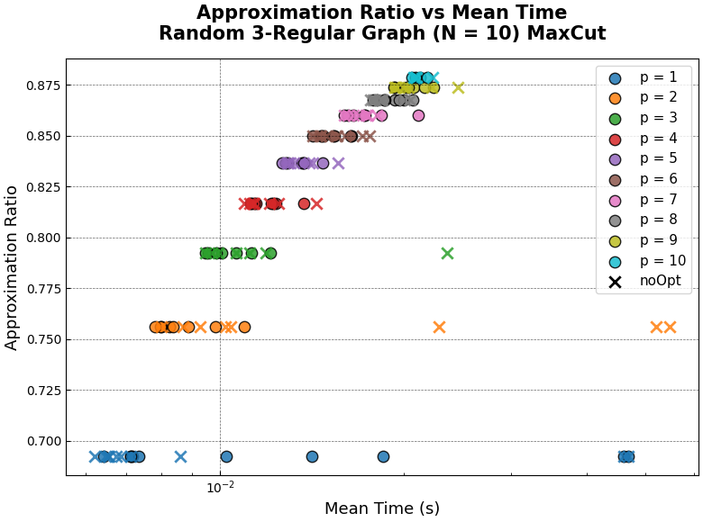
Performance Metric vs Resource
Consider 10 different instances of size N = 10 Random 3-Regular graphs each executed at different values of p as well as other parameters
Performance Metric : Approximation Ratio
Resource:
Mean Execution Time
Trainer: Fixed Angle Conjecture
Evaluator: State Vector

Slide 3
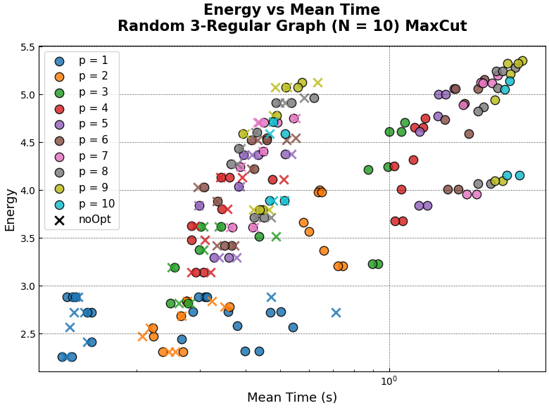
Performance Metric vs Resource
Consider 10 different instances of size N = 10 Random 3-Regular graphs each executed at different values of p as well as other parameters
Performance Metric: Energy
Resource:
Mean Execution Time
Trainer: Trotterized Quantum Annealing
Evaluator: State Vector

Slide 4
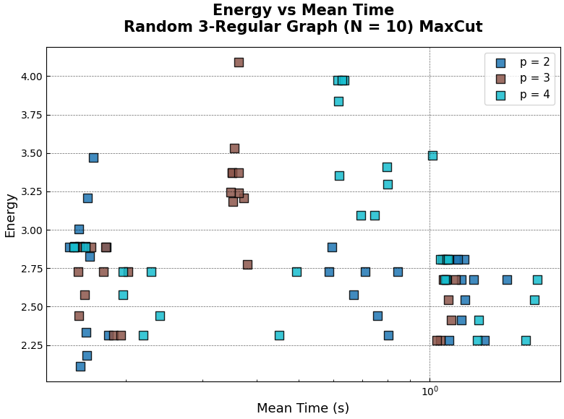
Performance Metric vs Resource
Consider 10 different instances of size N = 10 Random 3-Regular graphs each executed at different values of p as well as other parameters
Performance Metric: Energy
Resource:
Mean Execution Time
Trainer: Fourier
Evaluator: State Vector

Slide 5
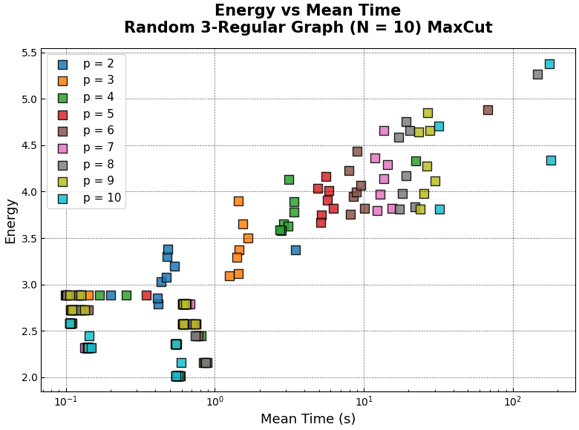
Performance Metric vs Resource
Consider 10 different instances of size N = 10 Random 3-Regular graphs each executed at different values of p as well as other parameters
Performance Metric: Energy
Resource:
Mean Execution Time
Trainer: Recursive Transition State
Evaluator: State Vector

Slide 6
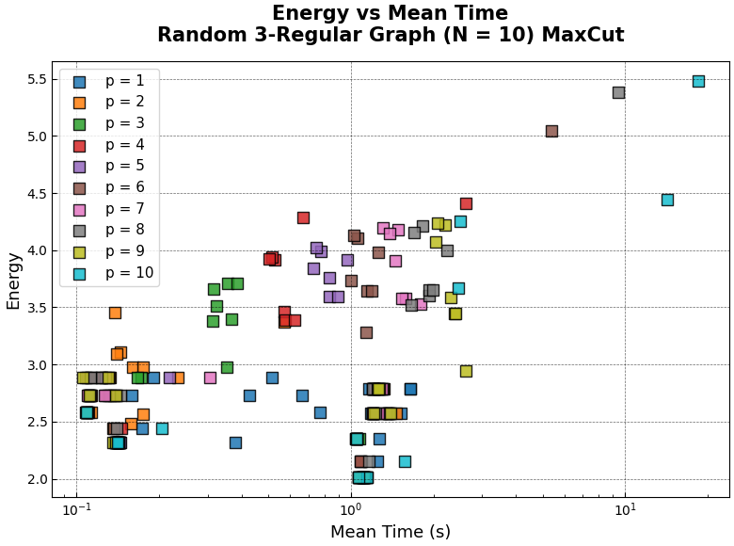
Performance Metric vs Resource
Consider 10 different instances of size N = 10 Random 3-Regular graphs each executed at different values of p as well as other parameters
Performance Metric: Energy
Resource:
Mean Execution Time
Trainer: Interpolation
Evaluator: State Vector

Slide 7
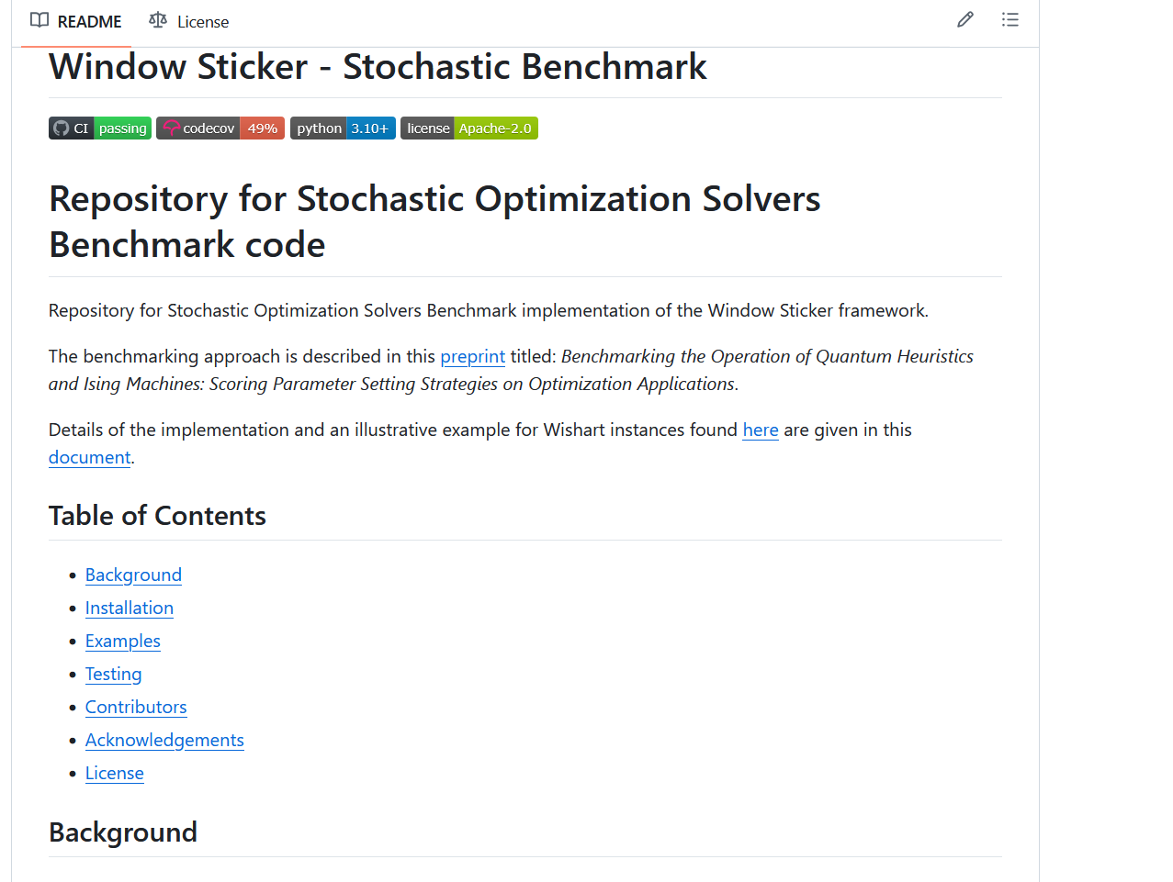
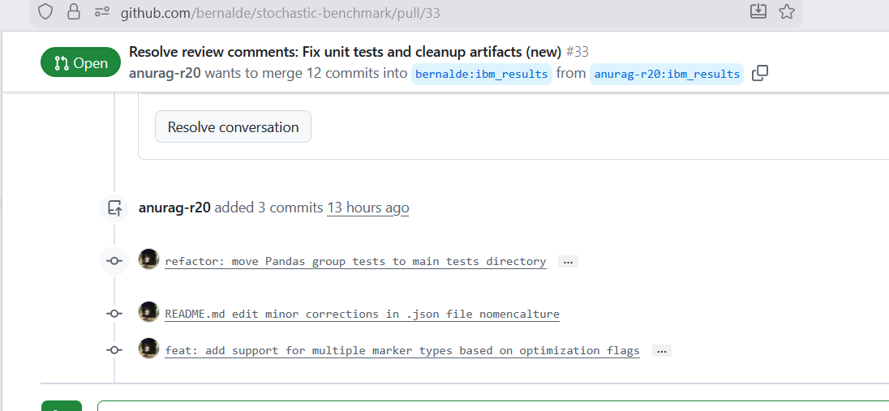
Next Steps
https://github.com/bernalde/stochastic-benchmark/pull/33
Analyze hardware data: Can produce plots with more detailed statistical analysis by treating this framework like a black-box

