Slide 1
QAOA parameter setting
12.08.2025

Slide 2
Summary and Agenda
Summary
QAOA training pipeline has been extended. Ready to run first benchmarks.
Agenda
Daniel: general update and next steps
Alejandro: TN methods
Other topics?

Slide 3
General update
Setup of the benchmarking
Resources for this project are available here Quantum-Working-Groups/QAOA-Parameter-Setting
Problem instances to benchmark on DONE
Method definition for the QAOA training pipeline IN PROGRESS (PR opened)
Transpilation for hardware execution IN PROGRESS (PR to follow soon opened)
Training pipeline
Now integrated with the Pauli propagation work of EPFL.
Recursive Transitions States trainer.
Pre-processing: SAT mapping which is relevant for TN evaluators.
Overleaf
Currently not much, focus was on code.

Slide 4
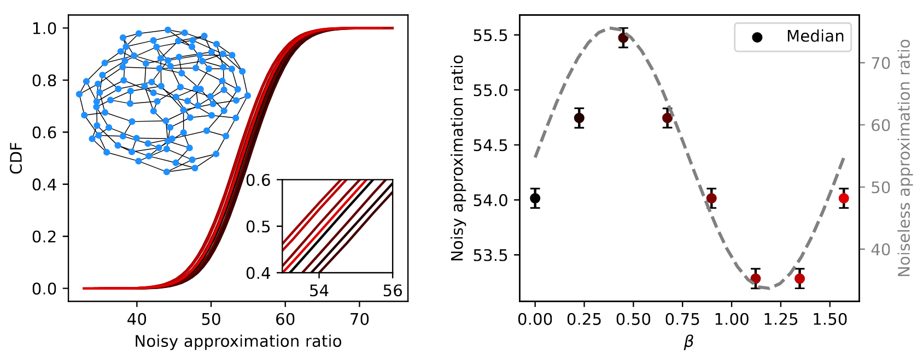
Next steps
Overview of QAOA parameter setting methods in main text: ONGOING – ~DONE
Taxonomy: sort the methods in the class ONGOING – ~DONE
Benchmarking planning
Define problem instances to test on ~DONE
Plan for what hardware can execute ONGOING
Transpilation for the problem instances ONGOING
Map which cases to execute (probably around 5k gates) ONGOING
Defne methods to test in the training pipeline: ONGOING
Define how to compare the benchmarking results: ONGOING
Integrate Pauli propagation and test DONE

Slide 5
Notes
Note

Slide 6
Next call
In three weeks from now: Tuesday 2nd September
Maybe an update on benchmarking, TBD

Slide 7
Discussion of 12.08.2025
Notes

