Slide 1
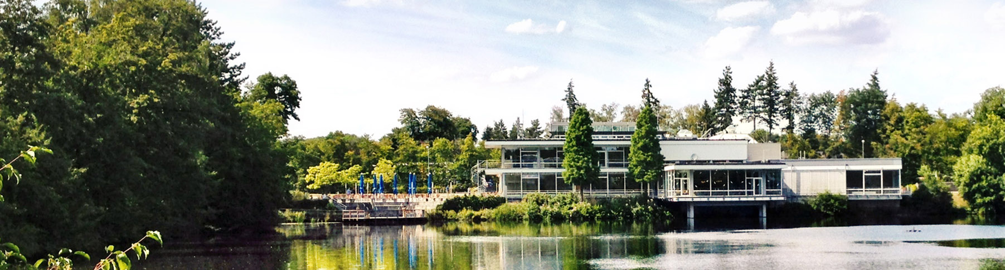
Belief propagation and MPS for LR-QAOA
Aug 13, 2025 I Alejandro Montanez-Barrera | FZJ - JSC

Slide 2
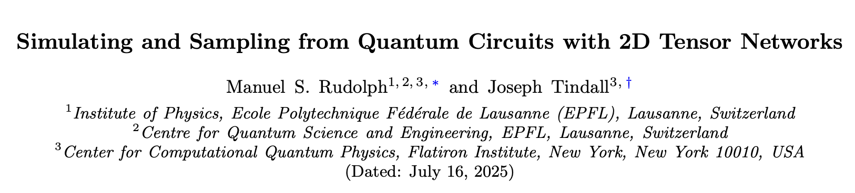
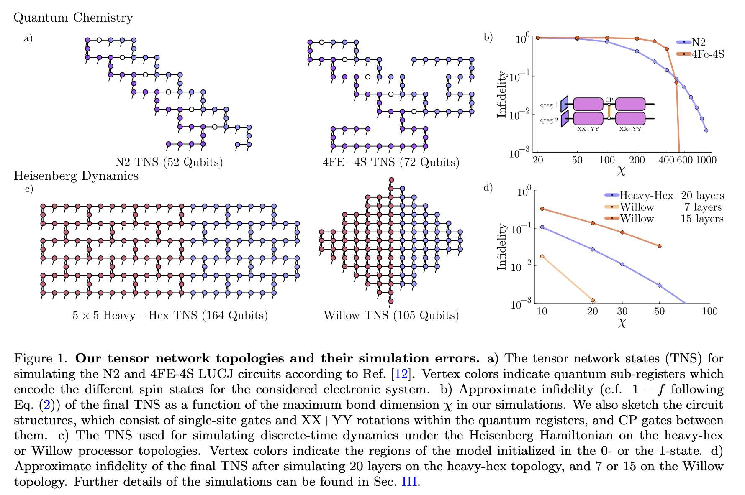

Slide 3
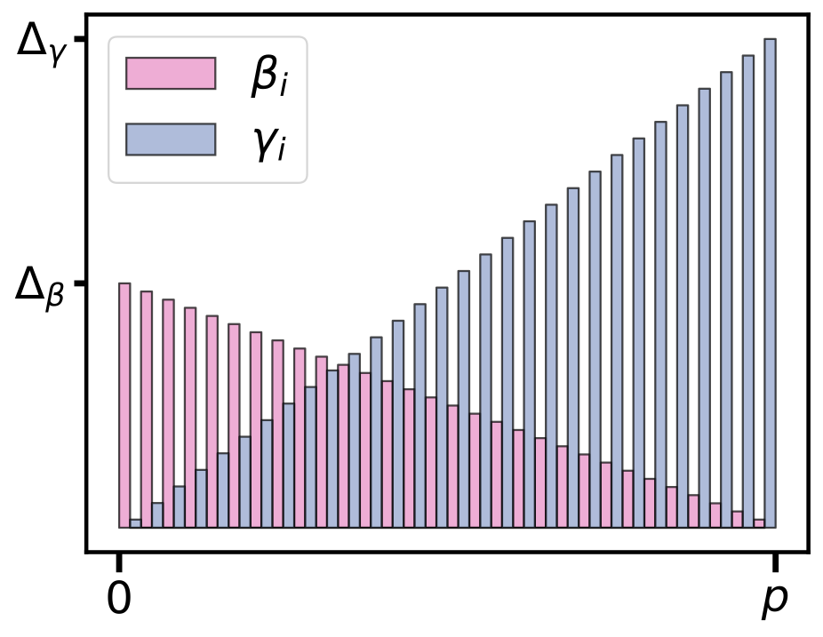
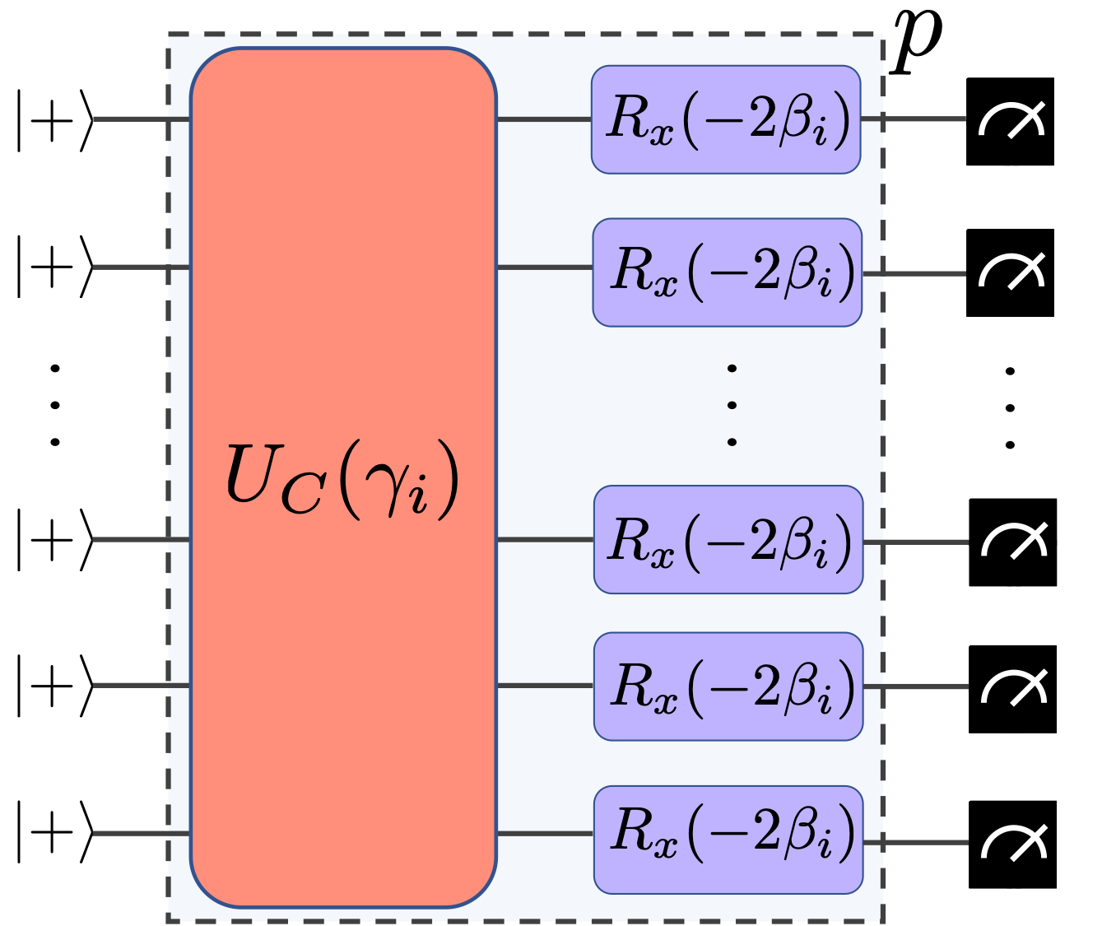
1. LR-QAOA
$$β_{i}=\left(1-\frac{i}{p}\right)Δ_{β}andγ_{i}=\frac{i+1}{p}Δ_{γ}$$

Slide 4
The problem behind LR-QAOA
$$x^{*}=00101$$
$$2$$
$$3$$
The weighted maxcut (WMC) problem involves determining the partition of the vertices in an undirected graph so that the total weight of the edges between the two sets is maximized.
$$1$$
$$0$$
$$4$$
Cost function
$$C(x)=\underset{(i,j)∈E}{∑}w_{ij}(x_{i}+x_{j}-2x_{i}x_{j})$$
$$w_{23}$$
$$w_{12}$$
$$2$$
$$3$$
$$r=\frac{∑_{k=1}^{n}C(x^{k})/n}{C(x^{*})}$$
Approximation ratio
$$1$$
$$w_{02}$$
$$w_{34}$$
$$w_{01}$$
$$w_{04}$$
$$0$$
$$4$$
$$x_{k}$$
sample solution
$$x^{*}$$
optimal solution
Performance metric
$$n$$
Samples

Slide 5
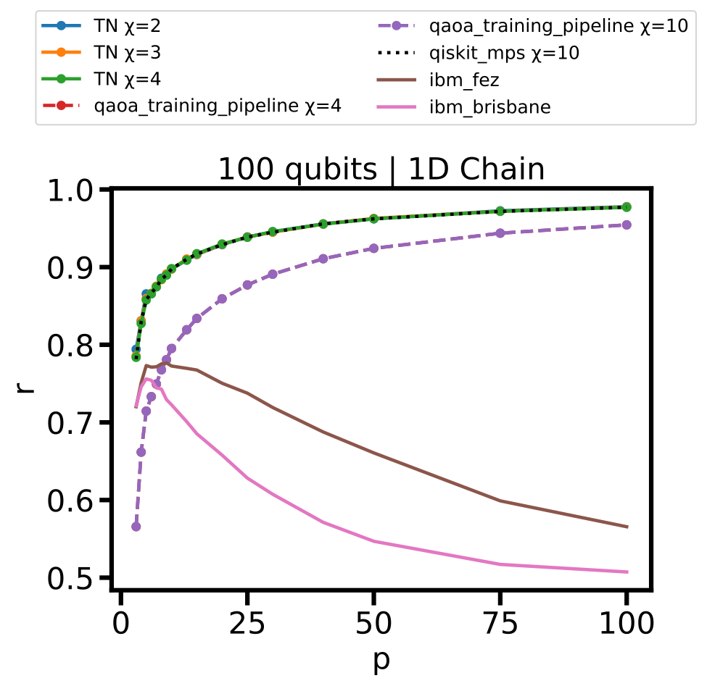
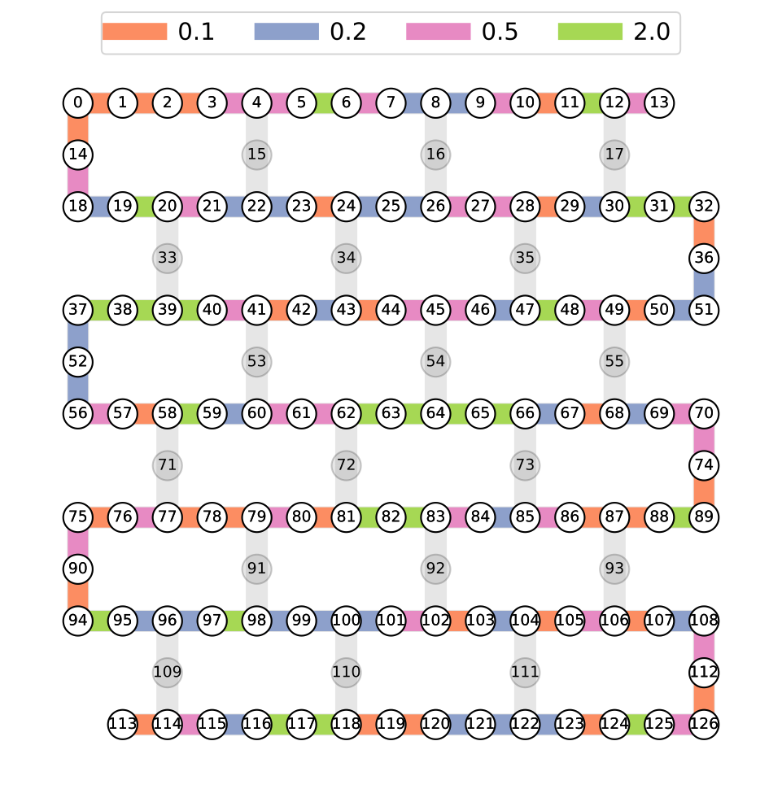
1D-Chain problem
$$q_{31}$$
$$ZZ\left(γ_{i}J_{31,32}\right)$$
$$q_{32}$$
$$q_{36}$$
$$ZZ\left(γ_{i}J_{36,51}\right)$$
$$q_{51}$$
$$q_{50}$$

Slide 6
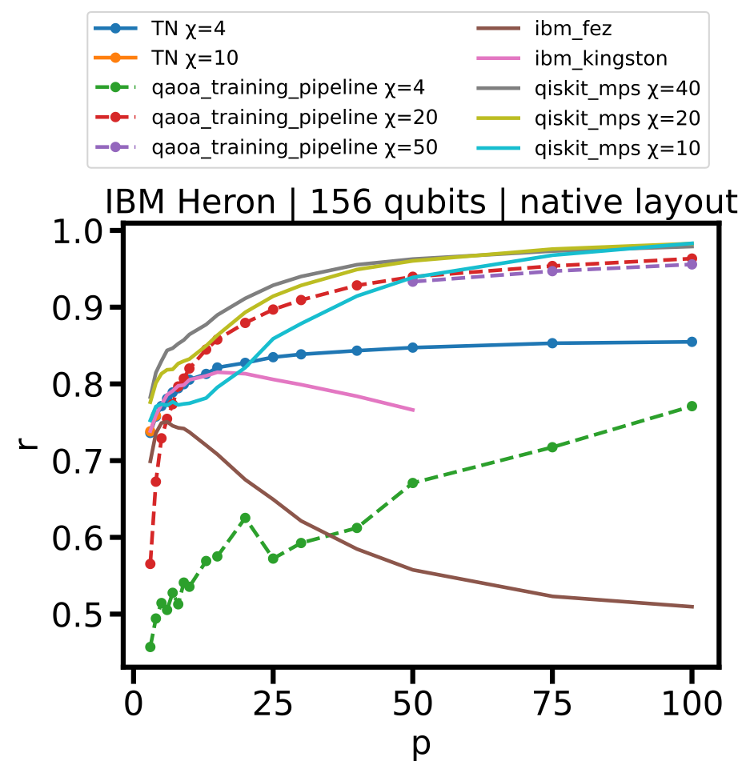
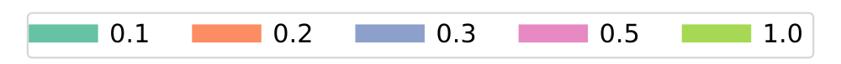
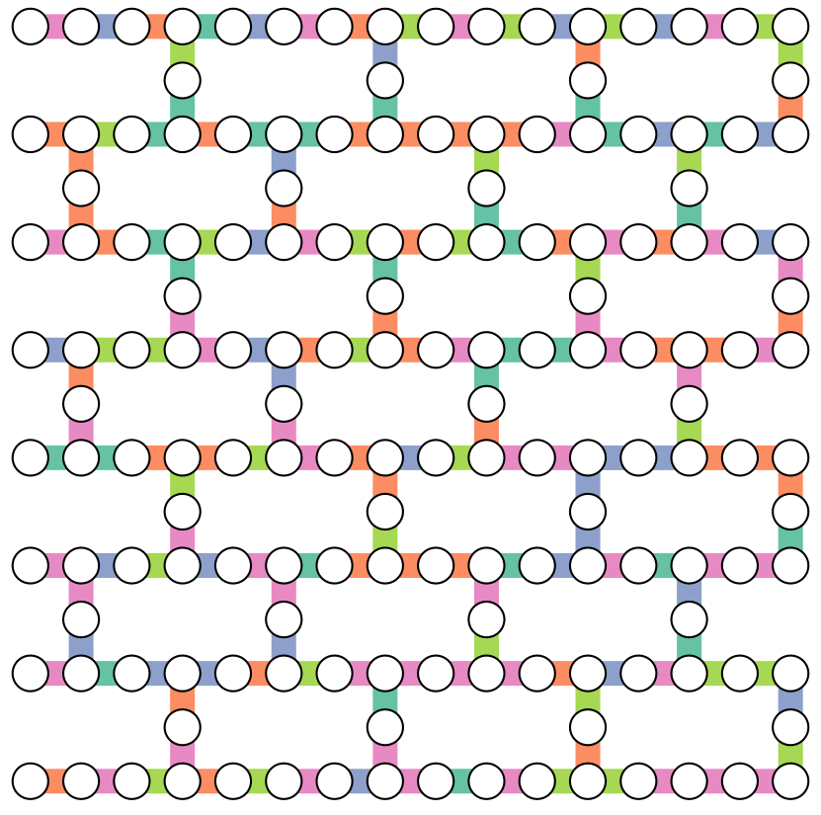
Heavy-Hex problem

Slide 7
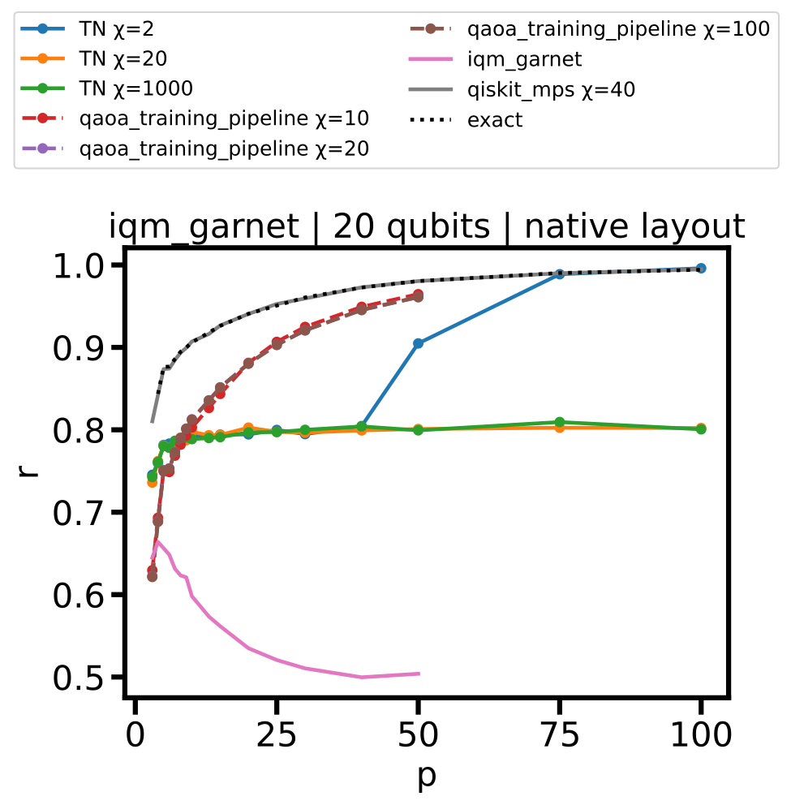
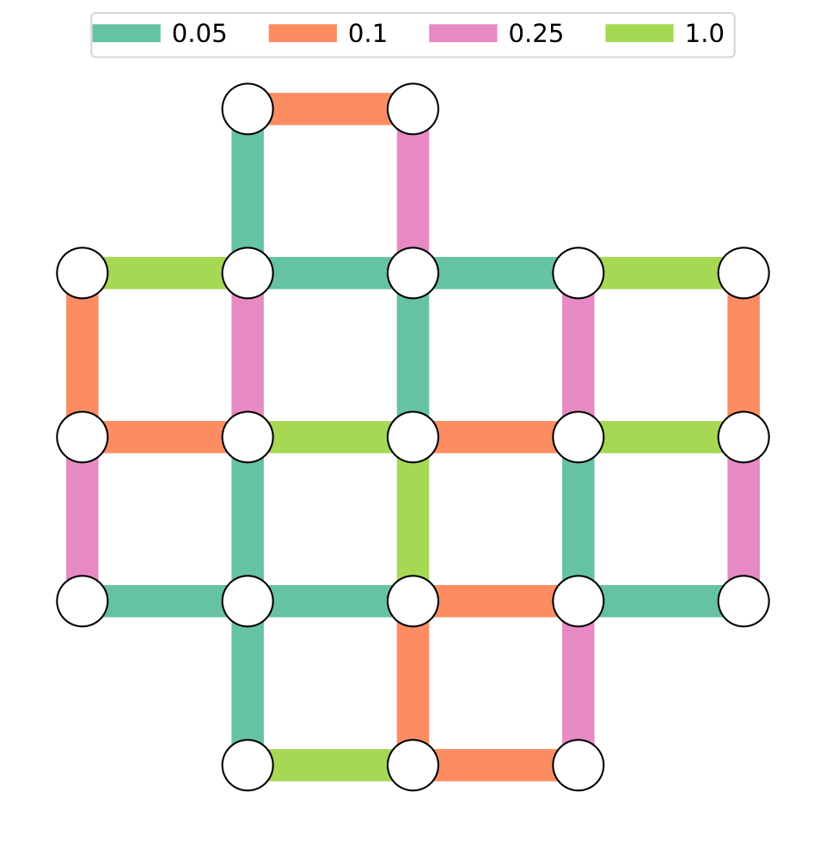
Square lattice problem

Slide 8
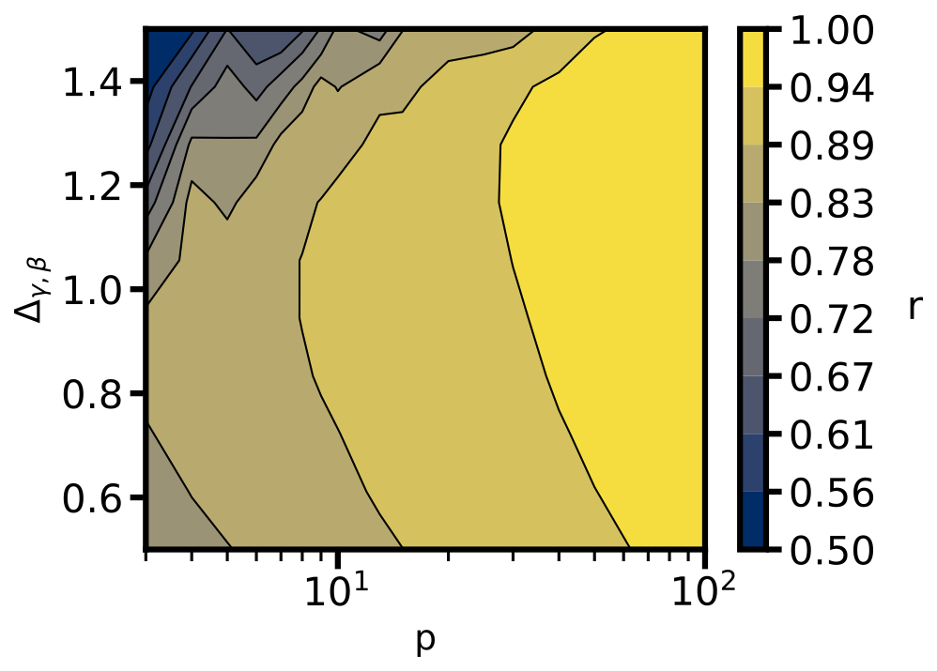
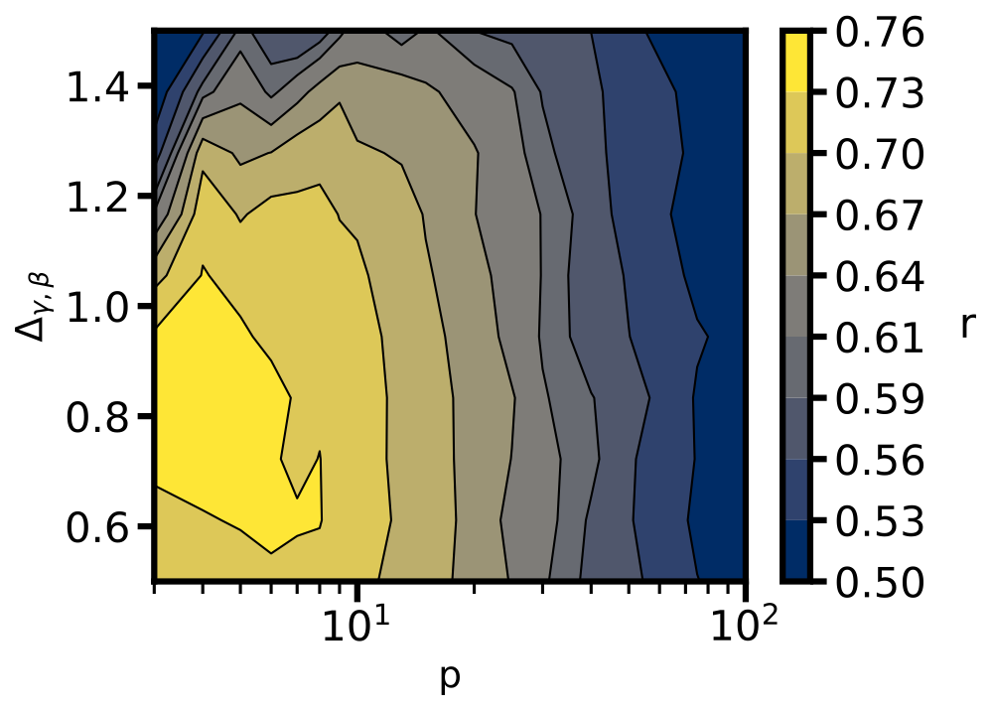
1D-Chain landscape - 30 qubit problem
MPS
ibm_brisbane

