Slide 1
A company pays to protect a forest. How do you know the forest was really saved?
Qanopy checks, every week.
Quantum x Finance Hackathon
Notes:
Companies pay to protect forests. The trees keep carbon out of the air. How do you know a forest was really saved? Today, auditors check now and then. We check every week.

Slide 2
You cannot see a forest that was never cut down
The promise
Pay to protect a forest. The trees keep carbon out of the air.
The catch
To prove it worked, you must know what would have happened without the project. That never happened, so it is guessed.
The check
Auditors look now and then. Nobody watches every week.
Qanopy · Carbon credit verification
2
Notes:
A carbon credit is a payment to protect a forest. To prove it worked, you must show how much forest would have been cut without the project. That never happened, so it is guessed on paper. Nobody watches week by week.

Slide 3
We compare protected forest with look-alike forest
Upload
Match
Watch
Compare
Publish
the project's
map file
50 look-alike
forest patches
weekly radar
from satellites
forest saved,
in tons of CO2
a public score
as an NFT
What is an NFT?
A public record on a blockchain. Anyone can read it. Nobody can quietly change it.
Any project
Upload a map file. Four projects run today.
Qanopy · Carbon credit verification
3
Notes:
Take the protected forest. Find 50 similar patches nearby that are not protected. Satellites with radar see trees disappear every week, even through clouds. If the protected forest loses less, the difference is forest saved. We turn that into carbon dioxide and compare it with the promise. The score goes on a blockchain as an NFT: a public record nobody can quietly change.

Slide 4
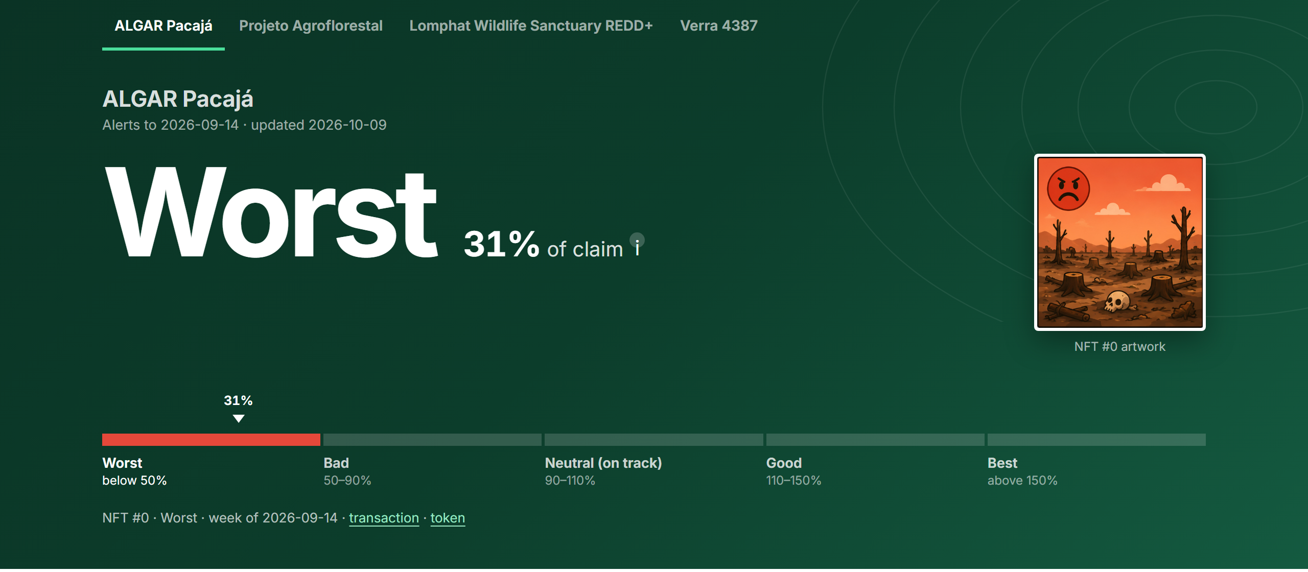
ALGAR, Brazil: 31% of the promise delivered so far
Protected forest lost 0.58%. Look-alikes lost 4.61%. Score: Worst. A warning to look closer.
Qanopy · Carbon credit verification
4
Notes:
Here is ALGAR in Brazil. The protected forest lost 0.58% of its trees. The look-alikes lost 4.61%. That is about 8,000 football pitches saved, or 31% of the promise so far. The score is Worst, a warning to look closer.

Slide 5
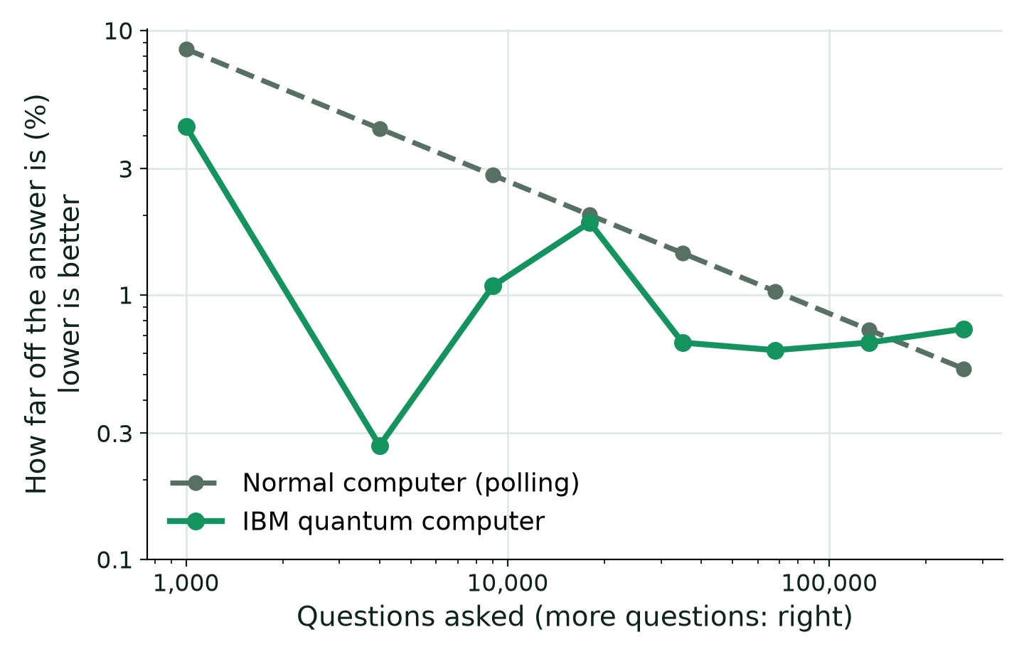
We tested a quantum shortcut on IBM's quantum computer
Idea
A poll needs many random questions. A quantum computer can ask smarter ones.
Result
Up to 16 times more accurate at 5 of 8 sizes.
Limit
Chip mistakes pile up. At the biggest size the edge was gone.
Qubit = quantum bit. One test run per point on IBM's 156-qubit chip.
Qanopy · Carbon credit verification
5
Notes:
Now the quantum part. A normal computer estimates an average like a poll: it asks random questions. Ten times more precision needs a hundred times more questions. Quantum amplitude estimation needs only ten times more. We ran it on IBM's quantum computer. It beat the normal method at five of eight sizes, up to sixteen times better. But quantum chips make small mistakes, and at the biggest size they cancelled the advantage.

Slide 6
Quantum could save computing time at large scale
Today
Normal computers win at every size we can run. Our quantum parts are tests.
Also tested
Picking the best 3 of 8 forest patches: found in 71% of valid runs. Guessing: 1.8%.
Later
For 1% precision, polling needs about 98,000 questions and quantum about 2,000. That helps when each question is a heavy simulation.
Needed
Chips that make about 3,000 times fewer mistakes.
Qanopy · Carbon credit verification
6
Notes:
Today, normal computers win at every size we can run. We also asked the quantum computer to pick the best three of eight patches. It found the best choice in 71% of valid runs, against 1.8% for guessing. Later, one-percent precision needs about 98,000 questions by polling and 2,000 by quantum. That matters when each question is a heavy simulation and we watch thousands of projects. Chips must first make 3,000 times fewer mistakes.

Slide 7
Who would pay for this
Who pays
Credit buyers, registries, insurers and banks. They need to trust credits.
How
A subscription for each project we monitor.
Today
Working prototype on 4 projects. NFTs on a test blockchain, not real money.
Built here
Quantum tests, weekly monitoring, NFT score, upload page.
Next
Use real carbon data from each project instead of our guess.
Built with: Google Earth Engine, radar satellite data, Qiskit, IBM Quantum, Base Sepolia, IPFS
Notes:
Credit buyers, registries, insurers and banks need to trust credits. They would pay a subscription per project. We have a working prototype on four projects. The NFTs are on a test blockchain, not real money. Next, we replace our guess of how much carbon a forest holds with project data.

