Slide 1
FACTSHIELD
FactShield
PROJECT SNAPSHOT
An explainable misinformation-verification system with retrieval, reasoning, analyst workflow, and report export in one platform.
Problem
Gap
Manual verification is slow and fragmented.
Ordinary tools do not connect verdicts, evidence, and workflow.
5
4
1
Approach
Product
Classify, retrieve, reason, explain, and operationalize.
Reports, team review, settings, and analyst handoff.
pipeline stages
validated demo cases
real report export flow
FactShield final presentation
April 28, 2026
Notes:
Open by naming the system clearly and telling the audience this is both a technical pipeline and a usable product.
[Sources]
- Current FactShield frontend with command center, reports, team, settings, and export workflow.

Slide 2
PROBLEM STATEMENT
02 / 12
Why misinformation verification is difficult in practice
Claims spread quickly across text, screenshots, and short videos, but reliable verification still depends on slow manual evidence collection and interpretation.
Speed mismatch
Evidence fragmentation
Low explainability
False or misleading content spreads in minutes, while manual cross-checking often takes much longer.
Sources, screenshots, and notes get scattered across tabs, chats, and ad hoc documents.
A simple label is not enough when an analyst must justify why a claim was supported or refuted.
CORE CHALLENGE
We need a system that reduces verification time while preserving evidence quality, reasoning transparency, and an auditable review workflow.
The project is motivated by workflow failure, not only model accuracy.
Problem framing
Notes:
Keep the story operational. Faculty will understand this better if you talk about the analyst's job rather than the internet in general.
[Sources]
- Current FactShield frontend with command center, reports, team, settings, and export workflow.

Slide 3
GAP ANALYSIS
03 / 12
What is missing in common verification setups
The gap is not just weak classification. The deeper gap is the absence of a unified pipeline from intake to evidence to final reporting.
Current approach
Observed gap
What FactShield adds
Outcome
Manual article search
Evidence gathering is slow and inconsistent.
Retrieval with FAISS and reranking.
Faster evidence surfacing
Label-only classifier
Users cannot justify the output.
Debate verdict plus trace and evidence tabs.
Explainable decision support
Static dashboards
No operational handoff after analysis.
Reports, team assignment, settings, export.
Usable SaaS workflow
This slide turns the project into a clear design response to an identified gap.
Gap analysis
Notes:
Use this slide to show that the project has a rationale beyond a model choice.
[Sources]
- Local architecture document and implemented backend pipeline.
- Current FactShield frontend with command center, reports, team, settings, and export workflow.

Slide 4
OUR APPROACH
04 / 12
Proposed solution: an end-to-end verification workspace
FactShield combines machine learning, retrieval, reasoning, and analyst operations so verification can move from raw claim to final report inside one system.
1
Ingest
2
Analyze
3
Reason
4
Explain
5
Operate
Accept claim text, image OCR output, or extracted video transcript.
Classify veracity and toxicity, then trigger search and retrieval when needed.
Use a structured debate to synthesize the final verdict.
Surface evidence, traces, and report-ready notes.
Assign, export, and review.
Design objective 1
Design objective 2
Design objective 3
Reduce analyst effort without hiding the reasoning path.
Connect verification outputs to persistent reports and review workflows.
Present results through a modern SaaS interface rather than disconnected scripts.
This is the high-level answer to the gap slide.
Approach overview
Notes:
Say clearly: our contribution is not only detection, but also operationalization.
[Sources]
- Local architecture document and implemented backend pipeline.
- Current FactShield frontend with command center, reports, team, settings, and export workflow.

Slide 5
ARCHITECTURE
05 / 12
System architecture
The system is organized as a frontend workspace, a FastAPI backend, and a verification pipeline with persistence and retrieval services.
FastAPI orchestration layer
Frontend SaaS
Receives verification requests, manages task state, exposes feed and workspace APIs, and returns structured results.
External evidence
Command center, reports, team, settings, archive, and review surfaces.
Trusted article sources and retrieved candidate evidence.
Verification pipeline
Classification, search, FAISS retrieval, reranking, debate reasoning, and explainability.
Operator actions
Outputs
Paste claims, open reports, assign investigations, export briefings.
Persistence and services
Verdict, evidence, reports, team assignment, and settings-aware workflow.
SQLite tasks, workspace state, result export, cache, and rate limits.
This slide is your static architecture diagram for the viva-style part of the presentation.
System view
Notes:
Move left to right: user-facing layer, core backend, services, and outputs.
[Sources]
- Local architecture document and implemented backend pipeline.
- Current FactShield frontend with command center, reports, team, settings, and export workflow.

Slide 6
FLOWCHART
06 / 12
Verification pipeline flow
This is the logic path that turns an incoming claim into an explainable verdict.
Decision gate
Input
Classify
Retrieve
Debate
Explain
When confidence is weak or uncertain, retrieval becomes more important.
1
2
3
4
5
User submits text, image, or video-derived text.
XLM-R predicts veracity and toxicity priors.
Search plus FAISS fetch evidence candidates.
Prosecutor, defense, and judge synthesize verdict.
Evidence tab, trace, notes, and report summary.
Stored output
Results become saved investigations and backend-backed report records.
Why this matters
The pipeline is designed so that model output is not the final artifact. The final artifact is an evidence-backed, reviewable verification result.
This is the clearest pipeline explanation slide.
Verification flow
Notes:
Stress that explainability and persistence are downstream from reasoning, not optional extras.
[Sources]
- Local architecture document and implemented backend pipeline.
- Current FactShield frontend with command center, reports, team, settings, and export workflow.

Slide 7
USER WORKFLOW
07 / 12
How a user moves through FactShield
This operator workflow shows how the product turns backend intelligence into an actual review process.
1. Verification console
Paste claim or upload media, then start analysis.
Immediate system response: status, pipeline stage, retrieved evidence.
2. Review queue and investigations
Open live items, inspect source context, and move cases into investigation handling.
3. Reports, assignment, and settings
Save metadata, assign investigators, update workspace controls, and export the final report.
4. Delivery and briefing
Decision-makers receive a downloadable report with verdict, confidence, notes, and evidence summary.
Use this slide to connect technical depth to actual product use.
User journey
Notes:
Say that this is where the system becomes a SaaS workflow rather than a lab pipeline.
[Sources]
- Current FactShield frontend with command center, reports, team, settings, and export workflow.

Slide 8
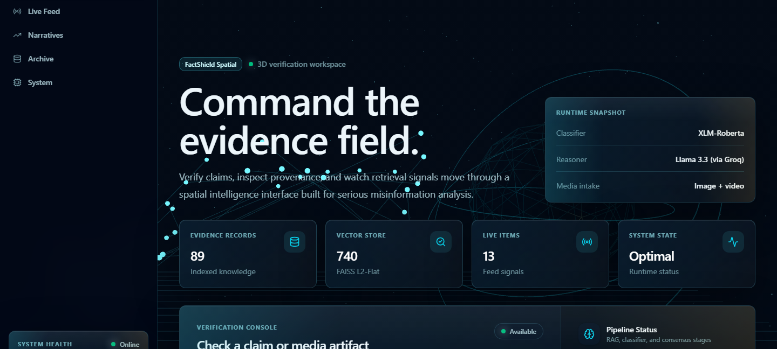
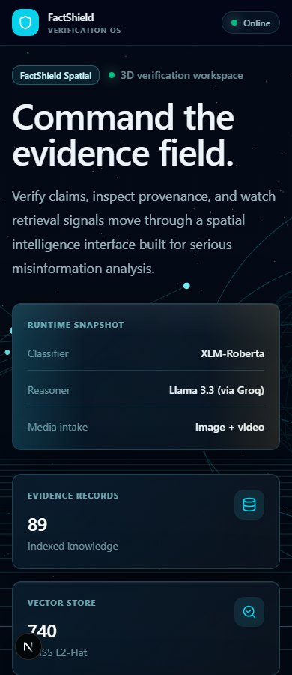
PRODUCT
08 / 12
Implemented SaaS workspace
We redesigned the frontend to behave like a coherent operator product rather than a disconnected set of screens.
REPORTS
TEAM
SETTINGS
A strong product slide matters because it proves implementation maturity.
Frontend redesign
Notes:
Call out the verification console, pipeline status, review queue, and the unified shell.
[Sources]
- Current FactShield frontend with command center, reports, team, settings, and export workflow.

Slide 9
IMPLEMENTATION
09 / 12
Key capabilities delivered
The project now includes backend-backed workflow features, not only verification endpoints.
Report export
Saved investigations
Team assignment
Export produces a real downloadable report instead of a visual placeholder button.
Reports are now derived from persisted verification tasks and live backend records.
Investigations can be assigned through the Team workspace and persisted.
Settings persistence
Approval workflow
Text normalization
Workspace controls save status, detail, and value instead of staying static.
Reports store owner, audience, approval status, reviewer identity, notes, and export metadata.
Historic stored payloads were cleaned so report-facing text remains presentation-ready.
This is the implementation-summary slide for the product engineering part.
Delivered work
Notes:
This is a good place to mention that the frontend is now backed by live data for reports, team, and settings.
[Sources]
- Current FactShield frontend with command center, reports, team, settings, and export workflow.

Slide 10
VALIDATION
10 / 12
Scenario testing before presentation
We tested a short set of claims against the live backend to identify strong demo paths and risky edge cases.
4
3
1
1
successful case types
evidence hits in strong cases
hate case flagged
invalid input blocked
Scenario
Verdict
Veracity
Evidence
RESULTS SNAPSHOT
Factual claim
Supports
real
3
Political misinformation
Refutes
fake
3
Toxic post
Refutes
misleading
3
Tiny invalid input
Rejected
400
0
These results are why tomorrow's demo should stay inside rehearsal-tested claims.
Scenario testing
Notes:
Be explicit that vague claims are possible but less convincing as a live presentation route.
[Sources]
- Live scenario tests run on April 28, 2026 before the presentation.

Slide 11
LIMITS & FUTURE WORK
11 / 12
Current limitations and next improvements
A credible system presentation should acknowledge what is working now and what still deserves improvement.
Current limitations
Near-term improvements
Why the project is still strong
1. Vague claims can still receive strong verdicts.
2. The strongest demo path is still text-first.
3. Wider multimodal validation is still limited.
4. Some judgments still depend on retrieval quality.
1. Better uncertainty handling for weak inputs.
2. More image and video demo validation.
3. Richer reviewer audit trail.
4. Expanded evidence-source diversity.
The system already connects ML, retrieval, explainability, persistence, and product workflow in one coherent implementation.
Good presentation framing: this project solves the integrated verification workflow problem and creates a solid base for deeper multimodal and uncertainty-aware research.
Faculty usually appreciate a strong limitations slide.
Roadmap
Notes:
This slide helps you stay honest and calm in Q and A.
[Sources]
- Current FactShield frontend with command center, reports, team, settings, and export workflow.
- Live scenario tests run on April 28, 2026 before the presentation.

Slide 12
CONCLUSION
12 / 12
FactShield in one sentence
FactShield is an explainable misinformation-verification platform that connects technical analysis to real analyst workflow.
Problem addressed
System contribution
Product contribution
Slow, fragmented, and weakly explainable verification workflows.
A pipeline that classifies, retrieves, reasons, explains, and operationalizes results.
A SaaS interface with reports, assignments, settings, and export built on live backend data.
Thank you. The next step in the presentation is the live walkthrough using the tested claim sequence.
Questions
End here before switching to the live product demo.
Presentation close
Notes:
This is the clean closing slide. Pause here before the live demo or Q and A.
[Sources]
- Current FactShield frontend with command center, reports, team, settings, and export workflow.

