Slide 1
RESULTS AND DISCUSSION
Objective 1 · Objective 2 · Objective 3 · Conclusion · Recommendations · Research Limitations and Future Work · References

Slide 2



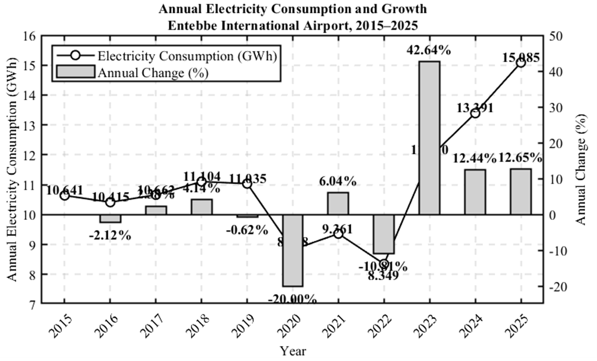


Annual Electricity Consumption Trend
SLIDE 1/6: RESULTS AND DISCUSSION-Objective 1
Main finding
Electricity demand entered a sustained higher-growth period after 2022.
Analytical Basis
Results
Annual change_{t} = (E_{t} − E_{t−1}) / E_{t−1} × 100%
Compound Annual Growth Rate (CAGR) = [(E₂₀₂₅ / E₂₀₁₅)^{1/10} − 1] × 100
Consumption increased from 10.641 GWh in 2015 to 15.085 GWh in 2025.
Overall increase: 41.8%.
CAGR: approximately 3.6%.
Largest decline: −20.00% in 2020.
Largest increase: 42.64% in 2023.
Consumption increased for three consecutive years from 2023 to 2025
Discussion
Demand was relatively stable before 2020, declined during 2020–2022 and then recovered strongly. The consecutive increases after 2022 indicate a sustained shift to a higher electricity-demand leve.
Practical implication
Future electricity procurement and electrical-infrastructure planning should account for the higher post-2022 demand level.

Slide 3
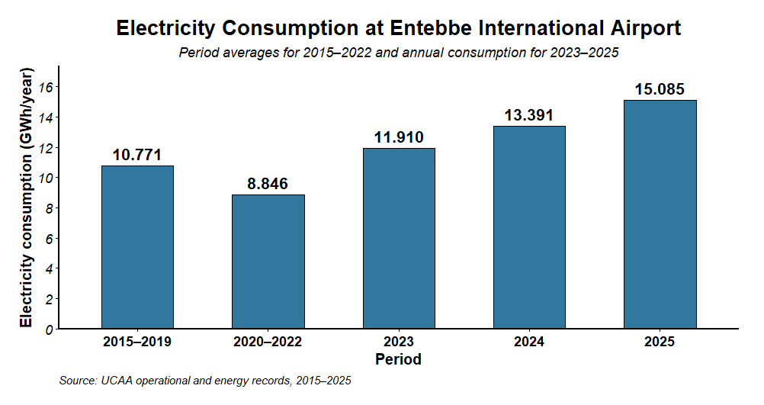
Monthly and Period Demand Characteristics
SLIDE 2/6: RESULTS AND DISCUSSION-Objective 1 contnd.
Main finding
Monthly observations confirm that the post-2022 recovery was sustained.
Analytical Basis
Results
E_{y} = Σ_{m=1}¹² E_{y,m} I_{y,m} = E_{y,m} / Ē_{y} × 100
Where E_{y,m} is monthly electricity consumption and Ē_{y} is the average monthly consumption in year (y).
Period | Average annual consumption
2015–2019 | 10.771 GWh/year
2020–2022 | 8.846 GWh/year
2023–2025 | 13.462 GWh/year
The 2023–2025 average was the highest of the three periods.
Annual consumption increased continuously after 2022.
Discussion
The increase after 2022 was reflected across several monthly observations rather than one isolated annual value, indicating a sustained change in the airport’s demand level.
Practical implication
Monthly observations were appropriate for examining temporal dependence and developing the forecasting models under Objective Two.

Slide 4
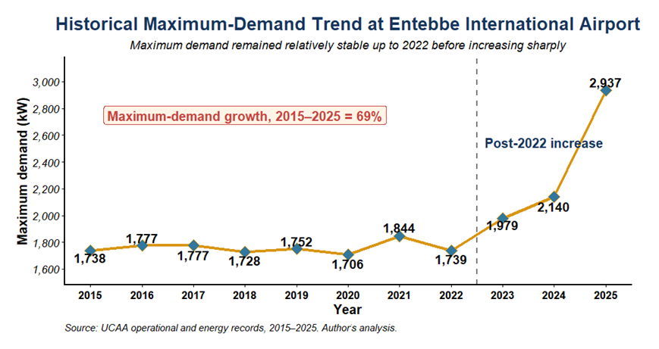
Historical Maximum-Demand Trend
SLIDE 3/6: RESULTS AND DISCUSSION-Objective 1 contnd.
Main finding
Maximum demand increased faster than annual electricity consumption.
Analytical Basis
Results
peak growth = (MD₂₀₂₅ − MD₂₀₁₅) / MD₂₀₁₅
Load factor (LF) = Annual Energy / (8760 × MD) × 100
Maximum demand increased from 1,738 kW in 2015 to 2,937 kW in 2025.
Overall peak-demand increase: 69.0%.
Increase between 2024 and 2025: 37.2%.
Annual energy increased by 41.8% between 2015 and 2025.
Approximate load factor declined from 69.9% to 58.7%.
Discussion
Maximum demand increased more strongly than annual energy, while load factor declined. This indicates increasingly pronounced peak loading relative to average demand.
Practical implication
The result has implications for transformer capacity, switchgear ratings, protection coordination and peak-demand management..

Slide 5
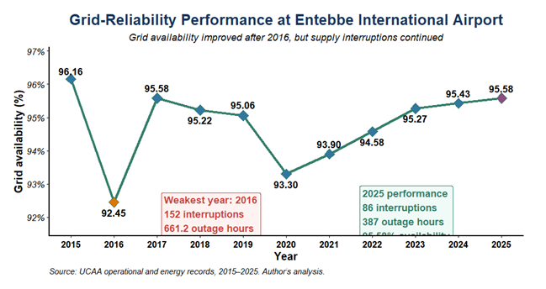
Grid-Reliability Performance
SLIDE 4/6: RESULTS AND DISCUSSION-Objective 1 contnd
Main finding
Grid reliability improved, but outages still required standby supply.
Analytical Basis
Results
Grid availability_{y} (A_{y}) = 100(8760 − H_{Out,y}) / 8760
D̄_{y} = Average intruption duration index = H_{out,y} / N_{out,y} × 100
Indicator | 2016: weakest year | 2025
Interruptions | 152 | 86
Outage duration | 661.2 h | 387.0 h
Availability | 92.45% | 95.58%
Average duration | 4.35 h/event | 4.50 h/event
Discussion
Grid availability improved after 2016, but 387 outage hours in 2025 remained operationally significant for an airport.
Practical implication
Standby generators and UPS systems remained necessary for critical loads and operational continuity.

Slide 6
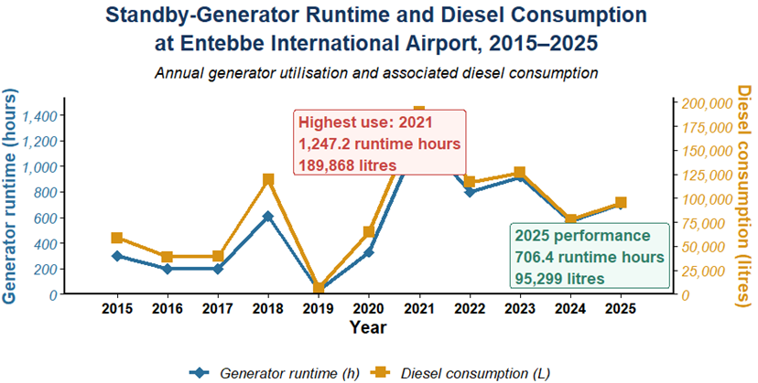
Standby-Generator Utilisation
SLIDE 5/6 RESULTS AND DISCUSSION-Objective 1 contnd.
Main finding
Generator runtime and diesel consumption remained operationally significant.
Analytical Basis
Results
fuel intensity_{y} (F̄_{y}) = D_{y} / R_{y}
Where (Dy) is diesel consumption in liters and (Ry) is generator runtime in hours
Indicator | 2021: highest use | 2025
Runtime | 1,247.2 h | 706.4 h
Diesel consumption | 189,868 L | 95,299 L
Average consumption rate | 152.2 L/h | 134.9 L/h
Discussion
Generator runtime and diesel consumption generally moved together. However, runtime may also have been affected by testing, outage timing, load level and other operational requirements..
Practical implication
Standby generation remained essential but continued to impose fuel and maintenance costs.

Slide 7
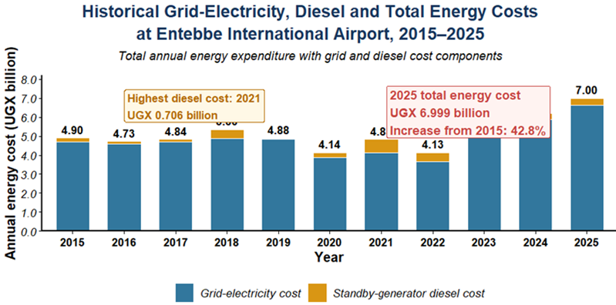
Historical Energy Expenditure
SLIDE 6/6 RESULTS AND DISCUSSION-Objective 1 contnd.
Main finding
Total energy expenditure reached its highest level in 2025
Analytical Basis
Results
Total energy costᵧ = Grid electricity costᵧ + Diesel costᵧ
Cost change = (C₂₀₂₅ − C₂₀₁₅) / C₂₀₁₅ × 100
Total energy cost in 2025: UGX 6.999 billion.
Increase from 2015: 42.8%.
Grid electricity remained the largest cost component.
Highest diesel cost: UGX 705.929 million in 2021.
Discussion
Increasing electricity consumption raised grid expenditure, while generator operation added a variable cost for maintaining supply continuity.
Practical implication
The historical expenditure provides the economic baseline for evaluating potential grid-cost savings from the proposed solar PV system.

Slide 8
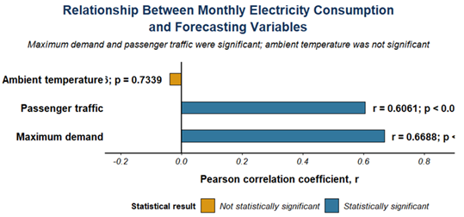
Dataset and Explanatory Variables
RESULTS AND DISCUSSION objective 2
Main finding
Electricity demand was primarily associated with maximum demand and passenger activity
Analysis Basis
Results
E_{t} = β₀ + β₁MD_{t} + β₂P_{t} + β₃T_{t} + ε_{t}
Maximum demand: (r=0.6688,p<0.001)
Passenger traffic :( r=0.6061, p<0.001).
Temperature: (r = -0.0376, p = 0.7339).
Combined ( R² =0.5664).
Dataset partition
Dataset | Period | Months | Share
Training | 2015–2021 | 84 | 63.6%
Validation | 2022–2023 | 24 | 18.2%
Independent test | 2024–2025 | 24 | 18.2%
Discussion
Maximum demand and passenger traffic were significantly associated with monthly electricity consumption. Temperature showed little independent statistical contribution
Practical implication
The variables were evaluated as external predictors in the SARIMAX model..

Slide 9
Stationarity and Lag Structurel
RESULTS AND DISCUSSION Objective 2 continued
Main finding
First differencing produced a stationary electricity-demand series
Analysis Basics
Results
ΔE_{t} = E_{t} − E_{t−1} H₀: the series contains a unit root
Strongest ACF/PACF response: lag 1, approximately −0.5055.
Seasonal lags 12, 24 and 36 remained within approximately ± 0.2151
Series | ADF statistic | p-value | Decision
Original | −2.9837 | 0.1724 | Non-stationary
First difference | −5.8071 | <0.01 | Stationary
Discussion
First differencing removed the non-stationary component, giving (d=1). Dependence remained mainly at short lags, while seasonal differencing was not supported, giving (D=0).
Practical implication
Seasonal AR and MA terms were still evaluated to determine whether annual seasonal dependence improved model fit.

Slide 10
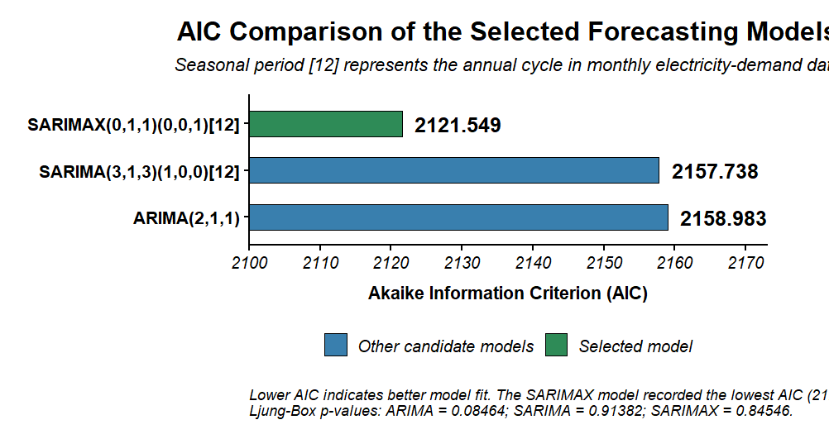
ARIMA and SARIMA Selectionl
RESULTS AND DISCUSSION Objective 2 continued
Main finding
Seasonal modelling produced a small but statistically supported improvement
Analysis Basics
Results
ARIMA(p,1,q) SARIMA(p,1,q)(P,0,Q)₁₂ Lower AIC indicates better relative fit
Model | AIC | Key diagnostic
ARIMA(2,1,1) | 2158.983 | Ljung–Box (p=0.08464)
SARIMA(3,1,3)(1,0,0)12 | 2157.738 | Seasonal AR (p=0.03281) Ljung–Box (p=0.91382)
Discussion
SARIMA reduced AIC by only 1.245. However, the significant seasonal AR coefficient supported retaining an annual seasonal component.
Practical implication
Model selection was based on AIC, coefficient significance and residual diagnostics rather than AIC alone

Slide 11
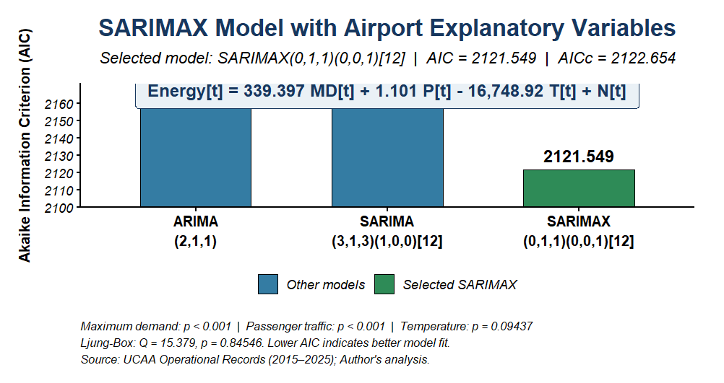
SARIMAX Model
RESULTS AND DISCUSSION Objective 2 continued
Main finding
Airport explanatory variables produced the largest improvement in model fit.
Analysis Basics
Results
Energy_{t} = 339.397MD_{t} + 1.101P_{t} − 16,748.92T_{t} + N_{t}, N_{t} = SARIMA(0,1,1)(0,0,1)12
Selected model: SARIMAX(0,1,1)(0,0,1)12
AIC: 2121.549.
AICc: 2122.654.
Maximum demand: (p <0.001).
Passenger traffic: (p <0.001).
Temperature: (p =0.09437).
Ljung–Box: (p =0.84546).
Discussion
Including airport variables reduced AIC by 36.189 relative to SARIMA. Maximum demand and passenger traffic were significant, while temperature provided limited additional information.
Practical implication
Airport loading and operational activity improved the representation of electricity demand more than ambient temperature.

Slide 12
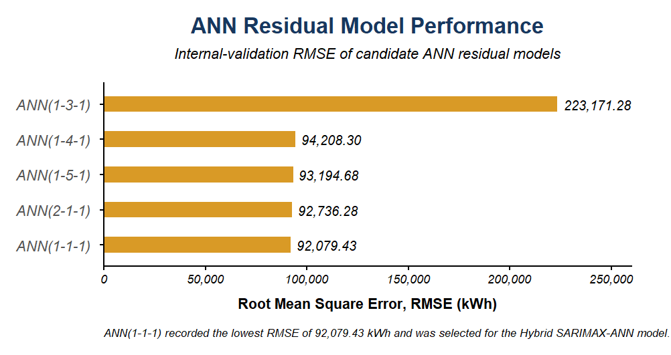
ANN Residual Learner and Hybrid Construction
RESULTS AND DISCUSSION Objective 2 continued
Main finding
The ANN supplied only a small residual correction.
Analysis Basics
Results
Ŷ_{t}^{Hybrid} = Ŷ_{t}^{SARIMAX} + ê_{t}^{ANN} ê_{t}^{ANN} = ANN(e_{t−1})
Selected architecture: ANN (1-1-1).
Input: one lagged SARIMAX residual.
Hidden layer: one neuron.
RMSE: 92,079.43 kWh.
MAE: 65,846.82 kWh.
Residual-prediction correlation: 0.0188.
Discussion
The simplest ANN recorded the lowest internal-validation error. However, the very low residual-prediction correlation indicates that it captured little remaining residual structure.
Practical implication
The ANN acted as a minor forecast correction rather than replacing the SARIMAX component.

Slide 13
Validation Performance
RESULTS AND DISCUSSION Objective 2 continued
Main finding
SARIMAX and Hybrid SARIMAX–ANN performed almost identically during validation
Analysis Basics
Results
RMSE = √[ (1/n) Σ_{t=1}^{n} (Y_{t} − Ŷ_{t})² ]
MAE = (1/n) Σ_{t=1}^{n} |Y_{t} − Ŷ_{t}|
MAPE = (100/n) Σ_{t=1}^{n} |(Y_{t} − Ŷ_{t}) / Y_{t}|
Ljung–Box (p): 0.0712 and 0.0716.
Hybrid lag-1 ACF: 0.615.
Approximate confidence limits: ±0.400
Measure | SARIMAX | Hybrid
RMSE (kWh) | 282,155.61 | 282,169.57
MAE (kWh) | 138,517.31 | 138,446.70
MAPE (%) | 225.37 | 225.40
R² | −0.0158 | −0.0159
Discussion
The ANN correction produced no material validation improvement. The overall Ljung–Box tests were not significant at 5%, but the Hybrid lag-1 ACF indicated remaining short-term dependence..
Practical implication
Validation alone did not justify selecting the Hybrid model over SARIMAX.

Slide 14
Sensitivity to October–November 2022
RESULTS AND DISCUSSION Objective 2 continued
Main finding
wo unusually low observations strongly influenced the validation statistics
Analytical Basis
Results
n_{s} = 24 − 2 = 22
Metrics were recalculated for 22 observations after temporarily excluding October and November 2022
October 2022 actual demand: 34,691 kWh.
November 2022 actual demand: 34,690 kWh
Measure | SARIMAX | Hybrid
RMSE (kWh) | 115,619.53 | 118,061.65
MAE (kWh) | 69,398.55 | 71,450.38
MAPE (%) | 10.31 | 10.61
R² | 0.3486 | 0.3208
Discussion
The low actual values strongly inflated MAPE because percentage error is divided by actual demand. After their temporary exclusion, all performance measures improved substantially.
Practical implication
The observations were retained in the principal analysis because they were part of the recorded dataset; the sensitivity analysis was used only to explain their influence.

Slide 15
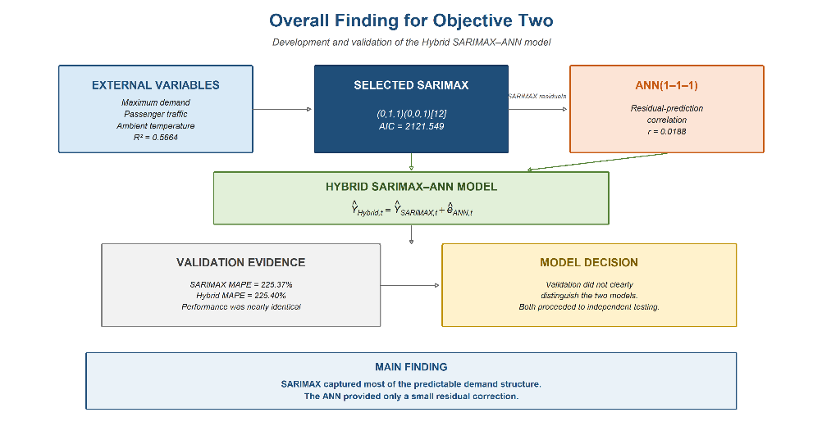
Overall Finding for Objective Two
RESULTS AND DISCUSSION Objective 2 continued
Main finding
SARIMAX captured most of the predictable demand structure.
Hybrid structure
Results
Ŷ_{t}^{Hybrid} = Ŷ_{t}^{SARIMAX} + ê_{t}^{ANN}
External-variable regression R² =0.5664.
Selected SARIMAX AIC: 2121.549.
ANN residual-prediction correlation: 0.0188.
SARIMAX and Hybrid validation performance was nearly identical.
Both models proceeded to independent 2024–2025 testing.
Discussion
Maximum demand and passenger traffic were the principal external variables associated with demand. SARIMAX captured most of the temporal and explanatory structure, while the ANN supplied only a small residual correction.
Model decision
Validation did not clearly distinguish SARIMAX from the Hybrid model. Final selection therefore required independent testing under Objective Three.

Slide 16
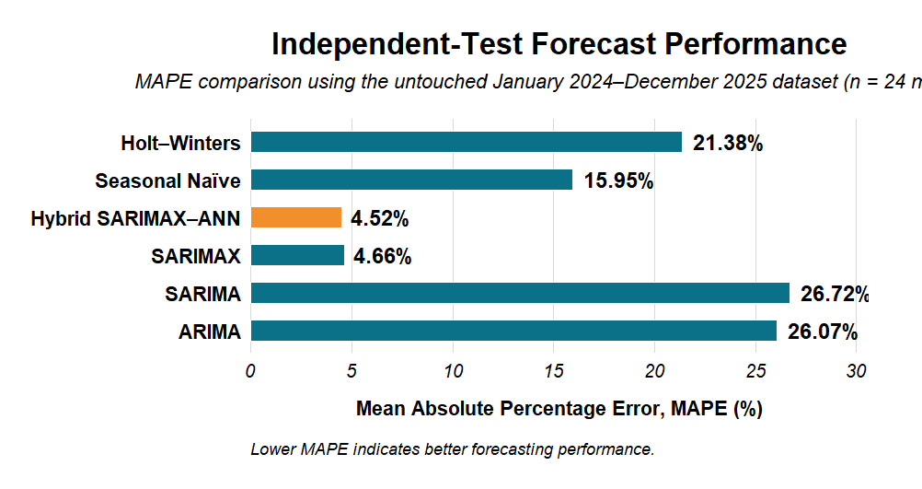
Independent test performance and final model selection
RESULTS AND DISCUSSION Objective 3
Main finding
The Hybrid SARIMAX–ANN achieved the highest forecasting accuracy on the independent 2024–2025 test data and was selected for long-term electricity-demand forecasting.
Analytical Basis
Results
Independent test: January 2024–December 2025 | n = 24 monthly observations | Lower errors indicate better forecasts
RMSE: 77,430.41 kWh
MAE: 55,194.30 kWh
MAPE: 4.52%
R²: 0.2483
Ljung–Box test: (p=0.3995)
Best-performing model: Hybrid SARIMAX–ANN
Discussion
The Hybrid model recorded the lowest independent-test errors. Compared with SARIMAX, it reduced RMSE by 2.21%, MAE by 2.94%, and MAPE by 3.00%. Although the improvement was modest, it was achieved on previously unseen data.
Practical implication
The selected Hybrid SARIMAX–ANN provides a sufficiently accurate demand basis for forecasting the airport’s electricity requirements from 2026 to 2045 and for sizing and evaluating the proposed grid-connected solar PV system.

Slide 17
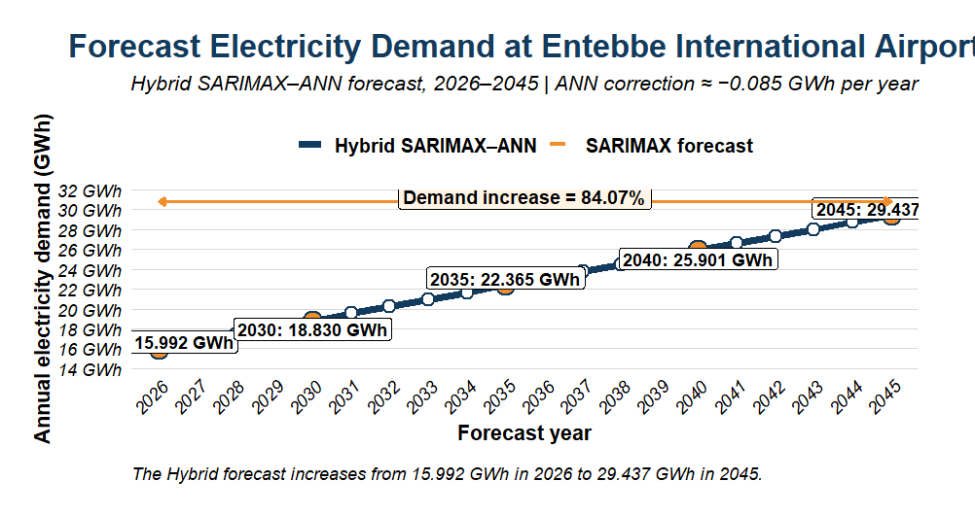
Long-term electricity-demand forecast, 2026–2045
RESULTS AND DISCUSSION Objective 3
Main finding
Forecast annual electricity demand increases from 15.992 GWh in 2026 to 29.437 GWh in 2045—an overall increase of 84.07%
Analytical Basis
Results
Rₜ = 335.91MDₜ + 1.1053Pₜ − 11,791.65Tₜ | Hybrid forecast = SARIMAX forecast + ANN residual correction
Where (MDt) is maximum demand, (Pt) is passenger traffic, and (Tt) is mean temperature.
Year | Forecast demand
2026 | 15.992 GWh
2030 | 18.830 GWh
2035 | 22.365 GWh
2040 | 25.901 GWh
2045 | 29.437 GWh
Discussion
Maximum demand and passenger traffic are the main drivers of the forecast increase, while mean temperature remains nearly constant. The small ANN correction of approximately −0.085 GWh per year indicates that the SARIMAX component determines most of the long-term forecast..
Practical implication
Using a fixed historical load would underestimate the airport’s future electricity requirements. The forecast therefore provides the demand basis for PV sizing, grid-capacity planning and long-term energy investment

Slide 18
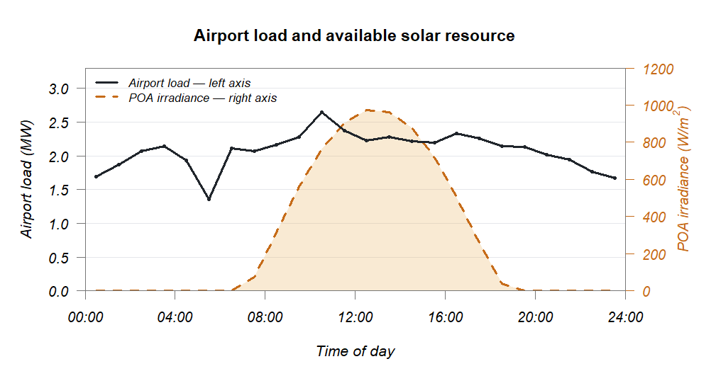
Load–Solar Compatibility and PV Capacity Selection
RESULTS AND DISCUSSION Objective 3
Main finding
The airport maintained substantial daytime demand during periods of available sunshine, supporting direct PV self-consumption.
Analytical Basis
Results
P_{Average} = 15.993 GWh / 8760 h = 1.826 MW
PV supplies coincident daytime load | Grid export = 0 | Capacity selected using useful PV supply, grid reduction and unused energy
Indicator | Result
Forecast airport demand, 2026 | 15.993 GWh/year
Average annual demand | 1.826 MW
Annual GHI | 1,889.8 kWh/m²/year
Annual POA irradiation | 1,879.0 kWh/m²/year
Discussion
Airport demand remained substantial during daylight hours. This overlap provides an opportunity for PV electricity to supply the coincident load and reduce grid purchases. The amount used depends on the hourly relationship between demand and PV output
Practical implication
The load–solar relationship provides the basis for comparing candidate PV capacities under zero-export operation.

Slide 19
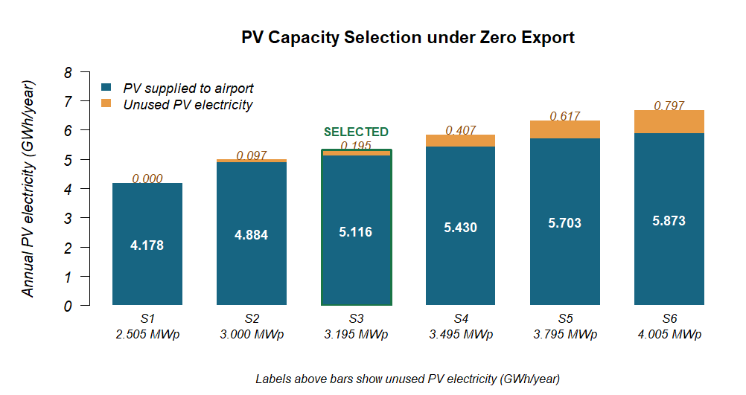
PV system sizing and capacity selection
RESULTS AND DISCUSSION Objective 3
Main finding
The 3.195 MWp system was selected because it provided a practical balance between useful PV supply, grid-energy reduction and unused generation under zero-export operation.
Analytical Basis
Results
PV serves coincident airport load | Grid export = 0 | Capacity selected by useful PV supply, grid reduction and unused energy
PV capacity: 3.195 MWp
Inverter capacity: 2.700 MWac
DC/AC ratio: 1.183
PV supplied to airport: 5.116 GWh/year
Unused PV energy: 0.195 GWh/yea
Discussion
Increasing PV capacity increased total generation and reduced grid-energy requirements. However, useful PV supply increased more slowly at higher capacities because more generation exceeded the coincident airport load and remained unused under zero-export operation.
Practical implication
PV capacity should be matched to the airport’s coincident daytime demand rather than selected by maximizing annual production alone, because unused PV generation provides no grid-energy or cost saving

Slide 20
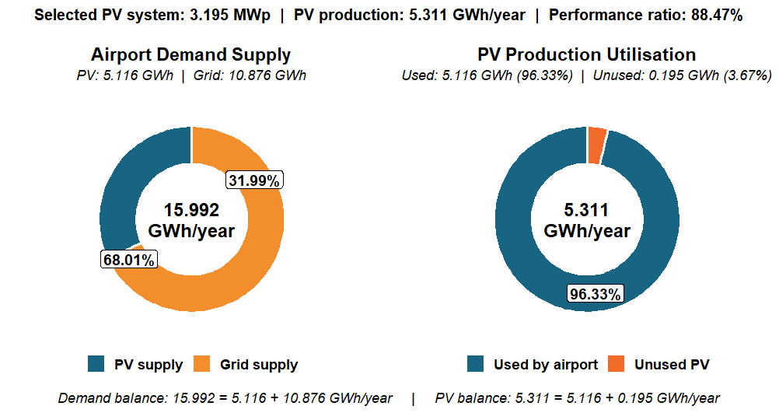
Technical Performance and PV–Grid Energy Balance
RESULTS AND DISCUSSION Objective 3
Main finding
The 3.195 MWp PV system supplied 31.99% of forecast 2026 airport demand, while 96.33% of its generated electricity was consumed directly by the airport.
Analytical Basis
Results
Installed PV capacity: 3.195 MWp
Annual PV production: 5.311 GWh
PV supplied to airport: 5.116 GWh
Grid supply: 10.876 GWh
Unused PV electricity: 0.195 GWh
PV share of airport demand: 31.99%
Direct PV utilisation: 96.33%
Performance ratio: 88.47%
Grid export: 0.000 GWh
Discussion
The PV system met almost one-third of forecast 2026 airport electricity demand. Approximately 96.33% of its generation was consumed directly, demonstrating a strong match between daytime airport demand and PV production. However, the grid remained the principal electricity source because airport demand continued beyond solar-generation hours
Practical implication
The PV system reduces daytime grid-electricity purchases but does not replace the utility grid, standby generators or UPS systems required for supply continuity and critical airport loads.

Slide 21
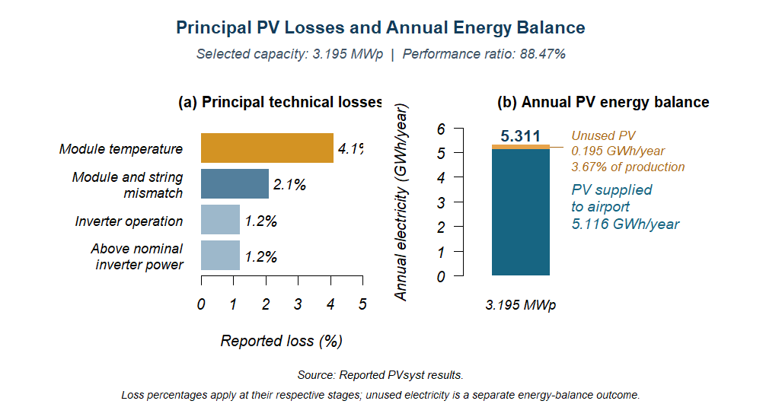
PV losses and diminishing benefit at larger capacities
RESULTS AND DISCUSSION Objective 3
Main finding
Module temperature was the largest reported technical loss at 4.1%. The selected system produced 5.311 GWh/year, of which 5.116 GWh/year supplied the airport.
Analytical Basis
Results
Useful PV = PV production − unused PV | Grid requirement = forecast demand − PV supplied to airport
Performance ratio: 88.47%.
Unused PV electricity: 0.195 GWh/year, equivalent to 3.67% of production.
Discussion
Temperature caused the largest reported technical loss, followed by module and string mismatch. Separately, some generated electricity remained unused because PV output exceeded the coincident airport load under zero-export operation.
Practical implication
The following capacity comparison examines whether additional generation increases useful airport supply or unused electricity..

Slide 22
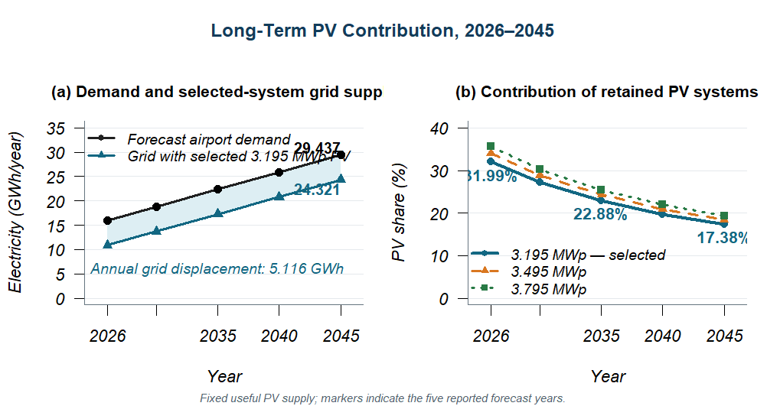
Long-term PV contribution and grid requirement
RESULTS AND DISCUSSION Objective 3
Main finding
The selected 3.195 MWp system’s contribution decreased from 31.99% in 2026 to 17.38% in 2045, while its assumed useful PV supply remained constant at 5.116 GWh/year.
Analytical Basis
Results
PV shareₜ = 100 × useful PV / forecast demandₜ | Gridₜ = forecast demandₜ − useful PV
Indicator | 2026 | 2045
Forecast airport demand | 15.992 GWh | 29.437 GWh
Grid requirement with selected PV | 10.876 GWh | 24.321 GWh
Selected-system PV share | 31.99% | 17.38%
Discussion
Airport demand grows while useful PV supply remains constant in this assessment, reducing the percentage supplied by solar. The selected system continues to displace 5.116 GWh/year of grid electricity, although the remaining grid requirement increases.
Practical implication
The following financial assessment evaluates whether the savings from displaced grid electricity justify the PV investment over the study period

Slide 23
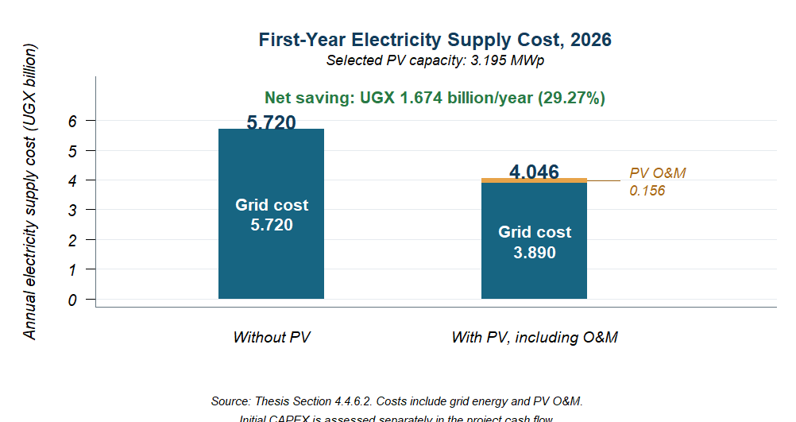
Capital investment and first-year electricity savings
RESULTS AND DISCUSSION Objective 3
Main finding
The proposed 3.195 MWp system required an estimated UGX 13.640 billion investment and reduced annual electricity supply expenditure by UGX 1.674 billion in 2026 after PV O&M.
Analytical Basis
Results
Net annual saving = (5,116,000 × 357.71) − 155,870,000 = UGX 1,674,174,360
Indicator | Result | Indicator
Estimated initial CAPEX | UGX 13.640 billion | Estimated initial CAPEX
Avoided grid expenditure | UGX 1.830 billion/year | Avoided grid expenditure
PV O&M | UGX 0.156 billion/year | PV O&M
Net electricity saving | UGX 1.674 billion/year | Net electricity saving
Reduction in annual supply expenditure | 29.27% | Reduction in annual supply expenditure
Discussion
Direct use of 5.116 GWh/year of PV electricity reduces grid purchases. O&M absorbs part of the avoided expenditure, leaving the reported net saving. Within the indicative CAPEX allocation, modules account for 27%; the remaining investment covers equipment, installation and integration with the airport electrical network.
Practical implication
The annual saving provides the cash inflow for the following capital-recovery and investment appraisal.

Slide 24
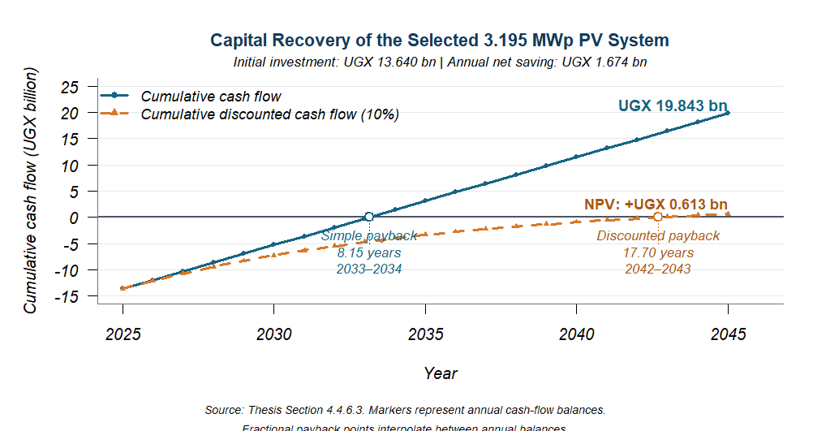
Cash flow and investment appraisal
RESULTS AND DISCUSSION Objective 3
Main finding
The proposed PV system was projected to recover its initial investment within the 20-year assessment period, with a positive NPV of UGX 0.613 billion under the base-case assumptions.
Analytical Basis
Results
NPV = −C₀ + Σ CFₜ/(1+r)ᵗ | IRR occurs where NPV = 0 | LCOE = discounted cost / discounted energy
Indicator | Result
Simple payback | 8.15 years
Discounted payback | 17.70 years
NPV at 10% | +UGX 0.613 billion
IRR | 10.65%
LCOE of useful PV electricity | UGX 343.64/kWh
Discussion
Discounting reduces the present value of later savings, extending capital recovery from 8.15 to 17.70 years. The IRR exceeds the assumed discount rate by only 0.65 percentage points, while LCOE is UGX 14.07/kWh below the adopted grid tariff. These results indicate a positive but limited financial advantage.
Practical implication
The base case supports investment, but its narrow margin makes capital-cost control and sustained PV utilisation important. The following break-even assessment examines how much financial margin remains.

Slide 25
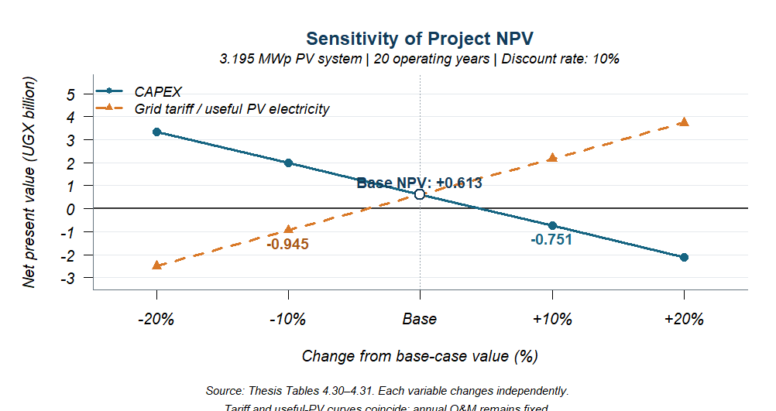
Financial sensitivity and airport operational compatibility
RESULTS AND DISCUSSION Objective 3
Main finding
The positive base-case NPV became negative with a 10% increase in CAPEX or a 10% reduction in grid tariff or useful PV electricity, indicating a narrow financial margin.
Analytical Basis
Results
Each financial variable changes independently; other inputs remain fixed. Assessment period: 20 years; discount rate: 10%.
NPV = Σ_{t=0}^{n} CF_{t} / (1+r)^{t} − C_{o}
Scenario | NPV (UGX billion)
Base case | +0.613
CAPEX increases by 10% | −0.751
Grid tariff decreases by 10% | −0.945
Useful PV electricity decreases by 10% | −0.945
Discussion
The narrow financial margin makes investment-cost control and sustained direct PV use important. Under zero-export operation, unused electricity provides no additional grid-cost saving. The proposed connection requires appropriate protection, anti-islanding and coordination with existing standby supplies.
Operational role:
PV supplies part of the daytime demand; the grid supplies the balance. Existing generators and UPS retain their standby and critical-power roles. Compatibility remains subject to protection and control coordination

Slide 26
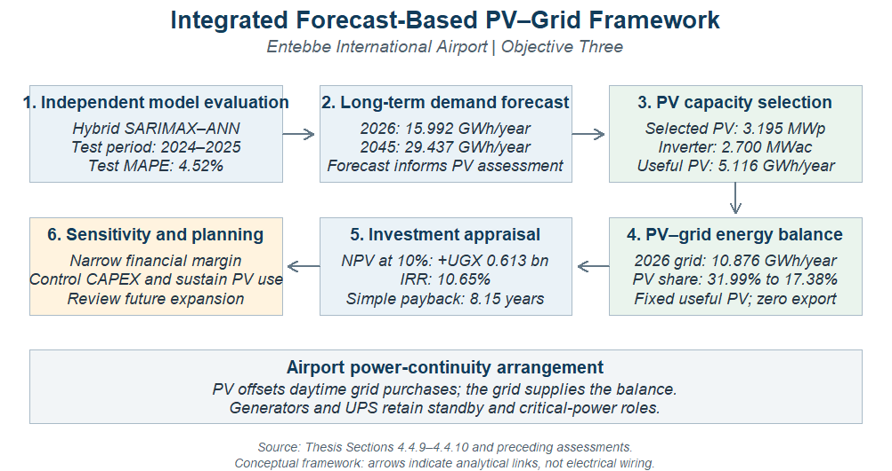
Overall finding for Objective Three
RESULTS AND DISCUSSION Objective 3
Main finding
The independently tested Hybrid SARIMAX–ANN model informed the assessment of a 3.195 MWp PV system projected to reduce airport grid purchases and electricity costs, with a positive but narrow financial margin..
integrated basis
Discussion
Independent model evaluation → Demand forecast → PV assessment → Investment appraisal
The selected PV system was projected to reduce grid purchases, although demand growth lowers its percentage contribution over time. The base-case financial return was positive, but sensitivity results showed that adverse changes in investment cost or useful PV savings could eliminate this benefit
Practical implication
The findings support forecast-informed PV planning, with investment decisions dependent on confirmed project costs, sustained PV utilisation and coordinated integration with the airport’s existing supplies.

Slide 27
Overall finding for Objective Three
RESULTS AND DISCUSSION Objective 3
Results
Assessment | Key finding
Independent forecasting test | Hybrid MAPE: 4.52%
Forecast airport demand | 15.992 GWh/year in 2026 → 29.437 GWh/year in 2045
Selected PV capacity | 3.195 MWp, with 2.700 MWac inverter capacity
Useful PV electricity | 5.116 GWh/year
PV contribution | 31.99% in 2026 → 17.38% in 2045, assuming fixed useful supply
Annual net saving | UGX 1.674 billion
Investment return | NPV: +UGX 0.613 billion; IRR: 10.65%
Capital recovery | 8.15 years simple; 17.70 years discou

Slide 28


Conclusion
The study found that electricity demand at Entebbe International Airport is increasing, and that combining demand forecasting with solar PV provides a practical approach for long-term power planning
Contribution to Knowledge
The study provides a practical approach for linking airport electricity-demand forecasting with long-term solar PV planning
Electricity consumption and maximum demand increased over the study period, 2015–2025.
The Hybrid SARIMAX–ANN gave the best forecasting performance on the independent test data, with a MAPE of 4.52%.
Annual electricity demand is expected to increase from about 15.99 GWh in 2026 to 29.44 GWh by 2045.
Solar PV can reduce the amount of electricity drawn from the grid, but the grid, standby generators and UPS systems will still be required for reliable airport operations.
The study therefore shows that forecasting future demand before sizing PV provides a better basis for long-term energy planning.
Established a 2015–2025 energy baseline for Entebbe International Airport covering demand, reliability and energy costs.
Developed and validated a Hybrid SARIMAX–ANN model for forecasting airport electricity demand.
Tested the forecasting models on independent 2024–2025 data before using the best model for future projections.
Linked the 2026–2045 demand forecast directly to the technical and economic assessment of grid-connected solar PV.

Slide 29
Recommendations
The proposed solar PV system should be taken to the next stage of detailed engineering and commercial assessment before implementation.
1
2
3
Update the demand forecast regularly as new electricity and airport operational data become available.
Carry out detailed engineering and commercial assessment of the proposed PV system before implementation.
Obtain current supplier quotations and update the economic analysis before making the final investment decision.
4
5
Maintain the grid, standby generators and UPS systems, since solar PV is intended to supplement rather than replace them.
Complete the required glint-and-glare, OLS, CNS, structural and grid-interconnection studies before installation

Slide 30


Research Limitations and Future Work
Research Limitations
Future Work
The forecasting models were developed using monthly data from 2015–2025.
The long-term forecast depends on projected future values of the explanatory variables.
The PV assessment considered self-consumption without battery storage or intentional grid export.
The PV design and economic assessment were carried out at planning level rather than detailed engineering level.
Complete generator fuel-consumption data were not available for all periods.
Update and test the forecasting models as more measured data become available.
Investigate other factors that may influence airport electricity demand, such as aircraft movements, HVAC operation, humidity and terminal occupancy.
Assess the benefits of combining the PV system with battery energy storage.
Investigate phased PV expansion as airport electricity demand increases.
Carry out the detailed engineering and site studies required before implementation

Slide 31
References
Akyüz, M. K., Altuntaş, Ö., & Söğüt, M. Z. (2017). Economic and environmental optimization of an airport terminal building’s wall and roof insulation. Sustainability, 9(10), 1849. https://doi.org/10.3390/su9101849
Anurag, A., Zhang, J., Gwamuri, J., & Pearce, J. M. (2017). General design procedures for airport-based solar photovoltaic systems. Energies, 10(8), 1194. https://doi.org/10.3390/en10081194
Ashford, N. J., Mumayiz, S. A., & Wright, P. H. (2011). Airport engineering: Planning, design, and development of 21st century airports (4th ed.). John Wiley & Sons.
Box, G. E. P., Jenkins, G. M., Reinsel, G. C., & Ljung, G. M. (2015). Time series analysis: Forecasting and control (5th ed.). John Wiley & Sons.
Graham, A. (2018). Managing airports: An international perspective (5th ed.). Routledge.
Gu, X., Xie, J., Luo, Z., & Liu, J. (2021). Analysis to energy consumption characteristics and influencing factors of terminal building based on airport operating data. Sustainable Energy Technologies and Assessments, 44, 101034. https://doi.org/10.1016/j.seta.2021.101034
Hyndman, R. J., & Athanasopoulos, G. (2021). Forecasting: Principles and practice (3rd ed.). OTexts. https://otexts.com/fpp3/
Kazda, A., & Caves, R. E. (2015). Airport design and operation (3rd ed.). Emerald Group Publishing.
Khashei, M., & Bijari, M. (2011). A novel hybridization of artificial neural networks and ARIMA models for time series forecasting. Applied Soft Computing, 11(2), 2664–2675. https://doi.org/10.1016/j.asoc.2010.10.015
Luthander, R., Widén, J., Nilsson, D., & Palm, J. (2015). Photovoltaic self-consumption in buildings: A review. Applied Energy, 142, 80–94. https://doi.org/10.1016/j.apenergy.2014.12.028
Ortega Alba, S., & Mañana, M. (2017). Characterization and analysis of energy demand patterns in airports. Energies, 10(1), 119. https://doi.org/10.3390/en10010119
Paida Tenemaza, C. E., & Inga Ortega, E. M. (2016). State of art, reliability in electrical distribution systems based on Markov stochastic model. IEEE Latin America Transactions, 14(2), 799–804. https://doi.org/10.1109/TLA.2016.7437225
Sembatya, R. K. (2022). Feasibility of large-scale grid connected solar PV systems for Entebbe International Airport [Master’s thesis, Makerere University

